Slide 1
3GPP TS 31.111
(GSM 11.14)
SIM Application Toolkit
for Value Added Services
Notes:
VAS & STK

Slide 2
SUMMARY – 31.111
Introduction to SIM Toolkit
SIM Toolkit Commands
SIM Toolkit Protocol
Initialization phase
Multiple Choice Quiz & Practical Exercise
Appendix: Command list
Notes:
Present the summary of this part of the training.

Slide 3


The GSM Market a Competition !
Race for market share
Average bill decreasing
Churn…
Need to find new differentiation
means…
…through VALUE ADDED SERVICES (VAS)
Notes:
Explain why VAS :
-> interest for the operator

Slide 4




SIM: from “GSM Security” to VAS
SIM at beginning
  Security
  Id
  Basic Services
SIM now, also =
Value Added Service platform for
  Customer Retention
  Competitive Differentiation
  ARPU boost
  Cost saving…
  …with simple/std VAS development, on secure operator-owned SIM
Notes:
Why SIM for VAS

Slide 5
VAS on the field
  Infotainment
  Roaming management
  Phone book management
  Prepaid applications
  Mobile banking
  Mobile Commerce…
Notes:
Some exemple of VAS

Slide 6



VAS : Information On Demand
« Yellow Pages » Location Based Services
Services
Search Hotel
Georges V
HolidayInn
Mercure
Next
Georges V
150m straight ahead
Next
Banking
Notes:
A VAS application

Slide 7



VAS and « SIM Toolkit » (STK)
SIM Application Toolkit allows design of VAS applications which run on a SIM:
« STK » allows VAS applications in SIM to communicate
with the external world via messages & commands :
SIM receives & processes
« STK » commands
which trigger VAS application
SIM Sends « STK » commands
Notes:
Concepts of toolkit to design,
With Mechanisms to communicate (cmd protocol)
And trigger
+ commands to make actions

Slide 8
VAS Commands sent by SIM
Command for mobile
Maybe to:
Display some text on the mobile screen, play a tone
Get an input from the user
Set-up a call, send an SMS to the network…
Notes:
Plus setup a timer (remember, SIM has no clock)
Ex of SIM initiated cmds in the « toolkit »

Slide 9
How VAS Commands?
Before STK not possible
APDU
commands
Simple data
SIM replies to Mobile commands, it is "slave" of Mobile
Notes:
Protocol limitations

Slide 10
« PROACTIVE » concept

Slide 11
How VAS Commands?
With STK is possible
Special APDU command
“PROACTIVE”
Behaviour
SIM “PROACTIVE” commands
initiate dialogue with User, Mobile or Network
Notes:
STK Proactive Mechanism allows SIM to initiate actions within "T= 0" protocol
(Mobile Terminal controls information flow)
New SW1 parameter (91 xx) indicates to mobile that SIM wants to initiate an action.
See Polling Interval command for details of "fetching" frequency from mobile

Slide 12
« EVENT » concept

Slide 13

When VAS?
USER wants
Entering a menu, for instance, the user triggers a VAS application:
  Weather report
  Bank balance
  …
User EVENT triggers SIM application
Notes:
Info on demand
Bank balance…

Slide 14
When VAS?
OPERATOR wants
The operator may want an application to start on a subscriber’s SIM:
  advertisement triggered
  update of information inside the SIM:
    configuration files
    new services (games…)
  …
Operator EVENT triggers SIM application

Slide 15

When VAS?
SWITCH ON Mobile
The operator may wish some applications to be triggered at mobile power up:
  welcome message/service
  configuration checking/updating
  smart roaming
  …
Power-on EVENT triggers SIM application

Slide 16
When VAS?
Something happens on MOBILE
An action happens on the Mobile such as:
  the mobile changes location
  the user disconnects a call
  …
Can trigger applications such as:
  Location-based advertising
  Call logging…
Mobile-related EVENT triggers SIM application

Slide 17
VAS and Standards
Standards needed to make VAS implementation possible
  => « STK » standards
To specify
  VAS COMMANDS
  VAS ME-SIM Communication and
  « PROACTIVE BEHAVIOUR »
  VAS Triggering « EVENTS »
Notes:
STK encompasses:
Commands (SIM & Mobile)
Proactive protocol
Events

Slide 18
“SIM Toolkit” Standards (I)
“GSM 11.14” standard created to specify
  Proactive SIM COMMANDS (displayText, sendSMS…)
  Triggering EVENTS (menu Selection, call disconnected…)
“GSM 11.11” standard evolved (Phase 2+) to specify new APDUs
  ENVELOPE commands for Mobile to send to SIM
    Events from User
    Events from Operator
    Events from Mobile
  ME-SIM Proactive PROTOCOL communication
  Compatibility mechanism for Terminal’s Profile
  to be known by SIM (ME supports STK features or not)
Notes:
STK split between different stds
GSM 11.11 Phase 2+
Evolution of GSM 11.11 : Profile download and Envelope mechanisms included
Release 96: GSM 11.11 (v 5.x.x)
Release 97: (v 6.x.x)
GSM 11.14 Phase 2+
New standard, GSM 11.14 describes in detail : Proactive commands and mechanisms
Release 96: GSM 11.14 (v 5.y.y)
Release 97: (v 6.x.x)
DH: GemXplore 98 SIM Toolkit features are compliant with:
GSM 11.11 and GSM 11.14 Phase 2+ Release 96
Most mobiles don't support Release 98 features (98 possible cost/need)

Slide 19
“SIM Toolkit” Standards (II)
ETSI - SMG9, 1995 : first ideas & draft documents
GSM 11.14 standard created
GSM 11.11 standard evolved (Phase 2+)
New “STK” Release/Version each year: Release 99/V8.x.x
“11.11 & 11.14” required also for USIM,
so ETSI handover GSM 11.11/14 to 3GPP, 2000
  New name for 11.11 = 3GPP TS 51.011
  New name for 11.14 = 3GPP TS 51.014, then 31.111
“SIM Toolkit” is a group of ETSI / 3GPP Standards
Notes:
History of stds & new names
Following the closure of ETSI SMG and the agreement of the 3GPP in July 2000 to undertake responsibility for remaining GSM specifications, the change requests listed below were approved by 3GPP TSG-T. This change in responsibility also changed the specification number from "GSM 11.14" to "3GPP TS 11.14". IDEM FOR GSM11.11 to 3GPP11.11, then
At TSG-T #11, it was agreed that all existing release 99 specifications should be reissued as release 4 specifications so as to create a complete set of release 4 specifications. Further more, it was agreed to change the specification number of all GSM-only specifications from AA.BB to (AA+40).0BB. Thus GSM 11.11 changed to 3GPP TS 51.011. At the same time, the version numbering scheme was harmonised with 3G specifications so that all release 4 specifications have a version number 4.x.y. The contents of TS 51.011 v4.0.0 are identical to GSM 11.11 v8.5.0
GSM 11.11 Phase 2+
Evolution of GSM 11.11 : Profile download and Envelope mechanisms included
Release 96: GSM 11.11 (v 5.x.x)
Release 97: (v 6.x.x)
GSM 11.14 Phase 2+
New standard, GSM 11.14 describes in detail : Proactive commands and mechanisms
Release 96: GSM 11.14 (v 5.y.y)
Release 97: (v 6.x.x)
DH: GemXplore 98 SIM Toolkit features are compliant with:
GSM 11.11 and GSM 11.14 Phase 2+ Release 96
Most mobiles don't support Release 98 features (98 possible cost/need)

Slide 20
SUMMARY – 31.111
Introduction to SIM Toolkit
SIM Toolkit Commands
SIM Toolkit Protocol
Initialization phase
Multiple Choice Quiz & Practical Exercise
Appendix: Command list

Slide 21
SIM Toolkit Commands
Commands
FROM
SIM

Slide 22
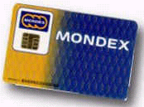
Commands FROM SIM: «PROACTIVE»
Commands can be classified into 5 categories
SIM - Network
SIM - Channelx
SIM - User
SIM - ME
SIM - Additional Card
Notes:
A proactive command allows the card to initiate a transaction with the mobile equipment. Proactive commands are defined in GSM 11.14 standards.

Slide 23
« PROACTIVE » COMMANDS

Slide 24
Proactive Commands
SIM - User
DISPLAY TEXT: SIM displays text message to User
GET INKEY: SIM requests User to enter a single digit only (0-9, *, #, +) or single character (SMS default alphabet)
        Ex: Character that user enters is sent back to SIM in Terminal Response
GET INPUT: SIM requests User to enter a string of digits (0-9, *, #, +) or characters (SMS default alphabet).
For response string, can define min-max length / hidden
        Ex: String that user enters is sent back to SIM in Terminal Response
Transaction
being
Processed..
Pay now?
Y / N
Enter bank
PIN code
>
Notes:
Display Text with Icons ?

Slide 25
Proactive Commands
SIM - User
SELECT ITEM : SIM displays sub-menu with list and requests User to choose an item
        Ex: For Restaurant Service, list is displayed, item that user selects is sent back to SIM in Terminal Response
PLAY TONE : SIM instructs mobile to play an audio tone
        (Optional text message can accompany the tone)
    Ex: "Beep" used to signal a User error
CHOOSE :
1 Indian
2 Chinese
3 Italian
Incorrect
entry
SIM can initiate a dialogue with the user

Slide 26
Proactive Commands
SIM - ME
SET-UP MENU: SIM sends an STK menu Title and Item list to be integrated in ME’s menu during initialization.
      After user selection of menu title, the "Menu-Selection" service (application) list is displayed
SET-UP EVENT LIST: SIM sends during initialization a list of Mobile- related events which can trigger installed STK applications.
Mobile warns SIM when one of these events occurs via Event-Download Env.
SET-UP IDLE MODE TEXT: SIM sends during initialization, Text to be displayed by the mobile when in Idle mode.
POLLING INTERVAL : SIM asks during initialization for a certain max. time interval between ME status commands.
Services :
> Bank
Taxi
Weather
Initialisation or “Set up” commands

Slide 27
Proactive Commands
SIM - ME
POLLING OFF: SIM cancels previous poll interval command,
ME uses default value
REFRESH: If SIM files are modified during an application, SIM informs ME, so as to re-read data from SIM
MORE TIME: SIM requests more processing time, if the task needs more than the normal allotted time
Notes:
More Time:
If long STK appli processing by SIM => Risk of Time out (clock stop) by Mobile. 2 solutions:
1. SIM sends Null (60) byte => gives extra time but blocks normal GSM operation (commands from ME)
2. MORE TIME = extra time (resets ME time-out) but allows GSM commands between 91xx and Fetch.
Polling:
Status Commands sent by ME for:
During CALL check SIM not removed
In IDLE mode = Proactive polling interval for 91xx cmds
(Too frequent bad for battery life)

Slide 28
Proactive Commands
SIM - ME
PROVIDE LOCAL INFORMATION: SIM requests either
  current location of mobile (country, mobile network,
  location area codes and cell ID)
  IMEI
  network measurement results (NMR), with the BCCH (Broadcast Control CHannel) channel list
  current date, time and time zone.
TIMER MANAGEMENT
  SIM requests ME to start timer with a given duration.
  STK application can be triggered on Timer Expiration
Notes:
More Time:
If long STK appli processing by SIM => Risk of Time out (clock stop) by Mobile. 2 solutions:
1. SIM sends Null (60) byte => gives extra time but blocks normal GSM operation (commands from ME)
2. MORE TIME = extra time (resets ME time-out) but allows GSM commands between 91xx and Fetch.
Polling:
Status Commands sent by ME for:
During CALL check SIM not removed
In IDLE mode = Proactive polling interval for 91xx cmds
(Too frequent bad for battery life)

Slide 29
Proactive Commands
SIM - ME
LAUNCH BROWSER: SIM requests to launch browser in Mobile
to a specified URL
LANGUAGE NOTIFICATION: SIM informs ME about currently used language in text strings issued by STK application.
RUN AT COMMAND: conveys AT Command to ME,
response to AT Command returned to the SIM
Notes:
More Time:
If long STK appli processing by SIM => Risk of Time out (clock stop) by Mobile. 2 solutions:
1. SIM sends Null (60) byte => gives extra time but blocks normal GSM operation (commands from ME)
2. MORE TIME = extra time (resets ME time-out) but allows GSM commands between 91xx and Fetch.
Polling:
Status Commands sent by ME for:
During CALL check SIM not removed
In IDLE mode = Proactive polling interval for 91xx cmds
(Too frequent bad for battery life)

Slide 30
Proactive Commands
SIM - ME
GET CHANNEL STATUS: SIM requests ME to return the current status of all available data channel(s)
OPEN CHANNEL:
  allows SIM to establish up to 7 data channels with ME,
  and then to a remote Server in the Network.
  The SIM provides information for the ME to select an available bearer
    CSD (Circuit Switched data), GPRS (Other bearers - BIP)
  ME allows SIM and the Server to exchange data on this channel, transparently.
Notes:
More Time:
If long STK appli processing by SIM => Risk of Time out (clock stop) by Mobile. 2 solutions:
1. SIM sends Null (60) byte => gives extra time but blocks normal GSM operation (commands from ME)
2. MORE TIME = extra time (resets ME time-out) but allows GSM commands between 91xx and Fetch.
Polling:
Status Commands sent by ME for:
During CALL check SIM not removed
In IDLE mode = Proactive polling interval for 91xx cmds
(Too frequent bad for battery life)

Slide 31
Proactive Commands
SIM - Channelx
SEND DATA:
    SIM requests ME to send on the specified channel data provided by the SIM.
RECEIVE DATA:
    SIM requests ME to return data received on the specified channel
CLOSE CHANNEL:
    SIM requests ME to close specified data channel
Notes:
More Time:
If long STK appli processing by SIM => Risk of Time out (clock stop) by Mobile. 2 solutions:
1. SIM sends Null (60) byte => gives extra time but blocks normal GSM operation (commands from ME)
2. MORE TIME = extra time (resets ME time-out) but allows GSM commands between 91xx and Fetch.
Polling:
Status Commands sent by ME for:
During CALL check SIM not removed
In IDLE mode = Proactive polling interval for 91xx cmds
(Too frequent bad for battery life)

Slide 32
Proactive Commands
SIM - Network
SEND SHORT MESSAGE: SIM instructs ME to send a short message (SMS)
    Ex: Request for weather, traffic report,
    currency exchange rate
SEND SS: SIM sends Supplementary Service Control string to ME to request SS from network
    Ex: Call forwarding...
SEND USSD: SIM sends Unstructured Supplementary Service Data to ME for network
REQUEST :
Traffic info
€ / $
> Weather
SIM can send short messages / data to Network
Notes:
GSM supplementary services provide a number of improvements compared to the teleservices and bearer services. They basically re-use the ISDN network supplementary services, most of which are also available on classic PSTN networks. There are two categories of supplementary services: "essential" services offered by all GSM networks and "additional" services which may be specific to one or more national operators.The GSM standard defines the following types of supplementary services:- Calling line identification- Call forwarding- Call waiting/call hold- Conference/group calls- Advice of charge- Call barring.
Call Fwding allows a called mobile subscriber to request the network to send incoming calls to another directory number. The ability of the mobile subscriber to originate calls is unaffected. If this service is activated, calls are forwarded no matter what the condition of the termination.The call forwarding supplementary service is detailed in GSM 02.82.

Slide 33
Proactive Commands
SIM - Network
SET UP CALL: SIM requests automatic call to a given number. Automatic redial possible
SET DTMF: SIM requests ME to send DTMF tone(s) during an established call.
BANK :
Calling...
SIM can set up calls
Notes:
GSM supplementary services provide a number of improvements compared to the teleservices and bearer services. They basically re-use the ISDN network supplementary services, most of which are also available on classic PSTN networks. There are two categories of supplementary services: "essential" services offered by all GSM networks and "additional" services which may be specific to one or more national operators.The GSM standard defines the following types of supplementary services:- Calling line identification- Call forwarding- Call waiting/call hold- Conference/group calls- Advice of charge- Call barring.
Call Fwding allows a called mobile subscriber to request the network to send incoming calls to another directory number. The ability of the mobile subscriber to originate calls is unaffected. If this service is activated, calls are forwarded no matter what the condition of the termination.The call forwarding supplementary service is detailed in GSM 02.82.

Slide 34


Proactive Commands
SIM – Additional Card
2nd
card
SIM
reader
nd
2
card
GET READER STATUS: SIM requests information from ME on Presence and Status of additional card readers
POWER ON CARD: SIM instructs ME to power on (open session with) additional card.
  Card’s ATR returned to SIM in mobile’s Terminal Response
Notes:
Max number of additional Readers = 8
Status = Card inserted, powered on…

Slide 35
Proactive Commands
SIM – Additional Card
PERFORM CARD APDU : SIM instructs ME to send an APDU command to the additional card.
  Card’s APDU response returned to SIM in Terminal Response
POWER OFF CARD : SIM instructs ME to power off (close session with) additional card.
  Additional card powered off => economy of battery life
SIM can communicate with other application cards
Notes:
4 STK Commands added - Release 98 (V7.1)
Class 3 proactive commands
SIMs wireless application can dialogue with Bank epurse, health service….
Other applications become Wireless !!!

Slide 36
SIM Toolkit Commands
Commands
TO
SIM
Notes:
We see command from the sim now see command to the sim

Slide 37
Commands TO SIM
« Events »
  1. Envelope
        Types
  2. Status
  3. Terminal profile
« Compatibility »
  Terminal Profile
« Proactive Protocol »
  Fetch
  Terminal Response
Notes:
Explain different type of command

Slide 38
« EVENT » COMMANDS
Notes:
Let us begin with the event command

Slide 39
«EVENTS» : 1. ENVELOPES
« USER
RELATED »
1. ENVELOPE
« OTA
RELATED »
« MOBILE
RELATED »
ENVELOPE APDU contains different EVENT information
Notes:
Event Download
A set of events for the ME to monitor can be supplied by the SIM using the proactive command SET UP EVENT LIST. If the SIM has sent this command, and an event which is part of the list subsequently occurs, the ME informs the SIM using the procedure below, relevant for that event.
Processing within the ME resulting from this event shall proceed as normal, independent of sending the ENVELOPE command to the SIM.
Where events occur while the SIM-ME interface is already busy, the ME shall queue events and send event download messages to the SIM in the order in which they occurred.

Slide 40
«EVENTS» : ENVELOPE Command
USER-related-Event ENVELOPEs
  User selects an application in the STK Menu
  Menu Selection
  Menu Selection Help Request
User
related
ENVELOPE

Slide 41
«EVENTS» : ENVELOPE Command
OTA-related-Event ENVELOPEs
  Network sends SMS messages
  Formatted and Unformatted SMS-PP Data Download
  Unformatted Cell Broadcast Data Download
OTA
related
ENVELOPE
Notes:
Formatted see after when we talk about OTA

Slide 42
«EVENTS» : ENVELOPE Command
MOBILE-related-Event ENVELOPEs
  Call Control by SIM
  MO Short Message Control by SIM
  Timer expiration
  Event Download (11 types)
● MT call
● call disconnected
● call connected
● location status
● user activity
● idle screen available
● card reader status
● language selection
● browser termination
● data available
● channel status
Mobile
Related
ENVELOPE
Notes:
A lot of event that help the develop to define the application

Slide 43
«EVENTS» : 2. CARD STATUS
STATUS Command
  Can trigger STK application after each Status command sent by the mobile to obtain information about the card status.
2. STATUS
Status
Command
STATUS
STATUS
Notes:
APDU Status command = mobile send to the card to know if it is ok
STK status command = to trigger a special event

Slide 44
«EVENTS» : 3. PROFILE DOWNLOAD
Terminal Profile Command
  Can trigger STK application after Profile Download initialisation command when mobile is powered on (if SIM card Ph 2+)
3. TERMINAL PROFILE
Profile download
Notes:
The Third event is the profile dowload
It’s the mobile that say to the sim card what it can support (which command)

Slide 45
« COMPATIBILITY » COMMANDS
Notes:
We see command on the sim as considered as un event …. Now we have specific command to know compatibility between mobile and card

Slide 46

«Compatibility» : Terminal Profile
SIM receives the list of STK features the ME can support via Terminal Profile command during initialisation power-up
Here are my STK capabilities
Thanks, I now know
what Proactive
Commands & Events
you support
TERMINAL PROFILE
TERMINAL PROFILE also begins STK Boot sequence
It can also be an EVENT to trigger an STK application
Notes:
SIM (GSM applet) receives mobile's STK capabilities via [1]Terminal Profile command, then GSM applet starts Boot mechanism... (specific to GemXplore Xpresso card)
You can execute application on your sim on this type of event

Slide 47
Proactive Protocol
How during STK application execution (Proactive STK session) does “slave” become “master”
Proactive command
Notes:
The last type of command allow sim to take command on the mobile ….. Card is the slave but it cas say the mobile to do specific thing. That’s wee call Proactive command

Slide 48
« PROACTIVE PROTOCOL »
COMMANDS

Slide 49
Proactive Protocol: FETCH Command
Used to transfer Proactive commands from the SIM to the ME
Proactive command waiting
FETCH APDU
APDU Response
Data
SW1 SW2
Proactive command
Notes:
Take an example
Explain apdu response = difference it’s not 9000 but 91xx
When the mobile receive 91xx from the sim, he know that the sim ask him to do something special
Fetch = mobile to say to the sim : ok i know you have to send me a specific response so send me it

Slide 50

Proactive Protocol: TERMINAL RESPONSE
Used to transfer from ME to SIM the response to the previous proactive command (Status and requested data, if any)
All proactive commands are concerned
Proactive command
Ex: Get user input – “Film Title”
Terminal Response (OK, data)
Ex: data = entered film
ME indicates result correct
and returns data (if any) Execution can continue
Notes:
The answer is Terminal Response where there is the status of the response and data that you are waiting for

Slide 51
SUMMARY – 31.111
Introduction to SIM Toolkit
SIM Toolkit Commands
SIM Toolkit Protocol
Initialization phase
Multiple Choice Quiz & Practical Exercise
Appendix: Command list
Notes:
Let us take some other examples

Slide 52
Running an Application
ME / SIM Interface (I)
1. User selects a menu
service “Bank”
SERVICES
Weather
Envelope (menu selection)
Taxi
>Bank
91xx
Fetch
2. the card identifies
which application to
run and starts
dialogue with the user
Select Item
Bank Service
Balance
Terminal Response (OK, Selection)
>Call Bank
The user's selection triggers the application
Notes:
First the user choose the third selection on the menu. The sim response 91xx to the mobile the mobile response fecth to say ok send me your command. Select Item command is sent to the mobile. The mobile response by an Terminalresponse (la suite dans le prochain slide)

Slide 53
Running an Application
ME / SIM Interface (II)
User has selected “Calling Bank” sub-menu
91xx
Calling Bank ...
Fetch
SetUpCall
Terminal Response (OK)
9000
the card has no more
proactive commands
to send
Application ends when SIM has no more proactive commands
Notes:
Sequence of related SIM Tool Kit commands and responses. A proactive SIM session starts with the status response '91xh' (proactive command pending) and ends with a status response of '90 00h' (normal command completion) after a Terminal Response

Slide 54
SUMMARY – 31.111
Introduction to SIM Toolkit
SIM Toolkit Commands
SIM Toolkit Protocol
Initialization phase
Multiple Choice Quiz & Practical Exercise
Appendix: Command list

Slide 55
STK Initialisation (Boot) Phase
How SIM knows what are Mobile’s STK capabilities
How Mobile knows what STK services are in SIM
Notes:
What happens when you switch on your mobile ?
Mobile want to know whick STK developped on the sim

Slide 56

Boot : Read EF phase
READ EF_{PHASE}
EF_{PHASE} content
1 byte
Byte value:
00 for phase 1
02 for phase 2
03 for phase 2+
Notes:
How does it works ?
Phase 2+ = STK is avalaible on the card
So first : mobile ask to the card : are you STK ?

Slide 57
Boot : Profile download
TERMINAL PROFILE
80
10
00
00
lgth
…
STK Command X: yes/no
STK Command Y: yes/no
…
STK Event E1: yes/no
STK Event E2: yes/no
…
lgth bytes – at least 25 bytes
Description of the terminal capacities.
1 bit per supported command.
Notes:
Ok after mobile send to the sim : ok it’s my STK that I can support.

Slide 58

Boot : Setup Menu
Menu
Selection
Event
Setup Menu
Menu:
Item 1 – Bank
Item 2 – Weather
Item 3 – Taxi
Items:
Bank
Weather
Taxi
Setup Menu is a proactive command that allows SIM to send the list of menu items that the mobile can display (via STK menu entry point).
Only sent if at least one STK application is registered for this event
Notes:
It’s a setup proactive command.
Sim says to the mobile which menu are available

Slide 59
Boot : Setup Menu (multiple apps)
Command for mobile
Menu
Selection
Event
MENU TITLE:
Item 1 – Bank
Item 2 – Weather
Item 3 – Taxi
Item 4 – restaurants
Item 5 – clubs
App 1:
Bank
Weather
Taxi
Menu
Selection
Event
App 2:
restaurants
clubs
SIM compiles list of menu Items from all the « Menu Selection Event » STK applications
MENU TITLE taken from EF sume (6F54) file under DF gsm

Slide 60
Boot : Setup Event List
Setup Event List
Event Download
Location
Update
Events:
…
Location Update
Call Disconnected
…
App:
Location
based
restaurant
service
Event Download
Call Disconnected
App:
Operator
message
Setup Event list is a proactive command that allows SIM to tell Mobile which MOBILE RELATED events it must be warned of (ex: EVENT DOWNLOAD: location status change, call disconnected…).
Only sent if at least one STK application is registered for this event
Notes:
Setup event list = c’est pour déterminer une liste de chose qui lorsqu’elle se passe alors un setup du mobile doit être fait

Slide 61
Boot : Set-up Idle Mode Text
set-up idle mode text
idle text
set-up idle mode text is a proactive command that allows SIM to tell the mobile which text it should display when in idle mode.
Only sent if optional EF is present in the SIM, and coded in correct format
Text taken from EF suimt (6FA1) file under MF
Notes:
Define idle mode:

Slide 62
Boot : Polling Interval
polling interval
polling interval
polling interval is a proactive command that allows SIM to tell the mobile the interval it shoud leave between each sending of the Status command.
Only sent if a STK application is registered for Status Event, requiring a specific interval

Slide 63
SUMMARY – 31.111
Introduction to SIM Toolkit
SIM Toolkit Commands
SIM Toolkit Protocol
Initialization phase
Multiple Choice Quiz & Practical Exercise
Appendix: Command list

Slide 64
QUIZ : Multiple Choice Questions
Practical2_STK_MCQ.html

Slide 65
QUIZ: Illustrate Proactive exchange for following application
Banking
SERVICES
Balance
= 10€
Weather
Taxi
>Bank
Bank Service
Balance
>Call Bank
Calling
Bank ...
Practical21bootProtocol.doc
Notes:
Firt do the Quiz on html format
And after to introduce which mecanism use between the mobile and the sim -> do the pratical (Practical21boot protocol.doc) to explain the different phases between toe mobile and the sim.

Slide 66
Introduction to STK Application
Loading/testing Tools
Notes:
<=
Unstructured Supplementary Services (USS) allow operators to define their own services while remaining compliant with GSM standards. The recommendations simply define the methods used to transmit the instructions entered by the subscriber on the mobile and information provided by the network.USS services can be initiated by the network or the subscriber both during calls or when the mobile is in idle mode

Slide 67

Manage the basic of all 2G SIM cards
(Native AND Java)
SIM
ADMIN Tool

Slide 68
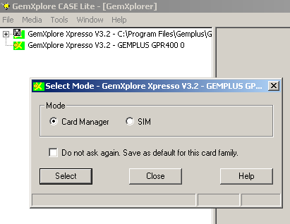
SIM Card
Content Management Modes
ADMIN enables you to:
    Manage GSM files => SIM Mode
    Manage STK applets => Card Manager Mode

Slide 69
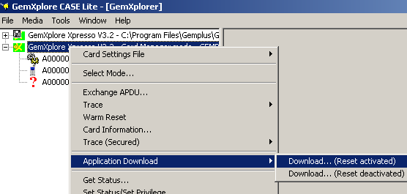
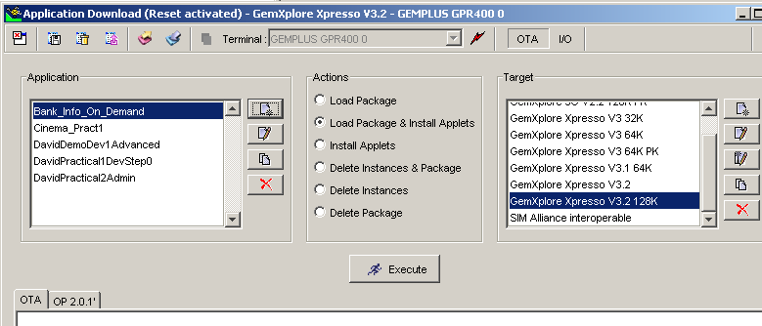
STK Application: Downloading
Application Download Management

Slide 70
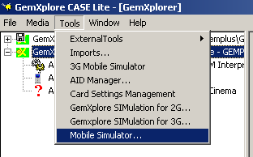
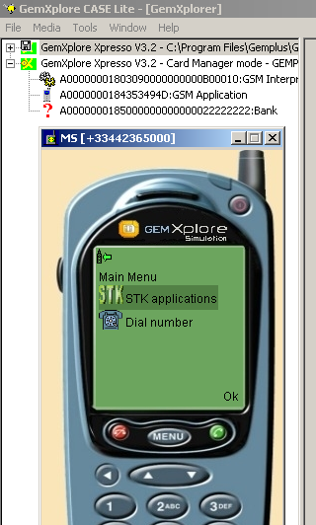


STK Application: Testing
Mobile Simulator for STK Testing & Demonstration, also
ME-SIM Protocol Exchanges
Analyzer

Slide 71
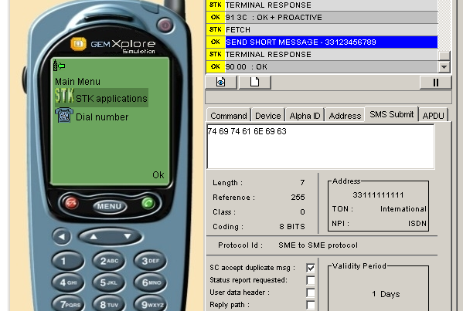
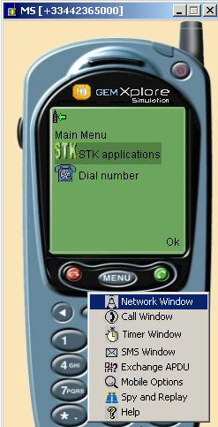
STK Application: Testing
Mobile Simulator
  ME configuration, Protocol exchange trace / log
  Event download, timer expiration, envelope call control…
  Verifies applet behavior and enables its triggering
  Can be connected to a virtual network to test network related actions / events.

Slide 72

Practical Exercise
Download & Test a STK application
Analyzer
Practical22STKTest.doc

Slide 73
SUMMARY – 31.111
Introduction to SIM Toolkit
SIM Toolkit Commands
SIM Toolkit Protocol
Initialization phase
Appendix: Command list

Slide 74
APPENDIX:
Additional SIM Toolkit
ENVELOPE Commands

Slide 75


ME => SIM :
Envelope SMS - Point to Point (PP)
Network sends an SMS message for SIM
passed transparently to SIM
SMS-PP
Envelope(SMS-PP)
9Fxx
Get Response
data
Ack. data
SIM runs application then sends back data (if any) for Network
GSM or STK data loading to SIM with Ack.
Can be considered as an event to trigger resident STK applications
Notes:
55

Slide 76
ME => SIM :
Envelope Cell Broadcast (CB)
Message passed transparently to SIM's
SMS-CB
Network sends an SMS message to all mobiles in cell with CB service activated in SIM
Envelope(SMS-CB)
Envelope(SMS-CB)
Envelope(SMS-CB)
Message sent to many SIM's without Ack. Can be considered as event
Notes:
55
Mechanism supported by GemXplore 98 BUT
Specific CB message processing requires a filter

Slide 77
ME => SIM :
Envelope Call/MO Short Message Control
Authorized Call
User has dialled a number
Envelope (Call Control, numbers)
If BDN service is active and if triggered STK application does not find number in Ex: EFbdn,
call authorized
9000 (OK)
Can be considered as an event to trigger STK application
If BDN service is not active, SIM will always authorize call
Notes:
55
Mechanism supported by GemXplore 98 BUT
Filter needed in SIM to define comparaison method to be implemented

Slide 78
ME => SIM :
Envelope Call/MO Short Message Control
Barred Call
User has dialled a number
Envelope (Call Control, numbers)
9F02
Triggered STK application finds number Ex: in EFbdn,
call is barred
Get response
01 00h : call not authorized
Notes:
56
Mechanism supported by GemXplore 98 BUT
Filter needed in SIM to define comparaison method to be implemented

Slide 79
ME => SIM :
Envelope Call/MO Short Message Control
Modified Call
User has dialled a number
Envelope (Call Control, numbers)
9Fxx
Get response
Triggered STK application can
modify the number.
02 yy...yyh : call modified
(response = xx bytes)
Notes:
57
Mechanism supported by GemXplore 98 BUT
Filter needed in SIM to define comparaison method and modification to be implemented

Slide 80
ME => SIM :
Envelope Event Download
Call Disconnected
Initialisation
Set-Up Event List
OK
Call is disconnected
Envelope (Event Download/
Call Disconnected)
Mobile sends corresponding event to SIM which triggers corresponding applications
11 Mobile-related events :
Call Connected/Disconnected/MT, Location status, User activity, Idle screen,
Card reader status, Language selection, Browser termination, Data available, Channel Status
Notes:
55
Language selection, Browser termination, Data available, Channel Status???

Slide 81
ME => SIM :
Envelope Timer Expiration
Timer Management, n
OK
Timer, n
expires
Envelope (Timer Expiration, n)
Mobile sends event to SIM which triggers corresponding
application
Up to 8 Timers can be defined
Notes:
55

Slide 82
Event Management
APDU
Command
Menu Selection
SERVICES
Weather
Profile download
Bank
Taxi
Status
SIM triggers corresponding STK Application depending on which event happens/which APDU is received from mobile
Notes:
APPLET TRIGGERING / Selection Mechanism
APDU command sent by ME following an EVENT
GSM applet always main applet in card, it manages APDUs
A Toolkit applet is registered as being triggered by Events. GSM applet translates APDU into Event and selects corresponding applet.
(A Toolkit applet may manage directly APDU commands, but not used during applicative life of card, handsets have no way to select other applets than GSM default applet)
Toolkit Applet registering: See later special class/methods for declaring applet to GSM application as being triggered by one or more events

Slide 83
Event Registration
When installed, the STK application will register events and menus in the SIM
This information will help SIM to trigger the correct STK application.
This information is accessible by the OS to build the initialisation commands Set Up Menu and Set Up Event List
Menu Selection
Bank
STK
Appli
Cinema
Event download (Call Disconnect)

