Slide 1
“ENHANCED” SHORT MESSAGE SERVICE
Notes:
1
1
Present the planning for this part : explanation and a lot of exercise, practicals

Slide 2

Summary III
Introduction to SMS
  Text short messages
  Enhanced short messages
An “ESMS Journey”
  3GPP TS 23.048 (GSM 03.48)
Gemalto Remote Application Management Tools
  "OTA" Demonstration
  Practical Exercises

Slide 3




Short Message Service (SMS)
TEXT Messages sent from one Short Message Entity (SME) to another
    From Network => Mobile : DELIVER-SM format (“GSM 03.40”)
Text server
SMS
Call
voice
mail
Call
voice
mail
DELIVER-SM
SMSC
TEXT message
Short Message format
Source/destination/Status information
TEXT message
SMS (“03.40”) Header
SMS Body
SMS = User Notification by Network or by another user
Notes:
4
16
Explain how does it work – standardisation of how it work and the structure of the message : 3.40
When it is the network send SMS to the SIM it is standardised : 3.48.
After explain the format of the SMS : header and the body
SMS is for text
Operator think using the SMS not as a simple text but to send command to the mobile and so to the SIM -> next slide

Slide 4





Enhanced Short Message Service (ESMS)
DATA messages (executable commands) can be sent from
Network to mobile to access SIM card data "Over-The-Air"
  ESM, using Short Message Service channel, is sent in SM Body
Data server
ESMS
DELIVER-SM
"Transfer
DATA message
Mechanism"
GSM Standard
“03.40” Header
SMS Body
ESMS Header
ESMS Body
Application, security info.
Executable commands
or « 03.48 »
or 11.11 or « 03.48 »
Services modified "OTA" (Ex: ADN, AOC, STK ...)
Notes:
4
16
Explain the specific structure of this SMS message
This specific header is essentially for security.
At the beginning is not standardised so in OTA server you find all the possibility ESMS format.
Now it is standardised : 3.48
Depending on different type of card the standard change and in the OTA platform you have all the format to use save in the platform.
Short is important – Because short limit the length of the message so to send a big « application » on the card that’s necessary a lot of message because of the length limitation.
Explain mechanism

Slide 5
Enhanced Short Message Service (ESMS)
GSM Standard
“03.40” Header
SMS Body
ESMS Header
ESMS Body
Application, security info.
Executable commands
or « 03.48 »
or 11.11 or « 03.48 »
An ESMS can be used for:
GSM file administration commands: update binary, create file..
application management: download, delete, …
resident application triggering: Ex, STK
Notes:
4
16
Explain type of command you can send by OTA
Trigger an application
Manage application

Slide 6
History of SMS Channel
GSM phase 2
  SMS: Text message service (two-way text, network <=> mobile)
  ESMS: Data transmission from network to SIM card via SMS message (user notified )
    network ACK of message receipt
GSM phase 2+
  Data transmitted to SIM via SMS message, transparently for user
    network ACK of message receipt and message execution
Notes:
3
22
skipped

Slide 7
Evolution of ME => SIM "Transfer Mechanism"
Phase 2
All GemXplore cards
MF
DELIVER-SM
ESMS executable message
UPDATE RECORD
DF
Telecom
subscription
update
EF
SMS
Data (or Text)
message stored
OK
Receipt OK
UPDATE RECORD command used with EFsms file to send text message, or data message to SIM. (SM header identifies if data for SIM)
Incoming message symbol displayed on mobile ,
text message used to notify user
Acknowledgement of correct message reception sent back to network
User notification of message reception
Notes:
8
16
Un sms transmit par Upd Rec SMS ne prévient pas forcement l'utilisateur de l'arrivé d'un SMS. Heuresement car si tu transmets des commandes par Upd, l'utilisateur n'a pas a le savoir.
En fait, c'est un octet, le Status, premier octet de la commande UPDSMS qui permettra de donner l'ordre à la SIM d'informer ou non l'utilisateur que un sms est arrivé, doit être lu, a été lu,...
En enveloppe, on a pas ce pb, l'utilisateur n'est jamais informé qu'un sms est arrivé.
C'est pour cette raison que les sms textes sont tjs envoyés par UpdSMS.

Slide 8
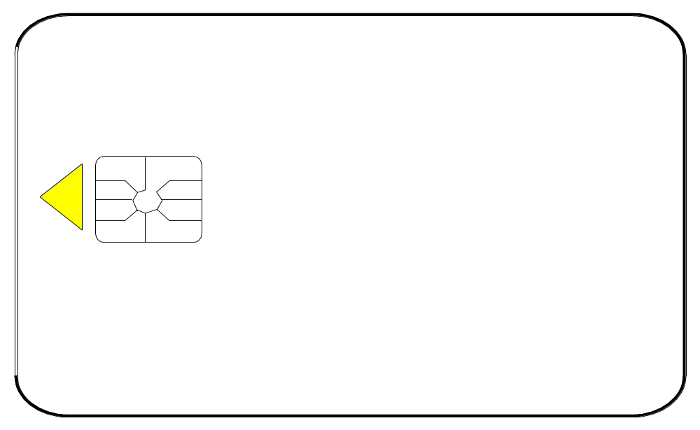
Evolution of ME => SIM "Transfer Mechanism"
Phase 2+
GemXploreXpresso
Data message stored in
MF
DELIVER-SM
ESMS executable message
buffer
ENVELOPE (SMS-PP Download)
SIM-Ack
DF
SMS-Ack
Text messages
SMS
(Receipt OK and Execution Data)
ENVELOPE data-download command is stored in a buffer in the SIM
SIM <=> Network data transfer is transparent for the user
Acknowledgement of message reception and execution + data can be sent back to network
GemXploreXpresso cards also support UPDATE RECORD mechanism
Notes:
8
16
Something say to the mobile that it is a special message that contains a command.
Avant ce type de message était considéré comme un SMS classique donc à chaque récéption l’utisateur en était informé comme qd on reçoit un sms. Maintenant non c transparent.
The card can send a proove of the reception (Proove of receipt : POR) : detail response that can be detail of why it doesn’t work.

Slide 9

Network/ME/SIM Phase Interactivity
Phase 2+ "ENVELOPE" Transfer mechanism
Network
Mobile
SIM card
UR
Data Server
Phase 2+
SMS-ACK
SIM-ACK
SMS configured for ENVELOPE
transfer mechanism
Phase 2
{
}
SMS
ENVELOPE
ENVELOPE
SMS-ACK
SIM-ACK
Phase 2+
Phase 2 ME/SIM do not recognize Envelope mechanism, revert to UR
Notes:
8
16
On peut avoir un response packet avec un UR , en demandant un SMS submit (SPI byte 2)

Slide 10
Change in naming of SMS Standards
GSM 03.40 standard adapted to 3G
  Creation of 3GPP 23.040 v3.0.0
  out of GSM 03.40 v7.1.0
GSM 03.48 standard adapted to 3G
  Creation of 3GPP 23.048 v4.0.0
  out of GSM 03.48 v8.5.0
Notes:
3
22
History of stds & new names
Following the closure of ETSI SMG and the agreement of the 3GPP in July 2000 to undertake responsibility for remaining GSM specifications, the change requests listed below were approved by 3GPP TSG-T. This change in responsibility also changed the specification number from "GSM 11.14" to "3GPP TS 11.14". IDEM FOR GSM11.11 to 3GPP11.11, then
At TSG-T #11, it was agreed that all existing release 99 specifications should be reissued as release 4 specifications so as to create a complete set of release 4 specifications. Further more, it was agreed to change the specification number of all GSM-only specifications from AA.BB to (AA+40).0BB. Thus GSM 11.11 changed to 3GPP TS 51.011. At the same time, the version numbering scheme was harmonised with 3G specifications so that all release 4 specifications have a version number 4.x.y. The contents of TS 51.011 v4.0.0 are identical to GSM 11.11 v8.5.0

Slide 11
An Enhanced Short Message Journey
1
2
Network => ME
ME => SIM
3
Reception
4
Security Verification
5
Execution message
6
User Notification
Network <= ME
ME <= SIM
Network
8
7
ME
Status Code
SIM card
ACK
Notes:
25
That was a brief introduction and now we go in detail.

Slide 12
Network => ME : SM Format
1
DELIVER-SM
SMS Header (“03.40”)
SMS Body
More
messages
UDHI
(bit)
OA
PID
DCS
User Data (140 Bytes)
SCA
UDHI : User Data Header Indicator
1=>Formatted SMS (header in User data)
0=>Unformatted SMS
OA : Originating Address of sender
DCS: Data Coding Scheme byte
  Coding of message - 7bit alphabet (text messages - 160 char max)
  - 8bit alphabet (SMS formatted - 140 char max)
  - or UCS2 (16bit alphabet - 70 char max)
  Destination class of message => Display, ME, or SIM (Class 2)
PID : Protocol IDentifier byte
  Protocol used by ME to send message to SIM
PID = 7Fh : ENVELOPE mechanism
PID ≠ 7Fh, or ME/SIM ≠ Phase 2+ : UPDATE RECORD mechanism
8-bit data
SIM (class2)
DCS = F6h
Notes:
4
16
SCA : Telephone number of the Service Centre, aca se definen parametros como Devices Identities(tag 82, de la red 83 al telefono 82),
SNS (TPDU) SMS-DELIVER)
TP-MTI:Parametro que indica el tipo de mensaje es SMS-DELIVER
TP-MMS (more messages)
PID=7f->Enveloppe
PID=40->UpdSMS
DCS=F6->alphabet 8bits.
Quand tu es en ESMS (formatté), alphabet 8 bits OBLIGATOIRE!
With GxxV3 card, TP-DCS is used to give TPUD coding informations to OS, TPUD which contains 03.48+data or data.
It can be equal to:
00--->7 bits alphabet, using with text message, in order to have a mpaximun number of characters (160)
F6 or 04--->8 bits, mandatory when your SMS is an ESMS (formatted), that mean TPUD=140 characters
08---->UCS2 alphabet, 16 bits-->70 characters max.
It's the TP MTI byte which give moving informations about SMS, if it is an Incomming SMS or a Submit.
Service Centre (SC): Function responsible for the relaying and store‑and‑forwarding of a short message between an SME and an mobile equipt. The SC is not a part of the GSM/UMTS PLMN, however MSC and SC may be integrated.SCA=SMSC address.
UDHI is to say to the mobile that’s a specific message with specific body
OA : telephon number of the OTA : who is sending the message
DCS : how the data is coded (7bit : use on Europe, 7 for sending image, UCS2 for chineese or Hebreu)
it’s to say to the mobile that the message is for the sim
PID : to say to the mobile how it can send this message to the sim

Slide 13
Network => ME : SM Format
1
DELIVER-SM
SMS Header (“03.40”)
SMS Body
SCA
More
messages
UDHI
OA
PID
DCS
User Data (140 Bytes)
OA : Originating Address of sender
OA in SM Header = OA in EF log file ?
Check only if file present.
MF
DF TEL
EF sms log
(5F14) Allowed
OA's
Notes:
4
16
OA is like an list of phone, adress to check. It is an option, if it uses there is the check.
GXXV3.2 Note: If EFSMS LOG is present under the DFTELECOM (7F10h) and
TP-OA is existing in the records, but the TP-OA does not match with
the addresses stored in EFSMS LOG, the message will not be executed.
This check is done for all formatted and unformatted messages.
However, if the EFSMS LOG is not present under the DFTELECOM
(7F10h), no check is done for the TP-OA.
EF sms log file optional (5F14)
OA: also used for billing when roaming.
For SMS and ESMS
If OA doesn’t match with address stored in EF SMS Log, message treatment is aborted. This check is done for all messages, formatted and unformatted ones.
If the EF SMS Log is not present under the DF Telecom, no check is done for the OA.

Slide 14
ME => SIM : SM format
2
SM format similar for UPDATE and ENVELOPE mechanisms
UPDATE / ENVELOPE Mechanism
Status
SCA
SMS - TPDU
ME formatting
if UPDATE =>
command
Message
new / old
SMSC
Address
Length
SMS Header
SMS Body
SCA
SMS - TPDU
ME formatting if
ENVELOPE =>
command
("Tag Length Value")
Tag
Length
Source /
Destination
SMSC
Address
Tag
Length
SMS Header
SMS Body
Tag
Length
Notes:
4
16
UPDATE command : SMS BODY = Text or 03.48 data
ENVELOPE command : SMS BODY = 03.48 data
TLV = use a tag and its length.
TAG SMS-PP=D1
TAG SMSCA =06
TAG SMS-TPDU= 8B

Slide 15
3GPP 23.048
(GSM 03.48)
Notes:
1
1

Slide 16
SIM Reception:“03.48” (Envelope Mechanism)
3
Phase 2+
GemXploreXpresso
ENVELOPE ( DATA DOWNLOAD)
buffer
ESMS
storage
SMS Body
“ESMS” Header (“03.48”)
ESMS Body
(19 bytes min)
(0-4 or 8 bytes)
MANDATORY
OPTIONAL
ESMS header contains Security and Application information
Notes:
4
16
We are going to see in detail what you can find in the sms header
Which security we find in the header -> next slide

Slide 17

OTA Security needs
Requirements
« 03.48 » Mechanisms
Authentication
message integrity
replay detection and sequence integrity
proof of receipt and execution
message confidentiality
...
Cryptographic Checksum
Redundancy Checksum
Counter
Acknowledgement
Encryption
Checksum A count of the number of bits in a transmission unit so that the recipient can make sure the correct number of bits arrived and that the message is intact.
Encryption A cryptographic procedure whereby a legible message is encrypted and made illegible to all but the holder of the appropriate cryptographic key
Notes:
Authentication: Verificar la veracidad del que envia el mensaje
Message integrity, saber si el mensaje no fue modificado

Slide 18
23.048 Structure (1/2)
M
M
M
M
M
M
M
M
O
O
User Data
Header
UDH
« ESMS »
length
CPL
« ESMS » header length
CHL
Key
refs
RC
CC
DS
Security
TAR
Counter
Padding
length
ESMS body
3 bytes
2 bytes
1 byte
2 bytes
2bytes
3 bytes
5 bytes
1 byte
0, 4 or 8 bytes
ESMS Body (data, APDUs)
ESMS Header (03.48)
UDH = User Data Header
UDH = 02 70 00 means « header 03.48 formatted »
Notes:
CPL Command Packet Length
CHM command Header Length

Slide 19
23.048 Structure (2/2)
M
M
M
M
M
M
M
O
O
« ESMS »
length
CPL
« ESMS » header length
CHL
Key
refs
Security
TAR
counter
RC
CC
DS
Padding
length
ESMS body
2 bytes
1 byte
2 bytes
2 bytes
3 bytes
5 bytes
1 byte
0, 4 or 8 bytes
ESMS Body (data, APDUs)
ESMS Header (03.48)
CPL = Command Packet Length (CHL to end of ESMS body)
CHL = Command Header Length (security to RC/CC/DS)
Notes:
CPL Command Packet Length
CHM command Header Length
Security = SPI = 1st byte for incoming message, 2nd for to sent message

Slide 20
ESMS Structure
ESMS length
ESMS header length
RC
CC
DS*
Security
keys
TAR
counter
padding
ESMS body
SPI
Security
Parameter
Indication
2 bytes
1st byte = indications on the security options which are enabled and the SIM will check on the incoming ESMS:
Message integrity and authentication
  - Redundancy Checksum (RC)
  or Cryptographic Checksum (CC)
  - and/or Counter
  - and/or Ciphering
YES/NO
Replay detection and sequence integrity
YES/NO
YES/NO
Confidentiality
2nd byte = indications for the response
*Digital Signature (DS) available in next version
Notes:
2nd byte
00: No PoR reply to the Sending Entity (SE)
01: PoR required to be sent to the SE
10: PoR required only when an error has occured
11: Reserved
PoR response shall not be ciphered
1 : PoR response shall be ciphered
For SMS only
0 : PoR response shall be sent using
SMS-DELIVER-REPORT
1 : PoR response shall be sent using SMS-SUBMIT
Reserved (set to zero and ignored by RE)

Slide 21
ESMS Structure
ESMS length
ESMS header length
RC
CC
DS
security
keys
TAR
counter
padding
ESMS body
0, 4 or 8 bytes
RC,CC,DS values must be equal to the ones calculated by SIM card.
Redundancy Checksum
message integrity
Crypto Checksum
authentication and message integrity
Digital Signature
authentication and message integrity
- RC = 4/8 bytes long (XOR)
- CC = 8 bytes long (DES- 3DES)
- DS = not implemented in this version
This field will not be present if there is no RC/CC/DS check
defined in the SPI field.
Notes:
If no calculation for RC so equal to 0
Keys is to define which key to use for crypto because crypto is calculation done in the server and the same calculation is done on the card. This calculation is based on key. This key is indicated in keys ref bit (explain on the next slide)

Slide 22

ESMS Structure
ESMS length
ESMS header length
RC
CC
DS
Security
Key refs
TAR
counter
padding
ESMS body
2 bytes
Part of the message ciphered
Kic: encryption
- key set number KIc to be used by SIM - algo which SIM should use for message decryption and response encryption
KIc KId
Kid = 3
Kic = 1
Key set n°1
KIc
Kid: signature
- key set number KId to be used - algo which SIM should use to verify the Cryptographic Checksum (CC) or Digital Signature (DS*)
KId
KIk
Key set n°3
Key set n°2
KIc
KIc
Kik:key update
- key set number Kik to be used by SIM - algo which SIM should use to decrypt keys
KId
KIk
KId
KIk
*Digital Signature (DS) available in next version
Notes:
Key set version number 0 is reserved
Kik is used to encrypt key value modifs or update.
Note:
Bits 5 to 8 define the key set number
Bits b1b2b3b4 are ignored by the card. The card will process
the ciphering/deciphering with the algorithm attached to the key in
the key set and act as if the algorithm known implicitly by both
entities was specified.
Just to say where you can find the key to decode the message

Slide 23
ESMS Structure
ESMS length
ESMS header length
RC
CC
DS
Security
keys
TAR
counter
padding
ESMS body
3 bytes
Toolkit
Application
Reference
STK appli
The message TAR shall match with an application TAR (GSM, STK,…)
if TAR <> any referenced application the formatted message is rejected
STK TARs are defined at installation of application
TAR2
GSM appli
TAR1
Notes:
TAR is telling the car who is the message for (référence to slide 5)
Valeurs de TAR / AID definies ds norme 101.220
10 valeurs possibles pour l ’OTA GSM interpreter.
GSM TAR is standardized (101.220) : « 47 53 4D » TAR by
default at perso stage.
Durant la perso 4 applets installées:
- Card manager
- GSM applet
- OTA Card Manager interpreter
- OTA GSM interpreter
Leur AID est stocké en EEPROM lors de la personnalisation.
TAR = 13,14,15 bytes of AID pour une appli STK
faire dire TAR1=GSM admin commands

Slide 24
ESMS Structure
ESMS length
ESMS header length
RC
CC
DS
security
keys
TAR
counter
padding
ESMS body
CNTR
Counter
5 bytes
Involved in the computation of the Redundancy Checksum and the Cryptographic Checksum
Synchronization performed according to reference counter (RCNTR associated to each key set). The RCNTR used depends on incoming Kic or Kid
Value of counter must be greater or one higher than the reference counter
Key set version
CNTR > RCNTR or
CNTR = RCNTR +1 ?
To ensure anti-replay and sequence integrity
Notes:
Each keyset has a counter associated
The counter must be checked
Why : because the standard define like this !
If Kic & Kid are different, the message is rejected.(as Counter value in a message is compared to a key set RCNTR)
Involved in the computation of the Redundancy Checksum and the Cryptographic Checksum(en fait tout le header et les data sont impliquées ds le calcul de RC et CC) cf p39 TFS.
can be incremented each time a new SMS application is initialized, thus avoiding replay attacks
the synchronization is performed according to reference counter (RCNTR stored in the EF sms system for every destination applet)
RCNTR is updated with CNTR value.

Slide 25
ESMS Structure
ESMS length
ESMS header length
RC
CC
DS
security
keys
TAR
counter
padding
ESMS body
PCNTR
5 bytes
1 byte
secured data
Padding
Counter
Number of padding bytes at the end of the secured data
If secured data are ciphered, the sending entity shall include padding bytes in the secured data (8 bytes blocks are necessary)
The SIM verifies that all padding bytes are equal to ‘ 00h ’. Otherwise, the message is rejected.
2 bytes of padding
PCNTR = 2
Secured data ...
0x32 …0xBA
0x45 …0x65
0x25 …00 00
8 bytes
8 bytes
8 bytes
Notes:
Faire un ex avec 5 octets pour le counter , 3 pour le Pcounter, et 13 octets pour le body, or je dois avoir un multiple de 8 pour le chiffrage, dc 13+5+3= donc

Slide 26
Minimum Security Level
ESMS length
ESMS header length
RC
CC
DS
security
Key refs
TAR
counter
padding
ESMS body
SPI
2 bytes
Minimum Security Level
  is defined on 1 byte (same coding as first byte of SPI)
  Min Security Level states mandatory checks in incoming ESMS :
    checksum (CC or RC)
    ciphering
    counter
Notes:
Concerning STK applets, you cannot allocate them an msl.
This would only be possible for applets that exend the OTAToolkitInterpreter class - but this class is G+ proprietary.
It’s mandatory to have a minimum security.
It is when the card is manufactured
It never been 0.

Slide 27
Execution - APDU /Resident Scripts
5
ESMS BODY
ESMS Header
TAR = GSM application
APDU
Remote File admin cmds
Ex: Update ADN file
ESMS BODY
ESMS Header
TAR = Appli manager
APDU
Remote Appli management cmds
Ex: load a new application
ESMS BODY
ESMS Header
TAR = STK application
Data
for STK application
Ex: trigger a resident STK application
Notes:
4
16

Slide 28
Execution - Available Commands
5
*File management APDU commands
    Select, GetResponse
    ReadBinary, UpdateBinary, ReadRecord, UpdateRecord
    Seek, Increase
    Verify, Change, Disable, Enable, Unblock CHV/ADM
    Invalidate, Rehabilitate GSM file status
    Create, Lock, Delete, Extend file (proprietary file commands)
* rights depend on
message ”MINIMUM SECURITY LEVEL" ==>
Notes:
4
16
Summary of command
Appli management and information APDU commands
Delete,
GetStatus, SetStatus,
Install, Load,
GetData, PutKey
GetResponse

Slide 29
Execution - Remote Access conditions (1/3)
5
ESMS
1 - GSM appli receives incoming envelope or URecord
2 - OS checks 03.40 and 03.48 security / command decryption
3 - envelope is dispatched according to the TAR
TAR=STK appli
GSM appli
TAR=GSM appli
STK appli
MF
EF
DF
EF
Notes:
4
16
Let’s summarise the different step we saw to send the message.(to introduce the slide, the suite it’s on the next slide)
To prevent attacks against an applet, the min security level of an applet cannot be decreased.
Commands : Set security and Get security
GSM applet Receives all incoming Envelope(SMS Data Download) or Update Record (SMS Data Download) and call OTA layer
OTA layer check 03.40 and 03.48 security
Decrypt encrypted message if necessary
Using TAR stored in the 03.48 security layer, dispatch the message
GOP Interpreter
is an applet designed to execute via OTA channel some 03.48 APDU commands (load, install, get status,…)
GSM Interpreter
is an applet designed to execute via OTA channel some GSM 11.11 APDU commands (update record, create file…)

Slide 30
Execution - Remote Access conditions (2/3)
5
… SPI Kic KId
- CC Yes
- ciphering Yes
- CNTR Yes
4 - security level of incoming SMS is compared by OS
Min security level:
- CC Yes
- ciphering No
- CNTR No
TAR=GSM appli
STK appli
GSM appli
Min security level:
- CC Yes
- ciphering Yes
- CNTR Yes
MF
EF
DF
EF
The minimum security level can be modified (increased OTA)
Notes:
4
16
The EF SMS SYSTEM file ( 5F11) must be present under MF.(RCNTR)
2 - Security level of message >=
required min security level of application set during installation of the GSM appli
Depending on the access domain of the targetted application, the command will be executed or not (for reading files, creating or updating files of the GSM application for instance).
The minimum security level can be modified (increased OTA) with PUT DATA APDU

Slide 31
Execution - Remote Access conditions (3/3)
5
… SPI Kic KId
4 - Security level of incoming SMS can be optionally compared by the STK appli itself
- CC Yes
- ciphering Yes
- CNTR Yes
Min security level:
- CC Yes
- ciphering No
- CNTR No
TAR=STK appli
STK appli
GSM appli
5 - if an access to GSM file is required, Application Access Domain will be used
Min security level:
- CC Yes
- ciphering Yes
- CNTR Yes
MF
EF
DF
EF
Notes:
4
16
2 - Security level of message >=
required min security level of application set during installation of the GSM appli
Depending on the access domain of the targetted application, the command will be executed or not (for reading files, creating or updating files of the GSM application for instance).

Slide 32
Execution - Access Domain
5
GSM Application
To have access to a file, the ‘ STK appli access domain ’ must be equal to I/O EF access conditions:
OK if Access Domain of STK appli owns ADM1 right
STK appli
update( )
EF
Application access conditions are defined during the installation of the applet.
Read : CHV1
Update : ADM1
STK appli
BODY
STK access domain
CHV1 OK
ADM1 OK
GSM Application
GSM appli checks the file access conditions:
OK if ADM1 granted to SIM
APDU update
« I/O »
EF
Read : CHV1
Update : ADM1
I/O access conditions are defined during gsm file creation.
BODY
Notes:
4
16
Rights granted on I/O line are also granted for application scripts (ESMS or resident)
Rights granted in application script cannot be inherited
on I/O line
Examples :
CHV1 verified by user at ME power on, also granted during “ESMS” execution
Local CHV2 verified during SIM Toolkit application script
is not granted for I/O access

Slide 33
User Notification
6
SMS BODY
text
The only means to notify the user is to send him a 2nd message, containing text message.
In case of an envelope command
2nd text message
GSM
« ADN updated »
MF
"ADN
updated"
DF
Telecom
EF sms
Notes:
4
16
un moyen serait par exemple de trigger une applet contenant un display text affichant un messa ge du type "vous avez recu un message!".NON car on s’adresse au GSM interpreter.
Le moyen c’est d’envoyer un second SMS text.
Au départ, l'enveloppe data download était faite pour downloader des data, et l'update recor sms des message txt. C'est la raison pour laquelle l'ef sms system n'est usité qu'avec l'upd rec sms.

Slide 34
SIM => ME : SIM-ACK (I)
7
ESMS Header
SPI
byte
1st byte
(incoming ESMS)
2nd byte
PoR required
use SMS DELIVER REPORT
Message
Use SMS DELIVER REPORT
SIM
9F xx
Status code
+ Execution data
Get Response
“PoR”
= Status Code + data
If SIM-ACK required, SIM returns "9Fxx" indicating execution data ready for network.
RC or CC can be applied for integrity and authentication purposes.It can also be ciphered.
Successful execution:
Execution failure: - command number when error occurs, Error Status code
90 00
Status code
Status of ESMS Security header processing
n° last executed command
…
…
data
Notes:
4
16
For Complete Format see MPH LOADER DOC
Table 13 - Response Packet Format
Response Status Code byte part of RESPONSE “HEADER” =
00: POR OK
01: RC/CC Fail
02-04: Counter problem
05: Cipher fail
….Security related problems, See MPH037 DOC for more info
ADDITIONAL RESPONSE DATA, depends on applet triggered (Ex See RAM info in MPH DOC)
At beginning is Error Report =
Number of the last command executed
Command status (SW1, SW2)
Data
P75 TFS
le byte status du RP sert à ce que l'émetteur du sms puisse savoir ce qui s'est passé.
Si erreur ou non et si l'émetteur a spécifié le desir d'avoir un RP, l'os va créer un sms avec une 0340, une 0348 et les data associées et le renvoyer à l'émetteur.
En effet, il arrive dans certains cas que le RP n'est pas renvoyé.
Cela veut dire qu'une erreur est intervenue lors de la réception du sms, dans ce cas, c'est l'enveloppe ou l'upd rec sms qui est en général en cause. Par exemple, un tp-oa >12bytes provoquerai cette erreur.
En clair cela peut arriver avant que les paramètres de sécurité soient checkes, donc sur la verification du format de l'enveloppe.
Dans tous les autres cas(ciphering, cntr ou rc/cc), l'erreur est gérée est prise en compte dans le rp sous forme du status.
*Status Codes can be standard GSM error codes, SIM Toolkit codes
or ESMS-related (format, security) codes
02[H1] 71 00 [H2][H3]00 0E [H5][H4]0A[H6] B0 00 00 [H7]00 00 00 00 19 [H8]00[H9] 00[H10] 01 67 00 [H11]90 00[H12]
[H1]User Data Header Length
[H2]UDH : User Data Header 71 00 : 23.048 formated
UDH=IEIa|IEIDLa|IEDa (table 8 23.048) avec IEIa=RPI (response packet Id cf table 3) IEIDLa (longueur de l’objet suivant qui est nul donc 0) IEDa = Null (existe pas)
[H3]
[H4]RPL : Response Packet length de l’octet suivant jusqu’à la fin des additional data compris
[H5]
[H6]RHL response header length : Longueur à partir du TAR jusqu'à additional resonse data (non compris)
[H7]TAR
[H8]Counter Value (celui du message arrivant pas celui de la carte !!!)
[H9]Padding counter (si Additional response data est chiffré)
[H10]Resonse Status Code pour dire si la secu du message entrant est OK (00:0K 01 :CC failed 02:counter low… see 23.048 5.2 response packet structure
[H11] Additional response data
01 : nbr command executed
67 00 : status (see 102.221) bad length in this example
[H12]Status de la commande GET RESPONSE (OK dans l’exemple)

Slide 35
SIM => ME : SIM-ACK (II)
7
SPI
byte
1st byte
(incoming ESMS)
2nd byte
PoR required
use SMS SUBMIT
ESMS Header
Use SMS SUBMIT
91 xx
Fetch
Status code
+ Execution data
Send SMS
(Status Code + data)
If SIM-ACK not required, SIM returns 90 00 indicating correct Envelope reception
! With an Update Record SIM-ACKcan be obtained with SMS SUBMIT only
Notes:
4
16
Si tu spécifies un DELIVER REPORT, le mobile récupèrera le rp avec un getresponse et renverra le sms au réseau.
Dans le cas d'un sms submit, il récupèrera le rp avec un fetch et renverra le sms au réseau.
Attention, avec un upd record sms, on ne peut avoir de rp qu'avec un sms submit.
2nd byte
00: No PoR reply to the Sending Entity (SE)
01: PoR required to be sent to the SE
10: PoR required only when an error has occured
11: Reserved
PoR response shall not be ciphered
1 : PoR response shall be ciphered
For SMS only
0 : PoR response shall be sent using
SMS-DELIVER-REPORT
1 : PoR response shall be sent using SMS-SUBMIT
Reserved (set to zero and ignored by RE)

Slide 36
SIM => Network : Message Acknowledgement
8
SMS DELIVER
ESMS Header
SPI
byte
Use SMS DELIVER REPORT
Get Response
SMS DELIVER REPORT
« PoR »
Status code + data
ESMS Header
SMS DELIVER
SPI
byte
Use SMS SUBMIT
Fetch
SMS SUBMIT
Send SMS
(status code + data)
Notes:
4
16
si l'émetteur a spécifié le desir d'avoir un RP, l'os va créer un sms avec une 0340, une 0348 et les data associé et le renvoyer à l'émetteur.
Il arrive dans certains cas que le RP n'est pas renvoyé.
Cela veut dire qu'une erreur est intervenue lors de la réception du sms, dans ce cas, c'est l'enveloppe ou l'upd rec sms qui est en général en cause. Par exeemple, un tp-oa >12bytes provoquerait cette erreur.
En clair cela peut arriver avant que les paramètres de sécurité soient checkés, donc sur la verification du format de l'enveloppe.
Dans tous les autres cas(ciphering, cntr ou rc/cc), l'erreur est gérée est prise en compte dans le rp sous forme du status.

Slide 37
Summary of “ESMS” features
ESMS length
ESMS header length
security
keys
TAR
counter
RC
CC
DS
padding
ESMS body
SPI
KIc KId
CNTR
RC/CC calculated by SIM ?
Key sets
TAR = GSM application
Access
domain
SPI
checksum ?
synch counter ?
ciphering data?
Key set RCNTR

Slide 38
What happens if ESMS sent with Update mechanism ?
3
OA check (optional)
1
SMS
2
EF SMS
EF Log
UPDATE RECORD
ESM data
OA's
PID = 7Fh or
7F not known
by mobile
4
Security
5
Execution
6
User Notification
Mandatory
Mandatory
Notification
Same as Envelope
mechanism
EF sms Strings
Success
Error
EF SMS
8
7
ESM data
SMS Submit
STATUS CODE
Network
ME ph2/2+
9000 or 91xx
(No SIM-ACK)
SIM card
Notes:
25
If an Update Record SMS is used, the response packet can be returned to the sending entity
only if an SMS-SUBMIT is used.
The error report is stored in the EFSMS SCRIPT STATUS.

Slide 39
User Notification in case of
Update Record mechanism
Formatted SMS
Message
In case of an update record command
2
Message execution
SIM
MF
1
DF TEL
EF SMS Strings
# 1 ex: ADN updated
# 2 error status failure string
"ADN
updated"
3
EF SMS
4
SMS message
The notification is available if the message is sent with an Update Record
and if the message is 03.48 formatted.
Successful execution: string # 1 overwrites SMS message in EF sms
Execution failure : string # 2 overwrites SMS message
Notes:
4
16
Additionally, a global information indicating the SMS execution status is provided to the
user by a text string overwriting the SMS record. Please refer to “Notification (SMS
Overwriting)” on page 65 for more details (EFSMS STRINGS)
. The error report is stored in the
EFSMS SCRIPT STATUS.
Concatenation:
several messages to send:
first one contains CLA INS … as a “normal” ESMS
second and following ones only contain a concatenation header (p50 52 TFS) and data (gain place 5 bytes less for CLA INS …. And some more for header)
mechanism :
open a buffer in EEPROM, store info, and interprets when the whole command is received.
Occupied space in buffer ~2 size command (one for receiving, one for executing)

Slide 40
Gemalto ESMS
Simulation & Test Tools
Notes:
1
1
Card supported in Mobile & OTA Tools
Mobile phone Simulator
GemXplore’Xpresso V3
Dual slot supported
All GSM card !

Slide 41

OTA formatting and routing process :
“ REAL LIFE ”
Formats with « 03.40 and 03.48 »
using library and Database
OTA application
Transmits with
Envelope/UR format to card
OTA Platform
Service
S
M
S
C
Library
Handles routing process
through network
DataBase
Notes:
Very basic representation
Service : design the message ‘script to modify ADN ’
OTA platform : format scrip into SMS
Libary : Format the data part of SMS (03.48 format)
Data base : keys

Slide 42

OTA formatting and routing simulation with SIMu Tool
Service
  simulated by the Server Simulator
  Can send Text, Data, Applications, Commands, Reply depending on the mobile/card behaviour with Agent
OTA Platform, Library, Card Database Parameters, SMSC
  simulated by the OTA Profile
Target
  Card profile and Reader/Mobile Simulator

Slide 43
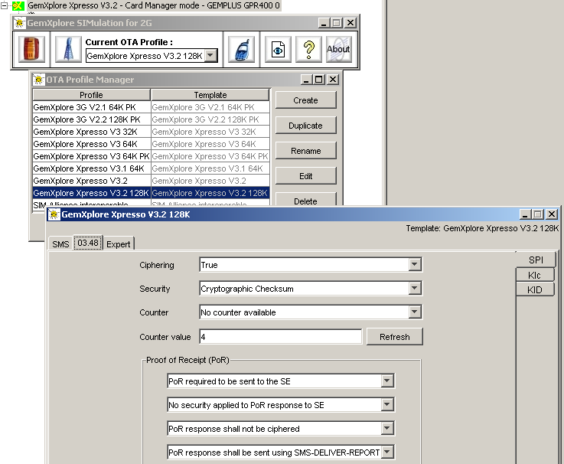
OTA Profile Manager
Configure
OTA
parmeters
for « 03.48 »
Security
Notes:
With service simulator you can send text, script (commands), applets, trigger application on the card.

Slide 44



OTA Service Possibilities
Server can send Messages:
    SMS text
    Formatted Data
    GSM administrative commands
    Unformatted Data
    Trigger STK applet
Server Agent can reply automatically to messages from target, with above actions
    SMS Text, Data…
Notes:
With service simulator you can send text, script (commands), applets, trigger application on the card.

Slide 45
OTA Demonstration
Notes:
Simulate a SMSC on a PC
Work in simulated card

Slide 46
Demonstration & Practicals
Examples
    Ex 1 : Sending SMS Text
    Ex 2 : Sending 03.48 formatted Data (unciphered)
    Ex 3 : Sending 03.48 formatted Data (ciphered)
    Ex 4 : Updating ADN file
    Ex 5 : Reply to Bank Balance request
practical3OTATest.doc
Notes:
For « Analyse the SIM Acknowledgement » in Pracical 3 step 4
Use Loader.pdf manual:
- page 42 gives overall coding of r-APDU DATA field
- page 63 gives « 04 90 00 » info in the additional response data
The error report is stored at the beginning of the additional response data and the response
data (if any) will be stored in the subsequent bytes.
The status byte of the response packet should contain the value "00" as no errors occur
until the remote management applet is triggered.
The table "Response Packet Format" shows the complete response packet format including
the status byte and the additional response data.

Slide 47
ANNEXE
How to Play with the Server Simulator

Slide 48
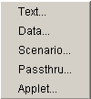
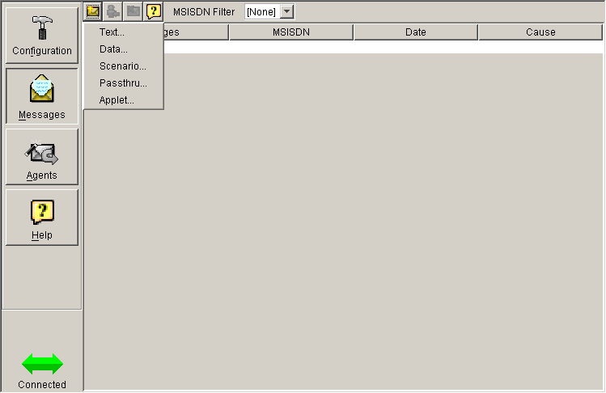
Server Simulator : Message Definition

Slide 49
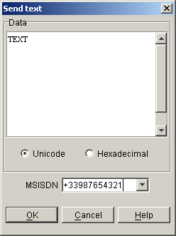
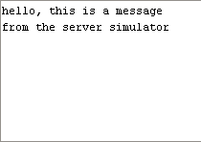

Server Simulator :
Sending an SMS text
03.40
03.40 H – TEXT

Slide 50
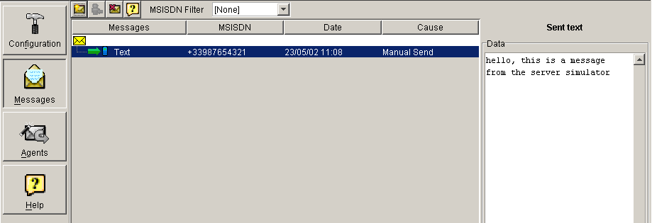
Server Simulator
Sending an SMS text, spying with the server

Slide 51
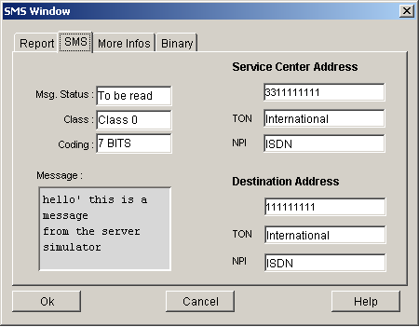
Server Simulator
Sending a SMS text, result on mobile SMS window

Slide 52
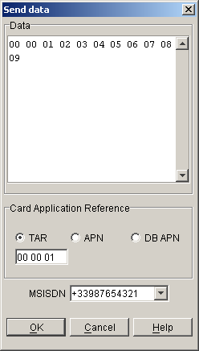

Server Simulator
Sending Data (formatted)
23.040
23.048
23.040 H – 23.048 H – 00 00 01 …
Card profile

Slide 53
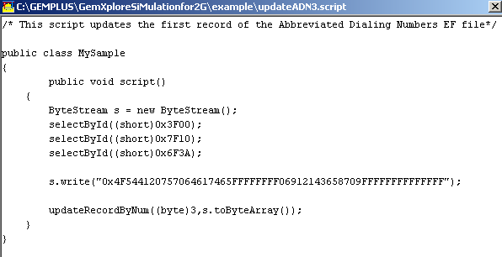
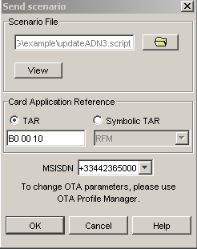
Server Simulator
Sending a scenario (.script)
Standard APDUs
23.048
23.040
23.040 H – 23.048 H – APDUs
Card profile

Slide 54
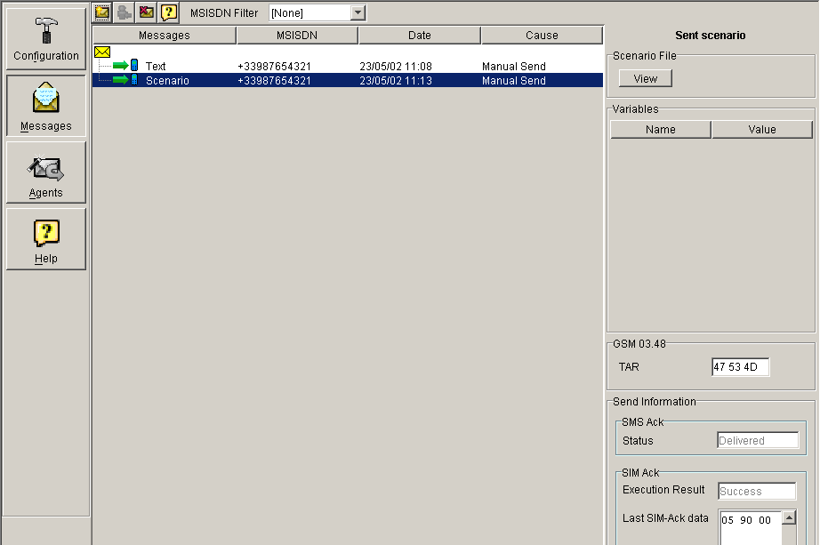
Server Simulator
Sending a scenario

Slide 55
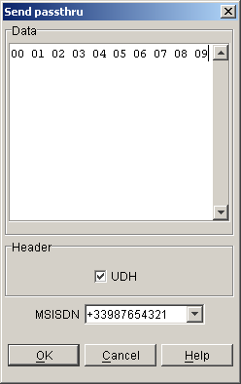
Server Simulator
Sending Passthru (unformated data)
03.40
23.040 H – 00 01 02 03
Card profile

Slide 56
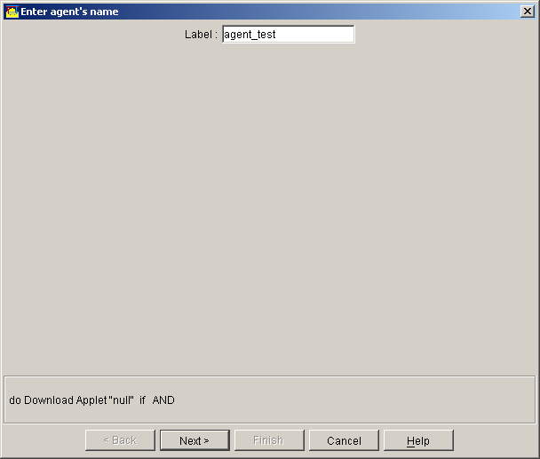
Agents
Create an agent

Slide 57
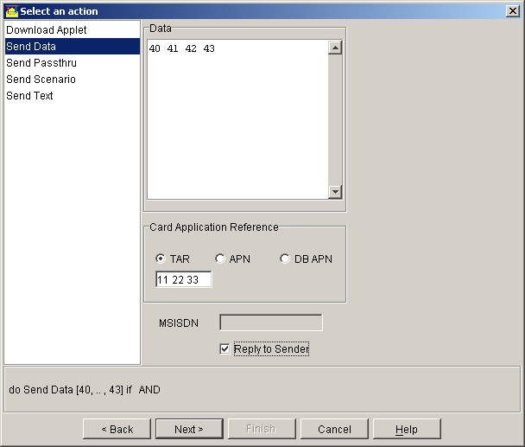
Agents
Select an action, if the agent is triggered
Send Data

Slide 58
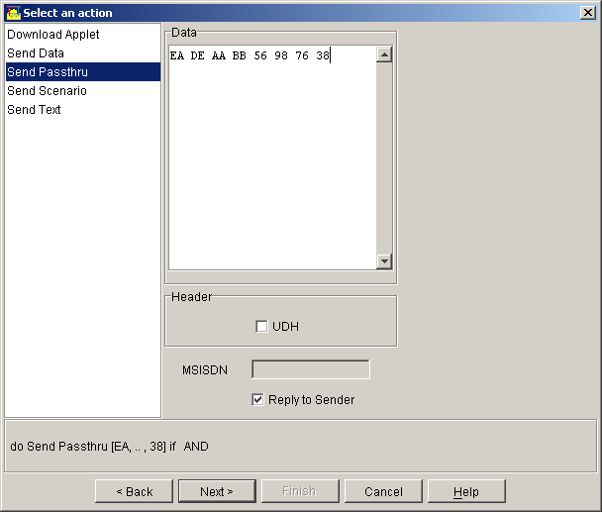
Agents
Select an action, if the agent is triggered
Send Passthru

Slide 59
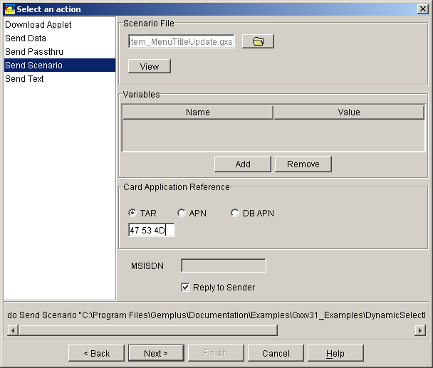
Agents
Select an action, if the agent is triggered
Send a scenario

Slide 60
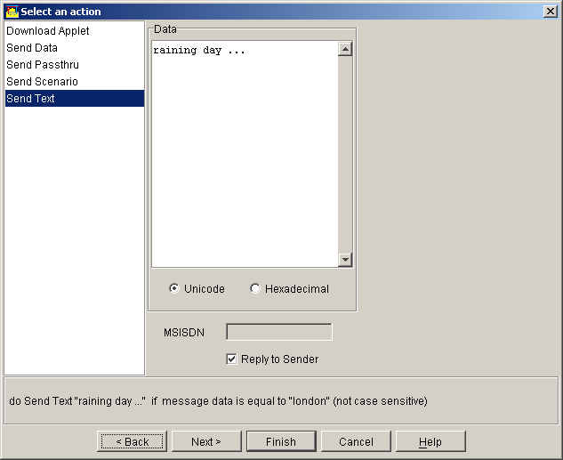
Agents
Select an action, if the agent is triggered
Send a SMS text

Slide 61
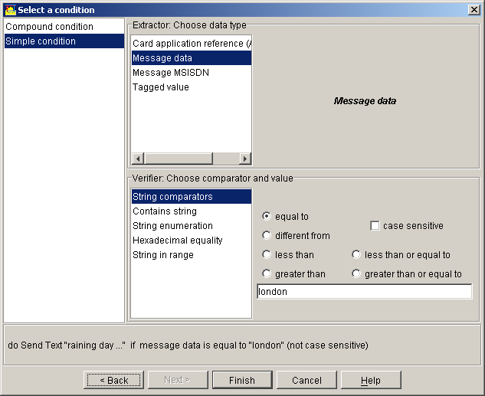
Agents
Select a condition to trigger the agent
Single condition

Slide 62
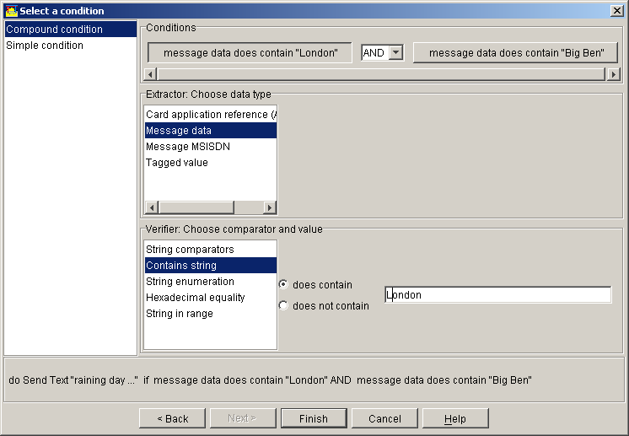
Agents
Select a condition to trigger the agent
Compound condition

Slide 63
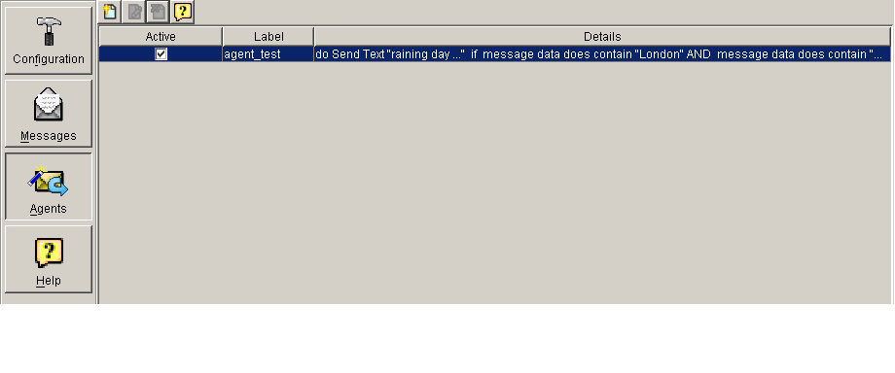
Agents
Activate the agent

