Slide 1
Objectives
  Provide a state of the art of 3G systems (technologies, features, standards)
  Help you to navigate efficiently in the 3G standards
  Identify the 3G main aspects and provide background on it
  Develop skills in order to be able to use and personalize a 3G card
  Provide a state of the art regarding migration path to 3G

Slide 2
USIM in 3G networks - AGENDA
DAY 1
PART 1 INTRODUCTION TO 3G
PART 2 3G STANDARDS
PART 3 The UICC platform
DAY 2
PART 4 The USIM application

Slide 3
DAY 1 - UICC

Slide 4
Introduction to 3G
3G standards
UICC charac. & transmission protocol
UICC File system
UICC Commands
UICC Access conditions
UICC Pin system

Slide 5
Roadmap to 3G (Techno)
Speech
Data
3G
2000 kb/s
UMTS
384 kb/s
EDGE
56 to 114 kb/s
GPRS
Speech
Data
2.5G
Up to 56 kb/s
HSCSD
9.6 to 14.4 kb/s
Speech
Data
GSM
2G

Slide 6




Origin of 3G
3G Origin
Technologies
Features
1992 : The 3G framework is born !
  its name : IMT 2000
    IMT : International Mobile Telecommunications
    “2000” stands for :
      The year 2000 : expected date of availability
      Data rates : 2000 kbps
      Frequency band : in the 2000 MHz area
  its family : International Telecommunication Union (ITU)
  its objective : offer broadband access at speed of 2Mbps !

Slide 7



ITU IMT 2000 System Family
3G Origin
Technologies
Features
UMTS (W-CDMA)
CDMA2000
TD-SCDMA
Standardised by:
  3GPP*
Supported by :
  ETSI*
  GSM companies (Nokia, Ericsson…)
Main deployments
  Europe – Asia
Standardised by:
  3GPP2*
Supported by :
  ANSI*
  American Vendors (Qualcomm, Lucent Tech…)
Main deployments
  Us – Asia
Standardised by:
  CWTS
Supported by :
  Datang Mobile
  Siemens
Main deployments
  China
3GPP : 3rd Generation Partnership Project
ETSI : European Telecom. Standard Inst.
W-CDMA : Wideband Code Division Multiple Access
CWTS : Chinese Wireless Telecom. Stand.
ANSI : American Nat. Standard. Inst
TD-SCDMA : Time Division Synchronous Code Division Multiple Access
3GPP2 : 3rd Generation Partnership Project2
ANSI : American Nat. Standard. Inst

Slide 8

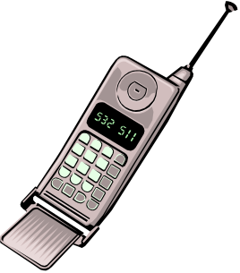



3G Radio Access
3G Origin
Technologies
Features
GSM → TDMA : Time Division Multiple Access
UMTS → CDMA : Code Division Multiple Access
  A unique code is assigned to each user
  The call is locked by this code no one else can open it
  All users are on the same frequency band (this code allows to separate the users)

Slide 9






UMTS: Universal Mobile Telecom. System
3G Origin
Technologies
Features
New W-CDMA
Core Network
new W-CDMA
USIM
Circuit Switch
new
new
Packet Switch
time
frequency

Slide 10

3G Origin
Technologies
Features
Architecture: Native 2G cards
SIM
GSM
2G APDU commands
A0…..
MF

Slide 11
3G Origin
Technologies
Features
Architecture: Java 2G cards
SIM
MF
GSM
2G APDU commands
A0…..
UICC

Slide 12
3G Origin
Technologies
Features
Architecture: Java 3G cards
SIM
USIM
BANK
MF
ADF
USIM
ADF
BANK
UMTS
3G APDU commands
00…..
UICC

Slide 13
3G Cards Features
3G Origin
Technologies
Features
A new card platform for 3G applications (UICC)
  UICC : Universal Integrated Circuit Card
  Designed to store several applications
plastic roaming
multi subscription
Telecom
R-UIM
WIM
Copyright
digital signature
end to end secure communication
USIM perso
Security
PKI
Others...
USIM pro
Security
E-Purse
SIM
EMV
Telecom
Banking
Banking
project with Europay Master Card Visa standards
digital right management for downloads
Copyright

Slide 14
3G Origin
Technologies
Features
USIM applications
There can be up to 7 USIM applications in the card (it is a limitation of the JC 2.1.1 standard)
Each USIM can be an independent application with a different MSISDN, IMSI, file system… (example: a professional USIM 1 & a personal USIM 2)
SIM
USIM 1
USIM 2
USIM 3
…
MF
ADF
USIM 1
ADF
USIM 2
ADF
USIM 3
UMTS
3G APDU commands
UICC

Slide 15




3G Cards Features
3G Origin
Technologies
Features
Logical Channels
  Possibility to run several applications in parallel
  ex : M-Commerce transaction using USIM combined with PKI application
Secure Local Link
  3G handsets support new bearers (Bluetooth, IrDA, RS232, USB)
  3G application can open and secure local channel
  ex : Using the mobile as a modem for a PC using Bluetooth link

Slide 16





USIM features
3G Origin
Technologies
Features
Enhanced Security
  Mutual authentication ( Network←→ User)
  New generation of Algorithms
    Ex : « Milenage » based on Advanced Encryption Standard
  Integrity check on signaling data
    Stamp to proof the identity of the sender
Advanced phonebook
  E-organiser format
  Easy to customise
  Synchronisation ready (SIM/USIM)

Slide 17
Introduction to 3G
3G standards
UICC charac. & transmission protocol
UICC File system
UICC Commands
UICC Access conditions
UICC Pin system

Slide 18
Agenda
Standard organizations
3G Card architecture & Standard documents
Historical view of the standards

Slide 19







3G STANDARD ORGANIZATIONS
IMT 2000 (ITU)
International Mobile Telecommunications
3G
Requirements
! 3GPP2
UMTS
3rd Generation
Partnership
Project 2
CDMA 2000
China Wireless
Telecom
Standards
TD-SCDMA
CWTS
3G
Standards Specifications
3rd Generation
Partnership
Project
Smart Card Platform
Standards Specifications
EP SCP
ETSI Project Smart Card Platform

Slide 20
3G Origin
Technologies
Features
Java 3G cards
3G Smart Card Platform is standardized by EP-SCP
  UICC : Universal Integrated Circuit Card
  Physical & electrical characteristics
  File system
  Commands
  Access conditions, PIN system...
ETSI Project
Smart Card Platform
SIM
USIM
BANK
MF
ADF
USIM
ADF
BANK
UMTS
3G APDU commands
UICC

Slide 21
3G Origin
Technologies
Features
Java 3G cards
USIM Telecom Application is standardised by 3GPP
  USIM : Universal Subscriber Identity Module
  List of UMTS files
  Security architecture & process (authentication…)
  Phonebook
  USIM application toolkit...
3rd Generation Partnership Project
SIM
USIM
BANK
MF
ADF
USIM
ADF
BANK
UMTS
3G APDU commands
UICC

Slide 22


3GPP Partners
China Wireless Telecommunication Standards Group (China)
Association of Radio Industries and Businesses (Japan)
European Telecom. Standard Inst
The Telecommunication Technology Committee (Japan)
Standard Committee T1 Telecommunication
Telecommunications Technology Association (Korea)

Slide 23





3GPP2 Partners
China Wireless Telecommunication Standards Group (China)
Association of Radio Industries and Businesses (Japan)
Telecommunications Technology Association (Korea)
Telecommunications Industry Association (North America)
The Telecommunication Technology Committee (Japan)
Notes:
Here the 3GPP2 partners

Slide 24



3G Licenses World-Wide
Europe, Middle East, Africa
Asia Pacific
Americas
UMTS
3GPP2
Americas
Asia Pacific
CDMA2000

Slide 25
Agenda
Standard organizations
3G Card architecture & Standard documents
Historical view of the standards

Slide 26
3G Standards Roadmap
3GPP & EP-SCP standards are organized in releases
  a new release adds new features
  a new release is backward compatible
  an old release can only be corrected
  Release 99 : approved in2000
  Release 4 : approved in 2001
  Release 5 : approved in 2002
  Release 6 : approved in 2003
Release 5

Slide 27
Legend
The cylinders are applets (Java card, toolkit…)
Ex: USIM
The rectangles are System APIs or low-level OS parts (hardware, drivers…)
Ex: Java Card 2.1.1
Hardware

Slide 28
Java USIM card architecture - Java Card
Card
manager
Global Platform 2.0.1’
Java Card 2.1.1
Hardware

Slide 29
Java USIM card architecture -
UICC API:
ETSI 102 241 R5
Commands and access conditions:
ETSI 102 221 R5
Administrative commands:
ETSI 102 222 R5
Toolkit:
ETSI 102 223 R5
UICC
API
Card
manager
UICC
Global Platform 2.0.1’
Java Card 2.1.1
Hardware

Slide 30
Java USIM card architecture –
SIM specification:
3GPP 51.011 R4
Toolkit:
3GPP 51.014 R4
USIM specification:
3GPP 31.102 R5
Toolkit:
3GPP 31.111 R5
Security (Remote manager):
3GPP 23.048 R5
VAS-SAT
VAS-USAT
RFM SIM
RFM USIM
RFM BANK
SIM
API
USIM
API
RAM
RFM
UICC
SIM
USIM
BANK
MF
ADF
USIM
ADF
BANK
UICC
API
Card
manager
UICC
JavaCard 2.1.1
SIM API:
3GPP 31.130 R5
Hardware
Refines the UICC platform for the telecom:
3GPP 31.101 R5
SIM API:
3GPP 43.019 R5

Slide 31

standards for OTA
SMS security:
3GPP 23.048 R5
SMS (transport – security)
APDU
SMS transport:
3GPP 23.040 R5

Slide 32

Standards used on “R5” cards
USIM specification:
3GPP 31.102 R5
Toolkit:
3GPP 31.111 R5
Security:
3GPP 23.048 R5
SMS (transport – security)
SIM specification:
3GPP 51.011 R4
Toolkit:
3GPP 51.014 R4
VAS-SAT
VAS-USAT
SMS transport:
3GPP 23.040 R5
RFM SIM
RFM USIM
RFM BANK
SIM API:
3GPP 31.130 R5
SIM
SIM
SIM
API
USIM
API
RAM
RFM
UICC
SIM
USIM
BANK
MF
ADF
USIM
ADF
BANK
UICC
API
UICC API:
ETSI 102.241 R5
Card
manager
UICC
Global platform 2.0.1’
SIM API:
3GPP 43.019 R5
Proprietary
API
JavaCard API
Refines the UICC platform for the telecom:
3GPP 31.101 R5
JavaCard VM
Javacard 2.1.1
Hardware
Commands and access conditions: ETSI 102 221 R5
Administrative commands: ETSI 102 222 R5
Toolkit: ETSI 102 223 R5

Slide 33
Agenda
Standard organizations
3G Card architecture & Standard documents
Historical view of the standards

Slide 34


& Evolutions (historical view)
Network Access Application SIM / USIM / UICC
legend
SIM Application
USIM Application
11.11
Up to R99
51.011
31.102
R99 to
Old standards
R4
R5
31.101
R99 to
R5
Standard Based on…
Card Platform / UICC
102 221
R99 to
Rx
R5
Last release used in the cards
102 222
R99 to
R5

Slide 35
& Evolutions (historical view)
OTA transport & security
Transport
Security
03.40
Up to R99
03.48
Up to R99
23.040
R4 to
R5
23.048
R4 to
R5

Slide 36
& Evolutions (historical view)
Toolkit: CAT / SAT / USAT
SIM Application Toolkit
USIM Application Toolkit
11.14
Up to R99
51.014
31.111
R99 to
R4
R5
Card Application Toolkit
102 223
R99 to
R5

Slide 37
& Evolutions (historical view)
Toolkit APIs: UICC / (U)SIM API
SIM API
(U)SIM API
03.19
Up to R99
43.019
R4 to
31.130
R5
R6
UICC API
102 241
R6

Slide 38
Other Useful Documents
Security Architecture
  Detailed specification on security features and process
33.102
SIM/USIM inter-working (Technical Recommendation)
  Authentication and key agreement in mixed networks
  Both SIM & USIM on an UICC ...
31.900
Milenage Algorithm Specification
35.205

Slide 39
How to be up to date with ETSI and 3GPP Standards ?
The standard list of 3GPP is available on
http://www.3gpp.org/specs/specs.htm
The standard list of the ETSI is available on:
http://portal.etsi.org/Portal_Common
ETSI Project
Smart Card Platform

Slide 40
Introduction to 3G
3G standards
UICC charac. & transmission protocol
UICC File system
UICC Commands
UICC Access conditions
UICC Pin system

Slide 41
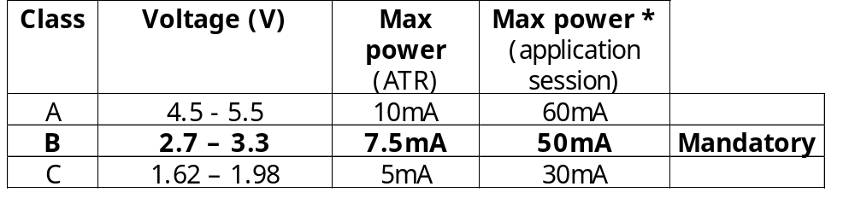
Physical & Electrical Characteristics
Size : same as GSM (ID-1 & Plug-In)
Electrical : 3 classes of operation (A, B, C)
  Class B is mandatory
  2 classes at least shall be supported
* Applications may specify their own maximum power consumption values in the response of the SELECT command.
Warm Reset and Clock Stop mode mandatory

Slide 42

Transmission Protocols
T=0 OR T=1 OR Both
T=0 AND T=1
T=1
Read record 12
of file EF 6F06 and get it back
T=0
Read record 12
of file EF 6F06
OK it’s done
What’s inside ?
“Hello world”
“Hello World”
Command APDU
Response APDU

Slide 43
Introduction to 3G
3G standards
UICC charac. & transmission protocol
UICC File system
UICC Commands
UICC Access conditions
UICC Pin system

Slide 44

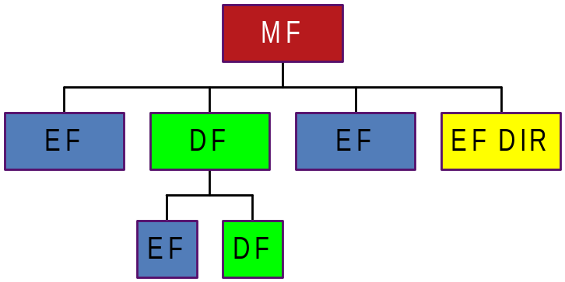
3G file system
Files Remain
Master File (MF)
Elementary files (EF)
Dedicated files (DF)
SIM
USIM
BANK
MF
ADF
USIM
ADF
BANK
UMTS
3G APDU commands
UICC

Slide 45

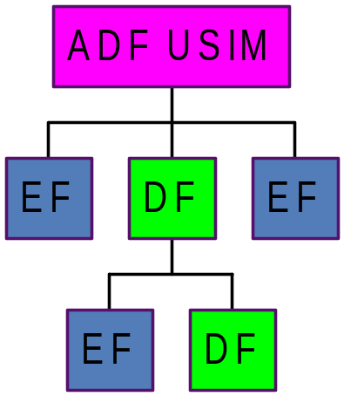
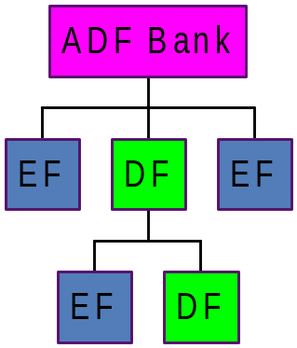
3G file system
AID 1
AID 2
New type of file
Application dedicated file (ADF)
dedicated to an application
contains the application file system
apart from the MF file system
only selected by its identifier AID
SIM
USIM
BANK
MF
ADF
USIM
ADF
BANK
UMTS
3G APDU commands
UICC

Slide 46
3G File system implementations
UICC application
file system
MF
SIM application
file system
EF Dir
ADF USIM
ADF Bank
EF PL
DF Telecom
DF GSM
EF ICCID
EF ARR
3rd Party application
File system
EF ADN
EF FDN
EF SMSP
EF PLMN Sel
EF HPLMN
EF IMSI
Each ADF is independent. Internal ADF
operations are regulated by the access domain mechanism. Each ADF has access to the UICC part.
ADF Bank
EF1
DF1
EF2
EF3
ADF USIM
EF4
EF5
EF6
EF IMSI
EF FDN
EF HPLMN
EF UST
USIM application
File system

Slide 47
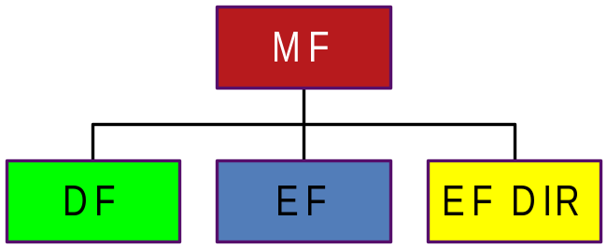
3G file system
EF DIR :
contains the list of the AID of all the applications except the SIM
AID1
AID2
AID3
AID1
AID2
AID3
SIM
USIM 1
USIM 2
PKI
MF
ADF
USIM1
ADF
USIM2
ADF
PKI
UMTS
3G APDU commands
UICC

Slide 48

Registered Application Provider IDentifier
AID
TS 101 220
RID (5 bytes)
PIX (between 7 & 11 bytes)
Example:
A000000087
1002 FF33 FFFF89 010101 00
Registered Application Provider IDentifier
 standard organization reference
3GPP : A000000087
ETSI : A000000009

Slide 49
Proprietary application Identifier eXtension
AID
TS 101 220
RID (5 bytes)
PIX (between 7 & 11 bytes)
Example:
A000000087
1002 FF33 FFFF89 010101 00
 application ref.
GSM : 0001, SAT : 0002, USIM : 1002, USAT:1003..
 Country code
France : FF33,…
  application provider field (optional)
TAR : 010101
Application Provider specific data : 00
  application provider code
Telecom : FFFF89…

Slide 50
AID (Application Identifier)
Application ref:
AID: … 0002…
AID1: …1002…
AID2: …1002…
AID: … 1003…
AID1: …1002…
AID2: …1002…
AID: …0001…
AID
AID
AID
VAS-SAT
VAS-USAT
AID
RFM SIM
RFM USIM1
RFM USIM2
SIM
SIM
SIM
API
USIM
API
RAM
RFM
UICC
SIM
USIM1
USIM2
AID
MF
ADF
USIM1
ADF
USIM2
UICC
API
Start USIM 1 ?
Start USIM 2 ?
Card
manager
UICC
Java Card
AID
Hardware

Slide 51
Introduction to 3G
3G standards
UICC charac. & transmission protocol
UICC File system
UICC Commands
UICC Access conditions
UICC Pin system

Slide 52
UICC Commands
Difference with GSM
Command APDU
CLA
INS
P1
P2
P3
A0h
General: select, update…
00h
01h
02h
03h
USAT: fetch, terminal response…
UICC
80h
80h
81h
82h
83h
Increase/Status

Slide 53
UICC Responses
Difference with GSM
Response APDU
SW1
SW2
Some GSM status bytes have been converted for UICC
ex
Terminal shall issue
a Get Response
9F
XX
61
XX
UICC
New status bytes for UICC
ex
Terminal shall issue
the previous command
6C
XX
UICC

Slide 54

Java Card 2.2.1
Logical channels
The card is NOT multi thread, only one APDU command can be sent at a time
Select a file under the ADF USIM (Channel 0)
NAA-SIM
NAA-USIM
BANK
WIM
MF
ADF
USIM
ADF
BANK
MF
Ch: 0
Command APDU
UICC
CLA
INS
P1
P2
P3
Ch: 0
00 SELECT (file under ADF USIM)
Type of command
(0: standard ISO, 8: non standard ISO, e.g. toolkit…)
Channel number

Slide 55
Java Card 2.2.1
Logical channels
The card is NOT multi thread, only one APDU command can be sent at a time
Select the BANK application by its AID
NAA-SIM
NAA-USIM
BANK
WIM
BANK
MF
ADF
USIM
ADF
BANK
MF
Ch: 0
Command APDU
UICC
CLA
INS
P1
P2
P3
Ch: 0
00 SELECT by AID (BANK application)
Type of command
(0: standard ISO, 8: non standard ISO, e.g. toolkit…)
Channel number

Slide 56
Java Card 2.2.1
Logical channels
The card is NOT multi thread, only one APDU command can be sent at a time
Assign channel 1 to BANK application
NAA-SIM
NAA-USIM
BANK
WIM
BANK
MF
ADF
USIM
ADF
BANK
MF
Ch: 0
Ch: 1
Command APDU
UICC
CLA
INS
P1
P2
P3
Ch: 0
00 MANAGE CHANNEL: ch 1
Type of command
(0: standard ISO, 8: non standard ISO, e.g. toolkit…)
Channel number

Slide 57
Java Card 2.2.1
Logical channels
The card is NOT multi thread, only one APDU command can be sent at a time
Select a file under the ADF BANK (Channel 1)
NAA-SIM
NAA-USIM
BANK
WIM
MF
ADF
USIM
ADF
BANK
MF
Ch: 1
Command APDU
UICC
CLA
INS
P1
P2
P3
Ch: 0
01 SELECT (file under ADF BANK)
Type of command
(0: standard ISO, 8: non standard ISO, e.g. toolkit…)
Channel number

Slide 58
Java Card 2.2.1
Logical channels
The card is NOT multi thread, only one APDU command can be sent at a time
Possible to open up to 4 logical channels
NAA-SIM
NAA-USIM
BANK
WIM
MF
ADF
USIM
ADF
BANK
MF
Ch: 0
Ch: 1
Ch: 2
Ch: 3
Command APDU
UICC
CLA
INS
P1
P2
P3
Ch: 0

Slide 59
UICC Command Set
Generic
USAT
SELECT / STATUS
READ BINARY / UPDATE BINARY
READ RECORD / UPDATE RECORD
SEARCH RECORD / INCREASE
VERIFY PIN / CHANGE PIN / DISABLE PIN / ENABLE PIN / UNBLOCK PIN
DEACTIVATE FILE / ACTIVATE FILE
AUTHENTICATE
MANAGE CHANNEL
GET CHALLENGE
TERMINAL PROFILE / FETCH / ENVELOPE / TERMINAL RESPONSE
TS 102 221
Transmission Oriented
GET RESPONSE
(T= 0 specific commands)
TS 102 221
Administrative (not mandatory)
CREATE FILE / DELETE FILE
TERMINATE EF/DF/ CARD USAGE
TS 102 221
TS 102 222

Slide 60
Differences with
SEARCH RECORD
based on GSM SEEK command
to find records with a specific pattern
EF adn
John
Robert
David
Anne
…
Search record (‘avi’)
Response (record n° 3)

Slide 61
Differences with
SEARCH RECORD
 VERIFY PIN / CHANGE PIN / DISABLE PIN / ENABLE PIN / UNBLOCK PIN
based on GSM SEEK command
to find records with a specific pattern
new PIN system for the UICC
(details later on)
possible to retrieve the counter value without presenting the PIN value
 AUTHENTICATE
3G version of Run GSM Algorithm command
(details later on)
 MANAGE CHANNEL
designed for multi-applications cards
to close and open logical channels
 DEACTIVATE FILE/ ACTIVATE FILE
Based on GSM INVALIDATE / REHABILITATE
reversible operation
deactivated file can only be Selected or Activated
 GET CHALLENGE
to make the card generate a random number

Slide 62
Differences with
TERMINATE EF/DF/CARD USAGE
Irreversible Operation
to make the EF/DF/Card unusable by the cardholder
When a file is terminated only the select command can be applied

Slide 63
Differences with
 SELECT
New options in command
  Select - by AID (Application ID)
    to select an application (ex : USIM)
    to manage application session
SIM
USIM
BANK
MF
ADF
USIM
ADF
BANK
APDU command:
Select by AID (USIM)
UICC

Slide 64
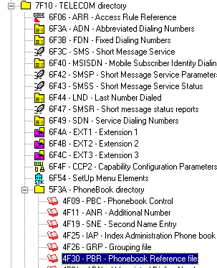
Differences with
 SELECT
New options in command
  Select - by AID (Application ID)
    to select an application (ex : USIM)
    to manage application session
  Select - by Path
    ex : Select [7F10||5F3A||4F30]

Slide 65

Differences with
 SELECT
New options in command
  Select - by AID (Application ID)
    to select an application (ex : USIM)
    to manage application session
  Select - by Path
    ex : Select [7F10||5F3A||4F30]
New items in response
  Response to Select (File Control Parameters)
  new parameters in FCP (coded in TLV)
Select file
Response to Select

Slide 66
Differences with
 SELECT
Response to Select (TLV)format
Data Objects (DO)
Descriptor
Identifier
Proprietary
Life cycle
T
L
V
Security
Size
Size Total
Short file ID

Slide 67
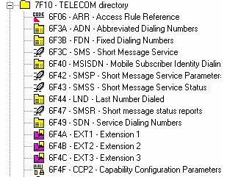
Differences with
The SFI mechanism
The SFI (Short File Identifier) mechanism is a local reference system for EFs under a DF
  SFI value from 1 to 30
  Assigned at the file creation
  Mandatory with a given value for specific files (EF DIR, EF PL…)
  Optional for other files
SFI: 1
SFI: 2
SFI: 3
SFI: 25

Slide 68

Differences with
The SFI mechanism
READ BINARY
UPDATE BINARY
READ RECORD
UPDATE RECORD
Only 4 commands support Short File Identifier (SFI)
SFI is a part of the command
  READ BINARY [APDU: 00 B0….(SFI=1)…]
implicit selection without using a select
  It saves times in the mobile-card exchange!
  Mechanism used with the 3G phone book

Slide 69
SFI example
SFI: 1
2 ways to update the EF_{FDN} 6F3B :
Or directly
SFI: 2
SFI: 3
SELECT (6F3B)
+ UPDATE RECORD (6F3B)
SFI: 25
UPDATE RECORD (by SFI: 3)
Only 30 SFI value per DF !

Slide 70
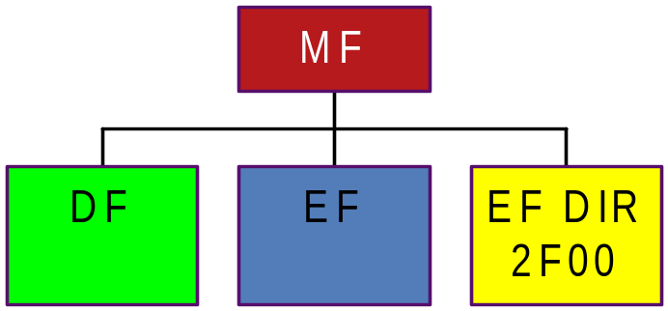

Differences with
The SFI mechanism
The SFI value of a file is present in the FCP (response to Select)
Select file 2F00
Response to Select
SFI=1E (30)
Why F0 ?

Slide 71
Differences with
The SFI mechanism
In the FCP the SFI value (from 1 to 30) is coded on 5 bits:
SFI
T
L
V
88h
01h
- - - - - 000b
SFI = 1E
Example:
T
L
V
88h
01h
11110 000b
F0h
Or:
T
L
SFI not supported
88h
00h

Slide 72
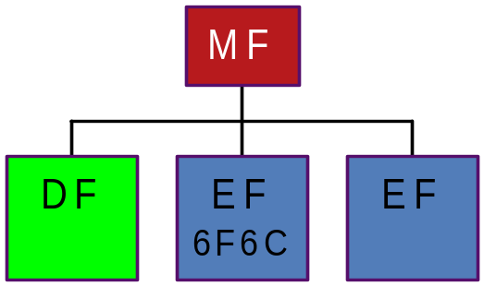
Differences with
The SFI mechanism (automatic assign)
T
If the tag is not present in the FCP, the SFI= 5 least significant bits of FID
88h
FID
- - - - - - - - - - - - - - - -
SFI
FID: 6F6C
Example:
0110 1111 0110 1100
SFI = 0C (12)

Slide 73
Practicals
Session A Managing File

Slide 74
Introduction to 3G
3G standards
UICC charac. & transmission protocol
UICC File system
UICC Commands
UICC Access conditions
UICC Pin system

Slide 75
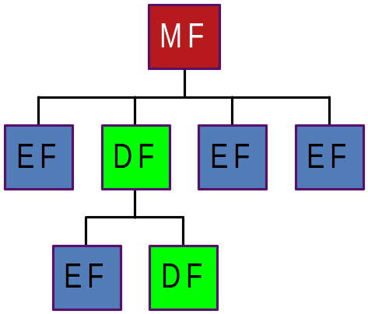
Access Conditions
All the files and folders are protected whatever the command received: ‘read binary’, ‘read record’, ‘create file’…
Can I Read this file ? YES if CHV1 granted
Can I Update this file ? YES if ADM2 granted
…
This file is protected:
‘Read’ by CHV1
‘Update’ by ADM2
…

Slide 76


Reminder : GSM Access Conditions
Access conditions in file descriptor
File descriptor
DF
EF
Group 1
RFU
Read / Seek
Example
Group 2
RFU
Update
File body
EF
Group 3
Delete
Increase (Cyclic)
RFU
Read / Seek
CHV1
Group 4
Create / Extend
Update
CHV2
Group 5
RFU
Rehabilitate
Increase
CHV2
Group 6
RFU
Invalidate
RFU
RFU
Rehabilitate
ADM1
Invalidate
ADM2
Access conditions defined at the file creation
Impossible after to modify an access condition (the only way is to delete and recreate the file)

Slide 77
USIM Access conditions
Reference to Expanded format
Security file EF ARR
EF
Access Condition 3G
EF ARR FID
EF ARR Record #
Access Condition 3G
Read: PIN1, Update: PIN2…
Read: ALWAYS, Update: PIN2…
Update: PIN2, …
…
…
File Header
EF ARR FID
EF ARR Record #
File Body
Access conditions defined in a record file EF ARR (ACCESS RULE REFERENCE)
Each record is a security profile
Can be modified at any time
An EF ARR is a file like another, its security is defined in its header
Notes:
ARR: Access rule reference

Slide 78
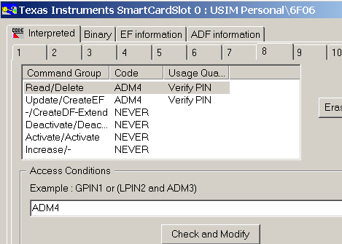
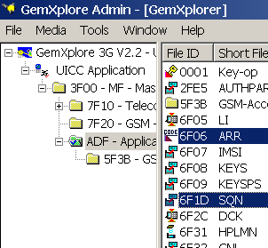
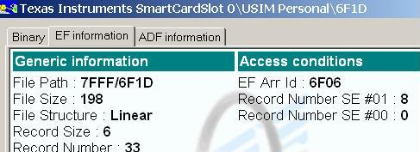
USIM Access conditions - Example
File EF_{ARR} 6F06 under USIM
File EF_{SQN} 6F1D under USIM

Slide 79
USIM Access conditions - Standards
The Access conditions, PIN system...
standardized by the ETSI 102 221
In line with
ETSI Project
Smart Card Platform
ISO 7816-9
SIM
USIM
BANK
MF
ADF
USIM
ADF
BANK
UMTS
3G APDU commands
UICC

Slide 80
UICC Access conditions
ISO 7816-9
Access condition are based on Security Attributes
  Security attributes are associated to each EF, DF
Security attributes
...
AM
SC
AM
SC
AM
SC
Access rule
Access Mode
‘The command(s) to protect’
Security Condition
‘How to protect the command(s)’
Group of Commands
Example : Read, Update
Security Procedure to allow execution
of the Group of Commands
Example : Verify Global Pin 1

Slide 81
Security Attributes Format
UICC Standards allow 3 types of Format :
AM
byte
SC
byte
Stored in the File Descriptor
Compact
header
Body
AM_DO
data object (TLV)
SC_DO
data object (TLV)
Expanded
Stored in a specific file
Reference to
Expanded
AM_DO
data object (TLV)
SC_DO
data object (TLV)
header
header
Body
Mandatory Format for USIM !!!

Slide 82
Assignment of Access Conditions to Files
FCP (response to Select) is used either to store or to indicate the path of the Security Attributes :
Response to the SELECT:
Mandatory for USIM
T
L
V
8C
L
Compact
AM
byte
SC
byte
T
L
V
AB
L
Expanded
AM_DO
TLV
SC-DO
TLV
T
L
V
8B
L
Reference to
Expanded
EF ARR
FID
EF ARR
Record #
Notes:
FCP: File control parameter information

Slide 83
EF ARR (Access Rule Reference) Files
DF1
Mandatory
  under the MF (2F06)
  under ADF_USIM (6F06)
  under DF TELECOM (6F06)
Backtracking possible
  EF EXAMPLE protected using “Reference to Expanded Format” with
  EF ARR 6F06 is not found at the parent level (DF2)
  ⇒ EF ARR 6F06 is searched at the grand parent level (DF1)
  The process continue until ADF or MF is reached
EF ARR (6F06)
DF2
NO 6F06
EF_EXAMPLE
(id EF ARR=6F06)
T
L
V
8B
L
Reference to
Expanded
EF ARR
6F06
EF ARR
Record #

Slide 84
Inside the EF_{ARR}

Slide 85
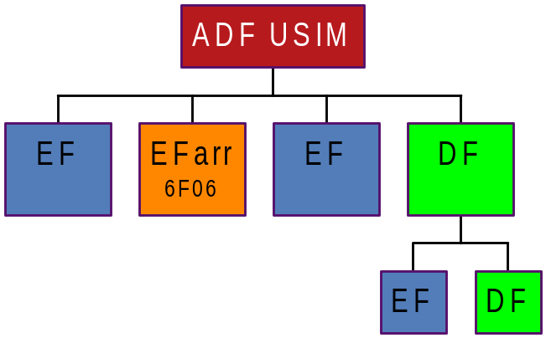
An example
Can I Read this file ? YES, always
Can I Update this file ? Protected by ADM1
Can I Activate this file ? NO, never
…
RECORD 1
Read: always
Update: ADM1
Activate: never
Deactivate: never
…

Slide 86
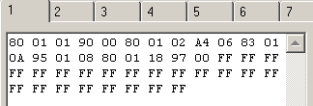
Inside the EF_{ARR}
The administration tool gives 2 views of the different records (security profiles) of the EF ARR
The interpreted mode
The binary mode

Slide 87
Inside the EF_{ARR}
_{Analyze of a record}
Read:
ALWAYS
Update:
ADM1
Access Mode
Security Condition
Activate/Deactivate: NEVER

Slide 88
The Access Mode
The command(s) to protect

Slide 89
ACCESS MODE DO (AM_DO) Format :
T
L
V
  Standard
Refer to a standard Command
(Read, Update…)
T
L
V
80h
01h
AM
byte
  APDU Specific
Refer to a Specific Combination of
CLA, INS, P1, P2
T
L
V
81h
to 8Fh
--
APDU
Param.
Notes:
El valor 80h es estandar pero tambien se pueden tener valores propietarios.

Slide 90
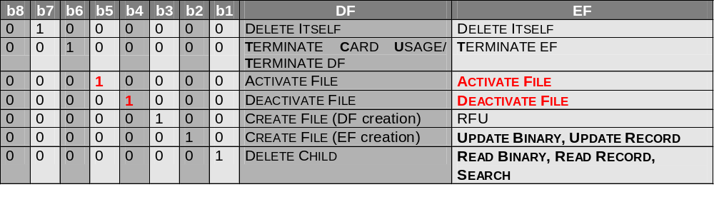
Standard Format (TAG 80):
Activate”&”Deactivate”
1 8

Slide 91
APDU Specific Format :
Can I use the command Increase on this file ? APDU: CLA INS(0x32) P1 P2
Increase is a proprietary command!
→ YES but Protected by GPIN1
RECORD1
Read: always
Update: ADM1
Activate: never
Increase: GPIN1
…
The file is protected when it receives a command with an instruction 32

Slide 92
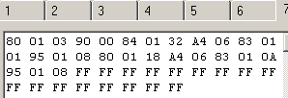
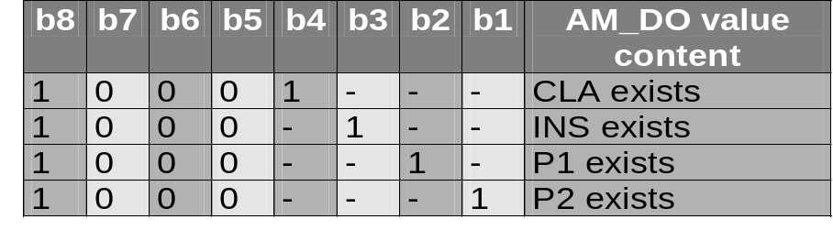
APDU Specific Format (TAG 81 to 8F):
For commands not standardized
T
L
V
81h
to 8Fh
--
APDU
param.
Specific Combinations of CLA, INS, P1, P2
APDU Parameter(s) Identification

Slide 93
APDU Specific Format : the example
The file is protected when it receives a command with an instruction 32
T
L
V
8 4
01
32

Slide 94
APDU Specific Format : other examples
T
L
V
81h
to 8Fh
--
APDU
param.
APDU Parameter(s) Identification
T
Examples

84h
:
INS

8Fh
:
CLA
INS
P1
P2
The verification can be done on the CLASS, the instruction, the parameters P1 P2 … or a combination of these parameters

Slide 95
The Security condition
How to protect the command

Slide 96
The Security condition
The Read is possible ?: ALWAYS
The Update is possible ?: ADM1
Access Mode
Security Conditions
The Activate/Deactivate is possible ?: NEVER

Slide 97
Security condition DO (SC_DO) format
It is coded on TLV, there are ‘3 types’ of security conditions: ALWAYS, NEVER and using a pin code.
T
L
T
L
V
ALWAYS
T
L
NEVER
T
L
V
A4
06
KEY_DO
(TLV)
Usage qualifier_DO
(TLV)
Secret code Reference
Ex : Global Pin 1, Local Pin 1...
Usage of Secret code
Ex : Verify

Slide 98
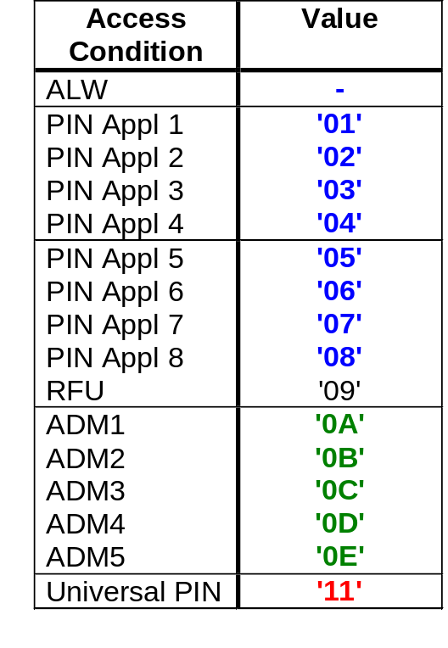
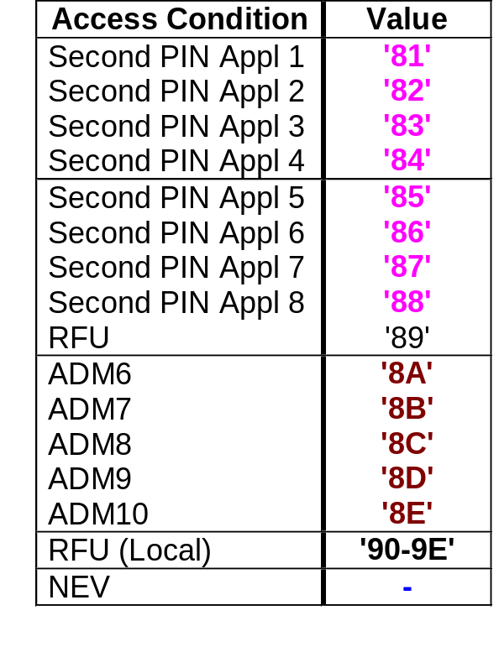

Security condition DO (SC_DO) format
T
L
V
A4
06
KEY_DO
(TLV)
Usage qualifier_DO
(TLV)
Ex: A4 06 83 01 0A 95 01 08
Key Reference DO (KEY_DO)
Usage Qualifier DO
  08 : Verify PIN or ADM
Which is the
type of verification?
Which is the code
to be used ?

Slide 99
USE of « OR » ; « AND »
Any command can be protected by a different combination of pin codes
Example, Update protected by ADM1 but can be protected by:
  - ADM1 and GPIN1
  ADM2 or ADM3
  (GPIN1 and GPIN2) or ADM1
  …
The Update is possible ?: ADM1

Slide 100
USE of « OR » ; « AND »
T
L
V
OR
AND
A0h
L
SC-DO
SC-DO
T
L
V
AFh
L
SC-DO
SC-DO
Example Read : PIN1 or ADM1
Read
OR
PIN1
ADM1
T
L
V
T
L
T
L
T
L
V
T
L
V
T
L
T
L
V
T
L
V
80 01 01
A0 10
A4 06
A4 06
83 01 01
95 01 08
83 01 0A
95 01 08
Example Update : PIN2 and ADM2
Update
AND
PIN2
ADM2
T
L
V
T
L
T
L
T
L
V
T
L
V
T
L
T
L
V
T
L
V
80 01 02
AF 10
A4 06
A4 06
83 01 02
95 01 08
83 01 0B
95 01 08

Slide 101
Access condition: 3 types of files
MF
EF ARR
Pointer
Pointer
Ex : EF PL
Files used in GSM only
Files used in GSM & 3G
Files used in 3G only
File having 2
independents sets
of Access Conditions

Slide 102
Introduction to 3G
3G standards
UICC charac. & transmission protocol
UICC File system
UICC Commands
UICC Access conditions
UICC Pin system

Slide 103

UICC PIN SYSTEM
Standard allows up to :
102 221
10 Administrative PINs
8 Global PINs
8 Local PINs
GPIN1
LPIN1
ADM1
GPIN2
1 Universal PIN
LPIN2
ADM2
GPIN3
GPIN4
LPIN3
ADM3
GPIN5
LPIN4
ADM4
GPIN6
…
…
UPIN
GPIN7
LPIN7
ADM9
GPIN8
LPIN8
ADM10

Slide 104
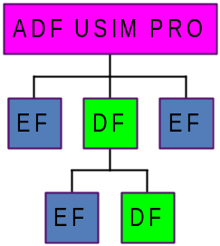
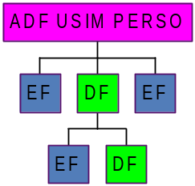
GLOBAL PIN
GPIN1
each Application must be linked to one Global PIN
in this example:
  GPIN1 is the current application PIN of ADF USIM,
  GPIN1 is the global PIN to be used to protect files under ADF USIM
several Applications can be linked to the same Global PIN
GPIN1
Any global PIN can be used to protect files under the MF
Notes:
Global PIN: Similar a CHV code in GSM, presented by Subscriber when 3G mobile phone is powered on
MF no puede ser asignado a ningun GP ya que este es compartido por todas las aplicaciones

Slide 105
UNIVERSAL PIN - Security Environment
File EF_{ARR} 6F06 under USIM
File EF_{SQN} 6F1D under USIM

Slide 106
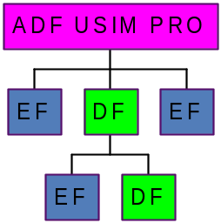

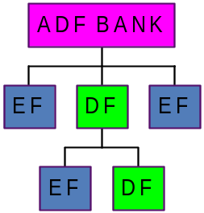
UNIVERSAL PIN - Security Environment
The Use of Universal PIN is dedicated to multi-application cards
Universal PIN can replace the current Global application PIN
SE01 by default
But if GPIN1 is disabled…
UPIN
GPIN1
SE00
SE01 by default
GPIN2
if GPIN2 is disabled…
UPIN
SE00
SE01 by default
if GPIN3 is disabled…
GPIN3
UPIN
SE00

Slide 107
UNIVERSAL PIN - Security Environment
File EF_{ARR} 6F06 under USIM
If the SE #00 is used it should refer to a record using the UPIN only

Slide 108
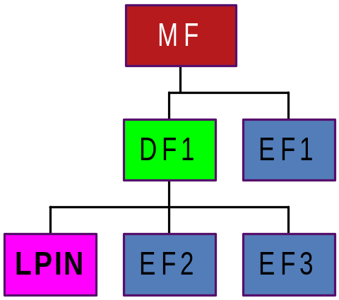
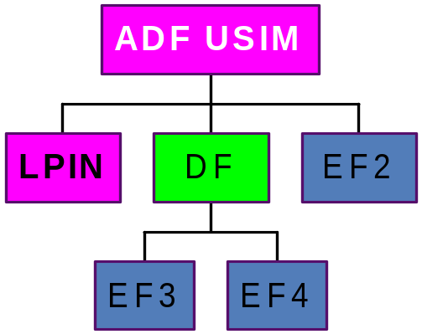
LOCAL PIN
Local PIN under a DF of MF file system:
  LPIN can be used to protect files under its current DF only (EF2, EF3 but not EF1)
Local PIN under an ADF
  LPIN can be used to protect all files under the current ADF.
Notes:
Local PIN se conoce como SECOND PIN y es usado mas que todo en banking cards

Slide 109
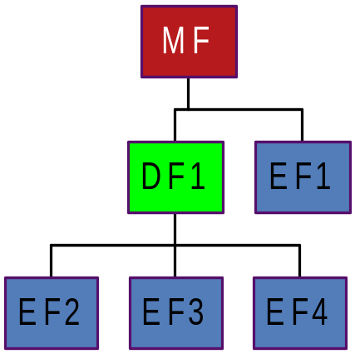
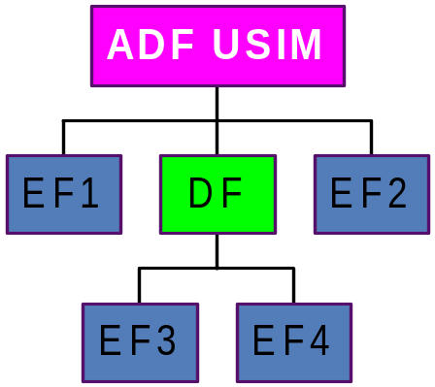
ADMINISTRATIVE PIN
Any administrative PIN can be used to protect files under the MF or any ADF

Slide 110
PIN code names
The Global PINs GPIN (or Application PINs)
The Local PINs LPIN
Key Reference DO (KEY_DO)
The Administration PINs ADM

Slide 111
Practicals
Session B Access Conditions

