Slide 1


Course Schedule
Day 1 :
  Introduction
  JavaCard concepts
  Demo & practical
  Java SIM Card
Day 2 :
  STK and Javacard
  Demo & practical
  Over The Air communication
  Demo & Practical
Notes:
Java Card 2.1 Overview
4/11/05: NEED TO SIMPLIFY SLIDES (see NOKIA version)
2. SIM Based on Java Card.
Basics on JC, compared to Java, architecture, classes, I/O communication,
applet structure, etc
Necessary to understand how GSM & STK (and other) applications
can be implemented on GemXplore Xpresso. Ex: of a pure JC applet
Ch2 general points on JC2.1
3. Specific points now given for G+ product
5. STK protocol = quick summary of STK std and specifically what
features GXpXpresso supports
Then how to develop STK applets

Slide 2
Content – Java Card Concepts
  Introduction
  JCRE, VM and API
  Applet definition
  Conversion step
  Load & Install
  Applet & Package interaction
  Security

Slide 3
Content
Introduction

Slide 4

Java Card
Based on JavaTM language and VM
BUT... for hardware resources and functional reasons some features had to be left out
Not a major issue
  relatively low complexity of applications
Notes:
Java Card 2.1 Overview

Slide 5

Java Card Specifications
A tool for developers, promoted by Java Card Forum and issued by SUN Microsystems
  JCF : composed of companies involved in the smart card world, which make standards evolving http://www.javacardforum.org
  SUN : issues specifications, write JDK and standard tests.
Java Card Specifications versions
  Java Card 2.1 allows developers to design the VM, the JCRE and write JC applets.
  Java Card 2.1.1 refines some features
  Java Card 2.2, next version of Java Card API issued in 2002, to be implemented in 2005

Slide 6






Java SIM Card Architecture Overview
GSM
Application
STK Applet
SIM Toolkit API
JavaCard API
Remote
Manager
Card
Manager
JavaCard VM
Native ressources
Microprocessor

Slide 7
Contents
JCRE, VM and API

Slide 8
Java SIM Card Architecture Overview
GSM
Application
STK Applet
SIM Toolkit API
JavaCard API
Remote
Manager
Card
Manager
JavaCard VM
Native ressources
Microprocessor

Slide 9
Java Card Runtime Environment
JCVM - Java Card Virtual Machine
  Understand & execute bytecode
API - Application Programming Interface
  Library related to ISO7816, SIM Toolkit
Native methods
  I/O, cryptographic, memory allocation services
JavaCard API
JavaCard VM
Native ressources
Microprocessor
Notes:
Java Card 2.1 Overview

Slide 10
Java Card Runtime Environment
JCRE is responsible for:
  Application management
    JCVM and applet lifetime
    Applet registration
    Applet selection
  Object and class management
  I/O management
    APDU dispatching
  Security enforcement
AID
STK
Applet =
Adress +
Key +
Pin code
Applet
Currently selected applet
STK
Applet
STK
Applet
Notes:
Java Card 2.1 Overview

Slide 11




Java Card Runtime Environment
Shields the developer from the smart card CPU, the CAD (Card Acceptance Device) and the particular ISO protocol employed
CAD
Applet 1
I/O
Native
Layer
JCRE
Applet 2
Applet i
Notes:
Java Card 2.1 Overview

Slide 12
Java SIM Card Architecture Overview
GSM
Application
STK Applet
SIM Toolkit API
JavaCard API
Remote
Manager
Card
Manager
JavaCard VM
Native ressources
Microprocessor

Slide 13
The Java Card Virtual Machine
"Software" processor
  Implemented by R&D following the JavaCard specifications
Subset of the Java language
  Definition of a specific instruction set
Notes:
Java Card 2.1 Overview

Slide 14
Split JCVM Architecture
JCVM
Converter
CAD
Interpreter
.class
.cap
PC
Card
Converter (off-card)
  Class verification
  Bytecode optimization and conversion
Interpreter (on-card)
  Bytecode execution and security enforcement
Notes:
Java Card 2.1 Overview

Slide 15
The Java Card Memory Model
Objects are persistent by default
  There is little RAM available
  Objects need to “survive” loss of power
Some arrays can be transient
  For efficiency reasons
  For security reasons

Slide 16

Memory Recovering
Persistent object must be explicitly deleted
No javacard command available
Deletion can only be performed sending an APDU DELETE (23.048 standard)
DELETE (AID)
Notes:
Java Card 2.1 Overview

Slide 17
Java Card VM in ROM
ROM
Bytecode
System Classes
Java Card Interpreter
Java Card API
Low-level system support for the API
Secure applets
  secure post issuance installation

Slide 18
Java Card VM in RAM
RAM
Transient
JStack
Transient objects
Internal data (coming from the interpreter, the native methods and cryptographic methods)

Slide 19
Java Card VM in EEPROM
EEPROM
Applets byte code
Additional packages byte code
Heap
  Persistent objects allocation space
  Installed applets allocation space
Persistent
Bytecode

Slide 20
Java SIM Card Architecture Overview
GSM
Application
STK Applet
SIM Toolkit API
JavaCard API
Remote
Manager
Card
Manager
JavaCard VM
Native ressources
Microprocessor

Slide 21
What is an API ?
code
data
Based on API
A tool box implementing the standard
Different types of API...
  JavaCard 2.1.1
  43.019 (SIM Toolkit API)
  Global Platform
  proprietary
Notes:
Java Card 2.1 Overview

Slide 22
Javacard 2.1.1 API
Contains everything related to the smart card world :
  4 packages :
    java.lang (object definition)
    javacard.framework (APDU, PIN code, AID, javacard Applet, Shareability, mathematical tools…)
    javacard.security (Keys, Signature, Random, Hash)
    javacardx.crypto (Cipher)
Notes:
Java Card 2.1 Overview

Slide 23

43.019 Toolkit API
Provide to the card the GSM Toolkit understanding (11.14 standard implemented in Java)
  2 packages
    sim.toolkit (Profile Download, Event, Menus, Tag Length Value format, Envelope, Terminal Response….)
    sim.access (access to the GSM file system)
Notes:
Java Card 2.1 Overview

Slide 24

Interoperability
to achieve a true interoperability for Java™ SIM cards, two factors has to be taken into account
On-board applications are using different APIs
  Java Card™ has then to implement the same APIs, the same Virtual Machine and the same framework. - “Write once, run anywhere”
Remote management of applications, dedicated to GSM
  the remote management of applications has to be exactly the same for different Java Card™.
SIM Alliance defines a common level of interoperability for SIM Java Cards™, including Java Card™ interoperability level and remote management interoperability level.
Notes:
Java Card 2.1 Overview

Slide 25
Interoperability
SIM Alliance and SUN issue different Test suite to auto-certify the SIM Java Card™
  Test Suite 3GPP TS 51.013, verifying the conformity with 3GPP TS 43.019
  SUN’s Test Suite: cJCK2.1.1b or the Java Card™ Compatibility Kit
    tests compliance to the current SUN Java Card™ specification.
    conformance allows a card distributor to call his product Java Card™.
GemXplore’Xpresso product range passes successfully Test Suite 51.013 R5 and SUN’s Test Suite cJCK2.1.1b.
Notes:
Java Card 2.1 Overview

Slide 26
Contents
Conversion

Slide 27


Applet Development
.class
myproject.CAP
compiler
converter
loader
AID_{package}
AID_{instance}
interpreter
AID2
AID1
AID3
JCVM
Notes:
Java Card 2.1 Overview
Applet1.java: package cinema, contains usually 1 class definition => Applet1.class
➔ Applet1.CAP (class component describes 2 classes)
Applet2.java: package cinema , contains usually 1 class definition => Applet2.class

Slide 28
Applet Conversion Details
MyApplet.class
myproject.CAP
myproject.EXP
myproject.JCA
myproject.IJC
myproject.JAR
converter
export files
JCVM
class file conversion
  To obtain a bytecode with a format adapted to the smart card
    Names are replaced by short identifiers
  Is ‘platform dependant’ due to export files
    used by converter to generate short identifiers, corresponding to card’s API Release (ex: import Rel5_api_package, requires a corresponding Rel5 .exp file)
Notes:
Java Card 2.1 Overview
CAP/IJC/JAR/EXPORT explanation:
- CAP/IJC formats supported by Gemplus CARDS (not JAR. JAR supported by tools.
Tools convert JAR into CAP before loading onto card)
- CAP made up of several TLV components, describing different parts of applet
(see FBrosset pour + d’infos), some components optional, depending on conditions (FB?)
- IJC made up of only mandatory TLV components
- JAR format includes TLV components but converted into file format, and all files are Zipped
(quel est l’interet d’un tel format si pas supporté par nos cartes?)
- JCA file?
- .exp file?
- EXPORT file used by Sun converter to indicate the token values to be used during conversion,
to replace EXTERNAL package names
(Ex bidon: javacardframework.Applet.register(), replaced by 83.10.16)
Tells card “where to find” this method in card’s package & class.
Exp file is dependant on version of API in card, so platform dependant
- One .JAVA can contain several class definitions (not usual), if this is the case then compilation
will generate several .class files
How are files linked in “Jar” project (also if several .java files, same question (FB?)

Slide 29

Converted Specific Formats
.CAP file
  Contains all the classes in a package
  Is semantically equivalent to a set of class files
  Differs greatly syntactically
    All names are replaced by short identifiers
  Format = TLV components (Mandatory & Optional), defining:
    Header (AID package), Applet (AID Class), Class (Number & type), Method (Types & code), Constant Pool (Links Class & Methods),
    Static Field (Variables belonging to package),
    Import (Ext Package AID + version),
    Export (Labels applet’s public methods, usable by other applets
    – see also .EXP file slide)
    Descriptor (Local variables: on-card debug) – Not supported by all cards
    …
Notes:
Java Card 2.1 Overview
COMPONENT DESCRIPTIONS
Header (AID package, version)
Applet (AID Class, APPLET component is optional as a package can just be a library (API)
called by another applet, it does not need to define a class so that an object can be instanciated)
Class (Number of classes and Interfaces in package & their types, inheritance…)
Method (Like class component with Types & also byte code)
Constant Pool (“Summary of package” Links Class (1) & Methods(18) internally defined as well as externally imported),
Static Field (Contains static Variables, which belong to package. They are faster in processing as easier to access.
Non static variables are defined in the class component),
Import (Ext Package AID + version which must be on the card. Version = Major – Minor,
Major must be same, minor on card must be >= to version required by applet. Ex Version 7.0 = Release 5.3
Version check by OS during load: package present on card & good version
Each import statement in code, requires an equivalent .exp file, ex import sim.access & import sim.toolkit, will need 2 .exp files,
They are included in the conversion stage by GXDev, and the version used is defined in the wizard for ex when you set SIM Card R5 parameter)
Export (Labels applet’s public class.methods, usable (importable) by other external applets, ex: SIMView (21) select (1); SIMView (21) update (3)
Need to use the corresponding .exp file (generated during conversion) when converting other external applets
Descriptor (Local variables: on-card debug) – In IJC file the Descriptor component is not present
as this component is optional and not supported by all cards
Also Directory component (Defines size of certain other components)

Slide 30
Converted Specific Formats
.JAR file
  Optional Conversion Format for Java Cards
  Includes .CAP TLV components, but formatted in separate files
    Header.cap, applet.cap, class.cap…
  All these separate files are zipped in the JAR
Notes:
Java Card 2.1 Overview
JAR file is optional JCVM spec format (not supported by G+ cards. Tools convert them into CAP format before loading)
which contains package path to
javacard Folder,
which contains several .cap files (Header.cap, Applet.cap, Class.cap…),
which are equivalent to the CAP file TLV components

Slide 31
IJC Interoperable Format
Interoperable file format defined by SIM Alliance
  .IJC for Interoperable JavaCard
  Is equivalent to .CAP file but with only mandatory components in Javacard specifications
    Ex: CAP’s Descriptor component is not present,
    as optional and not supported by all cards

Slide 32
Converted Specific Formats
.EXP file
  File generated by converter
  Lists public methods defined in the applet, which can be used (importable) by other applets
  .EXP file needed when converting these other applets
.JCA file
  Non-functional File generated by tools
  Equivalent to a “readable” CAP file
    Hex values replaced by text
    (ex: op code value replaced by op code name)
Notes:
Java Card 2.1 Overview
Import (Ext Package AID + version which must be on the card. Version = Major – Minor,
Major must be same, minor on card must be >= to version required by applet. Ex Version 7.0 = Release 5.3
Version check by OS during load: package present on card & good version
Each import statement in code, requires an equivalent .exp file, ex import sim.access & import sim.toolkit, will need 2 .exp files,
They are included in the conversion stage by GXDev, and the version used is defined in the wizard for ex when you set SIM Card R5 parameter)
JCA: Header component in CAP = 01 04…, in JCA it is readable as “Header component”
“aaload” opcode (in JCA) appears as value of 0x24 (in CAP)

Slide 33
Contents
Load & Install

Slide 34
Package and Instance
A package will represent an entire project
A package can contain more than one applet/class
Each applet/class can be instantiated (applet instance / instance / applet)
Class Counter
{debit();
credit();
getbalance();
}
Class Customer
{displayName();
displayInformation();
verifyPIN();
}
AID_{instance}
AID_{counter}
AID_{customer}
AID_{package}

Slide 35
Contents
Applet/Package interaction

Slide 36

Project Modification
Conversion step freezes the project
No way to modify/update the byte code once it has been downloaded
  Limited resources
  Security aspects
Class Counter
{debit();
credit();
getbalance();
}
Class Counter
{debit();
credit();
getbalance();
}
AID_{counter}
Notes:
Java Card 2.1 Overview

Slide 37
Exchanging Data Between Applets
Variables & Methods can be protected
  Key words defined in javacard
  “public”, "private“, "package"
Shareable
package
public
Private
Notes:
Java Card 2.1 Overview

Slide 38
Applet Interaction
STK applets applets can
  Be triggered by events
  Could receive some APDUs (Application Protocol Data Units) if they are selected
  Access other applets through the firewall with specific mechanism (Shareable)
Class Counter
{debit();
credit();
getbalance();
}
Class Customer
{displayName();
displayInformation();
verifyPIN();
}
Class Counter
{debit();
credit();
getbalance();
}
Class Customer
{displayName();
displayInformation();
verifyPIN();
}
AID_{counter}
APDU
AID_{counter}
AID_{customer}
AID_{customer}
event
Notes:
Java Card 2.1 Overview

Slide 39
A Java SIM card in a Mobile Equipment
The “currently selected” applet is always the GSM Application, containing the GSM file system
The GMS Application will trigger the STK applets
GSM Application
process()
event
STK
applet
APDU
APDU
J C R E
Notes:
Java Card 2.1 Overview

Slide 40

Content
Security

Slide 41
Javacard Security
Security features
  compilation and conversion checking
  context and firewall
  applet interaction only with ‘Shareable’
  applet internal security (pin code and secret keys)
  no access to the bytecode of an applet
Notes:
Java Card 2.1 Overview

Slide 42
Contents
Day 1 :
  Introduction
  JavaCard concepts
  Demo & practical
  Java SIM Card
Day 2 :
  STK applet development
  Demo & practical
  Over The Air communication
  Demo & Practical

Slide 43

Before Practical ….
Getting familiar with ...
  … Card ADMIN usage

Slide 44
Practical 1
Objective : Load, Install and Test a basic STK applet
The STK applet offers two services :
- “Call Cinema”: which Set Up a call to a server with pre-recorded voice giving the time schedule for the movies program
- “Movie Summary”: which sends an SMS to a server to retrieve the summary of a film, the user types in the name of the film.

Slide 45
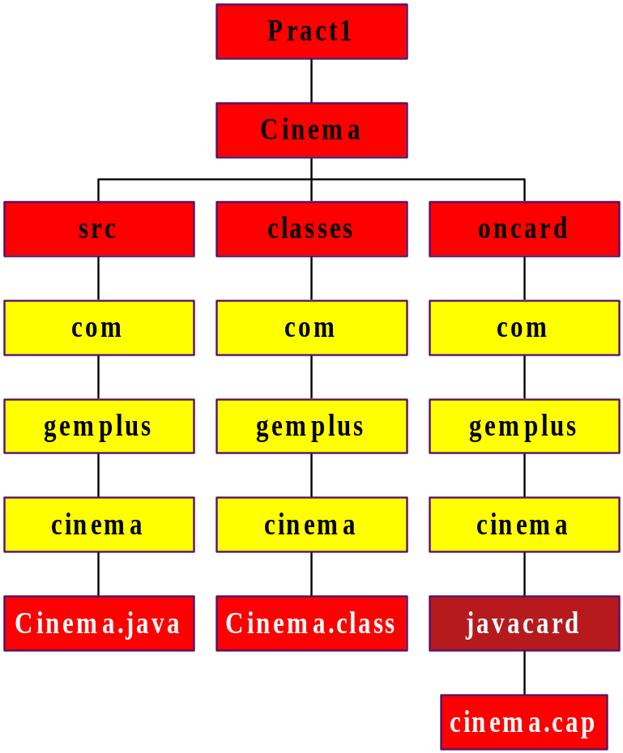
Practical 1: File Architecture
Compiled
with JDK
Converted
with SUN converter

