Slide 1


Course Schedule
Day 1 :
  Introduction
  JavaCard concepts
  Demo & practical
  Java SIM Card
Day 2 :
  STK and Javacard
  Demo& practical
  Over The Air communication
  Demo & Practical
Notes:
2. SIM Based on Java Card.
Basics on JC, compared to Java, architecture, classes, I/O communication,
applet structure, etc
Necessary to understand how GSM & STK (and other) applications
can be implemented on GemXplore Xpresso. Ex: of a pure JC applet
Ch2 general points on JC2.1
3. Specific points now given for G+ product
5. STK protocol = quick summary of STK std and specifically what
features GXpXpresso supports
Then how to develop STK applets

Slide 2
Content
Applet Management
GSM application
  GSM application features
  GSM data sharing
Notes:
Chapter 2 saw Java Card 2.1 for GemXplore Xpresso
Chapter 3 will look more specifically at GemXplore Xpresso's
(specific) functions…
Starting with Native resources...

Slide 3
Applet Management
or …. let’s try to understand the load and install processes during your practical session
Notes:
Chapter 2 saw Java Card 2.1 for GemXplore Xpresso
Chapter 3 will look more specifically at GemXplore Xpresso's
(specific) functions…
Starting with Native resources...

Slide 4

Java SIM Card Loader
Valid for mode 23.048 or mode GP
Standardised commands
  Install(load) command
  Load() command
  ...
  Load() command
  Install(install) command
Protected by a
Security step

Slide 5

Security Step
Depend on the mode use
23.048
  all incoming messages are encapsulated by 03.40 and 23.048 format
  security is checked by an ‘OTA layer’
Global Platform
  Mutual authentication before APDU exchange
  During APDU exchange integrity is always checked
Notes:
23.048 : APDUs INSTALL(LOAD), LOAD, INSTALL(INSTALL) are encapsulated in headers
GP : mutual authentication then APDU sent directly

Slide 6
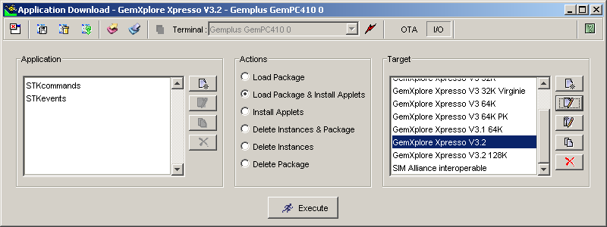
Mode Choice

Slide 7

Loading Preparation
Checks space in the EEPROM and RAM memories for load file and instance
install(for load)
Parameters : load file AID, EEPROM and RAM memory used load file and instance
Notes:
Preparation step to warn the OS that there will be a new package. The OS check AID name and memory free if it was indicated.

Slide 8

Loading
Loads bytecode in the EEPROM by blocks
load
MyApplet.cap
myproject.jar
package
Parameters : bytecode

Slide 9
Loading and OTA Concatenation
Gemalto Java SIM supports concatenation for data longer than 140 bytes, according to GSM 23.040
03.40Header
23.048Header
data
Concatenation
Control bytes
data>140 bytes
CC1
23.048 Header
data1
CC2
data2
CCN
dataN
Concatenation control bytes are added in the 23.040 format, indicating for each message the concatenation session number, the sequence number, total number of messages in this session.

Slide 10
Concatenation and GXXV3
A concatenation buffer is allocated in the EEPROM, depending on the total number of messages in the session
Only one concatenation session can be treated at the same time
If a simple SMS is received during a concatenation session, it is treated normally
Notes:
Les cartes G+ R5 (comme MPH037 que vous utilisez maintenant en training) supportent maintenant la concatenation de messages, meme si le message est destine a une applet STK. Auparavant, seule la concat etait supportee pour le RAM et RFM. Maintenant, si une applet est triggee avec un message qui fait 3 ou 4 SMS, quand cette applet accedera au message, par l'intermediaire du EnvelopeHandler, elle aura acces a tout le message.
C'est une fonctionalite qu'on ne mentionnait pas dans la formation Admin, donc a rajouter si le coeur vous en dit.
De plus, il faut supprimer dans les slides du Dev qui disent que les Handlers ont une taille limite : la taille est dynamiquement allouee par l'OS.

Slide 11
Installation
Creates an instance of the applet, with personalised parameters.
install(for install)
package
instance
Parameters : memory used in EEPROM and RAM, GSM parameters, application parameters.

Slide 12
Installation for STK Applet
Parameters provided :
  AID of Package and Applet
  AID of the new Instance
  Access Rights for the instance to GSM file system
  Max nber of timer
  Max text length
  Max nber of menus
  Identifier and position of the menus
  Priority level in case of multi-triggering
  Privileges (special rights to terminate/block the card…)
  Parameters for the personalisation of the instance (ex : pin code value)
GSM parameters
Notes:
List of parameters to install your instance

Slide 13
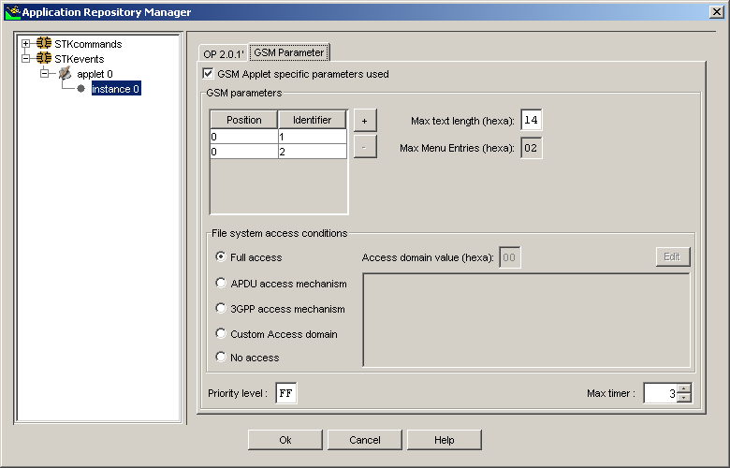
GSM ETSI Parameters

Slide 14
Memory Scheme in Java SIM Card
load
install(for install)

use
JStack
Load file
Persistent
Transient
EEPROM
RAM
Notes:
Your LOAD consumes memory in the EEPROM,
Your INSTALL(INSTALL) consumes EEPROM and RAM transient
The use (selection or trigering) should not consume any memory…

Slide 15
Deletion
Deletes an instance or a package, EEPROM and RAM memories are recovered.
Can not delete classes
in the package
delete
package
instance
Parameters : AID of package or instance.

Slide 16
Memory Feature
3 main points are important :
  EEPROM amount
  Memory consumption
  Fragmentation

Slide 17
Memory Feature : EEPROM
Java SIM: 128 Kbytes of available memory, before GSM personalisation.

Slide 18
Memory Feature : Management
Enhanced Memory Management:
  Recovering memory space after
    Applet deletion
    GSM File deletion
  Fragmentation mechanism
    Objects, applet byteCode, GSM files can be stored in NON-CONSECUTIVE clusters of 4 bytes with the GXXV3

Slide 19
Basic Garbage Collection
Applets deletion
  all applets (JC or STK) can be deleted with the DELETE command
  all memory spaces are restored E²PROM & RAM
all restored memory spaces are reusable by
GSM File System or Applets (JC or STK)
Notes:
DF reserves memory in RAM for Access Rights
Applets use Ram for transient objects

Slide 20
A Proven Platform Security Level
the Telecom industry is currently evolving towards a very open environment with similar risks as over the Internet
In order to face any risks related to data integrity, to data confidentiality, to application download, to the use of cryptographic algorithms, decision to make objectively evaluated its IT product: GemXplore’Xpresso V3.

Slide 21
What is Common Criteria ?
Method to evaluate security of IT products & systems
  covers both OS design and implementation
  ISO/IEC 15 408
Worldwide recognition of the security level in more than 20 countries
Certification granted by independent governmental bodies
Give a level of confidence on the security functions of a product or system
  Confidentiality, integrity, etc.
Notes:
The Common Criteria for information Technology Security Evaluation (CC) defines general concepts and principles of IT security evaluation and presents a general model of evaluation. It presents constructs for expressing IT security objectives, for selecting and defining IT security requirements, and for writing high-level specifications for products and systems.

Slide 22
Why Certifying Java Card’s Security Level ?
CC EAL5+
to boost acceptance of Digital ID and secure mobile payment
Major step towards true multi-application cards
  loading certified banking applet on a telecom card (VSDC, Visacash, etc.)
Proof that even an open OS can benefit from high levels of security.

Slide 23
Java Card certification
FIRST Java Open OS to be certified CC EAL5+
  World first
Covers protection of :
  Confidential data disclosure (PIN, codes, keys…)
  Identity usurpation
    management of applications by unauthorized parties…
  Data integrity loss
Main security objectives :
  prevent unauthorized operations from applications/actors
  no flaws in design
  secure loading process
  resistant to DPA and similar forms of attack

Slide 24
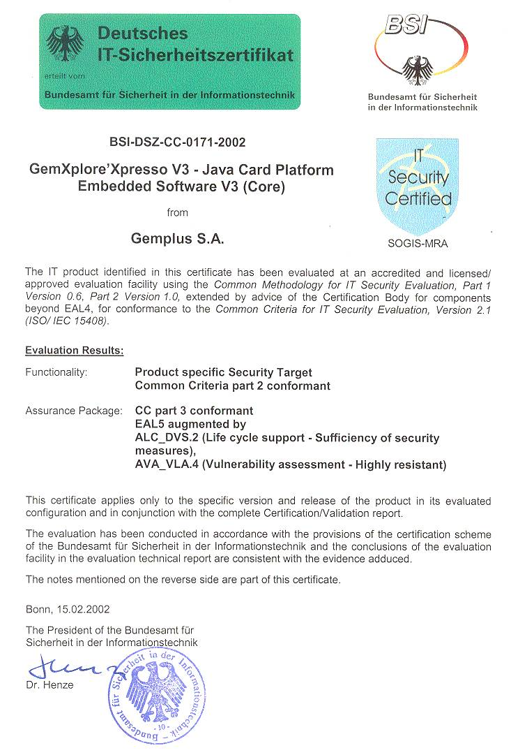
Certification CC5+

Slide 25
Content
Applet Management
GSM application
  GSM application features
  GSM data sharing
Notes:
Chapter 2 saw Java Card 2.1 for GemXplore Xpresso
Chapter 3 will look more specifically at GemXplore Xpresso's
(specific) functions…
Starting with Native resources...

Slide 26





Java SIM Card Architecture Overview
GSM
Application
STK Applet
SIM Toolkit API
JavaCard API
Remote
Manager
Card
Manager
JavaCard VM
Native ressources
Microprocessor

Slide 27
Java SIM Card Architecture Overview
GSM
Application
STK Applet
SIM Toolkit API
JavaCard API
Remote
Manager
Card
Manager
JavaCard VM
Native ressources
Microprocessor

Slide 28
GSM Application
GSM application is compliant with
  Manages event to trigger STK applets
  Manages GSM files (MF, DF, EF)
    Proprietary administrative commands
  Is compliant with 3GPP TS 51.014 R4 v 4.3.0
Provides security around GSM files with access conditions (CHV1, …, ADM3)
Is selected by default after issuance
Notes:
Is compliant with 3GPP TS 11.14 v.8.9.0 Release 09/2001 ???
Is compliant with ETSI TS 102.221 Release 4 ???????????????????
Applet which gives "GSM" functionality:
11.11 (Release 98) commands
Admin commands
STK & OTA mechanisms and commands
23.048 defines security for OTA access to card.
It now also defines GSM OP loader commands for
reader & OTA loading of applets in a std way (not supported
by V1 card, V2 yes)

Slide 29

Set of Commands (1)
File management
  SELECT
  STATUS
  READBINARY
  UPDATE BINARY
  READ RECORD
  UPDATE RECORD
  SEEK
  INCREASE
  INVALIDATE
  REHABILITATE
Security management
  VERIFY CHV
  CHANGE CHV
  DISABLE CHV
  ENABLE CHV
  UNBLOCK CHV
  Run GSM Algo
Other
  GET RESPONSE
Notes:
GSM 11.11 commands…
(sleep cmd redundant as G+ card has auto low
consumption mode)
Note: Some commands removed (cf GX98)
Create Record, Advanced, Load Key...

Slide 30
Set of Commands (2)
Administrative
  GET FILE INFO
  CREATE FILE
  EXTEND
  LOCK
  DELETE
  UPDATE GSM ALGO KEY
  INITIALIZE CHV
STK
  TERMINAL PROFILE
  ENVELOPE
  FETCH
  TERMINAL RESPONSE
Notes:
Admin & STK commands…
Proactive commands are built by custom applet and thus any
coding is possible (any present or future commands
are supported)
All envelopes are supported either directly or can be
implemented via "unrecognised" envelope command
See later in chapter 5...

Slide 31
GSM Data Sharing
All applets may have access to the GSM data (files)
  Using one of the 10 available functions:
    select(), status(),
    readBinary(), updateBinary(),
    readRecord(), updateRecord(),
    seek(), increase(),
    invalidate(), rehabilitate()
Notes:
Note this is the only 10 methods available in a STK applet !
Three sim.access classes are provided to give custom applets
controlled-access to GSM file data:
SIMSystem =>
Used to obtain a reference on a SIMView object:
SIMView theGsmApplet;
theGsmApplet = SIMSystem.getTheSIMView();
SIMView (extends Shareable) =>
an interface defining a set of SIM OS access methods
and constants (FID_DF_TELECOM):
theGsmApplet.readRecord(...);
SIMViewException => method exceptions
(File not found…) RefManual.pdf =>
Further security: Files are assigned a Category I-VIII at creation time,
the ACT table gives custom applet priveleges for each category/cmd

Slide 32
GSM file - Access Conditions
GSM application checks the file access condition
  I/O access conditions are defined during gsm file creation, and cannot be changed, except to NEVER.
    6 AC Groups with AC rights (1 byte per group) : NEVER - ALWAYS - CHV1 - CHV2 - ADM0 - ADM1- ADM2 - ADM3
  Applet access conditions are defined during the installation of the applet and cannot be changed (applet access domain)
    To have access to an EF file, the ‘applet access domain’ must be equal to I/O access condition

Slide 33
GSM file - Access Conditions
Example : access to an EF from an applet
EF
AC :
Read CHV1
Update ADM2
Invalidate ADM1
….
readRecord()
Install(CHV1, ADM2,...)
CHV1= CHV1 : OK
Body
updateRecord()
STK applet
ADM2= ADM2 : OK
CHV1 OK
ADM2 OK
I/O Access Condition
defined during EF
creation (11.11)
invalidate()
ADM1≠ADM2 : no access

Slide 34

What do you remember about this first day ??
Test your knowledge with MCQ on your PC

Slide 35

Q & A
Break

