Slide 1


Course Schedule
Day 1 :
  Introduction
  JavaCard concepts
  Demo & practical
  Java SIM Card
Day 2 :
  STK applet development
  Demo & practical
  Over The Air communication
  Demo & Practical
Notes:
2. SIM Based on Java Card.
Basics on JC, compared to Java, architecture, classes, I/O communication,
applet structure, etc
Necessary to understand how GSM & STK (and other) applications
can be implemented on GemXplore Xpresso. Ex: of a pure JC applet
Ch2 general points on JC2.1
3. Specific points now given for G+ product
5. STK protocol = quick summary of STK std and specifically what
features GXpXpresso supports
Then how to develop STK applets

Slide 2
STK Agenda
Boot mechanism
Java SIM Card related events and proactive commands
Card ADMIN software and applet design

Slide 3
STK Agenda
Boot mechanism
Java SIM Card related events and proactive comands
Card ADMIN software and applet design

Slide 4
Boot Mechanism (1)
SIM / GSM application receives the list of STK features the ME can support via Terminal Profile command
Here are my STK capabilities
Thanks, I now know
what Proactive
commands
you support
TERMINAL PROFILE
Notes:
SIM (GSM applet) receives mobile's STK capabilities via [1]Terminal Profile command, then GSM applet starts Boot mechanism... (specific to GemXplore Xpresso card)

Slide 5


Boot Mechanism (2)
If one applet is registered as being triggered by Profile Download event, GSM application sends this event to trigger this applet
Profile download
TERMINAL PROFILE
Profile download
Notes:
Last step after main Boot => If one applet is registered as being triggered by Profile Download event, GSM applet translates Term Profile COMMAND into Profile Download EVENT and sends this event to this applet

Slide 6
Boot Mechanism (3)
GSM Application starts boot procedure in
order to configure the ME and offer VAS
  SIM scans all registered applets
    ME Menu configuration
    Event Management
TERMINAL PROFILE
Weather
Taxi
Bank
Set-Up Menu
Weather
Taxi
Bank
Set-Up Event List
Notes:
SIM (GSM applet) receives mobile's STK capabilities via [1]Terminal Profile command, then GSM applet starts Boot mechanism... (specific to GemXplore Xpresso card)
SIM scans registered applets to prepare initialisation [2](SetUp) commands during the Boot procedure (SEE LATER)
(SIM checks if ME supports SetUpMenu & SetUpEventList proactive commands before sending them)
Note: The Profile Download event is also one of the events which can be used to trigger an applet (registered with this event - only one).
Thus at the end of the boot, the GSM applet checks to see if one such applet "exists", if so, it sends the [3]Profile Download event to this applet, to select and trigger it (See later)

Slide 7
Boot Mechanism (4)
Menu Selection
SIM may build
  1. Set-Up Menu command
    Up to 12 items in SetupMenu, help may be managed,
    Title stored in EF_{SUME} (6F 54h) under DFgsm,
    Sent to the ME only if at least one STK applet can handle the Menu Selection event…
  2. Set-Up Event List command
    Sent to the ME only if at least one STK applet can handle one of the
    "Event Download" Events…
Event Download
Notes:
SEE LATER: details on SETUP commands
(6 EventDownload events: MT call, Call Connected, Call disconnected, User activity, Idle screen, Location status)

Slide 8
Boot Mechanism (5)
SIM may build
  3. Set-Up Idle Mode Text command
    Contains one text string and/or icon
    Title stored in EF_{SUIMT} (6FA1h) under DF_{GSM}
    Sent to the ME only if optional file exists and format is correct
  4. Poll Interval command
    Sent to the ME only if at least one STK applet can handle the ‘ Status ’ Event and if a duration was requested
Event Card Status
Notes:
SEE LATER: details on SETUP commands
(6 EventDownload events: MT call, Call Connected, Call disconnected, User activity, Idle screen, Location status)

Slide 9
Dynamic Toolkit Set-Up (6)
The GXXV3 sends dynamically the Set-Up commands each time the ‘ toolkit Registry ’ is modified
for example, after a load/install OTA session
new STK applet
List of new
services
New Menu
on the ME
screen !
List of new
events
Notes:
SEE LATER: details on SETUP commands
(6 EventDownload events: MT call, Call Connected, Call disconnected, User activity, Idle screen, Location status)

Slide 10
STK Agenda
Boot mechanism
GXXV3 related events and proactive commands
Card ADMIN software

Slide 11

Java SIM card & SIM Toolkit
SIM Toolkit Procedure and Protocol compliant with :
  3GPP TS 11.14 Release 4 – version 4.3.0
SIM Toolkit API implementation compliant with :
  3GPP TS 43.019 Release 5 - version 5.4.0

Slide 12

Commands and Events
Profile download
FETCH
Proactive
Exchange
Process
TERMINAL RESPONSE
User
related
TERMINAL PROFILE
OTA
related
Events
ENVELOPE
Mobile
Related
STATUS
Unrecognized
Status Command
Notes:
Two Categories:
- General STK Protocol commands allowing Proactive exchanges (Fetch & Term Response)
- Event Triggering commands which initiate applets installed on SIM: Term Profile, Envelope
+ Proprietary Event & Statuses (Status command, ATR)
Envelope commands exist in different versions
See next slides...

Slide 13
Events Supported by Java SIM cards
Supported events:
  Profile Download
    trigger applet after Terminal Profile command if the SIM card is a Phase 2+
  Status Command
    trigger applet after a Status command sent by the mobile to obtain information about the card status.
  Unrecognized...
    trigger applet after a Enevlope command sent by the mobile which has some unrecognized TLV parts.
TERMINAL PROFILE
Profile download
Status
Command
STATUS
Unrecognized
ENVELOPE

Slide 14
Events Supported by Java SIM Cards
Supported event : user related envelope
  User select an application in the STK menu
  Menu Selection
  Menu Selection Help Request
User
related

Slide 15
Events Supported by Java SIM Cards
OTA
related
Supported events: OTA related envelope
  Network sends SMS messages
  Formatted and Unformatted SMS-PP Data Download
  Unformatted Cell Broadcast Data Download

Slide 16
Events Supported by Java SIM Cards
Mobile
Related
Supported events: mobile related envelope
  Call Control by SIM
  MO Short Message Control by SIM
  Timer expiration
  Event Download (11 types)
● MT call
● call disconnected
● call connected
● location status
● user activity
● idle screen available
● card reader status
● language selection
● browser termination
● data available
● channel status

Slide 17
Event Management
GSM Application
Status Command
APDU
Profile download
SERVICES
Weather
Bank
Taxi
Menu Selection
The GSM application
translates APDUs
into events
Notes:
APPLET TRIGGERING / Selection Mechanism
APDU command sent by ME following an EVENT
GSM applet always main applet in card, it manages APDUs
A Toolkit applet is registered as being triggered by Events. GSM applet translates APDU into Event and selects corresponding applet.
(A Toolkit applet may manage directly APDU commands, but not used during applicative life of card, handsets have no way to select other applets than GSM default applet)
Toolkit Applet registering: See later special class/methods for declaring applet to GSM application as being triggered by one or more events

Slide 18
Event Management
STK
processToolkit(event)
switch (event) {
case EVENT_PROFILE_DOWNLOAD…:
…
case EVENT_…:
…
}
}
event
All STK applets are based on the same framework
Notes:
Toolkit applets provide entry point for GSM application, processToolkit() method, with one input parameter, which is event identifier attached to triggering command by GSM applet.
Some events may be shared by several applets (Ex Menu...)
Some other events must be handled at most by one Toolkit applet
See next slide
Then look at event-related commands in detail...

Slide 19
Event Registration
At instanciation, the STK applet will register events and menus in the SIM framework
This information is accessible by the OS to build the proactive commands Set Up Menu and Set Up Event List
This information will help the GSM application to trigger the correct applet.
Menu Selection
Bank
STK
applet
Cinema
Event download

Slide 20
One or Several STK applet ... (1)
Events sent to 1 applet using an identifier :
  Menu Selection (Menu Identifier)
  Menu Selection Help (Menu Identifier)
  Formatted SMS PP Data Download/Update (TAR)
  Timer Expiration (timer number)
Events sent to the only applet supporting this event :
  Call Control by SIM
  MO short message control by SIM
Notes:
Some events can be registered by more than one applet as being one of its triggering events
All the other events can only be registered by the first applet as being its triggering event, no other applet can then be registered for this

Slide 21
One or Several STK applet ... (2)
Events sent to all applet supporting this event :
  All the others…
  Multi-triggering : all applets will be triggered regarding their priority order.
  Priority order is given during installation
  priority 255 is min priority
STK1
applet
Install(priority = 1)
STK2
applet
Install(priority = 255)
1
255
Notes:
Some events can be registered by more than one applet as being one of its triggering events
All the other events can only be registered by the first applet as being its triggering event, no other applet can then be registered for this

Slide 22
Multi Triggering and GXXV3
GXXV3 supports multi triggering
  more than one STK applet can be triggered by the same event
  They will be executed following the priority order
GXXV3 supports third context *
  While one applet is being executed, another event could trigger another STK applet,
  The current session will be frozen,
  …. But only one proactive session can be opened at the same time
  * SIM Alliance defines 4 events for re-entrance, GXXV3 implements all.
Notes:
Q:
Could you provide what are the events available in standards (3GGP/ETSI or SIM Alliance) to enter in re-entrance mode ?
I think we have SMS PP Data Download and I believe we have 4 different events.
A:
According to standard there is no obligation and no banning.
According to SIMAlliance Interoperability_Stepping_Stones_Release_2004:
Interoperable re-entrancy is supported at least for the following events:
- EVENT_CALL_CONTROL
- EVENT_SMS_MO_CONTROL
- EVENT_STATUS_COMMAND
- EVENT_PROFILE_DOWNLOAD.
Gemplus cards support re-entrance on any event
The 4 events you spoke about is the minimum to support.

Slide 23
Installation
Parameters provided :
  AID of package and Applet
  AID of the new instance
  Rights for the instance at triggering : applet access domain
  Priority level in case of multi-triggering
  Max nber of timer
  Max text length
  Max nber of menus
  Identifier and position of the menus
  Privileges (selectable by default, rights to terminate/block the card…)

Slide 24
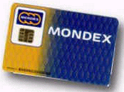
Commands Originated by SIM
Commands can be classified into 5 categories
  SIM => User
  SIM => ME
  SIM => Network
  SIM => Channelx
  SIM => Additional Card
SIM - Network
SIM - Channelx
SIM - User
SIM - ME
SIM - Additional Card
Commands initiated by the SIM are called PROACTIVE COMMANDS
Notes:
A proactive command allows the card to initiate a transaction with the mobile equipment. Proactive commands are defined in GSM 11.14 standards.

Slide 25


Proactive Cmd and Applet (1)
USER
Display Text
Get Inkey
Get Input
Select Item
MOBILE EQUIPMENT(1)
Provide Local Info
Timer Management
More Time
Play Tone
Poll Interval
Polling Off
Refresh
MOBILE EQUIPMENT(2)
Setup Event List
Setup Idle Mode Text
Setup Menu
Get Channel Status
Get Reader Status
Language Notification
Launch Browser

Slide 26

Proactive Cmd and Applet (2)
NETWORK
Setup Call
Send DTMF
Send SS
Send USSD
Send Short Message
CHANNEL X
Open Channel
Close Channel
Send Data
Receive Data
RunATCommand

Slide 27
Proactive Cmd and Applet (3)
ADDITIONNAL CARD
PerformCardAPDU
PowerOnCard
PowerOffCard
NEW PROACTIVE CMD
using API

Slide 28
Integration Test
Due to Mobile Equipment differences, an important phase of integration test is mandatory to ensure that all proactive commands will be correctly treated.
TERMINAL PROFILE
(local info)
FETCH
Proactive cmd : local info NMR
TERMINAL RESPONSE (permanent problem)
Notes:
Just show part of STK.pdf and do in Menu Editor & see in Mobile Simulator if short of time

Slide 29
STK Agenda
Boot mechanism
Java SIM Card related events and proactive commands
Card ADMIN software

Slide 30



Software Range
Card ADMIN
  To administrate files & applets
DEVELOPER Suite
  To write and debug applets
SIMULATION Chain
  To test applet deployment
  Composed of mobile simulator, card simulator, server and SMSC simulator

Slide 31
Software Used
Card ADMIN
  To administrate files & applets
For practicals all applet bytecode will be provided.
The development has been made with DEVELOPER Suite.

Slide 32


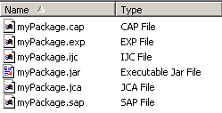

File Architecture

Slide 33
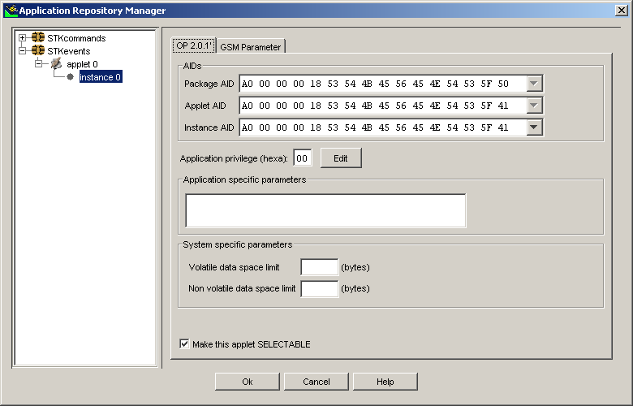
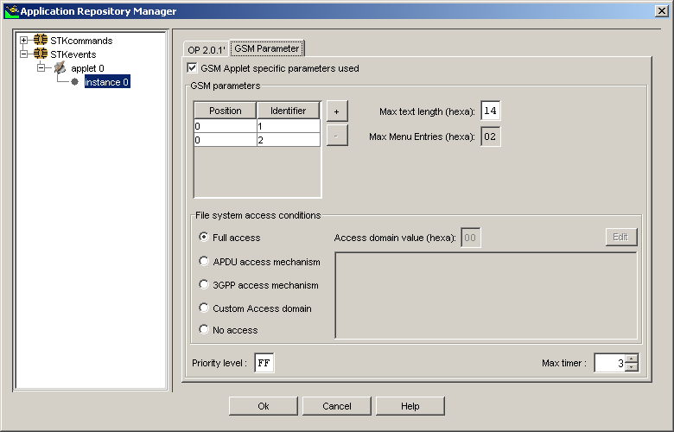
Load & Install Parameters in GemXplore ADMIN

Slide 34
Contents
Day 1 :
  Introduction
  JavaCard concepts
  Demo & practical
  Java SIM Card
Day 2 :
  STK applet development
  Practical
  Over The Air communication
  Demo & Practical

Slide 35
Practical 2
Objective : Configure Card ADMIN to download an STK applet
The Cinema STK applet offers services associated with 3 EVENTS :
Menu selection
Call Control
Location Status

Slide 36
Reminder on
SIM Toolkit
Protocol
  3GPP TS 11.14
  Release 4 – version 4.3.0

Slide 37
SIM Toolkit procedure
INITIALIZATION PHASE
  ME sends its capabilities to the phase 2+ SIM
  SIM builds the menu and sends it to the ME for display
RUNNING AN APPLICATION
  Command execution is triggerred by events
ERROR MANAGEMENT
  Temporary problems
  Permanent problems
DUAL SLOT
Notes:
Initialisation: SIM builds menu & SET UP EVENT list

Slide 38
Initialization Phase (1/4)
ME / SIM Interface
1. ME reads SIM
reads EF phase(6FAE)
2. If phase 2+ SIM, ME indicates its capabilities
Terminal profile (ME capabilities)
91xx
3. If ME OK, SIM may
send a SetUpMenu
command
Fetch
4. ME stores
STK menu items
Set-Up Menu (title, menu services, help)
Terminal Response (OK)
Title taken from EF sume (6F54) file under DF gsm
Notes:
Terminal Response :
A0 14 00 00 Lc Data
Data :
Command details simple TLV element : mandatory
Device Identities simple TLV element : Optional
Result simple TLV element : mandatory
some mandatory elements are mandatory for given proactive commands.
Result : 0x or 1x : command performed
2x : temporary problem
3x : permanent problem

Slide 39
Initialization Phase (2/4)
ME / SIM Interface
91xx
Fetch
Set-Up Event List
5. If ME OK,
SIM may send a
SetUpEventList command
Terminal Response (OK)
6. ME is configured to monitor certain events
and report to SIM
Notes:
SetUpEventList command issued by SIM ...
If at least 1 applet is registered (GSM applet) as being triggered by one of the six Event Download Envelope events (mobile-related activity such as idle screen, user keypad activity…)
(See later)

Slide 40
Initialization Phase (3/4)
ME / SIM Interface
91xx
Fetch
Set-Up Idle Mode Text
7. If ME OK,
SIM may send a
SetUpIdleModeText
command
Terminal Response (OK)
8. ME stores text
for display in Idle mode
Text taken from EF suimt (6FA1) file under MF
Notes:
SetUpEventList command issued by SIM ...
If at least 1 applet is registered (GSM applet) as being triggered by one of the six Event Download Envelope events (mobile-related activity such as idle screen, user keypad activity…)
(See later)

Slide 41
Initialization Phase (4/4)
ME / SIM Interface
91xx
Fetch
Polling Interval
9. If ME OK,
SIM may send a
PollingInterval command
Terminal Response (OK)
10. ME is configured with
Card Status command interval
9000
Notes:
SetUpEventList command issued by SIM ...
If at least 1 applet is registered (GSM applet) as being triggered by one of the six Event Download Envelope events (mobile-related activity such as idle screen, user keypad activity…)
(See later)

Slide 42

Ex: Running an Applet
ME / SIM Interface (I)
11. User selects a menu
service “Bank”
>Bank
Weather
Envelope (menu selection)
91xx
Fetch
12. the card identifies
which application to
run and starts
dialogue with the user
Select Item
Bank services
>Call Bank
Balance
Terminal Response (OK, Selection)
The user's selection triggers the application

Slide 43
Ex : Running an Applet
ME / SIM Interface (II)
13. User has selected “Calling Bank” sub-menu
91xx
Fetch
Calling
Bank…
SetUpCall
Terminal Response (OK)
9000
14. the card has no more
proactive commands
to send
Application ends when SIM has no more proactive commands
Notes:
Sequence of related SIM Tool Kit commands and responses. A proactive SIM session starts with the status response '91xh' (proactive command pending) and ends with a status response of '90 00h' (normal command completion) after a Terminal Response

Slide 44
Error Management
Temporary Problem
User has selected Calling Bank option
SetUpCall
Terminal Response (Temporary problem)
91xx
the SIM applet
could retry to
send the same
command.
Calling
Bank…
Fetch
SetUpCall
Terminal Response (OK)
9000

Slide 45
Error Management
Permanent Problem
User has selected Calling bank option
SetUpCall
Terminal Response (Permanent problem)
Calling
Bank…
91 xx or 90 00
the SIM application
can try to send
another command (91xx),
or exit (9000).

Slide 46
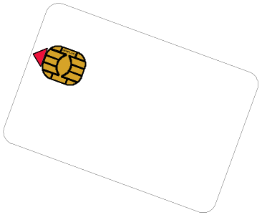
Running an Additional Card Application
SIM / ME / 2nd Card Interface (I)
Get Reader
Status
ME scans all possible
card reader interfaces
Terminal
Response (Status)
Additional
Reader(s)
Power On
Card
Activate/Reset Card
Terminal
Response (ATR)
Answer To
Reset
2nd Card
SIM Application opens communication session with Additional Card

Slide 47
Running an Additional Card Application
SIM / ME / 2nd Card Interface (II)
Perform Card APDU
(C-APDU)
C-APDU
Terminal
Response (R-APDU)
R-APDU
2nd Card
Additional
Reader(s)
Power Off
Card
Card deactivated
Communication
session closed
Terminal
Response ()
SIM Applet sends & receives APDU Commands & Responses

