Slide 1


Course Schedule
Day 1 :
  Introduction
  JavaCard concepts
  Demo & practical
  Java SIM Card
Day 2 :
  STK applet development
  Practical
  Over The Air communication with 23.048
  Demo & Practical
Notes:
2. SIM Based on Java Card.
Basics on JC, compared to Java, architecture, classes, I/O communication,
applet structure, etc
Necessary to understand how GSM & STK (and other) applications
can be implemented on GemXplore Xpresso. Ex: of a pure JC applet
Ch2 general points on JC2.1
3. Specific points now given for G+ product
5. STK protocol = quick summary of STK std and specifically what
features GXpXpresso supports
Then how to develGP STK applets

Slide 2
OTA Agenda
23.048 and GP standards
    Introduction
    Java SIM card architecture
Card ADMIN software
    Server Simulator

Slide 3
Post Issuance Communication
The card is issued in SECURED state
Post-issuance card communication follows Open Platform specifications
  23.048 specification
    Over The Air
    Connected mode
  OP 2.0.1’ specification
    Connected mode

Slide 4


Accessing the Card …
Real life possibilities
  Card inserted in a reader
    you are prototyping
    you have a service via internet, through a reader connected to your PC
    you have special Point of Sale to personalise the card for your customer
  Card inserted in your mobile
    the card has been issued, it is the common way to communicate with the SIM

Slide 5
Proprietary Implementation
Once the GXXV3 card has been issued, message format can be compliant with:
23.048 standard (3GPP)
  This format is standardised and used in the GSM world, it provides interoperability.
  Data are loaded with maximum 121 bytes blocks
  Used for ‘connected’ or ‘OTA’
  Global Platform
    This format is used in the banking world, to standardise communication and security (non standardised by ETSI)
    Data are loaded with 253 bytes blocks
    Only used in ‘connected’

Slide 6


Application Management Cmds
23.048 commands
  Load
  Install
  Delete
  SetStatus
  GetStatus
  GetData
  PutKey
GP commands
  Load
  Install
  Delete
  SetStatus
  GetStatus
  GetData
  PutKey
  Select
  InitializeUpdate
  ExternalAuthenticate
  PutData

Slide 7
23.048 and GP Active Components
OTA layer
23.048 elements
STK
Applet
03.19
JC 2.1
Remote File
Management
Remote Applet
Management
GSM Application
11.11
11.14
Card
Manager
GP elements
Security Domain
with keys
JC Applet
JC 2.1

Slide 8
How is Open Platform Implemented in GXXV3 ?
23.048 : implementation of GP for the GSM world, in the field of OTA communication
    3GPP issued 23.048 standard related to Security mechanism and remote management OTA, relies on GP 2.0.1.
    Components in the card : OTA layer, Remote File Manager and Remote Applet Manager, Security Domain.
GP : usually used in the banking world, for connected mode
    Global Platform issued GP specifications
    Components in the card : Card Manager, Security Domain.
Notes:
VGP gives details, refines GP spec’ but it is always written specification, it is not Java code. Each company will implement its own code to implement VGP specifications.
VGP refines which crypto algos to use and how. In particular the padding protocols.

Slide 9
OTA Agenda
23.048 and GP standards
    Introduction
    Java SIM card architecture
GemXplore ADMIN software
    Server Simulator

Slide 10
23.048 and GP Active Components
OTA layer
23.048 elements
Remote File
Management
Remote Applet
Management
Application
GSM
11.11
11.14
Card
Manager
GP elements
Security Domain
with keys

Slide 11
23.048 Structure (1/3)
User Data (140 bytes maximum according to 23.040)
User Data
Header
UDH
Enhanced SMS Header (23.048)
Secured Data
3 bytes
16 to 24 bytes depending on security level
from 113 to 121 bytes maximum
UDH = User Data Header
UDH = 02 70 00 means « header 23.048 formatted »
Notes:
CPL Command Packet Length
CHM command Header Length

Slide 12
23.048 Structure (2/3)
M
M
M
M
M
M
M
M
O
O
User Data
Header
UDH
« ESMS »
length
CPL
« ESMS » header length
CHL
Key
refs
RC
CC
DS
security
TAR
counter
Padding
length
ESMS body
3 bytes
2 bytes
1 byte
2 bytes
2bytes
3 bytes
5 bytes
1 byte
0/4/8
bytes
ESMS Header (23.048)
from 16 to 24 bytes
ESMS Body (data, APDUs)
Notes:
CPL Command Packet Length
CHM command Header Length

Slide 13

23.048 Structure (3/3)
SMS length
SMS header length
counter
RC
CC
DS
Secured data
security
keys
TAR
padding
KIc KId
CNTR
SPI security packet information
checksum ?
synch counter ?
ciphering data?
For incoming data and response
Applet destination
Key set version

Slide 14
23.048 “Enhanced” SMS Possibilities
GSM File Management
  example : update record
  Remote File Manager TAR will be used : ‘B0 00 10’
Applet Management
  example : load and install an applet
  Remote Applet Manager TAR will be used : 00 00 00
Applet triggering
  example : advertising display
  STK applet TAR will be used

Slide 15
23.048 : OTA layer
OTA layer
GSM application receives all incoming Envelope(SMS Data Download) or Update Record (SMS Data Download) commands and calls OTA layer,
OTA layer checks 23.040 and 23.048 security,
Decrypts encrypted message if necessary,
Using TAR stored in the 23.048 security layer, dispatches the message to the corresponding entity.

Slide 16
23.048 : Remote Management
RAM
Remote Applet Management (RAM)
  is an applet designed to execute 23.048 APDU commands (load, install, get status,…)
  TAR is 00 00 00
Remote File Management (RFM)
  is an applet designed to execute GSM 11.11 APDU enabling EF management commands (update record, create file…)
  TAR is between B0 00 00 and B0 00 FF
RFM

Slide 17
23.048 : Remote Management
RFM
RAM
Security
  In the 23.048 standard, a minimum security level (MSL) is asked for the Remote Managers (applet & file)
  The MSL is coded on 1 byte

Slide 18
23.048 Remote Security
RFM
RAM
Minimum Security Level
  Has same coding as first byte of SPI,
  indicates if it is mandatory in incoming SMS to use :
    checksum (CC or RC)
    ciphering
    counter
Security Check :
  if the incoming SMS has a 23.048 security level lower then the Minimum Security Level, the command is rejected.
  If Kic & Kid are different, the message is rejected.

Slide 19
23.048 Remote Security
SPI
Kic/Kid
23.048
Message
Security
Message
Security
Response
Security
Key Set
Encryption
Key Set
RC or CC
> or =
Before executing
a command,
Remote Manager
checks
Message
Security
Minimum Security Level
RAM
RFM

Slide 20
Proprietary Remote Security
Modification of Minimum Security Level
  With PUT DATA command and special tag
Available only with 23.048 layer
Can only be increased !

Slide 21
Let’s remember the 23.048 message journey !
OTA layer
23.048 elements
STK
Applet
03.19
JC 2.1
Remote File
Management
Remote Applet
Management
GSM Application
11.11
11.14
Card
Manager
GP elements
Security Domain
with keys
JC 2.1
JC Applet

Slide 22
Active Components in OTA Mechanism (1)
OTA layer
.
GSM
STK
RFM
RAM
❷ Then transmits message to the OTA layer
❶ GSM application receives incoming envelope or URecord.

Slide 23
Active Components in OTA Mechanism (2)
❸ OTA layer receives
the message, checks 03.40 and 23.048
security and may decrypt
OTA layer
.
GSM
❹ Then dispatches envelope to remote managers or STK applet according to TAR
STK
RFM
RAM
❺ Remote managers will compare security level with their MSL before executing command
Card Manager
Security Domain
with keys/algo

Slide 24
Active Components in OTA Mechanism (3)
OTA layer
GSM
STK
RFM
RAM
.
Card Manager
CM
❻ If an access to GSM file system is required, access domain will also be checked.
Security Domain

Slide 25

Access Domain
Access Domain values
  Full Access : 00
  Never : FF
  ‘APDU’ : 01 XX XX
‘APDU’ options XX XX
    CHV1
    CHV2
    …
    ADM0
    …
    ADM10
Install(access domain,...)
STK applet
CHV1 OK
ADM2 OK

Slide 26
Access Domain Use
Example : access to an EF from an applet
EF
AC :
Read CHV1
Update ADM2
Invalidate ADM1
….
readRecord()
Install(CHV1, ADM2,...)
CHV1= CHV1 : OK
Body
updateRecord()
STK applet
ADM2= ADM2 : OK
CHV1 OK
ADM2 OK
I/O Access Condition
defined during EF
creation (11.11)
invalidate()
ADM1≠ADM2 : no access

Slide 27

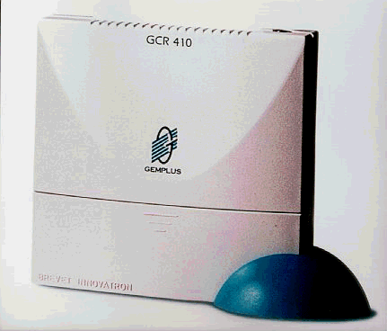
23.048 and GP Communication
APDU compliant with 11.11 (env or UR),
security compliant with 23.048
Maximum121 bytes
OTA layer
GP elements
Applet
STK
03.19
RFM
RAM
Appli
GSM
11.11
11.14
Card
Manager
GP elements
Security
Domain
Applet
JC
JC 2.1
Maximum 253 bytes
APDU compliant with GP

Slide 28
Card Manager (GP)
Card
Manager
Security Domain
with keys
Card Manager is considered as the on-card representative of the Card Issuer (card owner)
Responsible for:
  performing application loading & related card content management
  managing the card global data (life cycles, …)
  overall card security - Includes Security Domain to control issuer applications
The heart of the card architecture when connected !
Notes:
What are the card components defined by GP ? The card manager is the main component, main representative of the Issuer. Air France in our case. So through the CM, AF can load applet, install applet, update applet, delete applet, decide the life cycle of the card-package-applet, using the Security domain…
Because the Card Issuer owns applications on the card as well, the Card Manager includes the Card Issuer’s security Domain as a sub-component
CM loads applets
updates applets
installs applets
CM handles security (authentication)
CM is responsible for global data (life cycle)

Slide 29
23.048 & GP - Security Domain
Security Domain
with keys
Purpose of a Security Domain:
  provides cryptographic services (encryption, decryption, digital signature generation and verification).
  Contains keys used for 23.048 and GP security
Keys can be modified with a PUT_KEY command
Notes:
Security Domain insures the 3 security points : authentication,integrity, privacy. The security is provided by keys and algorithms. Each applet is linked with a Security Domain. And if someone wants to access to the AF applets he has to know the keys and algorithms defined in the AF Security Domain.
There can be more than one SD on the card, each of them can belong either to the Issuer, or to a provider. For the provider, it is the only way to have a representative on the card.
Let’s imagine that Hertz would like to load a new applet in the card, it can : (i) asks AF to perform that for Hertz with AF terminal with as parameters : hertz bytecode,Hertz keys, (ii) ask AF the right to perform that himself, with its terminals, this is DELEGATION.
Attention:
- Key set is only used for GP/VGP commands, if user wants to secure its own applet, it has to create a key using JavCard
buildKey public static Key buildKey (byte keyType,short keyLength,boolean keyEncryption)throws CryptoException
If you want to add a new security domain, you might use an install command on Package AID : A0 00 00 00 03 00 00, Applet AID : A0 00 00 00 03 00 01
then select, set status to personnalize, create a new key set version (don ’t forget to modify the .properties file!!!)

Slide 30


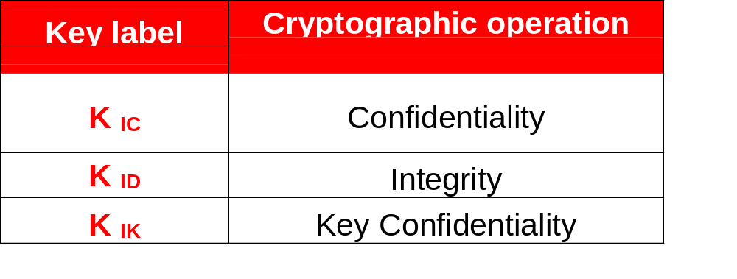
23.048 & GP
Security Domain Key Set
Security Domain
with keys
A Security Domain must contain at least one key set
A key set contains 3 16-byte keys, associated with 1 counter.
Counter
Notes:
As an example, let’s see requirements for a V2 card, in other words, for the config 1b.
On V2 card, each security domain only contains 1 secure channel key set .
VGP says that there will be only 3 keys in a key set version. The 3 indexes used are only 1 2 or 3, it is cyclic : there are three combination:
1 Kauth/enc Kkek Kmac
2 Kmac Kauth/enc Kkek
3 Kkek Kmac Kauth/enc
Cards with Config 2a and 2b must have 3 key sets:
1 Secure channel key set
1 Token Verification key set
1 Receipt DAP Generation key set

Slide 31
Secure Communication 23.048
In the 23.048 header :
  Calculation of signature (CC) will be performed with the K_{ID} key
  Calculation of encryption will be performed with K_{IC} key
By default all encryption and signature calculation are performed using 3DES
15 different key sets can be used for the OTA communication (from key set version 1 to 15)
Notes:
The second refinement concerns algorithms and keys that must be present in the card to respect VGP specifications and how these keys are used.
There always must be a secured channel, allowing authentication, integrity and privacy.
- MAC is performed with 3DES CBC
- Hash with SHA-1
- Signature for delegation is made with RSA and a minimum key of 1024 bits
- Encryption data is made with 3DES-CBC (Kenc)
- Encryption key is made with 3DES CBC (Kkek)
- Session key is calculated with 3DES-ECB from CPLC data and diversified keys.

Slide 32
Secure Communication ‘GP mode’
GP card session always starts with the opening of a secure channel
  Secure communication between card and host is initiated by INITIALIZE_UPDATE and EXTERNAL_ATHENTICATE commands
Secure channel allows to implement:
  Mutual authentication - check host & card have the same keys
  Integrity - calculation & verification of MACs
  Confidentiality - encryption of transmitted data
All encryption and signature are performed using 3DES
127 different key sets can be used for the GP communication (from key set version 1 to 127)
Notes:
The second refinement concerns algorithms and keys that must be present in the card to respect VGP specifications and how these keys are used.
There always must be a secured channel, allowing authentication, integrity and privacy.
- MAC is performed with 3DES CBC
- Hash with SHA-1
- Signature for delegation is made with RSA and a minimum key of 1024 bits
- Encryption data is made with 3DES-CBC (Kenc)
- Encryption key is made with 3DES CBC (Kkek)
- Session key is calculated with 3DES-ECB from CPLC data and diversified keys.

Slide 33
23.048 & GP
Key Set Management
Use PUT KEY to
  Create, modify a key set version or change key value (available with GP mode)
  Change key value (available with 23.048 mode)
Notes:
As an example, let’s see requirements for a V2 card, in other words, for the config 1b.
On V2 card, each security domain only contains 1 secure channel key set .
VGP says that there will be only 3 keys in a key set version. The 3 indexes used are only 1 2 or 3, it is cyclic : there are three combination:
1 Kauth/enc Kkek Kmac
2 Kmac Kauth/enc Kkek
3 Kkek Kmac Kauth/enc
Cards with Config 2a and 2b must have 3 key sets:
1 Secure channel key set
1 Token Verification key set
1 Receipt DAP Generation key set

Slide 34
Proprietary Counter Management
Use PUT DATA or GET DATA to
  Retrieve counter value via OTA
  Update counter value not available when the card is in SECURED mode
Notes:
As an example, let’s see requirements for a V2 card, in other words, for the config 1b.
On V2 card, each security domain only contains 1 secure channel key set .
VGP says that there will be only 3 keys in a key set version. The 3 indexes used are only 1 2 or 3, it is cyclic : there are three combination:
1 Kauth/enc Kkek Kmac
2 Kmac Kauth/enc Kkek
3 Kkek Kmac Kauth/enc
Cards with Config 2a and 2b must have 3 key sets:
1 Secure channel key set
1 Token Verification key set
1 Receipt DAP Generation key set

Slide 35
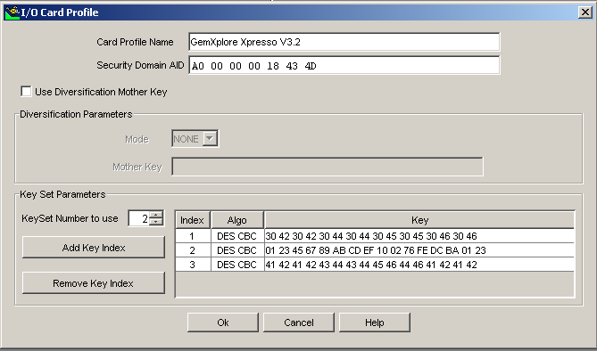
Key management with Card ADMIN
A dedicated profile stores keys of the card for I/0 Connected mode
Notes:
The second refinement concerns algorithms and keys that must be present in the card to respect VGP specifications and how these keys are used.
There always must be a secured channel, allowing authentication, integrity and privacy.
- MAC is performed with 3DES CBC
- Hash with SHA-1
- Signature for delegation is made with RSA and a minimum key of 1024 bits
- Encryption data is made with 3DES-CBC (Kenc)
- Encryption key is made with 3DES CBC (Kkek)
- Session key is calculated with 3DES-ECB from CPLC data and diversified keys.

Slide 36
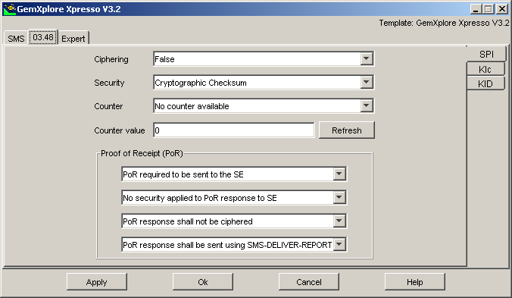
Key management with Card ADMIN
A dedicated profile is storing counter, level of security and keys required for ESMS (OTA mode)
Notes:
The second refinement concerns algorithms and keys that must be present in the card to respect VGP specifications and how these keys are used.
There always must be a secured channel, allowing authentication, integrity and privacy.
- MAC is performed with 3DES CBC
- Hash with SHA-1
- Signature for delegation is made with RSA and a minimum key of 1024 bits
- Encryption data is made with 3DES-CBC (Kenc)
- Encryption key is made with 3DES CBC (Kkek)
- Session key is calculated with 3DES-ECB from CPLC data and diversified keys.

Slide 37
23.048 & GP : Life Cycles (0)
GP and 23.048 specifications define life cycle for:
  Card
  Load File
  Applet
Lifecycle can be changed or recovered using SET STATUS or GET STATUS commands.
Notes:
LOAD FILE LIFE CYCLE managed by Card Manager:
* LOADED: Normal state
* LOGICALLY_DELETED: Load File in immutable persistent memory; Equivalent to physical deletion; Irreversible
APPLET LIFE CYCLE:
* INSTALLED: Application has been loaded, linked, instantiated from a Load File present on the card
* SELECTABLE: Available to process APDUs
* PERSONALIZED: Available to process applicative commands; data and keys have been personalized

Slide 38
23.048 & GP : Life Cycles (1)
‘life cycle of the card’
    GP_READY : first key set in the security domain
    GP_SECURED : normal state of the card
    GP_LOCKED : APDU cmds can only reach CM, Reversible
    GP_TERMINATED : card unusable, Irreversible
Pre-
issuance
Post-
issuance
Notes:
Now that we have seen the role of Card Manager, of Security Domain and the definition of Delegation, there is a last security point defined byGP, related to life cycle. This is a main point for the issuer to keep control on the cards which are in the field.
There are three kinds of Life Cycles : CM (in other word, the card communicator), package and applet.
Little explanation on packages/applet : a card with (i) a square part dedicated to package with packageAID, (ii) a round parts dedicated to applet instance with instanceAID. An instance is created from a constructor, this instructor is included in the install( ) method of the Java .class file.
Note : it is only in the GP_READY mode that the ATR can be modified (it can be interesting to change the speed communication during perso**). In SECURED and INITIALIZED mode, only historical bytes can be changed using the method GPSystem.setHistBytes(byte[] newhistoricalbytes, (short) offset, (byte) newhistoricalbytelength).
** perso Java 40s
perso GSM<10 s

Slide 39
23.048 & GP : Life Cycles (2)
package
  Load File (package)
    LOADED
    DELETED
Notes:
LOAD FILE LIFE CYCLE managed by Card Manager:
* LOADED: Normal state
* LOGICALLY_DELETED: Load File in immutable persistent memory; Equivalent to physical deletion; Irreversible
APPLET LIFE CYCLE:
* INSTALLED: Application has been loaded, linked, instantiated from a Load File present on the card
* SELECTABLE: Available to process APDUs
* PERSONALIZED: Available to process applicative commands; data and keys have been personalized

Slide 40
23.048 & GP : Life Cycles (3)
STK
  Applet Instance (JC or STK)
    INSTALLED : applet is instanciated but not selectable.
    SELECTABLE : applet is instanciated and selectable.
    PERSONALIZED : applet has all necessary personalization data for functionality.
    BLOCKED : Security problem has been detected, unblocked by the applet itself.
    LOCKED : Applet is not selectable, STK service not available.
    DELETED : applet is physically deleted, space is reclaimed.
JC
Notes:
LOAD FILE LIFE CYCLE managed by Card Manager:
* LOADED: Normal state
* LOGICALLY_DELETED: Load File in immutable persistent memory; Equivalent to physical deletion; Irreversible
APPLET LIFE CYCLE:
* INSTALLED: Application has been loaded, linked, instantiated from a Load File present on the card
* SELECTABLE: Available to process APDUs
* PERSONALIZED: Available to process applicative commands; data and keys have been personalized

Slide 41
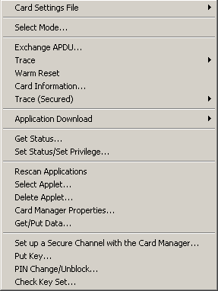
GP Commands in Card ADMIN
  Install
  Load
  SetStatus
  GetStatus
  Select
  Delete
  GetData
  PutData
  InitializeUpdate
  ExternalAuthenticate
  PutKey
Notes:
23.048 versus GP
Get Data (access to new object like MenuParameter)
Put Key (key set < 15, can not create a new key set)
Install (additional informations are required for loading and installing STK applet) : memory, menu entry priority, GSM specific parameters

Slide 42
Content
Day 1 :
  Introduction
  JavaCard concepts
  Demo & practical
  Java SIM Card
Day 2 :
  STK applet development
  Demo & Practical
  Over The Air communication with 23.048
  Demo & Practical

Slide 43
Practical 3&4 :
GP and 23.048 Management
Manage card OTA using secured 23.048 messages
Create a new key set in the GemXploreXpresso card and use it to download an applet OTA
Manage OTA Counter and Minimum Security Level

Slide 44

What Do You Remember
About This Second Day ??
Test your knowledge with MCQ on your PC

Slide 45

ANNEXE
How to Play with the Server Simulator

Slide 46
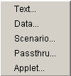
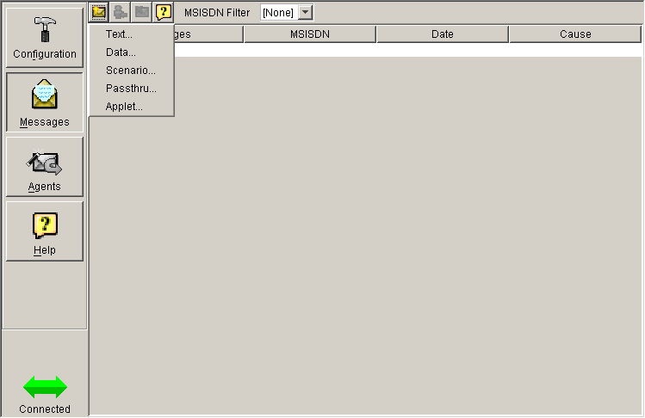
Server Simulator : Message Definition

Slide 47
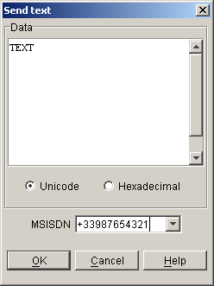
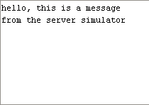

Server Simulator :
Sending an SMS text
03.40
03.40 H – TEXT

Slide 48
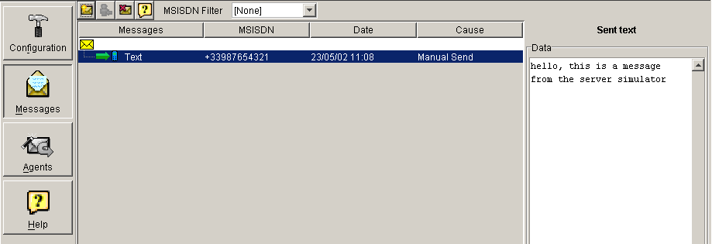
Server Simulator
Sending an SMS text, spying with the server

Slide 49
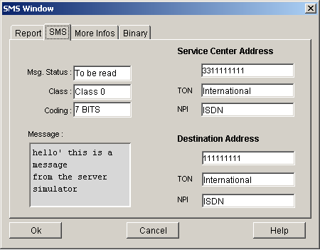
Server Simulator
Sending a SMS text, result on mobile SMS window

Slide 50
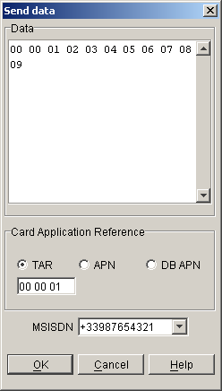

Server Simulator
Sending Data (formatted)
03.40
23.048
03.40 H – 23.048 H – 00 00 01 …
Card profile

Slide 51
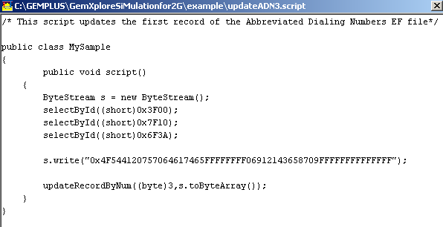
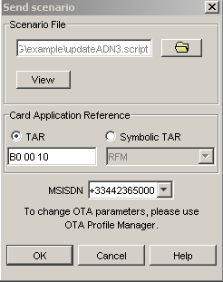
Server Simulator
Sending a scenario (.script)
Standard APDUs
23.048
03.40
03.40 H – 23.048 H – APDUs
Card profile

Slide 52
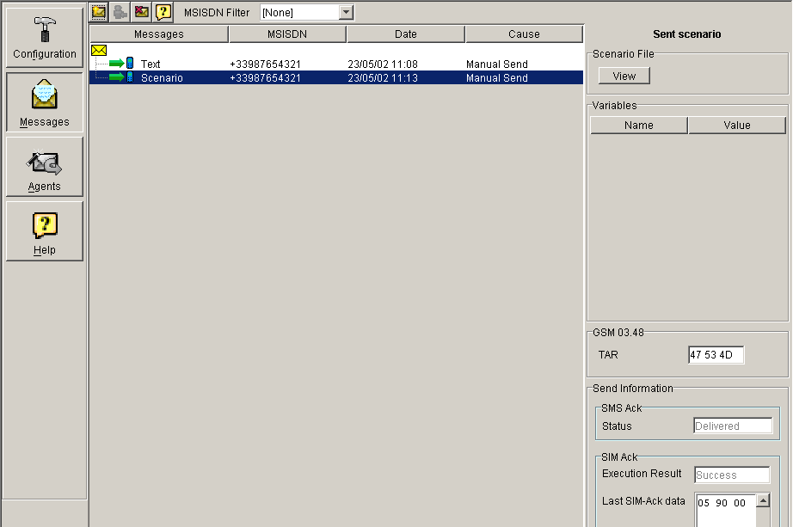
Server Simulator
Sending a scenario

Slide 53
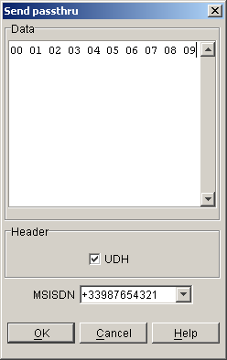
Server Simulator
Sending Passthru (unformated data)
03.40
03.40 H – 00 01 02 03
Card profile

Slide 54
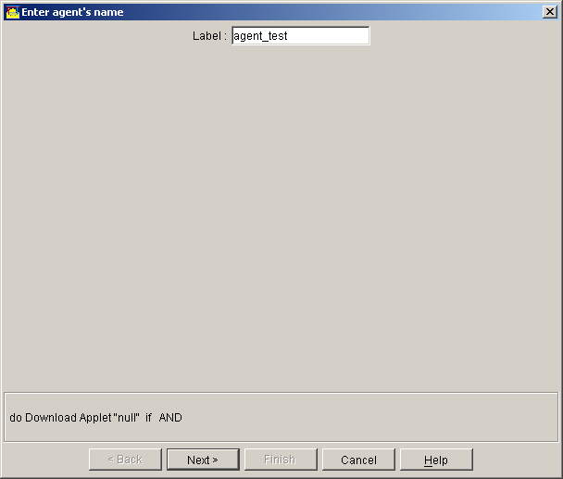
Agents
Create an agent

Slide 55
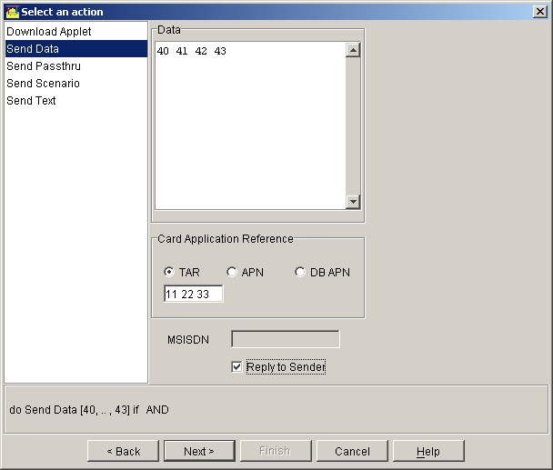
Agents
Select an action, if the agent is triggered
Send Data

Slide 56
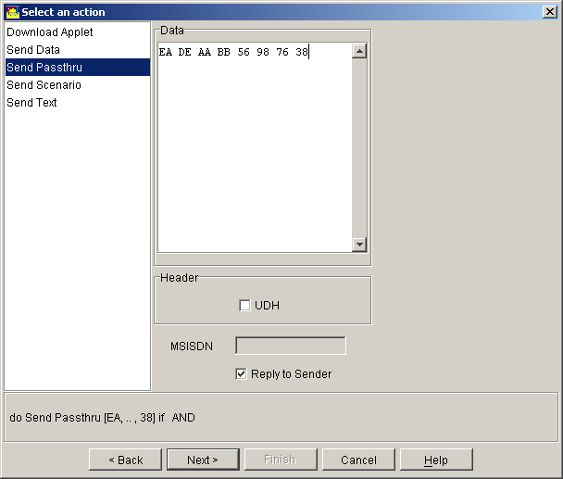
Agents
Select an action, if the agent is triggered
Send Passthru

Slide 57
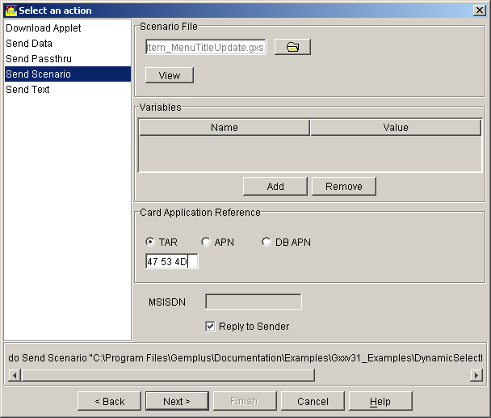
Agents
Select an action, if the agent is triggered
Send a scenario

Slide 58
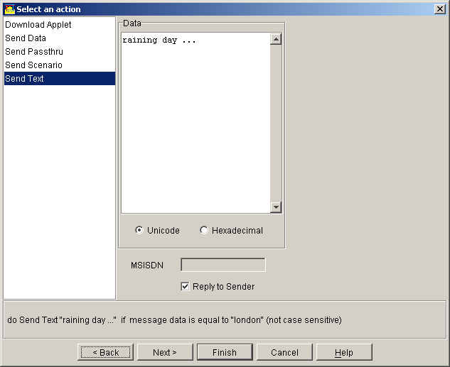
Agents
Select an action, if the agent is triggered
Send a SMS text

Slide 59
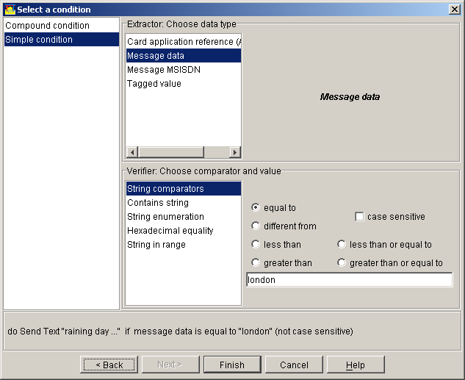
Agents
Select a condition to trigger the agent
Single condition

Slide 60
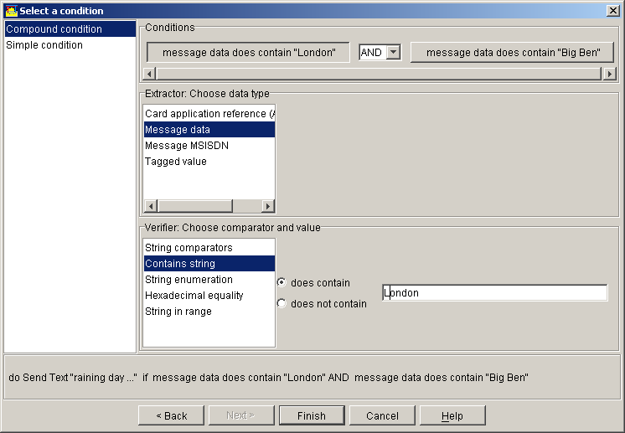
Agents
Select a condition to trigger the agent
Compound condition

Slide 61
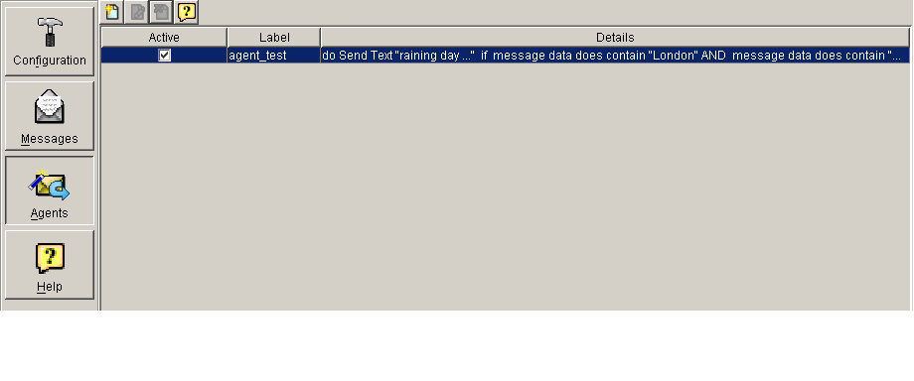
Agents
Activate the agent

