Slide 1
Installing Linux
Prepare for Linux Installation
Perform the Installation

Slide 2
System Requirements
More than just requirements for installation.
Also requirements for continued and reliable operation.
Based on many factors:
Linux distro being installed.
Hardware compatibility.
General category of system.
Intended function of system.
Specific apps running on system.
Price.

Slide 3
Partitioning Strategy
Plan for partitioning storage prior to installation.
Servers have different storage needs than workstations.
If root partition fills up, system will crash.
Home and log file directories can fill up quickly.
Isolate on separate partitions to prevent crashes.
Also plan for swap space partition.
Necessary for virtual memory storage.
Usually twice the quantity of RAM.
Size can vary.

Slide 4
Partitioning Examples (Slide 1 of 2)
Server:
/ as root file system.
/home to isolate home directory.
/var to isolate log files.
Dedicated swap partition.
Workstation:
/ as root file system.
Dedicated swap partition.

Slide 5
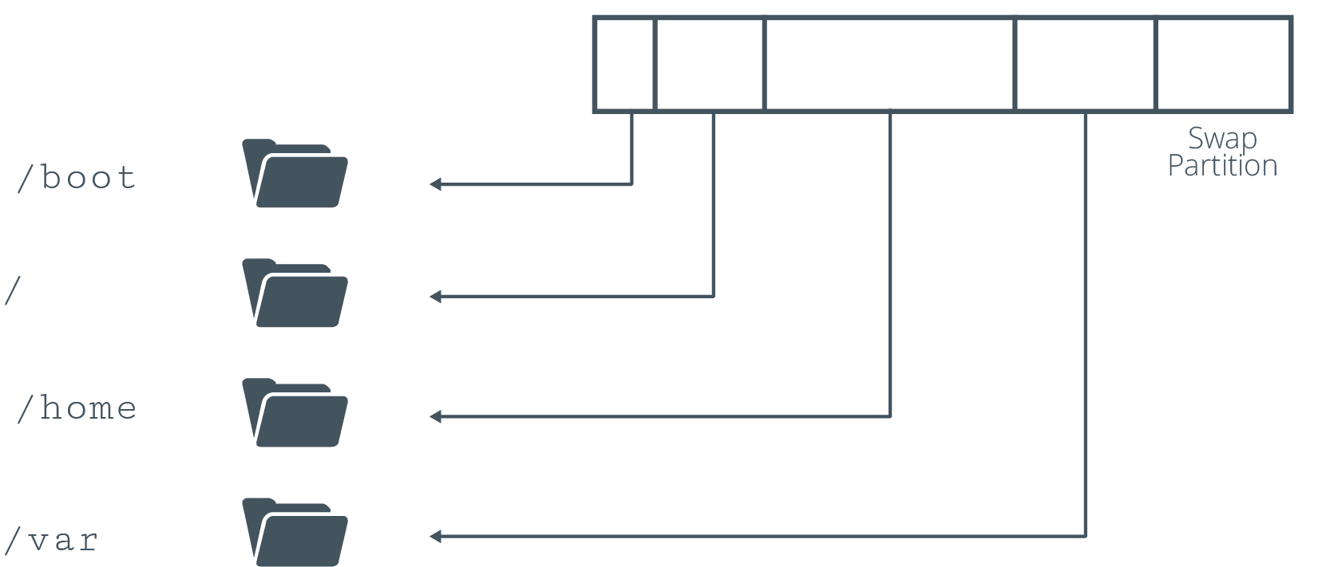
Partitioning Examples (Slide 2 of 2)

Slide 6
Hardware Compatibility
Before purchasing hardware, ensure it is compatible with distro.
If available, check HCL.
Stores vendors/models that distro supports.
Usually available online.
Many distros don't have an official HCL.
Gather hardware info about system.
Available in documentation that came with components.
Available in documentation on manufacturer's site.
Available from BIOS/UEFI.
Printed on physical component.

Slide 7
Questions to Address When Choosing Hardware
Universal:
Manufacturer?
Model?
Driver support?
Storage drive:
How many?
What interface controller technology?
What capacity?
Mechanical or solid-state?
Read/write speeds?
CPU:
Server or desktop market?
Clock rate?
Cache size?
Physical cores?
Hyper-threading?
Memory:
How much?
Enough DIMM slots?
Generation of DDR SDRAM?
Network card:
Technologies supported?
Maximum bandwidth?
Input device:
Hotpluggable?
USB version?
Monitor:
Connection interface?
Refresh rate?
Resolution?
Display adapter:
Chipset?
Video RAM?
Integrated or discrete?
Connection interface?

Slide 8
Installation Methods
Installing OS requires booting into install environment.
Boot methods you learned earlier can be used to boot installation media.
Boot from DVD/USB:
Prepare/burn install files (e.g., ISO) to physical media.
Might need to configure BIOS/UEFI.
Boot from media on local drive:
Download media to separate partition.
Configure GRUB 2 to boot from media.
Boot from network:
PXE/NFS services installation media to clients.
Clients use media to boot into install environment.

Slide 9
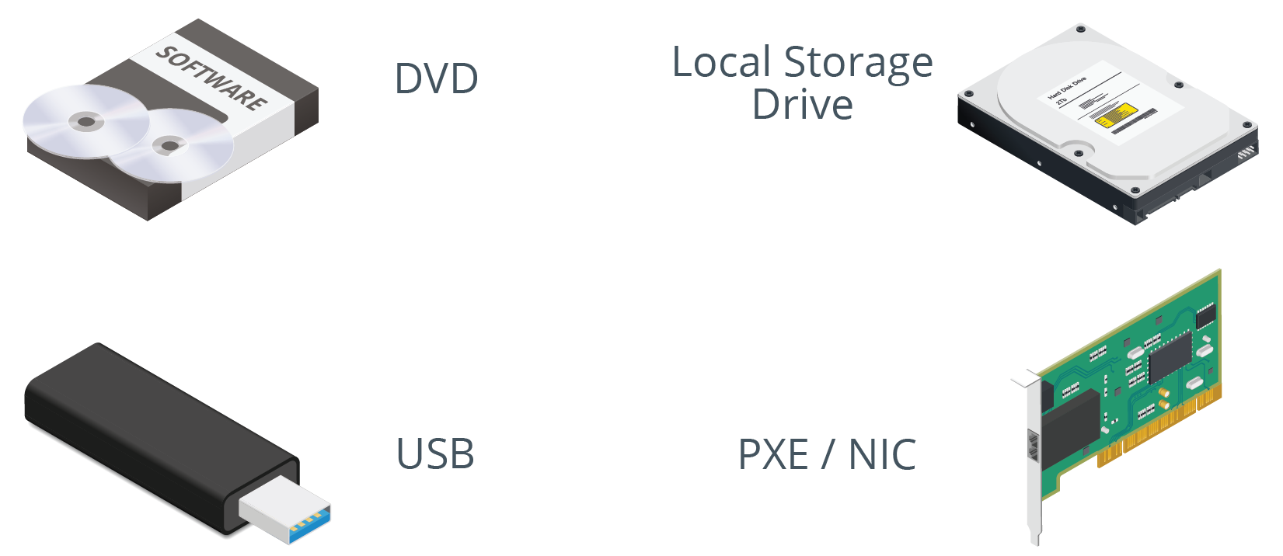
Installation Media

Slide 10
Guidelines for Preparing to Install Linux
Consider the factors that go into identifying system requirements.
Consider partition strategies based on role of Linux system.
Check HCLs or other resources for hardware support.
Address questions pertaining to hardware components.
Choose the optimal installation method for your environment.

Slide 11
Activity: Preparing to Install Linux (Slide 1 of 2)
You need to create Linux systems for different purposes:
Public-facing web server.
Desktop environment for graphic designer.
System for testing custom software.
Choose which hardware to apply to which purpose.
System A
System B
System C

Slide 12
Activity: Preparing to Install Linux (Slide 2 of 2)
System A:
32 GB RAM
Quad-core Intel Core i7 processor
2 TB hard drive
100 Mb/s Ethernet
Discrete video card
System B:
8 GB RAM
18-core Xeon processor
500 GB SSD
1 Gb/s Ethernet
Onboard graphics adapter
System C:
4 GB RAM
Dual-core AMD A6 processor
250 GB hard drive
100 Mb/s Ethernet
Onboard graphics adapter

Slide 13
Manual Installation Steps (Slide 1 of 3)
Vary depending on distro you're using.
Most installers have a GUI.
Most installers enable configuration of common options.

Slide 14
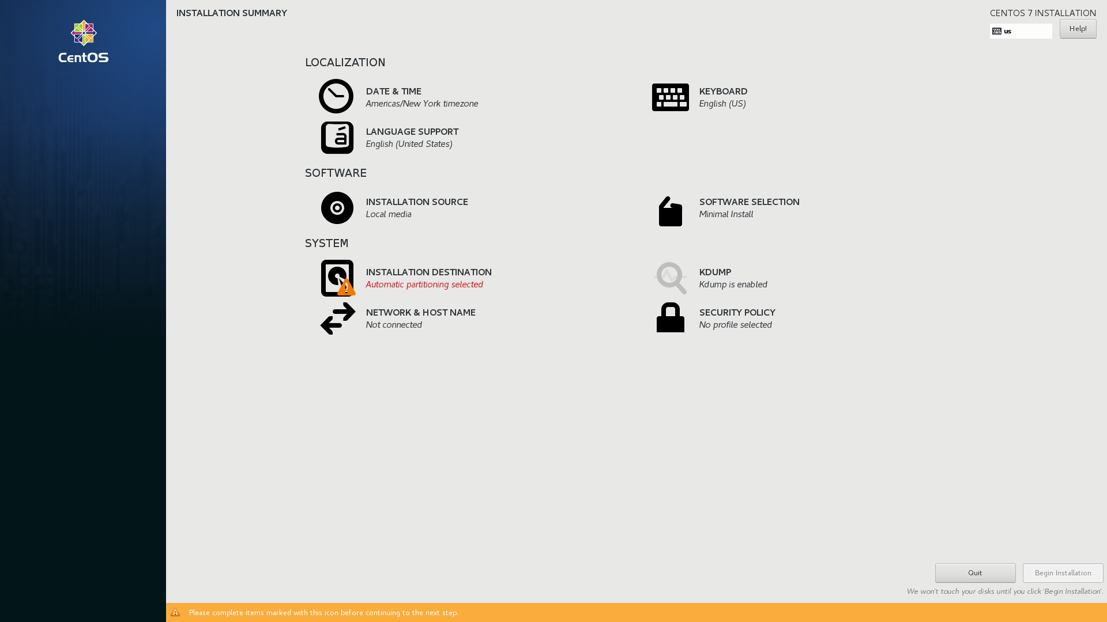
Manual Installation Steps (Slide 2 of 3)

Slide 15
Manual Installation Steps (Slide 3 of 3)
General steps:
Configure language/layout settings.
Configure date and time.
Choose other installation media.
Choose software environment/components.
Partition storage drives.
Configure network identity.
Configure user accounts.
Configure security policies.

Slide 16
Discussing Installing Linux

Slide 17
Activity: Installing Linux
You're ready to install Linux.
You'll start by installing CentOS 7 on a VM.
You'll configure various options to set up environment to your specs.

Slide 18
What Linux distributions do you think you'll install in your organization, or have you installed in the past?
Do you anticipate any hardware compatibility issues in your installations? Why or why not?

