Slide 1
Layoff Risk Classification
Extract → Learn → Predict
INFO 6105 — Final Project
Presented by: Pin-Yuan Tseng, Shirui Zhang, Yixin Mao
Date: Dec 8, 2025

Slide 2
Problem Statement & Context
Tech layoffs surged significantly across 2022–2024.
  Need early risk detection for employees, HR, investors.
  Goal: Classify companies into High vs Low layoff risk.
    High Risk (1): layoff_ratio > 5% OR recent heavy layoffs.
    Low Risk (0): otherwise.
Dataset
  Raw Data: 489 companies (from Kaggle)
  Cleaned: 142 usable companies after processing

Slide 3
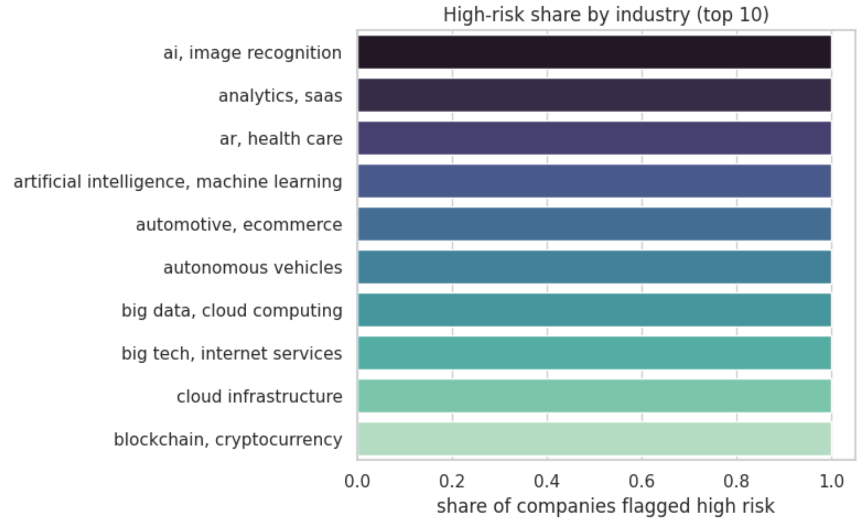
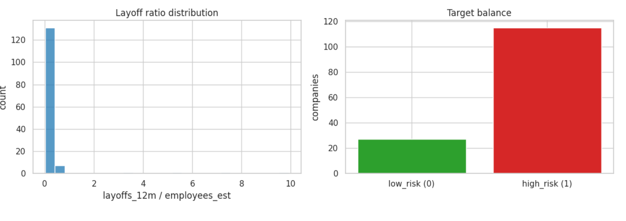
Data Extraction & EDA Insights
Layoff ratio is heavily right-skewed; most companies <0.2
Dataset is strongly imbalanced: 81% high-risk
Industry-level differences in high-risk rates

Slide 4
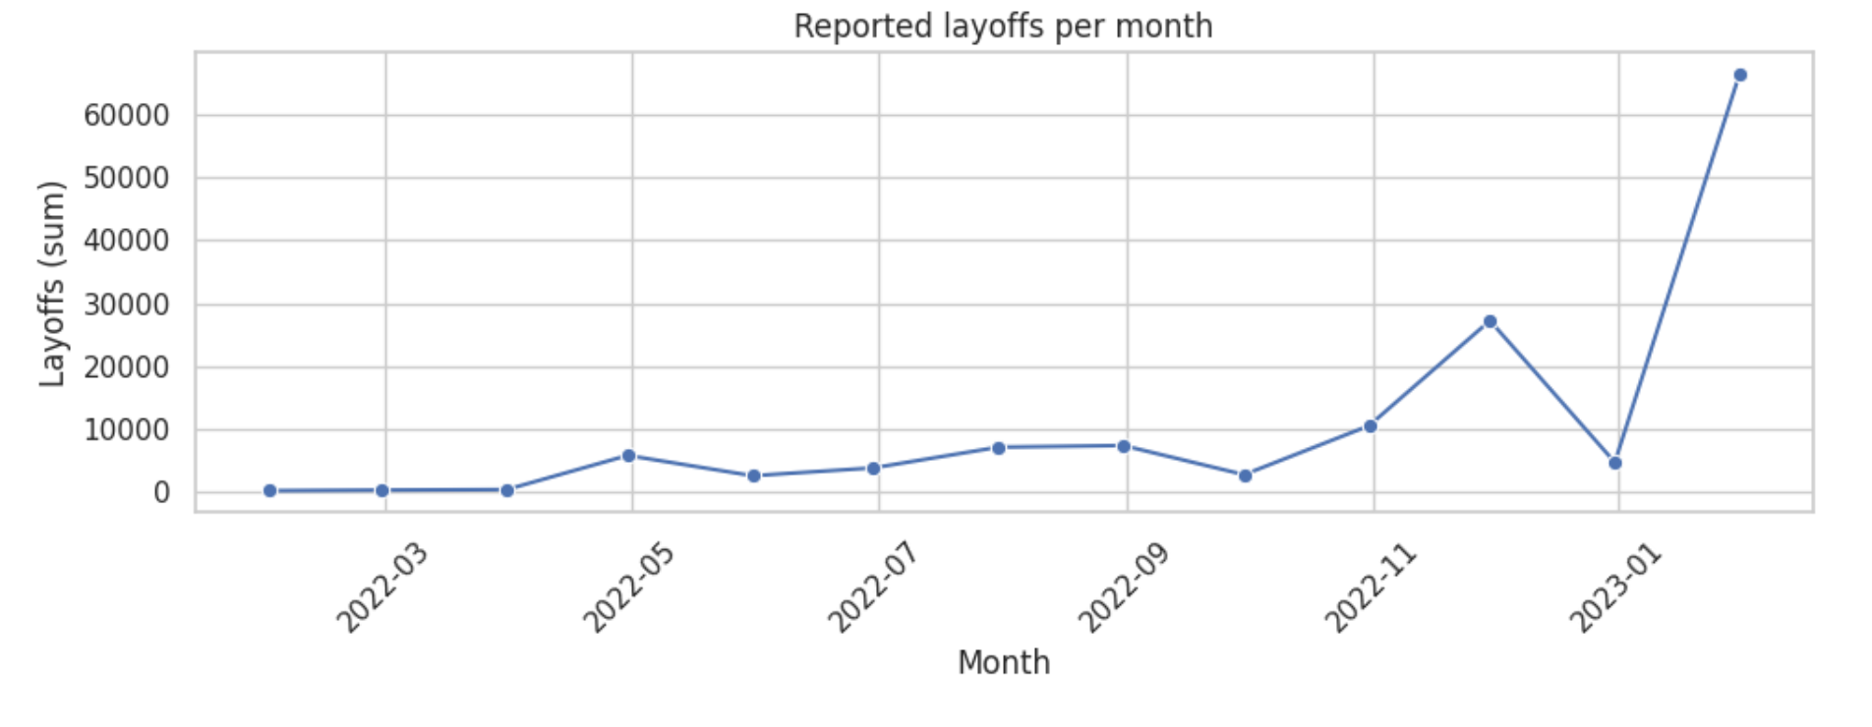
Layoff Trends Over Time
Layoff activity shows clear spikes in late 2022 and early 2023, driven by macroeconomic and tech-sector slowdowns.
Peaks are concentrated in tech and fintech companies, indicating heightened workforce risk during these periods.

Slide 5
Modeling Strategy (Learn Phase)
Preprocessing
  One-hot encode categorical columns
  Train/Test split = 80/20 with stratify (due to imbalance)
  class_weight='balanced' for fairness
  Models evaluated
  Decision Tree (primary)
  Random Forest
Metrics
  Accuracy
  F1 (positive)
  Recall (positive)
  ROC-AUC
  Confusion Matrix

Slide 6
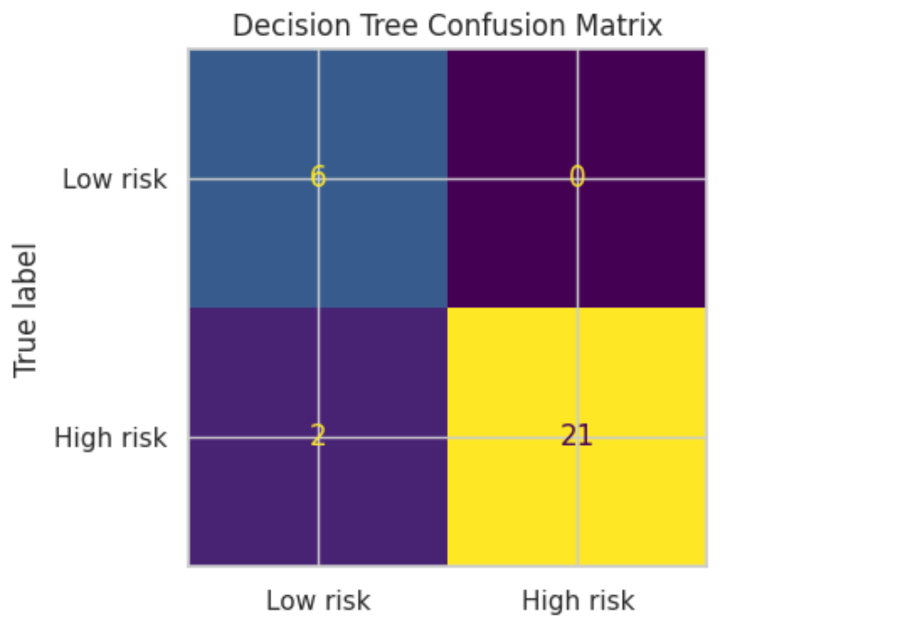
Decision Tree Results
Accuracy = 0.931 | F1 = 0.955 | Recall = 0.913 | ROC-AUC = 0.971
  False Negatives = 2 (old layoffs >1000 days)
  False Positives = 0
Error Analysis
False Negatives = 2 (Apollo, Rock Content)
  High historical layoff ratios
  But layoffs occurred >1000 days ago
  Tree down-weights old layoffs
False Positives = 0
  Very good precision & interpretability

Slide 7
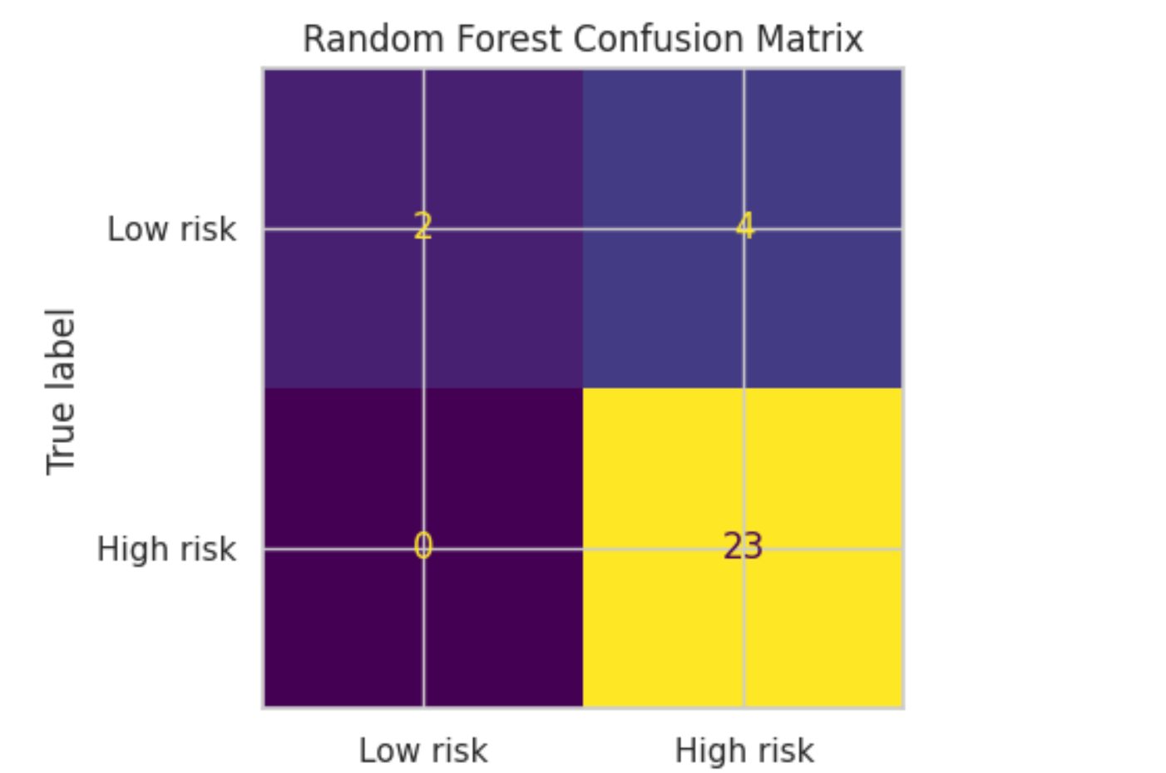
Random Forest Results
Accuracy = 0.862 | F1 = 0.920 | Recall = 1.000 | ROC-AUC = 0.928
  False Positives = 4 → overpredicts risk
Interpretation
Captures all positives (perfect recall)
But produces 4 false positives
Less accurate overall
Better for “don’t miss any risky company” use cases

Slide 8
Prediction Demo (Predict Phase)
Using the full-dataset trained Decision Tree
• High layoff_ratio companies (≥0.07–0.10) consistently predicted as high risk
• Predictions align with industry patterns (security, blockchain, ecommerce)
• Low ratio companies (<0.04) predicted as low risk → strong precision
• Interpretability: model behavior matches decision tree split thresholds
Company | Industry | layoff_ratio | pred
addepar | fintech | 0.03 | 0
aqua security | security | 0.10 | 1
superrare | blockchain | 0.12 | 1
informatica | cloud | 0.07 | 1
bigcommerce | ecommerce | 0.12 | 1
wonder | food delivery | 0.07 | 1
citizen | surveillance | 0.027 | 0
vimeo | media | 0.12 | 1

Slide 9
Usefulness & Users
Who benefits?
  Employees: Avoid unstable companies.
  HR: Workforce planning & forecasting.
  Investors/Analysts: Stability insights.
  Policy Makers: Track sector-level layoffs.
Why it works?
  Transparent Decision Tree
  Uses only public data
  Easy to extend and deploy

Slide 10
Future Work & Improvements
More Resources
Integrate richer company data
  Financial health (revenue, growth, cash flow)
  Hiring freeze & headcount trends
  Funding events and investor signals
  News sentiment & stock volatility
Add time-series features (recent layoff spikes)
Explore advanced models (XGBoost / LightGBM / AutoML)
Fairness & Bias Reduction
  Evaluate fairness across industries and company sizes
  Mitigate industry bias via reweighting or stratified training
  Apply post-hoc calibration to avoid overestimating risk
  Enhance model transparency using SHAP / LIME

Slide 11
Q&A

Slide 12
Thank you

