Slide 1
透過加法器
在IBM量子電路上實現糾錯算法​
曾品元 江庭瑄

Slide 2
Why Error Correction Algorithm Are Needed?
Because the qubit of a quantum computer is very sensitive, any external interference may cause errors or decoherence.
Classical computers also have error correction algorithms, such as ECC (error correction/correcting code).
Quantum computers have error rates on the order of 10²到10³

Slide 3
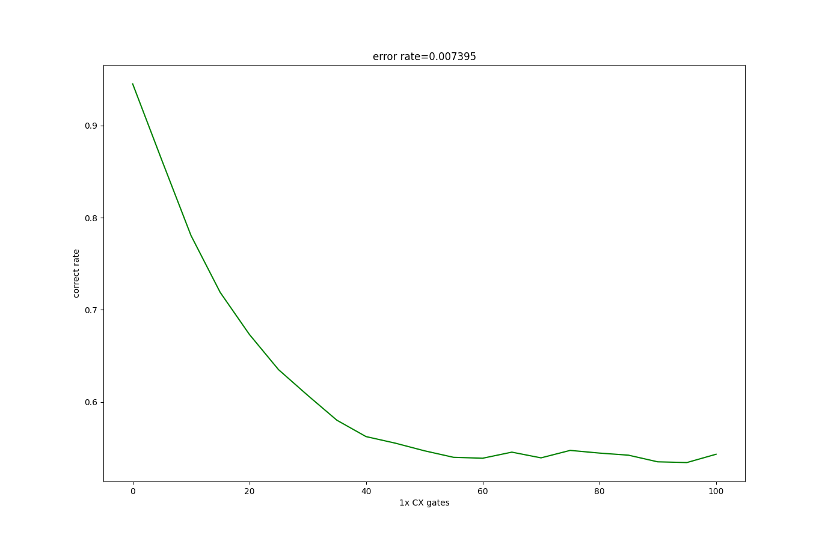

Slide 4
What Should We Pay Attention to in Error correction Algorithms For Quantum Computers?
quantum operation error rate(per gate)
qubit map
qubit amount

Slide 5
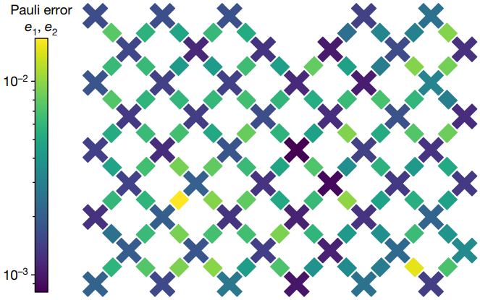
Google Sycamore processor

Slide 6
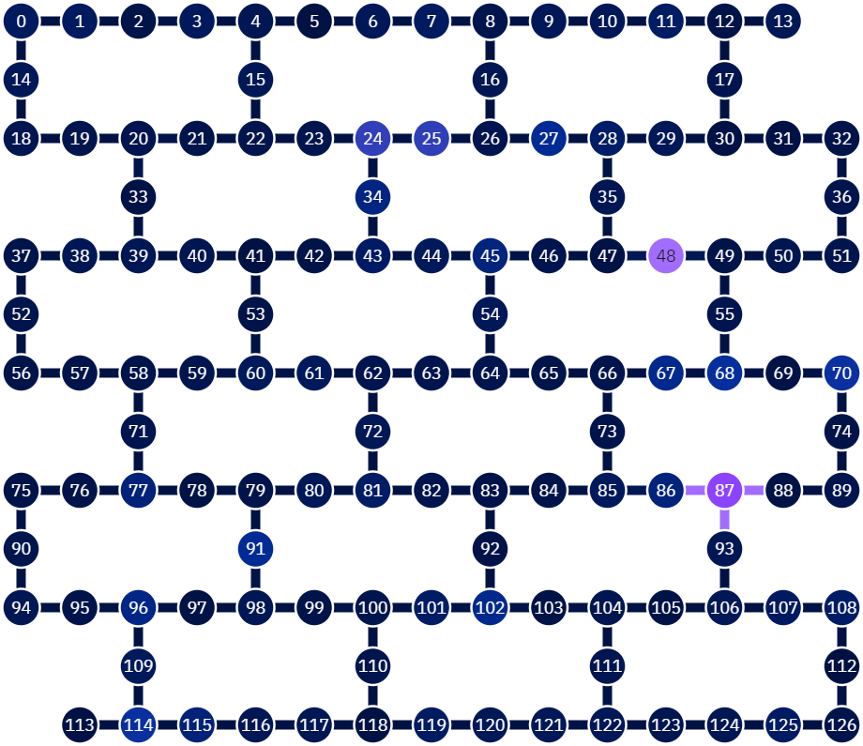
IBM brisbane

Slide 7
three-bit repetition code
1 -> 111
0 -> 000
000,001,010,100 -> 0
111,110,101,011 -> 1

Slide 8
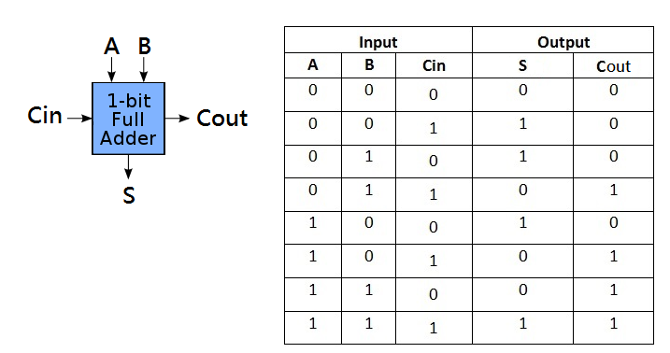
Full adder
https://tomorrow0w0.gitbooks.io/nand2tetris-homework/content/chapter2/FullAdder.html

Slide 9
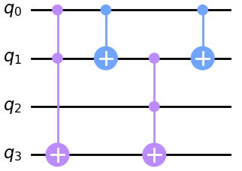
Full adder (quantum circuit)
input：q0,q1,q2
output：q3(carry)

Slide 10
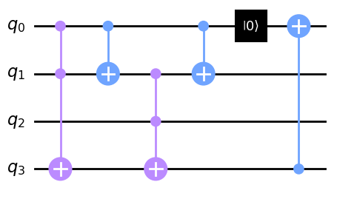
Write back into q0

Slide 11
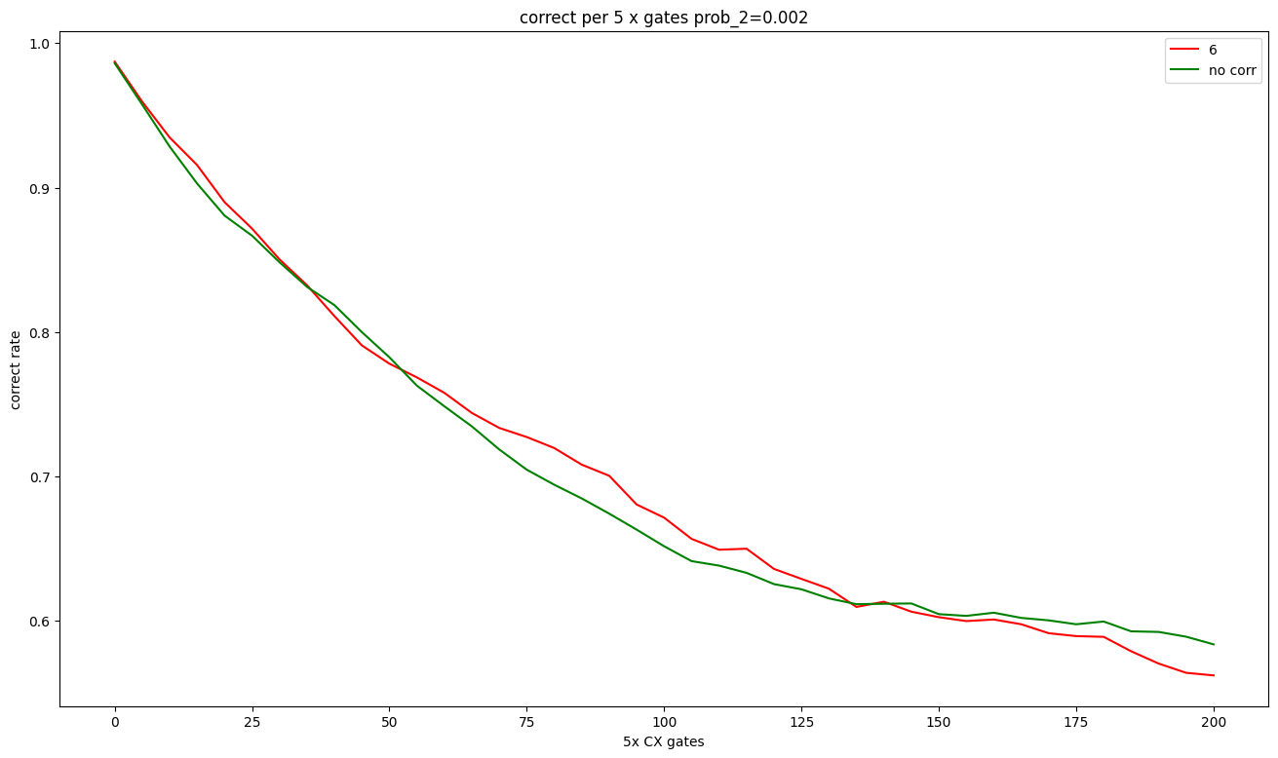
outcome 1

Slide 12
Why?
000101 -> 000000
000110 -> 000110 (Error)

Slide 13
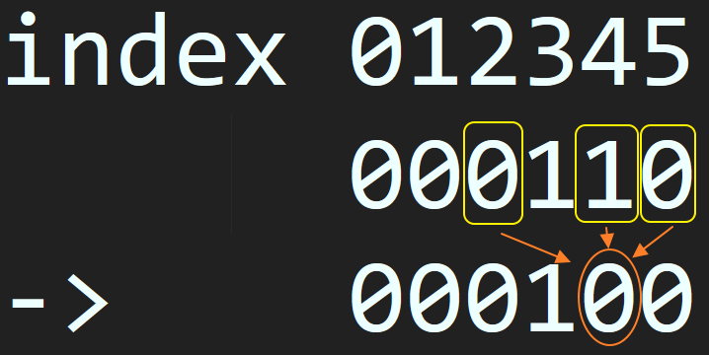
use bias [-2, 0, 1]：000110 -> 000100 -> 000000

Slide 14
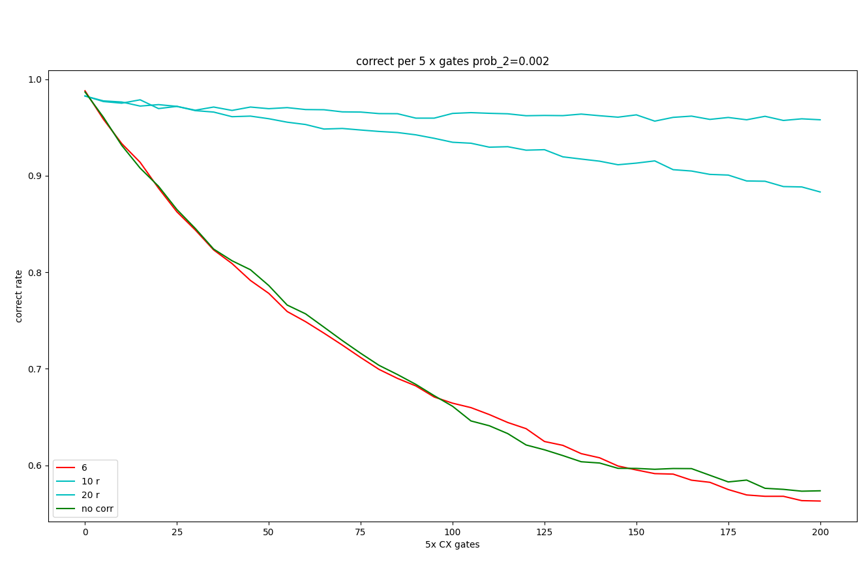
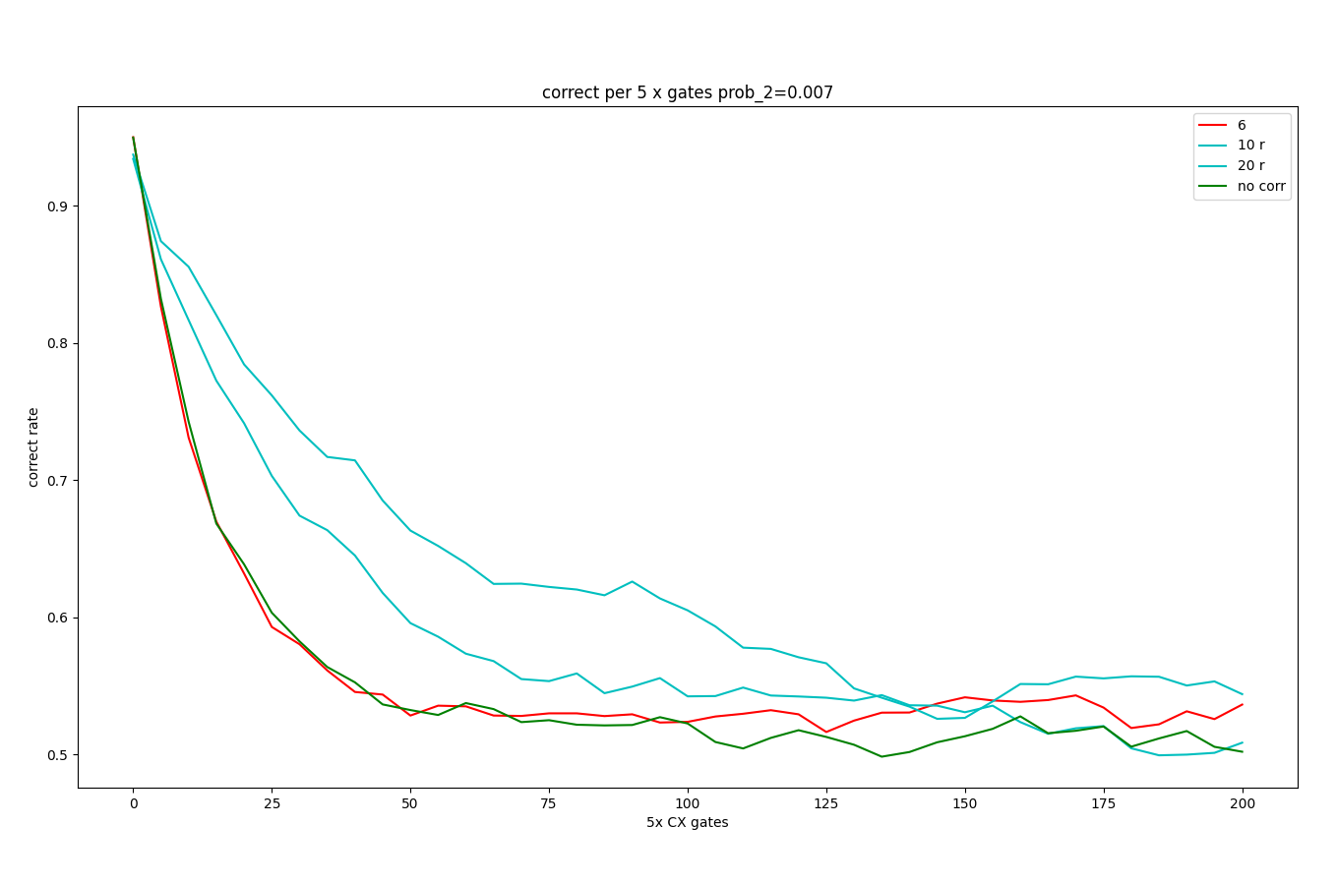

Slide 15
virous problem
take [-1,0,1] as an example(start from index 0)：
100001
->100001
->110001
->111001 …..

Slide 16
solution
wait until all calculations are completed, write back (use [-2,0,1] bias)
date qubit: 100001
support qubit:000000 calculate->
date qubit: 100001
support qubit:000001 copy(write back)
date qubit: 000001
support qubit:000001

Slide 17
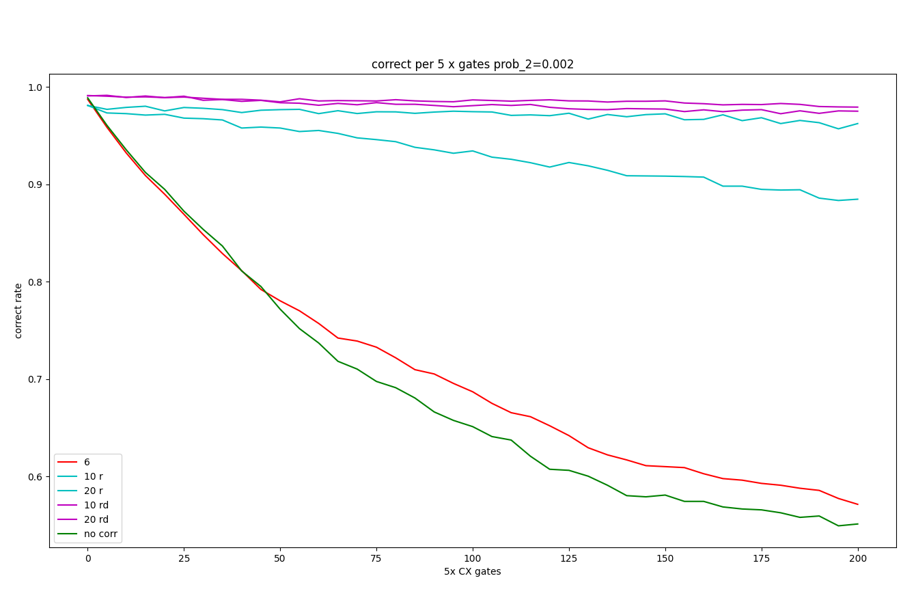
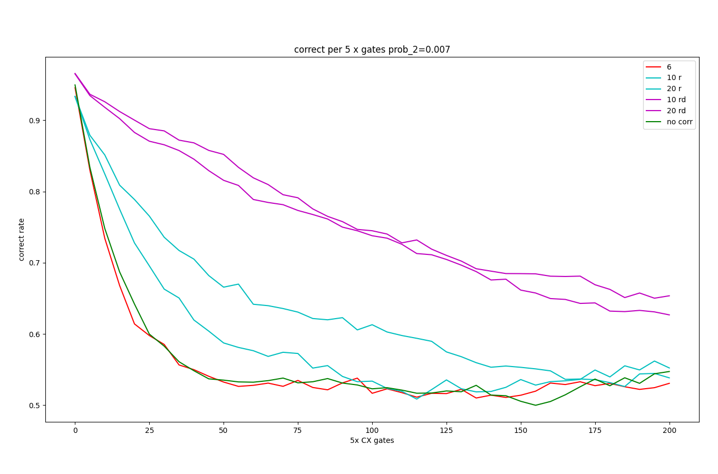

Slide 18
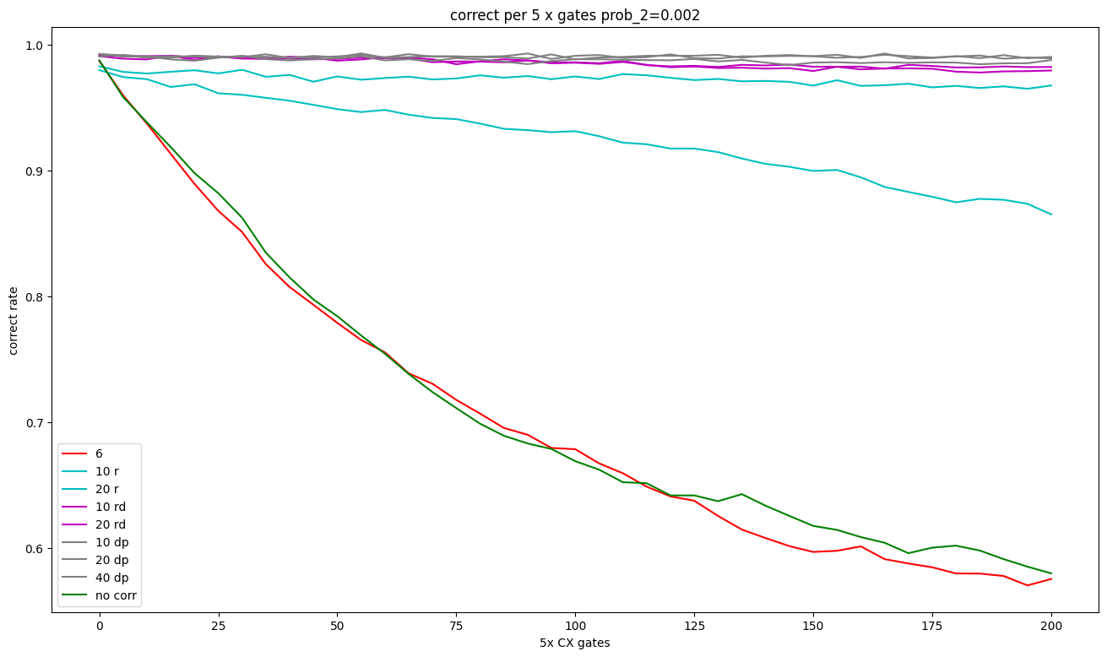
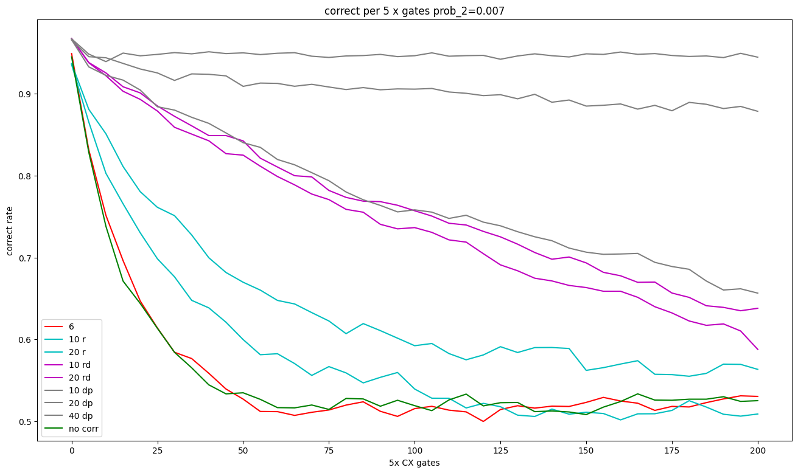

Slide 19
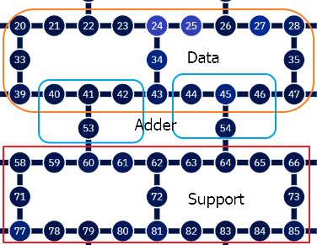
Actual Operation

Slide 20
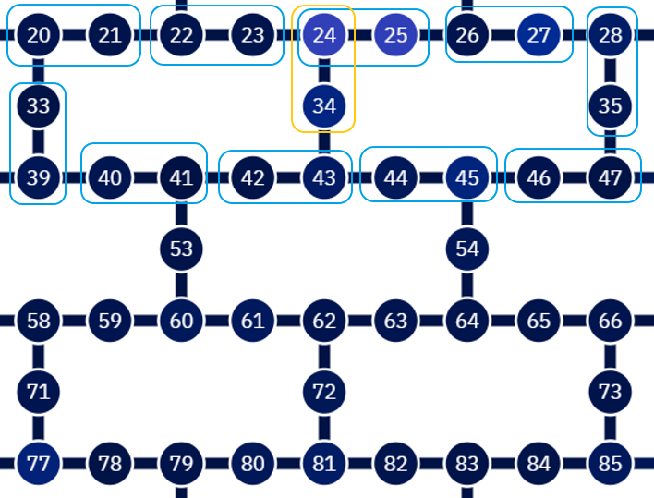

Slide 21
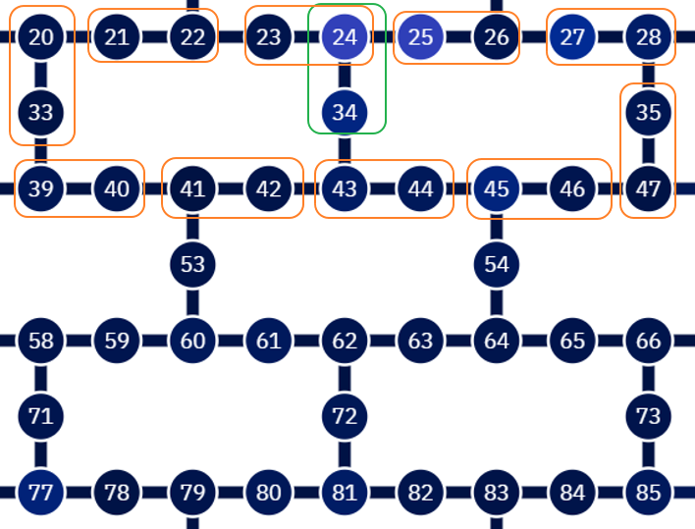

Slide 22
full adder uses these qubits to form new outcomes
[(1, 3, 25), (1, 5, 7), (1, 23, 27), (2, 4, 29), (3, 5, 27), (3, 7, 29), (4, 6, 7), (5, 6, 29), (8, 9, 13), (8, 10, 11), (8, 12, 14), (8, 20, 28), (9, 10, 12), (9, 18, 20), (10, 12, 17), (10, 14, 16), (10, 21, 28), (11, 16, 18), (12, 14, 15), (12, 16, 18), (12, 19, 21), (13, 14, 16), (14, 17, 19), (14, 18, 20), (15, 16, 17), (16, 20, 28), (18, 21, 28), (19, 20, 21), (22, 25, 27), (23, 24, 25)]

Slide 23
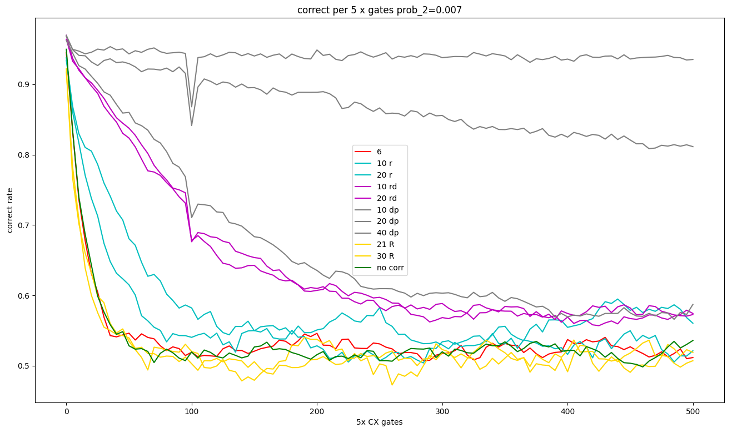

Slide 24
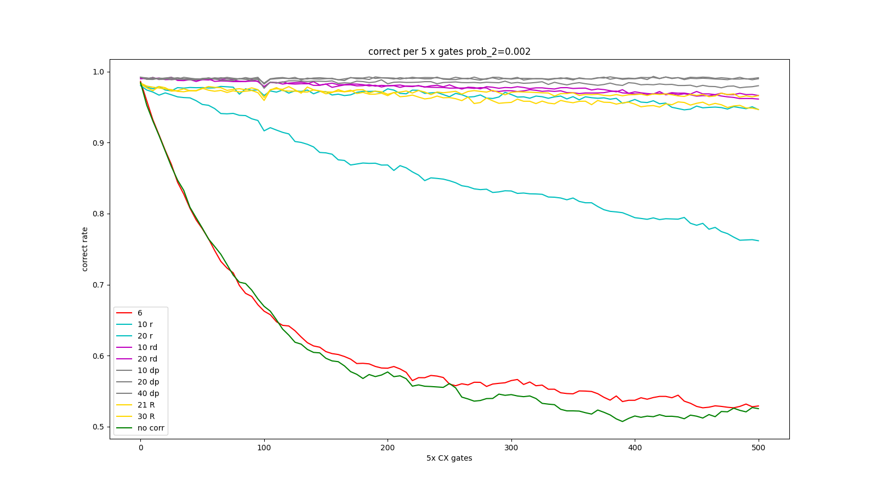

Slide 25
