Slide 1

taller android & VR powered by processing for Android
congreso de ciencias EXACTAS de la universidad autónoma de Aguascalientes
Del 20 al 22 de septiembre de 2017.

Slide 2
Agenda
1. Introduction to the android platform and the android development environment
2. Application Fundamentals and the Activity Class
Application Fundamentals
The activity Class
3. Intents & UI
4. Git
5. VR Processing

Slide 3

INTRODUCTION

Slide 4
¿What is Android?
Android is the world's most popular mobile platform
Android is a mobile operating system developed by Google, based on the Linux kernel and designed primarily for touchscreen mobile devices such as smartphones and tablets

Slide 5
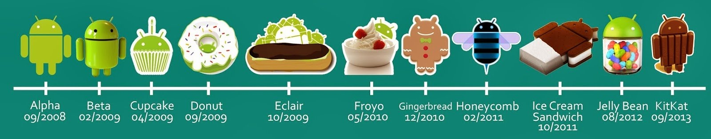
¿Since when?
Android Inc. 2003 - 2005.
Google’s Android. 2005 – 2007 - Nowadays.

Slide 6
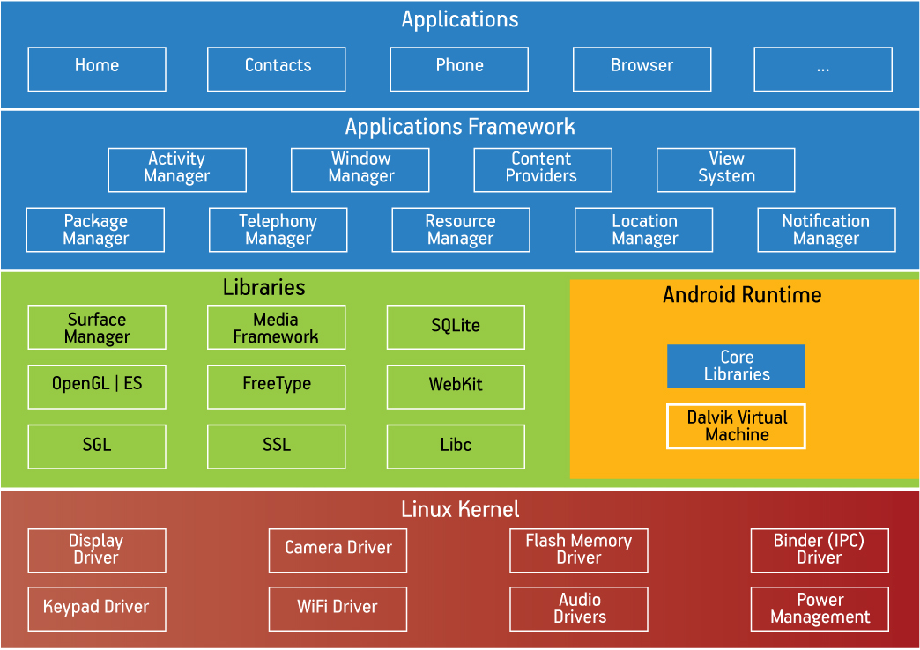

Slide 7

“I heared Android is Java”
Written in JAVA, C core, C++
& Kotlin!

Slide 8
Software Development Kit
Android does not use established Java standards, that is, Java SE and ME.
Android only reuses the Java language syntax and semantics.
Does not provide the full class libraries and APIs
Debugger
Libraries
Emulator
Documentation
Sample code
Tutorials

Slide 9


IDE’s

Slide 10
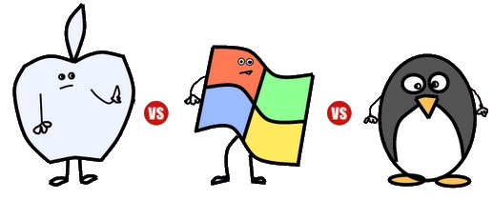


Android Studio
The official integrated development environment for Android platform development.
May 2013 => December 2014
Based on JetBrains' IntelliJ IDEA
Descargar

Slide 11
AS features
Gradle-based build support.
Android-specific refactoring and quick fixes.
Lint tools to catch performance, usability, version compatibility and other problems.
ProGuard integration and app-signing capabilities.
Template-based wizards to create common Android designs and components.
A rich layout editor that allows users to drag-and-drop UI components, option to preview layouts on multiple screen configurations.
Support for building Android Wear apps
Built-in support for Google Cloud Platform, enabling integration with Google Cloud Messaging and App Engine.

Slide 12
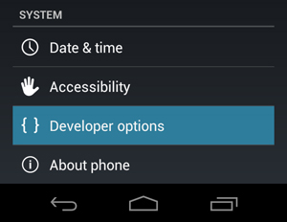


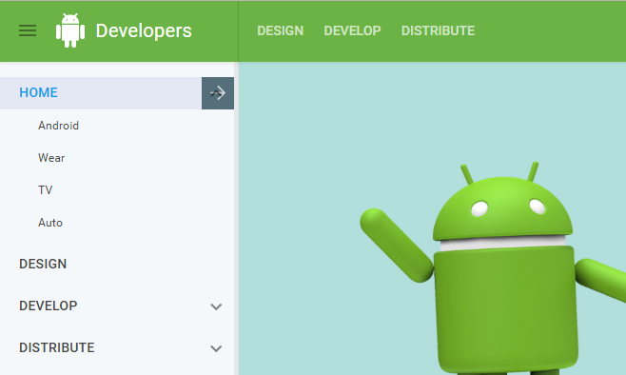
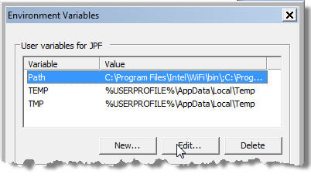
More Stuff to Begin

Slide 13

Stop
Stop to say Hello World

Slide 14
Application Fundamentals

Slide 15
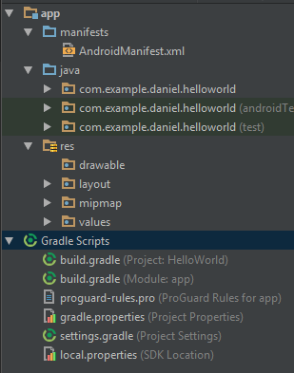
Directory, resources, classes and more

Slide 16
App Manifest
Every application must have an AndroidManifest.xml file in its root directory.
It names the Java package for the application.
It describes the components of the application. Intents.
It declares the permissions that the application
It declares the minimum level of the Android API

Slide 17
Common permissions
Permission Group | Permissions
CALENDAR | READ_CALENDAR WRITE_CALENDAR
CAMERA | CAMERA
CONTACTS | READ_CONTACTS WRITE_CONTACTS GET_ACCOUNTS
LOCATION | ACCESS_FINE_LOCATION ACCESS_COARSE_LOCATION
MICROPHONE | RECORD_AUDIO
PHONE | READ_PHONE_STATE CALL_PHONE READ_CALL_LOG WRITE_CALL_LOG ADD_VOICEMAIL USE_SIP PROCESS_OUTGOING_CALLS
SENSORS | BODY_SENSORS
SMS | SEND_SMS RECEIVE_SMS READ_SMS RECEIVE_WAP_PUSH RECEIVE_MMS
STORAGE | READ_EXTERNAL_STORAGE WRITE_EXTERNAL_STORAGE
<manifest xmlns:android="http://schemas.android.com/apk/res/android" package="com.android.app.myapp" > <uses-permission android:name="android.permission.RECEIVE_SMS" /> ... </manifest>

Slide 18
<?xml version="1.0" encoding="utf-8"?> <manifest> <uses-permission /> <permission /> <permission-tree /> <permission-group /> <instrumentation /> <uses-sdk /> <uses-configuration /> <uses-feature /> <supports-screens /> <compatible-screens /> <supports-gl-texture /> <application> <activity> <intent-filter> <action /> <category /> <data /> </intent-filter> <meta-data /> </activity> …
… <activity-alias> <intent-filter> . . . </intent-filter> <meta-data /> </activity-alias> <service> <intent-filter> . . . </intent-filter> <meta-data/> </service> <receiver> <intent-filter> . . . </intent-filter> <meta-data /> </receiver> <provider> <grant-uri-permission /> <meta-data /> <path-permission /> </provider> <uses-library /> </application> </manifest>

Slide 19








Resources: The Resource is the key
Additional files and static content that your code uses
bitmaps, layout definitions, user interface strings, animation instructions, and more.
Included in /res
Menu
Strings
Style
And More
Animation
Color
Drawables
Layouts

Slide 20
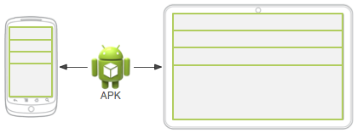
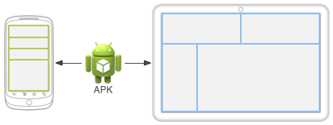
Resources: The Resource is the key
Two different devices, each using the default layout (the app provides no alternative layouts).
Two different devices, each using a different layout provided for different screen sizes.

Slide 21
Classes
Just like Java….
com.example.project
/com/example/project/
Main.java
iMain.interface
EnumerationClass.enum

Slide 22
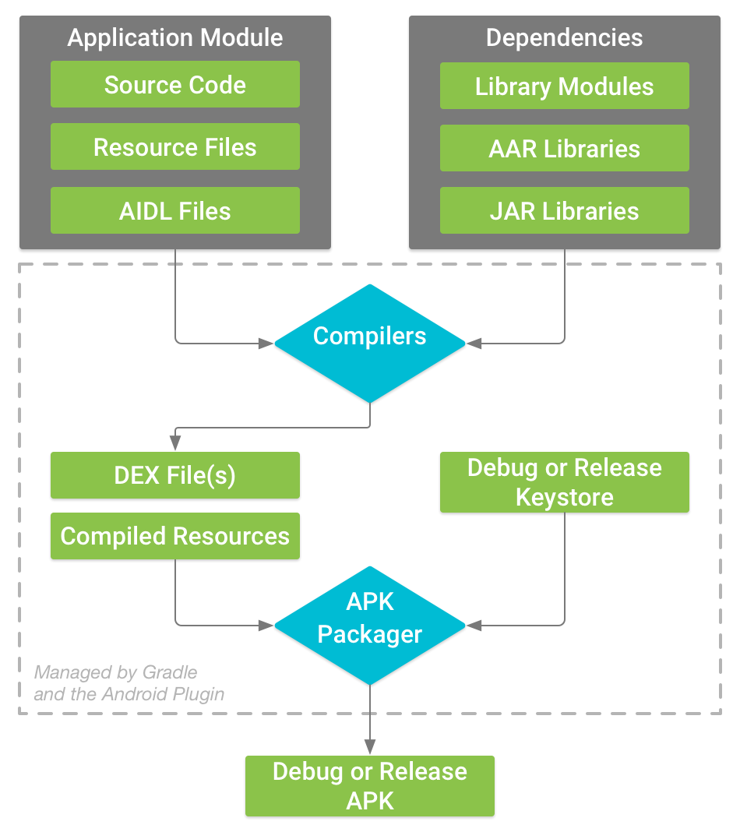
Gradle: your worst enemy
Modern open source build atomation
1. Convert your source code into DEX (Dalvik Executable) files
2. The APK Packager combines the DEX files and compiled resources into a single APK.
3. The APK Packager signs your APK using either the debug or release keystore
4. Before generating your final APK, the packager uses the zipalign tool to optimize your app to use less memory.

Slide 23
App Components
Activities
Services
Content providers
Broadcast receivers

Slide 24
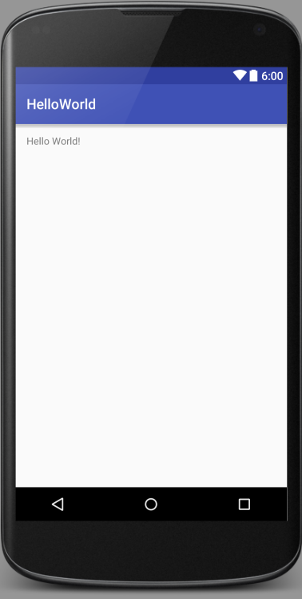
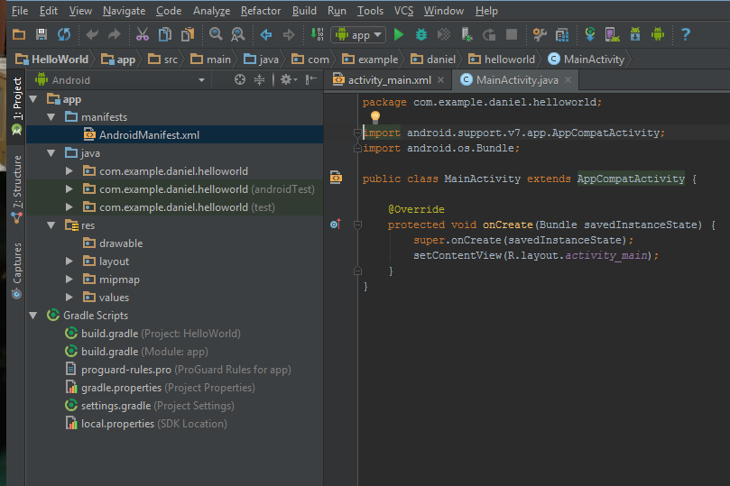
The Activity
Represents a single screen with a user interface

Slide 25
Creating an Activity
Create a Sublcass of Activity
Implementing a user interface, dinamically or xml.
Declaring the activity in manifest
Optionaly using intent filter
<activity android:name=".ExampleActivity" android:icon="@drawable/app_icon"> <intent-filter> <action android:name="android.intent.action.MAIN" /> <category android:name="android.intent.category.LAUNCHER" /> </intent-filter> </activity>

Slide 26
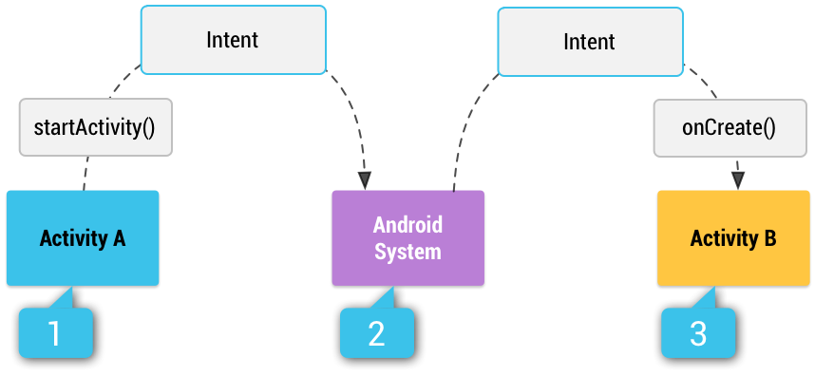
Starting an Activity
Intent intent = new Intent(this, SignInActivity.class); startActivity(intent);
Intent intent = new Intent(Intent.ACTION_SEND); intent.putExtra(Intent.EXTRA_EMAIL, recipientArray); startActivity(intent);

Slide 27
¿Contexts, Intents, Bundles?
Context | Intent | Bundles
Interface to global information about an application environment. This is an abstract class whose implementation is provided by the Android system. | An Intent is a messaging object you can use to request an action from another app component. To start an activity To start a service To deliver a broadcast | Bundles are generally used for passing data between various Android activities.

Slide 28
Intent types
Explicit intents specify the component to start by name (the fully-qualified class name).
For example, start a new activity in response to a user action or start a service to download a file in the background.
Implicit intents do not name a specific component, but instead declare a general action to perform, which allows a component from another app to handle it.
For example, if you want to show the user a location on a map, you can use an implicit intent to request that another capable app show a specified location on a map.

Slide 29
Explicit intent
Intent downloadIntent = new Intent(this, DownloadService.class); downloadIntent.setData(Uri.parse(fileUrl)); startService(downloadIntent);

Slide 30
Implicit intent
// Create the text message with a string Intent sendIntent = new Intent(); sendIntent.setAction(Intent.ACTION_SEND); sendIntent.putExtra(Intent.EXTRA_TEXT, textMessage); sendIntent.setType("text/plain"); // Verify that the intent will resolve to an activity if (sendIntent.resolveActivity(getPackageManager()) != null) { startActivity(sendIntent); }

Slide 31
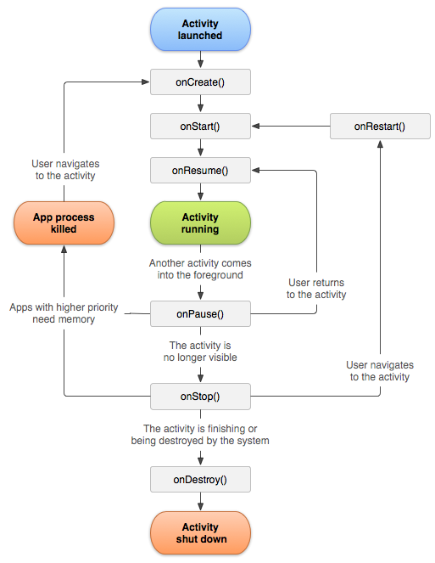
Activity lifecycle

Slide 32
Stop
Start an activity

Slide 33
Example code
1. In the file res > layout > activity_main.xm
2. In the file java > com.example.myfirstapp > MainActivity.java
<Button android:layout_width="wrap_content" android:layout_height="wrap_content" android:text="@string/button_send" android:onClick="sendMessage" />
public class MainActivity extends AppCompatActivity { @Override protected void onCreate(Bundle savedInstanceState) { super.onCreate(savedInstanceState); setContentView(R.layout.activity_main); } /** Called when the user clicks the Send button */ public void sendMessage(View view) { // Do something in response to button } }

Slide 34
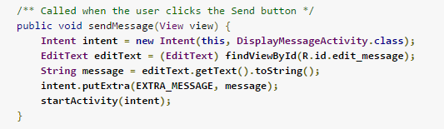
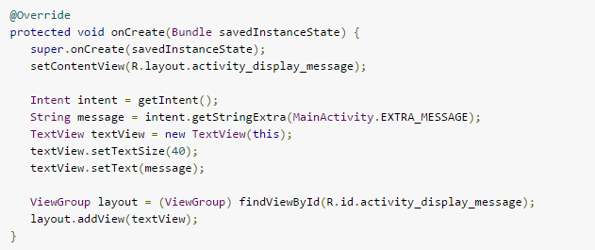
Example code
3. Build an intent
4. Display the message in DisplayMessageActivity.java

Slide 35
User Interface Classes

Slide 36
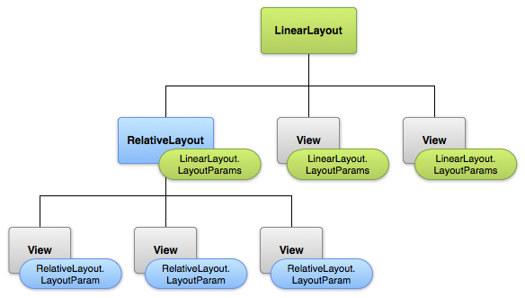
Layouts
Using Android's XML vocabulary, you can quickly design
UI layouts and the screen elements they contain,
in the same way you create web pages in HTML

Slide 37
Layouts
<?xml version="1.0" encoding="utf-8"?> <LinearLayout xmlns:android="http://schemas.android.com/apk/res/android" android:layout_width="match_parent" android:layout_height="match_parent" android:orientation="vertical" > <TextView android:id="@+id/text" android:layout_width="wrap_content" android:layout_height="wrap_content" android:text="Hello, I am a TextView" /> <Button android:id="@+id/button" android:layout_width="wrap_content" android:layout_height="wrap_content" android:text="Hello, I am a Button" /> </LinearLayout>
public void onCreate(Bundle savedInstanceState) { super.onCreate(savedInstanceState); setContentView(R.layout.main_layout); }

Slide 38
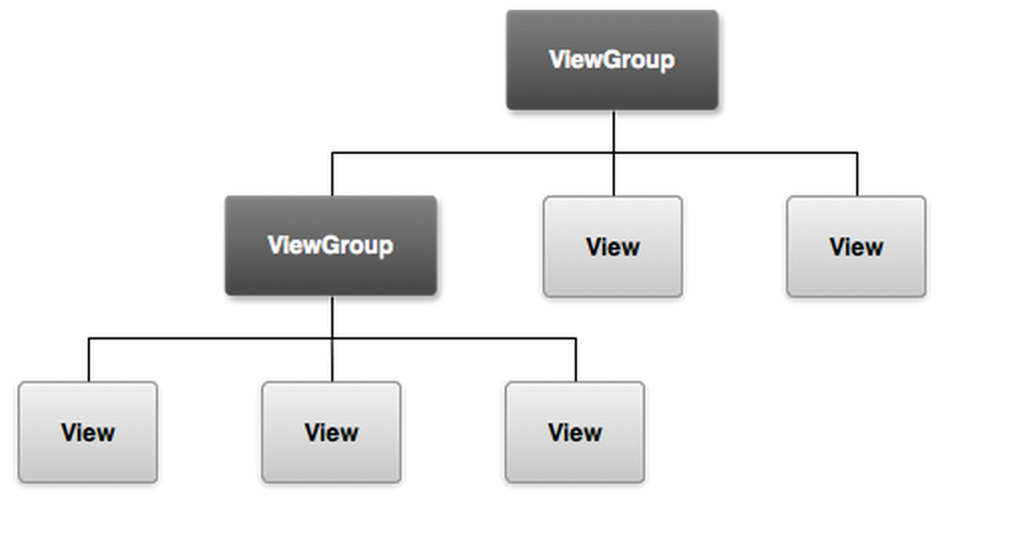
View
View is the base class for widgets, which are used to create interactive UI components (buttons, text fields, etc.)

Slide 39
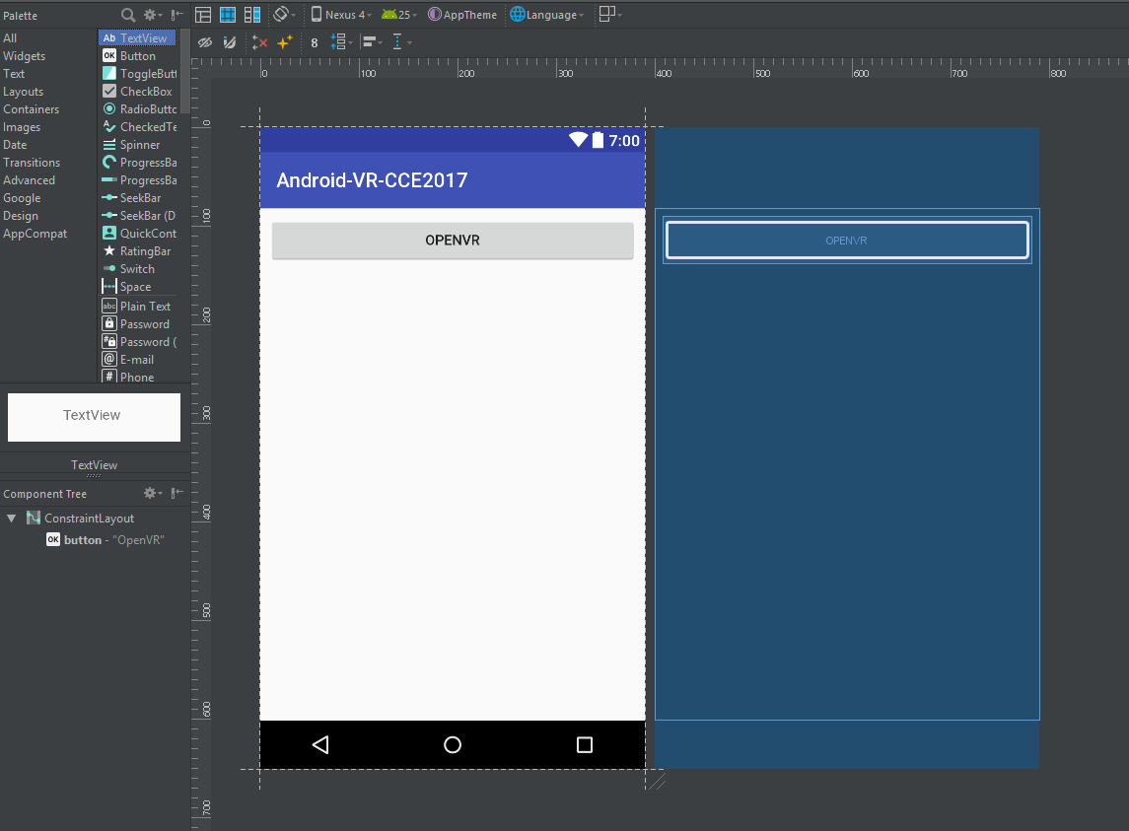
The UI designer

Slide 40
Stop
Do magic

Slide 41
Git

Slide 42

We need git ALWAYS
Or at least any source control
program

Slide 43


Why the git?
Git is a free and open source distributed version control system designed to handle everything from small to very large projects with speed and efficiency.

Slide 44


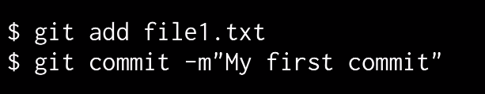
Git Basics
Configuration
Initialize a repo
First commit

Slide 45
Git Basics
$ git branch name_of_branch
Create a Branch
Change between branches
Remote branches
$ git checkout another_branch
$ git fetch origin
$ git pull origin branch_in_remote

Slide 46
Git Basics
$ git branch name_of_branch
Create a Branch
Change between branches
Remote branches
$ git checkout another_branch
$ git fetch origin
$ git pull origin branch_in_remote

Slide 47
Stop
Bring the VR codes!

Slide 48
Android VR CCE2017 project
Get the Android VR CCE2017 repository
Fetch all
Master of Project
$ git clone https://github.com/daniel553/Android-VR-CCE2017.git
$ git fetch origin
$ git checkout master

Slide 49
Processing VR

Slide 50

Processing project

Slide 51
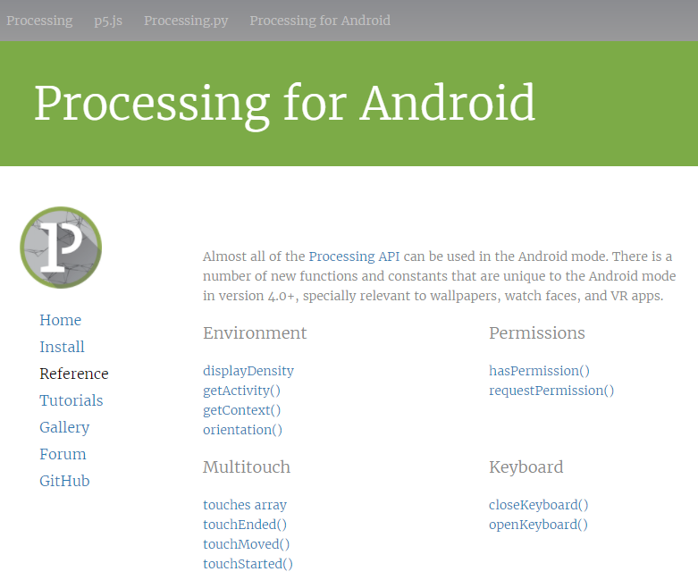
Processing project
http://android.processing.org/reference/index.html

Slide 52
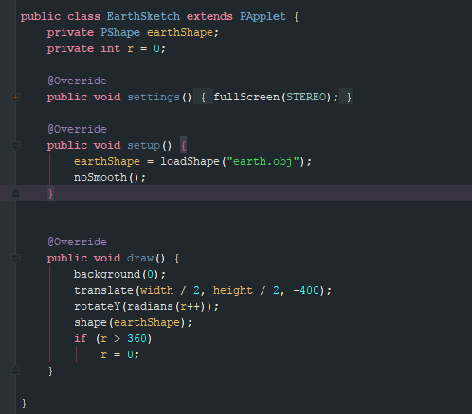
Android Mode
1. Settings
2. Set up
3. Draw

Slide 53


That’s all folks
By: Pedro Daniel García González
Android & VR 2017
danielgarcia@bonateck.com

