Slide 1
Color Course Project
Automatic Gaze Correction
Daniel Heilper
Moran Lefler

Slide 2

Problem Definition
When photographing people, Their gaze (the direction the people look to) is not always directing the camera, resulting in a less-emotional impact.
This is especially apparent in video conferencing, where the subjects cannot maintain eye- contact

Slide 3
Current work
We have put our emphasis so far on eye movement synthesis.
We have found it to be a non-trivial process, which includes many vision and color related tasks.
Work description:
Input: image of a person
Output: image of person with corrected eyes, after movement

Slide 4
Process Description
Given an image:
Detect faces in the image
For each face:
Detect eyes location
Segment eye and retrieve measurements
Compute transformation from given correction angle
Apply transformation
Fill missing areas

Slide 5
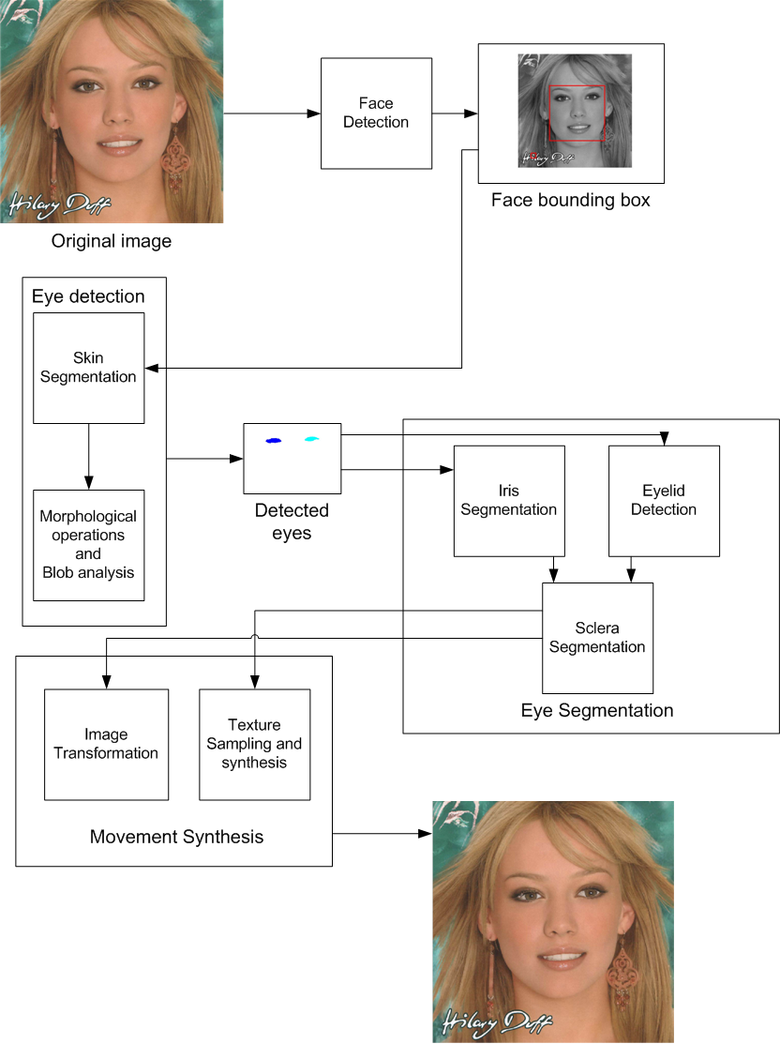
Algorithm Diagram

Slide 6
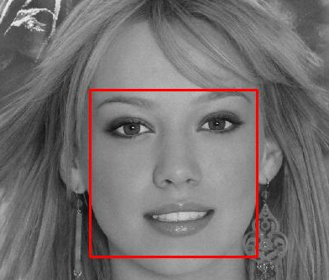
Detect Faces in image
Given an image of a person:
We used Robust Real-time Object Detection by Viola & Jones to get bounding box around faces in the image.
at this stage, due to false alarm problems, we only use images with one person. The process still helps to crop the region of the face.

Slide 7
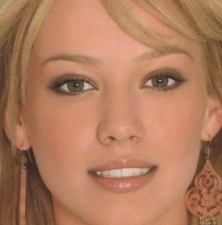
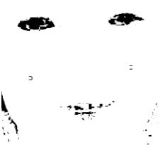
Detect Eyes in face
Given an image of a person’s face (cropped from full image):
We use a skin detection algorithm to segment skin areas.
The algorithm uses the hue Dimension from the HSV color space and transformation to YCbCr in order to map skin regions.
skin_mask =
140 <= cb <=195 & 140 <= cr <=165 & 0.01 <= hue <= 0.1;

Slide 8
Detect Eyes in face
Skin segmentation based on “Automatic Red-Eye Removal based on Sclera and Skin Tone Detection by Flavien Volken, Johann Terrier, Patrick Vandewalle”
Cai and Goshtasby, J. Cai, A. Goshtasby, and C. Yu, “Detecting Human Faces in Color Images, 1998 Int'l Workshop on Multi-Media Database Management Systems.”

Slide 9


Detect Eyes in face
Non-skin areas have the potential to be eye segments.
This means that this algorithm will only work on color images and will not work on intensity only images.
We use morphologic operations to avoid detecting non-skin regions which are not eyes.

Slide 10
Detect Eyes in face
We then use a set of blob analysis properties to see whether each candidate blob behaves like an eye segment. The examined properties are:
Height - Eyes should be at the top half of the face
Solidity — Scalar specifying the proportion of the pixels in the convex hull that are also in the region. We expect a solidity value of more than 0.7
Area – we check that the area of the blob is large enough, and that the ratio between the blob area and the rest of the image is not too small, in order to exclude small non-skin regions.

Slide 11
Detect Eyes in face
(properties examination continued)
Hue variance – since the color disparity is large within the eye, we assume that the hue variance should be large.
Orientation– eye blobs should be larger in the horizontal axis than in the vertical axis.
The blob analysis assume that the face detection step was successful and that the face region was detected tightly around the face.
NOTE: This does not result in accurate eye segmentation, but gives a good estimation for the location of the eyes.

Slide 12
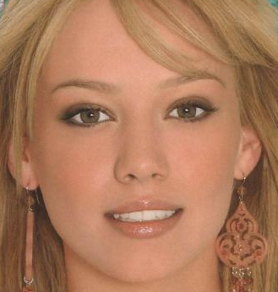

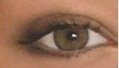
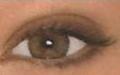
Detect Eyes example

Slide 13
Eye Segmentation
For a successful eye correction process, the eye should be segmented as accurately as possible.
In the eye segmentation step, we segment the different parts of the eye
Iris
Sclera
Eyelids

Slide 14
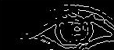

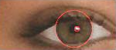

Iris Segmentation
We have tested two different methods for iris segmentation.
Using Hough transform for circle detection. For each possible radius, we search for the maximum intersection between the edge map and the strongest circle obtained by the transform.
strongest circle

Slide 15
Iris Segmentation
Other similar Iris segmentation concepts: John G. Daugman. High confidence visual recognition of persons by a teste of statisticalin dependence. In IEEE Transactions on Pattern Analysis and Machine Intelligence, vol. 15,no. 11, pages 1148–1161, U.S.A., 1993
Camus, T.A., and Wildes, R.: ‘Reliable and fast eye finding in closeup images’. IEEE 16th Int. Conf. on Pattern Recognition, Quebec,Canada, 2004, pp. 389–394

Slide 16
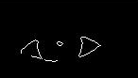
Eyelids Segmentation
Find edges in the image using canny edge detector.

Slide 17
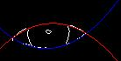

Find the topmost, leftmost, rightmost and bottommost points in the edge map.
Estimate 2 parabolas that will model the shape of the eye using ‘polyval’ in MATLAB on the found points
Every pixel between the two parabolas is marked as an eye pixel.

Slide 18
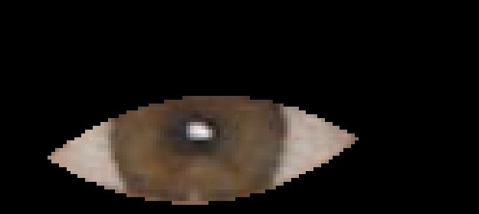
Image Transformation
We find that for smaller angles, translation obtains satisfactory results.
We work on the cropped bounding box of each eye separately.
First we apply the eyelids mask on the original eye image

Slide 19

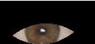
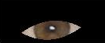
Image Transformation
Then, we apply the transformation on the segmented image
We then cut the original eye region from the translated image

Slide 20
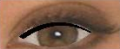
Transformation results
Eye image after translation of the segmented area.
The black region needs to be filled with missing sclera and iris parts

Slide 21
Filling missing areas
Two distinctive regions needs filling
Sclera (eye whiteness)
Iris (eye color)
We determine the 2 regions using set operations on the image pixels
The region are filled with texture synthesis method based on a sample from the available texture.
We use texture synthesis based on: Image Quilting for Texture Synthesis and Transfer by Alexei A. Efros and William T. Freeman from Proceedings of SIGGRAPH '01, Los Angeles, California, August, 2001.

Slide 22
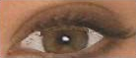
Texture synthesis example
Eye after transformation
Eye after sclera and iris synthesis

Slide 23
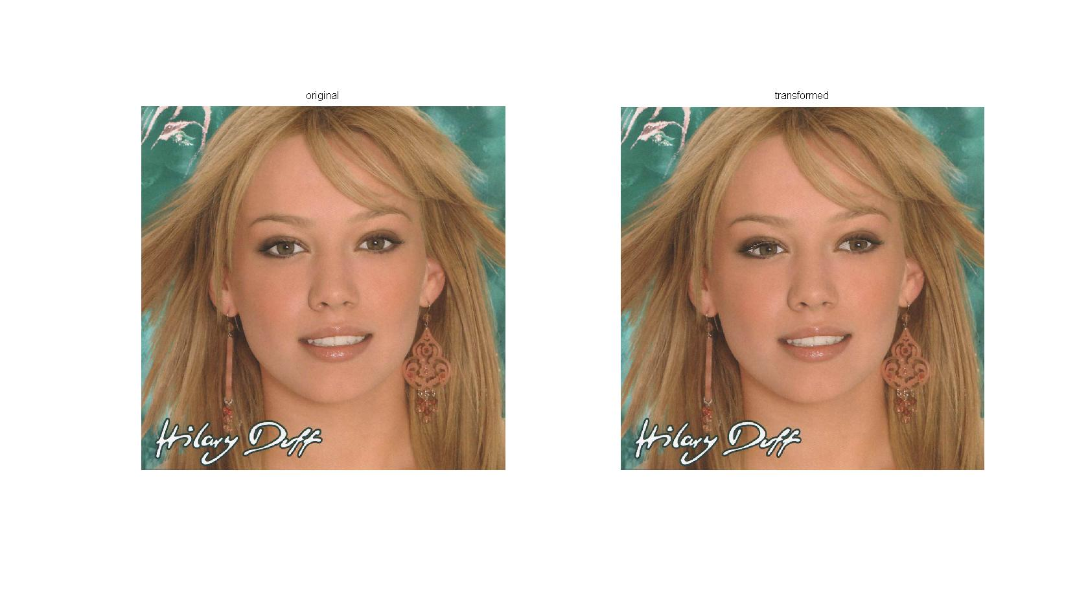
Output results
We then paste the transformed eye images back to the original image
After
After
Before

Slide 24
Future Work
Correction angle computation
Better Segmentation of eyelids
Better transformation using 3-d eyeball model

