Slide 1
Face Detection system, CV Lab
Implementing Viola & Jones
Heilper & Silnitsky, March 2009

Slide 2
Participants
Natan Silnitsky 039427687
Daniel Heilper 040910796

Slide 3
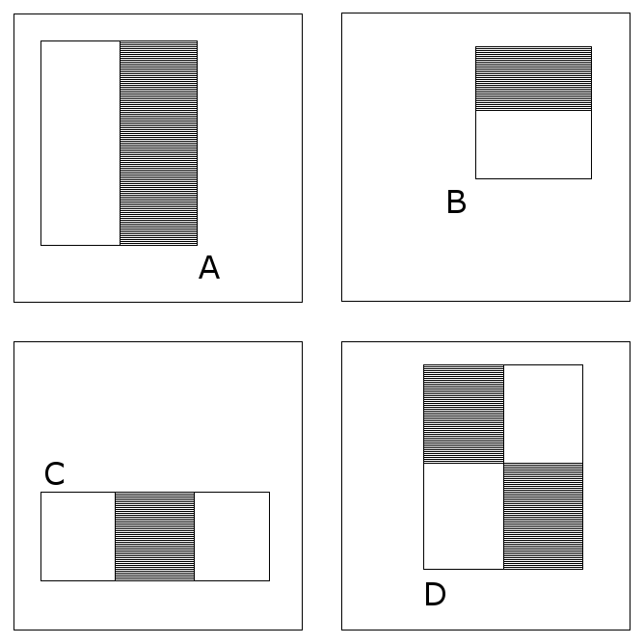
Robust Real-time Object Detection
Features:
Sum of pixels in dark rectangles minus
Sum of pixels in white rectangles
Scaled and shifted
across sub-window
Problem – a huge set of
features

Slide 4
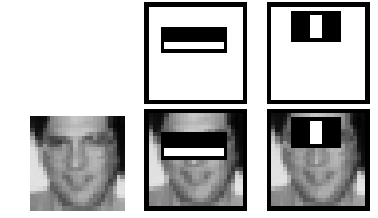
Robust Real-time Object Detection
Selected Features

Slide 5
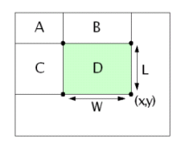
Robust Real-time Object Detection
Integral Image
Efficient Computation of features

Slide 6
Robust Real-time Object Detection
AdaBoost
Boosting weak classifiers (i.e. features) to make 1 strong classifer.
strong classifer = Weighted Combination of weak classifiers
In every iteration the weights of the misclassified examples increase
Problem – Creating a classifier out of a feature.
What threshold to take?

Slide 7
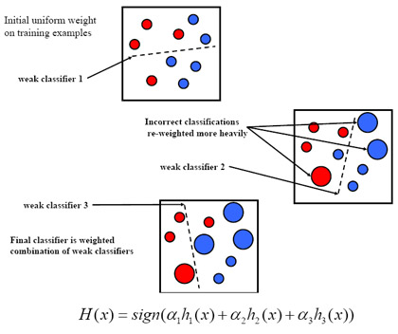
Robust Real-time Object Detection
AdaBoost
Problem –
Threshold

Slide 8
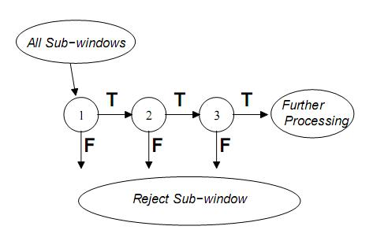
Robust Real-time Object Detection
Cascade
Every (strong, boosted) Classifier only deals with blocks not discarded by previous classifier
Stop when achieved
Desired detection rate
Problem – Sparse Vector Maintenance

Slide 9

Approach to solving the problem

Slide 10
Use of Matlab
Vector & matrix operations are basic operation in Matlab.
Matlab makes redundant the need for memory management (allocation, deallocation).
it has very good I/O capabilities vis-à-vis Images.
the Matlab environment is optimized for vector & matrix debugging (easy access to complex structures

Slide 11
Use of Matlab (2)
Matlab is an interpreted language, and is inherently slow.
In view of this we decided to migrate time consuming parts of the code to c, if running time turned out to be slow.
Any high time complexity task will inherently be slow both in Matlab & native languages, therefore we focused more on reducing algorithmic time complexity than lower complexity constants.

Slide 12
Order of Implementation
we decided to implement the Adaboost algorithm using the bottom-up approach, to “feel” it better.
We decided on a top-down approach for the cascade implementation, as we felt we understood the algorithm well in advance.

Slide 13
Finding Feature threshold –
Full Search
Sort the values array.
Create 2 additional arrays, positive and negative.
Scan the retrieved values array. Fill the arrays by Accumulating units of 1 multiplied by the value’s weights in the following fashion:
For a positive value,
in the positive array, add the previous element’s content and add 1 multiplied by the value’s weight.
in the negative array just add the previous element’s content
For a negative value,
in the negative array, add the previous element’s content and add 1 multiplied by the value’s weight.
in the positive array just add the previous element’s content

Slide 14
Finding Feature threshold –
Full Search (2)
The value index with the best threshold will be the index where the absolute difference between the arrays content is greatest.
Polarity is the side of the threshold which has more positive examples,
meaning polarity is positive if more positive examples occur on the left side of the threshold, and polarity is negative if there is less on that side.
Quick feature error calculation is achieved by logical vector operation (xor) between the classified vector and the sorted label vector (the “Y”).

Slide 15
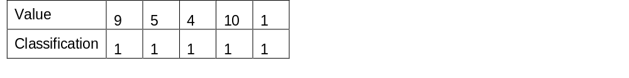
Finding Feature threshold – Example
Pos examples feature application values

Slide 16
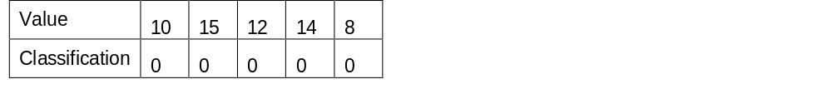
Neg examples feature application values

Slide 17
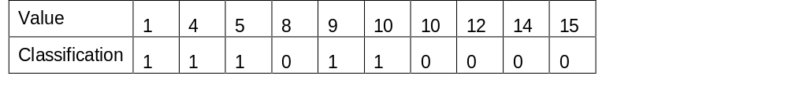
Sorted examples feature application values

Slide 18
Positive examples accumulation array

Slide 19
Negative examples accumulation array

Slide 20
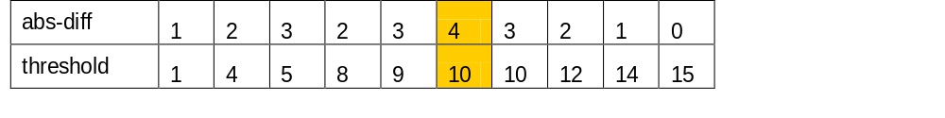
Absolute difference between the arrays

Slide 21
The chosen threshold is 10, polarity is positive (because more positive examples are on the left of the threshold)

Slide 22
Reducing Time complexity
building data structures such that in Matlab it was is possible to compute operation on them in 1 function call and avoid loops.
The overhead is an initial construction of these data structures.
Data Structure Examples follows:

Slide 23
“Boxing” the examples
Training Examples are 19X19 frames.
During Training, every features is applied on all integral images of the training examples.
In order to perform fast Integral Image computation, and to perform fast application of features on the examples, we decide to put all of the example frames in a 3D box.
We use the 3D box in Testing as well, putting all of the sliding windows of the test image in it.

Slide 24
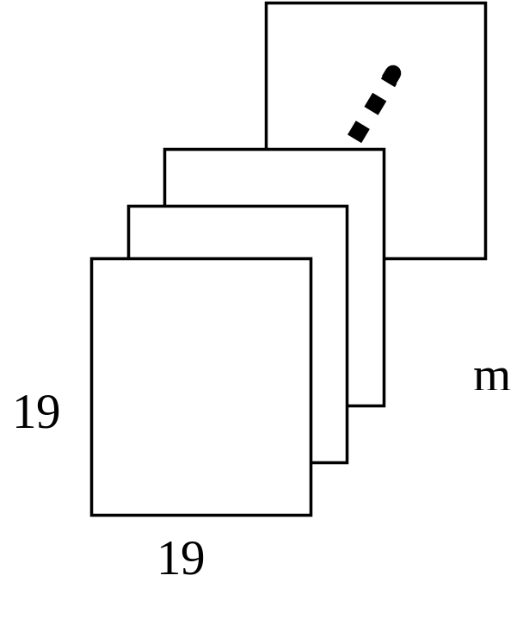
“Boxing” the examples (2)
A 3D box with m training examples in it

Slide 25
“Boxing” the examples (3)
Once all of the examples or sliding windows are in the box, simultaneous computation of each frame's Integral Image is as easy as 2 lines of code in matlab (no loops involved):
box = cumsum(box,1);
box = cumsum(box,2);
computing a feature's application simultaneously on all examples or sliding windows becomes much faster, (colon operation in Matlab).
Padding the image examples with zeros (as the 1st row & 1st column)

Slide 26
Calculating Feature application values only Once
In training, Feature application values are computed before we start the learning process for all training examples simultaneously.
The result is a matrix with m rows representing m features & n columns representing n examples. Each matrix element is a feature applied on a training example.
Because of this data structure we only compute the feature application for each training example once during the entire training process (adaboost + cascade).

Slide 27
Calculating Feature application values only Once (2)
All iterations of the Adaboost process use the same feature application values, including threshold determination & misclassification calculation.
Even when cascade training process discards parts of the negative examples that are definitely not considered as a face, there is no need for any new calculations. Instead of discarding the irrelevant negative examples, the corresponding irrelevant feature application values are discarded.

Slide 28
Simultaneous Misclassification Calculation & Examples Weights Update
Updating Weights Adaboost stage is performed as such that misclassification calculation of the example set & the weights updating of the example set are done at once.
Pseudo Code:
- sort examples values
- apply threshold
- xor with labels
- update weights for every misclassified example

Slide 29
Reduce correctness testing time
When we finished writing the code, we decided we will not immediately jump to check if we got nice results on test images, but write unit tests instead, i.e. methodically test for bugs and correctness of each of the functions we wrote.
In order for these unit tests to be independent of each other (so there will be no "running error") we simulated new inputs for each of the functions.
Only after we had finished this, we started testing to see if our implementation gives meaningful results.
The thought behind doing extensive unit testing was to significantly reduce functional testing time and to focus our minds first on simple bugs and in later stage on more complex errors in implementation.

Slide 30
Results

Slide 31
Our final detector is a cascade of 9 classifiers with a total of 206 features.
The training set was comprised of Faces & Non-Faces examples of size 19X19.
The first 5 classifiers were trained on 2429 faces & 4548 non-faces from the CBCL face database using the cascade method (we set the detection rate to be 99% and the false positive rate to be 0.25%).

Slide 32
The next 3 classifiers were trained independently on 4500 Non-faces examples each, that were taken from the previous partial cascade resulting false alarms on random images from the web, which had no faces in them
(we set the detection rate to be 99.7% and the false positive rate to be 0.1%).

Slide 33
The final 9th classifier was trained in the same way as the previous three, only this time the non-faces examples were taken from the partial cascade comprising 8 classifiers resulting false alarms
(we again set the detection rate to be 99.7% and the false positive rate to be 0.1%).

Slide 34
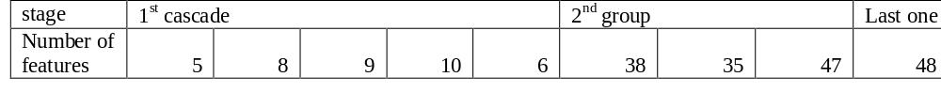
Detecting is done multiple scales up to a ceiling of 384X288. Images sized above this ceiling are downsized.
The final cascade:

Slide 35
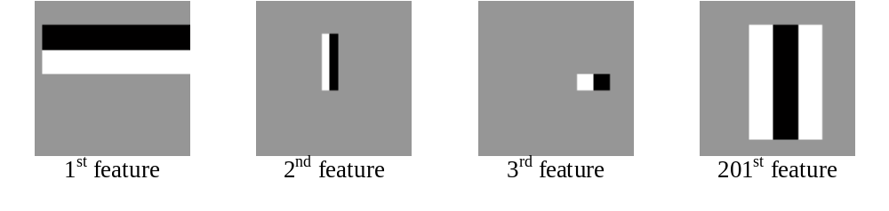

Slide 36
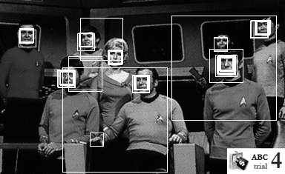

Slide 37
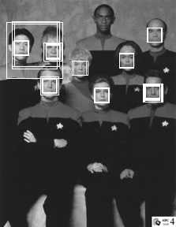

Slide 38
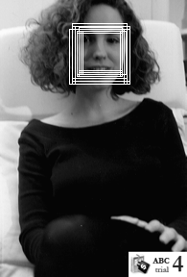

Slide 39
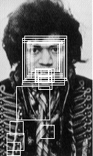

Slide 40
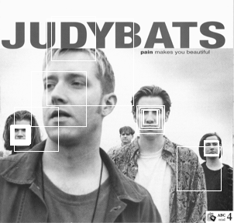

Slide 41
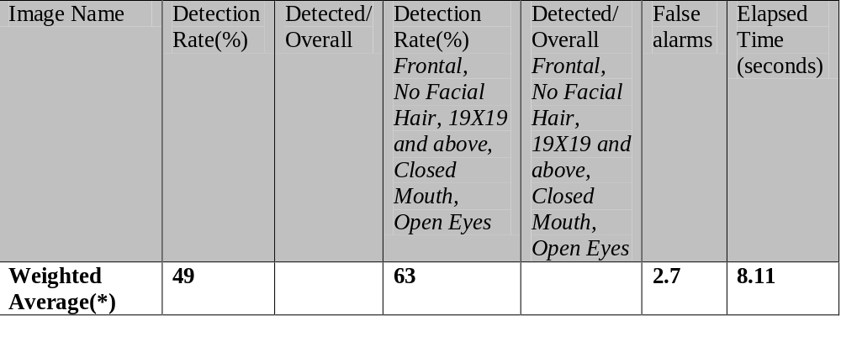

Slide 42
Analysis

Slide 43
Unnecessary recalculation (which we discarded)
After analyzing initial training results we’ve noticed superfluous recalculation of features in Adaboost.
Cascade calls Adaboost iteratively with the numOfFeatures argument increasing incrementally in order to achieve a lower false alarm rate.
In our original implementation, in every call to Adaboost, the process found the best features in the amount of numOfFeatures all over again, even though it calculated (numOfFeatures – 1) in the previous time it was called by cascade.
The reason for this inefficiency was our original bottom up approach (see “Order of Implementation”) which focused on Adaboost only, not realizing the strong coupling with cascade.

Slide 44
Overfitting
While experimenting with training parameters, we slowly raised detection rate and lowered false positive rate.
After some point (99.9% detection rate & 0.01% false positive rate) less faces from the CMU dataset were detected, while not improving false alarm rate.

Slide 45
Using partial cascade to find false alarm examples
We settled on 99% detection rate and 0.25% false positive rate.
After further examination of the paper we decided to stop the current cascade and start new ones which use false alarms from the old ones. False alarm rate improved significantly

Slide 46
Rounding of Scaling Operation
After 3 rounds of cascade and another round of negative set collecting from false alarms,
And another cascade the false alarm rate was sufficient for the base scale of our detector (19X19), but bad for higher scales.
We came up with the idea the problem lies with the way we scale up the features, particularly with rounding of small rectangle features (rounding effects small number much more proportionally than for larger numbers). As a result rectangles were not congruent.
We solved this problem by scaling up the size of rectangle sides instead of scaling up integral image indices.
For example, the following feature’s rectangles will not be congruent after scaling up:

Slide 47
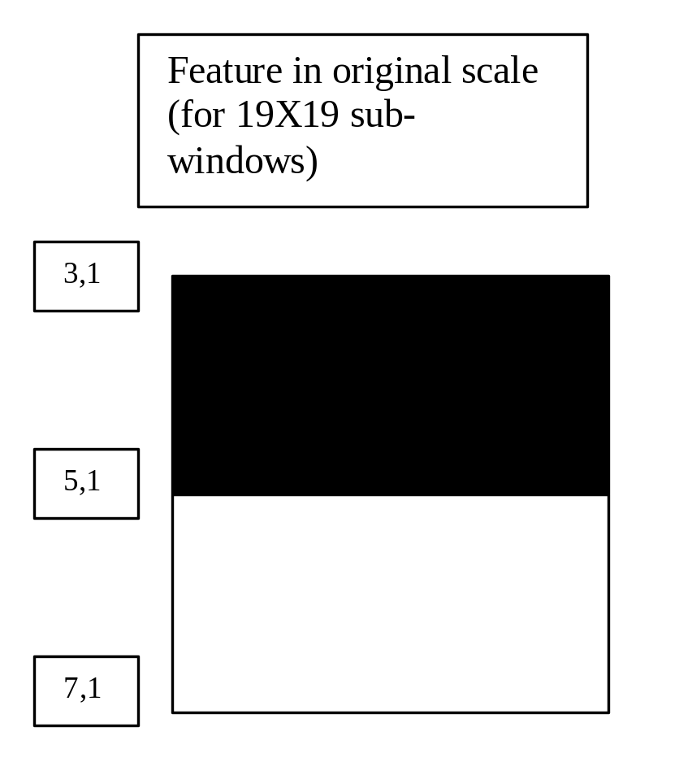
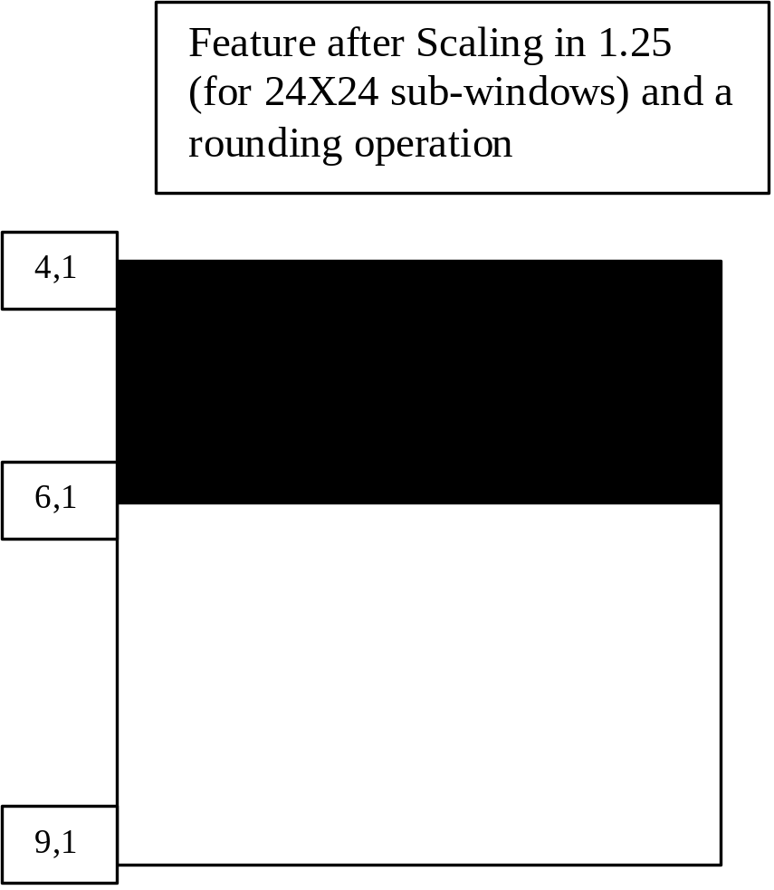

Slide 48
Memory limitations
Using a 32-bit machine (and Matlab), We faced serious memory limitation for vector operations on large arrays. In Order to avoid Matlab Memory limitations and still maintain vectorized implementation, we created Chunks of the set of Feature Values of all Available Data
In Training, FeatureValues data (All possible Feature and their Values for all Training Samples). was stored in chunks files.
~3000 faces
~10000-15000 Non Faces in each training phase
53130 features (all possible..)
A 64bit Matlab version of + 10 GB of memory, could make “chunking” unnecessary.
In Testing, we did not store the chunks in files, but processed each featureValuesXSubWin chunk, on at a time (about 200-500 MB per chunk), as we try the cascade fully on each SubWin.
Testing performance remained good as before.

Slide 49
Downsizing
Downsizing option is enabled for enhanced performance, default for downsizing is 384X288.

Slide 50
Post Processing
We have implemented simple overlapping detection merging, of locating and eliminating isolated detections. Does good jobs on well detected images, but can delete true singular detection when the detection subwindows are singular, which can occur for noisy image, big StepSize(deltaX, deltaY),etc.. .

Slide 51
Further Work:

Slide 52
Merging overlapping detections
In order to determine more precisely detection rate and false positive rate, it is crucial to be able to merge overlapping detections of multiple scales into a single detection window. At this stage, it seems as a non trivial task.

Slide 53
Reducing further discretization errors caused by scaling detectors
For a single feature, we adjusted the scaling such that they will still preserve a Haar-like shape for each scaling. However, there are at least two more possible fine tuning adjustments:
Compensating the deficiency of geometrical similarity to the original rectangles that builds the feature in its basic size.
Compensating the feature change of relative origin within a scaled window.
The above discretization errors have greater weight in the first few scaling stages, while as the scaling is bigger, it becomes more negligible. Future work on examinations and testing of appropriate linear interpolation methods could be considered.

Slide 54
Easy vector migration to SSE & openCV/IPP
During the Matlab implementation phase, we worked on the task of migration to C++ (later we dimmed the migration unnecessary), including enabling work with mex & with visual studio compiler.
As for mex-mechanism, we managed to transfer all types of data that we defined and used in our Matlab implementation.
As for the C++ coding, further work can be done on how to use OpenCV and IPP data built in structures and API for “Boxing” operations, in order to preserve our code structure.

