Slide 1

Note: The data and information in this document is reflective of a hypothetical situation and client. This document is to be used for KPMG Virtual Internship purposes only.
Sprocket Central Pty Ltd
Data analytics approach
[Division Name] - [Engagement Manager], [Senior Consultant], [Junior Consultant]

Slide 2
Note: The data and information in this document is reflective of a hypothetical situation and client. This document is to be used for KPMG Virtual Internship purposes only.
Agenda
Introduction
Data Exploration
Model Development
Interpretation

Slide 3
Note: The data and information in this document is reflective of a hypothetical situation and client. This document is to be used for KPMG Virtual Internship purposes only.
Introduction
Place headline insight or information here. This should be the most important point for this slide.
1000 potential customers do not have prior transaction history
Generate useful customer insights
Optimize resource allocation for targeted marketing.
Focus on high value customers
Generate useful customer insights
Optimize resource allocation for targeted marketing.
Focus on high value customers

Slide 4
Data Exploration
Data Cleaning and Quality Assessment
Data Quality Assessment Standards:
Accuracy: Correct Values
Completeness: Data Fields with Values
Consistency: Value Free From Contradiction
Currency: Values Up to Date
Relevancy: Items with Value Meta-data
Validity: Data Containing Allowable Values
Uniqueness: Duplicated Records

Slide 5
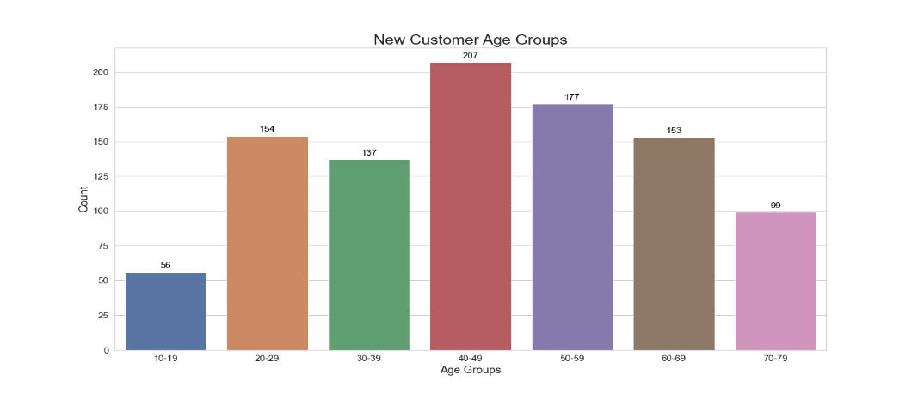
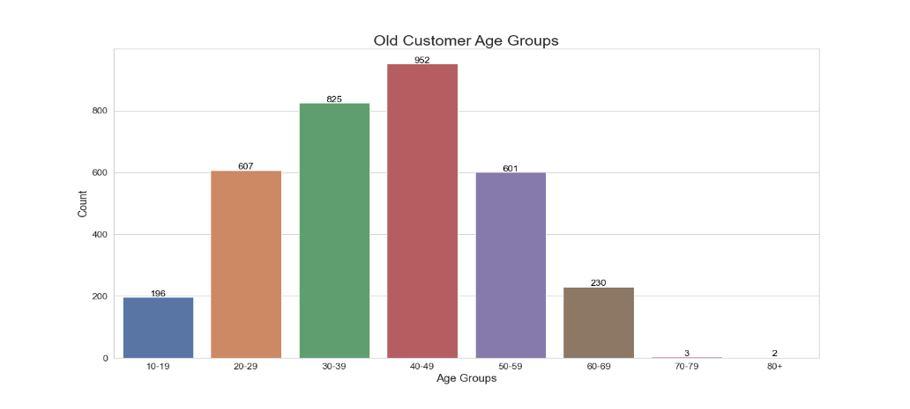
Data Exploration
Customer Age Distributions
Most customers age around 40 to 49 years old
The least popular groups are 10 to 19 and 70 years old and above
Popular shoppers tend to be between 20 to 69 years old

Slide 6
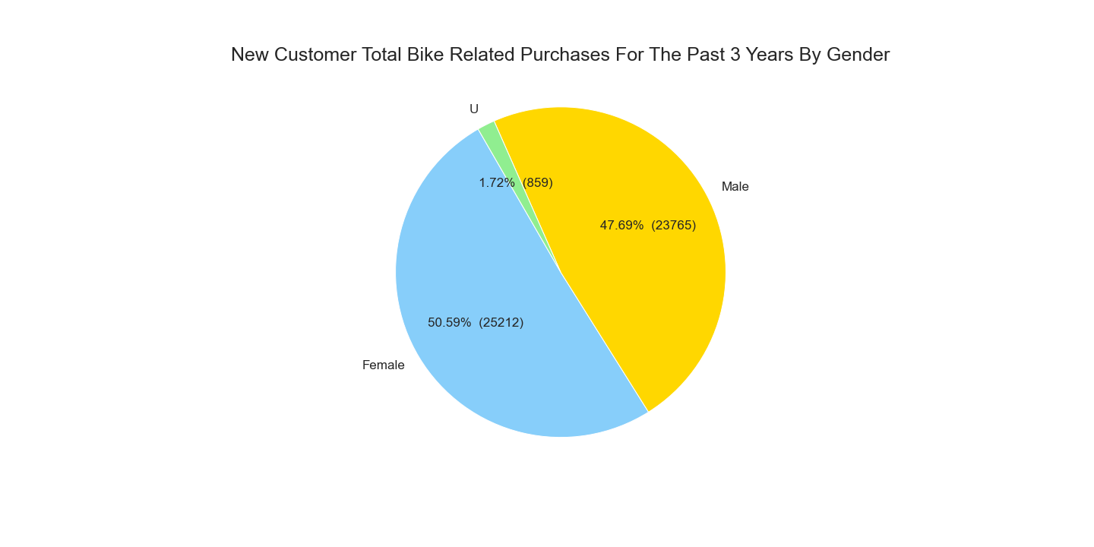
Data Exploration
Purchases in the Past 3 Years By Gender
Customer gender demographic evenly spread between male and females
Females make up majority of the bike purchases in the past three years

Slide 7
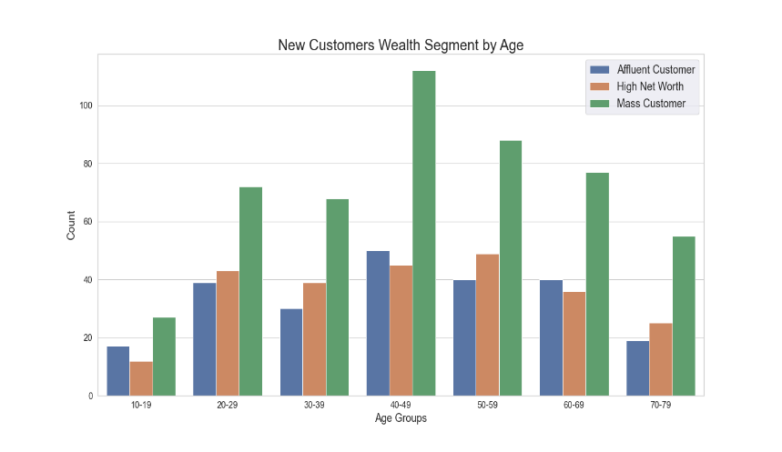
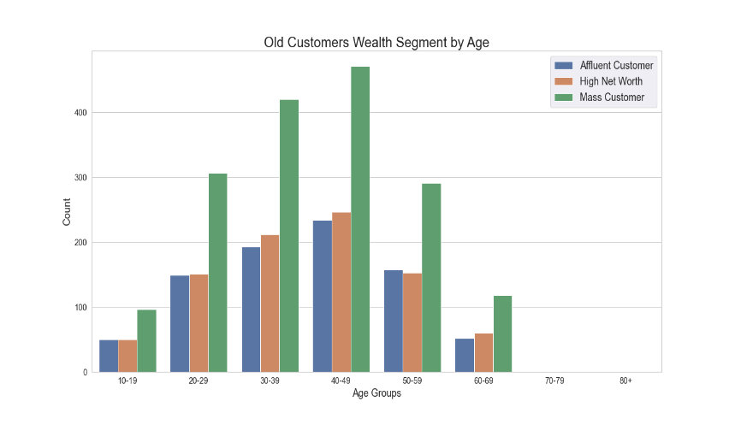
Data Exploration
Wealth Segmentation By Age
Most customers are labelled as Mass Customer
More customers labelled as High Net Worth than Affluent by a small margin

Slide 8
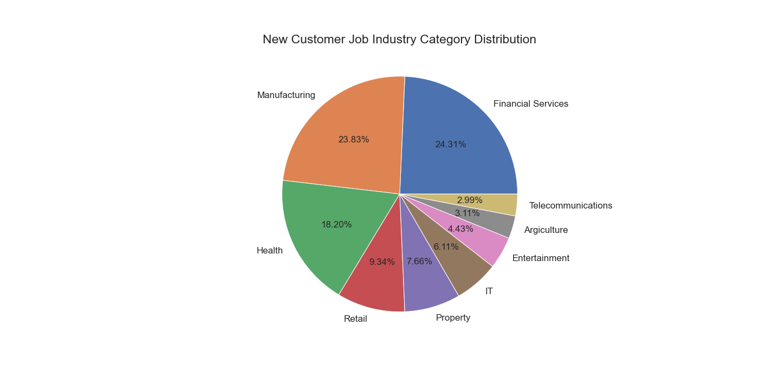
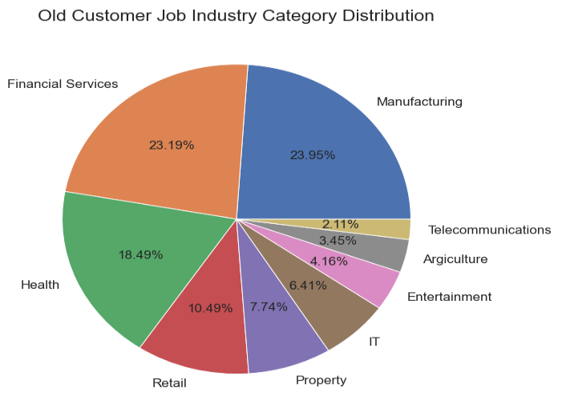
Data Exploration
Job Industry Distribution
Top three job industries that customers work in are financial services, manufacturing, and health respectively
Least popular job industries are telecommunications, agriculture, entertainment, and IT

Slide 9
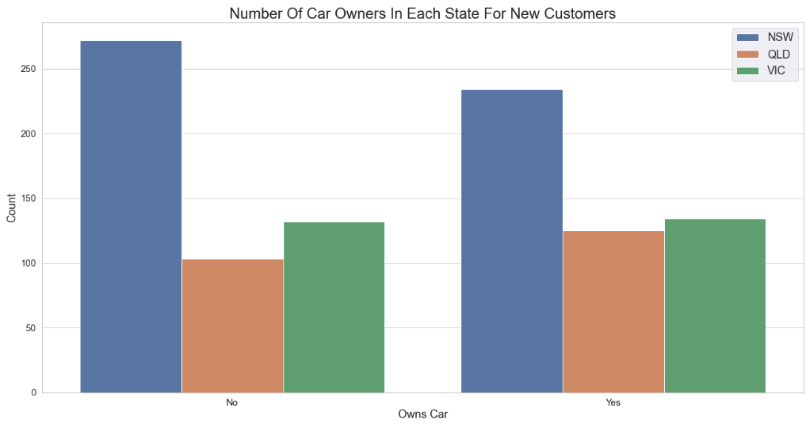
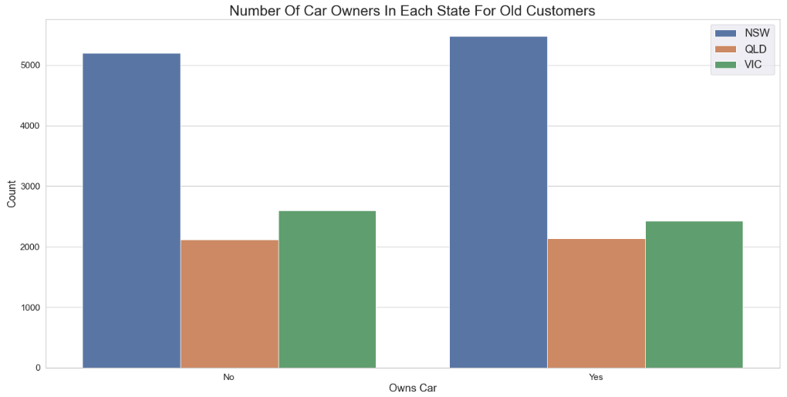
Data Exploration
Car Ownership By State
Most customers from New South Wales (NSW) don’t own a vehicle
Could allocate more resources on the NSW region

Slide 10
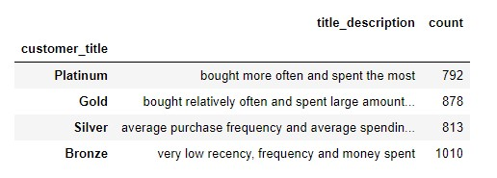
Model Development
Recency, Frequency, Monetary (RFM) Analysis
RFM measures customers’ behavior
Frequency and Monetary affects customer lifetime value
Recency affects customer retention
Classified into four groups by their RFM score from highest to lowest respectively: Platinum, Gold, Silver, and Bronze

Slide 11
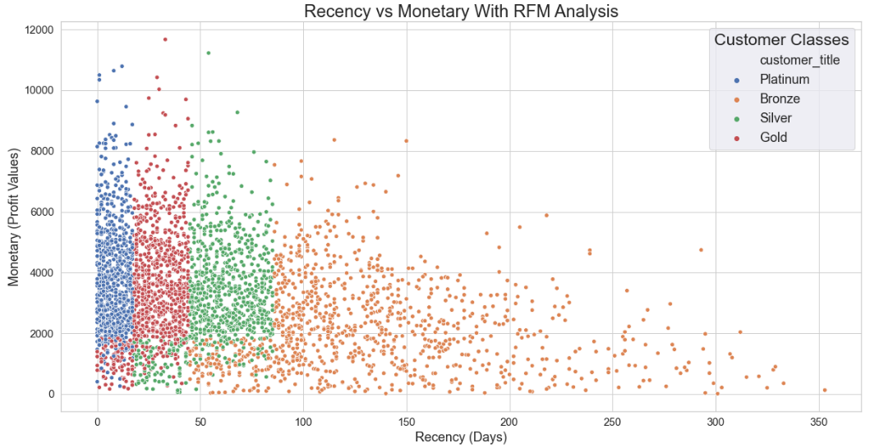
Interpretation
Recency vs Monetary
Platinum customers bought more recently and spent the most money
Negative correlation between recency and monetary
The less recent the last purchase is, the less profitable the customer

Slide 12
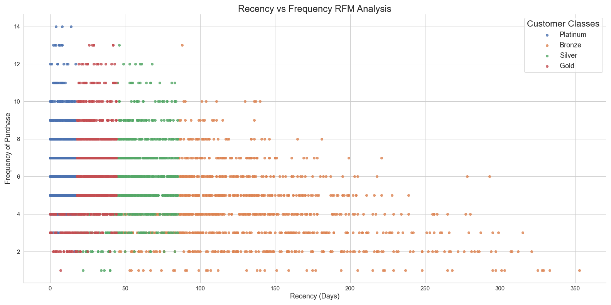
Interpretation
Recency vs Frequency
Platinum customers bought more recently and frequently than other groups
Negative correlation between recency and frequency
The less recent the last purchase is, the less frequent the customer buys

Slide 13
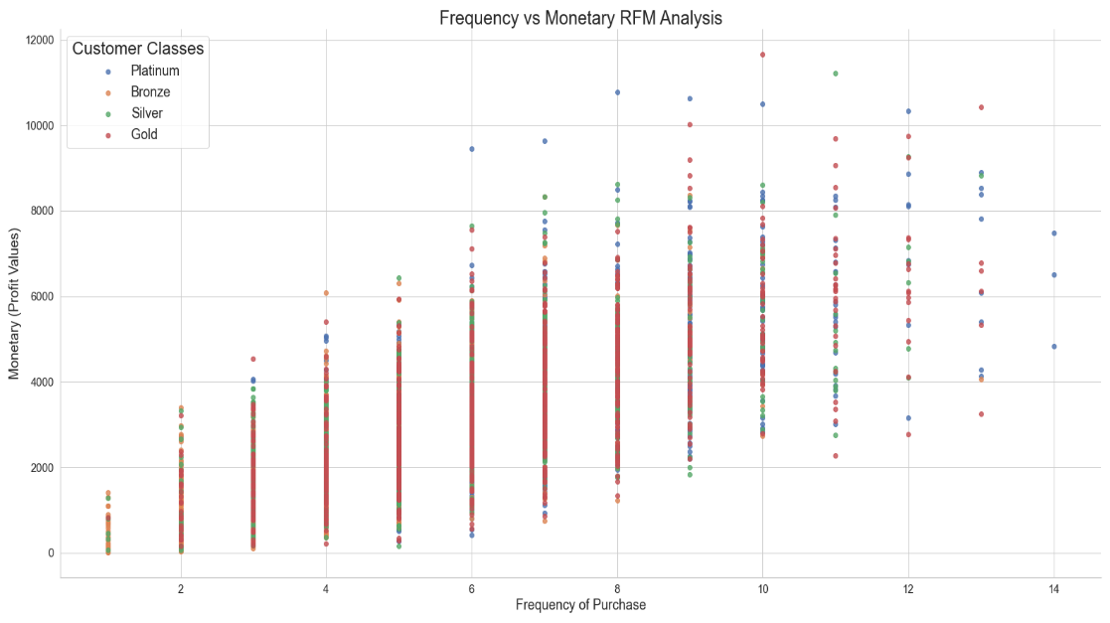
Interpretation
Frequency vs Monetary
Positive correlation between recency and monetary
Business should expect higher monetary gains, the more frequently the customer buys

Slide 14
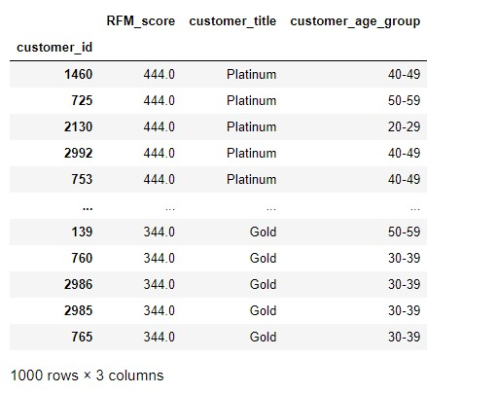
Interpretation
Target Market
Sprocket should filter out the customers based on RFM score as they tend to be the most valuable customers for the business
Most of the customers work in financial services, manufacturing, and health sectors
Most of the customers are aged between 40-49 years old
Target New South Wales (NSW) as most customers do not own a vehicle and will more likely to purchase bikes

Slide 15
Appendix

