Slide 1
Intro to Programming Nvidia GPUs with CUDA
Outline
Intro -- history and background
First accelerator model
First CUDA/GPU program
More on GPU Global Memory
Reality Check: Compile, Link, Run
Extended example: matrix multiply (what else!)
Notes:
One of the major themes of this course is the interaction between hardware and software. We build hardware to run software, we analyze software/hardware interactions to improve hardware, we analyze software to best take advantage of hardware. It’s the last of these that we will examine now.
Of course once we’re done, then we can figure out how to build hw that improves this sw, but now we bring it to a higher level – we can parameterize the software so that it runs best on a wide variety of hardware (after all, even thought the sw implementation can change, the underlying application is probably fixed). Then we can build hardware that optimizes the parameterized code!
No, we’re not in Kansas anymore: this is obviously much more difficult than just looking at a bunch of benchmarks. However, before we get carried away, technological/programming constraints also constrain what we can do with the hardware, as we shall see.

Slide 2
Review Parallel Processing
Performance measures
FLOPs, Memory BW
Superscalar & Pipelining
SIMD and Vector Processing
Vector lanes, SIMD PEs
Multithreading
Memory hierarchy
Spatial Locality
Temporal Locality
Arithmetic Intensity

Slide 3
NVIDIA Vocabulary
CPU NVIDIA/CUDA
Thread Block
Vector Lane Thread
Function Kernel
Coprocessor Device
Main Memory Global Memory
Scratch Pad Cache Shared Memory

Slide 4



GPU Themes
Q: When have you created an effective GPU program?
A: When the output looks like an image
A: When the pixels are computed independently
Q: What do GPU programs look like?
A: Often one or two funnels
simple command: “Draw dodecahedron!”
lots of computation
lots of computation
lots of computation
…
1 pixel
1 pixel
1 pixel
Complex output that affects many pixels

Slide 5
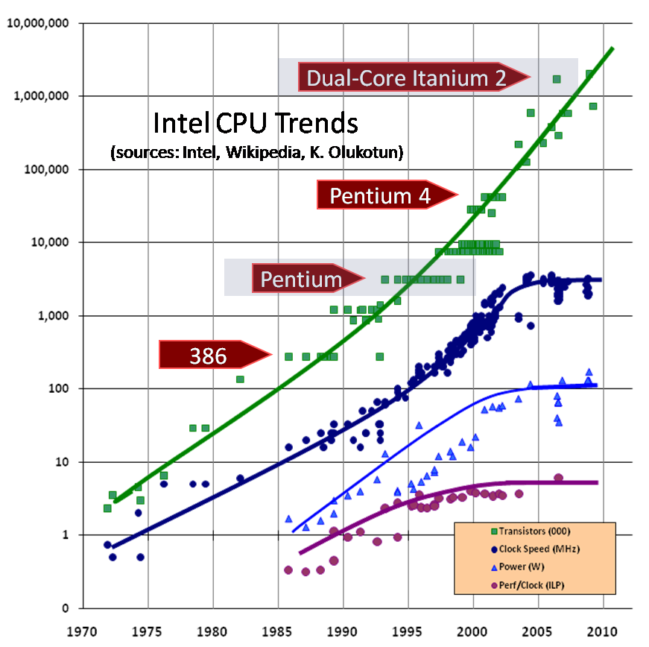
Rise of the Manycore
Paradigm Shift
Single core conventional CPUs to Multi-cores to Many-cores
GPU
Highly Parallel, Multithreaded, Manycore Processor
Notes:
<number>

Slide 6
GPU vs CPU (vs. FPGA)
Perform. Metric | Intel Xeon 7350 quad core | Nvidia Tesla C1060 | Xilinx V5 SX240T
Process | 65nm | 55nm | 65nm
Peak 32-bit Ops/s | 94 G | 500 G | 5200 G
Peak SP FP | 94 G | 933 G | 204 G
External Mem. BW | 8.5 GB/s | 102 GB/s | 40 GB/s
Internal Mem. BW | 188 GB/s | 1.62 TB/s | 3.7 TB/s
Power | 130 W | 188 W | 30 W
 | CPU | GPU | FPGA
Language | C/C++ | CUDA | OpenCL
Performance | 400 Gflops | 6 Tflops -> 10T | 100G -> 1T -> 10T
Efficiency | 5 Gflops/W | 20 Gflops/W | 40-50 G/W -> 80-100 Gflops/W
Scale | 2M+ and growing | 1s -> 10s -> 100s | 10Ks ->100Ks ->1M+
DRAM BW | 85 GB/s | 2x240 GB/s | 20GB/s -> 200GB/s
Connectivity | 153.6 Gb/s | 1.6 Tb/s | 51 Tb/s
Notes:
<number>

Slide 7
Top 500 List -- 11/2016
Rank | Site | System | Cores | Rmax (TFlop/s) | Rpeak (TFlop/s) | Power (kW)
1 | National Supercomputing Center in Wuxi China | Sunway TaihuLight - Sunway MPP, Sunway SW26010 260C 1.45GHz, Sunway NRCPC | 10,649,600 | 93,014.6 | 125,435.9 | 15,371
2 | National Super Computer Center in Guangzhou China | Tianhe-2 (MilkyWay-2) - TH-IVB-FEP Cluster, Intel Xeon E5-2692 12C 2.200GHz, TH Express-2, Intel Xeon Phi 31S1P NUDT | 3,120,000 | 33,862.7 | 54,902.4 | 17,808
3 | DOE/SC/Oak Ridge National Laboratory United States | Titan - Cray XK7 , Opteron 6274 16C 2.200GHz, Cray Gemini interconnect, NVIDIA K20x Cray Inc. | 560,640 | 17,590.0 | 27,112.5 | 8,209
5 | DOE/SC/LBNL/NERSC United States | Cori - Cray XC40, Intel Xeon Phi 7250 68C 1.4GHz, Aries interconnect Cray Inc. | 622,336 | 14,014.7 | 27,880.7 | 3,939
6 | Joint Center for Advanced High Performance Computing Japan | Oakforest-PACS - PRIMERGY CX1640 M1, Intel Xeon Phi 7250 68C 1.4GHz, Intel Omni-Path Fujitsu | 556,104 | 13,554.6 | 24,913.5 | 2,719

Slide 8
Where do you get your FLOPs?
More transistors devoted to data processing
Virtually no cache!
CPUs devote 50% to 90% of total transistors to on-chip cache!
Specialized for compute-intensive, parallel computations
Very little flow control logic
CPUs are general purpose
Notes:
<number>

Slide 9
2. Accelerator Model
Outline
A typical PC and where the GPU fits
Simplest GPU model → it has its own memory and computing structures
Simplest programming model → Host code, GPU code, interaction calls

Slide 10
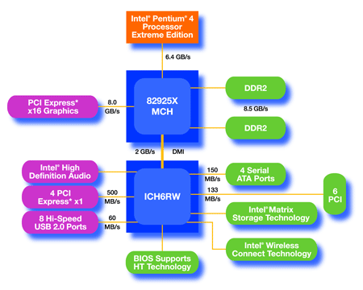
Physical Reality Behind CUDA
CPU
(host)
GPU w/
local DRAM
(device)
© David Kirk/NVIDIA and Wen-mei W. Hwu
Notes:
<number>

Slide 11
A Device Example
GPU has its own memory:
global interacts with host CPU, although not directly visible to CPU
“parallel data cache” comes in two flavors: (1) hardware managed cache and (2) software mangage “shared memory”
GPU has its own processing (of course!):
A large number (100s – 1000s) of Stream Processors (SPs) partitioned across Streaming Multiprocessors (SMs or SMXs). 8 SPs/SM on Tesla, 16 SPs/SM on Fermi, 192 SPs/SMX on Kepler.
# of SMs varies with performance grade.
Each SP is a “thread” processor that executes some number of copies of a thread in lock-step (SIMD-style) with all the other SPs on the chip. Note – these are not the “threads” you are used to.
Host
Input Assembler
Thread Execution Manager
Parallel Data Cache
Parallel Data Cache
Parallel Data Cache
Parallel Data Cache
Parallel Data Cache
Parallel Data Cache
Parallel Data Cache
Parallel Data Cache
Texture
Texture
Texture
Texture
Texture
Texture
Texture
Texture
Texture
Load/store
Load/store
Load/store
Load/store
Load/store
Load/store
Global Memory
Notes:
<number>

Slide 12

NVIDIA GPU Tesla&Fermi Architecture
Streaming Processor (SP)
Streaming Multiprocessor (SM)
Device Memory
Tesla 1060 Architecture
30 SMs
4 GB Device memory
240 Processor cores
1.3 GHz Clock
8 SPs per SM
Tesla 2070 (Fermi) Architecture
14 SMs
6 GB Device memory
448 Processor cores
1.15 GHz Clock
32 SPs (CUDA cores) per SM
© David Kirk/NVIDIA and Wen-mei W. Hwu
Notes:
<number>

Slide 13
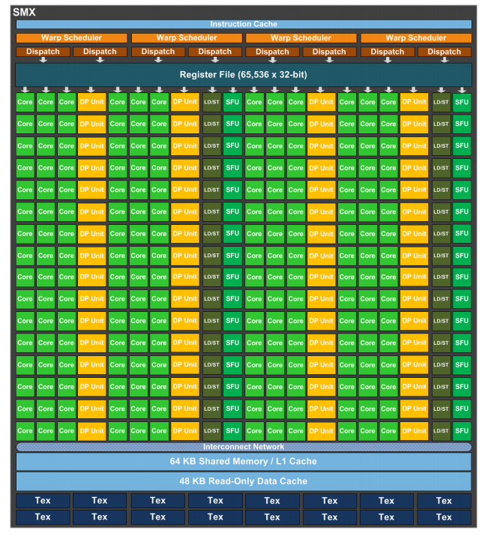
NVIDIA GPU Kepler Architecture
Modern Architecture
192 SPs per SMX!
14 SMXs
2688 SPs total
but
.732 GHz
More cores
Slower clock rate
Architectures are rapidly iterating!

Slide 14
CUDA Devices and Threads
A compute device
Is a coprocessor to the CPU or host
Has its own DRAM (device memory)‏
Runs many threads in parallel
Is typically a GPU but can also be another type of parallel processing device
Data-parallel portions of an application are expressed as device kernels which run on many threads
Differences between GPU and CPU threads
GPU threads are really vector lanes not control threads
Very little creation overhead
GPU needs 1000s of threads for full efficiency
Multi-core CPU needs only a few
© David Kirk/NVIDIA and Wen-mei W. Hwu
Notes:
<number>

Slide 15
CUDA Program Flow
Serial C code
executes on host
Parallel “kernels”
run on GPU
Compiled using nvcc
Kernel launches can be asynchronous
Overlapped execution
launches are expensive ~usecs
Notes:
<number>

Slide 16
Arrays of Parallel Threads
A CUDA kernel is executed by an array of threads
All threads run the same code (similar to SIMD)
Each thread has an ID that it uses to compute memory addresses and make control decisions
threadID
0
1
2
3
4
5
6
7
…
float x = input[threadID];
float y = func(x);
output[threadID] = y;
…
© David Kirk/NVIDIA and Wen-mei W. Hwu
Notes:
<number>

Slide 17
Sketch of CUDA Programming Model (more later)
Entire GPU executes a single function (kernel) at a time.
Fermi and Kepler allow multiple different kernels concurrently via streams
Copies of kernels (blocks) are generated by the high-level thread manager/scheduler and distributed to the SMs.
At the SM, blocks are executed SIMD style.
Basic programming model → Two levels of parallelism:
Level 1: blocks are the equivalent of multiprocessor threads (not CUDA threads).
Level 2: blocks are dataparallel/vector. That is, when blocks execute on SMs, they do so in dataparallel fashion.
CUDA threads in a block collectively form single vector instructions.

Slide 18
3. A First GPU/CUDA Program
Open the GPU
necessary because the GPU looks like an I/O device to the host system. Must allocate resource, initialize, set up drivers, etc.
Allocate memory on the GPU
necessary to tell the GPU where to put data on a transfer
Transfer data to the GPU
from host to allocated GPU memory
[execute GPU code]
Retrieve data from the GPU
from GPU allocated GPU memory to the host
Close the GPU
free the resource

Slide 19
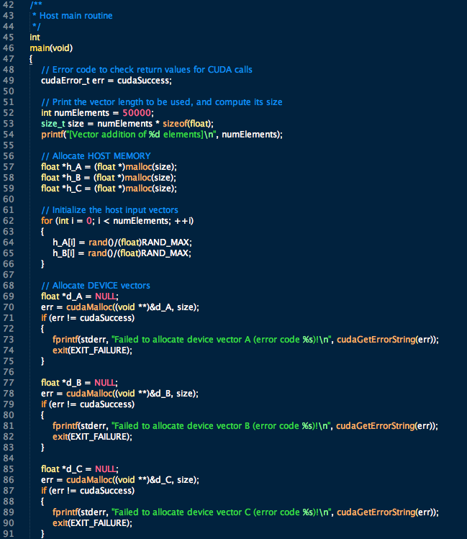

Slide 20
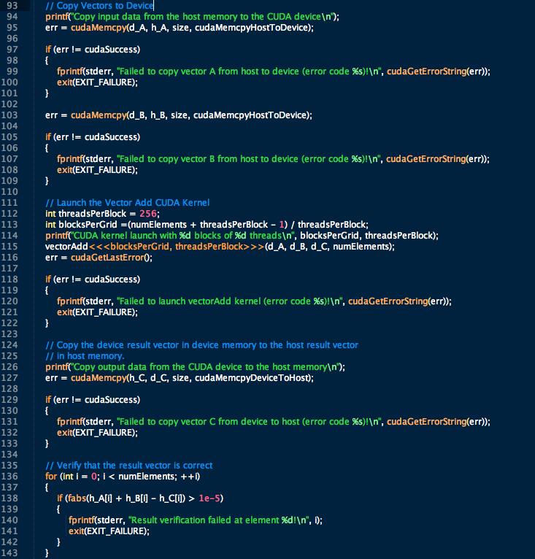

Slide 21
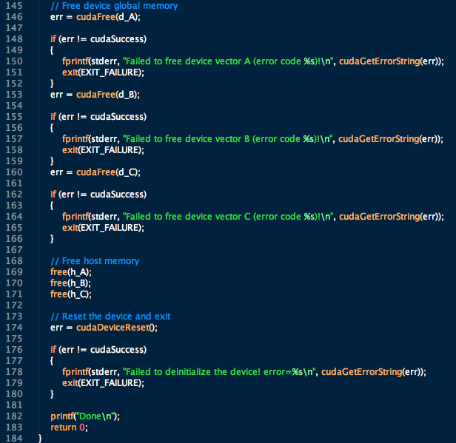

Slide 22
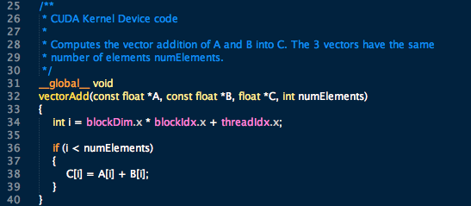
Now, the GPU part

Slide 23
4. More on Global Memory
Global memory
Primary means of communicating R/W data between host and device
Contents visible to all threads
Long latency access
We will focus on global memory for now
Also Shared Memory, which is on-chip and shared by threads in a block (critical)
and Constant and Texture memory (more advanced)
Grid
Block (0, 0)‏
Block (1, 0)‏
Shared Memory
Shared Memory
Registers
Registers
Registers
Registers
Thread (0, 0)‏
Thread (1, 0)‏
Thread (0, 0)‏
Thread (1, 0)‏
Host
Global Memory
© David Kirk/NVIDIA and Wen-mei W. Hwu
Notes:
<number>

Slide 24
Memory Allocation and Data Transfer
cudaMalloc()
Allocates object in the device Global Memory
Requires two parameters
Address of a pointer to the allocated object
Size of allocated object
cudaFree()
Frees object from device Global Memory
Pointer to freed object
cudaMemcpy()‏
Requires four parameters
Pointer to destination
Pointer to source
Number of bytes copied
Type of transfer: Host to Host, Host to Device, Device to Host, Device to Device
Grid
Block (0, 0)‏
Block (1, 0)‏
Shared Memory
Shared Memory
Registers
Registers
Registers
Registers
Thread (0, 0)‏
Thread (1, 0)‏
Thread (0, 0)‏
Thread (1, 0)‏
Host
Global
Memory
© David Kirk/NVIDIA and Wen-mei W. Hwu
Notes:
<number>

Slide 25
Memory Allocation and Data Transfer‏
Code example:
Allocate a 64 x 64 single precision float array
Attach the allocated storage to Md
“d” is often used to indicate a device data structure
Transfer a 64 x 64 single precision float array
M is in host memory and Md is in device memory
cudaMemcpyHostToDevice and cudaMemcpyDeviceToHost are symbolic constants
TILE_WIDTH = 64;
Float* Md;
int size = TILE_WIDTH * TILE_WIDTH * sizeof(float);
cudaMalloc((void**)&Md, size);
cudaFree(Md);
cudaMemcpy(Md, M, size, cudaMemcpyHostToDevice);
cudaMemcpy(M, Md, size, cudaMemcpyDeviceToHost);
© David Kirk/NVIDIA and Wen-mei W. Hwu
Notes:
<number>

Slide 26
5. Reality Check: compile, link, run
There are multiple parts to CUDA programs:
C code to run on host
Function calls to interact with the device
GPU code for thread execution
GPU directives, intrinsics, etc., that are either not executed directly, or whose execution is hidden
Kernel launch
Getting all this to work requires
A generic C compiler
A CUDA compiler
Link libraries, both static and dynamic

Slide 27
Lab 0
Goal: Learn to compile, execute, and debug CUDA programs.
Input: cuda_test.cu
Task: Follow tutorials

Slide 28
Arrays of Parallel Threads
A CUDA kernel is executed by an array of threads
All threads run the same code (SIMT)‏
Each thread has an ID that it uses to compute memory addresses and make control decisions
threadID
0
1
2
3
4
5
6
7
…
float x = input[threadID];
float y = func(x);
output[threadID] = y;
…
// Kernel definition - specified with __global__ syntax
__global__ void VecAdd (float* A, float* B, float* C)
{
int i = threadIdx.x; // get unique (1D) thread ID
C[i] = A[i] + B[i]; // do my bit of work
}
// Single block, but scales immediately to multiple blocks
int main()
{
…
// Kernel invocation
VecAdd<<<1,N>>>(A,B,C); // # of CUDA threads is specified
// with the <<<…>>> syntax
© David Kirk/NVIDIA and Wen-mei W. Hwu
Notes:
<number>

Slide 29
Lab 1
Goal: Practice dataparallel programming. See the effect of arithmetic intensity on performance.
Input: cuda_test.cu
Task: Add complexity to per thread code. Run and measure performance of different options.
Solution: cuda_test_AI.cu

Slide 30
Extended C
Decl specs
global, device, shared, local, constant
Keywords
threadIdx, blockIdx
Intrinsics
__syncthreads
Runtime API
Memory, symbol, execution management
Function launch
__device__ float filter[N];
__global__ void convolve (float *image) {
__shared__ float region[M];
...
region[threadIdx] = image[i];
__syncthreads()
...
image[j] = result;
}
// Allocate GPU memory
void *myimage = cudaMalloc(bytes)
// 100 blocks, 10 threads per block
convolve<<<100, 10>>> (myimage);
© David Kirk/NVIDIA and Wen-mei W. Hwu

Slide 31
CUDA Function Declarations
Executed on the:
Only callable from the:
__device__ float DeviceFunc()‏
device
device
__global__ void KernelFunc()‏
device
host
__host__ float HostFunc()‏
host
host
__global__ defines a kernel function
Must return void
__device__ and __host__ can be used together
__device__ functions cannot have their address taken
For functions executed on the device:
No recursion (Its now possible on Kepler!)
No static variable declarations inside the function
No variable number of arguments
© David Kirk/NVIDIA and Wen-mei W. Hwu
Notes:
<number>

Slide 32
Calling a Kernel Function – Thread Creation
A kernel function must be called with an execution configuration:
__global__ void KernelFunc(...);
dim3 DimGrid(100, 50); // 5000 thread blocks
dim3 DimBlock(4, 8, 8); // 256 threads per block
size_t SharedMemBytes = 64;// 64 bytes shared memory
KernelFunc<<<DimGrid,DimBlock,SharedMemBytes>>>(...);
Any call to a kernel function is asynchronous from CUDA 1.0 on, explicit synch needed for blocking
© David Kirk/NVIDIA and Wen-mei W. Hwu
Notes:
<number>

Slide 33
Extended C -- one example
Integrated source
(foo.cu)
cudacc
EDG C/C++ frontend
Open64 Global Optimizer
GPU Assembly
foo.s
CPU Host Code
foo.cpp
OCG
gcc / cl
G80 SASS
foo.sass
Mark Murphy, “NVIDIA’s Experience with Open64,”
www.capsl.udel.edu/conferences/open64/2008/Papers/101.doc
© David Kirk/NVIDIA and Wen-mei W. Hwu
Notes:
<number>
TBD: Define SASS = SPA Assembly language.
OCG: Optimized Code Generation

Slide 34
Compiling a CUDA Program
C/C++ CUDA
Application
float4 me = gx[gtid];
me.x += me.y * me.z;
Parallel Thread eXecution (PTX)‏
Virtual Machine and ISA
Programming model
Execution resources and state
NVCC
CPU Code
Virtual
PTX Code
Physical
PTX to Target
Compiler
ld.global.v4.f32 {$f1,$f3,$f5,$f7}, [$r9+0];
mad.f32 $f1, $f5, $f3, $f1;
G80
…
GPU
Target code
© David Kirk/NVIDIA and Wen-mei W. Hwu
Notes:
<number>

Slide 35
Compilation and Linking
Any source file containing CUDA language extensions must be compiled with NVCC
NVCC is a compiler driver
Works by invoking all the necessary tools and compilers like cudacc, g++, cl, ...
NVCC outputs:
C code (host CPU Code)‏
Must then be compiled with the rest of the application using another tool
PTX
Object code directly
Or, PTX source, interpreted at runtime
Any executable with CUDA code requires two dynamic libraries:
The CUDA runtime library (cudart)‏
The CUDA core library (cuda)‏
© David Kirk/NVIDIA and Wen-mei W. Hwu
Notes:
<number>

Slide 36
6. A Simple Running Example: Matrix Multiplication
A simple matrix multiplication example that illustrates the basic features of memory and thread management in CUDA programs
Global memory only -- leave shared memory usage until later
Single block only – leave multiple blocks until later
Local register usage
Thread ID usage
Memory data transfer API between host and device
Assume square matrix for simplicity
© David Kirk/NVIDIA and Wen-mei W. Hwu
Notes:
<number>

Slide 37
Programming Model: Square Matrix Multiplication Example
P = M * N of size WIDTH x WIDTH
Without tiling:
One thread calculates one element of P
M and N are loaded WIDTH times from global memory
N
WIDTH
M
P
WIDTH
WIDTH
WIDTH
© David Kirk/NVIDIA and Wen-mei W. Hwu
Notes:
<number>

Slide 38
Memory Layout of a Matrix in C
M_{0,0}
M_{1,0}
M_{2,0}
M_{3,0}
M_{0,1}
M_{1,1}
M_{2,1}
M_{3,1}
M_{0,2}
M_{1,2}
M_{2,2}
M_{3,2}
M_{0,3}
M_{1,3}
M_{2,3}
M_{3,3}
M
M_{0,0}
M_{1,0}
M_{2,0}
M_{3,0}
M_{0,1}
M_{1,1}
M_{2,1}
M_{3,1}
M_{0,2}
M_{1,2}
M_{2,2}
M_{3,2}
M_{0,3}
M_{1,3}
M_{2,3}
M_{3,3}
© David Kirk/NVIDIA and Wen-mei W. Hwu

Slide 39
Step 1: Matrix Multiplication A Simple Host Version in C
// Matrix multiplication on the (CPU)
// host in double precision
void MatrixMulOnHost(float* M, float* N, float* P, int Width)‏
{
for (int i = 0; i < Width; ++i)‏
for (int j = 0; j < Width; ++j) {
double sum = 0;
for (int k = 0; k < Width; ++k) {
double a = M[i * width + k];
double b = N[k * width + j];
sum += a * b;
}
P[i * Width + j] = sum;
}
}
N
k
j
WIDTH
M
P
i
WIDTH
k
WIDTH
WIDTH
© David Kirk/NVIDIA and Wen-mei W. Hwu
Notes:
<number>

Slide 40
Steps 2&3: Matrix Data Transfer (Host-side Code)‏
void MatrixMulOnDevice(float* M, float* N, float* P, int Width)‏
{
int size = Width * Width * sizeof(float);
float* Md, Nd, Pd;
…
2. // Allocate and Load M, N to device memory
cudaMalloc(&Md, size);
cudaMemcpy(Md, M, size, cudaMemcpyHostToDevice);
cudaMalloc(&Nd, size);
cudaMemcpy(Nd, N, size, cudaMemcpyHostToDevice);
// Allocate P on the device
cudaMalloc(&Pd, size);
(5.) // Kernel invocation code – to be shown later
…
3. // Read P from the device
cudaMemcpy(P, Pd, size, cudaMemcpyDeviceToHost);
// Free device matrices
cudaFree(Md); cudaFree(Nd); cudaFree (Pd);
}
© David Kirk/NVIDIA and Wen-mei W. Hwu
Notes:
<number>

Slide 41
// Matrix multiplication kernel
// – per thread code
__global__ void MatrixMulKernel(float* Md,
float* Nd, float* Pd, int Width)‏
{
// Pvalue is used to store the element of the
// matrix that is computed by the thread
float Pvalue = 0;
for (int k = 0; k < Width; ++k)‏ {
float Melement = Md[threadIdx.y*Width+k];
float Nelement = Nd[k*Width+threadIdx.x];
Pvalue += Melement * Nelement;
}
Pd[threadIdx.y*Width+threadIdx.x] = Pvalue;
}
Step 4: Kernel Function
Nd
k
tx
WIDTH
Md
Pd
ty
ty
WIDTH
k
tx
<number>
WIDTH
WIDTH
© David Kirk/NVIDIA and Wen-mei W. Hwu
Notes:
<number>
This should be emphasized! Maybe another slide on “This is the first thing”

Slide 42
Step 5: Kernel Invocation (Host-side Code)
// Setup the execution configuration
dim3 dimGrid(1, 1);
dim3 dimBlock(Width, Width);
// Launch the device computation threads!
MatrixMulKernel<<<dimGrid, dimBlock>>>(Md, Nd, Pd, Width);
© David Kirk/NVIDIA and Wen-mei W. Hwu
Notes:
<number>

Slide 43
Only One Thread Block Used
Nd
One Block of threads compute matrix Pd
Each thread computes one element of Pd
Each thread
Loads a row of matrix Md
Loads a column of matrix Nd
Perform one multiply and addition for each pair of Md and Nd elements
Compute to off-chip memory access ratio close to 1:1 (not very high)‏
Size of matrix limited by the number of threads allowed in a thread block
Grid 1
Block 1
Thread
(2, 2)‏
48
WIDTH
Md
Pd
© David Kirk/NVIDIA and Wen-mei W. Hwu
Notes:
<number>

Slide 44
Lab 2
Goal: Learn about MMM, single block execution, and multiple tasks per thread
Input: MMM_global_one_block.cu, parametrized
Task: Go to Labs/original/lab2
Look at kernel code.
Compile and execute.
Modify the array size by changing run command, and number of threads by changing the #define statement. How does output/ timing change?
Now, go Labs/solution/lab2
Look at that kernel code. What's the difference?
Modify array size and number of threads in the same way. Do the answers hold? How is the timing?
Modify code for different array sizes while keeping single task per thread (from 16x16 to 32x32). Modify code to handle larger arrays while keeping the number of blocks and threads/block constant (32x32 threads/block now handles an array of 2Kx2K). Try two ways, one which leads to coalesced and one not coalesced. Measure performance.
Solution: MMM_global_one_block_2.cu

