Slide 1
CUDA/GPU In Depth: Memory
Outline
Overview
Register File
Global Memory – coalescing
Notes:
One of the major themes of this course is the interaction between hardware and software. We build hardware to run software, we analyze software/hardware interactions to improve hardware, we analyze software to best take advantage of hardware. It’s the last of these that we will examine now.
Of course once we’re done, then we can figure out how to build hw that improves this sw, but now we bring it to a higher level – we can parameterize the software so that it runs best on a wide variety of hardware (after all, even thought the sw implementation can change, the underlying application is probably fixed). Then we can build hardware that optimizes the parameterized code!
No, we’re not in Kansas anymore: this is obviously much more difficult than just looking at a bunch of benchmarks. However, before we get carried away, technological/programming constraints also constrain what we can do with the hardware, as we shall see.

Slide 2
Technical specifications | Compute capability (version)
 | 1.0 | 1.1 | 1.2 | 1.3 | 2.x | 3.0 | 3.5 | 3.7 | 5.0 | 5.2
Maximum dimensionality of grid of thread blocks | 2 |  |  |  | 3
Maximum x-dimension of a grid of thread blocks | 65535 |  |  |  |  | 2³¹ − 1
Maximum y-, or z-dimension of a grid of thread blocks | 65535
Maximum dimensionality of thread block | 3
Maximum x- or y-dimension of a block | 512 |  |  |  | 1024
Maximum z-dimension of a block | 64
Maximum number of threads per block | 512 |  |  |  | 1024
Warp size | 32
Maximum number of resident blocks per multiprocessor | 8 |  |  |  |  | 16 |  |  | 32
Maximum number of resident warps per multiprocessor | 24 | 32 |  |  | 48 | 64
Maximum number of resident threads per multiprocessor | 768 | 1024 |  |  | 1536 | 2048
Number of 32-bit registers per multiprocessor | 8 K | 16 K |  |  | 32 K | 64 K |  | 128 K | 64 K
Maximum number of 32-bit registers per thread | 124 |  |  |  | 63 |  | 255
Maximum amount of shared memory per multiprocessor | 16 KB |  |  |  | 48 KB |  |  | 112KB | 64KB | 96KB
Number of shared memory banks | 16 |  |  |  | 32
Amount of local memory per thread | 16 KB |  |  |  | 512 KB
Constant memory size | 64 KB
Cache working set per multiprocessor for constant memory | 8 KB |  |  |  |  |  |  |  | 10 KB
TESLA
KEPLER
FERMI
MAXWELL

Slide 3
Review: CUDA Device Memory Space
Each thread can:
R/W per-thread registers
R/W per-thread local memory
R/W per-block shared memory
R/W per-grid global memory
Read only per-grid constant memory
Read only per-grid texture memory
(Device) Grid
Block (0, 0)
Block (1, 0)
Shared Memory
Shared Memory
Registers
Registers
Registers
Registers
Thread (0, 0)
Thread (1, 0)
Thread (0, 0)
Thread (1, 0)
Local
Memory
Local
Memory
Local
Memory
Local
Memory
The host can R/W global, constant, and texture memories
Host
Global
Memory
Constant
Memory
Texture
Memory
Notes:
Global, constant, and texture memory spaces are persistent across kernels called by the same application.

Slide 4
Review: Parallel Memory – Data Sharing
Local Memory: per-thread
Private per thread
Auto variables, register spill
Shared Memory: per-Block
Shared by threads of the same block
Inter-thread communication
Global Memory: per-application
Shared by all threads
Inter-Grid communication
Thread
Local Memory
Block
Shared
Memory
Grid 0
Global
Memory
. . .
Sequential
Grids
in Time
Grid 1
. . .

Slide 5
Review: SM Memory Architecture
SM 0
SM 1
t0 t1 t2 … tm
t0 t1 t2 … tm
MT IU
MT IU
Blocks
SP
SP
Blocks
Threads in a block share data & results
In Memory and Shared Memory
Synchronize at barrier instruction
Per-Block Shared Memory Allocation
Keeps data close to processor
Minimize trips to global Memory
Shared Memory is dynamically allocated to blocks, one of the limiting resources
Shared
Memory
Shared
Memory
Texture L1
TF
L2
Memory
Courtesy:
John Nicols, NVIDIA

Slide 6
Part 2: SM Register File
Register File (RF)
128 KB (32K entries) for each SM in GF100
Maximum registers per thread = 63
Minimum registers per thread = 21
With 1536 threads/SM, 32K/1536 = 21
TEX pipe can also read/write RF
2 SMs share 1 TEX
Load/Store pipe can also read/write RF
I
$
L
1
Multithreaded
Instruction Buffer
R
C
$
Shared
F
L
1
Mem
Operand Select
MAD
SFU

Slide 7
Programmer View of Register File
4 blocks
3 blocks
There are 32K registers in each SM in GF100
This is an implementation decision, not part of CUDA
Registers are dynamically partitioned across all blocks assigned to the SM
Once assigned to a block, the register is NOT accessible by threads in other blocks
Each thread in the same block only access registers assigned to itself
Block scheduler needs to know available resources
# of registers must be statically determinable (?)
Limiting factors for # of blocks per SM:
# of blocks
# of threads
# of registers
size of shared mem

Slide 8
G80 Matrix Multiplication Example
G80 ➔ 8K registers, max threads = 1K, no lower limit on registers/thread
If each Block has 16X16 threads and each thread uses 10 registers, how many blocks can run on each SM?
Each block requires 10*256 = 2560 registers
8192 = 3 * 2560 + change
So, three blocks can run on an SM as far as registers are concerned
How about if each thread increases the use of registers by 1?
Each Block now requires 11*256 = 2816 registers
8192 < 2816 *3
Only two Blocks can run on an SM, 1/3 reduction of parallelism!!
© David Kirk/NVIDIA and Wen-mei W. Hwu

Slide 9
More on Dynamic Partitioning
Dynamic partitioning gives more flexibility to compilers/programmers
One can run a smaller number of threads that require many registers each or a large number of threads that require few registers each
This allows for finer-grained threading than traditional CPU threading models.
The compiler can trade off between instruction-level parallelism and (p)thread level parallelism

Slide 10
G80 ILP vs. TLP Example
Assume that a kernel has
Blocks with 256 Threads (8 Warps)
4 independent instructions for each global memory load
Each THREAD uses 10 registers
Global loads take 200 cycles
3 Blocks can run on each SM (24 warps) → 4 Blocks require too many registers
Scenario: If a compiler can use one more register to change the dependence pattern so that 8 independent instructions exist for each global memory load
Now only 2 blocks can run on each SM
However, one only needs ceil[200/(8*4)] = 7 Warps to tolerate the memory latency
Two blocks have 16 Warps. The performance can be actually higher!

Slide 11
Part 3: Global Memory -- Performance Guidelines
Global memory instructions → 4 byte, 8 byte, or 16 byte
CUDA supports vector types of 2, 3, and 4 floats (and lots of other combinations)
Variables should be aligned using __align__(8) or __align__(16)
Global memory bus in the GTX 285 has 512 bits (64 bytes, 16 words)
and appears to have two banks
Global memory bandwidth is used most efficiently when the simultaneous memory accesses by THREADs in a HALF WARP (during the execution of a single read or write instruction) can be coalesced into a single memory transaction
of 32, 64, or 128 bytes
HALF WARP = 16 THREADs
64 bytes for single precision
Global memory is partitioned into segments of the following sizes in bytes:
32, 64, 128
© David Kirk/NVIDIA and Wen-mei W. Hwu

Slide 12
Overview: Coalescing Global Memory Ops
Off-chip memory is accessed in chunks
Even if you read only a single word
If you don’t use whole chunk, bandwidth is wasted
Chunks are aligned to multiples of 32/64/128 bytes
Unaligned accesses will cost more
Global memory access by all threads of a HALF-WARP (FULL-WARP in Fermi) is coalesced into a single transaction if the words accessed by all threads lie in the same segment of size
32 bytes for 1-byte words
64 bytes for 2-byte words
128 bytes for 4- or 8-byte words
Coalescing is achieved for any pattern of addresses requested by the HALF-WARP, including where multiple THREADs access the same address.
Unused words in a memory transaction are still read, so they waste bandwidth.
HW will automatically issue the smallest memory transaction that contains the requested words.

Slide 13
Coalescing, cont.
If a HALF-WARP addresses words in n different segments, then n memory transactions are issued.
Protocol:
Find the memory segment that contains the address requested by the lowest numbered active thread (not lowest address)
32 bytes for 1-byte data, 64 bytes for 2-byte data, 128 bytes for 4-, 8- and 16-byte data
Find all other active threads whose requested addresses lie in the same segment
Reduce the transaction size, if possible:
If the transaction is 128 (64) bytes and only the lower or upper half is used, reduce the transaction to 64 (32) bytes.
Carry out the transaction and mark the serviced threads
Repeat until all threads in the half-warp are serviced

Slide 14
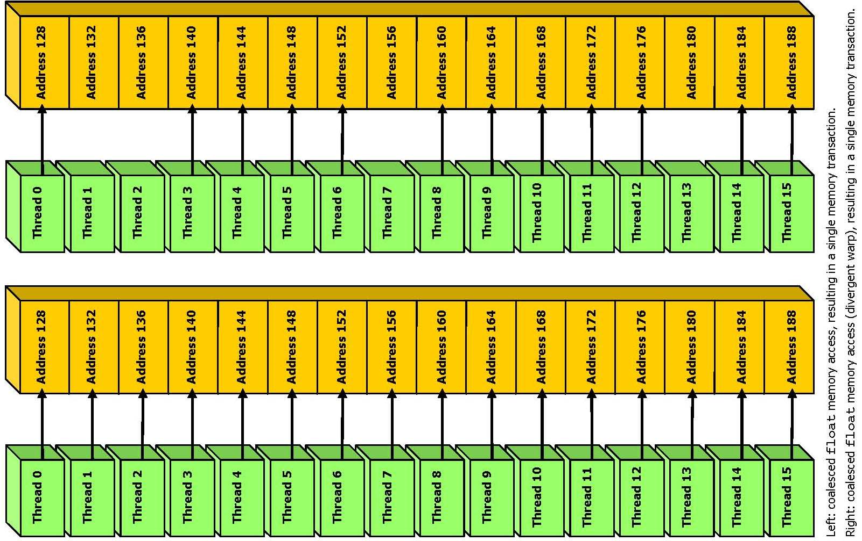

Slide 15
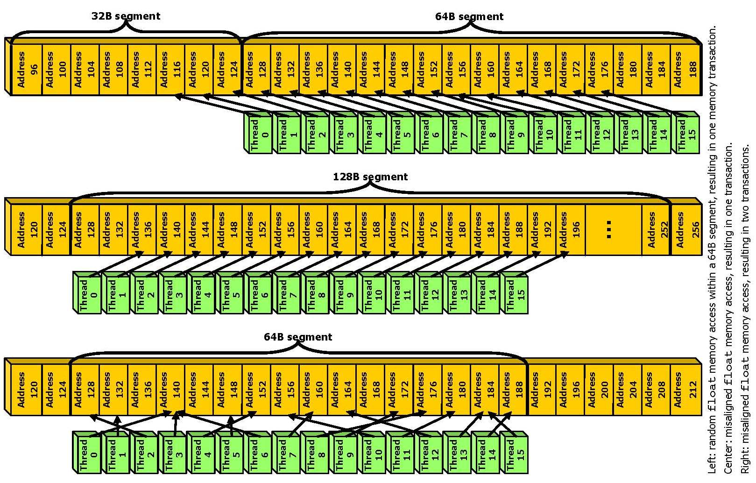

Slide 16
Threads 0-15 access 4-byte words at addresses 116-176
Thread 0 is lowest active, accesses address 116
128-byte segment: 0-127
t0
t1
t2
t3
t15
...
0
32
64
96
128
160
192
224
256
288
128B segment

Slide 17
Threads 0-15 access 4-byte words at addresses 116-176
Thread 0 is lowest active, accesses address 116
128-byte segment: 0-127 (reduce to 64B)
t0
t1
t2
t3
t15
...
0
32
64
96
128
160
192
224
256
288
64B segment

Slide 18
Threads 0-15 access 4-byte words at addresses 116-176
Thread 0 is lowest active, accesses address 116
128-byte segment: 0-127 (reduce to 32B)
t0
t1
t2
t3
t15
...
0
32
64
96
128
160
192
224
256
288
32B transaction

Slide 19
Threads 0-15 access 4-byte words at addresses 116-176
Thread 3 is lowest active, accesses address 128
128-byte segment: 128-255
t0
t1
t2
t3
t15
...
0
32
64
96
128
160
192
224
256
288
128B segment

Slide 20
Threads 0-15 access 4-byte words at addresses 116-176
Thread 3 is lowest active, accesses address 128
128-byte segment: 128-255 (reduce to 64B)
t0
t1
t2
t3
t15
...
0
32
64
96
128
160
192
224
256
288
64B transaction

Slide 21
Consider the stride of your accesses
__global__ void foo(int* input, float3* input2)
{
int i = blockDim.x * blockIdx.x
+ threadIdx.x;
// Stride 1
int a = input[i];
// Stride 2, half the bandwidth is wasted
int b = input[2*i];
// Stride 3, 2/3 of the bandwidth wasted
float c = input2[i].x;
}

Slide 22
Example: Array of Structures (AoS)
struct record
{
int key;
int value;
int flag;
};
record *d_records;
cudaMalloc((void**)&d_records, ...);

Slide 23
Example: Structure of Arrays (SoA)
struct SoA
{
int * keys;
int * values;
int * flags;
};
SoA d_SoA_data;
cudaMalloc((void**)&d_SoA_data.keys, ...);
cudaMalloc((void**)&d_SoA_data.values, ...);
cudaMalloc((void**)&d_SoA_data.flags, ...);

Slide 24
Example: SoA vs. AoS
__global__ void bar(record *AoS_data,
SoA SoA_data)
{
int i = blockDim.x * blockIdx.x
+ threadIdx.x;
// AoS wastes bandwidth
int key = AoS_data[i].key;
// SoA efficient use of bandwidth
int key_better = SoA_data.keys[i];
}

Slide 25
Structure of arrays is often better than array of structures
Very clear win on regular, stride 1 access patterns
Unpredictable or irregular access patterns are case-by-case

Slide 26
Review: Memory Layout of a Matrix in C
M_{0,0}
M_{1,0}
M_{2,0}
M_{3,0}
M_{0,1}
M_{1,1}
M_{2,1}
M_{3,1}
M_{0,2}
M_{1,2}
M_{2,2}
M_{3,2}
M_{0,3}
M_{1,3}
M_{2,3}
M_{3,3}
M
M_{0,0}
M_{1,0}
M_{2,0}
M_{3,0}
M_{0,1}
M_{1,1}
M_{2,1}
M_{3,1}
M_{0,2}
M_{1,2}
M_{2,2}
M_{3,2}
M_{0,3}
M_{1,3}
M_{2,3}
M_{3,3}

Slide 27
Memory Coalescing
When accessing global memory, peak performance utilization occurs when all threads in a half warp access contiguous memory locations
Not coalesced
coalesced
Md
Nd
Thread 1
H
T
D
Thread 2
I
W
WIDTH
Thread 1
Thread 2
© David Kirk/NVIDIA and Wen-mei W. Hwu

Slide 28
Memory Layout of a Matrix in C
Access direction in Kernel code
M_{0,0}
M_{1,0}
M_{2,0}
M_{3,0}
M_{0,1}
M_{1,1}
M_{2,1}
M_{3,1}
M_{0,2}
M_{1,2}
M_{2,2}
M_{3,2}
M_{0,3}
M_{1,3}
M_{2,3}
M_{3,3}
Time Period 1
Time Period 2
…
T₁
T₂
T₃
T₄
T₁
T₂
T₃
T₄
M
M_{0,0}
M_{1,0}
M_{2,0}
M_{3,0}
M_{0,1}
M_{1,1}
M_{2,1}
M_{3,1}
M_{0,2}
M_{1,2}
M_{2,2}
M_{3,2}
M_{0,3}
M_{1,3}
M_{2,3}
M_{3,3}
© David Kirk/NVIDIA and Wen-mei W. Hwu

Slide 29
Memory Layout of a Matrix in C
Access direction in Kernel code
M_{0,0}
M_{1,0}
M_{2,0}
M_{3,0}
M_{0,1}
M_{1,1}
M_{2,1}
M_{3,1}
M_{0,2}
M_{1,2}
M_{2,2}
M_{3,2}
M_{0,3}
M_{1,3}
M_{2,3}
M_{3,3}
…
Time Period 2
T₁
T₂
T₃
T₄
Time Period 1
T₁
T₂
T₃
T₄
M
M_{0,0}
M_{1,0}
M_{2,0}
M_{3,0}
M_{0,1}
M_{1,1}
M_{2,1}
M_{3,1}
M_{0,2}
M_{1,2}
M_{2,2}
M_{3,2}
M_{0,3}
M_{1,3}
M_{2,3}
M_{3,3}
© David Kirk/NVIDIA and Wen-mei W. Hwu

Slide 30
Review multiple block MMM – Are memory transfers coalesced?
// Single thread still does a single dot product,
// but within an output submatrix
__global__ void MatrixMulKernel(float* Md, float* Nd, float* Pd, int Width)
{
// Calculate the row index of the Pd element and M
// blockIdx.x gets ID within a block
int Row = blockIdx.y*TILE_WIDTH + threadIdx.y;
// Calculate the column index of Pd and N
int Col = blockIdx.x*TILE_WIDTH + threadIdx.x;
float Pvalue = 0;
// each thread computes one element of the block sub-matrix
for (int k = 0; k < Width; ++k)
Pvalue += Md[Row*Width+k] * Nd[k*Width+Col];
Pd[Row*Width+Col] = Pvalue;
}

Slide 31
Lab 5
Goal: : Learn about global memory reference patterns and their effect on performance
Input: MMM_global.cu
Task: Change code with loop interchange
Solution: MMM_global_ikj.cu

