Slide 1
Network Infrastructure for the Universidad Distrital Francisco José de Caldas New Building
Luis Daniel Lavado Carreño
20191020158

Slide 2

General Objective
Design and develop a robust, efficient, and scalable network infrastructure for the new building of Universidad Distrital Francisco José de Caldas, capable of supporting approximately 10000 devices, ensuring optimal and efficient connectivity for all users.

Slide 3
Specific Objectives
Design.
Perform.
Configure and simulate.
Develop comprehensive and detailed documentation.

Slide 4
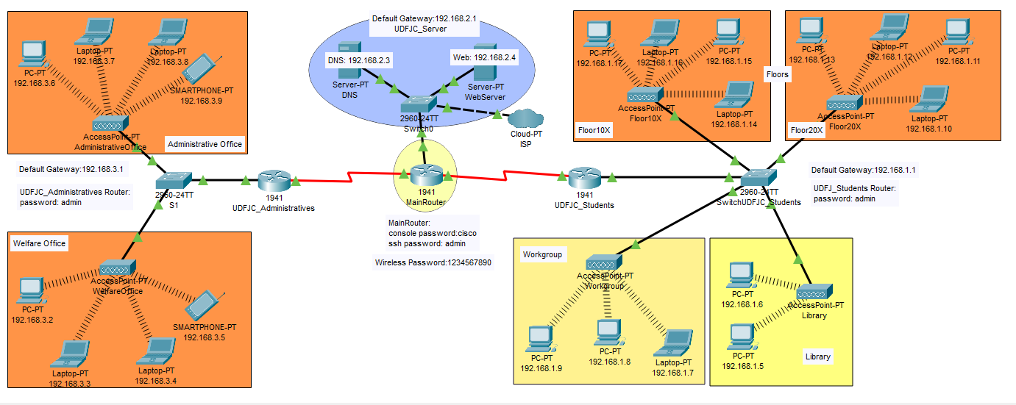
Packet Tracer - DEMO

Slide 5
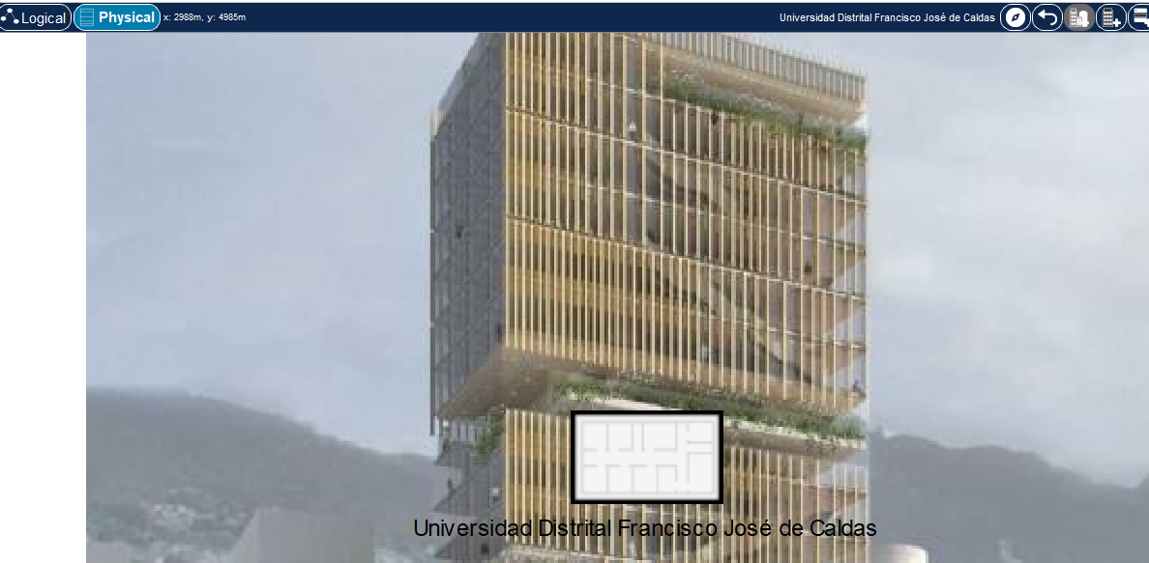

Slide 6
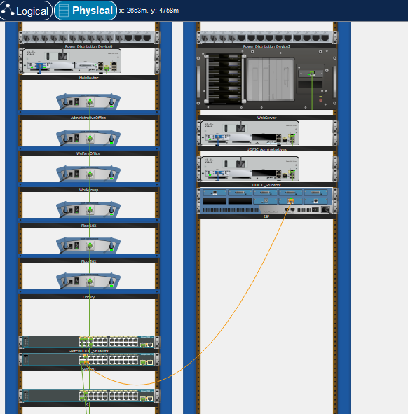

Slide 7
References
Instructables. (2017, August 27). Configure VLAN in Cisco Packet Tracer. Instructables. https://www.instructables.com/Configure-VLAN-in-Cisco-Packet-Tracer/
Rojas, A. R. (2023). Obtenido de https://bogota.gov.co/mi-ciudad/educacion/avanza-obra-del-nuevo-edificio-de-ingenieria-de-universidad-distrital
Cisco. (2022). What is network infrastructure? https://www.cisco.com/c/en/us/solutions/enterprise-networks/what-is-network-infrastructure.html
Cisco. (2017). Packet Tracer - Packet Tracer Physical View https://contenthub.netacad.com/legacy/I2PT/1.1/en/course/files/4.1.1.2%20Packet%20Tracer%20-%20Packet%20Tracer%20Physical%20View.pdf

Slide 8

THANKS

