Slide 1
Student/Teacher Ratios in Australian Schools
Data sourced from ABS- https://www.abs.gov.au/statistics/people/education/schools/latest-release

Slide 2
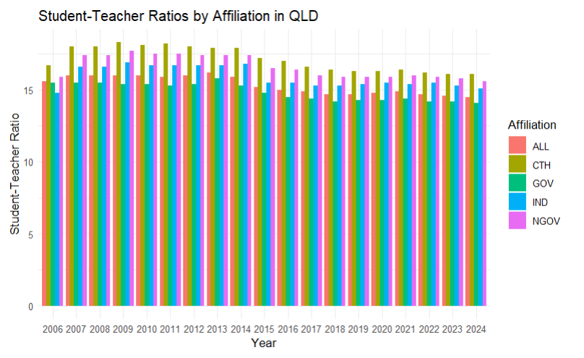
How do different affiliations of schools in Queensland perform in terms of student/teacher ratios?
Since 2006, Catholic schools have had the highest student to teacher ratio, this being approximately 14 students for each teacher.
The ratio remained quite stagnant over this period, with it only slightly decreasing in 2015.

Slide 3
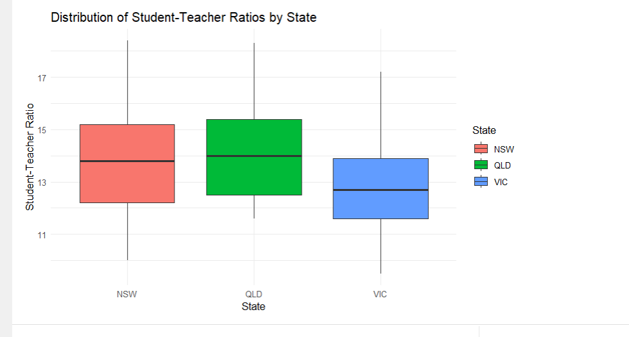
How do Queensland schools compare to other states?
Queensland has the highest average student teacher ratio, whereas Victoria has the lowest. However, New South Values has the highest observed student teacher ratio.

