Slide 1
Prisoners’ Dilemma: The Story
Invented by Merrill Flood & Melvin Dresher in 1950s
Studied in game theory, economics, political science
Two criminals have been caught
They cannot communicate with each other
If both confess, they will each get 10 years
If one confesses and accuses other:
confessor goes free
accused gets 20 years
If neither confesses, they will both get 1 year on a lesser charge

Slide 2
Prisoners’ Dilemma Payoff Matrix
 |  | Bob
 |  | cooperate | defect
Ann | cooperate | –1, –1 | –20, 0
 | defect | 0, –20 | –10, –10
defect = confess, cooperate = don’t
payoffs < 0 because punishments (losses)

Slide 3
Ann’s “Rational” Analysis (Dominant Strategy)
 |  | Bob
 |  | cooperate | defect
Ann | cooperate | –1, –1 | –20, 0
 | defect | 0, –20 | –10, –10
if cooperates, may get 20 years
if defects, may get 10 years
∴, best to defect

Slide 4
Bob’s “Rational” Analysis (Dominant Strategy)
 |  | Bob
 |  | cooperate | defect
Ann | cooperate | –1, –1 | –20, 0
 | defect | 0, –20 | –10, –10
if he cooperates, may get 20 years
if he defects, may get 10 years
∴, best to defect

Slide 5
Suboptimal Result of “Rational” Analysis
 |  | Bob
 |  | cooperate | defect
Ann | cooperate | –1, –1 | –20, 0
 | defect | 0, –20 | –10, –10
each acts individually rationally ⇒ get 10 years (dominant strategy equilibrium)
“irrationally” decide to cooperate ⇒ only 1 year

Slide 6
Summary
Individually rational actions lead to a result that all agree is less desirable
In such a situation you cannot act unilaterally in your own best interest
Just one example of a (game-theoretic) dilemma
Can there be a situation in which it would make sense to cooperate unilaterally?
Yes, if the players can expect to interact again in the future

Slide 7
The Iterated Prisoners’ Dilemma
and Robert Axelrod’s Experiments

Slide 8
Iterated Game
In simulation, the endpoint of the game is unknown to the players, making it essentially an infinitely iterated game
Each player has a memory of the previous three or more) rounds on which to base his strategy
Strategies are deterministic - for a given history h players will always make the same move
With 4 possible configurations in each round and a history of 3, each strategy is comprised of 4³ = 64 moves

Slide 9
Axelrod’s Experiments (1984)
Intuitively, expectation of future encounters may affect rationality of defection
Various programs compete for 200 rounds
encounters each other and self
Each program can remember:
its own past actions
its competitors’ past actions
14 programs submitted for first experiment

Slide 10
IPD Payoff Matrix
 |  | B
 |  | cooperate | defect
A | cooperate | 3, 3 | 0, 5
 | defect | 5, 0 | 1, 1
Notes:
The alternating defection/cooperation would be interesting in itself, but here the goal is to understand the circumstances under which mutual cooperation may emerge.

Slide 11
Indefinite Number of Future Encounters
Cooperation depends on expectation of indefinite number of future encounters
Suppose a known finite number of encounters:
No reason to C on last encounter
Since expect D on last, no reason to C on next to last
And so forth: there is no reason to C at all
Notes:
Axelrod’s first tournament was for a fixed number of rounds (200).
For the second, there was a fixed probability (“the shadow of the future”) of ending on the next move
(Axelrod & Dion)

Slide 12
Analysis of Some Simple Strategies
Three simple strategies:
ALL-D: always defect
ALL-C: always cooperate
RAND: randomly cooperate/defect
Effectiveness depends on environment
ALL-D optimizes local (individual) fitness
ALL-C optimizes global (population) fitness
RAND compromises
Notes:
ALL-D: the safest strategy; cannot be beat or exploited; good at exploiting;
does poorly against self or nasty strategies
thus it optimizes local (own) fitness at expense of population
ALL-C: does well when interacting with self or other nice strategies
endlessly exploited by ALL-D and other nasty strategies
RAND: a compromise
somewhat resistant to exploitation
can occasionally exploit others
does reasonably well against self

Slide 13
Expected Scores
⇓ playing ⇒ | ALL-C | RAND | ALL-D | Average
ALL-C | 3.0 | 1.5 | 0.0 | 1.5
RAND | 4.0 | 2.25 | 0.5 | 2.25
ALL-D | 5.0 | 3.0 | 1.0 | 3.0
Notes:
Average is for a population with all three distributed equally
Go across ALL-C row
Then across ALL-D row
Finally across RAND row
ALL-D’s avg score equals the best ALL-C can ever get
but does poorly against self
If we have survival of fittest, then in long term ALL-D does worse than other (look at diagonal)
ALL-D can survive only if it has “suckers” to exploit

Slide 14
Result of Axelrod’s Experiments
Winner is Rapoport’s TFT (Tit-for-Tat)
cooperate on first encounter
reply in kind on succeeding encounters
Second experiment:
62 programs
all known TFT was previous winner
TFT wins again

Slide 15
Expected Scores
⇓ playing ⇒ | ALL-C | RAND | ALL-D | TFT | Avg
ALL-C | 3.0 | 1.5 | 0.0 | 3.0 | 1.875
RAND | 4.0 | 2.25 | 0.5 | 2.25 | 2.25
ALL-D | 5.0 | 3.0 | 1.0 | 1+4/N | 2.5+
TFT | 3.0 | 2.25 | 1–1/N | 3.0 | 2.3125–
N = #encounters
Notes:
Average is for a population with all three distributed equally
Go across ALL-C row
Then across ALL-D row
Finally across RAND row
ALL-D’s avg score equals the best ALL-C can ever get
but does poorly against self
If we have survival of fittest, then in long term ALL-D does worse than other (look at diagonal)
ALL-D can survive only if it has “suckers” to exploit

Slide 16
The Genetic Algorithm

Slide 17
The Model
Darwinian Survival of the Fittest
Genetic representation of entities
Fitness function
Select most fit individuals to reproduce
Mutate
Traits of most fit will be passed on
Over time, the population will evolve to be more fit, optimal

Slide 18
GA’s and the Prisoner’s Dilemma
Population: 100 individuals
Chromosome: 64-bit string representing a strategy
A bit: a choice between the Cooperate or Defect move played for a specific configuration of past moves

Slide 19
Individuals = strategies
How to encode a strategy by a string?
Let memory depth of previous moves=1
Fix a canonical order of cases:
A B 2⁴=16 possible strategies for A
Case 0: C C C D C …
Case 1: D C C C D …
Case 2: C D C C C ...
Case 3: D D C C C …
e.g. strategy encoding (for A): ‘CDCD’

Slide 20
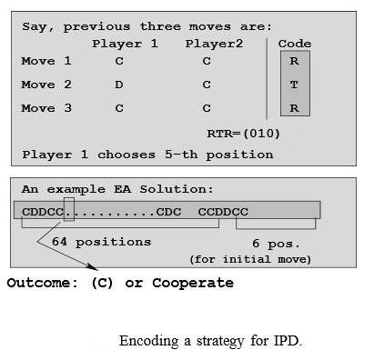

Slide 21
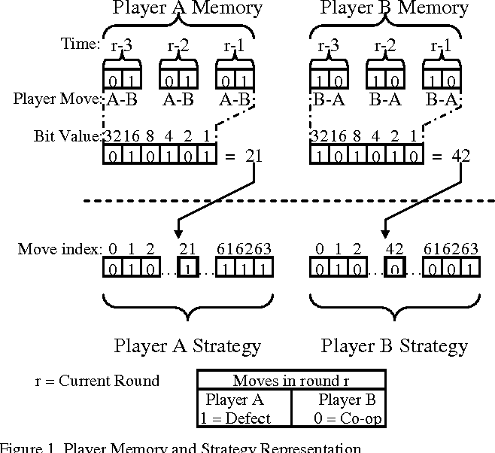

Slide 22
One strategy, then 2⁶⁴ strategies are possible in total

Slide 23
GA’s and PD
Fitness: Each player competes against every other for 100 consecutive rounds, and a cumulative score is maintained
Selection: Roulette Wheel selection
Reproduction: Random point crossover with replacement
Mutation rate 0.001
Generations: 1,000 generations

Slide 24
Tit for Tat (TFT)
The action chosen is based on the opponent’s last move.
On the first turn, the previous move cannot be known, so always cooperate on the first move.
Thereafter, always choose the opponent’s last move as your next move.

Slide 25
Key Points of Tit for Tat
Nice; it cooperates on the first move.
Regulatory; it punishes defection with defection.
Forgiving; it continues cooperation after cooperation by the opponent.
Clear; it is easy for opponent to guess the next move, so mutual benefit is easier to attain.

Slide 26
Tit for Two Tat (TF2T)
Same as Tit for Tat, but requires two consecutive defections for a defection to be returned.
Cooperate on the first two moves.
If the opponent defects twice in a row, choose defection as the next move.

Slide 27
Key Points of Tit for Two Tat
When defection is the opponent’s first move, this strategy outperforms Tit for Tat
Cooperating after the first defection causes the opponent to cooperate also. Thus, in the long run, both players benefit more points.

Slide 28
Suspicious Tit for Tat (STFT)
Always defect on the first move.
Thereafter, replicate opponent’s last move.
Key Points of Suspicious Tit for Tat
If the opponent’s first move is defection, this strategy outperforms Tit for Tat
However, it is generally worse than Tit for Tat.
The first move is inconsequential compared to getting stuck in an infinite defection loop.

Slide 29
Free Rider (ALLD)
Always choose to defect no matter what the opponent’s last turn was.
This is a dominant strategy against an opponent that has a tendency to cooperate.

Slide 30
Always Cooperate (ALLC)
Always choose to cooperate no matter what the opponent’s last turn was.
This strategy can be terribly abused by the Free Rider Strategy.
Or even a strategy that tends towards defection.

Slide 31
Use and compare different optimization methods (GA, EDA, hill climbing, tabu search…) to find the best possible strategies.
Try different parameters of the optimization methods (like population size or mutation probability for GA)
Try different memory depth: 3, 4, 5…
Try to compete against human designed strategies.
Compared the obtained strategies with TFT, TF2T or STFT
Use machine learning to try to predict if a strategy will be good or not. How to build the train set? What size? How to evaluate?
Compare different machine learning method.
Can you extract some patterns or some rules from the good strategies?

