Slide 1
CS445 spring 2025
Final Project Stage 4

Slide 2
The Team
Cole Manchester
DATA ANALYST
Interpreted Results And Drew Key Insights.
Daniel Tongu
VISUALIZATION SPECIALIST
Designed And Developed Visualizations
Fisher Bachman-Rhodes
DATA ENGINEER
Responsible For Data Acquisition And Preprocessing

Slide 3

World Happiness Report
Gallup World Poll and other sources

Slide 4
World Happiness Report
Dataset:
Singh, Ajaypal. “World Happiness Report 2021.” Kaggle, 22 Mar. 2021, www.kaggle.com/datasets/ajaypalsinghlo/world-happiness-report-2021
The report provides a comprehensive view of global well-being, ranking countries based on their citizens' self-perceived happiness.
It draws on data from the Gallup World Poll and other sources, evaluating well-being using a mix of economic, social, health-related, and perception-based factors.
Key Variables includes
Happiness score
GDP per capita
Social support
Healthy life expectancy
Freedom to make life choices
Generosity
Perceptions of corruption

Slide 5
Why This Matters
Happiness is a key indicator of societal well-being.
Insights can influence policy-making and social programs.
Cross-country analysis helps identify universal and local factors

Slide 6
Tools and Technologies
Python Libraries
PowerPoint (presentation)
Pandas (data processing)
Matplotlib & Seaborn (visualization).
Jupyter Notebook (Data analysis)

Slide 7
World Happiness Report
Loaded dataset into Pandas DataFrame.
Cleaned missing and inconsistent entries.
Aggregated data by country and year.
Generated visualizations using Seaborn and Matplotlib.

Slide 8

OVERVIEW

Slide 9
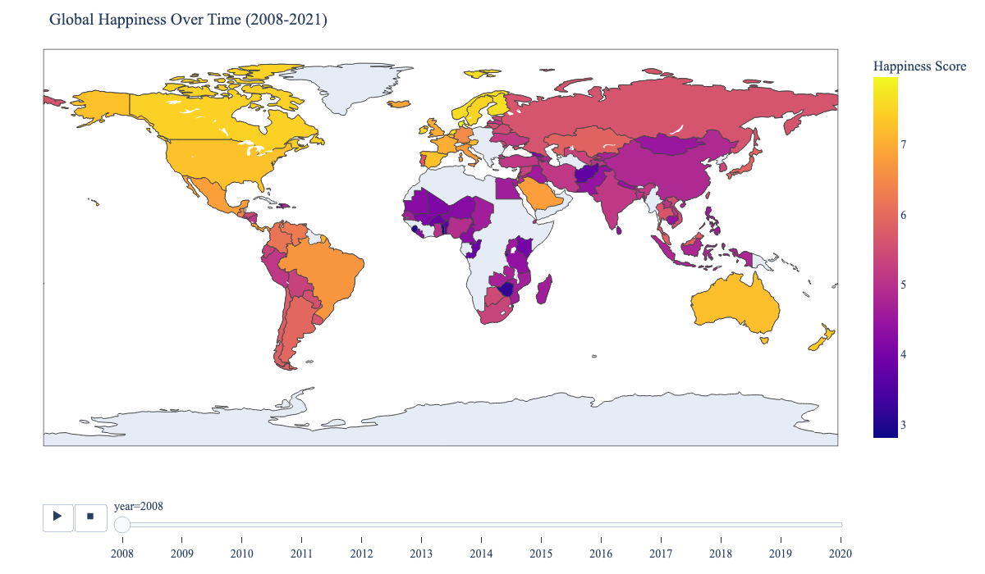
Animated Map: Global Happiness Over Time (2008–2021)
Watch how happiness scores shift across countries and years.
Notice: Regions with rising or falling happiness, and how global events may impact well-being.
Why it matters: Reveals trends, resilience, and disparities—helping policymakers and researchers identify where and when interventions may be needed.

Slide 10
Happiness Determinants
Factor | Description | Why It Matters
1. GDP per Capita | Economic output per person, adjusted for purchasing power. | Higher income improves access to resources and opportunities, though benefits taper off at higher levels.
2. Social Support | Feeling of having someone to rely on during difficult times. | Strong support networks improve resilience, reduce stress, and increase well-being.
3. Healthy Life Expectancy | Expected number of years a person will live in good health. | Health is essential for enjoying life and contributing to society.
4. Freedom to Make Life Choices | Perceived freedom to make decisions about one’s own life. | Autonomy is central to happiness and personal fulfillment.
5. Generosity | Willingness to donate or help others. | Fosters social bonds and purpose; varies by cultural and contextual factors.
6. Perceptions of Corruption | Belief in the prevalence of corruption in government and business. | Trust in institutions promotes societal well-being; corruption undermines satisfaction.
7. Life Ladder (Happiness Score) | Self-rated life satisfaction on a scale from 0 (worst) to 10 (best). | Captures an individual’s subjective view of their overall life situation.

Slide 11
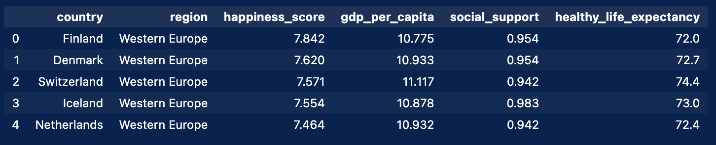
sample_columns = ["country", "region", "happiness_score", "gdp_per_capita", "social_support", "healthy_life_expectancy"] df_2021[sample_columns].head(20)

Slide 12
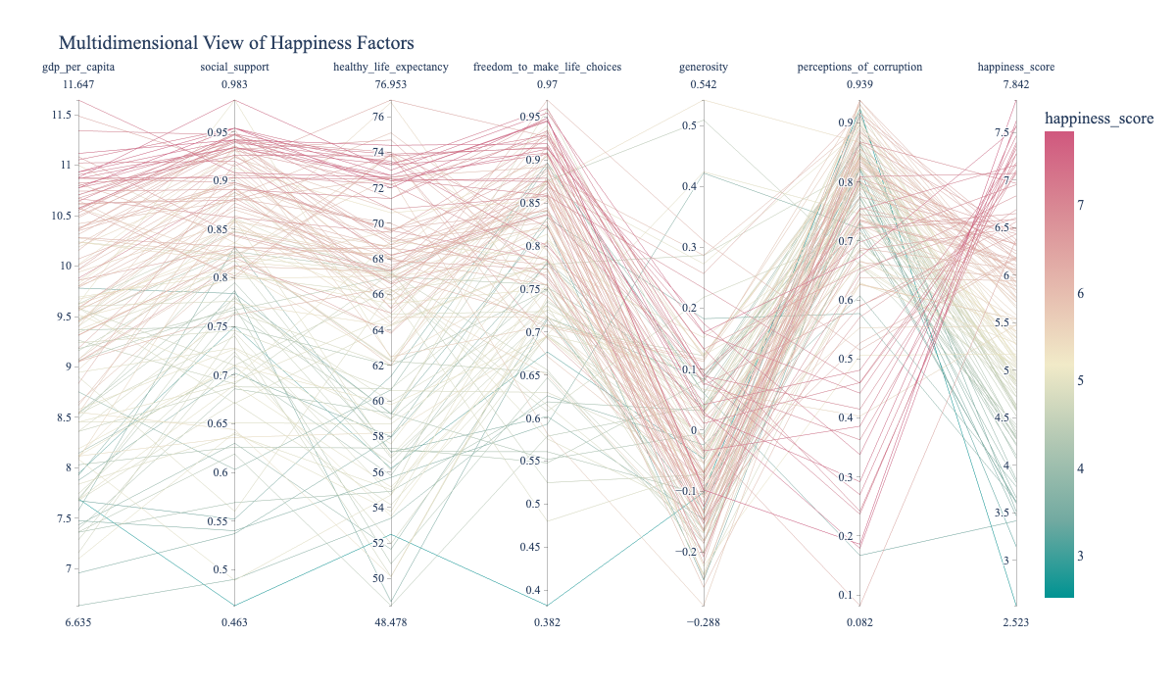
Parallel Coordinates Plot: Multidimensional Happiness Factors
Explore how countries compare across key happiness drivers.
Notice: Patterns and outliers among economic, social, and health factors.
Why it matters: Reveals which combinations of factors are most associated with higher happiness, and highlights countries with unusual profiles.

Slide 13

Regional Analysis

Slide 14
Regional Analysis
The "Regional Contributors" section explores how happiness scores and their underlying factors vary across different regions of the world.
This analysis helps us identify not only which regions are the happiest, but also the unique social, economic, and cultural drivers behind these patterns.
Why Regional Analysis Matters
Happiness is not determined by a single factor but by a combination of influences that differ by region. Regional analysis uncovers these nuances.
By comparing regions, we can identify successful policies and cultural practices that could be adapted elsewhere.
Recognizing regional strengths and weaknesses enables more effective, context-sensitive strategies to improve well-being.
In summary: The regional contributors section provides a comprehensive look at how happiness is distributed around the world, what drives these differences, and how this knowledge can inform better policy and societal outcomes.

Slide 15
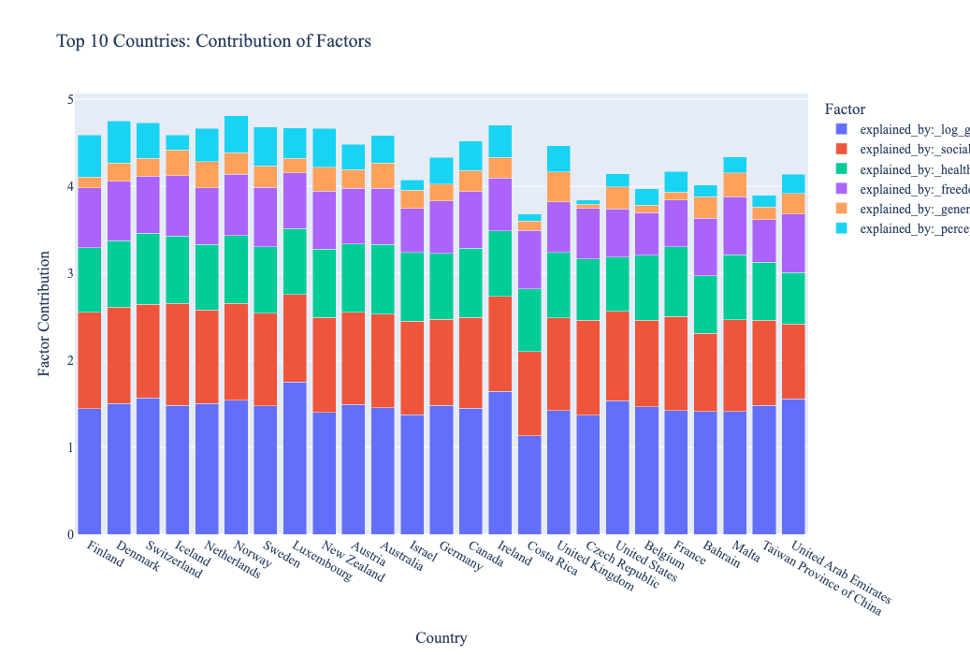
Stacked Bar: Factor Contributions for Top 25 Happiest Countries
See how much each factor (e.g., GDP, social support, health) explains the happiness scores of the world's happiest countries.
Notice: Which factors dominate for each country, and how the mix varies.
Why it matters: Highlights the diverse drivers of happiness, showing that top scores can result from different combinations of strengths.

Slide 16
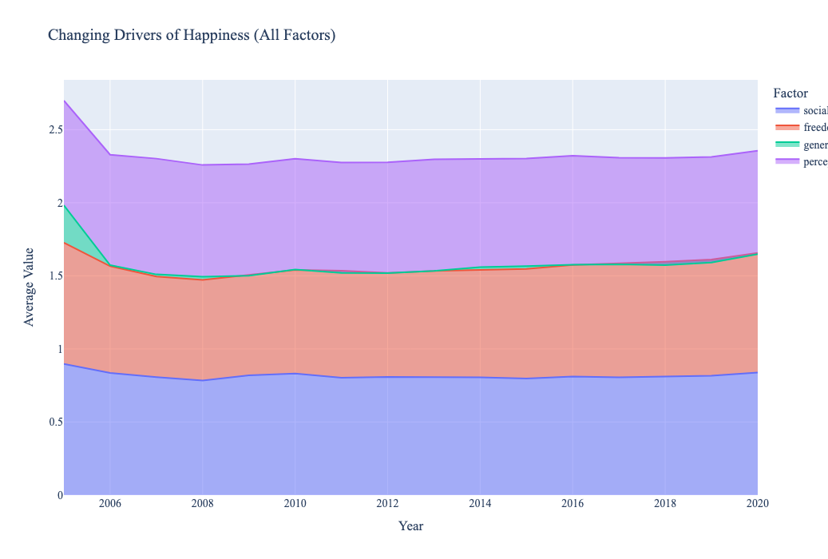
Area Chart: Changing Drivers of Happiness Over Time
See how the average values of key happiness factors (e.g., GDP, social support, health) have shifted globally each year.
Notice: Which factors are rising or falling, and how their relative importance changes.
Why it matters: Highlights evolving global trends and helps identify which drivers may be most influential for future well-being.

Slide 17
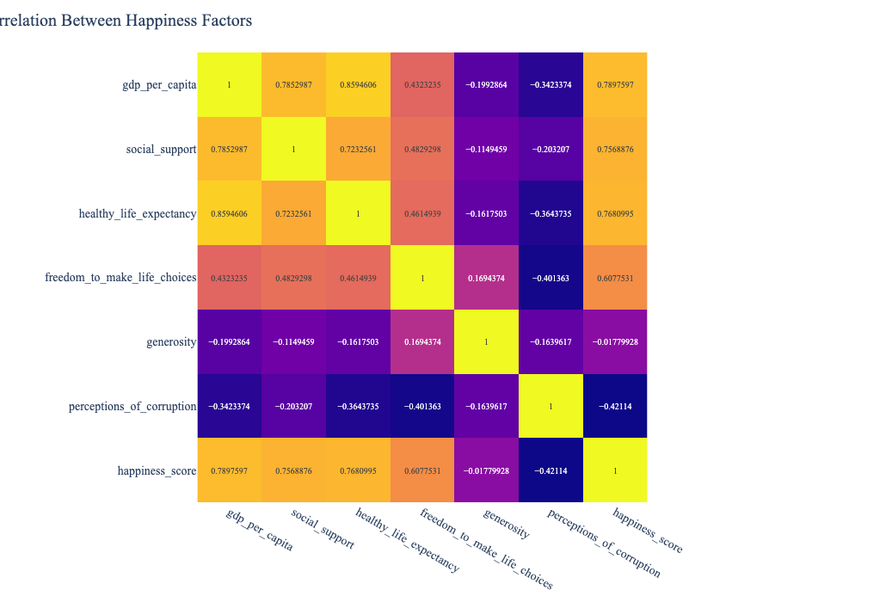
Correlation Heatmap: Happiness Factors
Examine how key drivers of happiness relate to each other.
Shows the relationships between key happiness factors such as GDP per capita, social support, healthy life expectancy, freedom, generosity, and perceptions of corruption.
Strong positive or negative correlations highlight which factors tend to move together, revealing the interconnected nature of well-being and inequality.
Notice: Strong positive or negative relationships between factors (e.g., GDP, social support, health, freedom).
Why it matters: Understanding these correlations helps identify which factors tend to move together and may inform policy priorities or further analysis.

Slide 18
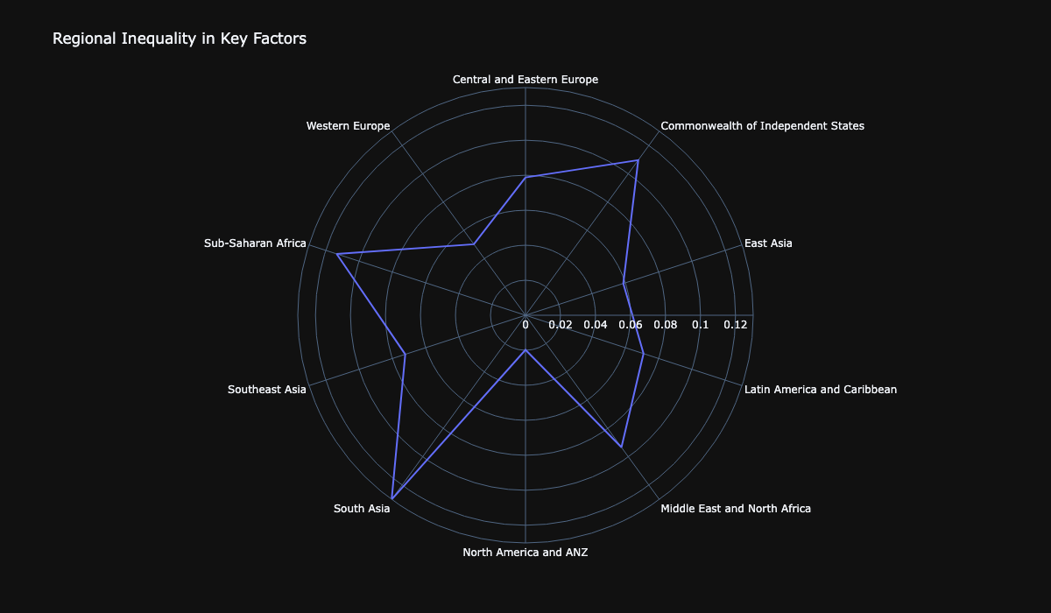
Radar Chart: Regional Inequality in Key Happiness Factors
Compare the variability (inequality) of social support, freedom, and generosity across regions.
Notice: Which regions have the most or least variation in these factors.
Why it matters: High inequality within a region may signal disparities in well-being and access to resources, highlighting areas for targeted improvement.

Slide 19
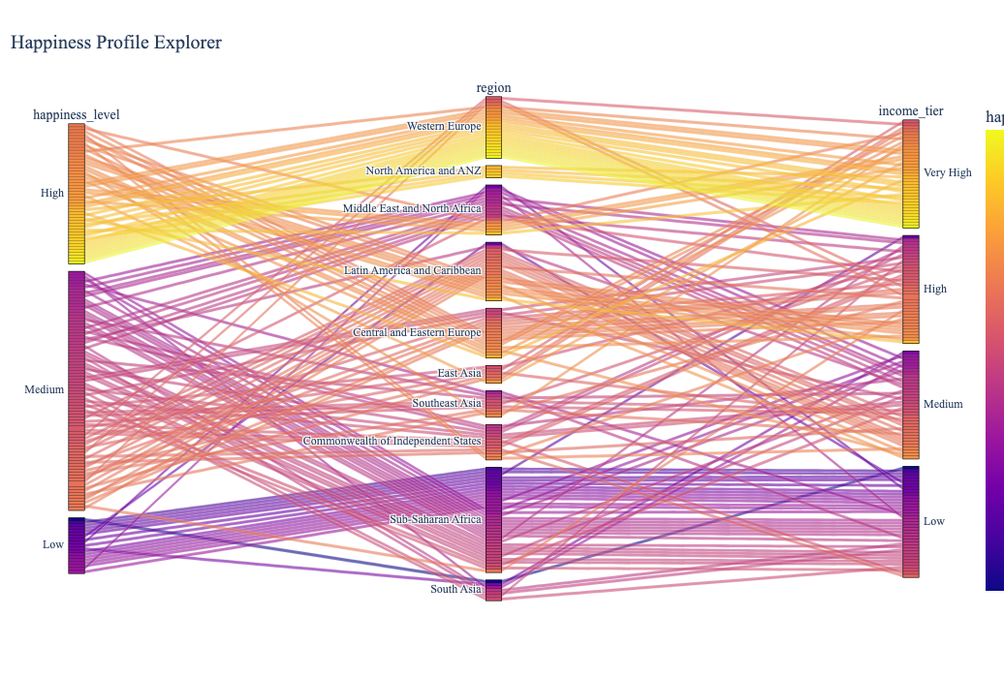
Interactive Happiness Diagnostic Tool
Explore how happiness levels relate to region and income tier.
Each vertical axis represents a categorical variable (happiness level, region, income tier).
The colored bands show how countries flow between categories, e.g., which regions have more countries in the "Very High" income tier and "High" happiness level.
The color intensity reflects the happiness score, making it easy to spot patterns (e.g., most "Very High" income countries cluster in "High" happiness).
Notice: Patterns in which regions and income groups have higher or lower happiness.
Why it matters: Helps identify where well-being is strongest or most at risk, guiding targeted interventions and policy focus.

Slide 20
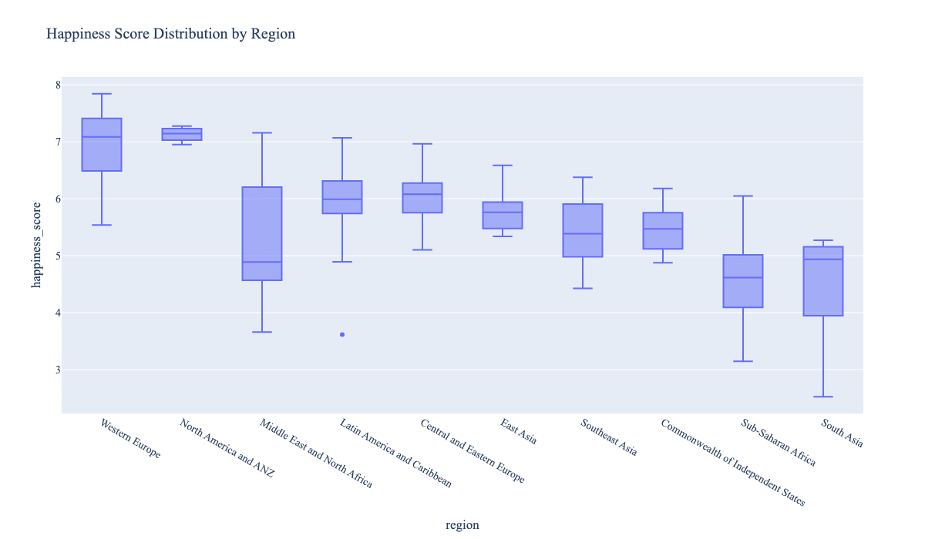
Box Plot: Regional Happiness Score Distribution
Compare the spread and central tendency of happiness scores across world regions.
Shows the distribution of happiness scores within each region.
Highlights both the median happiness and the spread (inequality) within regions,
Notice: Which regions have the highest and lowest median happiness, and where the variability is greatest.
Why it matters: Highlights disparities and outliers, helping to identify regions with both strengths and challenges in well-being.

Slide 21
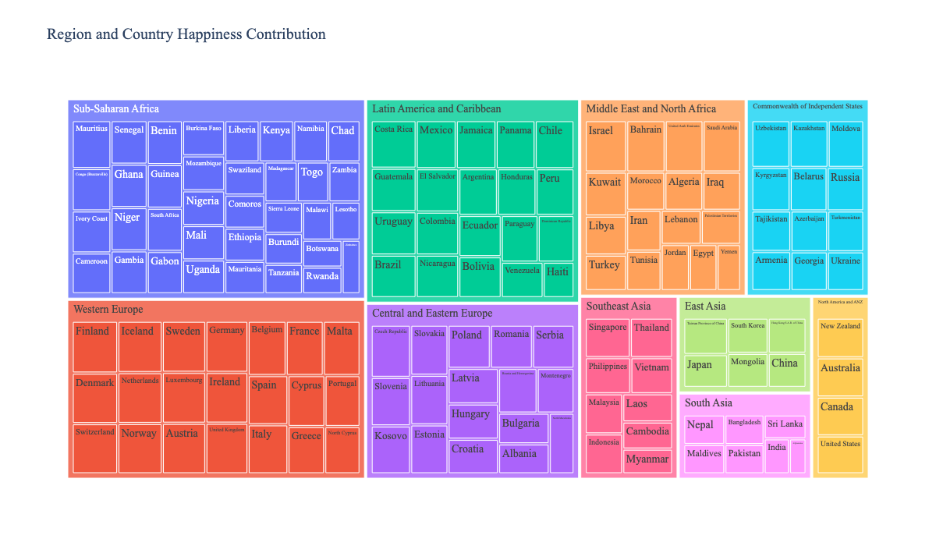
Treemap: Regional and Country Happiness Contribution
Explore the relative happiness scores of countries within each region.
Visualizes the hierarchical structure of happiness, starting from regions and drilling down to individual countries.
The size and color of each box represent the happiness score, making it easy to spot regional leaders and laggards.
Notice: Which regions and countries contribute most to global happiness, and the internal disparities within regions.
Why it matters: Highlights both regional leaders and laggards, helping to identify where well-being is concentrated or lacking.

Slide 22
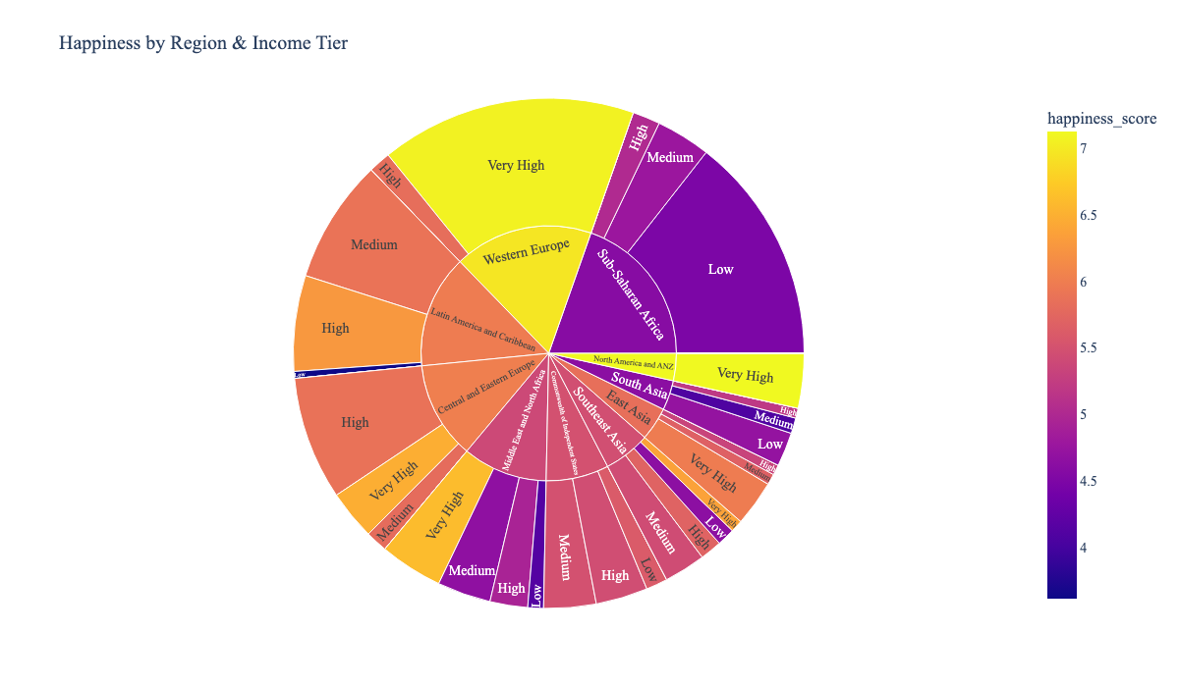
Sunburst: Happiness by Region & Income Tier
Explore how happiness scores are distributed across regions and economic tiers.
The size of each segment corresponds to the total happiness score for that group.
The color gradient indicates the average happiness score, highlighting which regions and income tiers are happiest.
Notice: Which regions and income groups have the highest or lowest happiness.
Why it matters: Reveals intersections of geography and wealth in shaping well-being, highlighting where disparities or strengths exist.

Slide 23
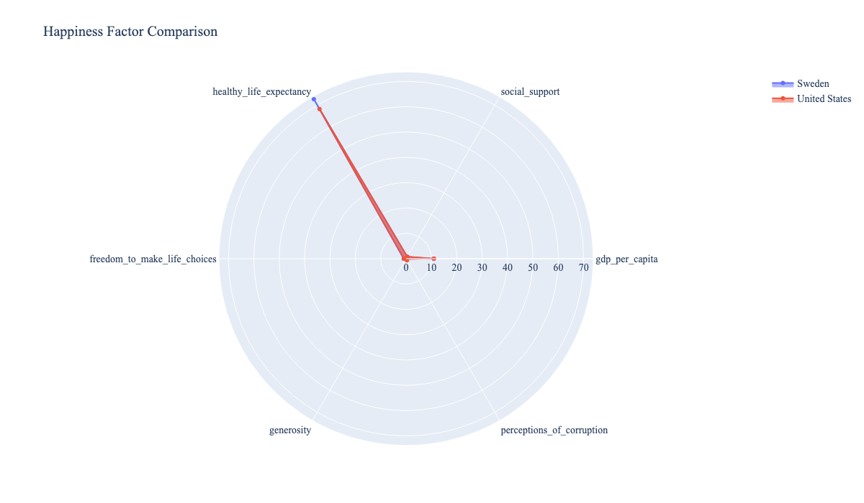
Radar Chart: USA vs Sweden on Key Happiness Factors
Compare the profiles of the United States and Sweden across major happiness drivers.
Notice: Where each country stands out or lags—such as economic strength, social support, or perceived corruption.
Why it matters: Highlights how different combinations of strengths and weaknesses can lead to similar or different happiness outcomes, informing targeted improvements.

Slide 24
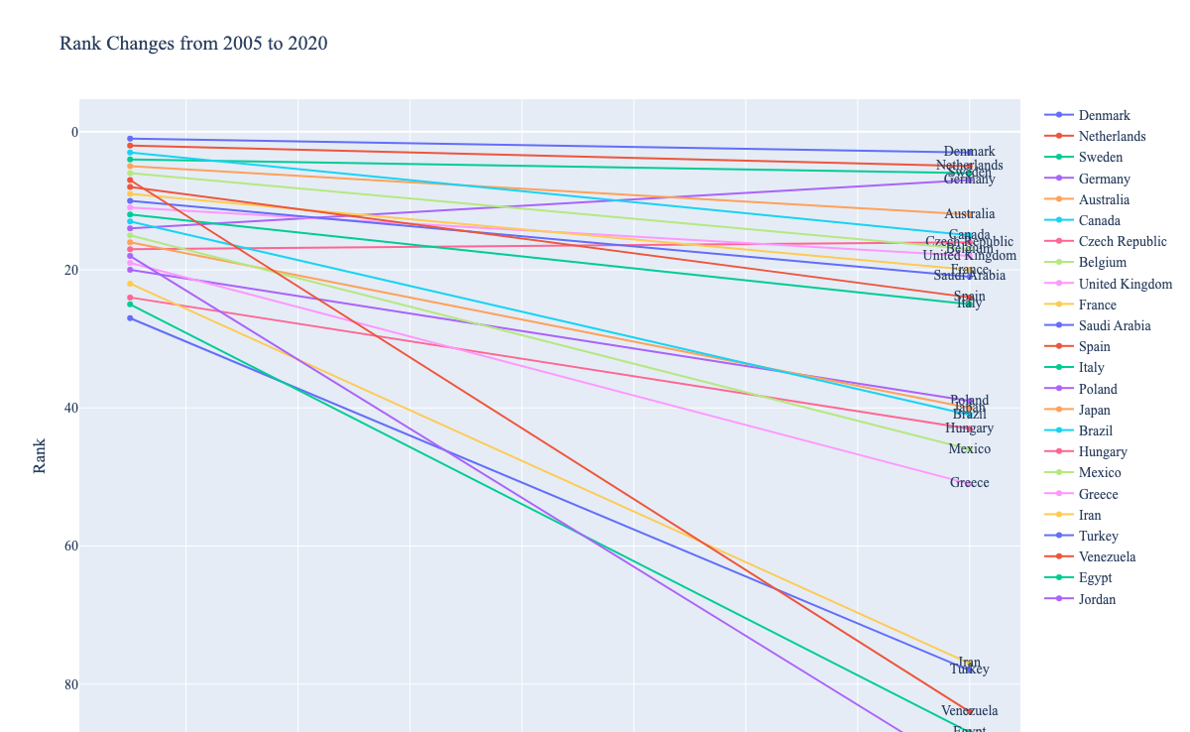
Slope Chart: Changes in Country Happiness Rankings
Tracks how the happiness rankings of selected countries have changed from 2005 to 2020.
It visually highlights countries that have improved or declined in happiness rank, illustrating dynamic shifts and growing or shrinking inequalities between nations.
Notice: Which countries have risen or fallen most in rank.
Why it matters: Highlights long-term progress or decline, revealing the impact of national policies, crises, or improvements on well-being.

Slide 25
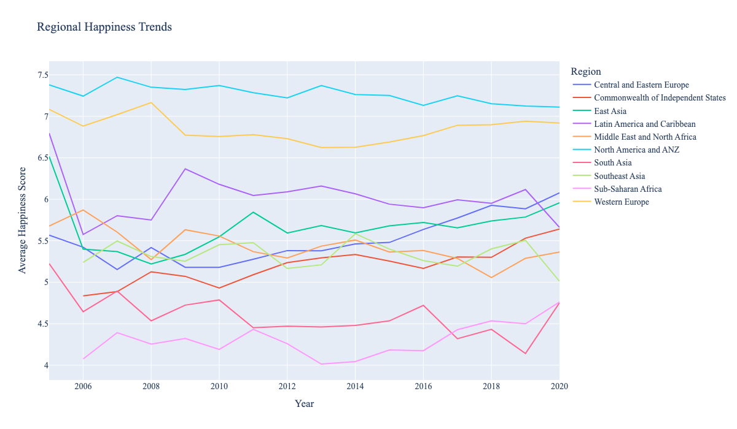
Regional Happiness Trends: Line CharT
Track how average happiness scores have changed over time in each world region.
Notice: Which regions are improving, declining, or stable in happiness.
Why it matters: Reveals long-term regional patterns and helps identify where progress or challenges are most pronounced.

Slide 26
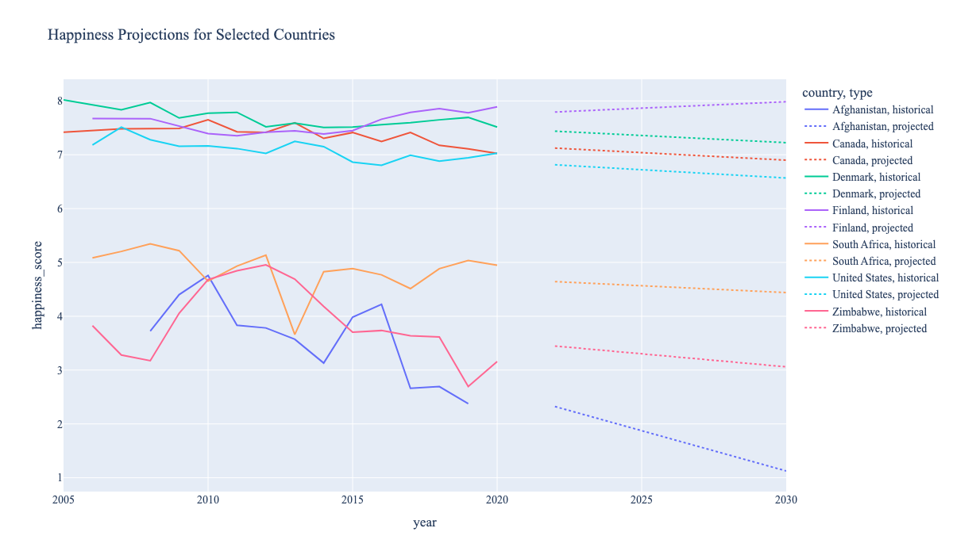
Predictive Happiness Trajectories: Projected Country Trends
See how happiness scores are expected to change for selected countries through 2030, based on historical trends.
Notice: Which countries are projected to rise or fall, and the differences between historical and projected lines.
Why it matters: Anticipating future well-being helps policymakers and researchers identify where interventions may be needed and track the impact of past changes.

Slide 27

Derived Data

Slide 28
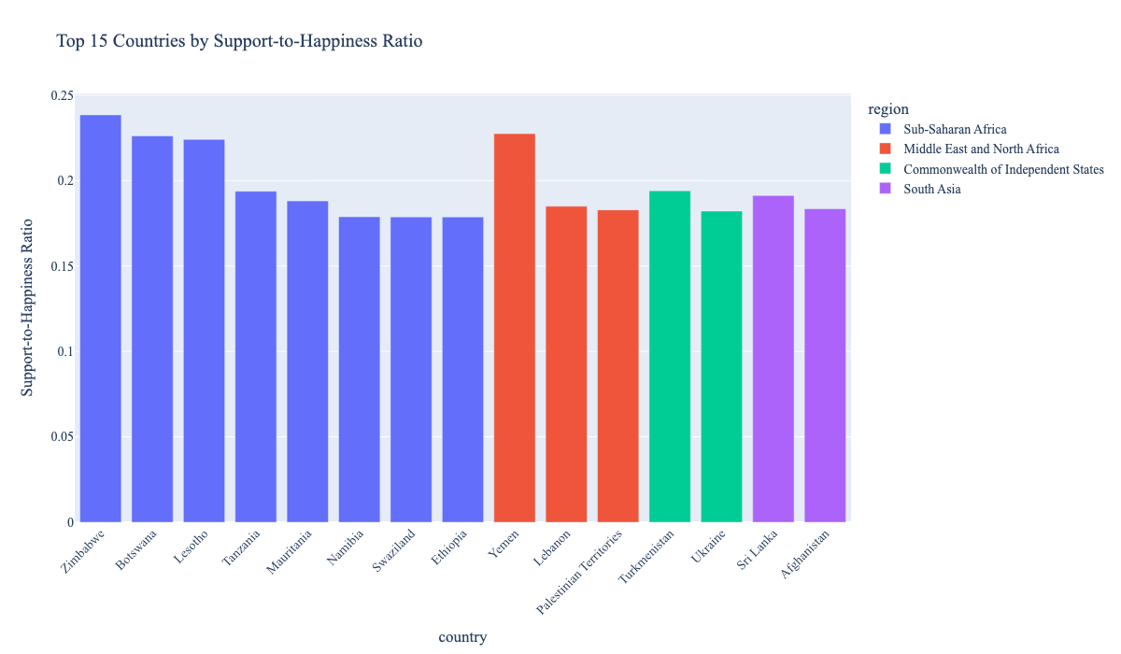

Slide 29
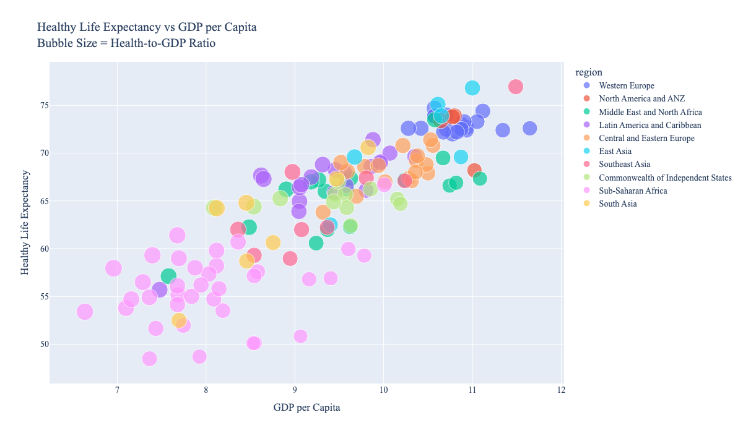

Slide 30
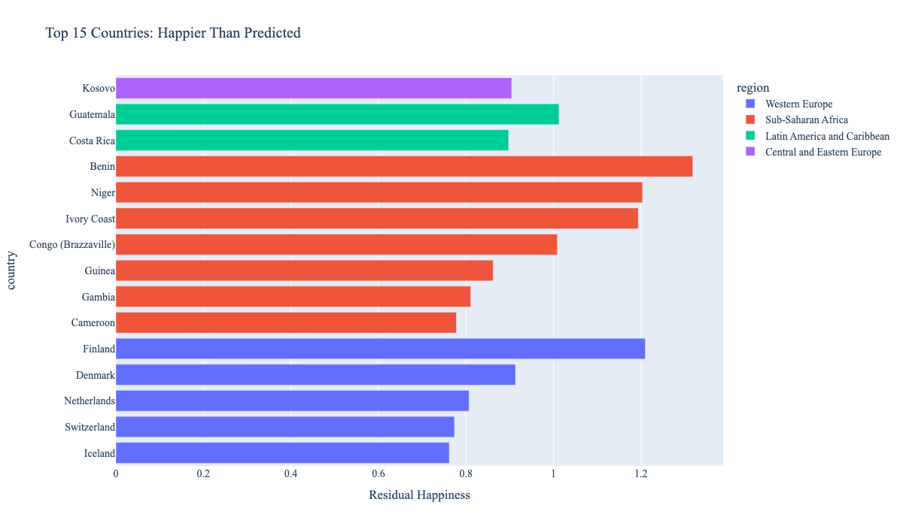

Slide 31

CONCLUSION

Slide 32
Key Takeaways
Happiness is Multidimensional:
No single factor determines happiness.
Happiness emerges from a combination of GDP per capita, social support, healthy life expectancy, freedom, generosity, and perceptions of corruption.
The correlation heatmap (fig6) highlights strong positive relationships between economic/social factors and happiness, and negative correlations with corruption.
Regional Disparities Persist:
Western Europe and North America & ANZ consistently top the happiness rankings, while regions like Sub-Saharan Africa and South Asia face greater challenges.
However, there are outliers—some countries achieve higher happiness than their income or region might predict, often due to strong social support or governance.
Trends Over Time:
The slope chart shows that happiness rankings are not static.
Some countries have improved significantly, while others have declined, reflecting the impact of policy, economic changes, and global events.
Income Matters, But Isn't Everything:
Higher income tiers generally correspond to higher happiness, but the relationship is not absolute.
Social and institutional factors can compensate for lower income in some contexts.
Inequality Within and Between Regions:
Radar and box plots reveal that disparities in happiness and its drivers exist not only between regions but also within them.
Addressing these inequalities requires targeted, context-sensitive interventions.

Slide 33
Key Takeaways
Economic strength and social support are major happiness drivers.
Northern European countries consistently top the happiness index.
Complex interactions exist among various social and economic indicators.

Slide 34
What We Learned
Policy Implications: Effective policies to boost happiness must address multiple dimensions—improving economic conditions, strengthening social support networks, promoting health, and building trust in institutions.
Importance of Social Support and Trust: Countries with strong social support and low corruption often outperform their peers, even at similar income levels. Investing in social capital and good governance pays dividends in well-being.
Dynamic Nature of Happiness: Happiness is not fixed; it responds to changes in society, economy, and governance. Monitoring trends over time is crucial for understanding the impact of interventions and global events.
Value of Data-Driven Insights: Combining subjective well-being data with objective indicators enables a richer, more actionable understanding of what drives happiness. This approach can guide both national policy and international development efforts.

Slide 35
Challenges and Limitations
Some countries lacked data in specific years.
Cultural interpretation of happiness may vary.
Survey-based scores are inherently subjective.

Slide 36
Questions & Answers
Thank you for your attention!
We welcome your questions and feedback on our project.

Slide 37
The end

