Slide 1
Datenvisualisierung 2
Darstellung der zusammenfassenden Statistik Daniela Palleschi

Slide 2
Inhaltsverzeichnis
Heutige Ziele
0.1 Lust auf mehr?
1. Einrichtung
2. Review: Bericht 2
2.1 Producing a summary table
2.2 Re-constructing a plot
3. Output formats
3.1 Documents
3.2 Slides
3.3 Slides
Session Info

Slide 3
Heutige Ziele
This week we will learn how to…
0.1 Lust auf mehr?
Section 30 (Visualising relationsips) in Wickham et al. (o. J.)
Ch. 4 (Representing summary statistics) in Nordmann et al. (2022)

Slide 4
1. Einrichtung
pacman::p_load(tidyverse, here, ggthemes, patchwork, devtools, knitr, kableExtra, gt)

Slide 5
2. Review: Bericht 2
region | adverb_time | verb_tense | N | mean_total_time | sd
verb | Future | Future | 948 | 602.7521 | 411.5918
verb | Future | Past | 945 | 628.4836 | 423.4241
verb | Past | Past | 953 | 556.7817 | 366.4723
verb | Past | Future | 949 | 642.0242 | 433.0259
library(introdataviz)
df_biondo <- read_csv(here("daten", "Biondo_etal_2021_bericht2.csv")) %>% janitor::clean_names()
df_biondo_long <- df_biondo %>% pivot_longer( cols = c(first_pass, regression_path, total_time), names_to = "measure", values_to = "time" ) %>% relocate(measure, time, .after=gramm)
2.1 Producing a summary table
try to reproduce this table
df_biondo %>% drop_na() %>% filter(region == "verb", adverb_time != "none") %>% summarise(N = n(), mean_total_time = mean(total_time), sd = sd(total_time), .by = c(region, adverb_time,verb_tense)) %>% arrange(region, adverb_time) %>% gt()

Slide 6
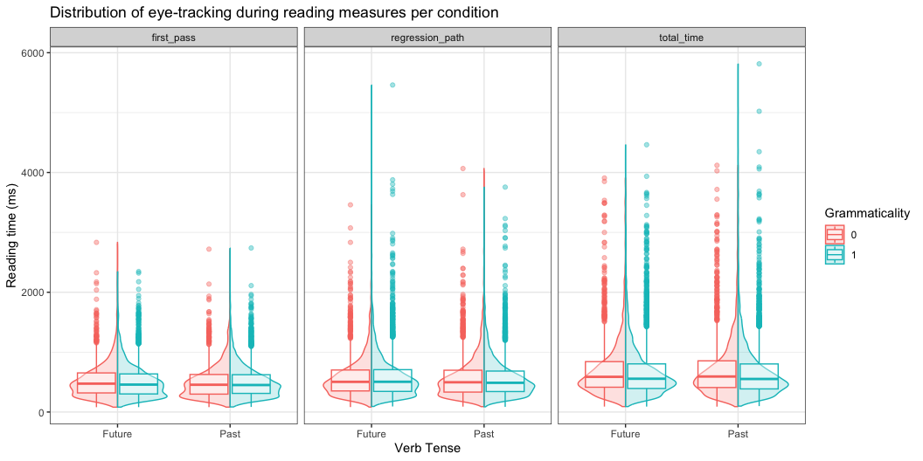
2.2 Re-constructing a plot
what is needed in order to reproduce this plot?
which variable(s) are mapped along the axes?
what variable(s) are in the legend?
Abbildung 1: A split-violin boxplot

Slide 7
3. Output formats
recall that Quarto can output various file formats
Documents
html
PDF
MS Word
Slides
html slides
PowerPoint slides
Beamer (LaTeX)
3.1 Documents
let’s try first creating an MS Word document
change format: to docx
title: "Datenvisualisierung 2" subtitle: "Darstellung der zusammenfassenden Statistik" author: "Daniela Palleschi" date: "`r Sys.Date()`" format: docx: toc: true number-sections: true

Slide 8
Render and inspect
3.2 Slides
let’s try first creating a HTML slides with revealjs
change format: to revealjs
title: "Datenvisualisierung 2" subtitle: "Darstellung der zusammenfassenden Statistik" author: "Daniela Palleschi" date: "`r Sys.Date()`" format: revealjs: toc: true number-sections: true

Slide 9
Render and inspect
3.3 Slides
let’s try first creating a HTML slides with PowerPoint
change format: to pptx
title: "Datenvisualisierung 2" subtitle: "Darstellung der zusammenfassenden Statistik" author: "Daniela Palleschi" date: "`r Sys.Date()`" format: pptx: toc: true number-sections: true

Slide 10
Render and inspect

Slide 11
Session Info
Hergestellt mit R version 4.3.0 (2023-04-21) (Already Tomorrow) und RStudioversion 2023.3.0.386 (Cherry Blossom).
print(sessionInfo(),locale = F)
R version 4.3.0 (2023-04-21) Platform: aarch64-apple-darwin20 (64-bit) Running under: macOS Ventura 13.2.1 Matrix products: default BLAS: /Library/Frameworks/R.framework/Versions/4.3-arm64/Resources/lib/libRblas.0.dylib LAPACK: /Library/Frameworks/R.framework/Versions/4.3-arm64/Resources/lib/libRlapack.dylib; LAPACK version 3.11.0 attached base packages: [1] stats graphics grDevices utils datasets methods base other attached packages: [1] introdataviz_0.0.0.9003 gt_0.9.0 kableExtra_1.3.4.9000 [4] knitr_1.43 devtools_2.4.5 usethis_2.1.6 [7] patchwork_1.1.2 ggthemes_4.2.4 here_1.0.1 [10] lubridate_1.9.2 forcats_1.0.0 stringr_1.5.0 [13] dplyr_1.1.2 purrr_1.0.1 readr_2.1.4 [16] tidyr_1.3.0 tibble_3.2.1 ggplot2_3.4.2 [19] tidyverse_2.0.0 loaded via a namespace (and not attached): [1] tidyselect_1.2.0 viridisLite_0.4.2 farver_2.1.1 fastmap_1.1.1 [5] janitor_2.2.0 pacman_0.5.1 promises_1.2.0.1 digest_0.6.31 [9] timechange_0.2.0 mime_0.12 lifecycle_1.0.3 ellipsis_0.3.2 [13] processx_3.8.1 magrittr_2.0.3 compiler_4.3.0 sass_0.4.6 [17] rlang_1.1.1 tools_4.3.0 utf8_1.2.3 yaml_2.3.7 [21] labeling_0.4.2 prettyunits_1.1.1 htmlwidgets_1.6.2 bit_4.0.5 [25] pkgbuild_1.4.0 curl_5.0.1 plyr_1.8.8 xml2_1.3.4 [29] pkgload_1.3.2 miniUI_0.1.1.1 withr_2.5.0 grid_4.3.0 [33] fansi_1.0.4 urlchecker_1.0.1 profvis_0.3.8 xtable_1.8-4 [37] colorspace_2.1-0 scales_1.2.1 cli_3.6.1 rmarkdown_2.22 [41] crayon_1.5.2 generics_0.1.3 remotes_2.4.2 rstudioapi_0.14 [45] httr_1.4.6 tzdb_0.4.0 sessioninfo_1.2.2 rbbt_0.0.0.9000 [49] cachem_1.0.8 parallel_4.3.0 rvest_1.0.3 vctrs_0.6.3 [53] webshot_0.5.4 jsonlite_1.8.5 callr_3.7.3 hms_1.1.3 [57] bit64_4.0.5 systemfonts_1.0.4 glue_1.6.2 ps_1.7.5 [61] stringi_1.7.12 gtable_0.3.3 later_1.3.1 munsell_0.5.0 [65] pillar_1.9.0 htmltools_0.5.5 R6_2.5.1 rprojroot_2.0.3 [69] vroom_1.6.3 evaluate_0.21 shiny_1.7.4 memoise_2.0.1 [73] snakecase_0.11.0 httpuv_1.6.11 Rcpp_1.0.10 svglite_2.1.1 [77] xfun_0.39 fs_1.6.2 pkgconfig_2.0.3

Slide 12
Literaturverzeichnis
Nordmann, E., McAleer, P., Toivo, W., Paterson, H., & DeBruine, L. M. (2022). Data Visualization Using R for Researchers Who Do Not Use R. Advances in Methods and Practices in Psychological Science, 5(2), 251524592210746. https://doi.org/10.1177/25152459221074654
Wickham, H., Çetinkaya-Rundel, M., & Grolemund, G. (o. J.). R for Data Science (2. Aufl.). https://r4ds.hadley.nz/

