Slide 1
UBER EATS · MEXICO
ATD OPTIMISATION · Q1 2026 · ISSUE 01
Where does
the time go?
What ~1 million Mexico deliveries say about delivery time, and the three plays that get it back.
AUTOMATION & ANALYTICS · BUSINESS CASE
APRIL 2026

Slide 2
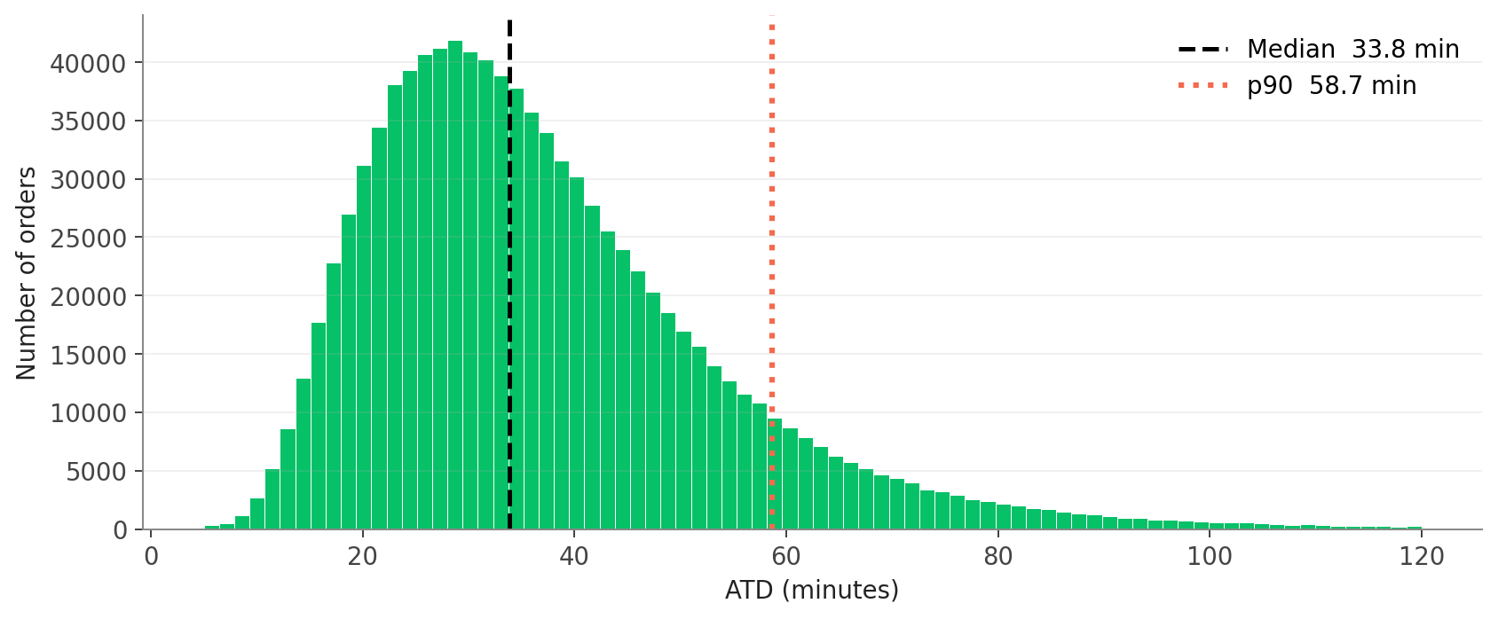
01 · THE PROBLEM
Why ATD matters more in Mexico than anywhere else.
Mexico is the second-largest delivery market in Latin America, and Uber Eats is fighting Didi Food and Rappi for share. Every minute of ATD is retention we don't earn.
33.8 min
58.7 min
25%
9%
MEDIAN ATD
P90 ATD
ORDERS > 45 MIN
ORDERS > 60 MIN
Half of orders take longer.
1 in 10 crosses the hour.
The slow tail customers feel.
Where ops loses NPS.
WHY THIS MATTERS
The shape is right-skewed. A long tail of slow orders pulls the mean above the median. Cross-platform users (Mobility plus Eats) spend 3x more and retain 35% better. A reliable Eats experience is what turns a Mobility user into a cross-platform user.
01 · THE PROBLEM
02 / 10

Slide 3
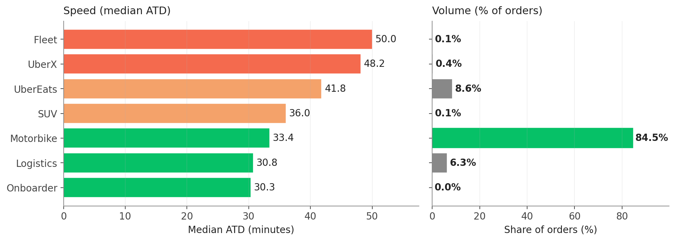
02 · VOLUME, NOT VARIANCE
The slowest segments are not where the volume lives.
Fleet runs at 50 minutes. It's also 0.1% of orders. Motorbike runs the business and it runs it well.
WHERE THE ORDERS ACTUALLY GO
84.5%
of orders run on Motorbike
Half a minute off Motorbike beats anything we could do to Fleet or UberX combined. The 19-minute Logistics-to-Fleet spread is real but it lives in 0.5% of orders. Optimise where the volume is, then move UberEats (8.6%) toward Motorbike timing.
WHAT TO DO ABOUT IT
Protect the Motorbike experience first. Move UberEats orders toward Motorbike-equivalent ETAs second. Stop chasing variance in the long tail of small flows.
02 · VOLUME OR VARIANCE
03 / 10

Slide 4
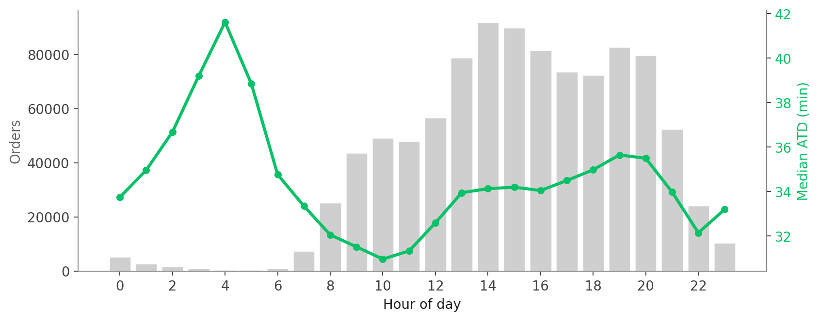
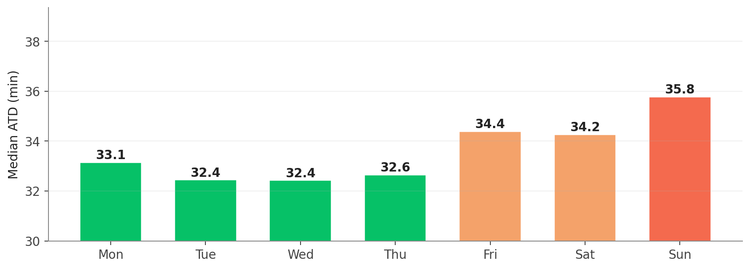
03 · WHEN OPS STRESSES
Demand peaks aren't the problem. Supply gaps are.
Lunch and dinner peaks get absorbed. Late nights and Sunday are when ATD slips.
DAY OF WEEK
Mon-Thu 32.4 to 33.1. Fri 34.4. Sun 35.8.
HOUR OF DAY
THE STORY
Schedule supply against the curve. Sunday adds 2 minutes. 4 AM hits 41 minutes because couriers aren't online. Pair forecasts with proactive incentives 90 minutes ahead.
03 · WHEN OPS STRESSES
04 / 10

Slide 5
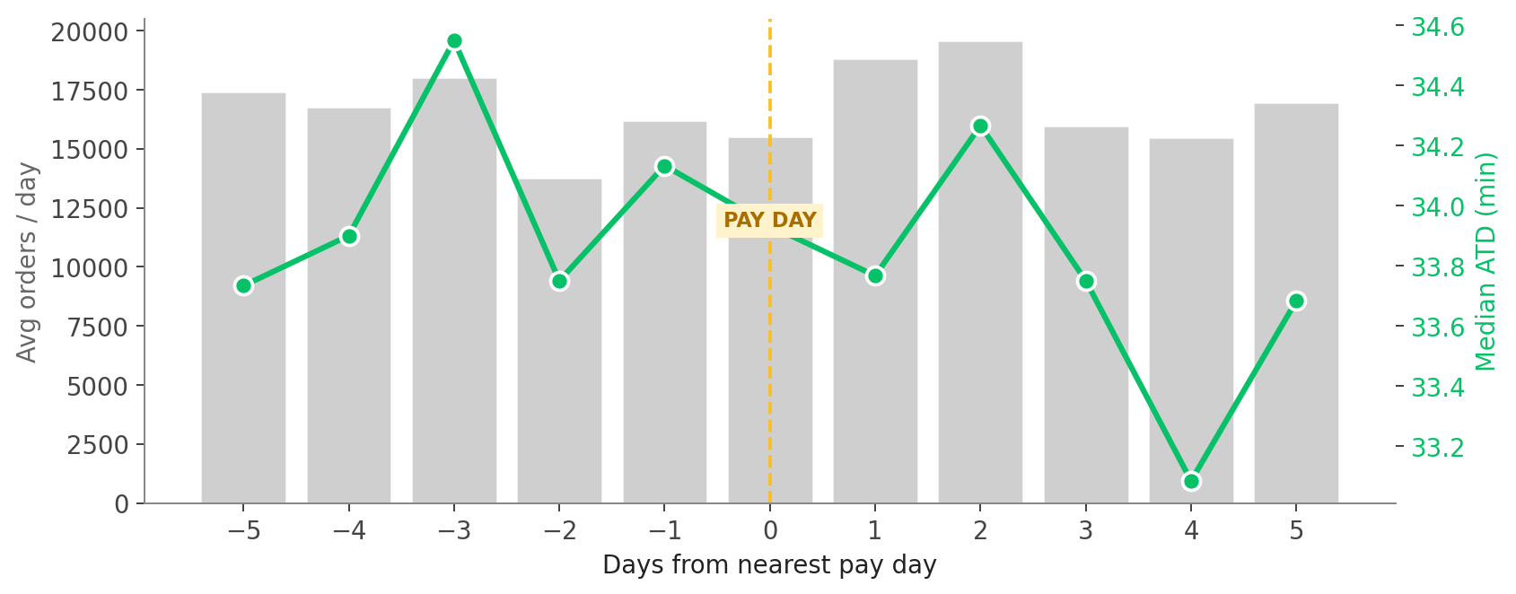
04 · LA QUINCENA
La quincena barely moves the dial in this window.
Mexicans get paid on the 15th and the last day of each month, shifted to the preceding Friday when those land on a weekend. We collapsed every day onto its position vs the nearest effective pay day.
SAMPLE SIZE NOTE
Only 3 actual pay days in this 2-month window. Treat any pattern as directional, not conclusive.
PAY-DAY WINDOW VS OTHER DAYS
+0.1 min
Pay-day window (-1, 0, +1) vs the rest of the month. Effectively flat.
VOLUME LIFT
+0.5%
vs other days. Not a meaningful spike.
04 · LA QUINCENA
05 / 10

Slide 6
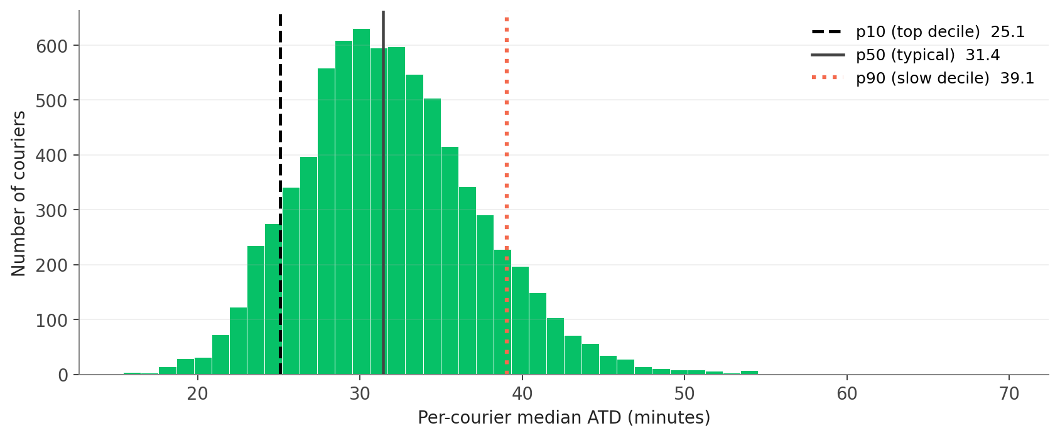
05 · THE SLOW TAIL
Same trips, different times. That's coachable.
Even on similar-length trips, the slowest 10% of couriers take 7.3 minutes longer than the typical courier.
25.1 min
31.4 min
38.7 min
P10 · TOP DECILE
P50 · TYPICAL
P90 · SLOW DECILE
Fastest 10%
Median courier
+7.3 min vs typical
DISTANCE-CONTROLLED
Slow couriers do average 6.7 km trips vs 3.5 km for the top decile. So distance explains some of the gap. But not all of it. Inside any distance band, the p90 to p50 gap stays around 5 to 7 minutes. Field Ops can act on this with scorecards, route coaching, and re-tenuring.
05 · THE SLOW TAIL
06 / 10

Slide 7
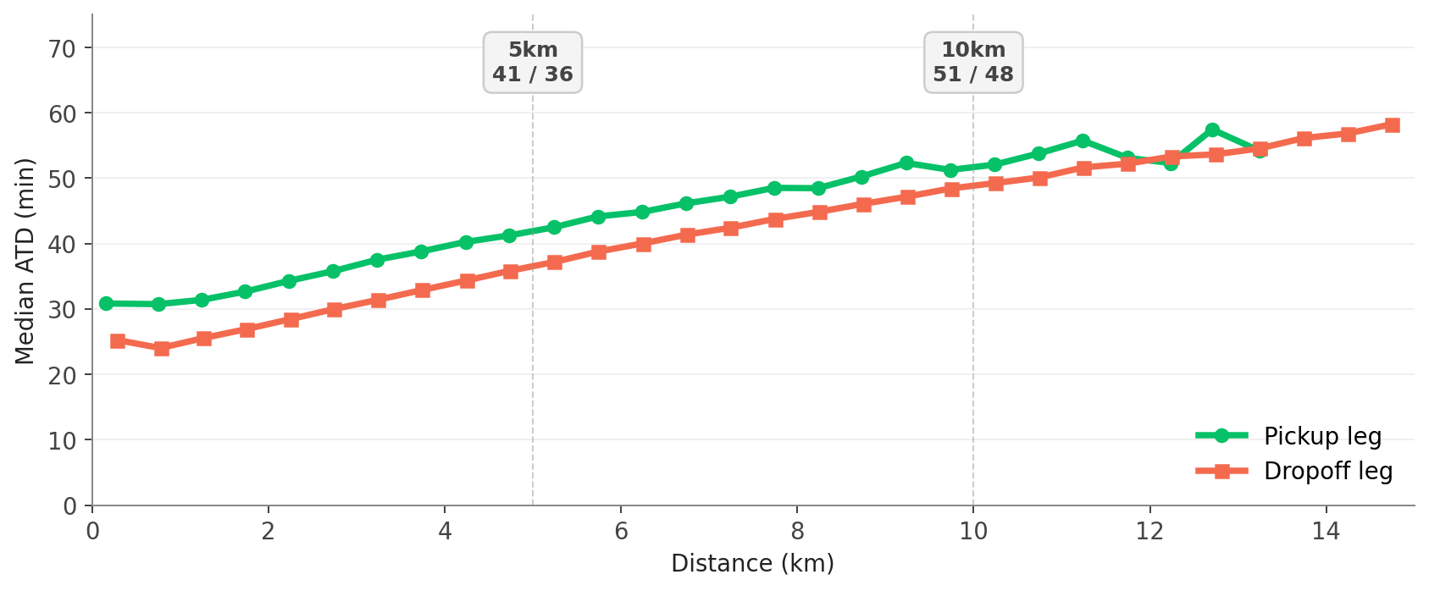
06 · DISTANCE PHYSICS
The dropoff leg pulls 2.5x harder than pickup.
Each kilometre on the dropoff costs about 2.5 minutes. Each kilometre on the pickup costs about 2.0 minutes.
CORRELATION WITH ATD
Pickup 0.17 Dropoff 0.43
Dropoff is the stronger signal.
READING THE MARKERS
At 5 km a typical pickup takes 41 minutes and a dropoff takes 36. At 10 km the pickup leg climbs to 51 minutes. Dropoff climbs to 48. Each extra kilometre on dropoff is 2.5 minutes of customer wait. Neither correlation crosses 0.5. Distance is the floor, not the ceiling.
WHY THIS MATTERS
Half of ATD variation has nothing to do with distance. That gap is restaurant prep, dispatch latency, traffic, and courier behaviour. Operating model, not maps.
06 · DISTANCE PHYSICS
07 / 10

Slide 8
07 · HOW THE SYSTEM RUNS
Built once. Re-runs every Monday with zero changes.
One SQL query, one Airflow DAG, one model. Same dashboard the team is looking at right now.
TASK 1 · THE SQL PIPELINE
TASK 3 (BONUS) · THE MODEL
atd_weekly.sql
MAE
SELECT COALESCE(c.territory, 'Unspecified') AS territory, d.country_name, t.workflow_uuid, t.driver_uuid, t.delivery_trip_uuid, t.courier_flow, t.restaurant_offered_timestamp_utc, t.order_final_state_timestamp_local, t.geo_archetype, t.merchant_surface, m.pickupdistance / 1000.0 AS pickup_distance, m.traveldistance / 1000.0 AS dropoff_distance, TIMESTAMPDIFF(MINUTE, t.restaurant_offered_timestamp_utc, t.order_final_state_timestamp_local) AS ATD FROM tmp.lea_trips_scope_atd_consolidation_v2 t INNER JOIN delivery_matching.eats_dispatch_metrics_job_message m ON t.workflow_uuid = m.jobuuid AND m.isfinalplan = TRUE INNER JOIN dwh.dim_city d ON m.cityid = d.city_id LEFT JOIN kirby_external_data.cities_strategy_region c ON d.city_id = c.city_id WHERE d.country_name = 'Mexico' AND DATE(t.eater_request_timestamp_local) BETWEEN DATE_SUB(DATE('{{ ds }}'), 7) AND DATE_SUB(DATE('{{ ds }}'), 1);
10.4 min
60% of predictions within 10 minutes
R²
vs median
vs distance LR
0.29
−2.0 min
−0.9 min
WEEKLY RHYTHM · AIRFLOW DAG, MONDAYS 03:00 UTC
WHAT TO READ INTO IT
R² of 0.29 reads modest in isolation, but the model beats every simpler baseline. The remaining gap is data we don't have yet: live traffic, kitchen prep, batching state.
1. Freshness
2. Build
3. DQ gate
4. Swap
5. Retrain
6. Notify
Sources fresh?
Run query, write staging
Validate before swap
Rename staging to prod
Refresh model + score
Slack summary
07 · HOW THE SYSTEM RUNS
08 / 10

Slide 9
08 · INSIGHT TO ACTION
Three plays, ordered by impact.
Each one is sized in minutes saved, owned by a specific team, and trackable on the same dashboard from week one.
1
From slide 6
2
From the dashboard
3
From slides 4 & 5
Coach the slow tail
Move slow merchants to POS
Schedule supply, not algorithms
p90 couriers run 7.3 minutes slower than typical even on similar trips. Surface scorecards to Field Ops weekly. Route coaching, hot-zone hints, re-tenuring.
POS is about 6 minutes faster than the 'Other' surface. The slow non-POS list is finite (~20% of merchants). Assign a Merchant Success rep, prioritise volume.
Sunday adds 2 min. Late night adds 8 min. The day before pay day adds 1.5. Pair forecasts with proactive incentives 90 minutes before each curve climbs.
OWNER
OWNER
OWNER
Courier Operations
Merchant Success
Dispatch + Driver Ops
TARGET
TARGET
TARGET
−2 min global median · Ongoing
−4 min on the cohort · 8 to 10 weeks
−3 min on Sun + late-night · 4 to 6 weeks
08 · INSIGHT TO ACTION
09 / 10

Slide 10
THE TAKEAWAY
The lever is volume,
not variance.
Three plays. Same data foundation. Same dashboard, refreshed every Monday at 03:00 UTC. ATD is how we earn the next Mexican consumer who already has Didi or Rappi on their phone.
01
COACH
02
MOVE
03
SCHEDULE
Close the courier slow tail.
Slow merchants onto POS.
Supply against the curve.
THANK YOU · QUESTIONS WELCOME
10 / 10

