Slide 1

G2M Case Study
Daniela Alvarez Zegarra
Sep-3rd-2021

Slide 2
Background
XYZ is an investment firm that, due to the cab industry growth, wants to invest on the right cab company.
As part of their go to market strategy, they wish to understand the market before investing on it. So the purpose of this presentation is to help XYZ take the right decision.

Slide 3
Frame the problem
What is the business objective?
The business objective is to invest in the right company
How does the company expect to use and benefit from this insights?
How does the company expect to use and benefit from this insights?

Slide 4
Structure
Analysis has been divided into:
Reading the data
Examine potential outliers
Creating hypothesis
Recommendations

Slide 5
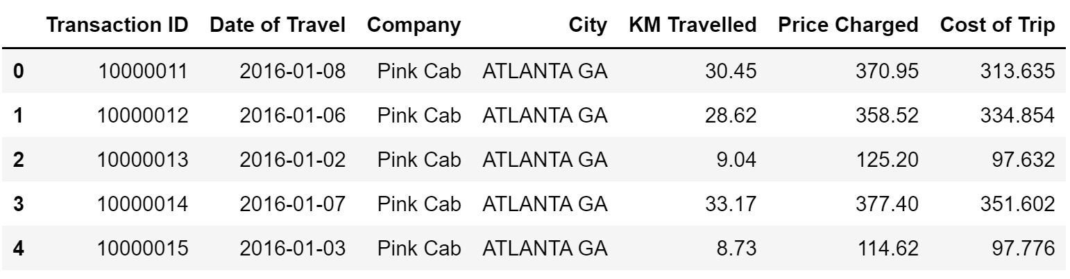
Reading the data
As an investment decision we need to make sure that the Company where we are going to invest our money is having profits, so we create a new column for profit and profit %.

Slide 6
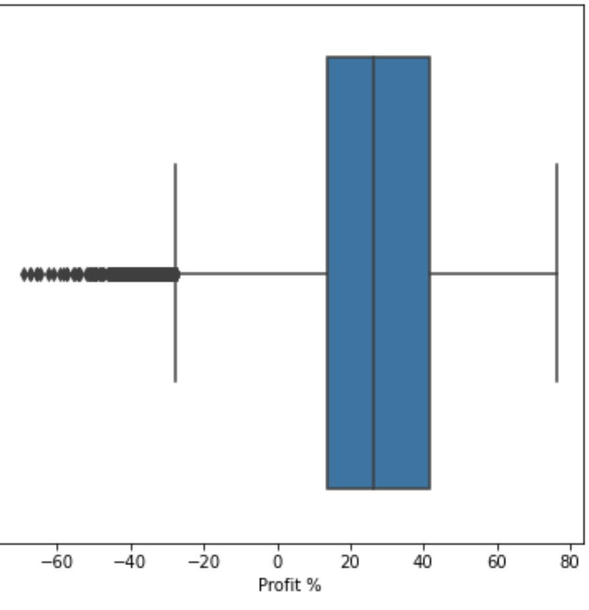
Examine potential outliers
According to the graph we can verify that there are some outliers on the profit column, generating negative profit ( or loss). By creating an IQR rule we now have a lower and upper bound to know when a value becomes an outlier.
As there were only 666 rows having negative profit and also an outlier, we created a new dataframe dropping all the outliers in Profit.

Slide 7
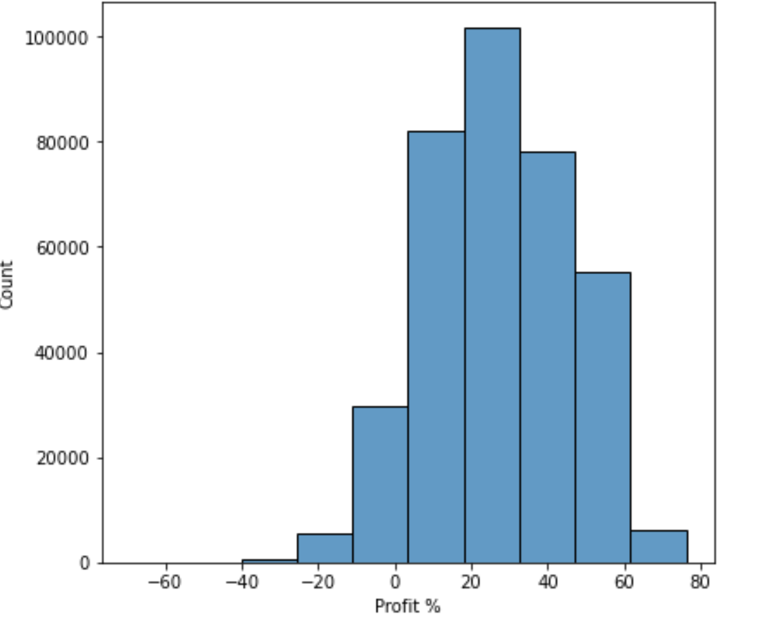
1. Is any of the companies having any loss or are they both having profits?
We can see that most of the cab transactions have a profit between 20 % and 30 %. However there are still some transactions with a negative profit (loss).

Slide 8
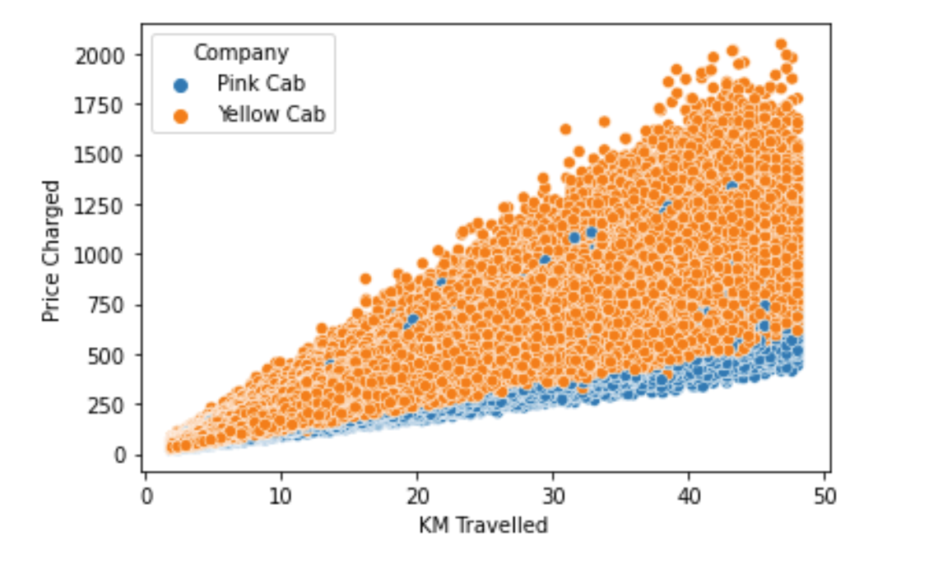
2. How does the Company affect the relationship between kms travelled and price charged?
There is clearly a positive linear relation. However, as more kms are being travelled, the price increases much more in Yellow Cab than in Pink Cab, and it still has much more rides.

Slide 9
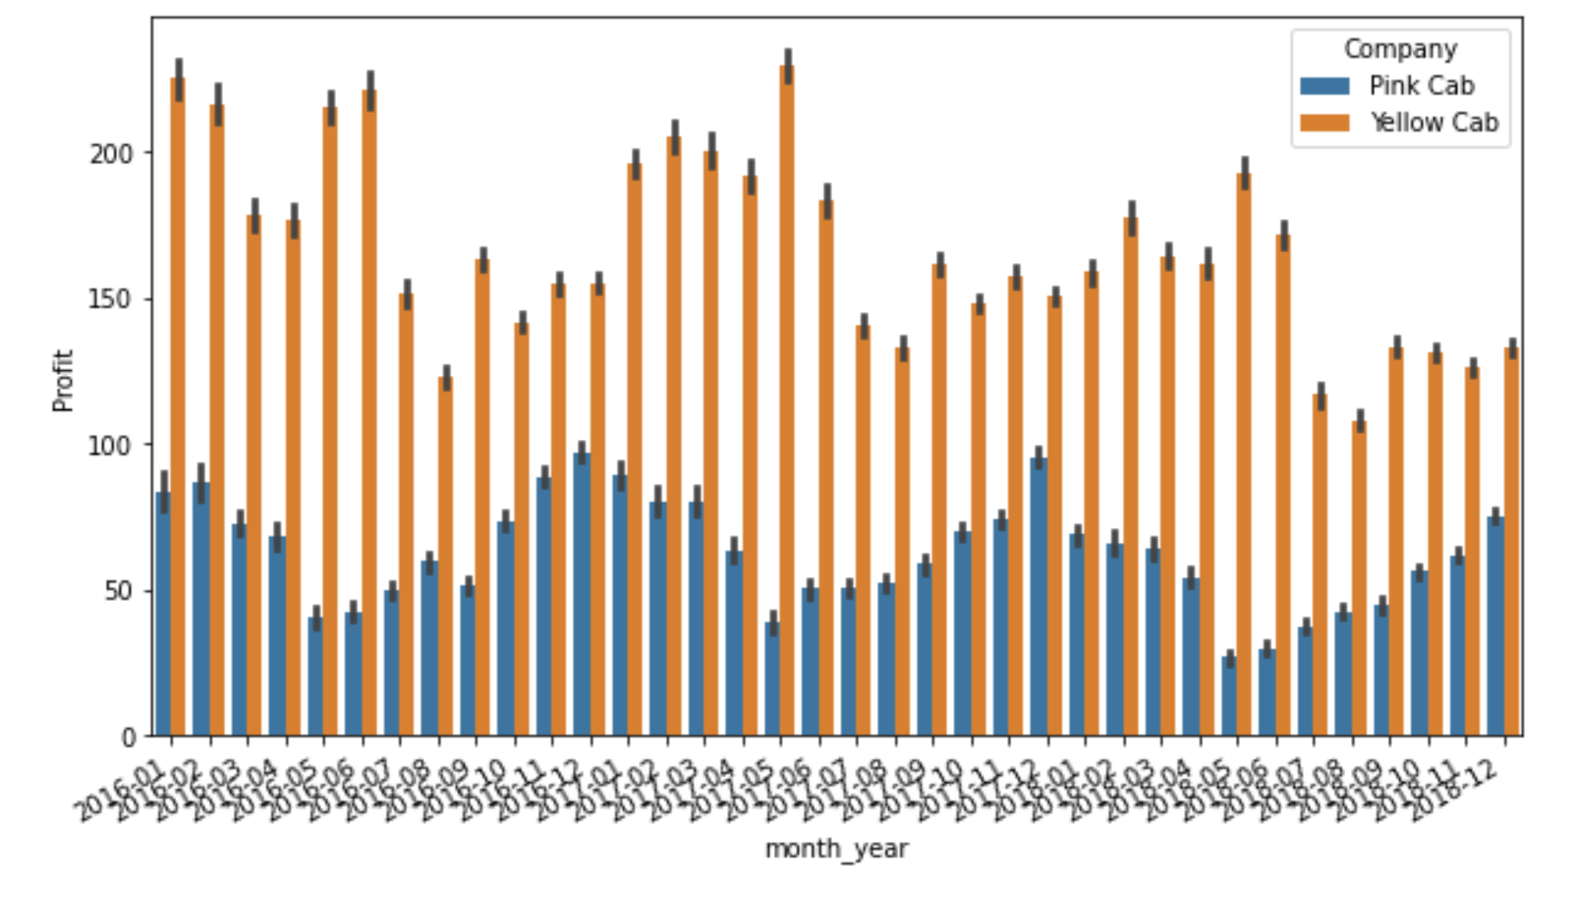
3. Is there any seasonality? What is the best season of the year for each company?
Yes there is a seasonal component in both companies, and they are opposed to each other. While profit for Pink Cab improves between January and March, it decreases for Yellow cab during those months. However, when profits for Pink Cab decreases between May and June, it improves in Yellow cab, and this seasonal pattern repeates every year.

Slide 10
Recommendations
The recommendation would be to invest in the Yellow Cab company due to the amount of rides and profit % of the price.

Slide 11
THANK YOU

