Slide 1
ScrápEle
@danifeitosa
@andy_tow
@leo_m_martinez

Slide 2
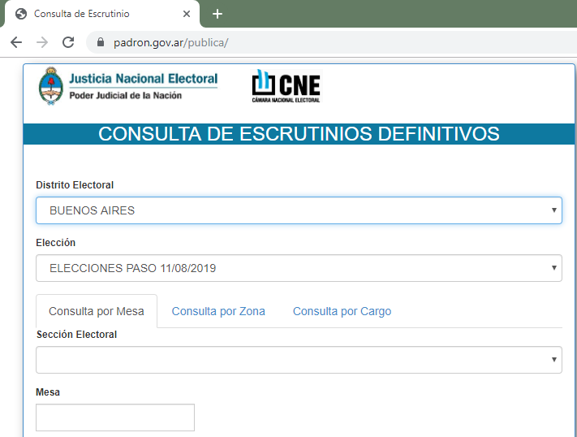
Capturar los resultados por mesa

Slide 3
ScrápEle https://github.com/danielafeitosa/scrapele
Scrap for https://www.padron.gov.ar/publica/
Windows:
Chrome https://www.google.com/intl/es-419/chrome/
Ruby https://rubyinstaller.org/downloads/
Java https://www.java.com/es/download/
Selenium Standalone Server https://www.seleniumhq.org/download/
Selenium - Webdriver https://rubygems.org/gems/selenium-webdriver
ChromeDriver - WebDriver for Chrome https://sites.google.com/a/chromium.org/chromedriver/downloads
Syntax: in Ruby command prompt, type:
result.rb X Y
Where X is district number in tables_all and district > 2.
Where Y is election number from 0 to n
If no parameter given, it will scrap all districts.
For district 2, Buenos Aires

Slide 4
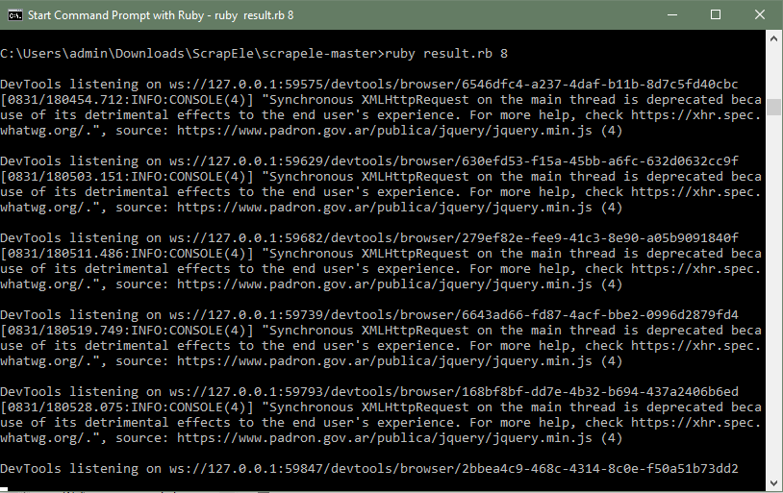
ScrápEle https://github.com/danielafeitosa/scrapele

Slide 5
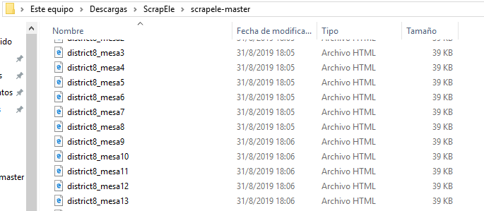
ScrápEle https://github.com/danielafeitosa/scrapele

Slide 6
To do list
Agregar parámetro de elección
Conversión de HTML a CSV
Normalización a codificación de distritos, secciones, circuitos y mesas
Correspondencias con centros de votación
Desarrollo de User Interface

