Slide 1
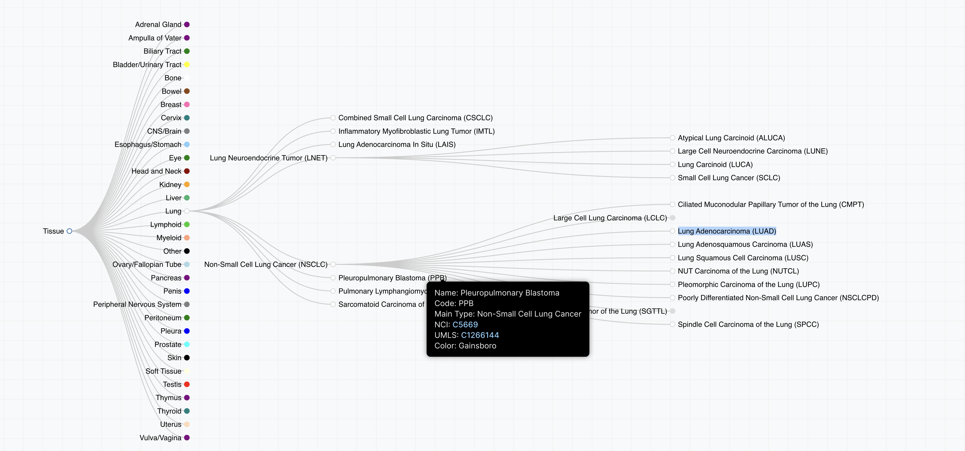
Set Up (1)
We have about 36K Clinical Samples
Each Sample has at least 1 OncoTree Code (https://oncotree.mskcc.org )
  If there are clinical samples with no Oncotree code: We need to rope in Oliver and Jeronimo and fix it
  If there are samples with multiple Oncotree codes:
    Short term: we pick 1
    Long term: we need to rope in Oliver and Jeronimo and fix it

Slide 2
Set Up (2)
Sample are annotated by different level of oncotree codes. Example: Sample 1 is Lung (level 1), Sample 2 is Lung Adenocarcinoma (LUAD) (Level 3).
Each Sample is associated with multiple data files (raw data / processed data)
  Each data file, goes through our automated processing pipeline and has many steps: 1) file was dropped into our storage, 2) file was QCd, file was associated with our database, 3) a new clinical sample was created (once all corresponding files finished the QC / harmonization)

Slide 3
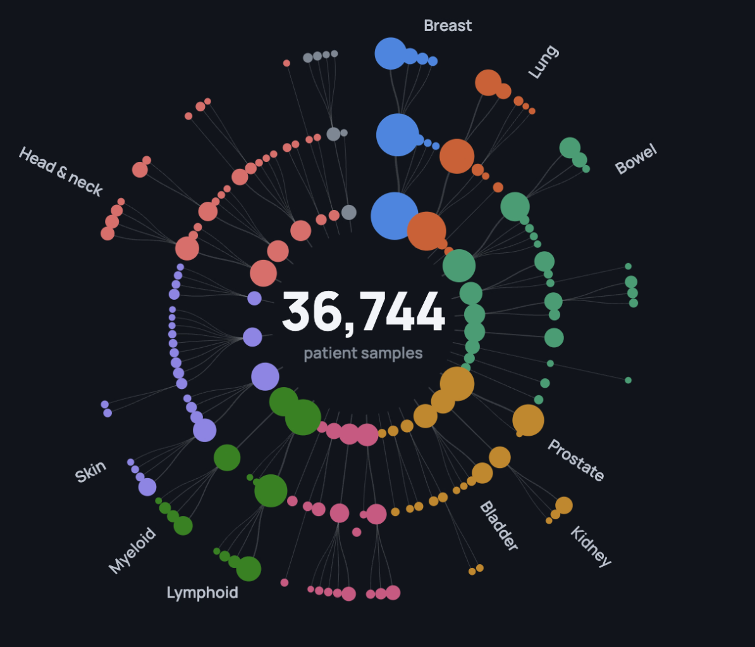
Viz Idea
We should visualize our clinical samples, based on their Oncotree code. Node will be the respective Oncotree code, and edge will indicate the parent-child Oncotree relationship. Perhaps Level 1 should be closer to the center, and Level 3 annotations on the perimeter of the circle?
Every time we have an event (eg a file has been QCd, we should indicate it with a popping circle that each close to the respective Oncotree code.

Slide 4
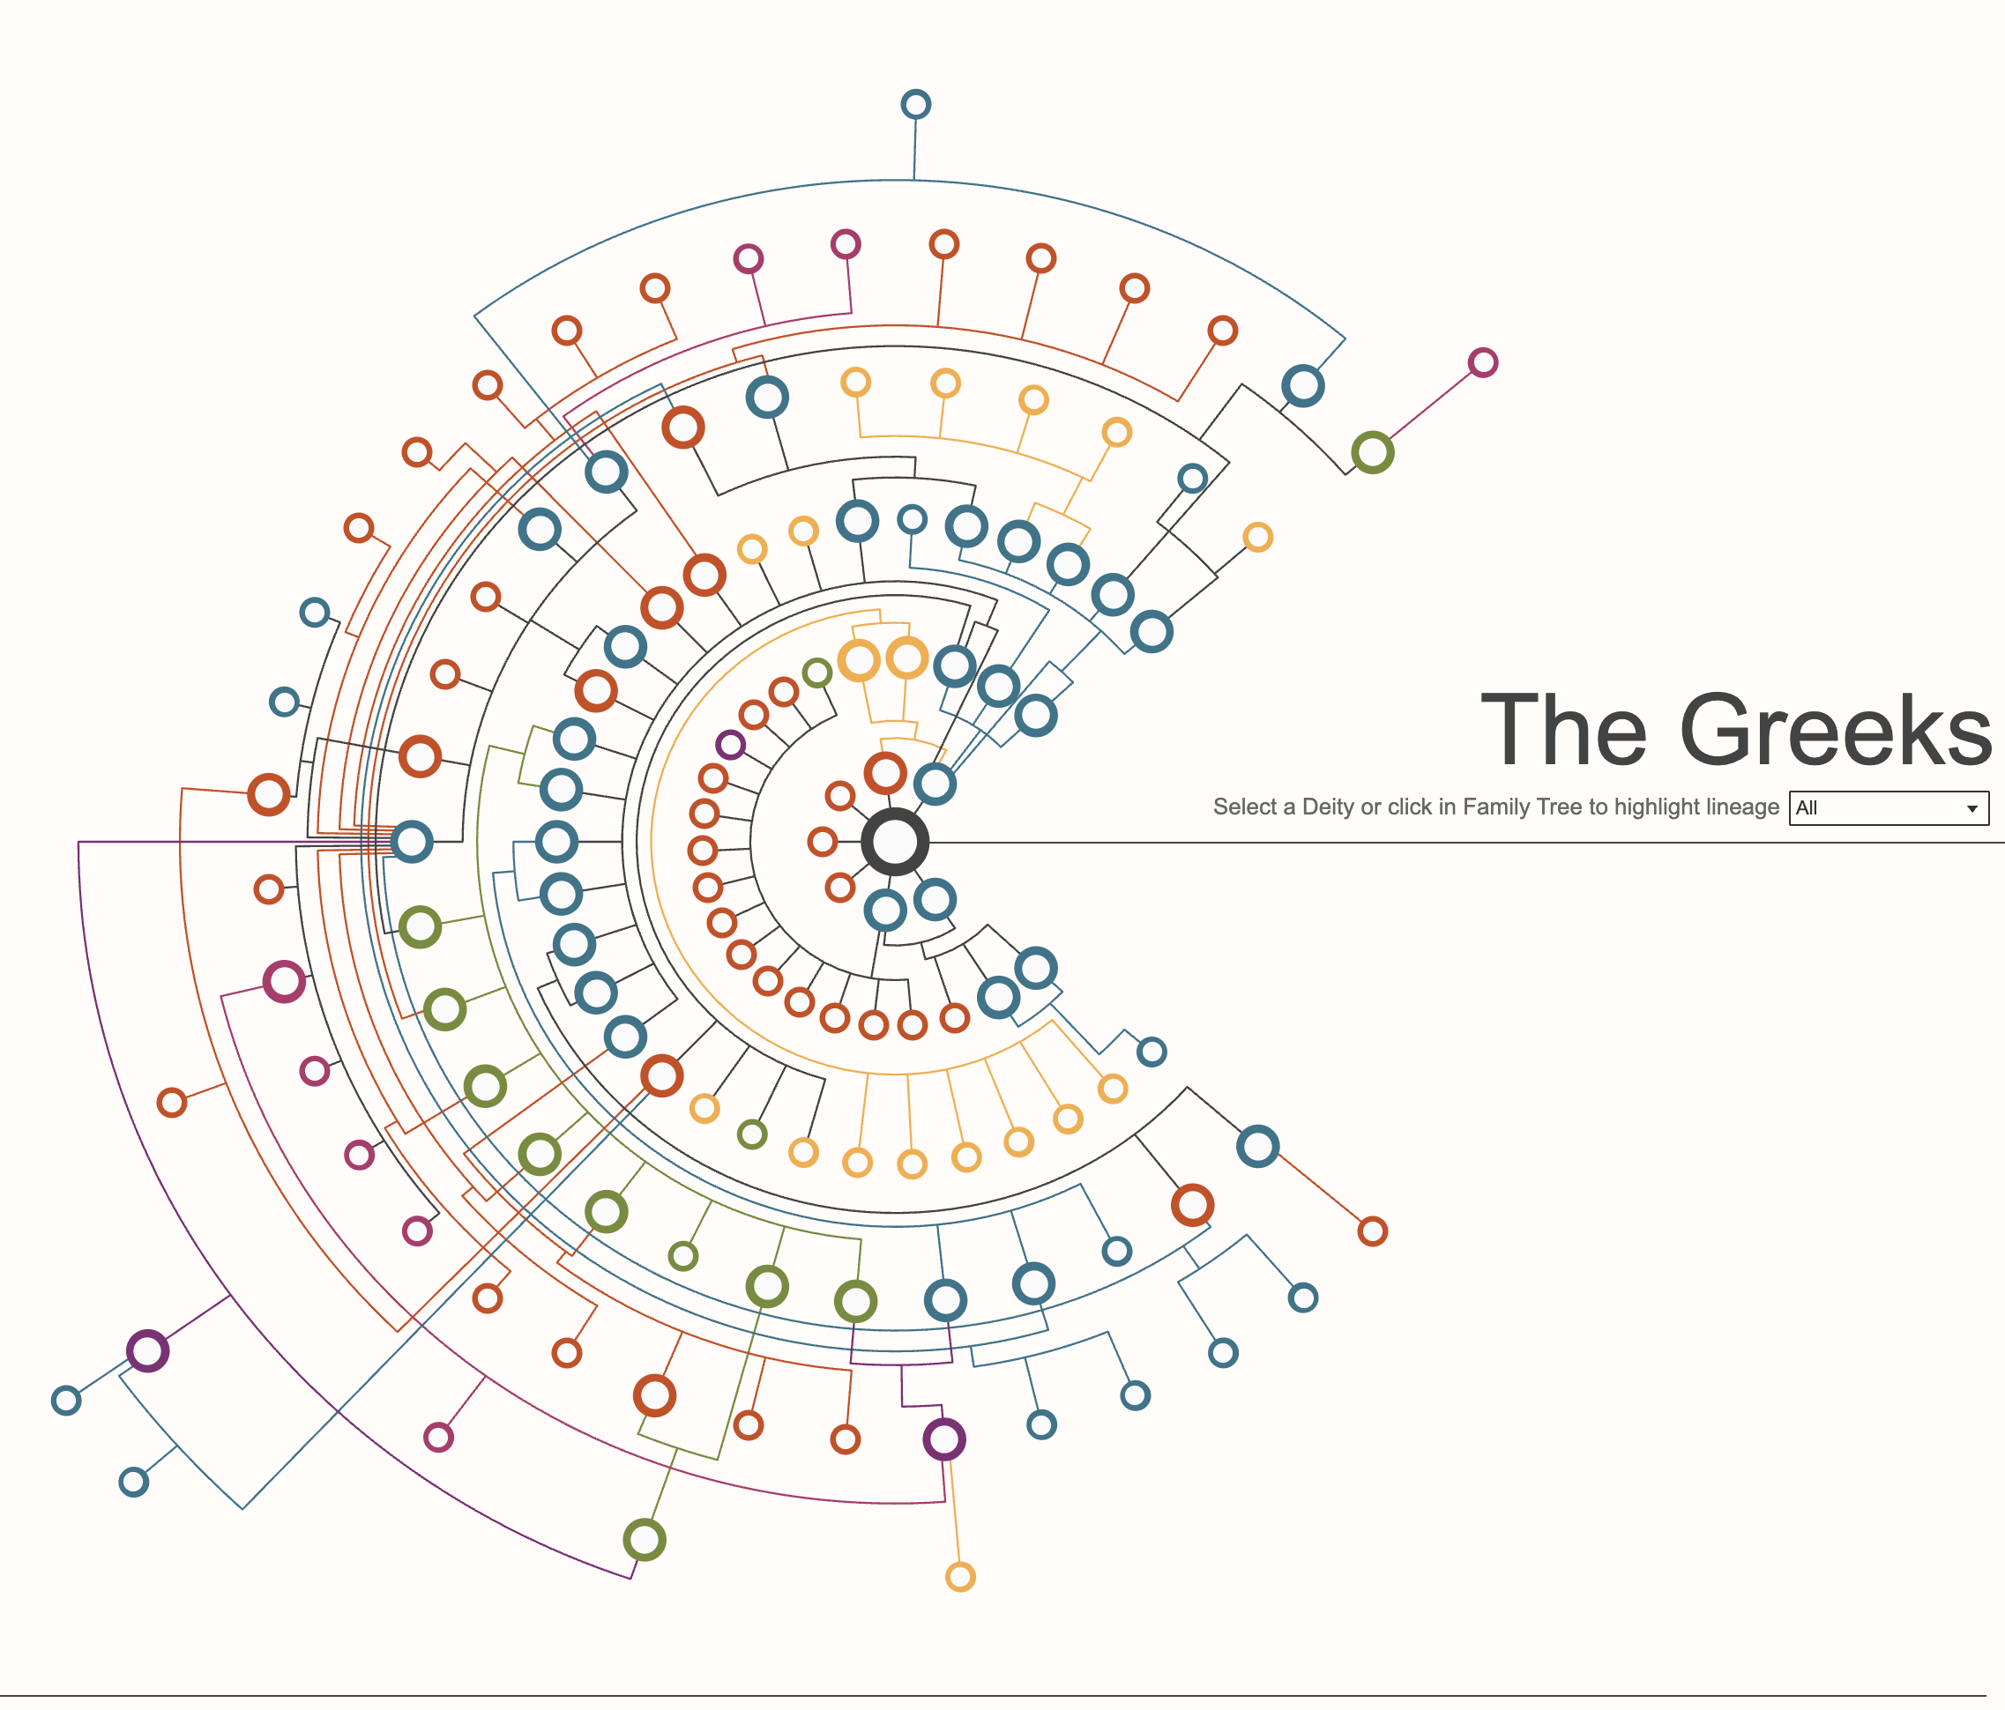
Viz Idea (2)
Alternatively, we can have the new events popping on the right side (where The Greeks is) and then moving towards the radial plot (from right to left) and then popping out of view. And then the corresponding Oncotree circle, will become a bit bigger
Files (nodes) should appear here and move towards left
https://public.tableau.com/app/profile/brian.moore7221/viz/FamilyTreesofAncientMythology/FamilyTrees

Slide 5
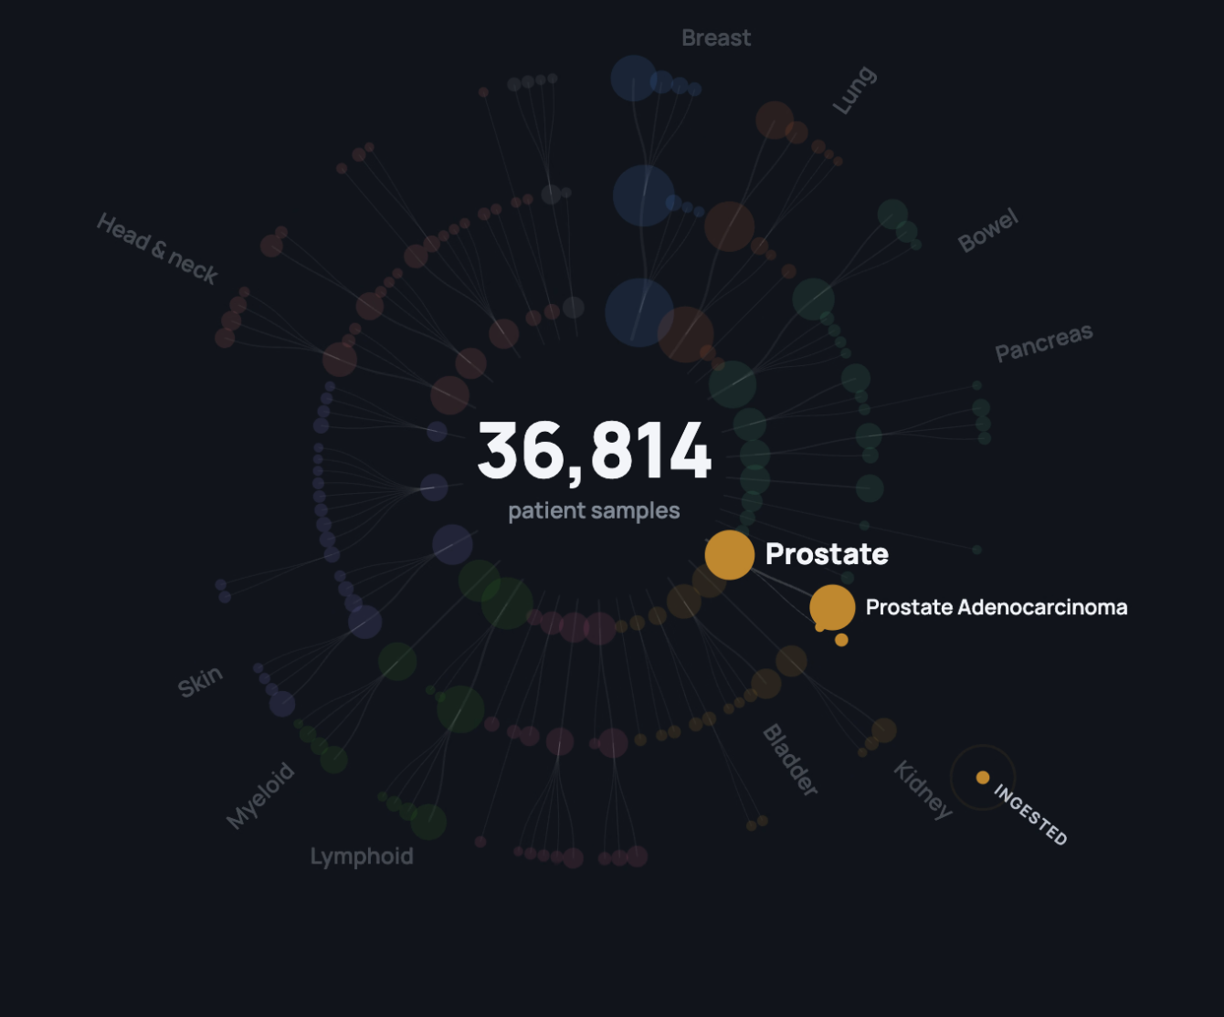
Viz Idea (3)
We can stagger the events, so we are showing events for only one Level 1 Oncotree at the same time. For example, we highlight the Prostate Oncotree nodes, and then we show only information that correspond to 1 clinical sample, in the Prostate category
Perhaps, while we highlight a specific site group (eg Prostate) we then can also show on the right side of the screen some other information about that site disease group (e.g. how many of those clinical samples were biopsies NGS vs liquid biopsies
Once the node for that oparticualr sample, becomes +1, then we highlight a different cancer site (e.g. breast) and start again the visualization anew)
Stats about Highlighted Oncotree catehory

Slide 6
Data That we will need
Events in the Vizualization will be based on actions on files (each clinical sample can have multiple files)
File ID | File Type | Timestamp | Clinical Sample ID | Oncotree code (we need to select only one) | Action (trigger)
File 1 | VCF | 10/9/2026 12:03 | Sample1 | Brain | File landed in our storage
File 2 | VCF | 10/9/2026 12:04 | Sample1 | Brain | File passed QC
File 3 | FASTQ | 10/9/2026 12:06 | Sample1 | Brain | File passed QC
File 4 | VCF | 10/9/2026 12:08 | Sample2 | Skin | File passed QC

