Slide 1
30 March 2026
Physical Benchmarking
Private and Confidential

Slide 2
Report Overview
The SkillCorner AI platform has been used to provide objective physical data on the following players during season(s) 2025/2026:
Alexia Putellas Segura (11 matches)
In addition, the following players have been included for benchmarking purposes:
Central Midfielders playing in the ESP - Primera División Femenina - 2025/2026 (860 performances).
As well as all Central Midfielders from the ESP - LaLiga 2 - 2025/2026 on pages 4 to 8. Only performances of 10 matches over 60 minutes in the Central Midfielder position have been included.

Slide 3
Physical Data Context
The physical data in this comparison study is reported in isolation, however we acknowledge that the highly tactical and dynamic nature of Football means that physical output should not generally be considered in isolation. It is also a function of playing style, tactics, formations, transitions, set pieces and in-possession and out-of-possession strategies.
The influence of other factors means there is a high level of variability in match-to-match performances as documented through scientific research by Gregson et al. (2010) and Carling et al. (2016). Therefore data should be viewed longitudinally to understand the physical capability of players.
We are providing this data as a framework to support player profiling but understand that the physical data needs to be reviewed alongside technical and tactical data to fully understand and evaluate performance.
Gregson W. ,Drust, B., Atkinson, G., Di Salvo, V. (2010). Match-to-Match Variability of High-Speed Activities in Premier League Soccer. International Journal of Sports Medicine, 31 (4). pp. 237-242
Carling, C, Bradley, P., McCall, A and Dupont, G (2016). Match-to-Match Variability in High-Speed Running Activity in a Professional Soccer Team. Journal of Sports Sciences, 34 (24). pp. 2215-2223.

Slide 4
Glossary
Total Distance: Total distance covered. M/min: Total distance covered divided per number of minutes. For TIP (resp OTIP), it's divided per number of minutes TIP (resp OTIP). Running Distance: Distance covered between 15km/h and 20km/h. High Speed Running (HSR) Distance: Distance covered between 20 and 25 km/h. Sprinting Distance: Distance covered above 25 km/h. High Intensity (HI) Running Distance: Distance covered above 20 km/h. Number Of High Speed Runs: Discrete activity between 20 and 25 hm/h. The activity needs to last for at least 0.7s. Number Of Sprints: Discrete activity exceeding 25 km/h. The activity needs to last for at least 0.7s. Number Of High Intensity Actions: Discrete activity exceeding 20 km/h. The activity needs to last for at least 0.7s.
Distance Per Sprint: Sprinting distance divided by number of sprints. Number Of Medium Accelerations: Discrete activity between 1.5 m/s² and 3 m/s². The activity needs to last for at least 0.7s. Number Of High Accelerations: Discrete activity exceeding 3 m/s². The activity needs to last for at least 0.7s. Number Of Medium Decelerations: Discrete activity between -1.5 m/s² and -3 m/s². The activity needs to last for at least 0.7s. Number Of High Decelerations: Discrete activity under -3 m/s². The activity needs to last for at least 0.7s.
Count Explosive Accelerations to Sprint: Count of High Accelerations (see definition above) starting from a speed below 9km/h when achieving an Explosive Acceleration to Sprint during a performance.
Time to Sprint: The minimum time spent between 9 km/h and 25 km/h when achieving an Explosive Acceleration to Sprint during a performance.
Top 3 Time to Sprint: When averaging performances, provides the average of the 3 best Time to Sprint performances. Note that this metric is provided only if the player has 3 performances with a Time to Sprint. PSV-99: Peak sprint velocity 99th percentile. This metric reflects the peak speed of a player and its ability to reach it multiple times or sustain it long enough.
Top 5 PSV-99: When averaged by player only. Best 5 PSV-99 performances by player.
TIP: Team in Possession OTIP: Opponent Team In Possession
BIP: Ball in Play. The sum of TIP & OTIP
P90: Per 90 minutes
P60 BIP: Per 60 BIP minutes

Slide 5
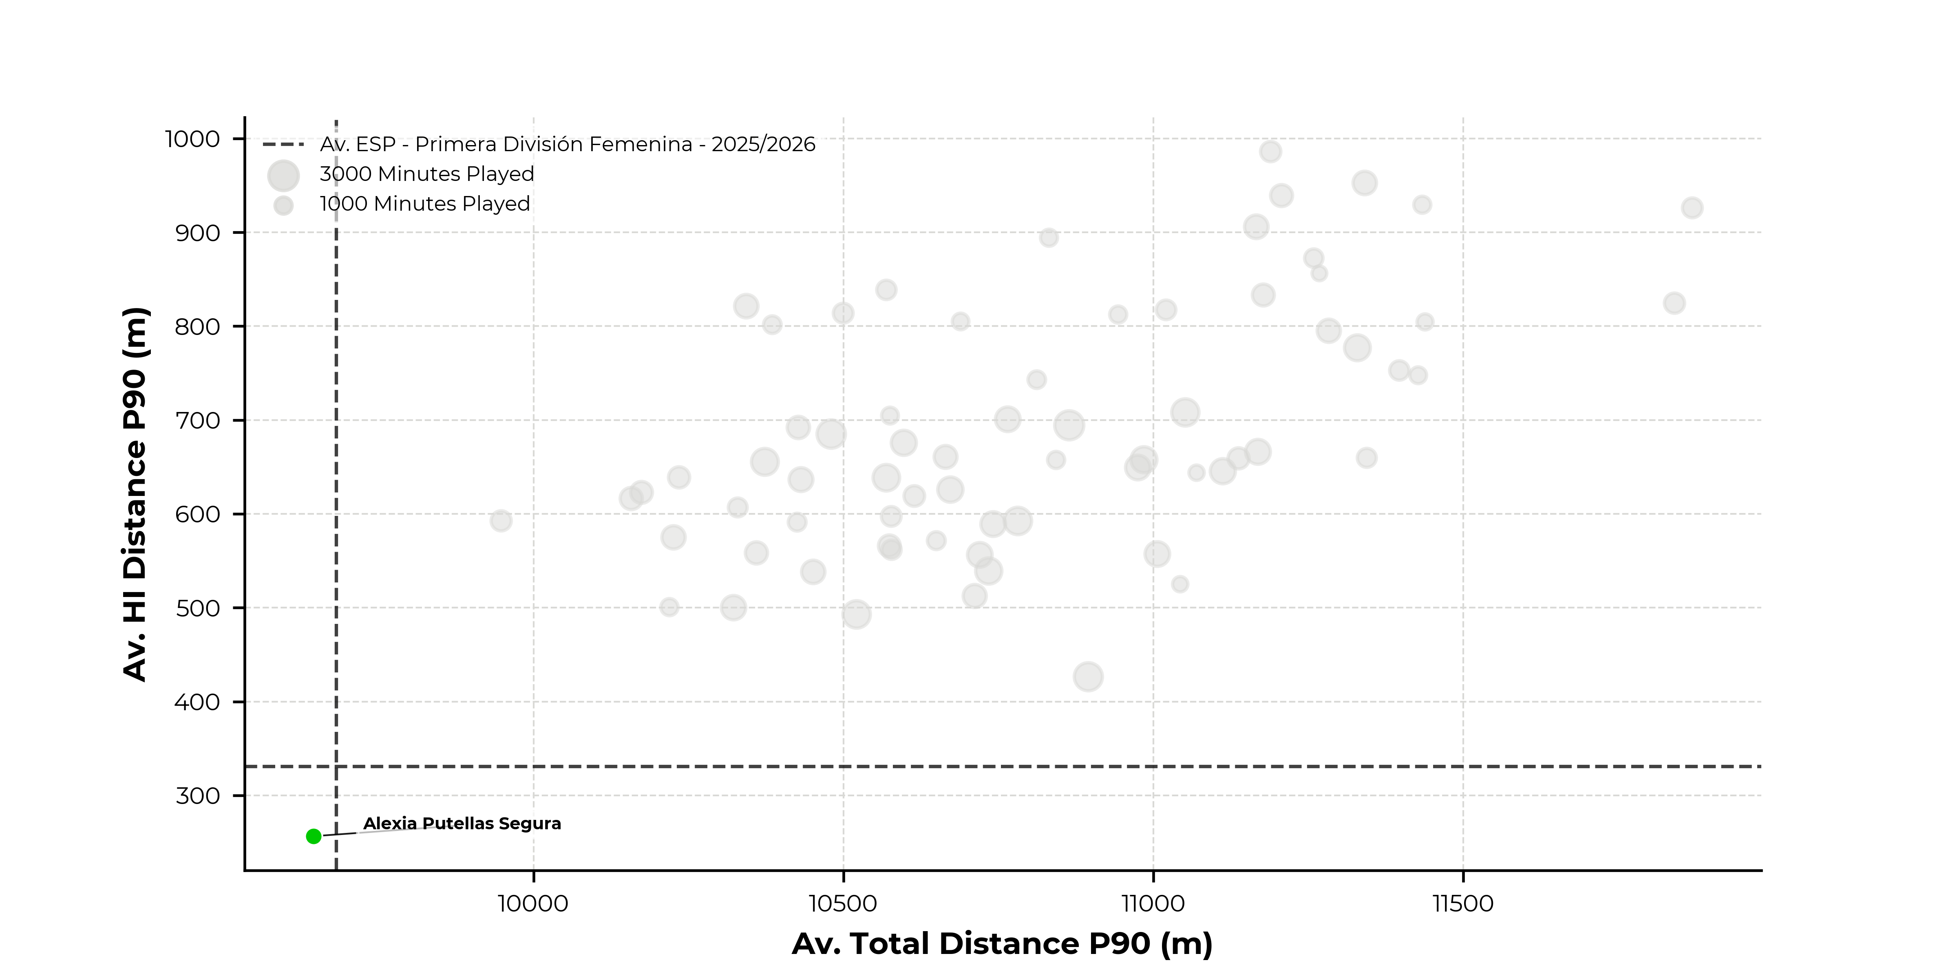
Volume
Total Distance: Total distance covered.
High Intensity (HI) Running Distance: Distance covered above 20 km/h.
Notes:
H 0.3 V1.03
8.77 Width

Slide 6
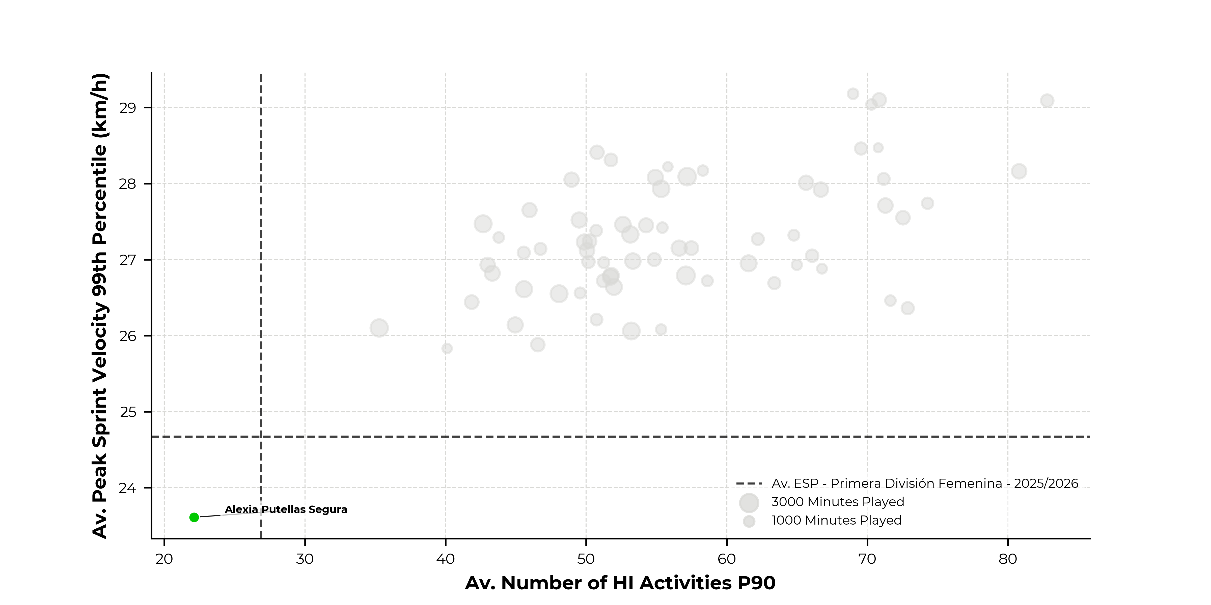
Intensity
Number Of High Intensity Actions: Discrete activity exceeding 20 km/h. The activity needs to last for at least 0.7s.
PSV-99: Peak sprint velocity 99th percentile. This metric reflects the peak speed of a player and its ability to reach it multiple times or sustain it long enough.
Notes:
H 0.3 V1.03
8.77 Width

Slide 7
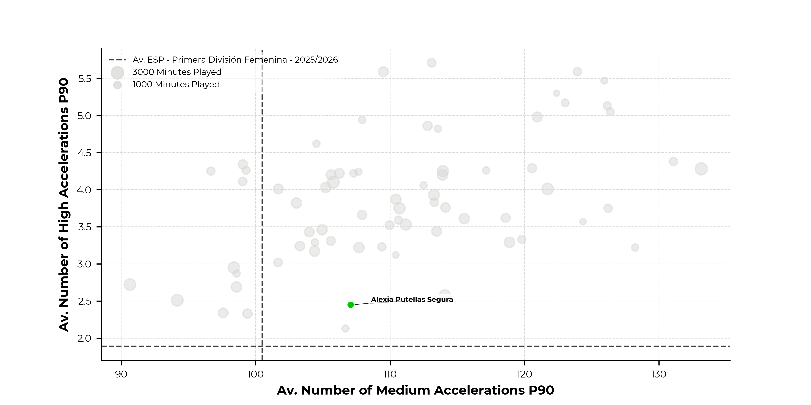
Acceleration
Number Of Medium Accelerations: Discrete activity between 1.5 m/s² and 3 m/s². The activity needs to last for at least 0.7s. Number Of High Accelerations: Discrete activity exceeding 3 m/s². The activity needs to last for at least 0.7s.
Notes:
H 0.3 V1.03
8.77 Width

Slide 8
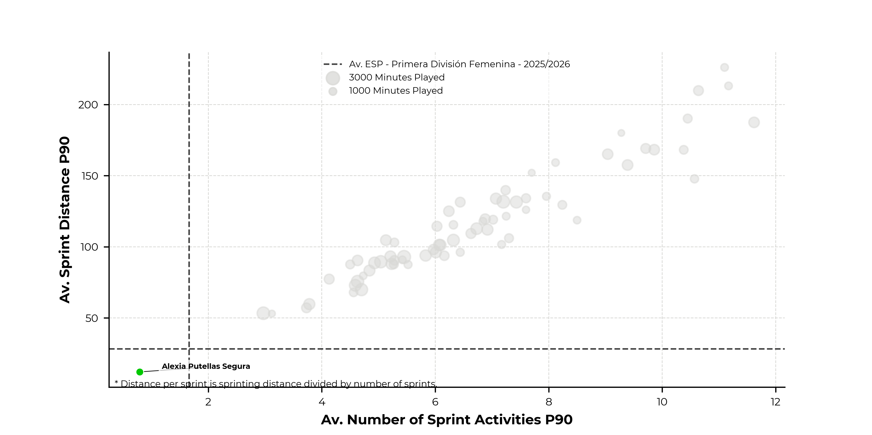
Sprinting
Number Of Sprints: Discrete activity exceeding 25 km/h. The activity needs to last for at least 0.7s.
Distance Per Sprint: Sprinting distance divided by number of sprints.
Notes:
H 0.3 V1.03
8.77 Width

Slide 9
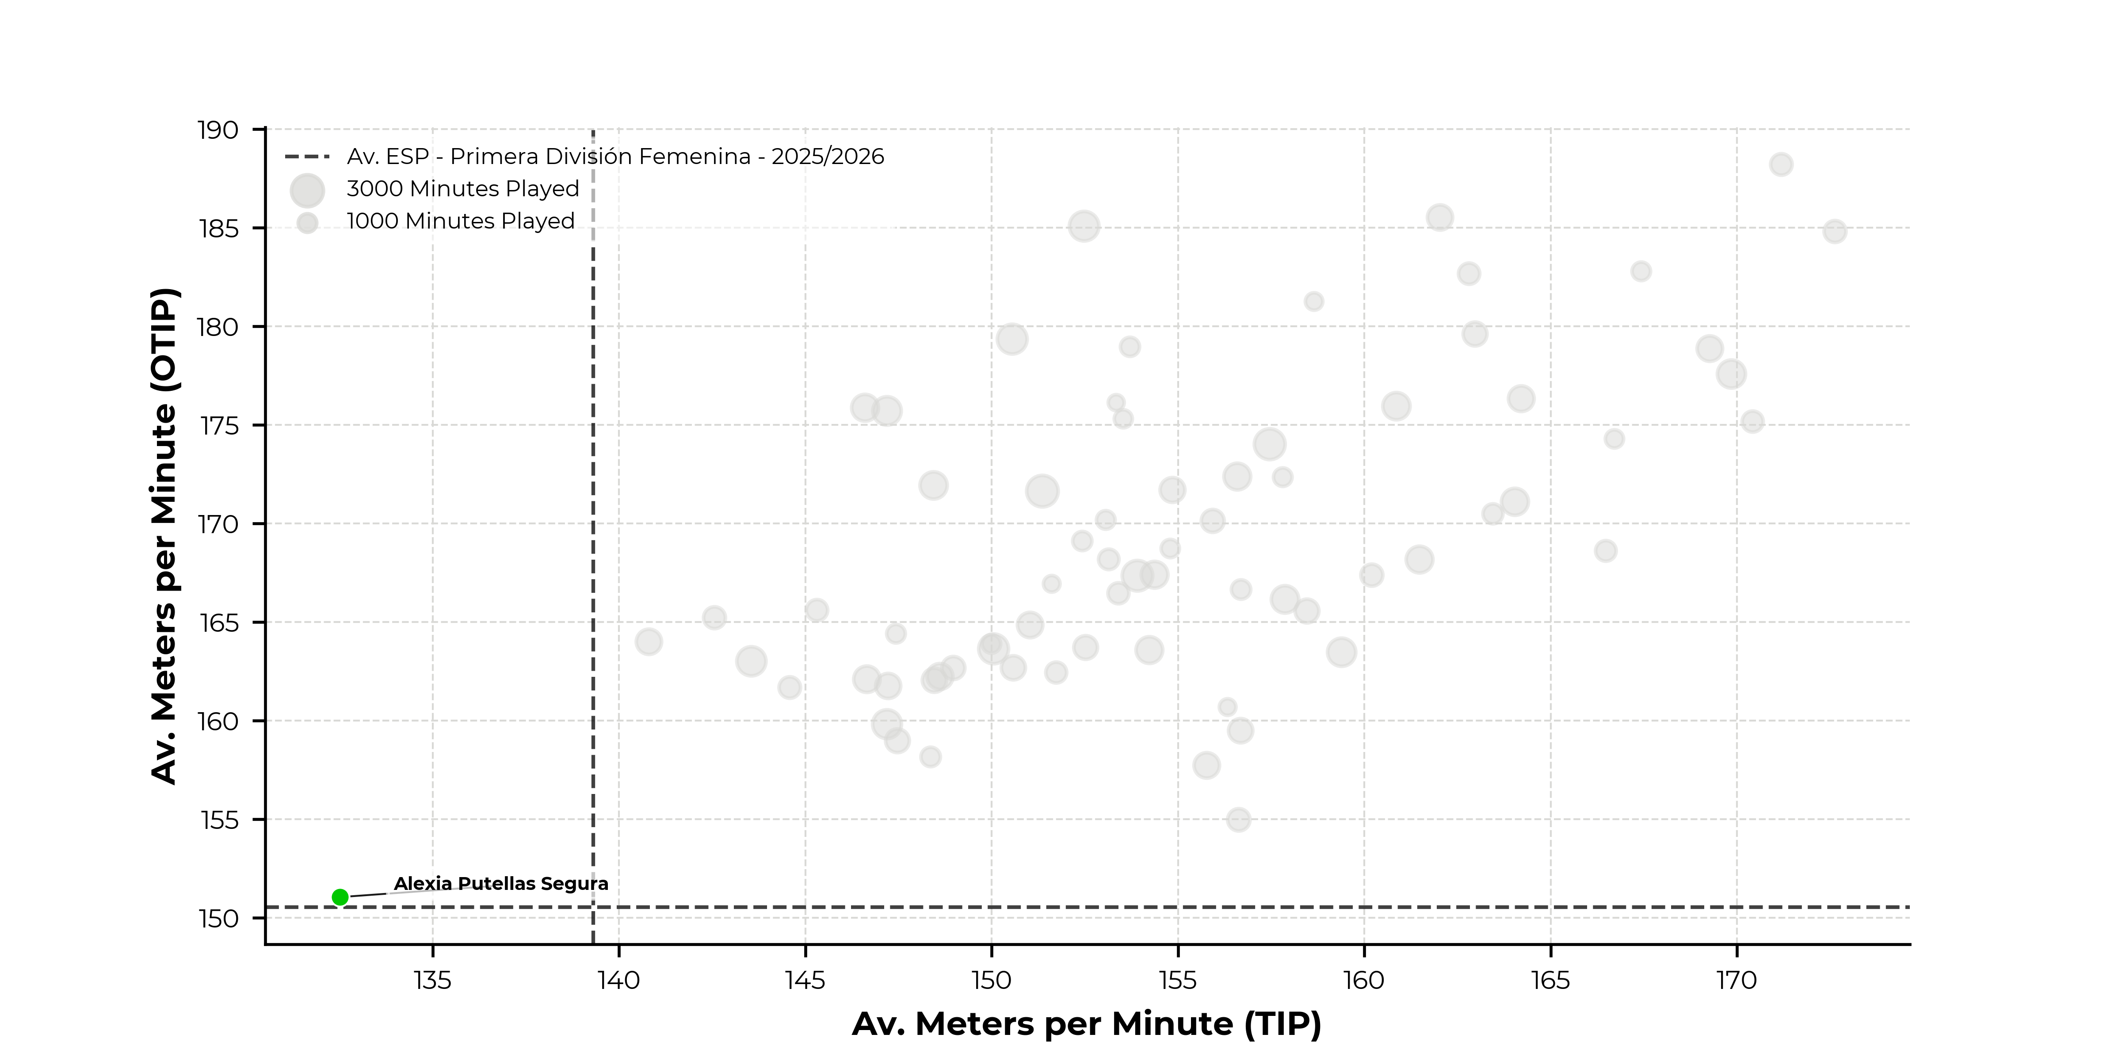
Meters Per Minute
M/min: Total distance covered divided per number of minutes. For TIP (resp OTIP), it's divided per number of minutes TIP (resp OTIP).
Notes:
H 0.3 V1.03
8.77 Width

Slide 10
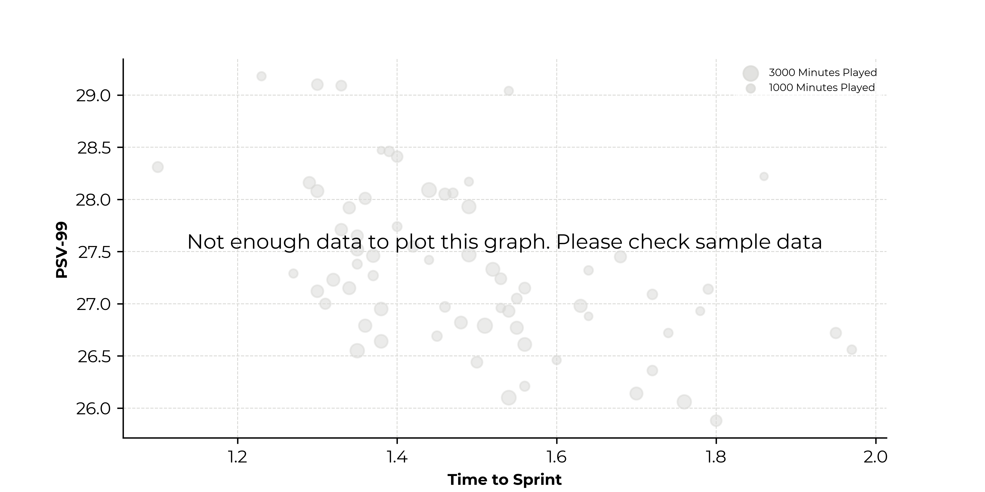
Time to Sprint
Time to Sprint: 3 best Time to Sprint performances. Note that this metric is provided only if the player has 3 performances with a Time to Sprint.
PSV-99: Peak sprint velocity 99th percentile. This metric reflects the peak speed of a player and its ability to reach it multiple times or sustain it long enough.
Notes:
H 0.3 V1.03
8.77 Width

Slide 11
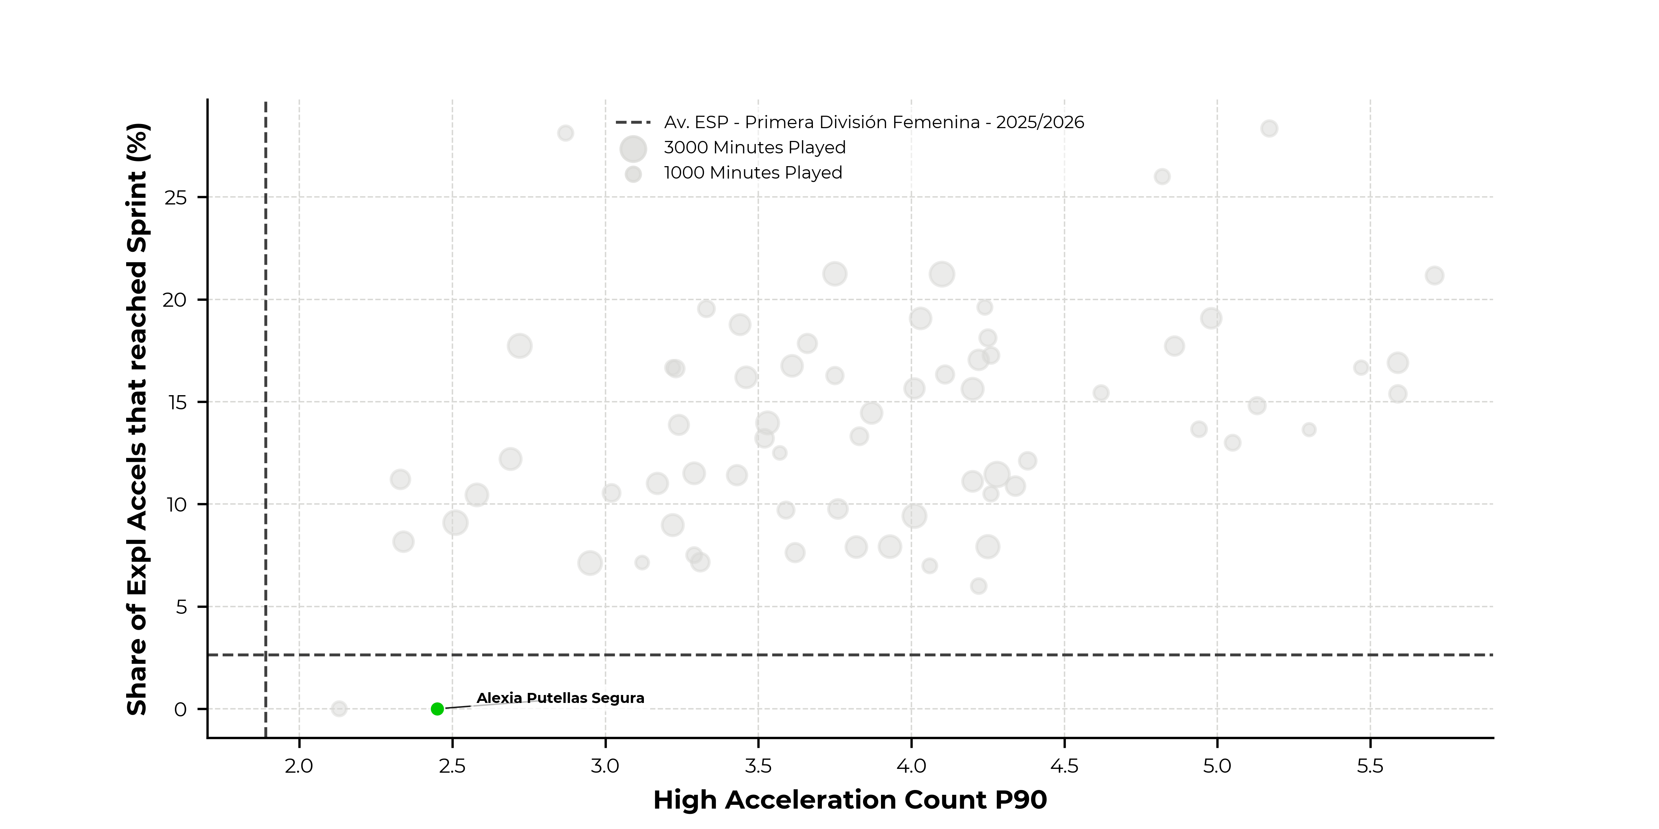
Players Explosiveness
Count Explosive Accelerations to Sprint : Count of High Accelerations starting from a speed below 9km/h and reaching at least 25 km/h.
Number of High Accelerations: Discrete activity exceeding 3 m/s². The activity needs to last for at least 0.7s.
Notes:
H 0.3 V1.03
8.77 Width

Slide 12
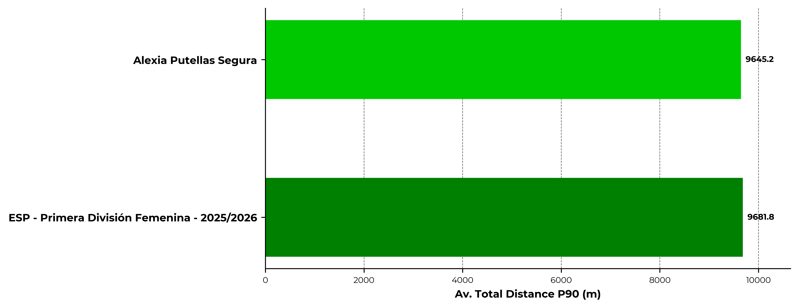
Total Distance P90 (m)
Total distance covered.
Notes:
H 0.3 V1.03
8.77 Width

Slide 13
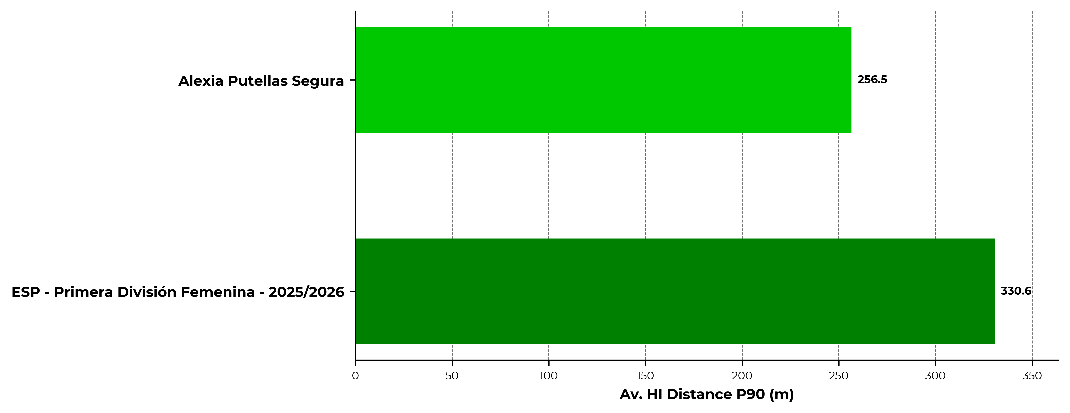
High Intensity (HI) Running Distance P90 (m)
Distance covered above 20 km/h.
Notes:
H 0.3 V1.03
8.77 Width

Slide 14
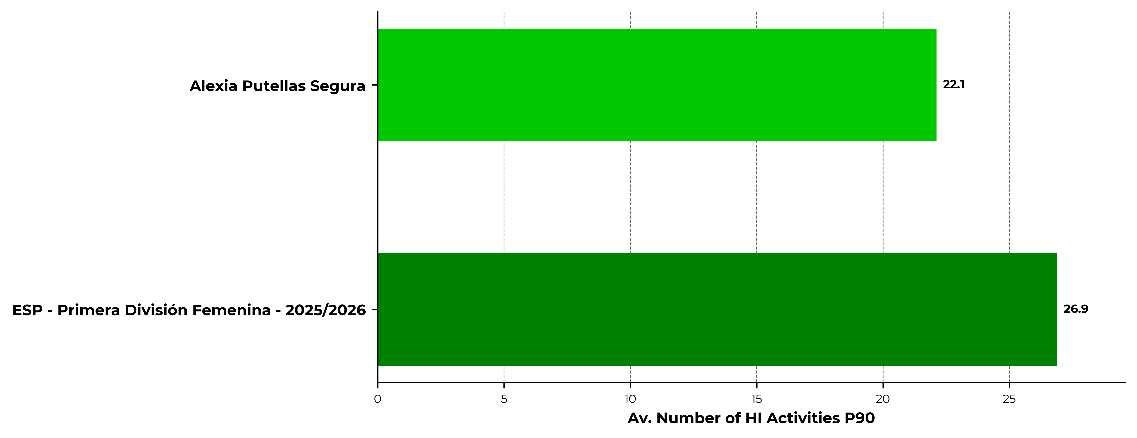
Number Of High Intensity Actions P90
Discrete activity exceeding 20 km/h. The activity needs to last for at least 0.7s.
Notes:
H 0.3 V1.03
8.77 Width

Slide 15
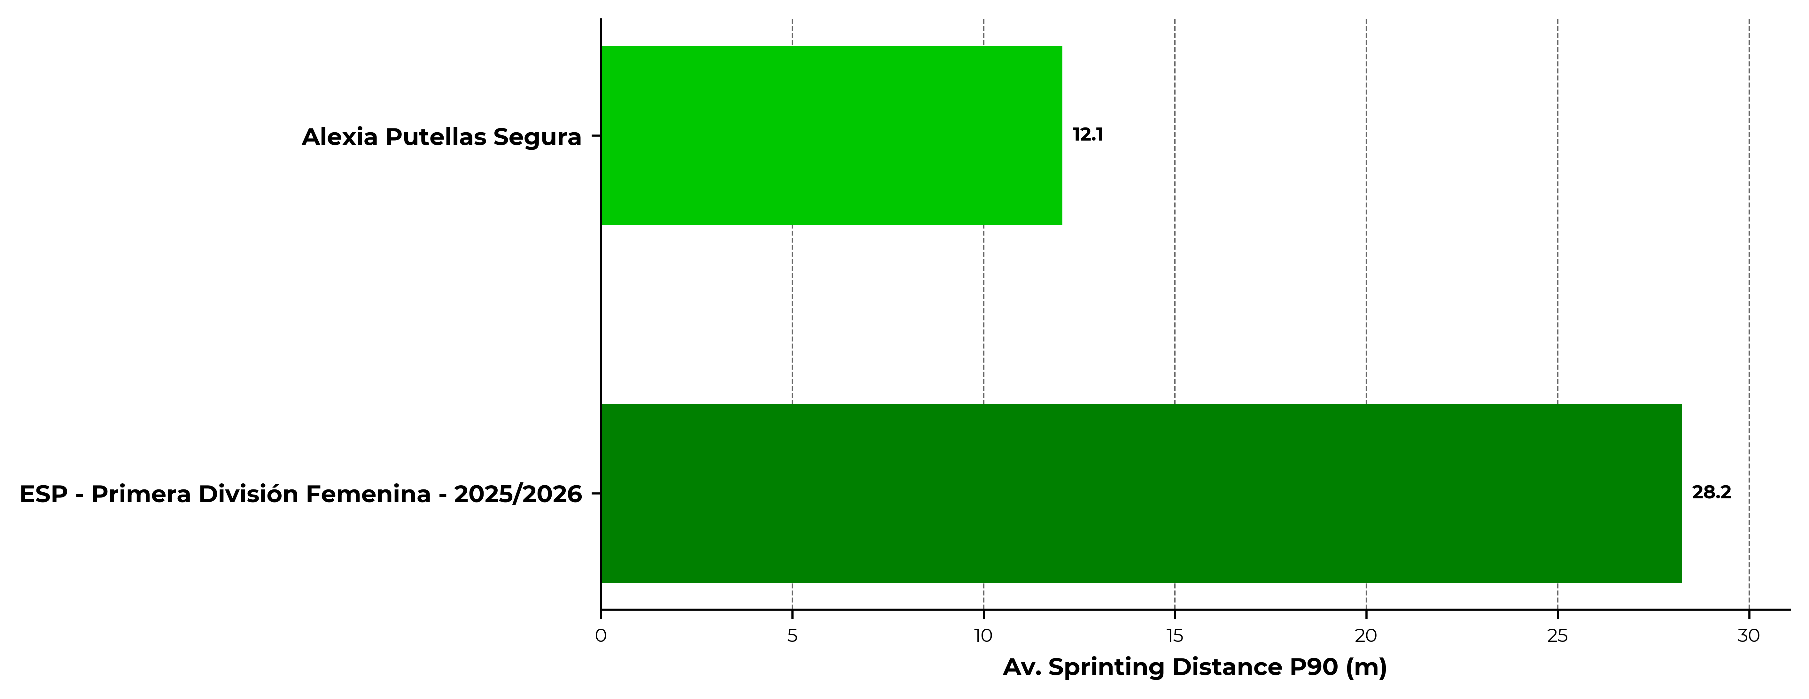
Sprinting Distance P90 (m)
Distance covered above 25 km/h.
Notes:
H 0.3 V1.03
8.77 Width

Slide 16
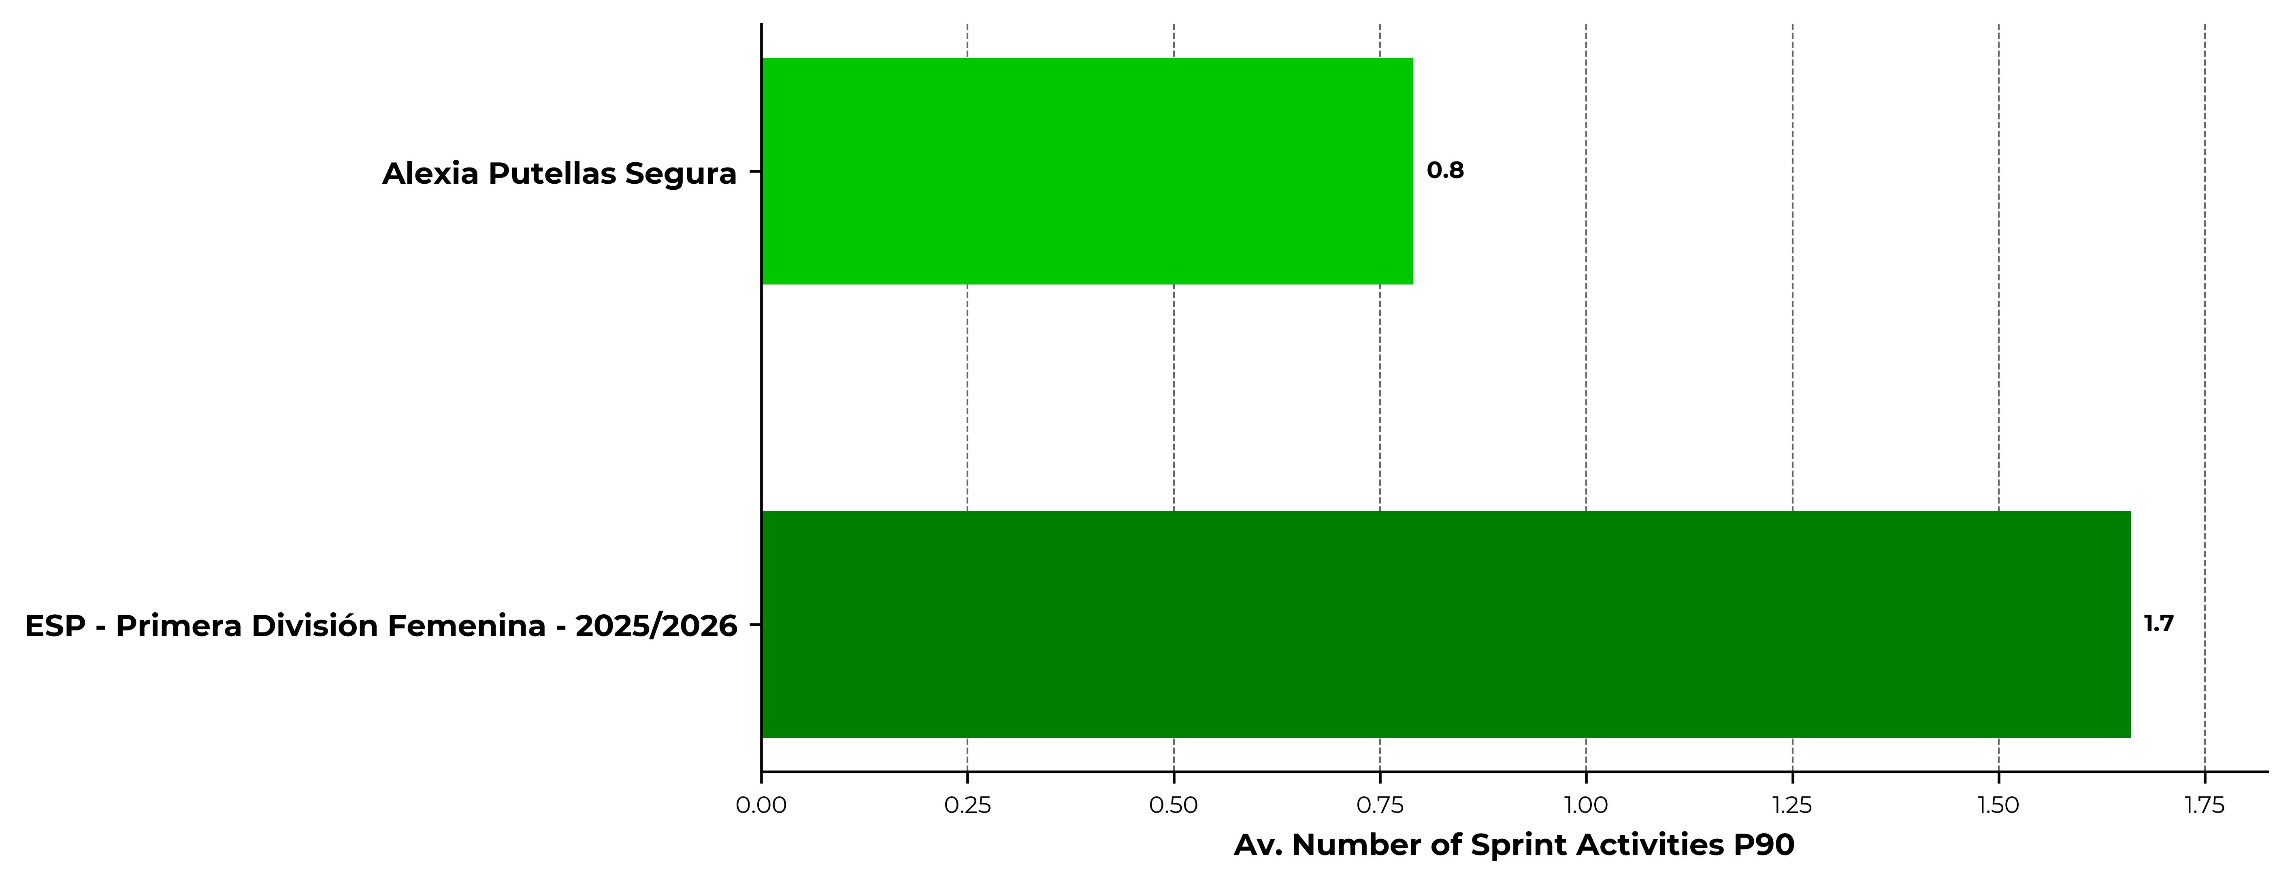
Number Of Sprints P90
Discrete activity exceeding 25 km/h. The activity needs to last for at least 0.7s.
Notes:
H 0.3 V1.03
8.77 Width

Slide 17
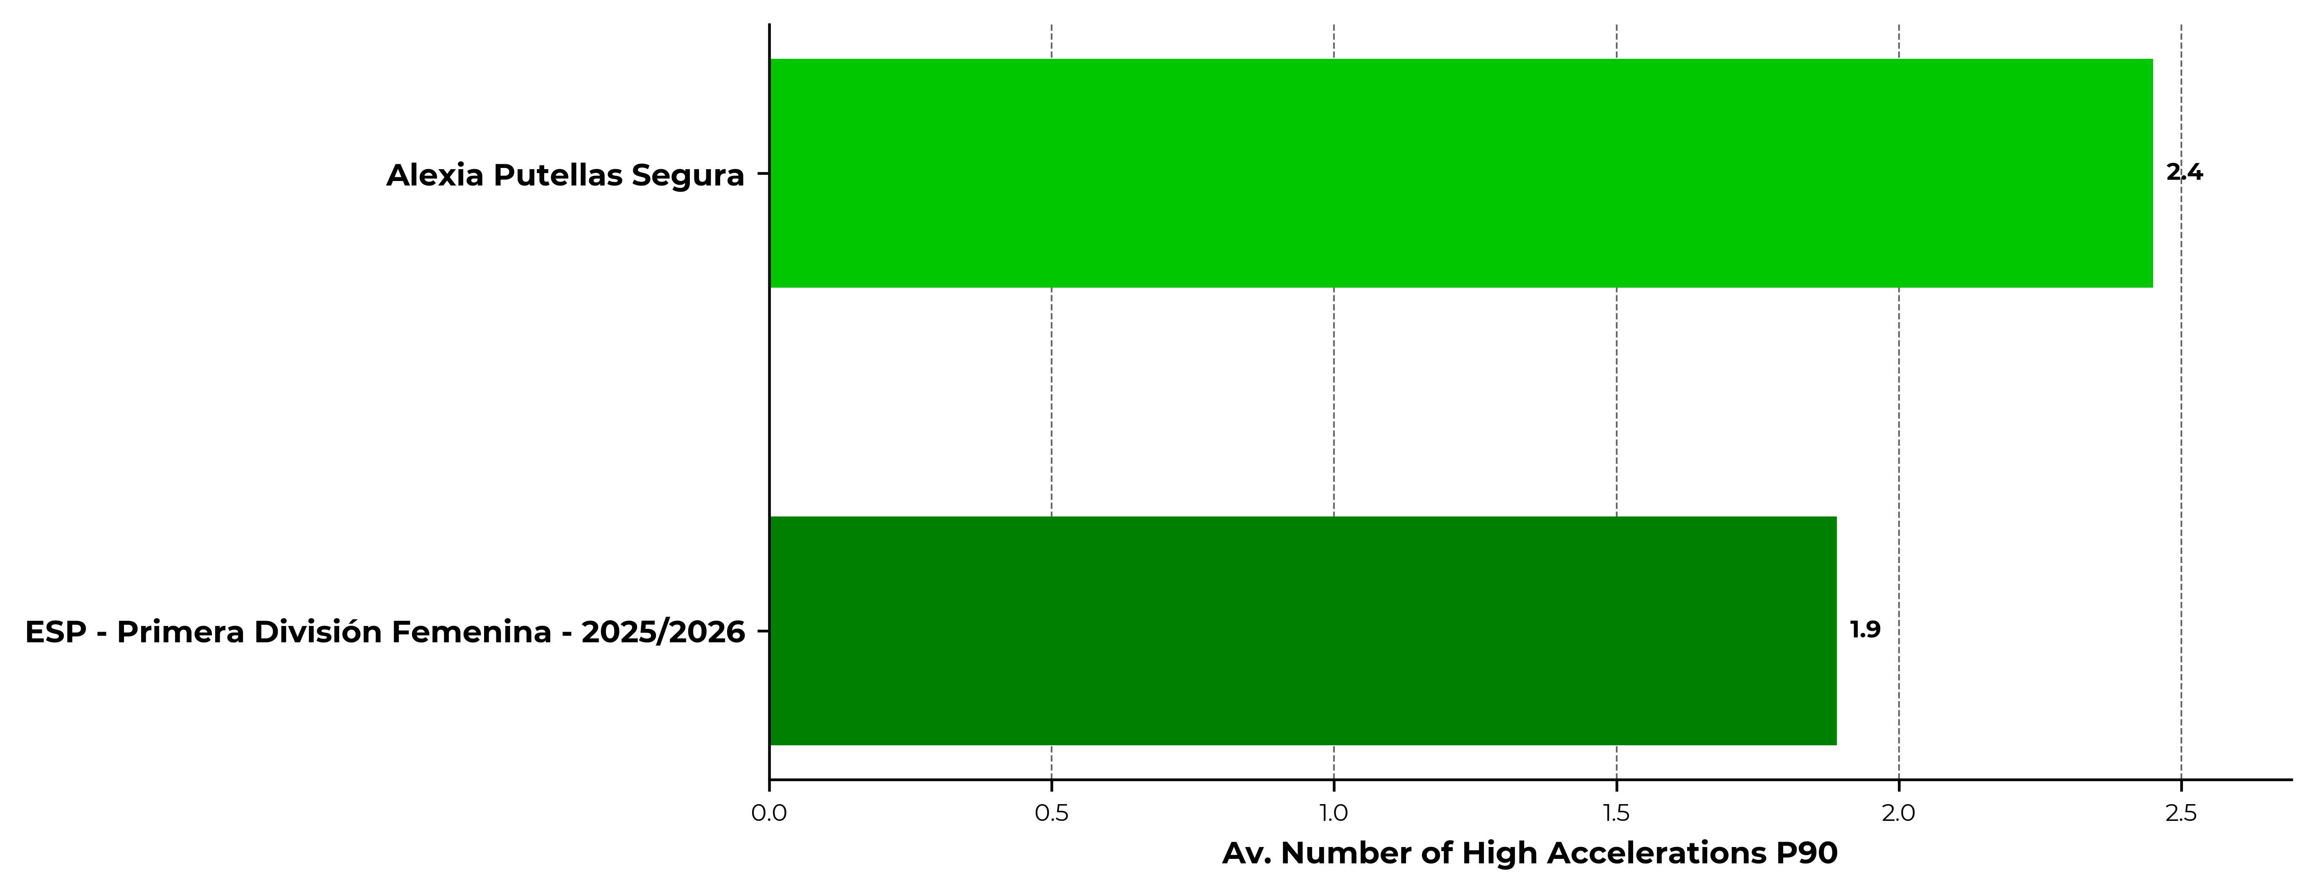
Number Of High Accelerations P90
Discrete activity exceeding 3 m/s². The activity needs to last for at least 0.7s.
Notes:
H 0.3 V1.03
8.77 Width

Slide 18
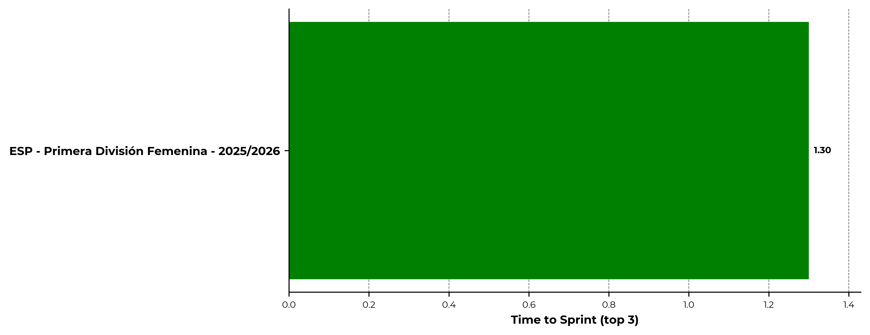
Three best TTS performances (s)
Time to Sprint measures the ability of a player to reach sprint speed quickly
Notes:
H 0.3 V1.03
8.77 Width

Slide 19
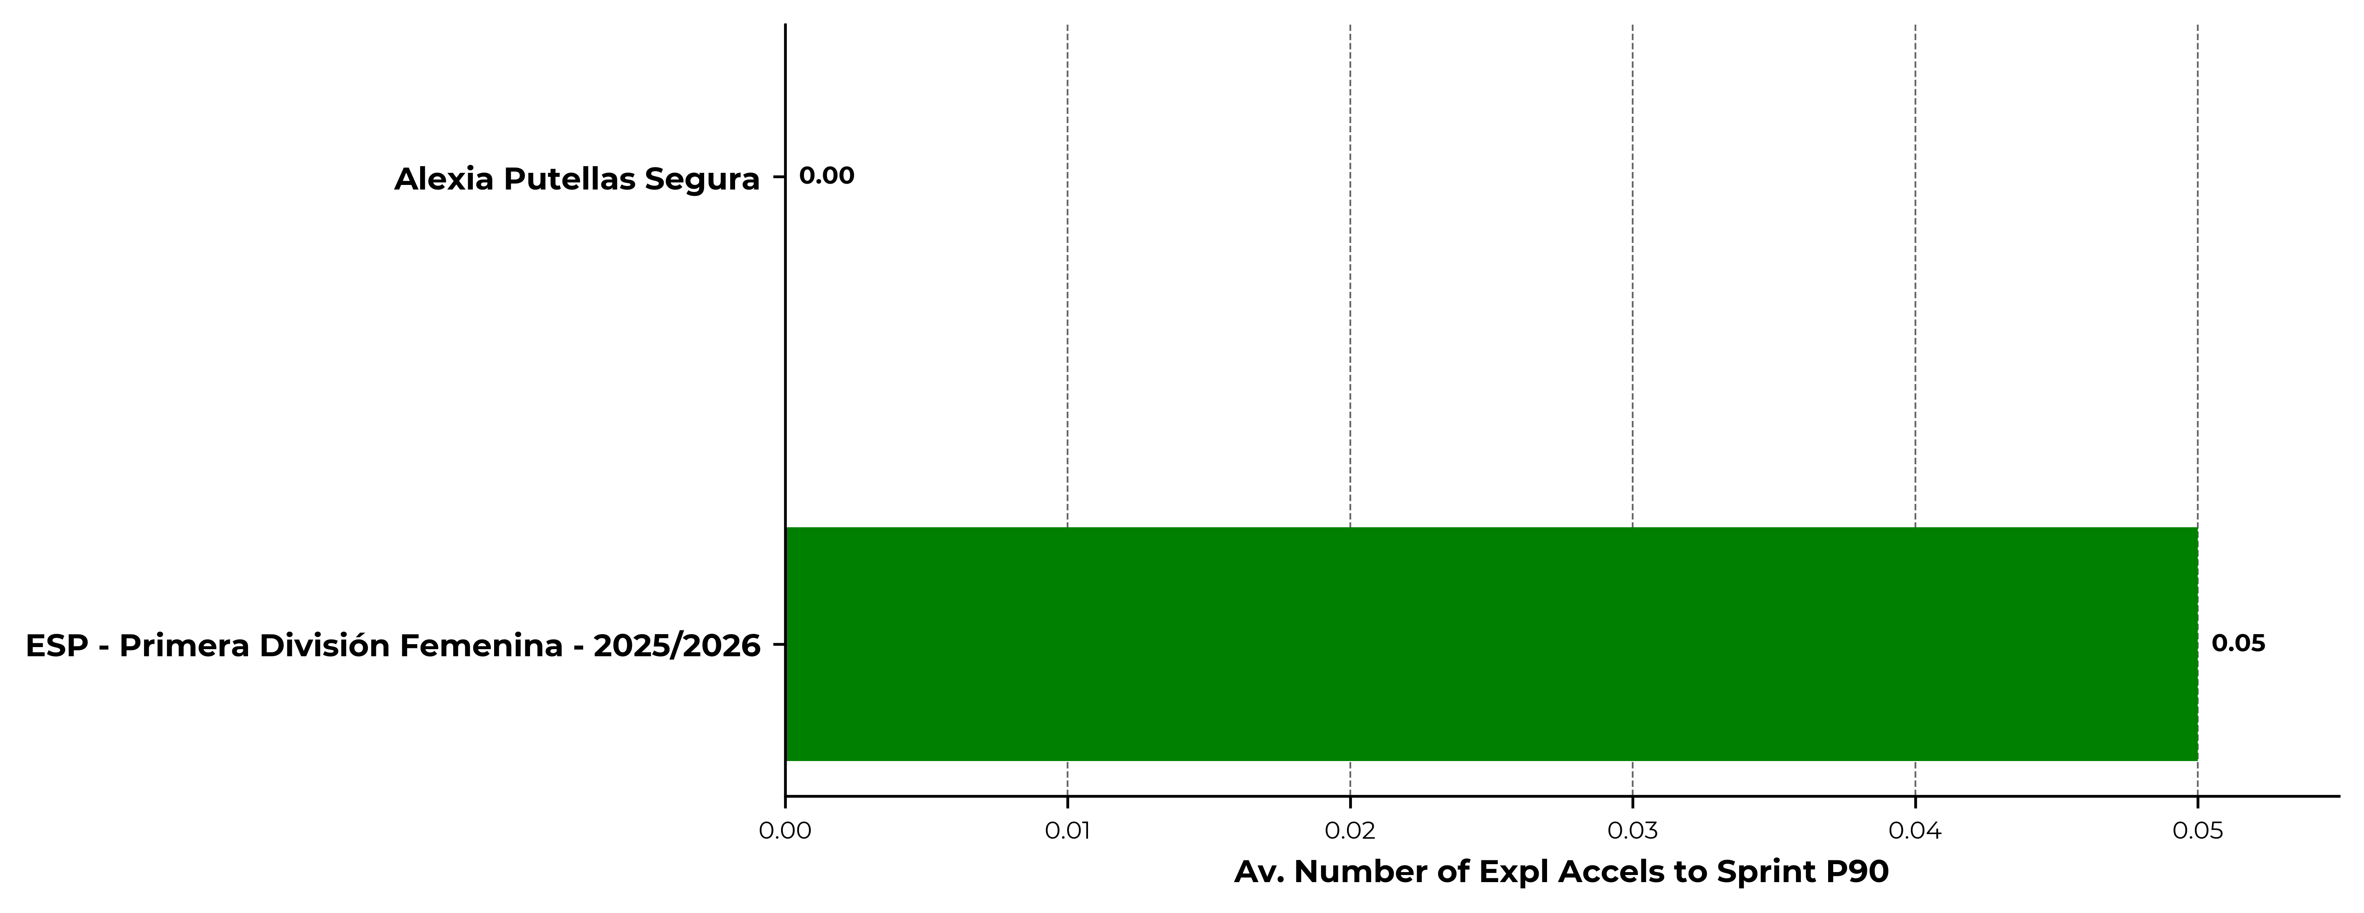
Explosive accels that reached Sprint P90
We can measure the degree of explosiveness through ability to reach HSR vs Sprint
Notes:
H 0.3 V1.03
8.77 Width

Slide 20
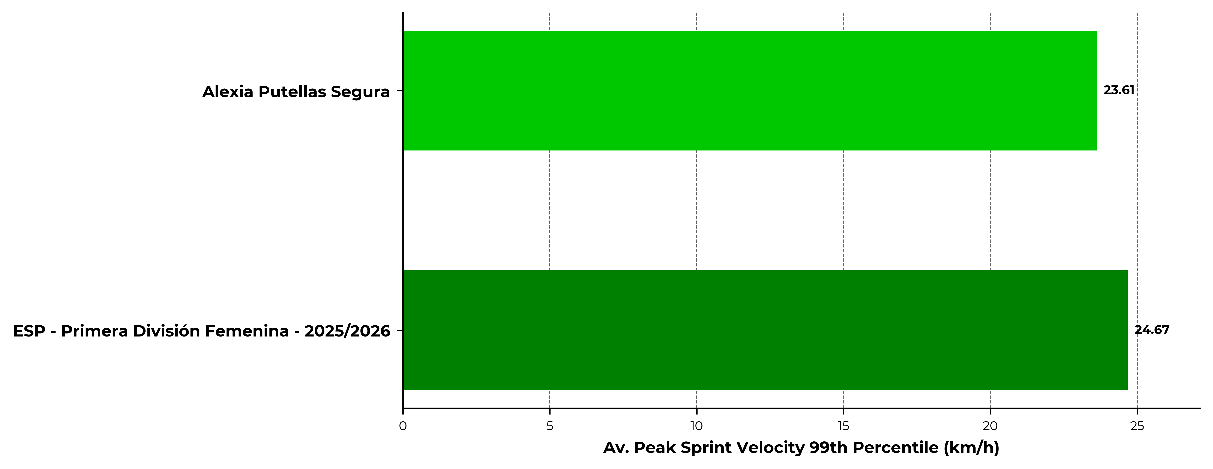
Average PSV-99 (km/h)
Peak sprint velocity 99th percentile. This metric reflects the peak speed of a player and its ability to reach it multiple times or sustain it long enough.
Notes:
H 0.3 V1.03
8.77 Width

Slide 21
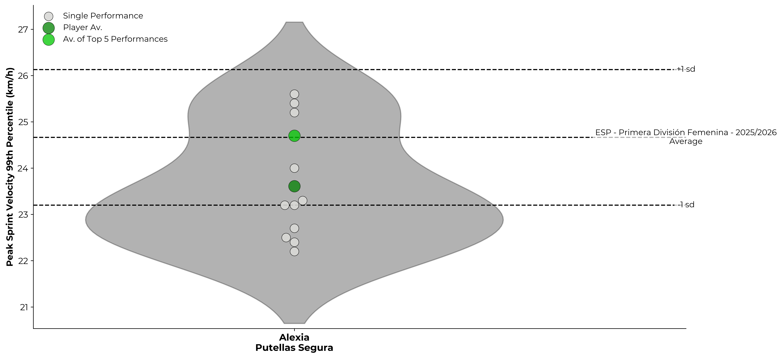
2025/2026 - PSV-99 Variation (km/h)
Peak sprint velocity 99th percentile. This metric reflects the peak speed of a player and its ability to reach it multiple times or sustain it long enough.
Notes:
H 0.3 V1.03
8.77 Width

