Slide 1
Software Design Principles

Slide 2
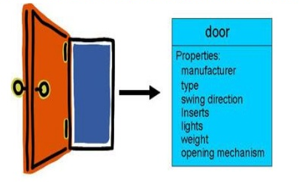
Abstraction

Slide 3
Procedural abstraction
A procedural abstraction is a mental model of what we want a subprogram to do (but not how to do it). For example, if you wanted to compute the length of the a hypotenuse of a right triangle, you might write something like:

Slide 4
Data abstraction
A data abstraction is a mental model of what can be done to a collection of data. It deliberately excludes details of how to do it. We implement a data abstraction by:
choosing an appropriate data structure - a specific construction of data
providing appropriate operations (algorithms) to manipulate that data.

Slide 5
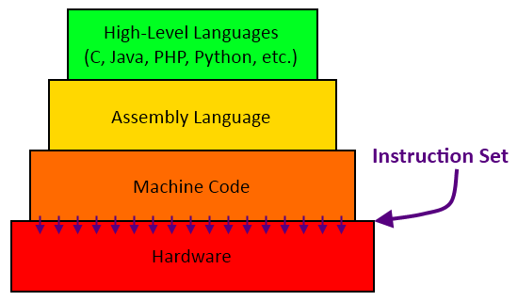
Control abstraction

Slide 6
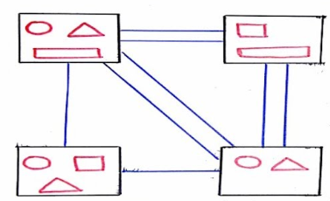
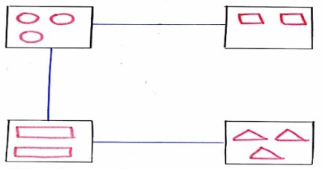
Cohesión y Acoplamiento
Tomado de: https://www.youtube.com/watch?v=nJLfQmAsIdg

Slide 7
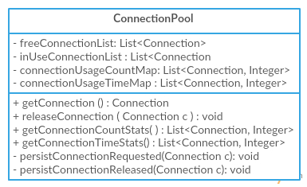
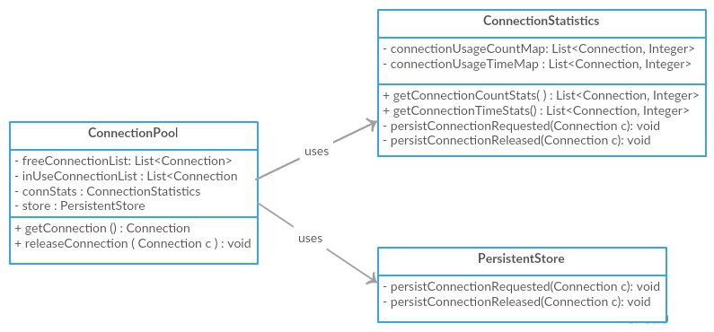
Cohesion & Coupling

Slide 8
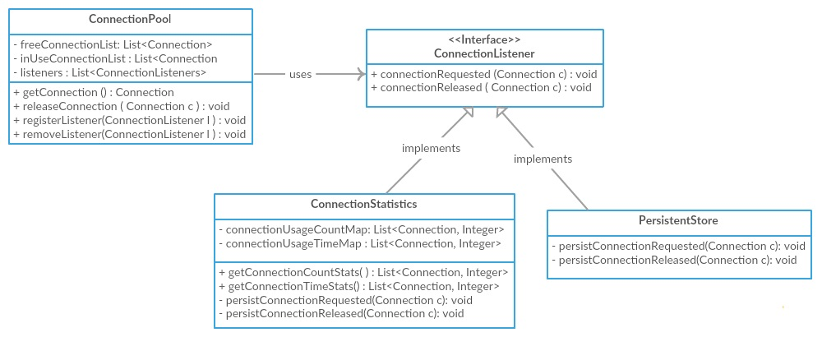
Cohesion & Coupling

Slide 9
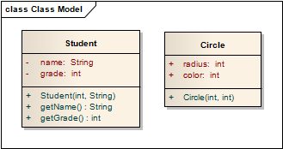
Encapsulation

Slide 10
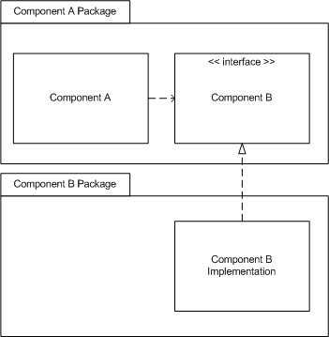
Separation of interface and implementation

Slide 11
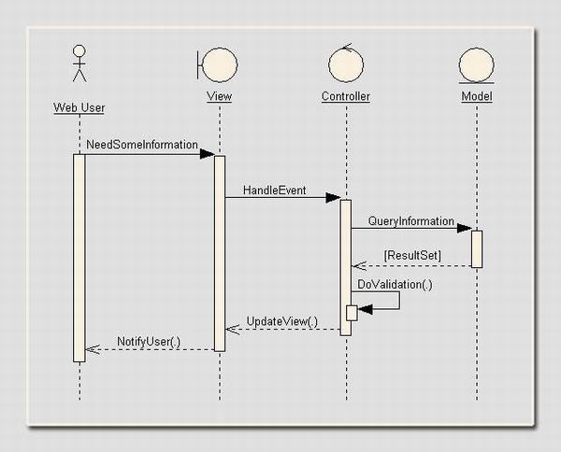
Separation of concerns

