Slide 1
ALL HANDS MEETING
March 19, 2026

Slide 2

Agenda
Founders Updates
Partnerships
New Team Members
SDR
Product & Tech
Marketing
Commercial ORG
Legal & Compliance
Americas
People
Latam & Brazil
AI Demo
APAC
Europe
Menat

Slide 3
Founders
08:00 - 08:10

Slide 4
NEW TEAM MEMBERS
08:11 - 08:12

Slide 5
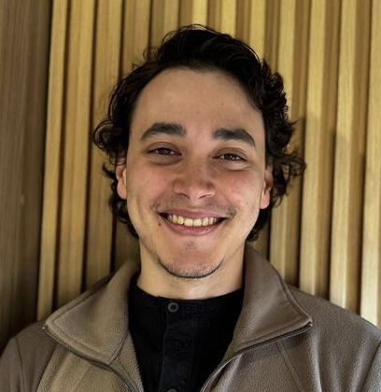
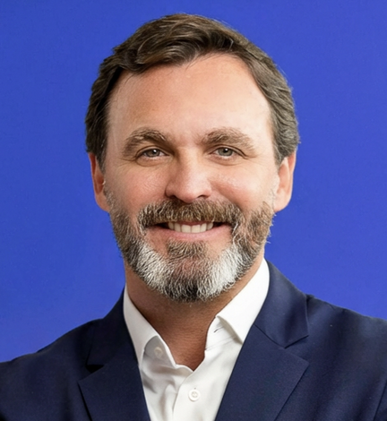
WELCOME TO THE TEAM
NEW TEAM MEMBERS
AI Infrastructure
GTM
GUSTAVO MENDES
Senior AI Engineer
MAURICIO SCHWARTZMANN
Chief Banking & Financial Institutions Officer

Slide 6
PRODUCT & TECH
08:13 - 08:17

Slide 7
Integrations
SECTION TITLE
 | LATAM | APAC | NORTHAM | EMEA
New Releases | Refacil - PSE and Breb-B Cielo - Antifraud Fintoc - Enrollable Transbank - Merchant order ID for BigBox Mercadopago Checkout Pro - binary_mode feature request for Epson Peru PayU - Rapyd API Bamboo - Migration V1 to V3 | NTT Data - Korea Cards Forter - Card |  | MPGS builder - Card (SAB, ICICMS, QNB_MPGS)
In Progress | Diners - Cards (EC) PagarMe – Card SafetyPay – Cash BBVA Bancomer - Card VR - Card API BAC - Card Adyen - PIX Automático | EBANX - Dispute API BillDesk - UPI Autopay Razorpay - UPI Autopay Adyen - UPI Autopay Antom - Cards | Shift4 - Cards | CCAvenue – Card JP Morgan - Card QNB - QPay and Card EBANX - Provider Installments Card AMEX - NT support

Slide 8

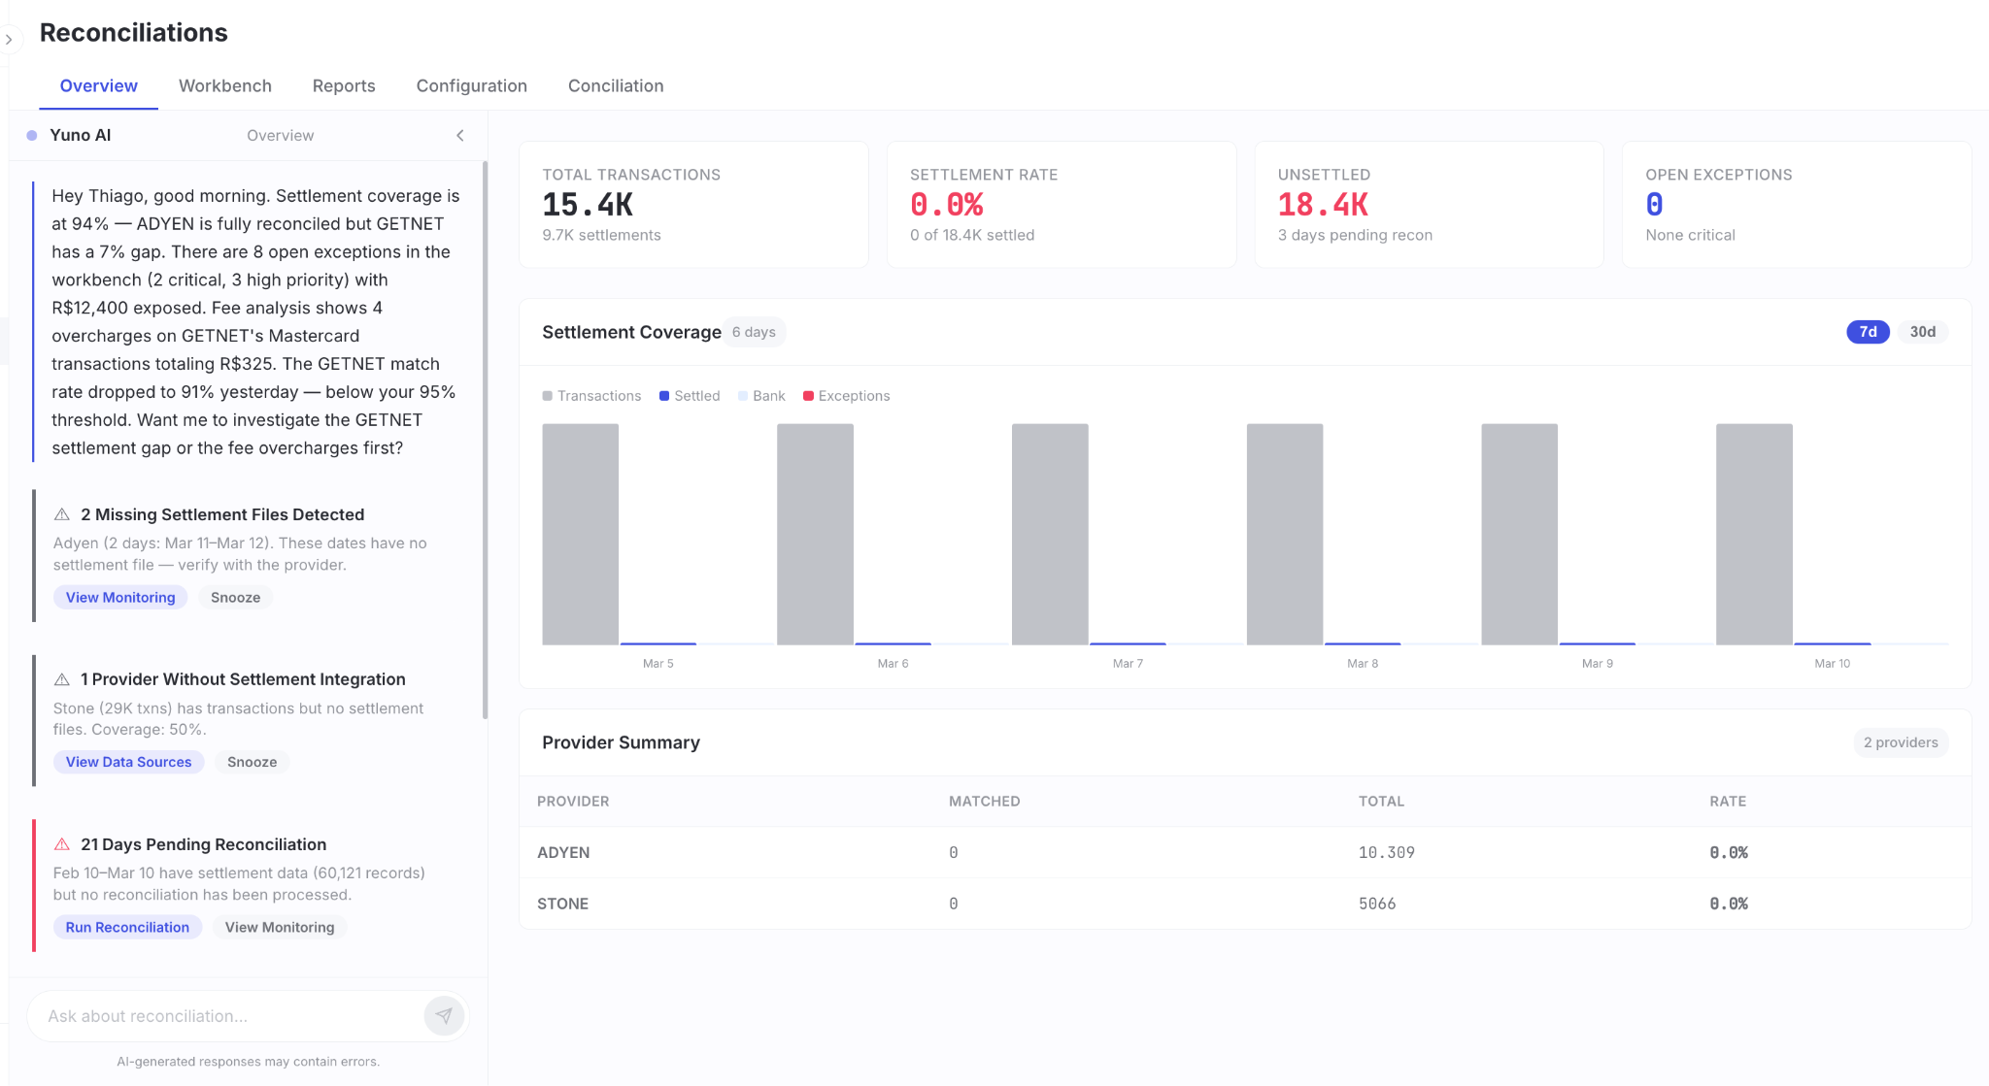
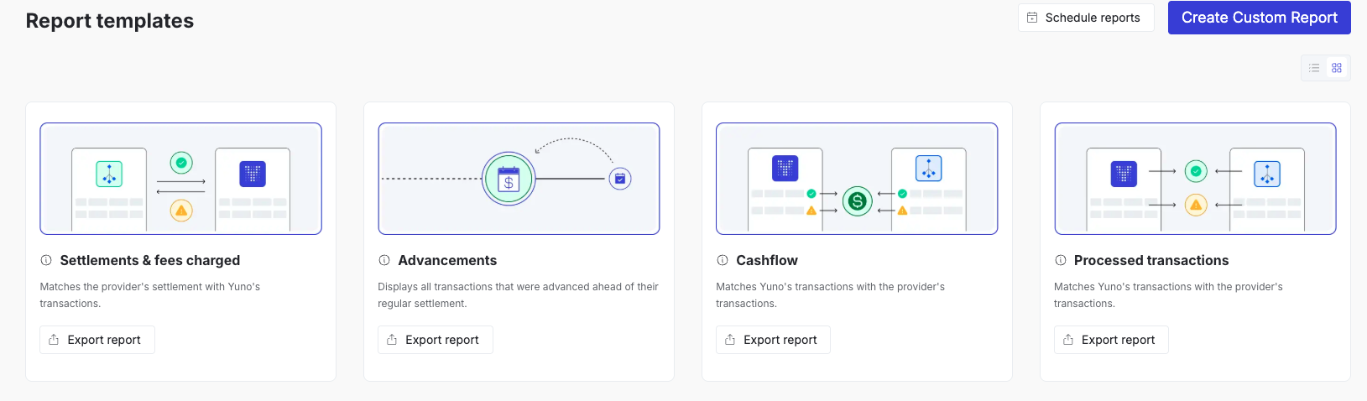
Dashboard & Reconciliations
PRODUCT & TECH
New releases
In progress
Tembici - Mercado Pago - Colombia: Activation
Mercado Libre - Diners: Mapping custom report
Agentic Recon Milestone 0: Definitions
Uber - QI - Iraq: Automation of the flow and alerts
Rappi - Nupay: Forward raw settlement files to Rappi SFTP
Mercado Pago - Refactor implementation
Agentic recon: Raw processor microservice

Slide 9
COMMERCIAL ORG
08:18 - 08:28

Slide 10









North America
COMMERCIAL ORG
Recent Events
New Deals
Payments Dinner (New York)
VGS - AGENT CONNECT (San Francisco)
GDC (San Francisco)
MRC (Las Vegas)
Discord
Western Union
ARB Interactive
BILT
Plusgrade
Deals in Motion
EpicVin (Go-live) - 90k ARR
Cencosud (Integration workshop) - 500k ARR
Allegiant (Final workshop Las Vegas next week) -800k ARR
Roblox (In Person meeting) -Awaiting RFP
Open AI (In person meeting) - Sold on Yuno -> Timing/resourcing constraints
Kraken - final stages (reference checks)
Live Merchants
3thix - live prod testing with large Korean Social Casino. Expected $1-$4bn in PIV
GoFundMe - ramping

Slide 11






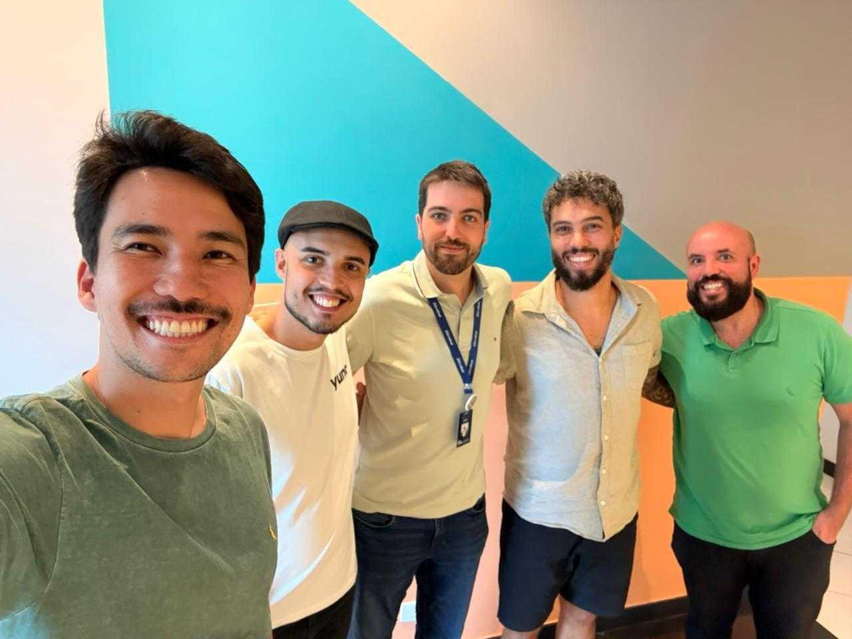
LATAM
COMMERCIAL ORG
BUSINESS DEVELOPMENT
KAM/TAM
Posthaus: In-person meeting in SC; 200K Trx potential (Vitor Mazurek)
Magazord: In-person meeting in SC; 600K Trx potential (Vitor Mazurek)
Hertz MX: Negotiation completed; moving forward with contract signature and tech scoping (Saman Mortazavi)
Petz: In-person meeting held to kick off Payments Concierge pilot (Felipe Geraldelli, Emanuel Guiraud)
OficialFarma: Went live with NuPay (Martin Seggewiss, Amanda Lie Kaneko)
Pague Menos: We are officially LIVE currently live in 5 accounts, ramping next week to 100 stores, and continuing the rollout up to 1.5k stores. (Joao Athas, Paola, Helio)
PARTNERSHIPS & MARKETING
Nuvei: Executive dinner confirmed for Mar 26 (Sandra Gerena, Walter, Saman, Rasheed, Daniela)

Slide 12












APAC
COMMERCIAL ORG
SALES OVERVIEW
BUSINESS MEETINGS AND PARTNERSHIPS
In Demo (5): two e-commerce company , two AI company, one gaming company
In Negotiation (6): two AI companies, one e-commerce marketplace, one e-learning company, one gaming company, one global reading platform
In Contracting (3):
Yuzhen, Lanyang and Pavami
Partnership Agreement is close to be signed.
New partners under KYP & Contract Negotiating
KAM/TAM
MARKETING
EBANX APAC HQ Opening Ceremony
Mar 24, 2026 （Singapore)
Yuno Attendee: Leslie
Yuno*MC*TD Joint BJ Event
Mar 26, 2026 (Beijing)
RSVP: 14 (as of Mar 19)
Press Release: Yuno*Triple-A Partnership Announcement
Target release Date: end April
ICross-Sell & Up- Sell
NetEase Games
KR acquiring via NTTD, 6K ARR
AR acquiring via Ebanx, 10K ARR
waiting for NetEase QA and go-live

Slide 13














Europe
EMEA
COMMERCIAL ORG
The Demo Wave
Deals in Progress
Dozens of conversations at MPE Berlin
(including Bolt, Max Mara, Delivery Hero, Adidas, LVMH, Volkswagen Rohlik., Allegro - amazing support from SDR Team, Magdalena & Alejandro)
Hotels OTA - HQ Germany
Apps Publisher, HQ Poland
Fitness Studio Management Software - HQ London
Meeting - reconnection and exploring new opportunities
Vueling - RFP defense today
Vendo Services - Expecting decision this week
Titans are about to sign
KAM + TAM Team smashing it (or fixing it)
SIGNED!!!
Sending to contracting - signatures expected still in March
In Signature
End to End testing Riskified test on Sunday.
New round of performance test from Monday
Wroking along with Unlimit to unlock MITs via NTiD. Debugging has been complex but we demonstrated competence and ownership.
Municorn - Integration advanced at 80% - almost ready
GameBoost - Integration well advanced, latest test in SBX before switching to live testing

Slide 14














MENAT
COMMERCIAL ORG
KAM+TAM
Key Winning Logos
Demo / POC scoping
RFP inclusion’ NDA signed
Preparing for MX Launch!
Negotiation
Project kicked off/ Agreement
Negotiation
GPay and PayTR connection pending for TR market. Stripe SBX testing.
Tazapay connection pending - APMs integration.
RFP inclusion; NDA signed
RFP inclusion; NDA signed
Working hard to meet the deadline to go-live. (Phase1)
New Opportunities
Deals Go-live
Launched! expected to reach ~200K monthly transactions at peak

Slide 15
PARTNERSHIPS
08:29 - 08:34

Slide 16
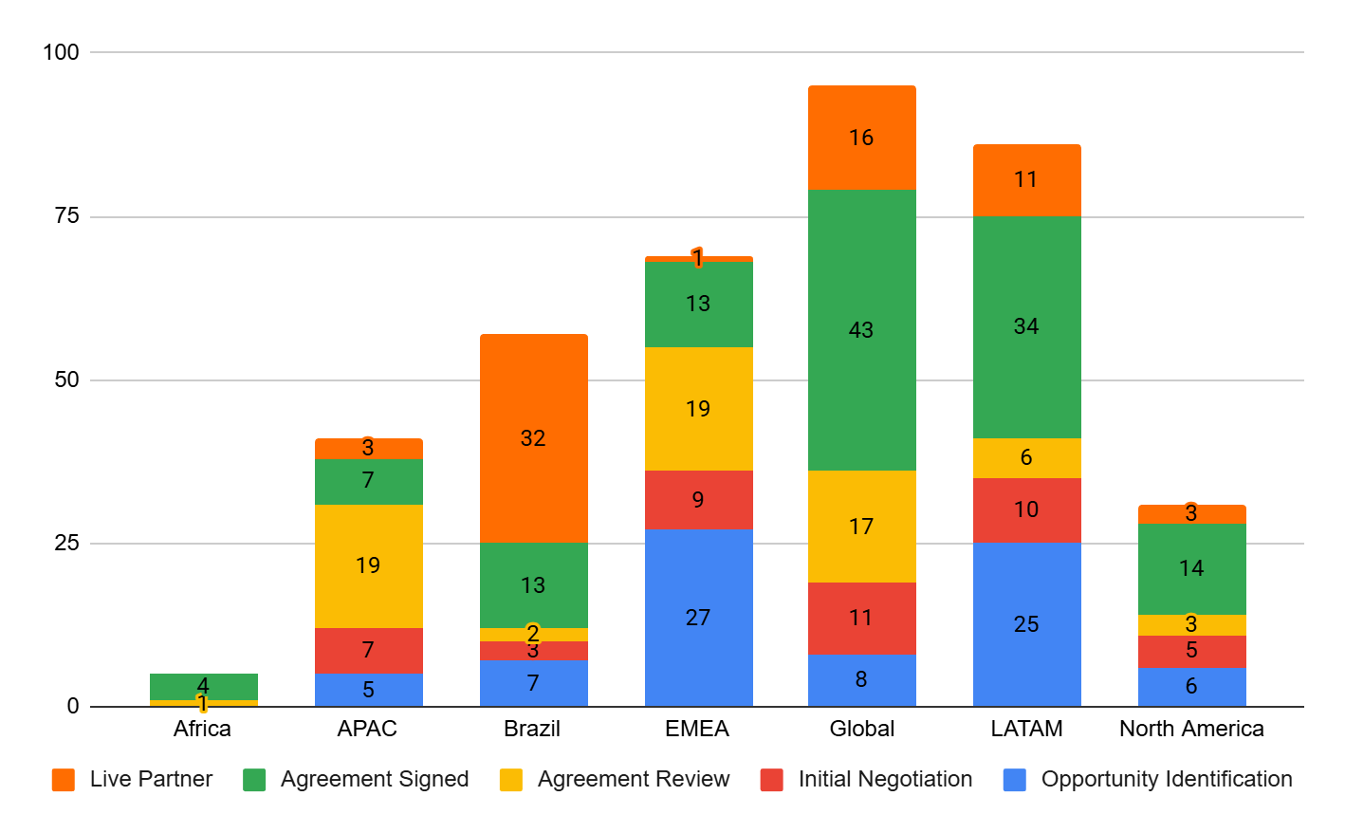
Partnerships Monthly Overview
Our Growing Network
Partnerships
388
Total Partners
+4
+114 in current negotiation (38 strategic)
+4
76
LIVE
+10

Slide 17
Partnerships Weekly Highlights
Partnerships
Partnership Pipeline- Key Deals Overview
Global | Americas (LATAM & NA) | EU | MENAT | APAC
Adyen Partner Manager Assigned | Davivienda/Rappi (DSE) Close to being signed | Paycomet Close to being signed | Thawani Pay Close to being signed | Xendit Close to being signed
Visa - Strategic In Negotiation | Crypto.com Close to being signed | Payaza Close to being signed | PayTR Close to being signed | Antom+2C2P Close to being signed
Merchant Deals Supported
Space x—> multiple acquirers | Copa Airlines/ NA→ North Amex—> Mexico | Wix → Mapping providers | Pegasus →Mapping Providers Soulchill→ | Tripla → KCP & Hecto Financial
Qatar Airlines—>Amex, MPGS etc | Whoosh → Brazil , CL Motiva → BR | Fever → Toss Payments, PhonePe, PayPhone, Paystack, KCP, Shift4 | Trip → Price Negotiation | Hello Clever → Hitpay & Fiuu
Ahead of the Curve
Must-Have/Popular
Merchant Opportunity
Innovator/Influencer

Slide 18






Events Pipeline
Partnerships
Upcoming Partner Events — Q1/Q2 2026
03/26
04/09
04/13
04/15
04/16
05/07
Nuvei
Getnet
Riskified
Itaú
Clearsale
Koin
MX
CH
UK
BR
BR
CO
TrustDecision
MasterCard
E-commerce Day Chile
MRC London
Coffee Break
VTEX Day
E-commerce Day Colombia
CN

Slide 19
Useful Material/ Team Initiatives
Partnerships
MENAT Insights Guide - Available
Recently released guide for Commercial Teams to Guide Merchants interested in expanding in MENAT Region
Partner Portal- Coming Soon
Phase I: Internal, one stop shop for all info relating to partners
Phase II: External, partner user-level access

Slide 20
SDR
08:35 - 08:39

Slide 21







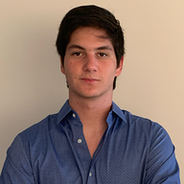
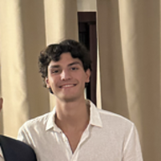


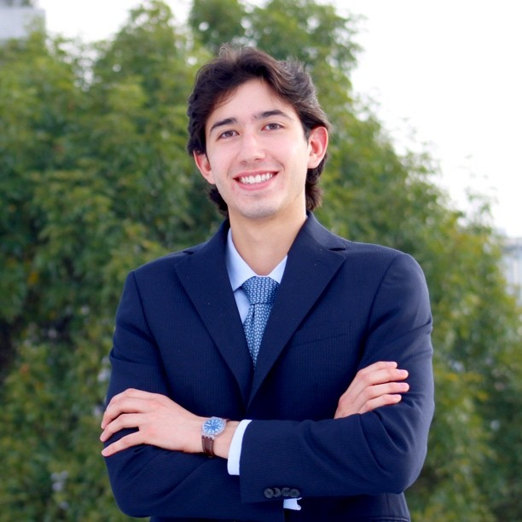









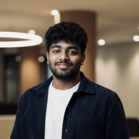













+5 MORE
SDR Update
Confirmed Logos this week
SQLs TBC in March
Next week
SQLs coming from events (MRC & MPE)

Slide 22
MARKETING
08:40 - 08:43

Slide 23


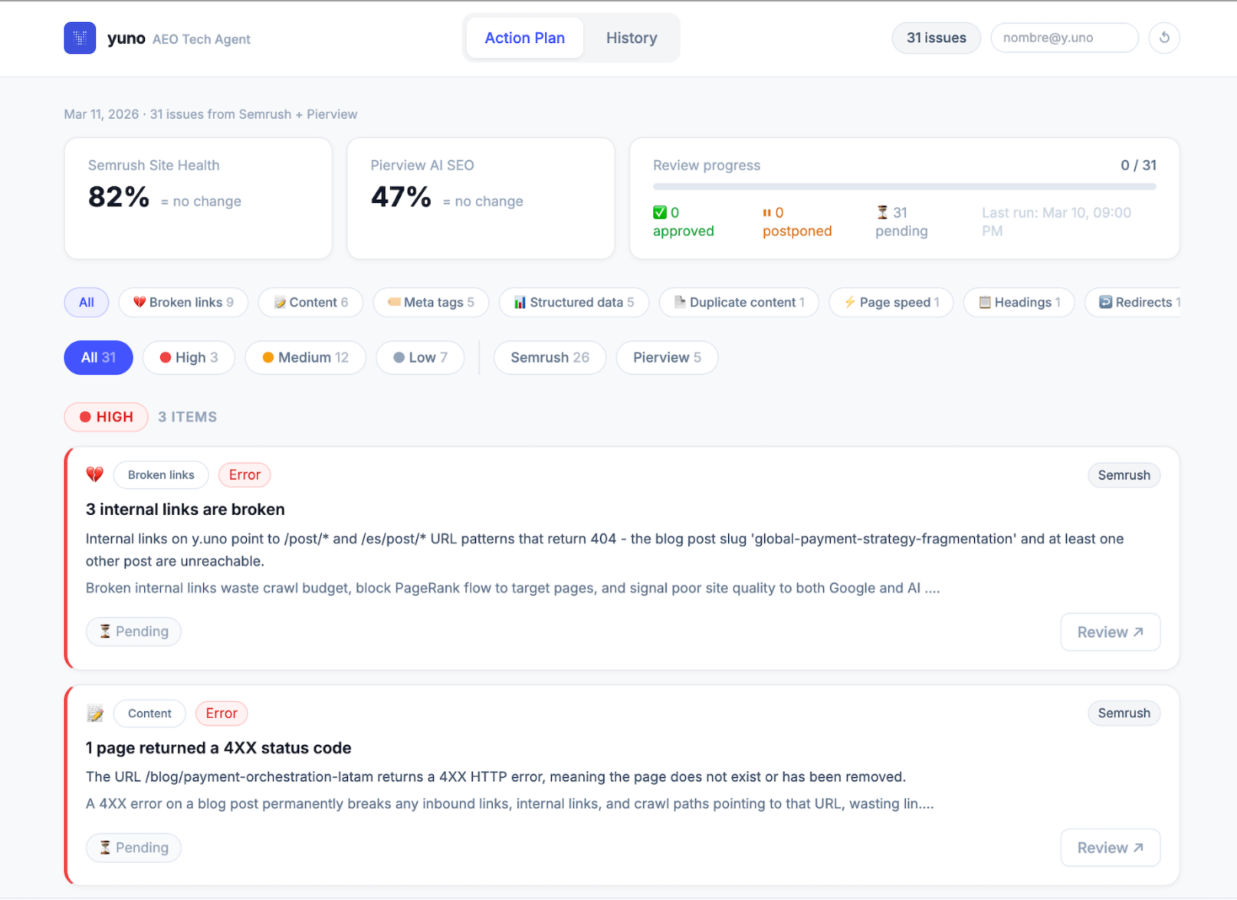

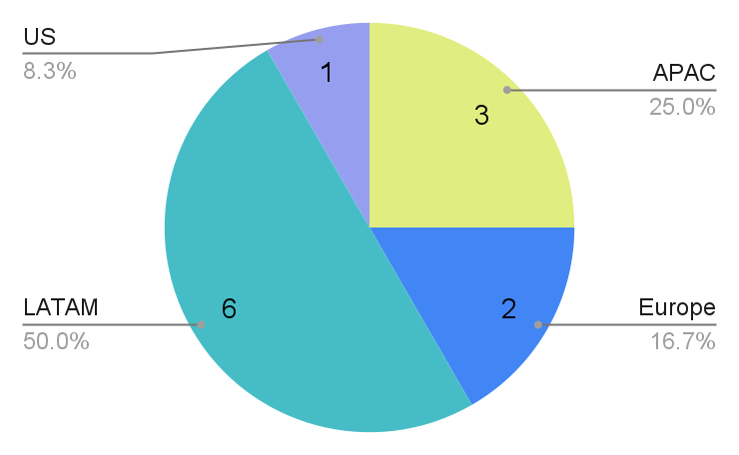
Marketing
ALL HANDS 19 MAR
PERFORMANCE MARCH MTD
EVENTS
AEO Tech Agent
MQL DIGITAL | MQL EVENTS | MQL TOTAL | % TO TARGET
30 | 14 | 44 | 40%
SQL DIGITAL | SQL EVENTS | SQL TOTAL | % TO TARGET
8 | 4 | 12 | 55%
12 SQLs total: LATAM: Utel University, AuxPay, Delivery Much Brasil, Centauro APAC: Manjuu Games, Kimi, GOGOGO, Directv, Mobility ADO EMEA: Fitune, Icelandair US: Automatiq
MRC Vegas this week (16-19 March)
SQLs BY REGION
Weekly technical SEO/AEO audits – scraping Semrush and Pierview.ai, analysing every issue with Claude, and pushing approved fixes directly to Webflow. No manual CMS work.
MRC London next month (13-15 April)
Side event: Networking drinks Riskified x Yuno x AWS (13 Apr) Landing page

Slide 24
AI DEMO KAM EXPERIMENTS
BY ALEJANDRA GARCÍA AND DAVID FRANCESCONI
08:44 - 09:00

Slide 25
Let’s grow together
Thanks

