Slide 1
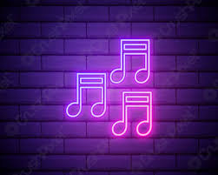
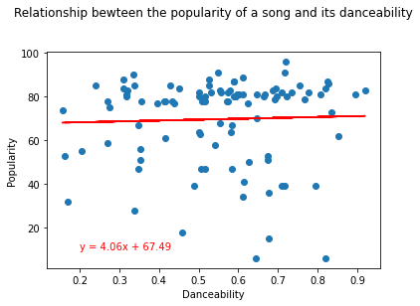
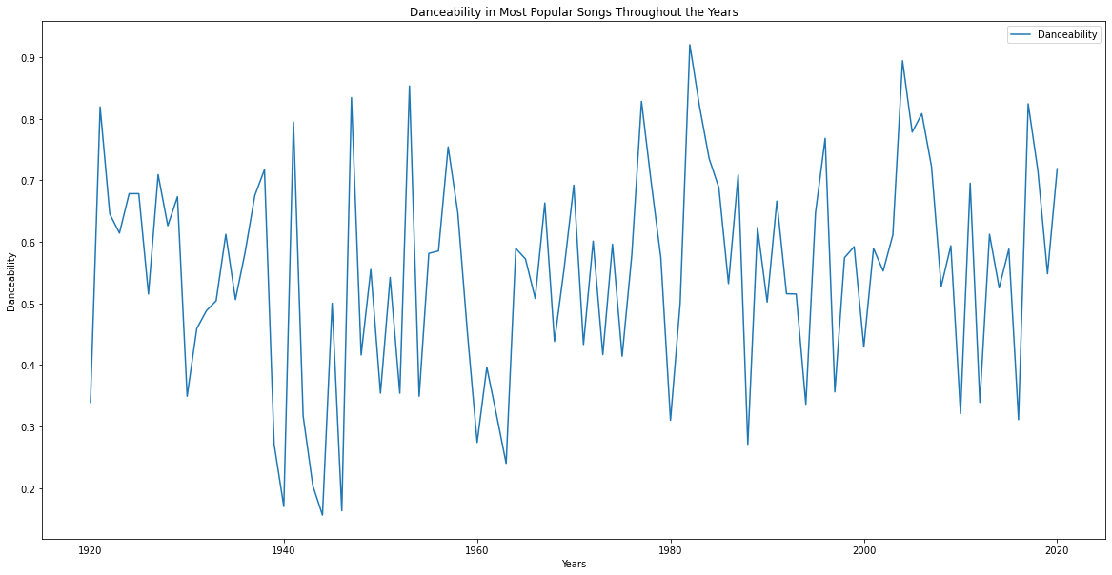
DANCEABILITY
This is one that has stayed varied consistently over time, with less extreme popularity swings as we near the present day.
The sudden increase towards 2020 is somewhat surprising at first glance given international lockdown measures, but less so when one considers that many socially distanced listeners are/were very likely trying to make themselves feel as if they are still at “the party” in some capacity.
Sometimes people feel like dancing, sometimes they don’t.
Notes:
This is one that has stayed varied consistently over time, with less extreme popularity swings as we near the present day. The sudden increase towards 2020 is somewhat surprising at first glance given international lockdown measures, but less so when one considers that many socially distanced listeners are/were very likely trying to make themselves feel as if they are still at “the party” in some capacity.

Slide 2
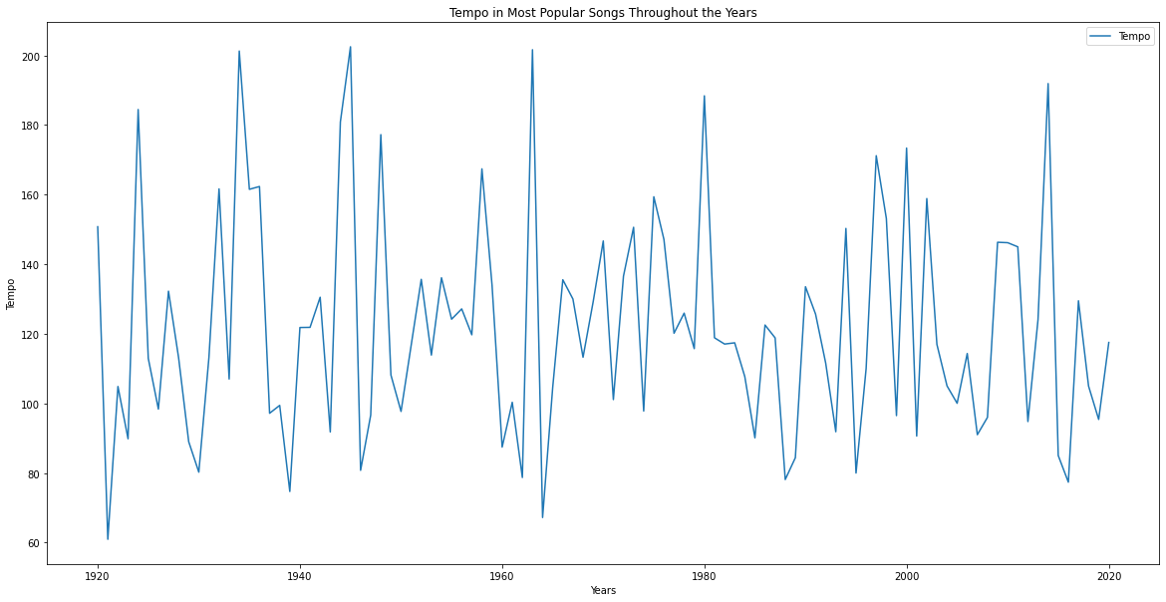
TEMPO
Like Danceability, the consistently changing tempo of popular songs indicates that listeners are drawn to variety in their music.
Sometimes they feel like a fast song, sometimes they feel like a slow one.

Slide 3
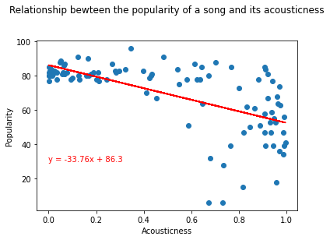
ACOUSTICNESS
The similarity between the graphs for both most popular and least popular songs by Acousticness speaks towards the decrease in popularity of acoustic instrumentation in contemporary popular music.
To most contemporary listeners, acoustic instrumentation often sets the expectation that a song or album will be of the more introspective singer/songwriter variety (think John Mayer or Sufjan Stevens) and very likely “sad”.
Notes:
The similarity between the graphs for both most popular and least popular songs by Acousticness speaks towards the decrease in popularity of acoustic instrumentation in contemporary popular music. A far cry from the audience that sparked a now legendary near-riot when Bob Dylan went electric in 1965 at the Newport Folk Festival, today’s listeners show a clear preference towards songs with electric/electronic instrumentation. Acoustic vs electric/electronic is now more of a matter of choice for musicians, and the meaning of sounds has thus changed over time. To most contemporary listeners, acoustic instrumentation often sets the expectation that a song or album will be of the more introspective singer/songwriter variety (think John Mayer or Sufjan Stevens) and very likely “sad”. With this in mind, it should not come to a surprise that listeners looking to lift their spirits during the Pandemic seem to have been drawn more towards less Acoustic music.

Slide 4
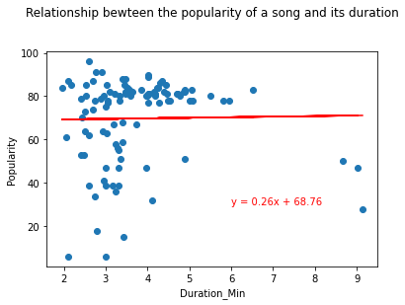
DURATION
What was once dictated by a track’s ability to fit on a record or play on the radio between ad breaks has been solidified by the average listener’s attention span as well.
It’s not unheard of for longer suite-style rock songs or extended dance remixes to find success, but the three-to-five minute pop song is virtually as old as the Music Industry and is not going anywhere.
Notes:
Like Danceability, this one has held steady over time. What was once dictated by a track’s ability to fit on a record or play on the radio between ad breaks has been solidified by the average listener’s attention span as well. It’s not unheard of for longer suite-style rock songs (*Bohemian Rhapsody* will never die) or extended dance remixes to find success, but the three-to-five minute pop song is virtually as old as the Music Industry and is not going anywhere

Slide 5
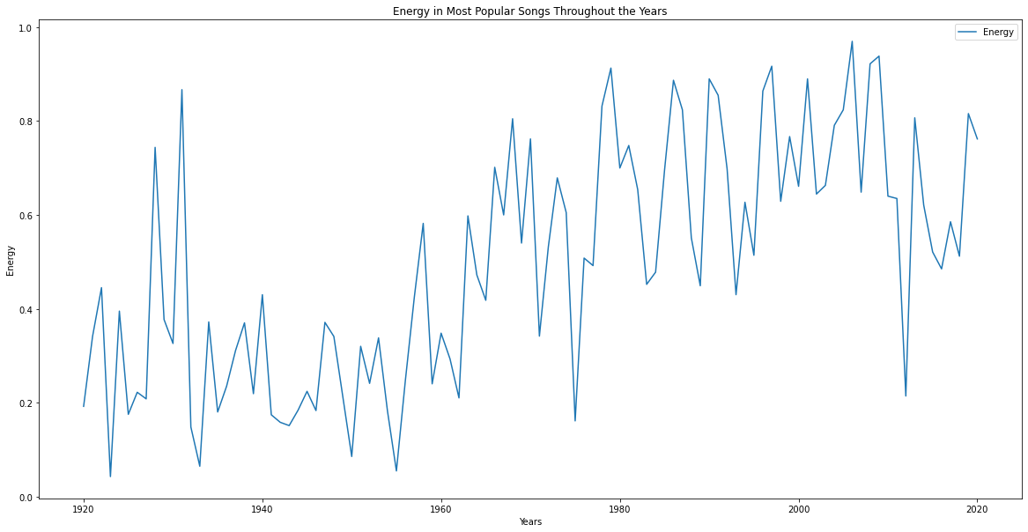
ENERGY
Popular music has become more energetic as time has gone on.
Electric and electronic instrumentation have allowed artists to exponentially increase the energy, and listeners and dance floors have been eager to keep up.
The outlier dip just before 2020 indicates that listeners might have ”crashed” for a brief period. This can most likely be attributed to the existential dread induced by the Brexit vote (2016) and the 2016 American presidential election.
Notes:
Popular music has become more energetic as time has gone on. This increase very likely has more to do with the capabilities and innovation of modern instruments. Electric and electronic instrumentation have allowed artists to exponentially increase the energy, and listeners and dance floors have been eager to keep up.

Slide 6
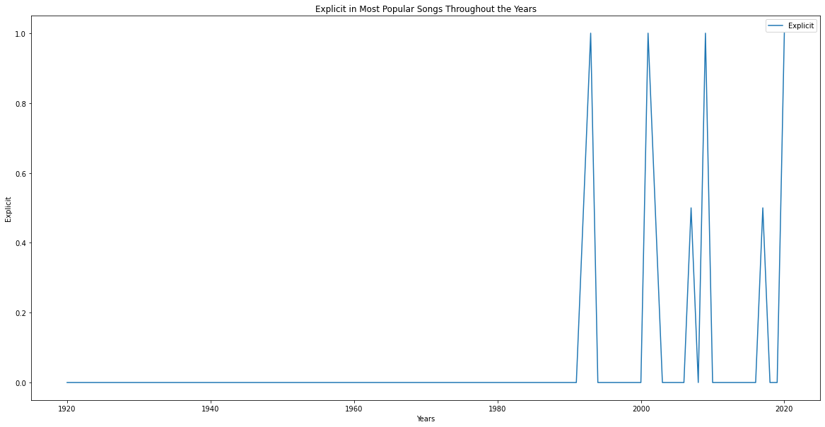

EXPLICITNESS
The popularity of explicit songs has increased over time as well.
Where making a song that couldn’t be played on the radio was once a deal-breaker for many artists, the largely streaming-based nature of most music now makes the decision of how explicit a song should be less relevant to many artists.
Notes:
The popularity of explicit songs has increased over time as well. They used to be basically non-existent, but cultural standards (particularly around the late ‘60s) began to loosen in relation to what was allowed on disc. Where making a song that couldn’t be played on the radio was once a deal-breaker for many artists, the largely streaming-based nature of most music (and the perpetually near-impossible nature of actually getting a song on the radio) now makes the decision of how explicit a song should be less relevant to many artists. This gives them significantly more freedom.
And most listeners do not seem put off by the explicit nature of popular songs. Just like popular cable shows like *The Sopranos* and *Game of Thrones* offer viewers with “premium” content often more explicit than what they can see in movie theaters, occasional explicit words or themes can remind listeners that they are getting their money’s worth over the handful of the same few “clean edits” that make their way into popular radio rotation.

Slide 7
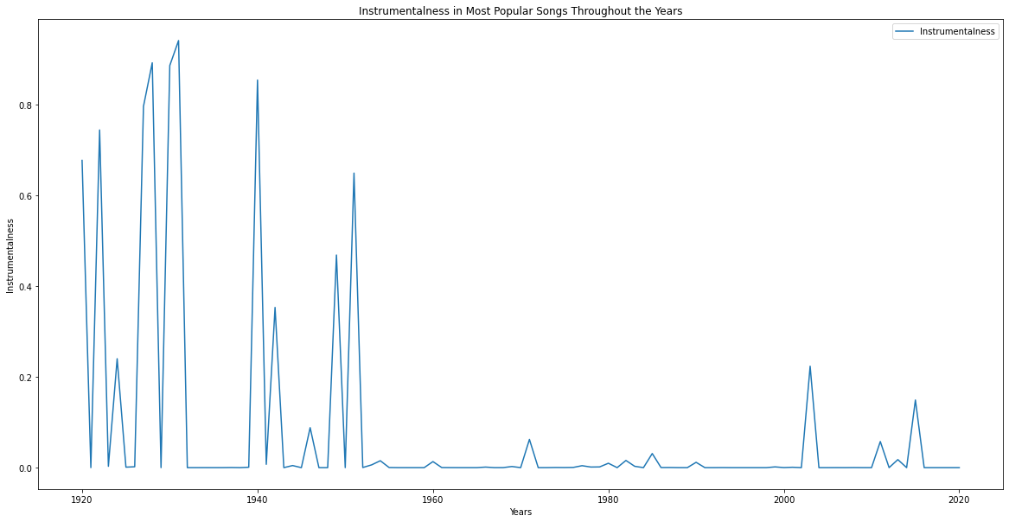
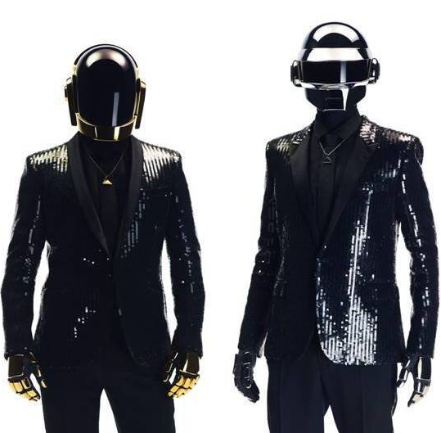
INSTRUMENTALNESS
By 1960, songs without vocals nearly flatline in popularity. The only significant outlier is the sudden increase just after the year 2000 on the graph. This can almost certainly be attributed to Daft Punk’s album Discovery, which was released to enormous popularity in 2001 and spawned countless imitators.
Notes:
As improvements in recording technology made it easier for artists to mix vocal tracks into their recordings, listeners have essentially never looked back. By 1960, songs without vocals nearly flatline in popularity. The only significant outlier is the sudden increase just after the year 2000 on the graph. This can almost certainly be attributed to Daft Punk’s Electronic Dance Music album Discovery, which was released to enormous popularity in 2001 and spawned countless imitators while blurring the already fuzzy lines between rock and dance music.

Slide 8
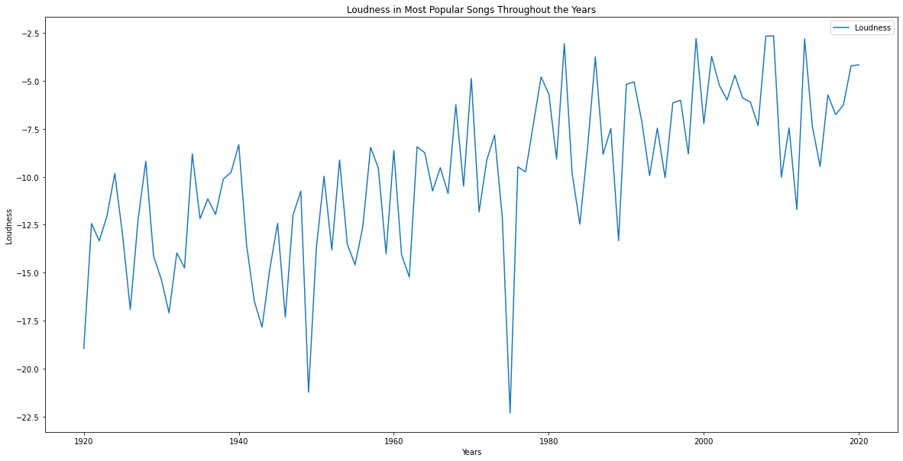
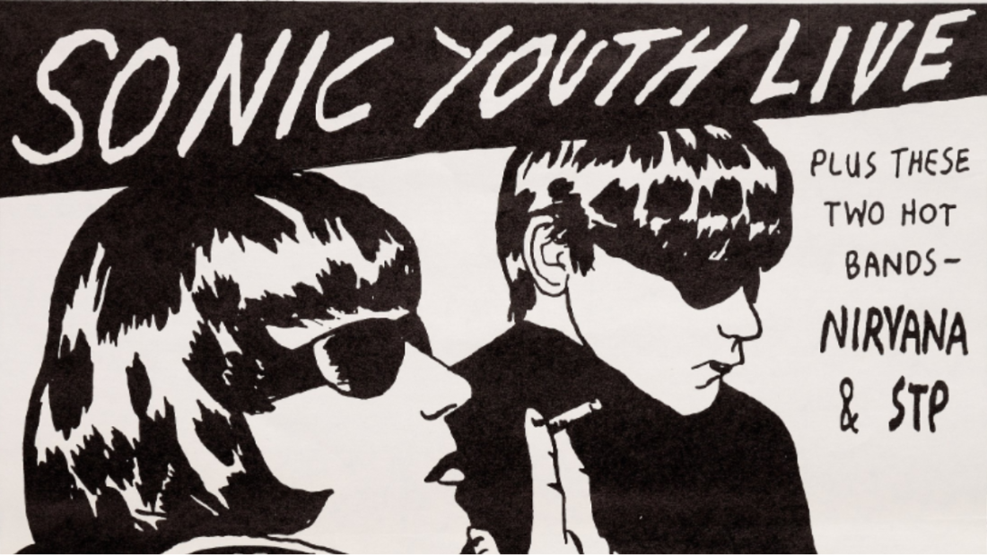
LOUDNESS
Louder songs tend to be more popular than their quiet competition.
Music has gotten steadily louder over time.
Louder songs are more likely to grab a listener’s attention on the radio, a personalized “Release Radar” playlist or even a television commercial.
Notes:
Louder songs tend to be more popular than their quiet competition. As improvements in recording technology have allowed music to be recorded and played at higher volumes before they begin to distort, popular artists have been happy to turn it up. Louder songs are more likely to grab a listener’s attention on the radio, a personalized “Release Radar” playlist or even a television commercial.

Slide 9
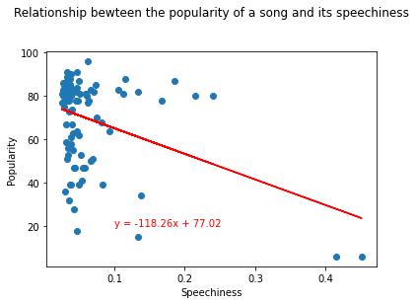
SPEECHINESS
Songs and tracks with higher levels of speechiness are quite simply not popular.
As soon as tracks incorporate more than a just a few lines of spoken (as opposed to sung) vocals, they sacrifice whatever chance they had at popularity.
Notes:
Songs and tracks with higher levels of speechiness are quite simply not popular. As soon as tracks incorporate more than a just a few lines of spoken (as opposed to sung) vocals, they sacrifice whatever chance they had at popularity.

Slide 10
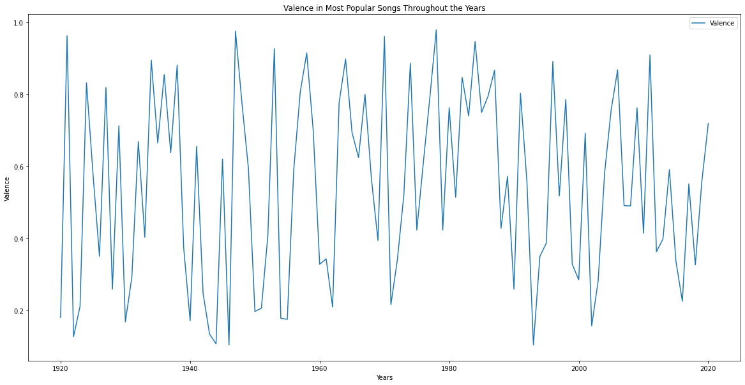
VALENCE
Songs with popular songs tend to have high valence rates.
The drop in Valence towards 2020 indicates that there was an increase in negative and angry songs during the Pre-Pandemic years of the Trump Administration.
The sudden spike back up for 2020 could be explained by a shift towards feel-good/escapist music during the Pandemic.
Notes:
It should come as no surprise that songs with popular songs tend to have high valence rates. Popular music is, after-all, a “feel-good” medium so it is only natural that popular songs are at least a little bit positive. The drop in Valence towards 2020 indicates that there was an increase in negative and angry songs during the Pre-Pandemic years of the Trump Administration. The sudden spike back up for 2020 could be explained by a shift towards feel-good/escapist music during the Pandemic as well as a rising sense of relief that came with the election of Joe Biden as well as the announcement of the Covid Vaccine towards the end of the year.

Slide 11
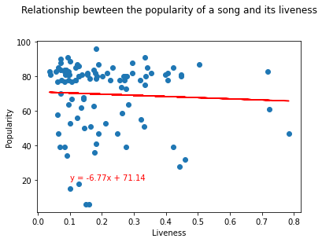
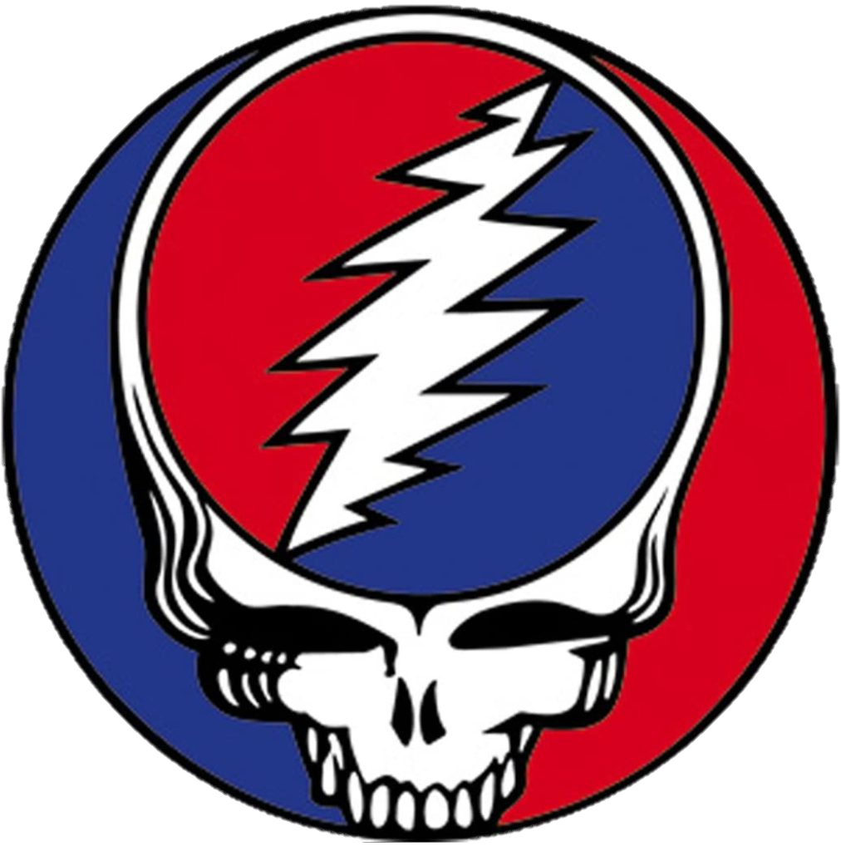
LIVENESS
Songs with a high level of liveness do not tend to be popular.
A little bit can make the song feel less “canned” and more spontaneous.
Full-fledged live recordings tend to appeal more to an artist’s specific fan base.
Notes:
Songs with a high level of liveness do not tend to be popular. Having a little bit can make the song feel less “canned” and more spontaneous, but full-fledged live recordings tend to appeal more to an artist’s specific fan base.

