Slide 1

Principles of web application architecture
Daniel Ranc
RS2M
daniel.ranc@telecom-sudparis.eu

Slide 2
Agenda
Generic architecture concepts
Web Applications
MVC in Web Applications

Slide 3
Agenda
Generic architecture concepts
Web Applications
MVC discussion

Slide 4
Generic architecture concepts
What is an architecture ?
    Software application architecture is the process of defining a structured solution that meets all of the technical and operational requirements, while optimizing common quality attributes such as performance, security, and manageability (Microsoft).
    Architecture is a term applied to both the process and the outcome of thinking out and specifying the overall structure, logical components, and the logical interrelationships of a computer, its operating system, a network, or other conception (whatis.techtarget.com).
Objective of the architecture
  The design of the architecture intends to provide the functions required by the functional analysis (cf. V cycle)

Slide 5
Generic architecture concepts
V cycle - architecture
Operational concepts
- requirements
- functional analysis
Operation
Architecture
System test
Module design
Unit test
Implementation

Slide 6
Generic architecture concepts
Architecture properties
  Abstraction
    An architecture is a specification
    Designed in terms of logical components
    Independent of its implementation
  Cooking metaphor: “logical” soup assembled from “logical” components (see implementation later) : cooking receipt

Slide 7

Generic architecture concepts
What is a software application ?
    A system carefully designed and assembled from existing or ad hoc software components with respect to an architecture specification, in order to obtain efficient behaviour.
    Cooking metaphor: implementation of the cooking receipt

Slide 8





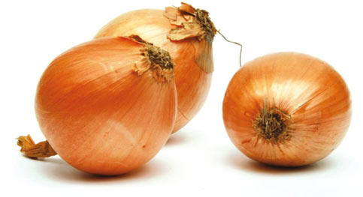

Generic architecture concepts
Architecture problem statement
  How to design the system (from logical components) to obtain the behaviour intended by the functional analysis ? (i.e. how to write the receipt?)
?
?
?
?
?
?

Slide 9
Generic architecture concepts
In general, many systems carry “classical” logical components, such as:
    User interface
    Data persistence
    Business logic i.e. algorithms
    Support components i.e. IPC, security, management
Additionaly, specific logical components are often needed
    Depending on functional specifications

Slide 10
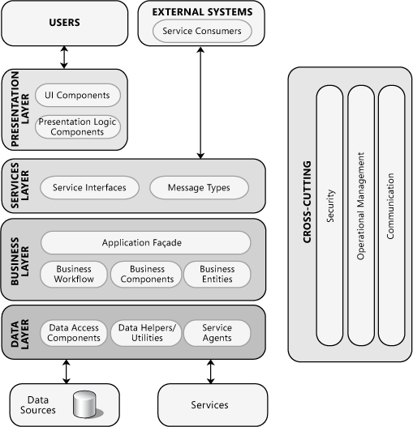
Generic architecture concepts

Slide 11
Generic architecture concepts
The problem of architecture design is unfortunately open
    No rules, tools or theorems available for automatic design
    No automated proof available for design validation
Architecture design relies on:
    Best practices
    Experience
    Best effort
    Trial and error
And on Design Patterns

Slide 12
Generic architecture concepts
Design pattern examples
  Centralized
  Monolithic
  Distributed (coarse/fine grain)
  Client-server
  J2EE
  Model-View-Controller (MVC)
  Service Oriented Architecture (SOA)

Slide 13
Generic architecture concepts
Architecture design guidelines
  Desired qualities
      Modularity
      Flexibility
      Reuseability
      Maintenance
      Efficiency
      Simplicity (K.I.S.S.)
      Realisticness
  Common pitfalls
      Single source of truth problem
      Single point of failure
      Redundancy
      Complexity

Slide 14
Agenda
Generic architecture concepts
Web Applications
MVC in Web Applications

Slide 15



Web Applications
For web applications the architectural context is heavily constrained by physical infrastructure
network
browser
server

Slide 16
Web Applications
For web applications the architectural context is heavily constrained by physical infrastructure
network
browser
server
Javascript
HTML, CSS
PHP
J2EE
Javascript
...and (we should not say that loud) their associated technologies

Slide 17
Web Applications
New problem statement
  How to map the logical components onto web application infrastructure ?
?
?
?
?

Slide 18
Web Applications
New problem statement
  How to map the logical components onto web application infrastructure ?
    Technical criteria:
      Simplicity
      Efficiency (application reactivity)
      Modularity, re-use
      Bandwidth efficiency (cf. Smartphone target)
      Maintenability
    User-oriented criteria:
      User experience (ergonomy)
      Action-response turn-around time

Slide 19
Web Applications
New problem statement
  How to map the logical components onto web application infrastructure ?
    Critical factor: page reloading turn-around time
      In traditional systems the view update implies to reload the whole page
      Bandwidth cost
      Delay cost
    Solution: reload/update only portions of the page
    Led to build Single Page Applications (SPAs)
      One web page (and its Js code) for the whole application

Slide 20
Web Applications
New problem statement
  How to map the logical components onto web application infrastructure ?
user interface | UI engine | business logic | persistency | example | technologies
character | server | server | server | terminal-based | C
graphic | server | server | server | Wordpress, Moodle | PHP, Java J2EE
graphic | browser | mixed server/browser | server | Google Docs | Javascript/?
graphic | browser | mixed server/browser | mixed server/browser | Facebook | Javascript/?

Slide 21
Web Applications

Slide 22
Web Applications
New problem statement
  How to map the logical components onto web application infrastructure ?
    We observe significant trends:
      More and more logical components are mapped to the browser side (“client side”)
      First, the Presentation Layer, then part of business logic, and even part of persistency
      Particular case if 100% of components are on the client (“standalone web apps”); ex: smartphone apps
      Current trend: web-based desktop applications (electron)
The client side Presentation Layer has become a full UI engine supporting SPA logic and part of business logic

Slide 23
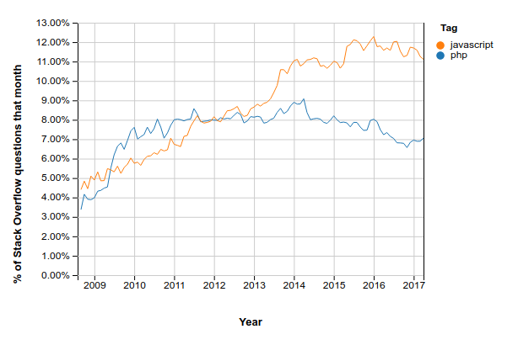
Web Applications
New problem statement
  How to map the logical components onto web application infrastructure ?
    This is reflected in stackoverflow statistics

Slide 24
Web Applications
In other words,
  Client-side technology has become the foundation for modern application design
  Server-side technology becomes infrastructure for:
    Business logic
    Persistency
  Communication between the two becomes crucial, and relies on HTTP
    Bare bones or REST or ad hoc
  In implementation terms:
This is the Javascript epoch

Slide 25
Web Applications
Current Javascript technology
  Any browser
    JS engine with libraries to manage DOM + user events
  Node.js
    Standalone Javascript engine, allows to write portable desktop or server applications
    Node Packet Manager ecosystem
  Electron
    Embedded browser + Node.js to build portable desktop applications
      Atom, Visual Studio
  Cordova
    Libraries + embedded browser to build portable smartphone apps

Slide 26
Agenda
Generic architecture concepts
Web Applications
MVC in Web Applications

Slide 27
MVC in Web Applications
MVC reminder
    A Design Pattern is a layout or organization of modules “known to be good” with respect to a given software design question.
    The Model-View-Controller design pattern is an architectural model for task decomposition in graphical applications.
      The Model is the core component in charge of business logic, persistence, calculus.
      The View is the graphical component (user interface).
      The Controller takes in charge event management, callbacks, synchronization.
Model
Controller
View
request
event
interaction
result
update
update

Slide 28
MVC in Web Applications
How to interpret MVC in the context of a web application ?
  Where to locate the View, the Controller, the Model ?
Model
Controller
View
request
event
interaction
result
update
update

Slide 29
MVC in Web Applications
How to interpret MVC in the context of a web application ?
  Where to locate the View, the Controller, the Model ?
    In a Single Page Application, the View and the Controller are surely located on the client
Model
Controller
View
request
event
interaction
result
update
update

Slide 30
MVC in Web Applications
How to interpret MVC in the context of a web application ?
  Where to locate the View, the Controller, the Model ?
    In a Single Page Application, the View and the Controller are surely located on the client
    But how shall we interpret the concept of Model ?
      Given that a traditional Model component is tighly coupled with the data source
Model
Controller
View
request
event
interaction
result
update
update

Slide 31
MVC in Web Applications
How to interpret MVC in the context of a web application ?
  Where to locate the View, the Controller, the Model ?
    In a Single Page Application, the View and the Controller are surely located on the client
    But how shall we interpret the concept of Model ?
      Given that a traditional Model component is tighly coupled with the data source
Model
Controller
View
request
event
interaction
result
update
update

Slide 32
MVC in Web Applications
How to interpret MVC in the context of a web application ?
  Where to locate the View, the Controller, the Model ?
    For the Model,

Slide 33
Any questions?

