Slide 1

Network Management: an introduction
Daniel Ranc
RS2M
daniel.ranc@telecom-sudparis.eu

Slide 2
Plan
Global overview
TMN reference architecture
TMN functional framework
TMN architecture
Protocols
Standards reality check

Slide 3
Plan
Global overview
TMN reference architecture
TMN functional framework
TMN architecture
Protocols
Standards reality check

Slide 4
Networks…
SDH, WDM
transport
giga ethernet
metro
ADSL
3G, 4G
access

Slide 5
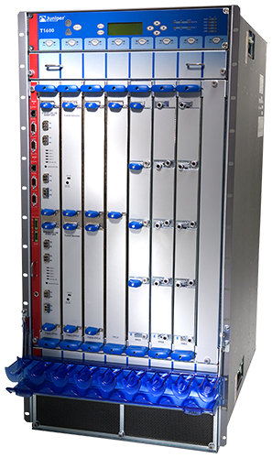
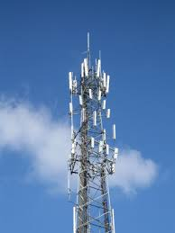
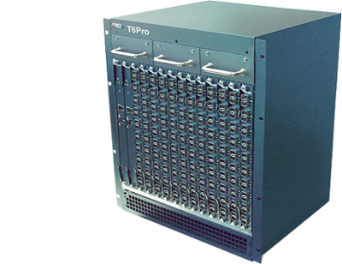
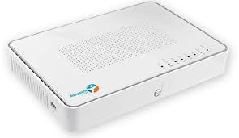
Networks…
SDH, WDM
transport
giga ethernet
metro
ADSL
3G, 4G
access

Slide 6
Networks… and services…
applications
mail
messaging
contents
VoIP
directory
cloud
…
SDH, WDM
transport
giga ethernet
metro
ADSL
3G, 4G
access

Slide 7
Networks… and services… and organization
applications
mail
messaging
contents
VoIP
directory
cloud
…
customer
BtoB
marketing
products
investment
information
CRM
processes
…
SDH, WDM
transport
giga ethernet
metro
ADSL
3G, 4G
access

Slide 8
Networks… and services… and organization
applications
mail
messaging
contents
VoIP
directory
cloud
…
customer
BtoB
marketing
products
investment
information
CRM
processes
…
SDH, WDM
transport
giga ethernet
metro
ADSL
3G, 4G
access
Scope of Network Management

Slide 9
Networks and Services Management functions
What is to do?
  Network awareness: does it work?
  Configuration management
  Evolution management
  Integration management
  QoS management
  Flow management
  Services management
  CRM
  …etc.

Slide 10
Networks and Services Management lifecycle
operation &
maintenance
marketing
deploy &
configure
planning &
engineering

Slide 11
Main concerns in Network & services Management
Multiple technologies
    protocols: SNMP, TMN, ethernet, IP, …
    networks: WDM, SDH, ethernet, IP, …
    software : OO, C++, Java, SOA, REST, ...
Multiple viewpoints
  technical
    informational, architectural, infrastructural
    the time axis
  non-technical
    competition, time to market, economy, …

Slide 12
Why manage networks ?
Network Management allows, at least, to monitor & configure the network
  To capture knowledge on network sanity and service efficiency
    In order to insure QoS control
  To make provision for network evolution
    Maintenance & new systems deployment
As such, Network Management is in the value chain of the operator
  and included in a broader landscape of OSS/BSS

Slide 13
Why manage networks ?
Networks Business Model
  Deliver Bandwidth
    On time
    Contracted quality
      Lost paquets, availability, delay, …
      SLA
  For increasingly real-time oriented services
    Low jitter, low delay
    High bandwidth
    High stress

Slide 14
What is managed ?
Network resources:
  Routers, switches, repeaters, …
  Links
  Applications (software)
But also:
  Technologies (Moore law)
  Users (acces rights, profiles, priviledges, QoS, …)
  Business aspects (RoI, OPEX, CAPEX)
  Legal aspects (local ruling i.e. ARCEP, CNIL)

Slide 15
Plan
Global overview
TMN reference architecture
TMN functional framework
TMN architecture
Protocols
Standards reality check

Slide 16
TMN reference architecture
The Telecommunication Management Network
  Defined by ITU-T (M.3010, 2000)
    ITU-T concept for Network Management in Open Systems
  Framework defining an architecture and a protocol
  A functional framework is defined by ITU-T M.3400

Slide 17
TMN reference architecture
TMN relationship to managed network
TMN
Operations
System
Operations
System
Operations
System
Data Communication Network (DCN)
Workstation
Exchange
Transmission
System
Exchange
Transmission
System
Exchange
Telecommunication Network

Slide 18
TMN reference architecture
TMN overview in this course:
  Functional framework
  Architecture
  Protocols

Slide 19
Plan
Global overview
TMN reference architecture
TMN functional framework
TMN architecture
Protocols
Standards reality check

Slide 20
TMN functional framework
The M.3400 standard defines the functional domains:
  Fault,
  Configuration,
  Accounting,
  Performance,
  Security
Also known as :
FCAPS

Slide 21


TMN functional framework
/Fault Management
The activity to manage network failures
Alarm lifecycle workflow :
Network Management Center (NMC)
Network
Management
Server
Alarm
Display
Network
Management
Operator
Alarm
generated
reconfiguration
Repair
On site
Return to normal

Slide 22
TMN functional framework
/Configuration Management
The activity to configure and maintain network equipment
  Initiating or modifying features, behaviour, etc.
  Updating firmware/software
  From the distance or locally (craft terminal)
  Via either:
    A network management protocol
    Command line (manual telnet/ssh session or scripting)
  Timescale:
    Long term
    Short term, even realtime (on demand MPLS connectivity)

Slide 23
TMN functional framework
/Accounting Management
Has its roots in legacy SS7 billing activity
  Generating monthly billing from detailed POTS usage
In the Internet, revenue sources have shifted:
  From usage based billing to flat rate
    Operators becoming cheap “dumb pipes”
  From network service billing to contents based revenues
    Ads, premium services (VoD, teleconferencing), payed contents (NetFlix)
    These are OTT revenues (not for operators)
    Made the GAFA rich
  From end user billing to BtoB revenues
    Cache selling, proxies (Akamai, http://wwwnui.akamai.com/gnet/globe/index.html), peering

Slide 24
TMN functional framework
/Accounting Management
Peering
Operator A
Operator B
Σ (A to B) - Σ (B to A) → $$$

Slide 25
TMN functional framework
/Performance Management
Definitions
    Network performance management is the collective techniques that enable, manage and ensure optimal performance levels of a computer network.
    Relies on monitoring of Key Performance Indicators (KPIs) such as Network delays, Packet losses, Throughput, Error Rate.
    In addition to internal metrics, network performance management also reviews, analyzes, maintains and manages performance from a user perspective.

Slide 26
TMN functional framework
/Performance Management
Performance Management
  Monitors QoS
    identifying performance bottlenecks, ensuring that problems are mitigated and the network is restored back to the required performance level.
  Relates to Traffic Management
    Reservation of bandwidth, limiting bandwidth, traffic prioritization and classification etc.
  Relates to Investment Management
    Identifying weak spots, guiding investment decisions
  Added value
    QoS is a crucial differentiating factor
    QoS contracts = SLA
    Additional revenue

Slide 27
TMN functional framework
/Security Management
Internet = Achille’s tendon of modern society
  Backbone of 100% of economical activity
  Requires extreme security management
    Access control to premises (biometric)
    Access control to Management Applications (NAD, FAD)
    DCN isolation/protection
    Protocol security (authentication, encryption)
    Network Management Center redundancy

Slide 28
Plan
Global overview
TMN reference architecture
TMN functional framework
TMN architecture
Protocols
Standards reality check

Slide 29
TMN architecture
/layered architecture
Layered architecture
A metaphor: the enterprise business layers
Strategical
Services
Tactical
Execution
Definition of enterprise
goals and business model
marketing, definition of
services and workflows
order management,
workflow execution
order execution

Slide 30
TMN architecture
/layered architecture
Using the metaphor :
  Business Management Layer (BML)
  Service Management Layer (SML)
  Network Management Layer (NML)
  Element Management Layer (EML)

Slide 31
TMN architecture
/layered architecture
long term strategy
business model,
customer relationship management
Business Management Layer
OS
Q3
Service provisioning on behalf of
customer
Service QoS control
Service Management Layer
OS
Q3
Topology knowledge/model
End-to-end connectivity
End-to-end QoS control
Network Management Layer
OS
Q3
OS
FCAPS at the equipment level
Granularity : one single equipment
Element Management Layer
QX
MF
QX
Network Element Layer
NE

Slide 32
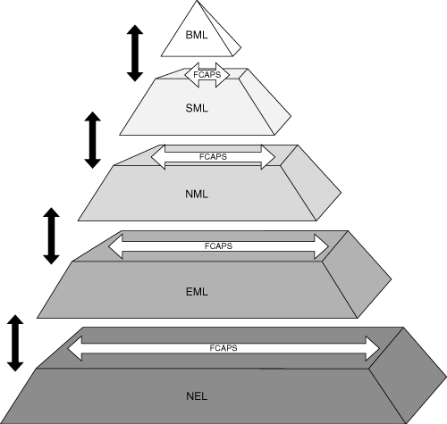
TMN architecture
/layered architecture
M.3010 layout

Slide 33
TMN architecture
/layered architecture
Criticism
  Centralized layout
    Scaling concerns
    Low flexibility
    No provision for local optimizations
    Single Point of Failure pitfall

Slide 34
TMN architecture
/software components
Management processes are either
  Managers
  Agents
Management system
Managed system
requests
manager
agent
Managed Objects
Managed Information
Base
notifications

Slide 35
TMN architecture
/software components
Management Object access
  The MIB is a tree
  MOs are identified by their placement within the tree
    Object Identifier
    Based on X.400 strategy
    The FDN is the tagged path from the root of the tree, to the MO
id=”root”
id=”tag 1”
id=”tag 2”
FDN: { id=”root”, id=”tag 1”, id=”tag 2” }

Slide 36
TMN architecture
/software components
The Frame :
Conceptual
view
including
managed
resources
Management system
Q3 interface
managed objects
managed information base
TMN
agent
Managed resources

Slide 37
TMN architecture
/software components
Cascading interaction
system A
info model B
system B
info model C
system C
M
sees
A
M
sees
A
CMIS
MIB
CMIP
CMIP
resource

Slide 38
TMN architecture
/software components
Sofware engineering – C++ example
compiler
GDMO
compiler
C++
classes
C++
objects
GDMO specs
compiler
ASN.1
compiler
C++
libraries
framework
classes
C++
LINK
objects
ASN.1 specs
compiler
C++
classes
C++
objects
programmer
agent
+
manager

Slide 39
Plan
Global overview
TMN reference architecture
TMN functional framework
TMN architecture
Protocols
Standards reality check

Slide 40
Network Management protocols
Evolution in history
  ITU-T prescribed usage of CMIP protocol
    Common Management Information Protocol
    Mostly implemented by european vendors
    Today : legacy
  IETF proposed SNMP
    Simple Network Management Protocol
    Both architecture and protocol
    De Facto standard
    Limited to EML

Slide 41
Network Management protocols
/CMIS-P
Common Management Information Services/Protocol
To solve the limitations of SNMP
Layer 7 specifications
Requires ROSE, ACSE services
Serves a Systems Management Application Entity (SMAE)
Transport of management information
  defined by information models in GDMO
  carried by ASN.1 structures

Slide 42
Network Management protocols
/CMIS-P
General invocation:
<primitive> (fdn, oid, type, scope, filter);

Slide 43
Network Management protocols
/CMIS-P
General invocation:
<primitive> (fdn, oid, type, scope, filter);
get
set
create
delete
action

Slide 44
Network Management protocols
/CMIS-P
General invocation:
<primitive> (fdn, oid, type, scope, filter);
get
set
create
delete
action
Full
distinguished
name

Slide 45
Network Management protocols
/CMIS-P
General invocation:
<primitive> (fdn, oid, type, scope, filter);
get
set
create
delete
action
Object
Identifier
Full
distinguished
name

Slide 46
Network Management protocols
/CMIS-P
General invocation:
<primitive> (fdn, oid, type, scope, filter);
get
set
create
delete
action
Object
Identifier
Full
distinguished
name
best effort/
transactional

Slide 47
Network Management protocols
/CMIS-P
General invocation:
<primitive> (fdn, oid, type, scope, filter);
get
set
create
delete
action
Object
Identifier
Depth
in MIB tree
Full
distinguished
name
best effort/
transactional

Slide 48
Network Management protocols
/CMIS-P
General invocation:
<primitive> (fdn, oid, type, scope, filter);
get
set
create
delete
action
Object
Identifier
Depth
in MIB tree
Full
distinguished
name
best effort/
transactional
Conditions
on object

Slide 49
Network Management protocols
/CMIS-P
CMIP scope : Depth of request execution
Starting point
Scope = 2

Slide 50
Network Management protocols
/CMIS-P
CMIP scope : Depth of request execution
Starting point
Scope = 2

Slide 51
Network Management protocols
/CMIS-P
CMIP filtering : Conditions on any object property
Starting point
filter =
« AdministrativeState = none »,
scope = any

Slide 52
Network Management protocols
/CMIS-P
CMIP filtering : Conditions on any object property
Starting point
filter =
« AdministrativeState = none »,
scope = any

Slide 53
Network Management protocols
/CMIS-P
Advantages
  many results possible in one request
  transactional on 1 request basis
  full TMN GDMO support
  uses OSI stack
Drawbacks
  transactional on 1 request basis
  complexity, important learning curve
  uses OSI stack
  industrial tools heavy & cumbersome

Slide 54
Network Management protocols
/SNMP
Simple Network Management Protocol - IETF
To solve rapidly, with a transient solution by tinkering, management problems (1986), while ITU-T will provide the absolute perfect solution
0 learning curve
Classical protocol scheme over UDP
Small but beautiful

Slide 55
Network Management protocols
/SNMP
General invocation:
<primitive> (oid, value);
get
set
+ trap
Object
Identifier

Slide 56
Network Management protocols
/SNMP
Flat information model
  no OO
  no containment
  no create, delete = static MIBs
  not GDMO, but Simple Management Interface (SMI) language
  static objects defined by OIDs of IETF specs
  full use of ASN.1
Many IETF MIBs
  MIB II
  RMON
  …. (RFCs)

Slide 57
Network Management protocols
/CMIP-SNMP Comparison
CMIP SNMP
learning curve 0 +++
power +++ +
OO +++ 0
access asynchronous synchronous
dynamicity +++ 0
penetration + +++
security ACSE/ROSE UDP
notifications +++ trap
understanding 0 +++

Slide 58
Network Management protocols
Conclusion
  Distributed management technology is evolving and developing constantly
  CMIP, SNMP have been complemented/superceded by many paradigms such as:
    CORBA
    SOA
    REST
  See courses on:
    SNMP
    Distributed Management paradigms

Slide 59
Plan
Global overview
TMN reference architecture
TMN functional framework
TMN architecture
Protocols
Standards reality check

Slide 60
Standard reality check current landscape
NM
application
NM
application
NM
application
hypervisor
EML
Vendor 1
EML
Vendor 2
EML
Vendor 3
Switch/router
Vendor 1
Switch/router
Vendor 1
Switch/router
Vendor 2
Switch/router
Vendor 3
Switch/router
Vendor 3
Silo 1
Silo 2
Silo 3

Slide 61
Standard reality check assessment
Industry has failed to implement thoroughly the standards
  Many excuses
    Complexity
    Security
    Cost
However SNMP strong in F and P:
  Alarm management
  Monitoring
Evolution towards flexibility and agility
  SOA, REST
  OpenFlow

Slide 62
Any questions?

