Slide 1

Network Management: an introduction
Daniel Ranc
RS2M
daniel.ranc@telecom-sudparis.eu

Slide 2
Plan
Global overview
TMN reference architecture
TMN functional framework
TMN architecture
Protocols
Standards reality check

Slide 3
Plan
Global overview
TMN reference architecture
TMN functional framework
TMN architecture
Protocols
Standards reality check

Slide 4
Networks…
SDH, WDM
transport
giga ethernet
metro
ADSL
3G, 4G
access

Slide 5
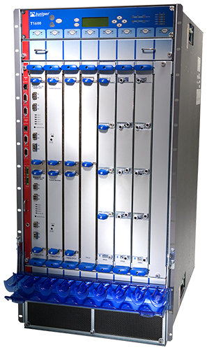
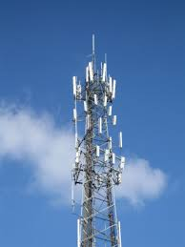
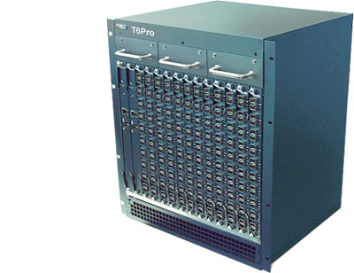
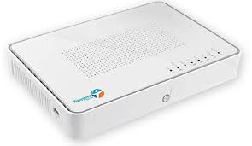
Networks…
SDH, WDM
transport
giga ethernet
metro
ADSL
3G, 4G
access

Slide 6
Networks… and services…
applications
mail
messaging
contents
VoIP
directory
cloud
…
SDH, WDM
transport
giga ethernet
metro
ADSL
3G, 4G
access

Slide 7
Networks… and services… and organization
applications
mail
messaging
contents
VoIP
directory
cloud
…
customer
BtoB
marketing
products
investment
information
CRM
processes
…
SDH, WDM
transport
giga ethernet
metro
ADSL
3G, 4G
access

Slide 8
Networks… and services… and organization
applications
mail
messaging
contents
VoIP
directory
cloud
…
customer
BtoB
marketing
products
investment
information
CRM
processes
…
SDH, WDM
transport
giga ethernet
metro
ADSL
3G, 4G
access
Scope of Network Management

Slide 9
Networks and Services Management functions
What is to do?
  Network awareness: does it work?
  Configuration management
  Evolution management
  Integration management
  QoS management
  Flow management
  Services management
  CRM
  …etc.

Slide 10
Networks and Services Management lifecycle
operation &
maintenance
marketing
deploy &
configure
planning &
engineering

Slide 11
Main concerns in Network & services Management
Multiple technologies
    protocols: SNMP, TMN, ethernet, IP, …
    networks: WDM, SDH, ethernet, IP, …
Multiple viewpoints
  technical
    informational, architectural, infrastructural
    the time axis
  non-technical
    competition, time to market, economy, …

Slide 12
Plan
Global overview
TMN reference architecture
TMN functional framework
TMN architecture
Protocols
Standards reality check

Slide 13
TMN reference architecture
The Telecommunication Management Network
  Defined by ITU-T (M.3010, 2000)
    ITU-T concept for Network Management in Open Systems
  Framework defining an architecture and a protocol
  A functional framework is defined by ITU-T M.3400

Slide 14
TMN reference architecture
TMN relationship to managed network
TMN
Operations
System
Operations
System
Operations
System
Data Communication Network (DCN)
Workstation
Exchange
Transmission
System
Exchange
Transmission
System
Exchange
Telecommunication Network

Slide 15
TMN reference architecture
TMN overview in this course:
  Functional framework
  Architecture
  Protocols

Slide 16
Plan
Global overview
TMN reference architecture
TMN functional framework
TMN architecture
Protocols
Standards reality check

Slide 17
TMN functional framework
The M.3400 standard defines the functional domains:
  Fault,
  Configuration,
  Accounting,
  Performance,
  Security
Also known as :
FCAPS

Slide 18
TMN functional framework
/Fault Management
The activity to manage network failures

Slide 19
Any questions?

