Slide 1


A Comparative Risk Analysis of Sports Books and Options Traders
Daniel Aybar
12/7/23
Final Pre-Capstone Seminar Presentation

Slide 2
Main Question
Is there a significant difference in risk taking strategies employed by options traders and sports books?
How do risk premia differ between these groups?
How does hidden risk differ?
If a difference is found, it could expose inefficiencies in the riskier market.
Will focus on single-day options and college basketball data.

Slide 3
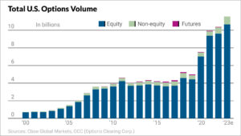
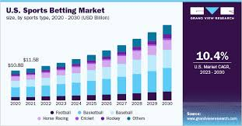
Background
- Options trading and sports betting are both multi-billion dollar industries in the US alone and have grown exponentially in the past few years.
- Recent legislation changes have openned the sports betting market to wider audiences, cuasing increased projected growth in the near future.
- Day trading apps such as Robinhood have opened up the options market to everyday investors.

Slide 4
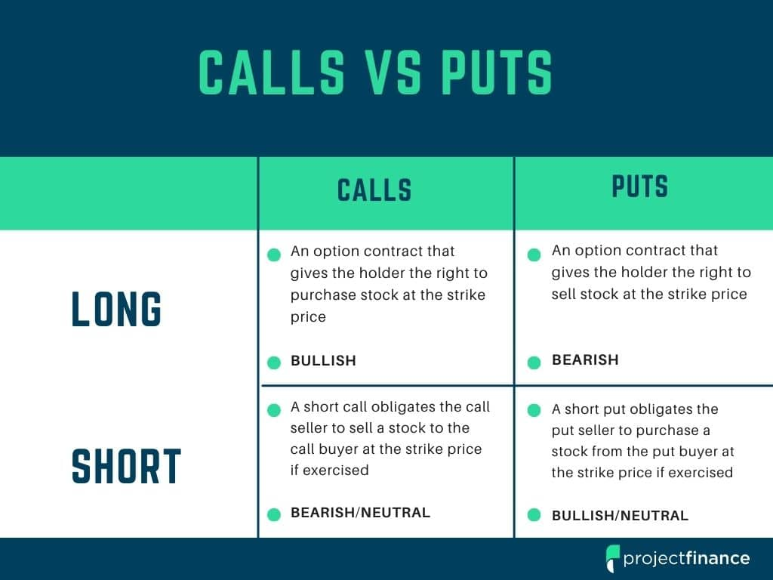
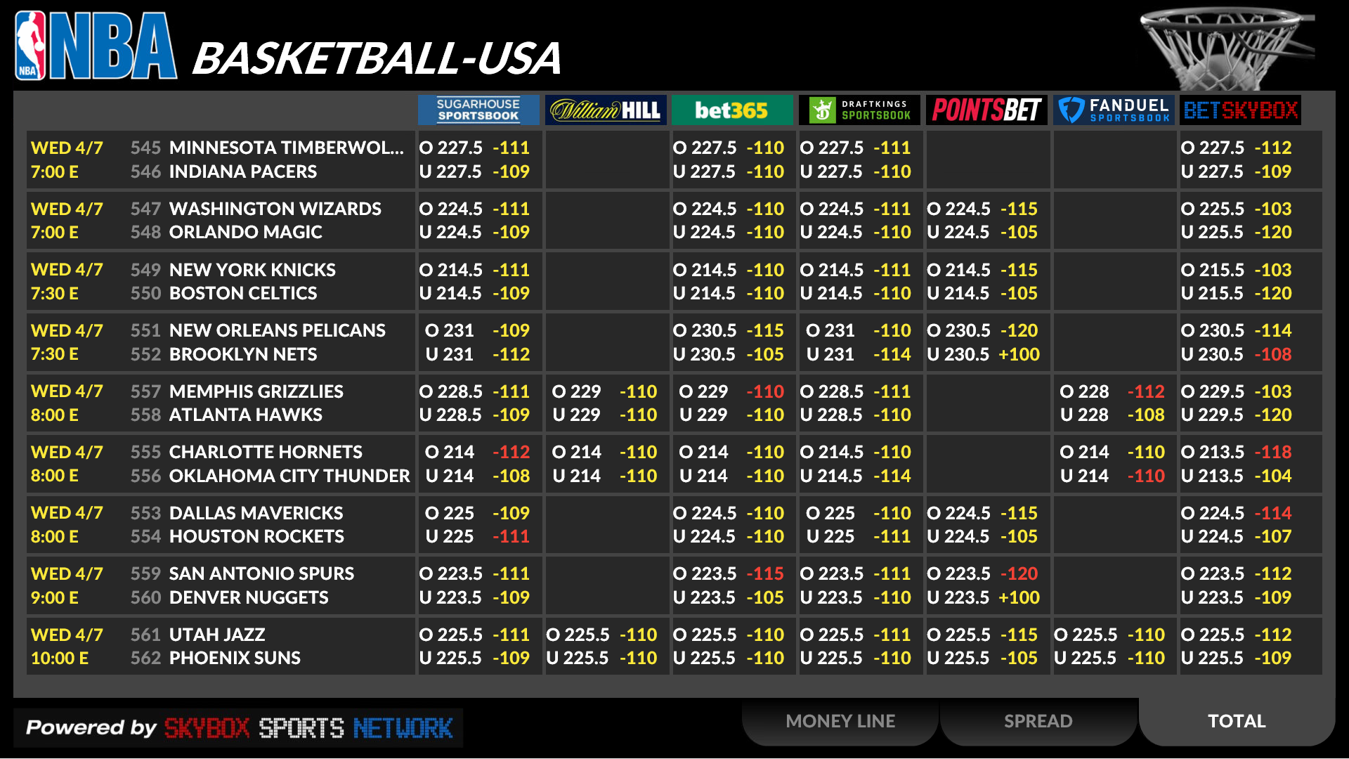
Domain Background:
Options give investors the right but not the obligation to uphold their contract
Put options give the buyer the right to sell at the “strike price”
Call options give the buyer the right to buy at the “strike price”
Pay a price for the option that fluctuates based on intrinsic and extrinsic value
Sports betting returns are based on “Money Lines”
+200 money line: bet $1 to win an additional $2.
-200 money line: bet $2 to win an additional $1.
This paper will only look at positive money lines

Slide 5

Existing Literature
Options Pricing and Risk Literature:
- Bates, (1996): Options Pricing Models
- Merton, (1973): Modern Options Pricing
- Johnson & Stultz, (1987): Pricing Options with Default Risk
- Ahlawat (2012): Value-at-Risk Calculation
- Aguilar et al (1987): Fractional Diffusion Equation for Options Risk Calculation
- Pan (2002): Jump-Risk Premia in Options
- Bollerslev and Todorov (2011): Tail Events and Risk Premia
Sports Betting Pricing Literature:
- Moskowitz, (2021): Asset Pricing and Sports Betting
- Berkowitz et al., (2018) : Converting Money Lines into Win Probabilities
- Arscott, (2022): Risk Management in Shadow Markets

Slide 6
What is Being Added By My Paper?
- Nobody has compared these two markets and their risk profiles.

Slide 7
Conceptual Framework: Risk Premia
- Risk Premium:
- Risk Premium = 1 - P(default)*E(payout/bet_size | default)
- Options: Premium = 1 - (𝟙_{Ri >(strike+ask)/start} (∑P(y = R_{i} )*(R_{i} *start - (strike + ask))/ask))
- y = random variable representing returns | R_{i} represents all possible returns |
start = start price of the stock | ask = ask price: the amount the option holder pays per contract
- Sports Betting: Premium = 1 - (P(U_{win} )*(1 + ML/100))
- ML = moneyline | P(U_{win} ) is the probability that the underdog wins
- based off of concpets from Markowitz (2021)

Slide 8

Conceptual Framwork: Hidden Risk
- Hidden Risk:
- E(returns) = E(gains) - E(losses)
- Options: E(return) = P(y < strike/start)*ask*Q - (𝟙_{(Ri >= strike/start)} *(∑P(y = R_{i} )*((R_{i} - (strike + ask)/start)*Q*start)))
- Sports Betting: E(return) = (1 - P(U_{win}))*(ML/100)*bet_size - P(U_{win} )*(ML/100)*bet_size
- Hidden Risk = E(losses²) - E(losses)²
- Based on risk “edge” proposed by Taleb (2012) and Jensen’s Inequality.

Slide 9

Hypothesis
Options traders have a lower risk premium in addition to higher hidden risk when compared to sports books.
Implies that there these traders take on excess risk.

Slide 10

Methodology Clarification
- Probability of underdog winning will be based on historical data at each moneyline level (i.e the probability of a +400 underdog winning is ~17.5%)
- Based on division I college basketball data from 2007-2022
- Probability of that option will make profit is calculated by taking historical stock market data. (i.e the probability that a stock’s high price is more than 1% greater than it’s start price in a day is ~ 49%)
- Based on a random selection of over 200 stocks’ daily returns from 1997 - 2017

Slide 11

Data
Data Sources:
- Options Data: Kaggle: Muhammad Anas
- Stock Market Data: Kaggle: Boris Marjanovic
- College Basketball Moneyline Data: Sportsbook Reviews Online
All of these have been collected and cleaned.

Slide 12
Summary Table
Dataset Name | Variable Name | Min | Median | Max | Mean | SD | n
Options | Necessary Returns | -33% | 0.49% | 9% | 0.33% | 3.36% | 135
Options | Ask Price | $0.13 | $3.60 | $20.49 | $4.47 | $3.70 | 135
Options | Quantity of Contracts Ordered | 500 | 600 | 4600 | 802.96 | 585.39 | 135
Stocks | Daily High and Low Percent Change from Start | -90% | 0% | 922% | 0% | 2.74% | 1.69M
Sports Betting | Returns on $10 Bet | -$10 | -$10 | $850 | -$1.36 | $18.93 | 59,633
Sports Betting | Money Line | +100 | +240 | +19500 | +514 | 1,106.17 | 59,633

Slide 13
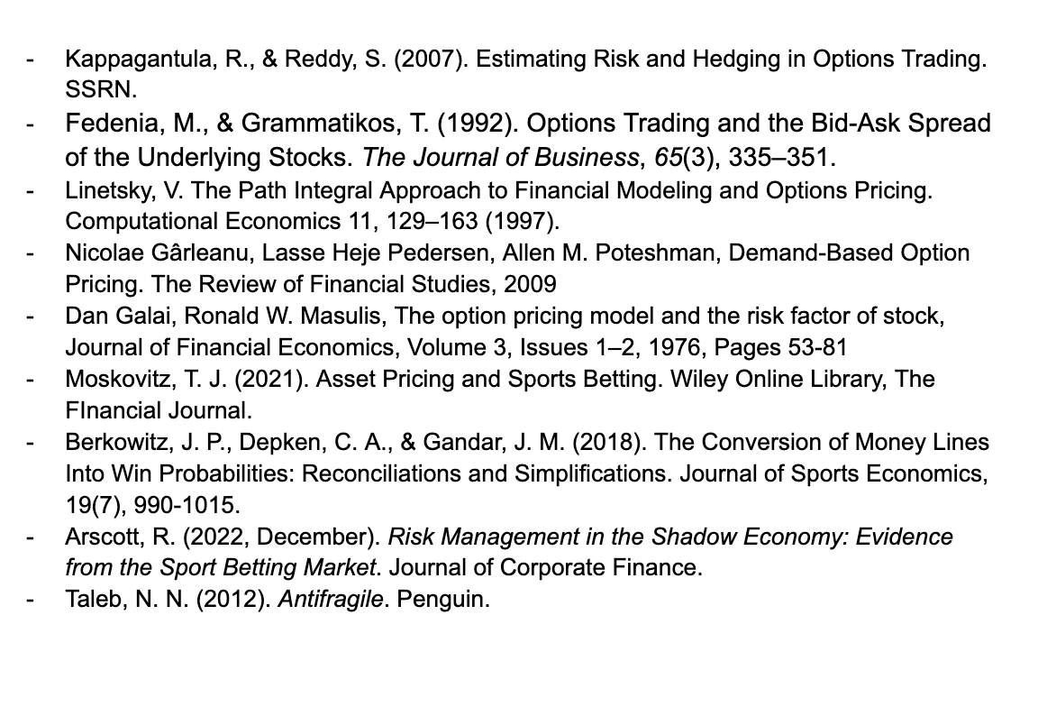
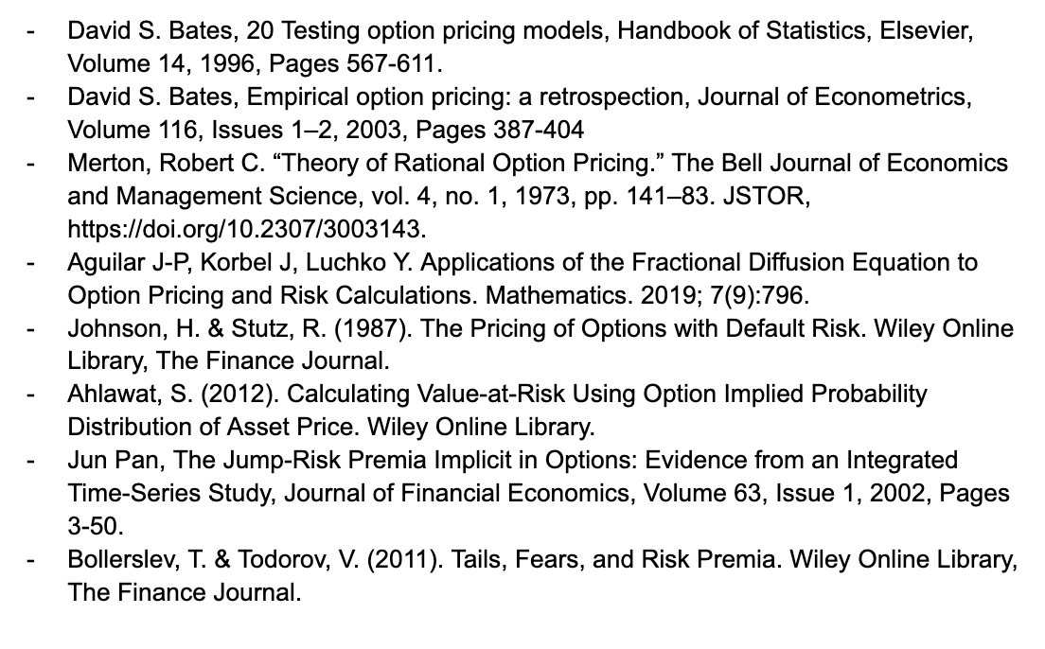
All Sources

