Slide 1
Letter recognition using k-nn (and boosting)
by: Daniel Babalola

Slide 2


introduction
Learning task:
To correctly classify the capital letters of the English alphabet
Planned experiments:
To perform this task by implementing a k-NN using python
To implement a boosting algorithm on the k-NN
Dataset:
Source: UCI Machine Learning Repository
20000 black and white, capital letters
Training set: 12000 (60%)
Validation set: 4000 (20%)
Test set: 4000 (20%)
16 numeric attributes for each character

Slide 3
BACKGROUND
k-NN first implemented in 1951, by Fix and Hodges
Conceptually simple
Required little or no prior knowledge about data distribution
But consumed memory and resources
Further works to improve efficiency:
In 1968, Hart introduced the condensed nearest neighbors (CNN)
In 1996, Robert Schapire and Freund introduced ADABOOST.M1 and ADABOOST.M2
Reduced number of training samples required
Improved computation (and classification) time

Slide 4

METHODOLOGY

Slide 5
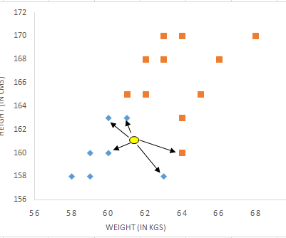

The k-nn algorithm
How it works:
Simply store training data
For each new instance:
Calculate its distance from all training points
Select its k nearest neighbors
Use a majority vote to predict its label
For each new example, distance computations are restarted
Implemented using Scikit-learn (Python)

Slide 6
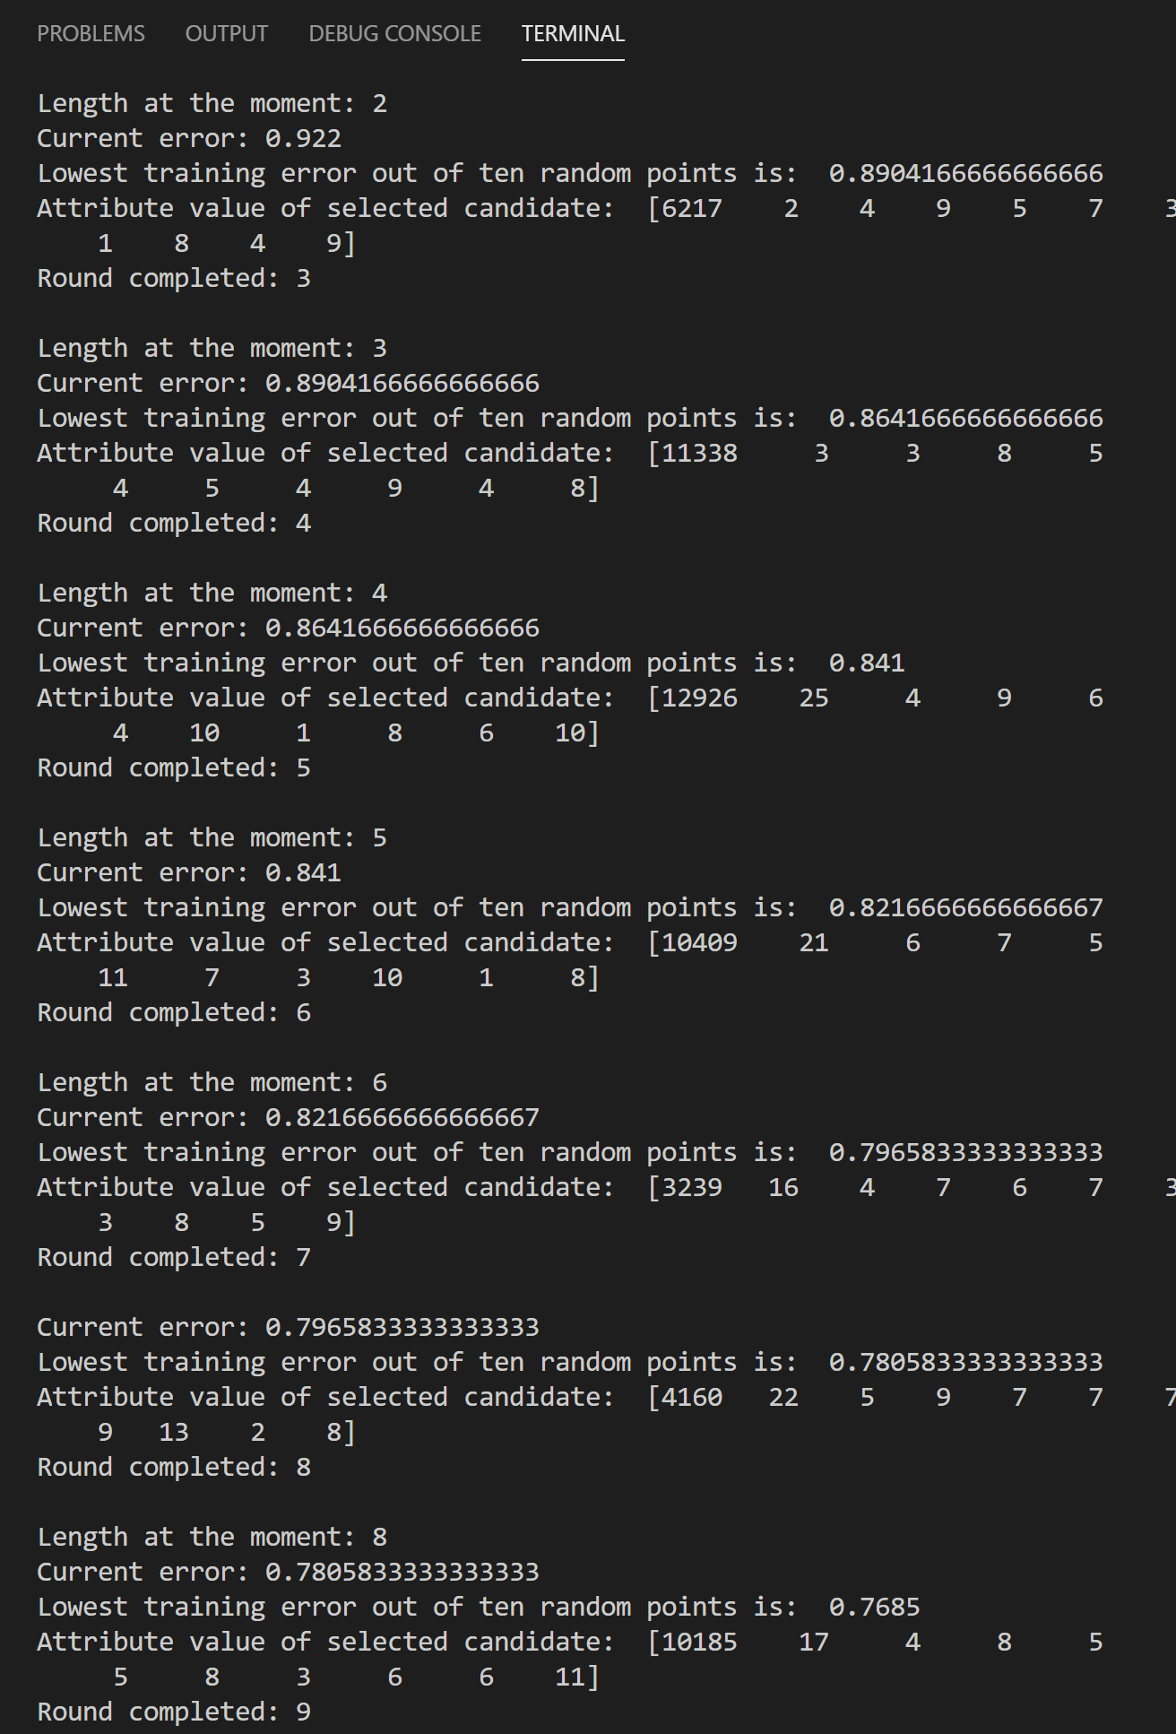
The boosting algorithm (danboost.m1)
Self implemented in python
Inspired by ADABOOST.M2
Algorithm:
Select n points at random
Find point which causes the largest error decrease
Add this point p to a prototype set P
Repeat until P is of defined size k
Remarks:
Very long training time
Significantly reduces number of prototypes needed

Slide 7
Results

Slide 8
Summary
After training on several values of k, k was assigned a value of 3.
Without boosting, the k-NN achieved an accuracy of 93.8% i.e. Test error: 6.2% using 16000 training examples.
Training error: 2.7%
Validation error: 7%
With boosting, I have been able to achieve an accuracy of 82.6% with only 2000 examples. Without boosting, this was achieved at about 5000 examples.
Training error: 15%
Validation error:17.4%
Mislabels occurred mainly on structurally similar letters: (F, P), (G, C), (B, R) etc.

Slide 9
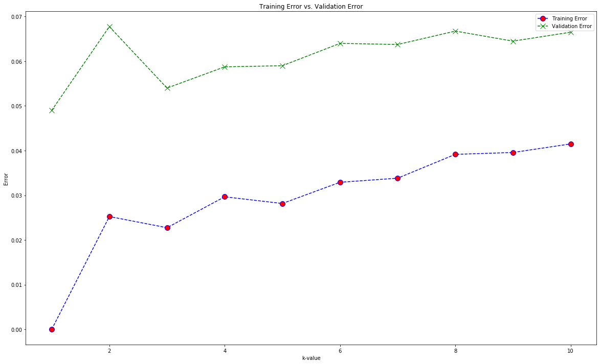
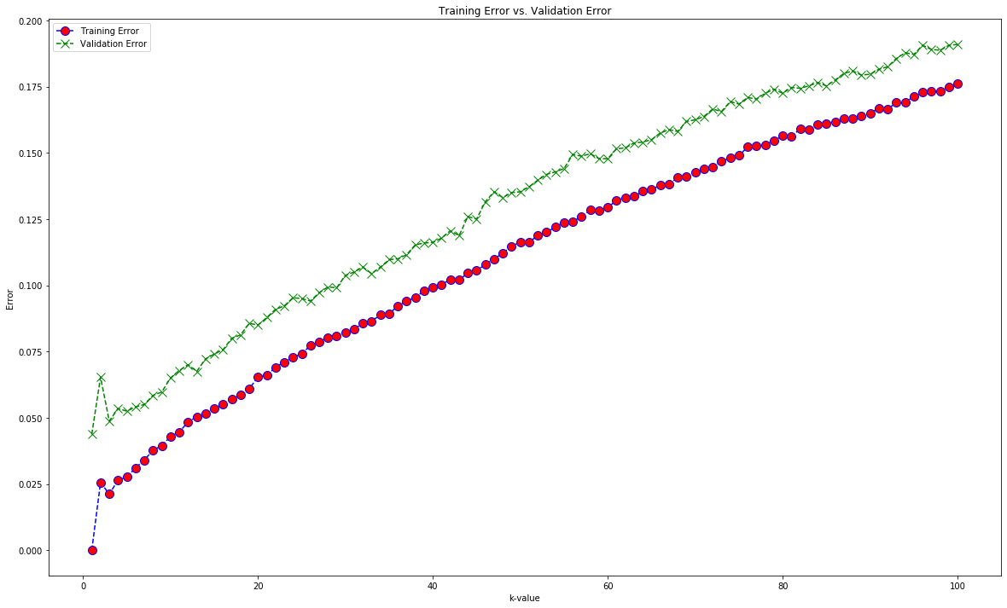
Error as K grows

Slide 10
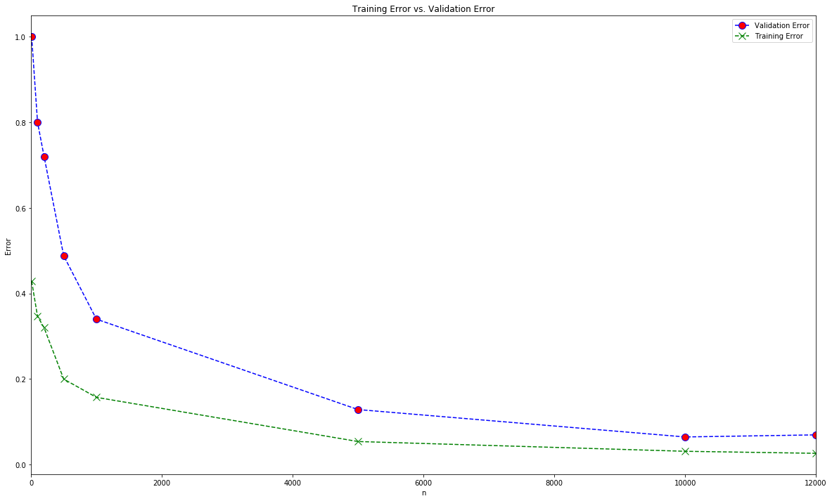
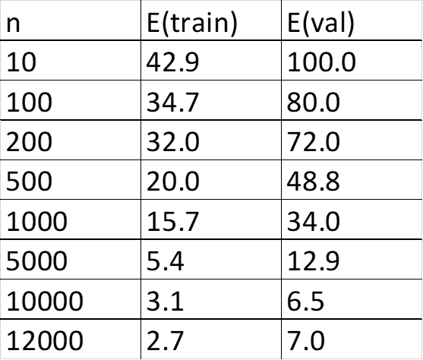
Error as N grows

Slide 11
K-NN vs boosted k-nn

Slide 12
Conclusion

Slide 13
CONCLUSION
K-NN is an easy to implement yet effective classification algorithm
Its major drawback is that it has huge classification costs
With boosting, we can significantly reduce the number of samples required to correctly classify future examples
More work can be done to produce even better boosting algorithms, in terms of both efficiency and training time

Slide 14
References
Fix, E. and Hodges, J.L. (1951) Discriminatory Analysis, Nonparametric Discrimination: Consistency Properties. Technical Report 4, USAF School of Aviation Medicine, Randolph Field.
P. E. Hart, "The condensed nearest neighbor rule", IEEE Trans. Inform. Theory, vol. IT-14, pp. 515-516, May 1968.
G. W. Gates, "The reduced nearest neighbor rule", IEEE Trans. Information Theory, vol. IT-18, no. 3, pp. 431-433, May 1972.
P. W. Frey and D. J. Slate. "Letter Recognition Using Holland-style Adaptive Classifiers". (Machine Learning Vol 6 #2 March 91)
Y. Freund, R. E. Schapire, Experiments with a new boosting algorithm, Machine Learning: Proceedings of the Thirteenth International Conference, 1996, 148, 156
Scikit-learn: Machine Learning in Python, Pedregosa et al., JMLR 12, pp. 2825-2830, 2011.

Slide 15

Questions?

Slide 16
Thank you!

