Slide 1
Federal Spending Estimation
Mohin Banker, Daniel Banko
Consumer Financial Protection Bureau
Elo Lewis
Ntrepid
Notes:
My name is Elo Lewis, (Mohin Banker, Daniel Banko)
I’ll provide a brief introduction to the features and methods used in yesterday’s hackathon

Slide 2
Objectives
Analyze contract data
Create a model predicting federal government contract size
Identify relevant factors
Notes:
all teams were presented with a dataset of U.S. Navy contracts and asked to predict total contract size in dollars.
The data contained 77k observations covering 225 variables.

Slide 3
Process
Features
Models
Results
Next steps
Notes:
I will describe some of the features we used, the models we tested, our results, and potential areas for improvement.

Slide 4
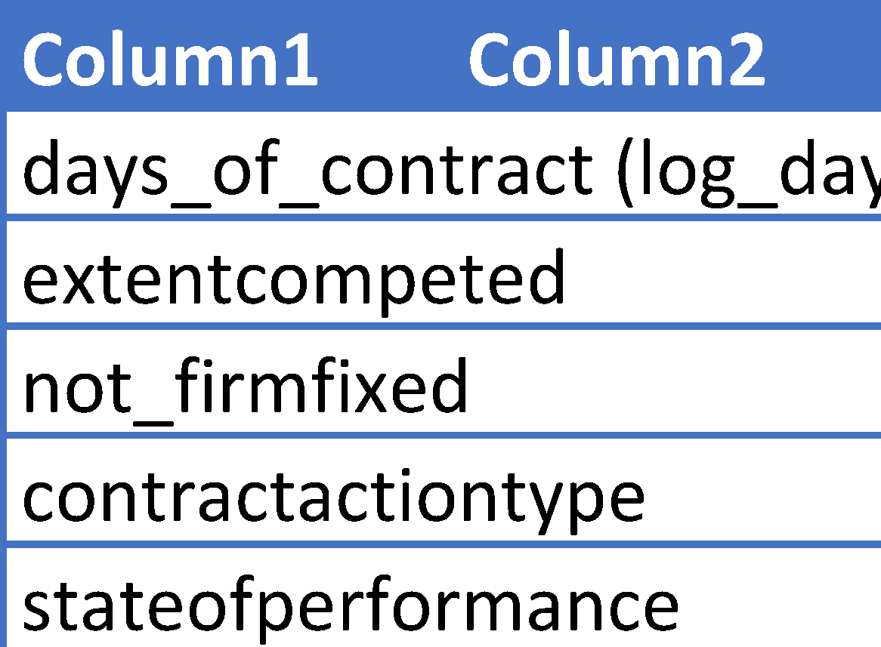
Influential Features
Name | Description
days_of_contract (log) | Log of contract duration (days)
extentcompeted | Measure of competitiveness of contract
not_firmfixed | All contract pricing types (excluding firm fixed)
contractactiontype | Type of award (PO, DO, BPA Calls, Definitive Contracts)
stateofperformance | U.S. state where work was/is performed
Notes:
of the 225 variables we manually selected a small subset of features that believed would be relevant to our response.
in the end, we settled on 20 factors.
the most influential factors were the duration of the contract, the level of competition, whether the contract price was fixed or not, the type of service being performed, and the state where that service was being delivered.

Slide 5
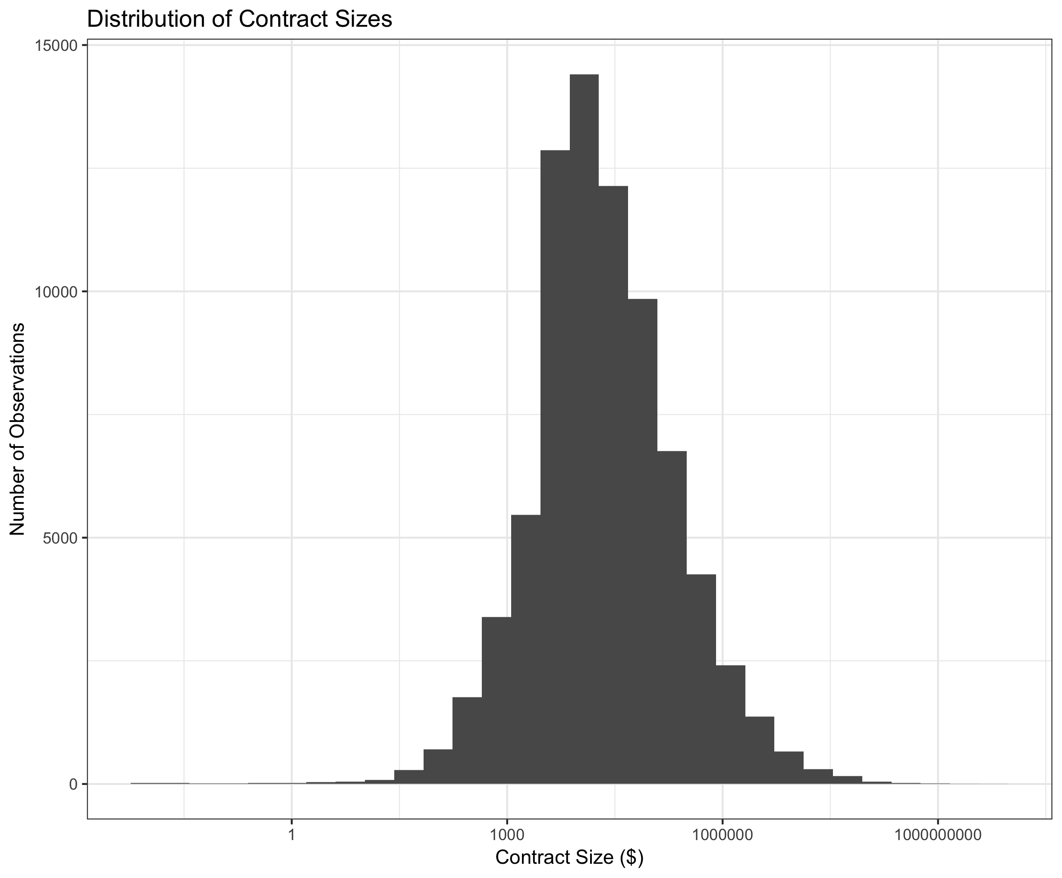
Notes:
Our response variable is the log of overall contract size in dollars.
this graph shows the distribution of our response variable on a log scale.

Slide 6
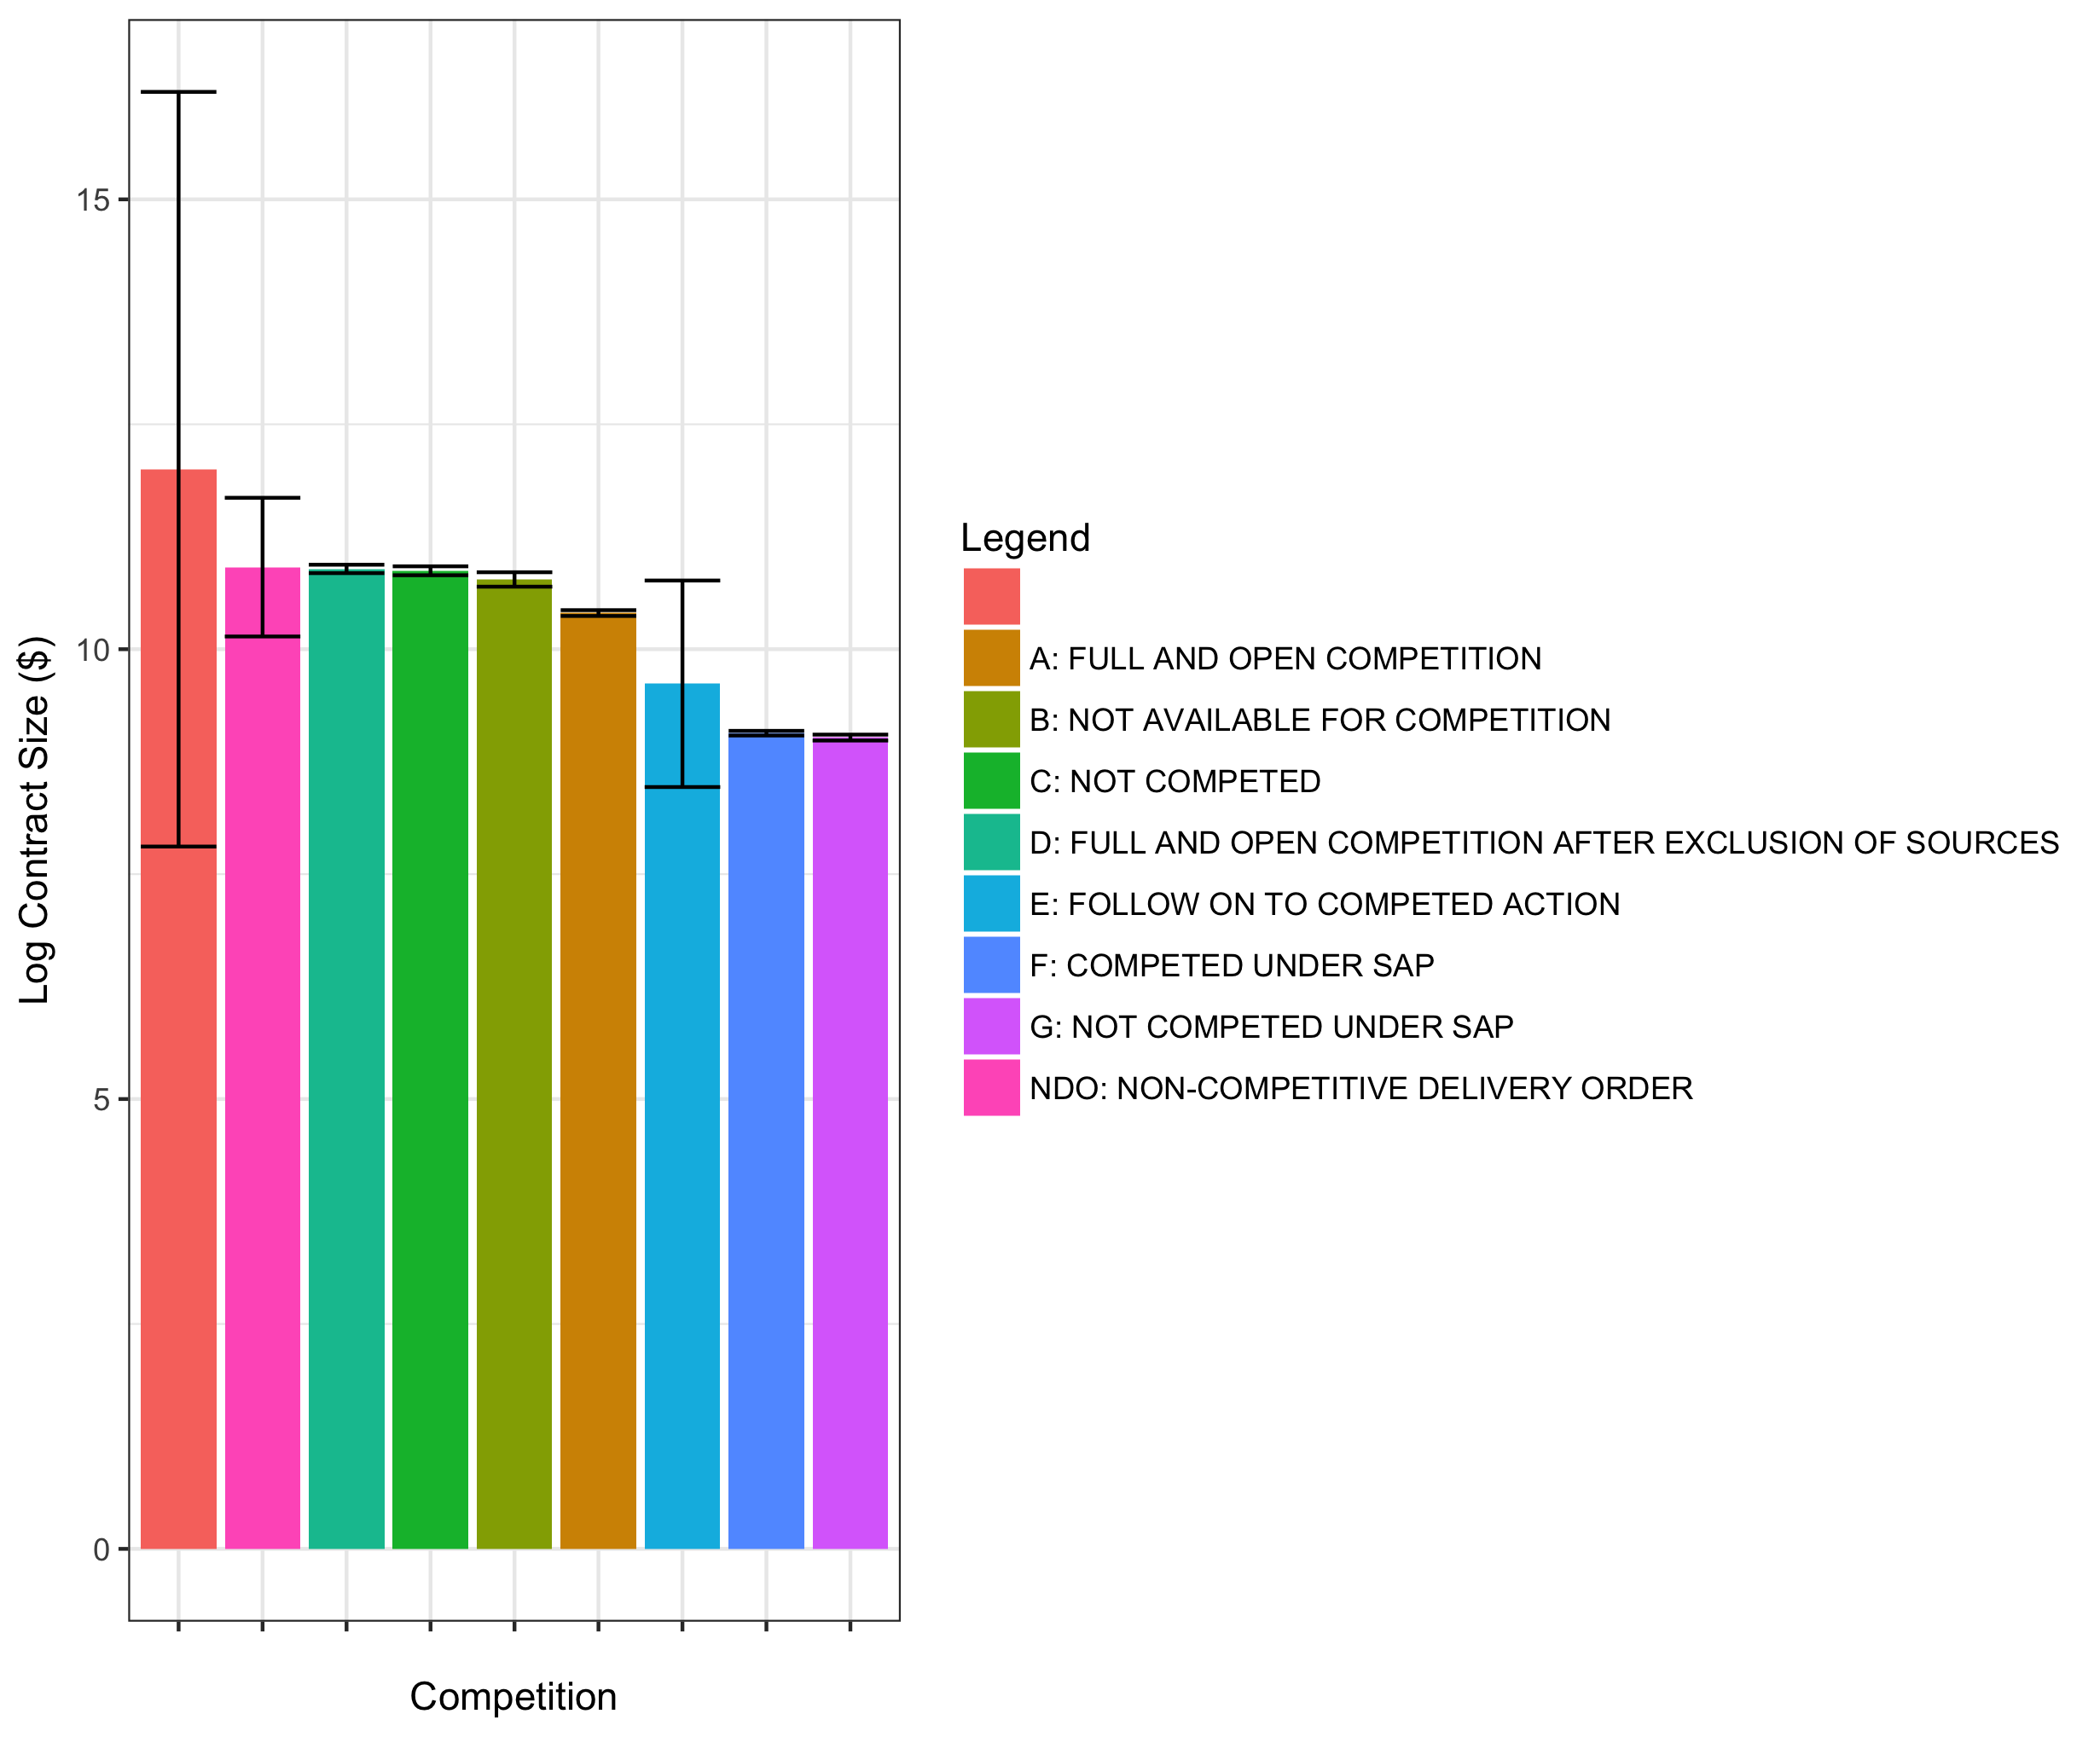
Notes:
this chart shows another feature - extent competed. as you can see, full and open competition is correlated with slightly smaller contracts than non-competitive options.

Slide 7
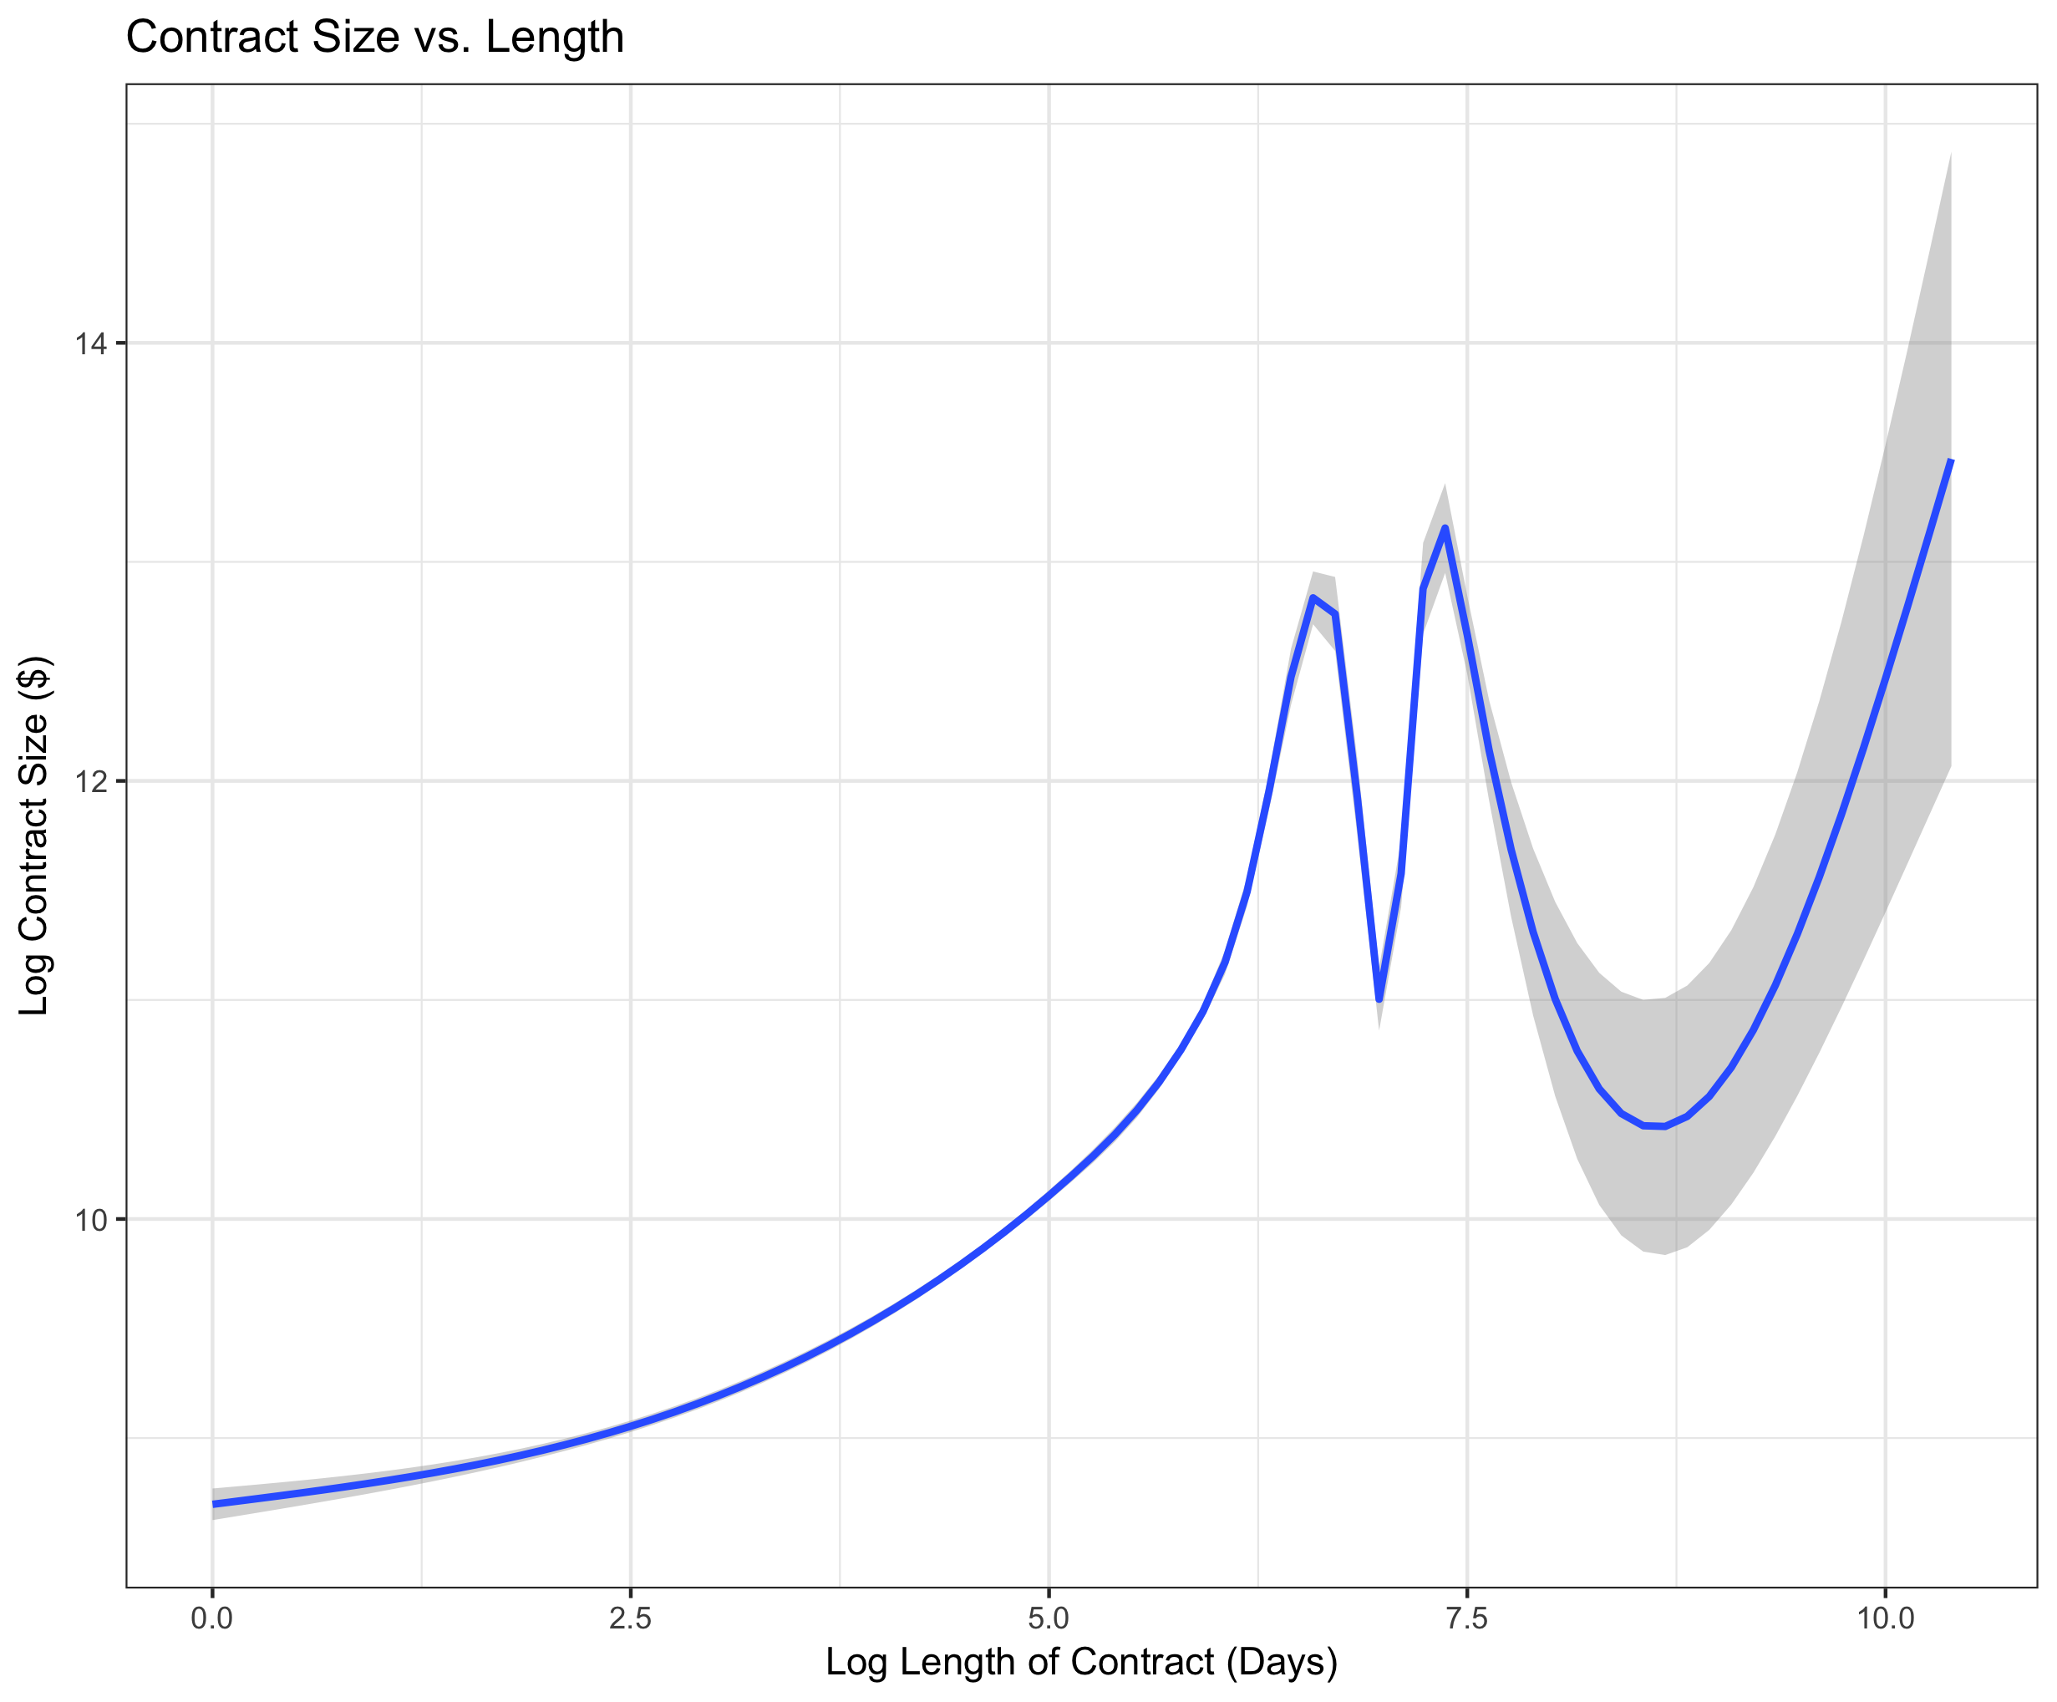
Notes:
This graph is a localized regression of log contract size against log contract length. We can’t explain the valleys, but suspect they may be related to the fulfillment timeframes of different types of services. for example, office supplies might take 2 weeks to deliver, while a new ship may take years to build.

Slide 8
Models:
OLS regression
Gather sense of data properties
Stepwise regression
Simplify model by excluding insignificant variables
Bagged regression models
Run model on random subsamples of data and average results
Gradient boosting regression
Calculate average results of weak prediction models
Notes:
we trained four models on an 80% training set
first we used OLS to get a general sense of the data.
we then used stepwise regression to test our feature selection.
since the data was non-homogenous, we were concerned that our subsample may be skewed. to test this, we ran regressions on random subsamples of the data, and aggregated the results.
finally, we used gradient boosted regression trees. for those of you unfamiliar with gradient boosting, its an ensemble method that relies on multiple weak decisionmakers, where each successive decisionmaker learns from the errors of the one before it. when tuned properly, this method is known to perform very well in both regression and classification problems.

Slide 9
Results
 | Stepwise | Bagged | Gradient boosting
RMSE | 1.95 | 1.97 | 1.88
Iterations | 1 | 1000 | 1000
shrinkage | NA | NA | 0.01
Interactions | Yes | No | No
R² | .303 | NA | NA
Notes:
gradient boosted model achieved the best performance.
for iterative models, we use 1000 iterations.
the stepwise regression also included interaction terms

Slide 10
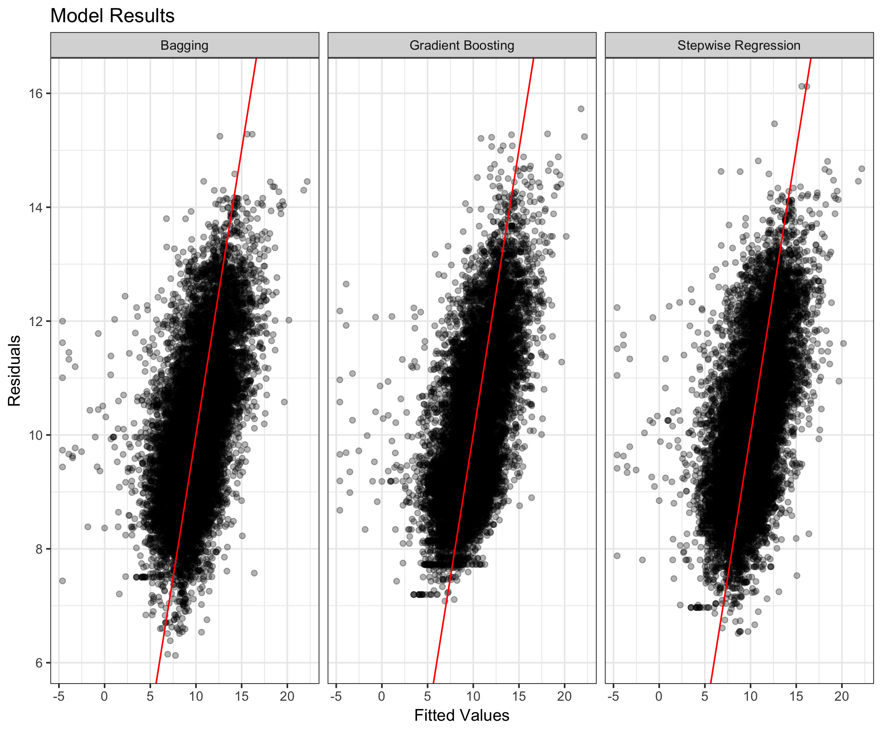
Notes:
here we have each fitted values compared to a line of best fit.
a perfect model should see fitted values exactly along the line
as you can see, the gradient boosting was able to achieve a more compact representation

Slide 11
Next steps
Possible limitations
mislabeled and missing data
Omitted variables
Influence of outliers
Potential solutions
Adjust loss parameter
Stochastic subsampling
Adjust evaluation metric
Notes:
there are a number of opportunities to improve our gradient boosted model
initial analysis of the data revealed some instances where data was missing or mislabeled.
also, our ols model showed a tendency to overestimate contract sizes. this may be due to influential outliers or omitted variable bias.
for solutions,
we could change the loss parameter to be more robust against outliers and missing data.
second, combining bagging and boosting methods has been shown to greatly increase accuracy (Friedman, 1999).
finally, all of our models were trained using RMSE. A different evaluation metric might be more appropriate.

Slide 12
Federal Spending Estimation
Mohin Banker, Daniel Banko
Consumer Financial Protection Bureau
Elo Lewis
Ntrepid
Notes:
Thank you for listening

