Slide 1
Textons
Basic of preattentive human vision
Ahmed Karam Eldaly
Daniel Barmaimon
Notes:
````

Slide 2
Index
1. Human vision modes
2. Models in preattentive vision
3. Texture characterization using textons
1 - 2D Textures
2 - 3D Textures
3 - Learning the universal vocabulary of local structures
  a - 2D textons for planar texture.
  b - 3D textons for natural materials.
4. Textons and color

Slide 3
Index
1. Human vision modes
2. Models in preattentive vision
3. Texture characterization using textons
1 - 2D Textures
2 - 3D Textures
3 - Learning the universal vocabulary of local structures
  a - 2D textons for planar texture.
  b - 3D textons for natural materials.
4. Textons and color

Slide 4

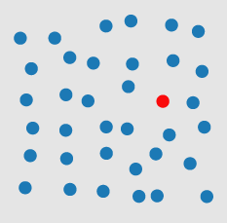
(1) Textons – Human Vision Modes
Differences in color
What is preattentive processing in vision?
Notes:
Preattentive Processing now tries to find characteristics that make use of the potential of the low-level human vision.
· The eye perceives a lot of data at the same time (parallel). The subject is not aware of all perceived information, which was filtered by the brain so just the
relevant information is ”seen” by the subject (focus).
· If the desired item is not found at the first sight the subject has to look at each item one after another (serial). It takes more time.
Healey, Christopher G. [1992]. Visualization of Multivariate Data Using Preattentive Processing. Master’s
thesis, Department of Computer Science, University of British Columbia.

Slide 5
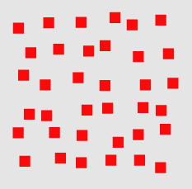
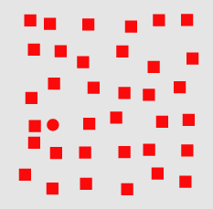
(1) Textons – Human Vision Modes
Differences in shape
What is preattentive processing in vision?
Notes:
Preattentative processing has been studied and developed since the 1980’s. The three classical targets where it is helpful are:
· Target detection: a subject has to detect rapidly whether there is a defined target item (using preattentive properties) within a field of distractor elements.
· Counting and estimation: a subject has to count or estimate the number of elements using a common preattentive property.
· Boundary detection: a subject has to detect rapidly and accurately a boundary between two groups of elements.
(group = elements with a common preattentive property)

Slide 6
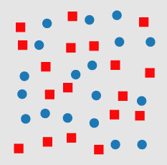
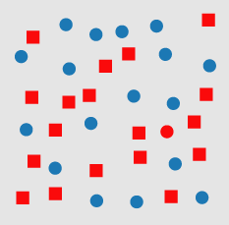
(1) Textons – Human Vision Modes
Conjunction Search
Not so easy or quick
What is preattentive processing in vision?

Slide 7
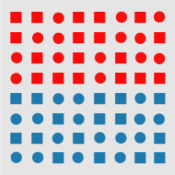
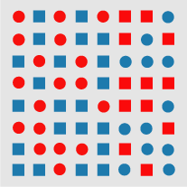
(1) Textons – Human Vision Modes
Edge detection by hue
What is preattentive processing in vision?
Notes:
200 to 250 msec threshold allows to detect the boundary – ‘ONE LOOK’ vision
http://www.csc.ncsu.edu/faculty/healey/PP/, Christopher G. Healey
Department of Computer Science, North Carolina State University’

Slide 8





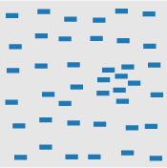

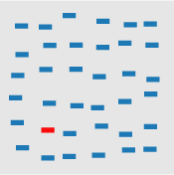
(1) Textons – Human Vision Modes
What is a preattentative feature?
Notes:
A 200 to 250 msec threshold allows to detect the boundary – ‘ONE LOOK’ vision -> Allows to experiment with different features
Orientation, Length, Closure, Width,
Curvature, Element Density, Number, Hue,
Treisman, Anne [1985]. Preattentive processing in vision. Computer Vision, Graphics and Image Processing,
31(2), pages 156–177. doi:10.1016/S0734-189X(85)80004-9.

Slide 9

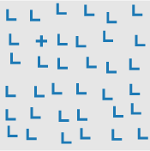
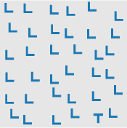
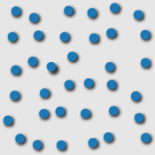
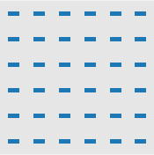
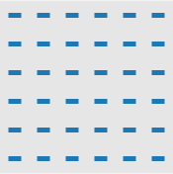
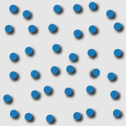
(1) Textons – Human Vision Modes
What is a preattentative feature?
Notes:
Intensity, Crossing, Terminators, 3D Depth,
Flicker, Velocity, Direction of Motion, Lighting Direction,
Treisman, Anne [1985]. Preattentive processing in vision. Computer Vision, Graphics and Image Processing,
31(2), pages 156–177. doi:10.1016/S0734-189X(85)80004-9.
http://www.csc.ncsu.edu/faculty/healey/PP/, Christopher G. Healey
Department of Computer Science, North Carolina State University’

Slide 10
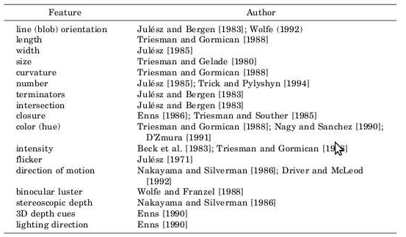
(1) Textons – Human Vision Modes
What is a preattentative feature?
Notes:
Overview of the preattentavie features made by Healey.
Healey, Christopher G. [1992]. Visualization of Multivariate Data Using Preattentive Processing. Master’s
thesis, Department of Computer Science, University of British Columbia.

Slide 11
Index
1. Human vision modes
2. Models in preattentive vision
3. Texture characterization using textons
1 - 2D Textures
2 - 3D Textures
3 - Learning the universal vocabulary of local structures
  a - 2D textons for planar texture.
  b - 3D textons for natural materials.
4. Textons and color

Slide 12
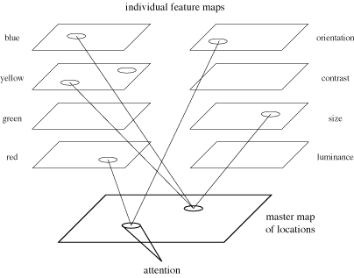
(2) Models in preattentive vision
Feature Integration
Experiments to get:
· Target
· Boundary detection
If t < 250 ms
preattentive feature
Notes:
Treisman tried several experiments using target and boundary detection to classify preattentive features. During the
experiments the number of distractors per scene was changed in several iterations. If the time to finish the task
stayed rather constant over all iterations, this was an indicator for a pre-attentive feature. As a threshold 250ms
per scene was used, to make sure the eye has no time to focus on an item. At this time conjunction search was
seen to be pre-attentive.
Treisman’s feature list: Line Length, Orientation, Contrast, Hue, Curvature, Closure

Slide 13
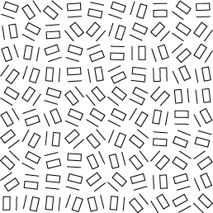
(2) Models in preattentive vision
Textons
Elongated blobs
Terminators
Crossing lines
(a)
(b)
Notes:
Bela Julesz also did research in the area of the human low-level vision system. He tried to find which patterns
in textures are seen or not seen.
· Elongated blobs (e.g., line segments, rectangles, ellipses) with specific properties such as hue, orientation, and width.
· Terminators (ends of line segments).
· Crossings of line segments.
Julesz Bela, L. A. Shepp, E. N. Gilbert and H. L. Frisch [1973]. Inability of humans to discriminate between
visual textures that agree in second-order statistics – revisited. Perception, 2(4), pages 391–405.
doi:10.1068/p020391.

Slide 14
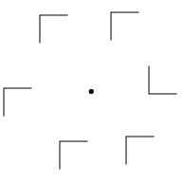
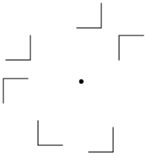
(2) Models in preattentive vision
Similarity Theory
T – N : Similarity between targets and not targets
N – N : Similarity within non targets themselves
(a)
(b)
N – N is high
N – N is low
Notes:
T – N increases, search efficiency decreases and time search increases
N – N decreases, search efficiency decreases and time search increases
Duncan and Humphrey proposed a three step visual selection:
The visual field is segmented into structural units which share some common property (orientation, hue,motion).
Each unit can be segmented again into smaller subunits sharing again some common property, creating a hierarchy. The process of separation occurs parallel.
2. During search a template for the sought unit is created. Each structural unit is compared to the template.
To better the match the more resources of the limited short term memory is allocated for this unit.
3. Because units are organized in a hierarchy (step 1), a poor match of an unit and the template allows to
reject other units that are strongly related to the rejected unit.
Duncan, John and Glyn W. Humphreys [1989]. Visual search and stimulus similarity. Psychological Review,
96(3), pages 433–458. doi:10.1037/0033-295X.96.3.433.

Slide 15
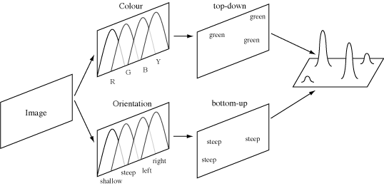
(2) Models in preattentive vision
Guided Search Theory
Top-down (user-driven search)
Finds items with a specific property or set of properties
Bottom-up (feature categorization)
Measures how different an element is from its neighbours.
Notes:
· Bottom-up: how different are the elements in terms of colour, how different are they in terms of orientation
· Top-down : not always intuitive to find ‘best’ cathegory
Each map filters one specific type (e.g colour) but divide this type in subcategories (e.g green, red). While colour his the top-down activation in Wolfes model the orientation (subcategories: shallow, steep) represents the bottom-up part.
Target elements generate the highest level of activation (they pop out of their surrounding elements) regardless the number of distractors.
Wolfe, Jeremy M. and Susan L. Franzel [1988]. Binocularity and visual search. Perception & Psychophysics,
44(1), pages 81–93. http://search.bwh.harvard.edu/new/pubs/BinocSearchPandP88.pdf.
Wolfe, Kyle R. Cave, JeremyM. and Susan L. Franzel [1989]. Guided search: An alternative to the feature integration
model for visual search. Journal of Experimental Psychology: Human Perception and Performance,
15(3), pages 419–433. doi:10.1037/0096-1523.15.3.419.
31

Slide 16
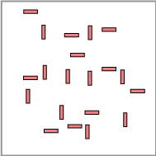
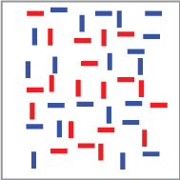
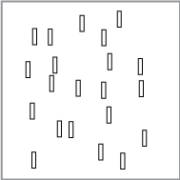
(2) Models in preattentive vision
Boolean Map Theory
Two different tasks:
Selection
Access
Notes:
Selection of a value for a feature. All objects that contain the feature are collected and evaluated.
In the example. Selection of feature ‘color: red’ and ‘orientation: undefined’. Selection ‘color: undefined’ and ‘orientation: vertical’
Huang, Anne Treisman, Liqiang and Harold Pashler [2007a]. Characterizing the Limits of Human Visual
Awareness. Science, 317(5839), pages 823–825. doi:10.1126/science.1143515.
Huang, Liqiang and Harold Pashler [2007b]. A Boolean map theory of visual attention. Psychological Review,
114(3), pages 599–631. doi:10.1037/0033-295X.114.3.599.

Slide 17
Index
1. Human vision modes
2. Models in preattentive vision
3. Texture characterization using textons
1 - 2D Textures
2 - 3D Textures
3 - Learning the universal vocabulary of local structures
  a - 2D textons for planar texture.
  b - 3D textons for natural materials.
4. Textons and color

Slide 18
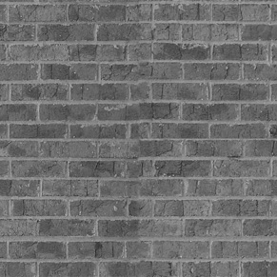
(3-1) 2D textures
Traditional Texture Descriptors are used to recognize 2D textures
http://opengameart.org/textures/all
Notes:
Traditional texture descriptors like:-
Markov random fields, Filter responses, Local binary patterns

Slide 19
Index
1. Human vision modes
2. Models in preattentive vision
3. Texture characterization using textons
1 - 2D Textures
2 - 3D Textures
3 - Learning the universal vocabulary of local structures
  a - 2D textons for planar texture.
  b - 3D textons for natural materials.
4. Textons and color
Notes:
Next:- Examples for 3D textures

Slide 20
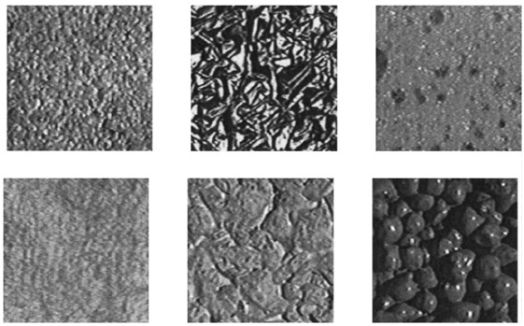

(3-2) 3D Textures
http://www.cs.berkeley.edu/~malik/papers/LM-3dtexton.pdf

Slide 21
(3-2) 3D Textures
What if we used the traditional texture descriptors to recognize 3D textures?
1- The illumination is assumed to be constant.
2- We did not take into account specularities, shadows, and occlusions (3D nature of the images)
Notes:
Texture recognition/discrimination is assumed as a 2D problem.

Slide 22
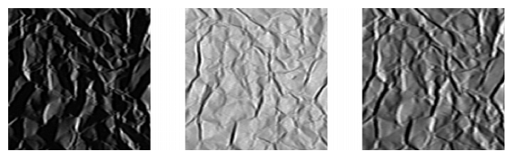
(3-2) 3D Textures
1- Lighting and viewing conditions problem:-
The material “Crumpled Paper” imaged under three different lighting and viewing conditions.
http://www.cs.berkeley.edu/~malik/papers/LM-3dtexton.pdf

Slide 23
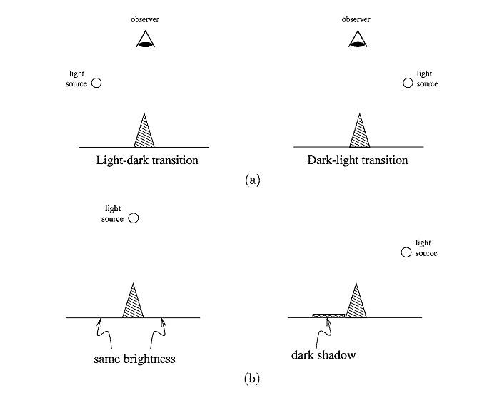
(3-2) 3D Textures
2- Shadow and the 3D nature of the images:-
http://www.cs.berkeley.edu/~malik/papers/LM-3dtexton.pdf
Notes:
(a) A ridge: under one illumination, the ridge appears as a light-dark transition, while it appears as a dark-light transition under another.
(b) Shadows: under one illumination, two regions have the same brightness, while under another, the brightness is different.
Next:- So, The idea is to find a new technique for describing 3D textures

Slide 24
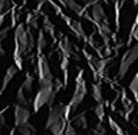
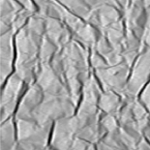
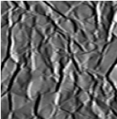
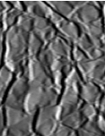
(3-2) 3D Textures
Database
???
Test image
Crumpled Paper
http://www.cs.berkeley.edu/~malik/papers/LM-3dtexton.pdf
Notes:
Given image database, we need to recognize a new sample of different lighting conditions and different views

Slide 25
Index
1. Human vision modes
2. Models in preattentive vision
3. Texture characterization using textons
1 - 2D Textures
2 - 3D Textures
3 - Learning the universal vocabulary of local structures
  a - 2D textons for planar texture.
  b - 3D textons for natural materials.
4. Textons and color

Slide 26
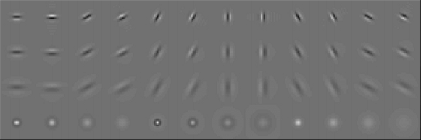
(3-3-a) 2D Textons
Usage:- Used for planar texture.
Goal:- Find canonical local features in a texture;
Method:-
We will characterize a 2D texture by its responses to a set of orientations and spatial frequency linear filters (Filter Banks).
Notes:
There are a total of 48 filters (36 elongated filters at 6 orientations, 3 scales, and 2 phases, 8 center-surround difference of Gaussian filters, and 4 low-pass Gaussian filters.).

Slide 27
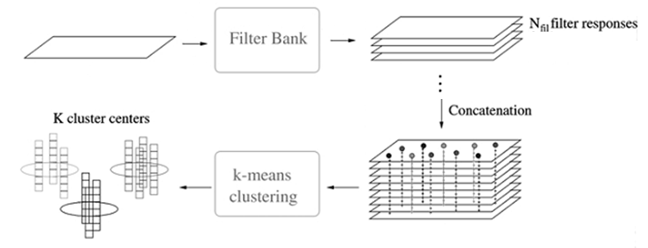
(3-3-a) 2D Textons

Slide 28
(3-3-a) 2D Textons
Each pixel is transformed to a N_{fil} =48 dimensional vector.
These vectors are clustered using K-means:-
1- Assign data vectors to the nearest of the K centers.
2- Update each of the K centers to the mean of the data vectors assigned to it.
These two steps are continued until the algorithm converges and a local minimum of the criterion is achieved.
These K - centers are called “Textons”.

Slide 29
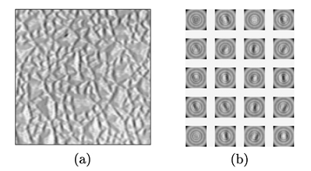
(3-3-a) 2D Textons
http://www.cs.berkeley.edu/~malik/papers/LM-3dtexton.pdf
Notes:
Illustration of K-means clustering and reconstruction from filter responses with K=20.
(a) Original image.
(b) the K-means centers reconstructed as local filters. These centers correspond to the dominant features in the image: bars and edges at various orientations and phases;

Slide 30
Index
1. Human vision modes
2. Models in preattentive vision
3. Texture characterization using textons
1 - 2D Textures
2 - 3D Textures
3 - Learning the universal vocabulary of local structures
  a - 2D textons for planar texture.
  b - 3D textons for natural materials.
4. Textons and color

Slide 31
(3-3-b) 3D Textons
Usage:-
Consider textures with 3D features, e.g. bumps, grooves, ridges, etc…
Goal:-
Want textons to capture local 3D geometric and photometric features.
Idea:-
If we used only one image: different features can look the same under certain illumination and viewing conditions.
More images will discriminate between the different cases.

Slide 32
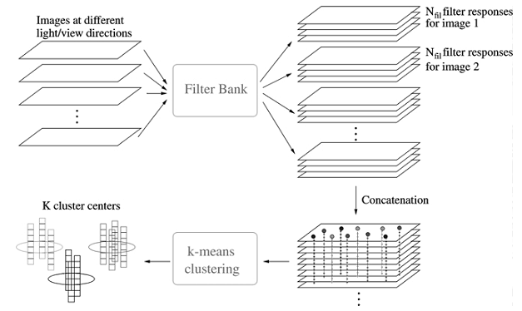
(3-3-b) 3D Textons
http://www.cs.berkeley.edu/~malik/papers/LM-3dtexton.pdf
Notes:
Figure 6. Each image at different lighting and viewing directions is filtered using the filter bank. The response vectors are concatenated together
to form data vectors of length Nfil Nvl. These data vectors are clustered using the K-means algorithm. The resulting centers are the 3D textons
and the associated filter response vectors are called the appearance vectors.

Slide 33
(3-3-b) 3D Textons
Constructing the Universal Vocabulary of 3D Textons
1- 20 materials, for each material, 20 images at different lighting and viewing directions.
For each material:-
2- Apply the filter bank (48 filters) for the 20 images.
3- Each pixel becomes a 960 (20x48) dimensional feature vector.
Notes:
Our goal is to use images from a set of training materials to learn a vocabulary which can characterize all natural materials.

Slide 34
(3-3-b) 3D Textons
4- The K means clustering algorithm is applied to the feature vectors. The number of centers, K, is 400.
5- The centers for all the materials are merged together to produce a universal alphabet of size K=8000.
6- Merging centers too close together or getting rid of those centers with too few data assigned to them , K=100.
7- The resulting K centers are the 3D textons.

Slide 35
(3-3-b) 3D Textons
Different illumination
and viewing directions
Texton 1
Texton 2
Texton 3
Texton 4
Texton 5
Texton 6
Texton 7
http://www.cs.berkeley.edu/~malik/papers/LM-3dtexton.pdf

Slide 36
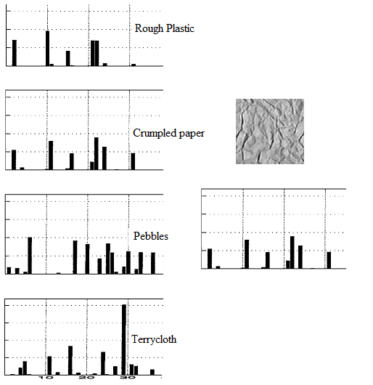
(3-3-b) 3D Textons

Slide 37
Index
1. Human vision modes
2. Models in preattentive vision
3. Texture characterization using textons
- 2D Textures
- 3D Textures
- Learning the universal vocabulary of local structures
  - 2D textons for planar texture.
  - 3D textons for natural materials.
4. Textons and color

Slide 38
(4) Textons and Color
Features and p-blobs
Is it possible to introduce color as a new feature?
The basic attributes are called now p-blob
Wide
Length
Orientation
I
RG
BY
How to get them automaticly?
1.- Normalized Laplacian filtering
2.- Maximum detection over scale
3.- Detecting blobs by structural tensor at integration scale
4.- Local maxima over overlapping blobs
5.- Textons are finally extracted
“Texton theory revisited: A bag-of-words approach to combine textons”
Notes:
Colour attributes, are estimated using colour information from all pixels belonging to a p-blob.
We obtain them (identified by (i, rg, by)) employing the median statistic operator which is robust to noise and outliers.
Steps
1.- ∇^2_norm [L(·;)] = sigma^2∇^2[L(·;)] - Normalized differential Laplacian of the Gaussian operation in a subset of scales.
sigma = {1.284^n, n ∈ [1..11]} L(x, y;) = I(x, y) ∗G(x, y; sigma)
2.- Analysis of results checking the with of the p-blob, where width = s (s = logaritmic scale) -> Spatial localitation and optimal scale
3.- Detecting eigenvectors and eigenvalues for each p-blob scale. A large amount of them will overlap. More information reference Lindeberg
4.- Removes redundancy.
5.- Textons are finally extracted computing the attributes of p-blobs detected (wide, length, orientation, I, RG, BY)
Susana Alvareza, Maria Vanrell, Texton theory revisited: A bag-of-words approach to combine textons
Universitat Aut onoma de Barcelona
T. Lindeberg, Discrete derivative approximations with scale-space properties:
A basis for low-level feature detection, Journal of Mathematical
Imaging and Vision 3 (1993) 349–376.

Slide 39
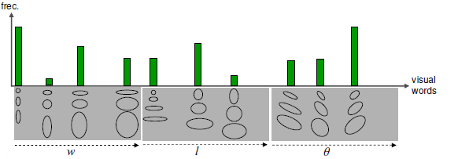
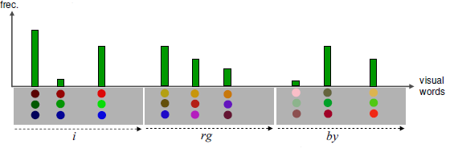
(4) Textons and Color
Vocabulary construction
Textons features are related with the shape, and now with colors.
Wide
Length
Orientation
Texton Descriptor (TD)
“Texton theory revisited: A bag-of-words approach to combine textons”
Notes:
Vocabulary constructed with direct adquisition of two low-dimensional spaces of p-blobs attributes, one for shape and one for color.
This extends the basic definition of the texton descriptor
TD = [PW, PL, P, PI , PRG, PBY]
“Texton theory revisited: A bag-of-words approach to combine textons”
Susana Alvareza, Maria Vanrell, Universitat Aut onoma de Barcelona

Slide 40
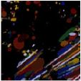
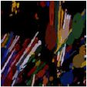
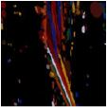
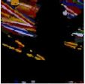
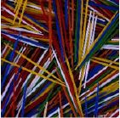
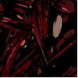
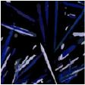
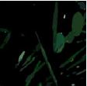
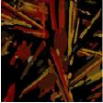
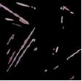
(4) Textons and Color
Textons and Color
Is it possible to introduce color as a new feature?
22,5º
67,5º
112,5º
157,5º
Red
Blue
Green
Yellow - Orange
White - Pink
“Texton theory revisited: A bag-of-words approach to combine textons”
Notes:
Vocabulary constructed with direct adquisition of two low-dimensional spaces of p-blobs attributes, one for shape and one for color.
Detection of p-blobs with orientation dimension.
Detection of p-blobs with color dimension.
“Texton theory revisited: A bag-of-words approach to combine textons”
Susana Alvareza, Maria Vanrell, Universitat Aut onoma de Barcelona

Slide 41
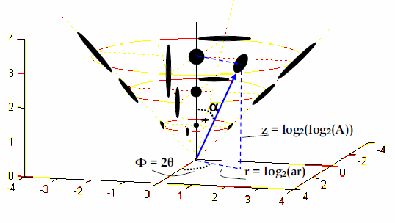



(4) Textons and Color
What if the attributes for the blobs could be correlated? Why is useful?
Existances of perceptual relationships between attributes
The occurrance of shape and color attributes at the same level
The shape space in cylindrical coordinates
The color space also in cylindrical coordinates
“Texton theory revisited: A bag-of-words approach to combine textons”
Notes:
The new space variables are going to be transformed as
r = log2(ar), z = log2(log2(A)) and gamma= 2,
being ar the blob aspect ratio (ar = w/l), A its area (A = w · l) and its orientation. In this way texton shape space is represented in two axis.
Transformation of the color space to HIS. This colour space allows us to work with perceptual axes and present similar properties to uniform colour spaces.
Texton spaces are bounded and their axes have perceptual properties, these two interesting properties allow a generation of vocabularies by a direct quantization of these spaces.
“Texton theory revisited: A bag-of-words approach to combine textons”
Susana Alvareza, Maria Vanrell, Universitat Aut onoma de Barcelona

Slide 42


(4) Textons and Color
Vocabulary construction
Co-Joint Texture Descriptor (JTD)
Semi Joint Texture Descriptor (STD)
“Texton theory revisited: A bag-of-words approach to combine textons”
Notes:
Quatization
· Cartesian model: Spaces are uniformly quantified using the same number of bins in each dimension.
· Cylindrical model: It exploits the benefits of having perceptual axes in texton spaces, therefore the quantisation can be directly
applied on each texton independently, these are (r, z, theta) and (h, s, i) for shape and colour respectively.
· Circular model: Variant of the previous one but improving the quantization on the central area. This case is specially useful for shape space where isotropic blobs are located near the vertical axis. In this way they are clearly separated from non-isotropic blobs
“Texton theory revisited: A bag-of-words approach to combine textons”
Susana Alvareza, Maria Vanrell, Universitat Aut onoma de Barcelona

Slide 43

(4) Textons and Color
Notes:
JTD example1

Slide 44

(4) Textons and Color
Notes:
JTD example2

Slide 45

(4) Textons and Color
Notes:
JTD example3

Slide 46
Conclusions
Texton is one of the preattentive models.
Textons allow to recognize 2D and 3D textures.
Using textons is better than PCA for 3D texture recognition.
Textons are compatible with colors and easy to implement.
Notes:
Texton representation can be considered as a form of data compression.
PCA recognizes only linear attributes, but the effects caused by the surface relief of natural material (shadows, occlusions, specularities, mutual illumination, etc ) are non linear properties.
http://www.cs.berkeley.edu/~malik/papers/LM-3dtexton.pdf

Slide 47
Questions?

