Slide 1
Textons
Basic of preattentive human vision
Ahmed Karam Eldaly
Daniel Barmaimon

Slide 2
Index
1. Human vision modes
2. Models in preattentive vision
3. Texton: Definition and Characteristics
4. Evolution and uses
5. Textons and color

Slide 3
Index
1. Human vision modes
2. Models in preattentive vision
3. Texton: Definition and Characteristics
4. Evolution and uses
5. Textons and color

Slide 4

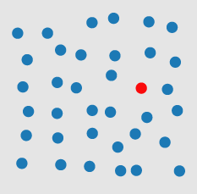
Textons – Human Vision Modes
Differences in color
What is preattentive processing in vision?
Notes:
Preattentive Processing now tries to find characteristics that make use of the potential of the low-level human vision.
· The eye perceives a lot of data at the same time (parallel). The subject is not aware of all perceived information, which was filtered by the brain so just the
relevant information is ”seen” by the subject (focus).
· If the desired item is not found at the first sight the subject has to look at each item one after another (serial). It takes more time.
Healey, Christopher G. [1992]. Visualization of Multivariate Data Using Preattentive Processing. Master’s
thesis, Department of Computer Science, University of British Columbia.

Slide 5
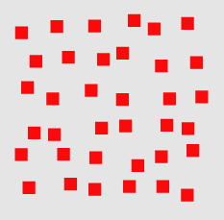
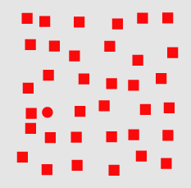
Textons – Human Vision Modes
Differences in shape
What is preattentive processing in vision?
Notes:
Preattentative processing has been studied and developed since the 1980’s. The three classical targets where it is helpful are:
· Target detection: a subject has to detect rapidly whether there is a defined target item (using preattentive properties) within a field of distractor elements.
· Counting and estimation: a subject has to count or estimate the number of elements using a common preattentive property.
· Boundary detection: a subject has to detect rapidly and accurately a boundary between two groups of elements.
(group = elements with a common preattentive property)

Slide 6
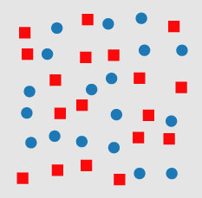
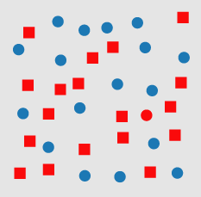
Textons – Human Vision Modes
Conjunction Search
Not so easy or quick
What is preattentive processing in vision?

Slide 7

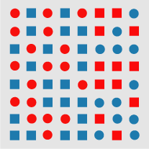
Textons – Human Vision Modes
Edge detection by hue
What is preattentive processing in vision?
Notes:
200 to 250 msec threshold allows to detect the boundary – ‘ONE LOOK’ vision
http://www.csc.ncsu.edu/faculty/healey/PP/, Christopher G. Healey
Department of Computer Science, North Carolina State University’

Slide 8







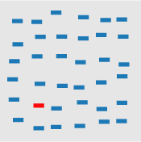
Textons – Human Vision Modes
What is a preattentative feature?
Notes:
A 200 to 250 msec threshold allows to detect the boundary – ‘ONE LOOK’ vision -> Allows to experiment with different features
Orientation, Length, Closure, Width,
Curvature, Element Density, Number, Hue,
Treisman, Anne [1985]. Preattentive processing in vision. Computer Vision, Graphics and Image Processing,
31(2), pages 156–177. doi:10.1016/S0734-189X(85)80004-9.

Slide 9

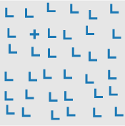

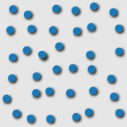
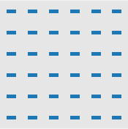
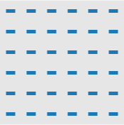
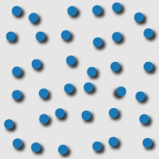
Textons – Human Vision Modes
What is a preattentative feature?
Notes:
Intensity, Crossing, Terminators, 3D Depth,
Flicker, Velocity, Direction of Motion, Lighting Direction,
Treisman, Anne [1985]. Preattentive processing in vision. Computer Vision, Graphics and Image Processing,
31(2), pages 156–177. doi:10.1016/S0734-189X(85)80004-9.
http://www.csc.ncsu.edu/faculty/healey/PP/, Christopher G. Healey
Department of Computer Science, North Carolina State University’

Slide 10
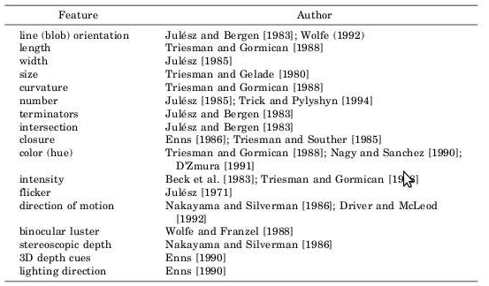
Textons – Human Vision Modes
What is a preattentative feature?
Notes:
Overview of the preattentavie features made by Healey.
Healey, Christopher G. [1992]. Visualization of Multivariate Data Using Preattentive Processing. Master’s
thesis, Department of Computer Science, University of British Columbia.

Slide 11
Index
1. Human vision modes
2. Models in preattentive vision
3. Texton: Definition and Characteristics
4. Evolution and uses
5. Textons and color

Slide 12
Index
1. Human vision modes
2. Models in preattentive vision
3. Texton: Definition and Characteristics
4. Evolution and uses
5. Textons and color

Slide 13
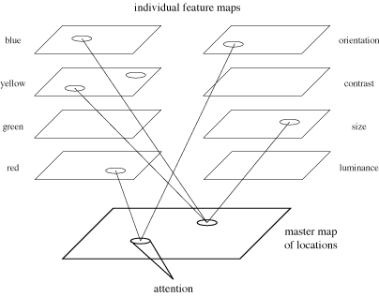
Models in preattentive vision
Feature Integration
Experiments to get:
· Target
· Boundary detection
If t < 250 ms
preattentive feature
Notes:
Treisman tried several experiments using target and boundary detection to classify preattentive features. During the
experiments the number of distractors per scene was changed in several iterations. If the time to finish the task
stayed rather constant over all iterations, this was an indicator for a pre-attentive feature. As a threshold 250ms
per scene was used, to make sure the eye has no time to focus on an item. At this time conjunction search was
seen to be pre-attentive.
Treisman’s feature list: Line Length, Orientation, Contrast, Hue, Curvature, Closure

Slide 14

Models in preattentive vision
Textons
Elongated blobs
Terminators
Crossing lines
(a)
(b)
Notes:
Bela Jul`esz also did research in the area of the human low-level vision system. He tried to find which patterns
in textures are seen or not seen.
· Elongated blobs (e.g., line segments, rectangles, ellipses) with specific properties such as hue, orientation, and width.
· Terminators (ends of line segments).
· Crossings of line segments.
Julesz Bela, L. A. Shepp, E. N. Gilbert and H. L. Frisch [1973]. Inability of humans to discriminate between
visual textures that agree in second-order statistics – revisited. Perception, 2(4), pages 391–405.
doi:10.1068/p020391.

Slide 15
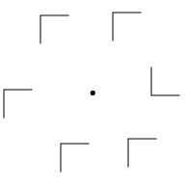
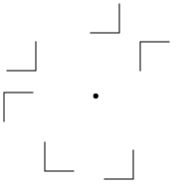
Models in preattentive vision
Similarity Theory
T – N : Similarity between targets and not targets
N – N : Similarity within non targets themselves
(a)
(b)
N – N is high
N – N is low
Notes:
T – N increases, search efficiency decreases and time search increases
N – N decreases, search efficiency decreases and time search increases
Duncan and Humphrey proposed a three step visual selection:
The visual field is segmented into structural units which share some common property (orientation, hue,motion).
Each unit can be segmented again into smaller subunits sharing again some common property, creating a hierarchy. The process of separation occurs parallel.
2. During search a template for the sought unit is created. Each structural unit is compared to the template.
To better the match the more resources of the limited short term memory is allocated for this unit.
3. Because units are organized in a hierarchy (step 1), a poor match of an unit and the template allows to
reject other units that are strongly related to the rejected unit.
Duncan, John and Glyn W. Humphreys [1989]. Visual search and stimulus similarity. Psychological Review,
96(3), pages 433–458. doi:10.1037/0033-295X.96.3.433.

Slide 16
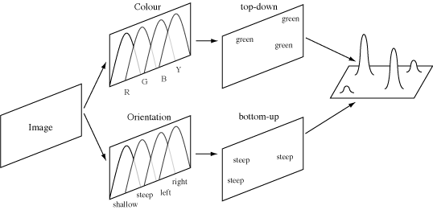
Models in preattentive vision
Guided Search Theory
Top-down (user-driven search)
Finds items with a specific property or set of properties
Bottom-up (feature categorization)
Measures how different an element is from its neighbours.
Notes:
· Bottom-up: how different are the elements in terms of colour, how different are they in terms of orientation
· Top-down : not always intuitive to find ‘best’ cathegory
Each map filters one specific type (e.g colour) but divide this type in subcategories (e.g green, red). While colour his the top-down activation in Wolfes model the orientation (subcategories: shallow, steep) represents the bottom-up part.
Target elements generate the highest level of activation (they pop out of their surrounding elements) regardless the number of distractors.
Wolfe, Jeremy M. and Susan L. Franzel [1988]. Binocularity and visual search. Perception & Psychophysics,
44(1), pages 81–93. http://search.bwh.harvard.edu/new/pubs/BinocSearchPandP88.pdf.
Wolfe, Kyle R. Cave, JeremyM. and Susan L. Franzel [1989]. Guided search: An alternative to the feature integration
model for visual search. Journal of Experimental Psychology: Human Perception and Performance,
15(3), pages 419–433. doi:10.1037/0096-1523.15.3.419.
31

Slide 17
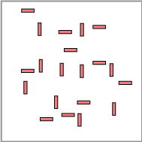
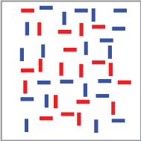
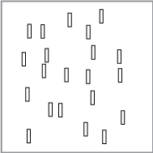
Models in preattentive vision
Boolean Map Theory
Two different tasks:
Selection
Access
Notes:
Selection of a value for a feature. All objects that contain the feature are collected and evaluated.
In the example. Selection of feature ‘color: red’ and ‘orientation: undefined’. Selection ‘color: undefined’ and ‘orientation: vertical’
Huang, Anne Treisman, Liqiang and Harold Pashler [2007a]. Characterizing the Limits of Human Visual
Awareness. Science, 317(5839), pages 823–825. doi:10.1126/science.1143515.
Huang, Liqiang and Harold Pashler [2007b]. A Boolean map theory of visual attention. Psychological Review,
114(3), pages 599–631. doi:10.1037/0033-295X.114.3.599.

Slide 18
Index
1. Human vision modes
2. Models in preattentive vision
3. Texton: Definition and Characteristics
4. Evolution and uses
5. Textons and color

Slide 19
Index
1. Human vision modes
2. Models in preattentive vision
3. Texton: Definition and Characteristics
4. Evolution and uses
5. Textons and color

Slide 20
Textons - Models in preattentive vision

Slide 21
Index
1. Human vision modes
2. Models in preattentive vision
3. Texton: Definition and Characteristics
4. Evolution and uses
5. Textons and color

Slide 22
Index
1. Human vision modes
2. Models in preattentive vision
3. Texton: Definition and Characteristics
4. Evolution and uses
5. Textons and color

Slide 23
Textons and Color
Features and p-blobs
Is it possible to introduce color as a new feature?
The basic attributes are called now p-blob
Wide
Length
Orientation
I
RG
BY
How to get them automaticly?
1.- Normalized Laplacian filtering
2.- Maximum detection over scale
3.- Detecting blobs by structural tensor at integration scale
4.- Local maxima over overlapping blobs
5.- Textons are finally extracted
“Texton theory revisited: A bag-of-words approach to combine textons”
Notes:
Colour attributes, are estimated using colour information from all pixels belonging to a p-blob.
We obtain them (identified by (i, rg, by)) employing the median statistic operator which is robust to noise and outliers.
Steps
1.- ∇^2_norm [L(·;)] = sigma^2∇^2[L(·;)] - Normalized differential Laplacian of the Gaussian operation in a subset of scales.
sigma = {1.284^n, n ∈ [1..11]} L(x, y;) = I(x, y) ∗G(x, y; sigma)
2.- Analysis of results checking the with of the p-blob, where width = s (s = logaritmic scale) -> Spatial localitation and optimal scale
3.- Detecting eigenvectors and eigenvalues for each p-blob scale. A large amount of them will overlap. More information reference Lindeberg
4.- Removes redundancy.
5.- Textons are finally extracted computing the attributes of p-blobs detected (wide, length, orientation, I, RG, BY)
Susana Alvareza, Maria Vanrell, Texton theory revisited: A bag-of-words approach to combine textons
Universitat Aut onoma de Barcelona
T. Lindeberg, Discrete derivative approximations with scale-space properties:
A basis for low-level feature detection, Journal of Mathematical
Imaging and Vision 3 (1993) 349–376.

Slide 24
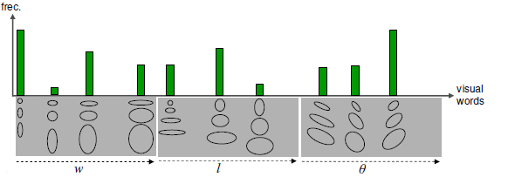
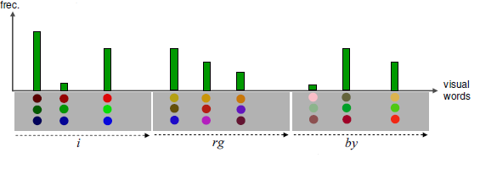
Textons and Color
Vocabulary construction
Textons features are related with the shape, and now with colors.
Wide
Length
Orientation
Texton Descriptor (TD)
“Texton theory revisited: A bag-of-words approach to combine textons”
Notes:
Vocabulary constructed with direct adquisition of two low-dimensional spaces of p-blobs attributes, one for shape and one for color.
This extends the basic definition of the texton descriptor
TD = [PW, PL, P, PI , PRG, PBY]
“Texton theory revisited: A bag-of-words approach to combine textons”
Susana Alvareza, Maria Vanrell, Universitat Aut onoma de Barcelona

Slide 25
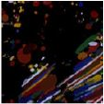
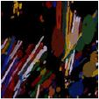
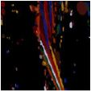
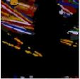
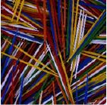
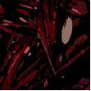


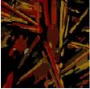

Textons and Color
Textons and Color
Is it possible to introduce color as a new feature?
22,5º
67,5º
112,5º
157,5º
Red
Blue
Green
Yellow - Orange
White - Pink
“Texton theory revisited: A bag-of-words approach to combine textons”
Notes:
Vocabulary constructed with direct adquisition of two low-dimensional spaces of p-blobs attributes, one for shape and one for color.
Detection of p-blobs with orientation dimension.
Detection of p-blobs with color dimension.
“Texton theory revisited: A bag-of-words approach to combine textons”
Susana Alvareza, Maria Vanrell, Universitat Aut onoma de Barcelona

Slide 26
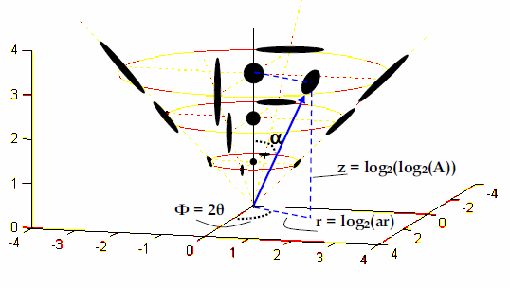

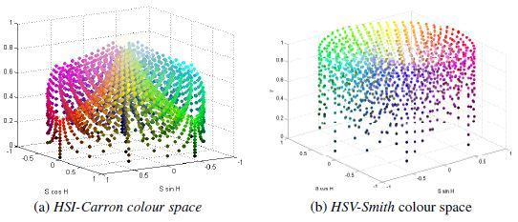

Textons and Color
What if the attributes for the blobs could be correlated?
The shape space in cylindrical coordinates
The color space also in cylindrical coordinates
“Texton theory revisited: A bag-of-words approach to combine textons”
Notes:
The new space variables are going to be transformed as
r = log2(ar), z = log2(log2(A)) and gamma= 2,
being ar the blob aspect ratio (ar = w/l), A its area (A = w · l) and its orientation. In this way texton shape space is represented in two axis.
Transformation of the color space to HIS. This colour space allows us to work with perceptual axes and present similar properties to uniform colour spaces.
Texton spaces are bounded and their axes have perceptual properties, these two interesting properties allow a generation of vocabularies by a direct quantization of these spaces.
“Texton theory revisited: A bag-of-words approach to combine textons”
Susana Alvareza, Maria Vanrell, Universitat Aut onoma de Barcelona

Slide 27
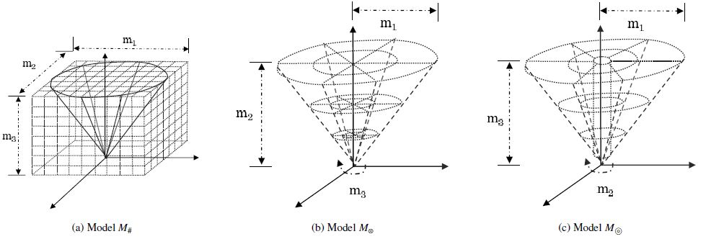
Textons and Color
Now, how do we construct the vocabulary for these spaces?
Cartesian model
Cylindrical model
Circular model
“Texton theory revisited: A bag-of-words approach to combine textons”
Notes:
Quatization
· Cartesian model: Spaces are uniformly quantified using the same number of bins in each dimension.
· Cylindrical model: It exploits the benefits of having perceptual axes in texton spaces, therefore the quantisation can be directly
applied on each texton independently, these are (r, z, theta) and (h, s, i) for shape and colour respectively.
· Circular model: Variant of the previous one but improving the quantization on the central area. This case is specially useful for shape space where isotropic blobs are located near the vertical axis. In this way they are clearly separated from non-isotropic blobs
“Texton theory revisited: A bag-of-words approach to combine textons”
Susana Alvareza, Maria Vanrell, Universitat Aut onoma de Barcelona

Slide 28
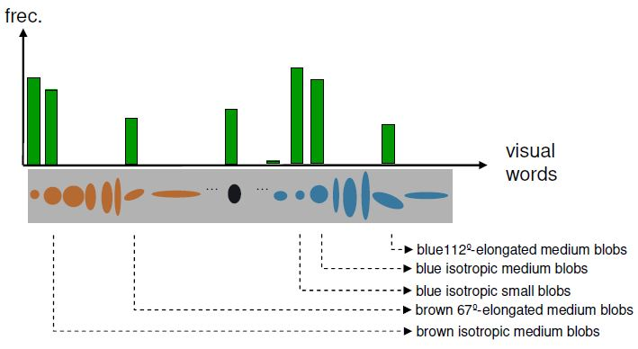
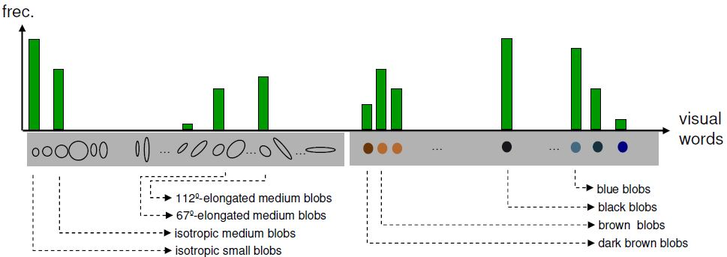
Textons and Color
Vocabulary construction
Co-Joint Texture Descriptor (JTD)
Semi Joint Texture Descriptor (STD)
“Texton theory revisited: A bag-of-words approach to combine textons”
Notes:
Quatization
· Cartesian model: Spaces are uniformly quantified using the same number of bins in each dimension.
· Cylindrical model: It exploits the benefits of having perceptual axes in texton spaces, therefore the quantisation can be directly
applied on each texton independently, these are (r, z, theta) and (h, s, i) for shape and colour respectively.
· Circular model: Variant of the previous one but improving the quantization on the central area. This case is specially useful for shape space where isotropic blobs are located near the vertical axis. In this way they are clearly separated from non-isotropic blobs
“Texton theory revisited: A bag-of-words approach to combine textons”
Susana Alvareza, Maria Vanrell, Universitat Aut onoma de Barcelona

Slide 29
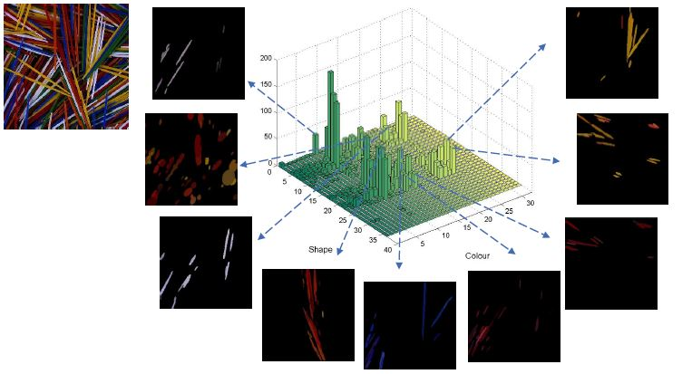
Textons and Color
Notes:
JTD example1

Slide 30
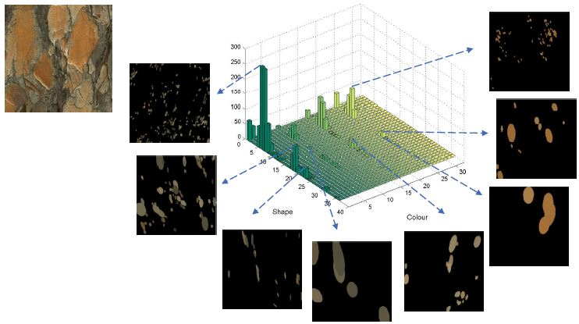
Textons and Color
Notes:
JTD example2

Slide 31
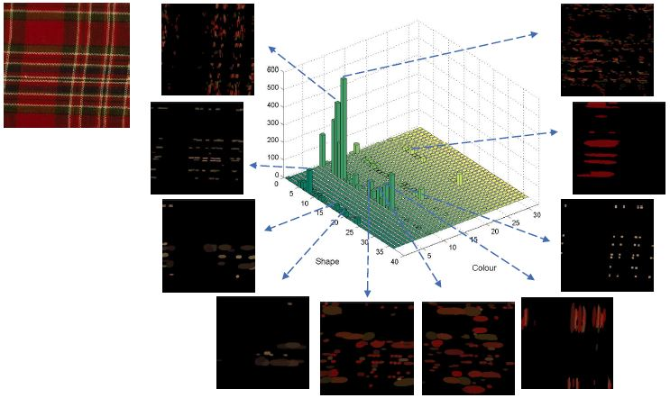
Textons and Color
Notes:
JTD example3

