Slide 1
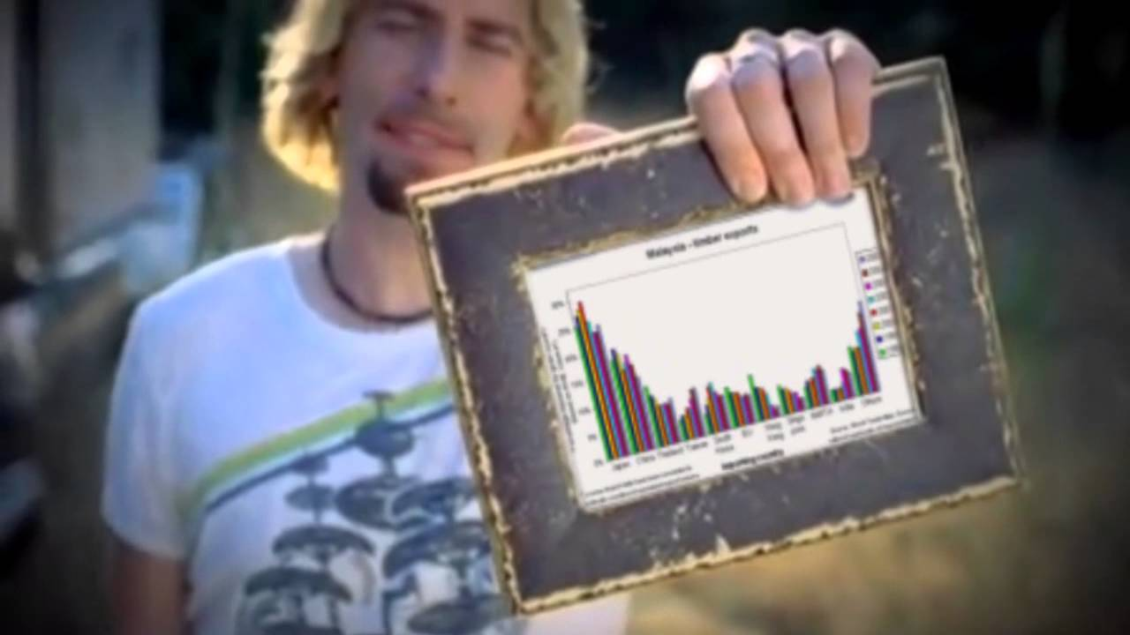
Look at my Datagraphs:
1
By Daniel Bauwens, Junior Data Engineer at BeCode | 2023

Slide 2
Technical Challenges
2
Getting used to new libraries (again).
How to find (relevant) correlations between data?
Lack of data.

Slide 3
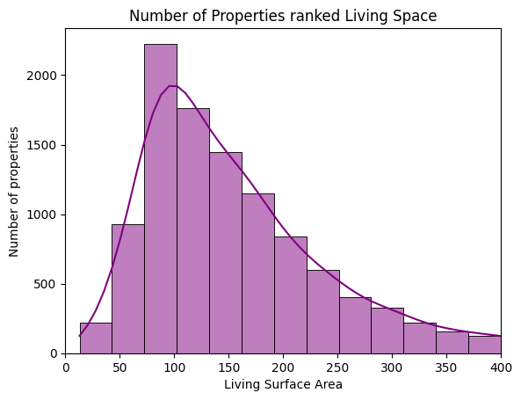
Histogram (with KDE line)
3
Kernel
Density
Estimate

Slide 4
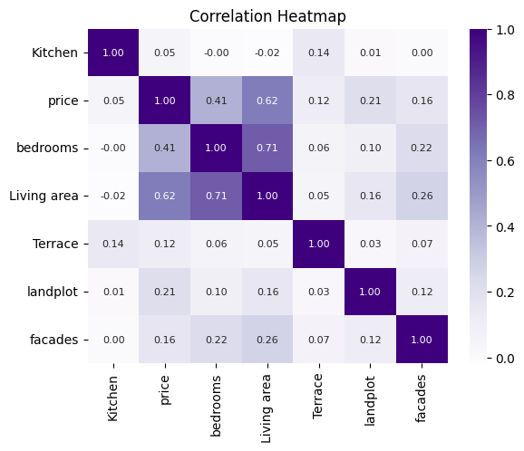
My top 5 variables:
4
Living Area
Bedrooms
Land Area
Facades
Terrace*

Slide 5
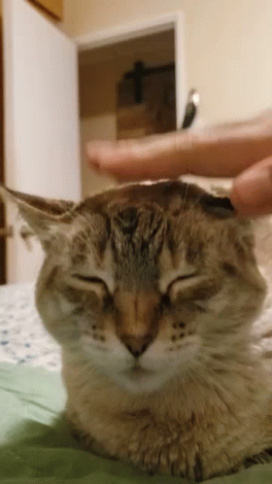
Honourable Mention:
5
Swimming pool
(he was too small a sample to be taken serious)

Slide 6
Question Time!
6
LinkedIn: https://www.linkedin.com/in/daniel-bauwens-5515a8256/
GitHub: https://github.com/danielbauwens

