Slide 1


Slide 2
k-means clustering in CUDA
Daniel Berhane
May 3, 2015
Department of Electrical and Computer Engineering

Slide 3
Outline
Problem Definition
K-means clustering
Sequential k-means
Parallel k-means
Implementation
Parallelism
Performance
Bench Marking
Conclusion

Slide 4
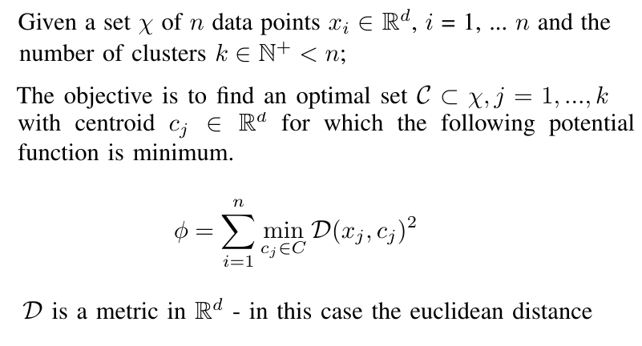
Problem Definition

Slide 5
k-means clustering
Computationally difficult (NP-hard)
Lloyd’s algorithm a fast heuristic widely used

Slide 6
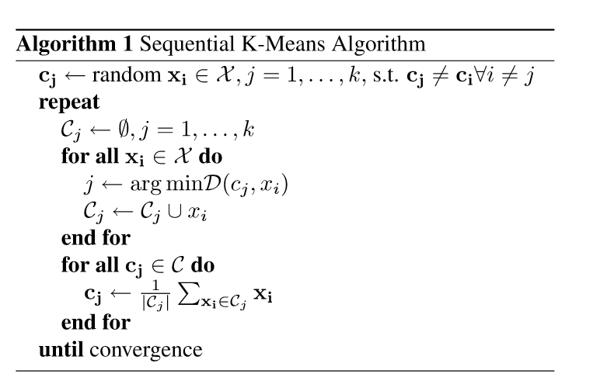
Sequential K-Means

Slide 7
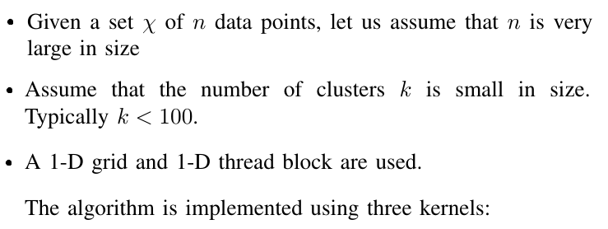
Parallel K-Means Algorithm

Slide 8
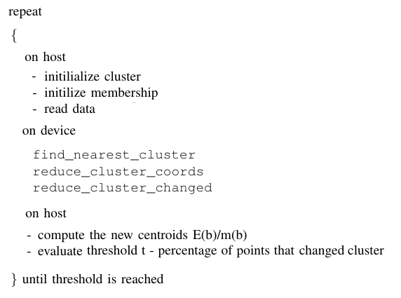
K-means CUDA algorithm

Slide 9
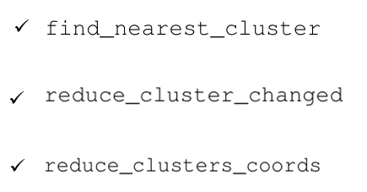
Kernels

Slide 10

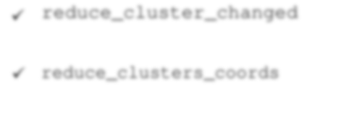
Kernel 1

Slide 11

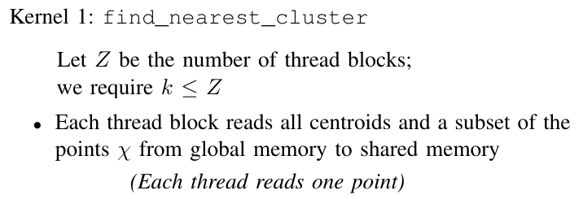

Slide 12
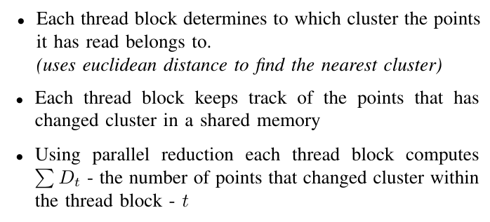

Slide 13
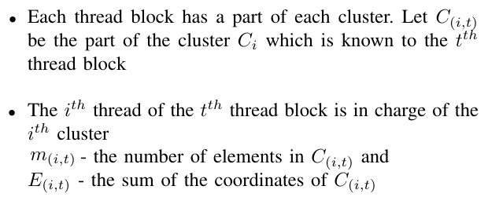

Slide 14
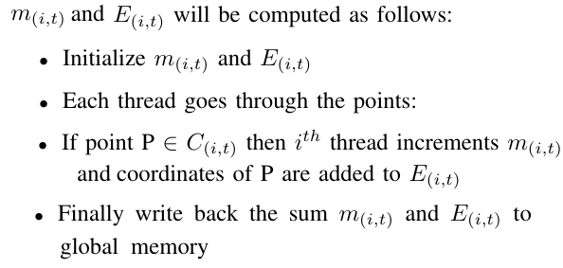

Slide 15
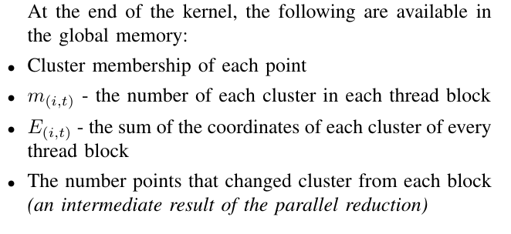

Slide 16

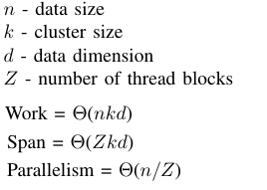

Slide 17



Kernel 2

Slide 18
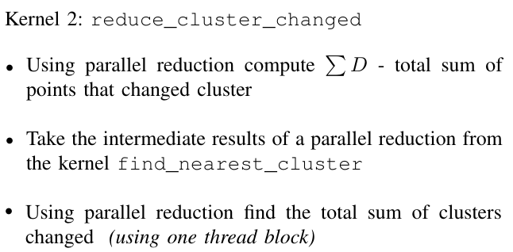

Slide 19
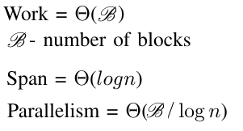

Slide 20
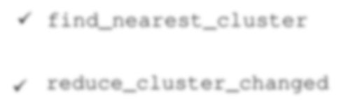

Kernel 3

Slide 21
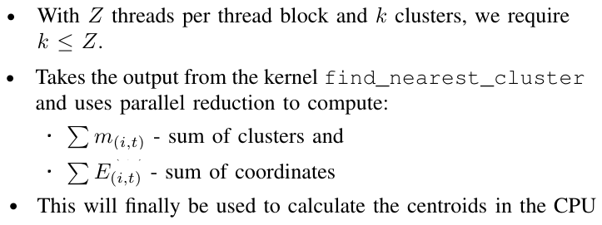

Slide 22
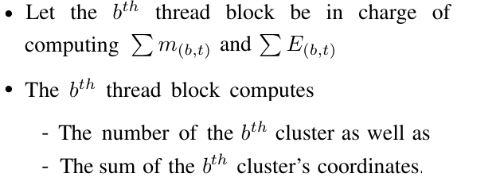

Slide 23
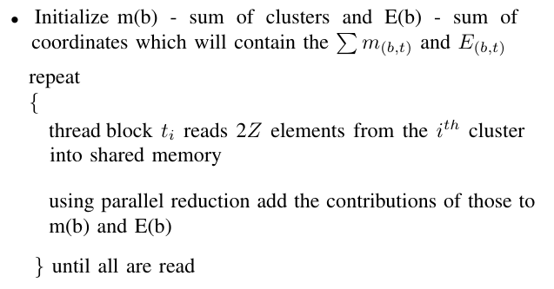

Slide 24
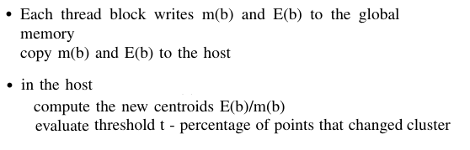

Slide 25
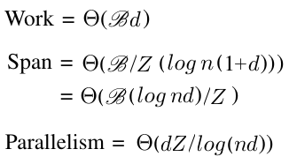

Slide 26


Slide 27
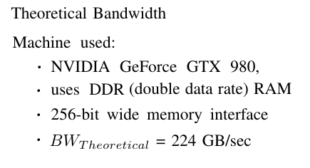

Slide 28
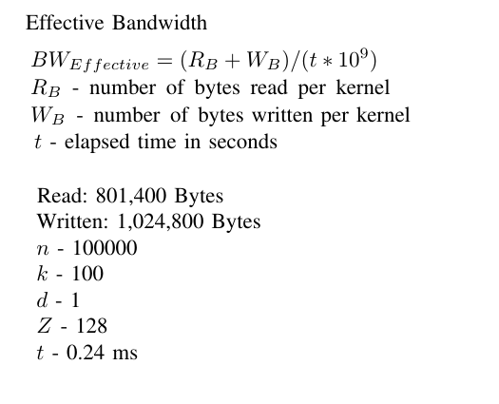


Slide 29
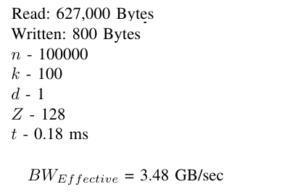

Slide 30
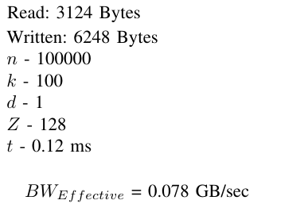

Slide 31
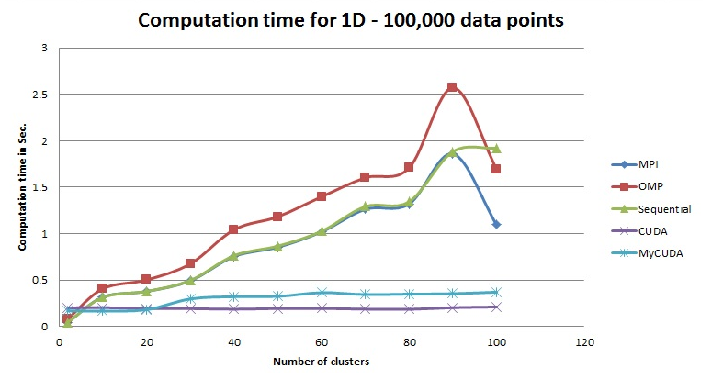

Slide 32
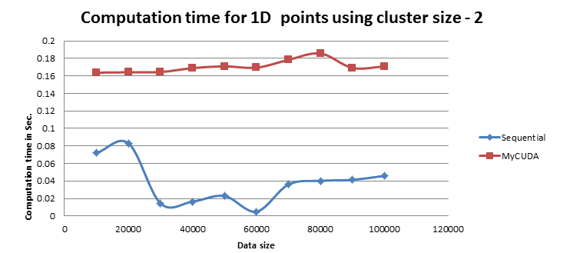

Slide 33
Conclusion
For small cluster size the overhead of data copying between device and host outweighs the parallelism advantages

