Slide 1
Why so Many Items? Complex Constructs and Item Selection
An example with a Subjective Well-Being Survey
Daniel Katz
w/
Dr. Karen Nylund-Gibson and Dr. Michael Furlong

Slide 2
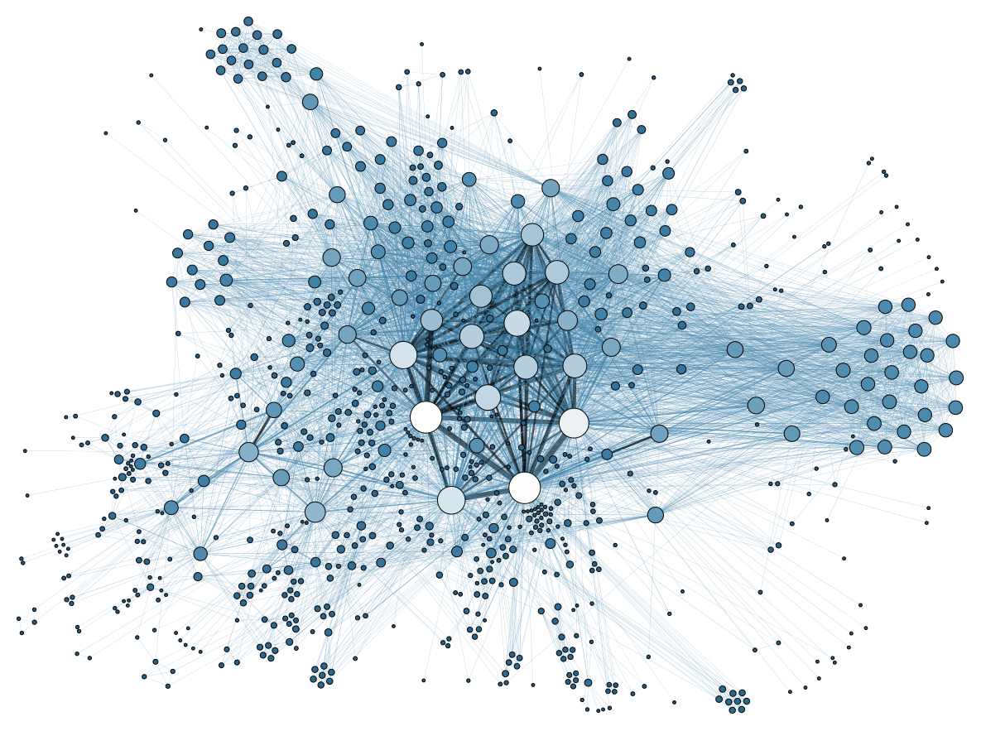
Complex Constructs to the Fore
Popular: Measuring “non-academic” constructs in schools via self report
For instance, CORE districts in California, attempting to measure:
Social Emotional Skills
Growth Mindset
Self-Efficacy
School Climate
All complex: construct-wise and self-report-wise
How does this complexity enter item selection?

Slide 3
Subjective Well-Being as Archetype
With these complex constructs: does it make sense to sum survey responses, treat them as continuous?
Theory might expect non-ordered solutions (different clusters of students/non-invariance)
How do theoretical considerations (vs statistical methodological considerations) enter item selection?
A classic example of a complex construct: Subjective Well-Being (SWB)
Typical validation: items selected based on fit to factor model
This fit does not indicate adherence to theory

Slide 4
Typical Treatment of SWB Surveys
Break down SWB into individual parts and sum the item scores
However, a lot of assumptions about continuousness, equal weighting of items, etc
In this case, factor analysis would not be adequate for validation
Not allowing for this is “theory avoidant” (Alexandrova and Haybron, 2016)
So what would not be theory avoidant?
Allow for models that represent what we think!

Slide 5
One Solution: Mixture Modelling with Distal Outcomes
Latent Class Analysis (LCA), a form of mixture modelling, allows for disorder
Caveat: completely exploratory
Assumes no ordering, so clusters of students, or classes, can emerge in a non-ordered, heterogeneous way
If there is disorder: theoretically could see a group of students that have similar overall SWB but very different response profiles across a set of items
However, many SWB surveys were validated via only-factor analysis

Slide 6
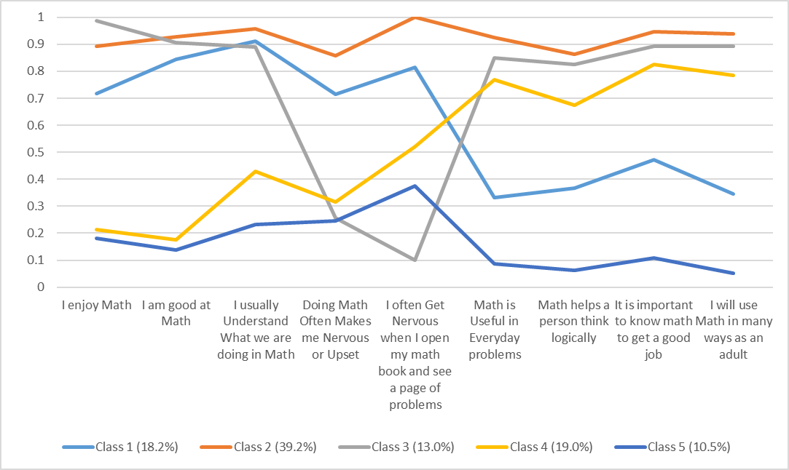
Disorder

Slide 7
Research Questions:
So, what happens with items used to measure SWB? Does order emerge?
RQ1: Is there a mixture-model solution that shows disorder among classes/students as one may expect?
Example: No set of clusters that indicates classes of students that progress from low to high on each item
RQ2: How do these classes relate to an overall one-item measure of life satisfaction?
Can classes of respondents with different sumscores have equivalent reported overall life satisfaction?

Slide 8
Sample 1
N = 1,908 high school students
48.1% Male, 50.5% Female, 28 total marked as missing or
Grade Breakdown:
9th Grade: 26.4%
10th Grade: 26.0%
11th Grade: 25.0%;
12th Grade: 22.6%
48.6% Latino/a or Hispanic; 38.2% White; 7.4% “two or more groups”; 3.1% Asian; 1.3% Black or African American.

Slide 9

Surveys/Measures
Used some traditionally combined measures:
Measure 1: 5-ItemBrief Multidimensional Measure of Satisfaction with Life Scale (BMLSS)
Measure 2: Positive and Negative Affect Schedule (PANASP and PANASN)
Both often taken as a sum: this is problematic if the construct of interest is not thought to be perfectly continuous
Often combined based on Diener’s dual-factor mental health model (see: Suldo, S. M., Thalji-Raitano, A., Kiefer, S. M., & Ferron, J. M., 2016).
For presentation, items were dichotomized, but ordinal-lca provided the same solution

Slide 10
Note: Matter of Rhetoric
Since item selection was not based on anything but factor analysis, would not expect a non-ordered solution

Slide 11
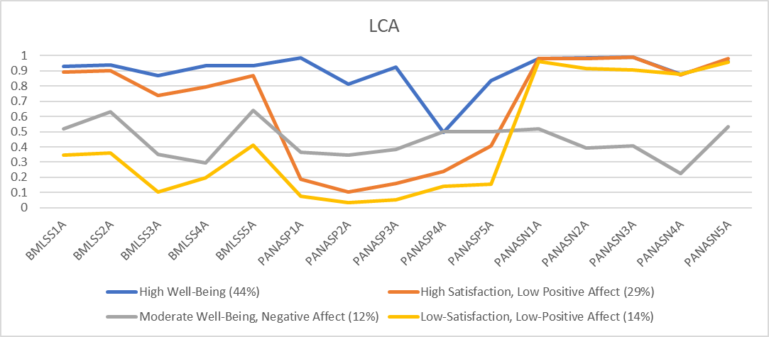

Slide 12
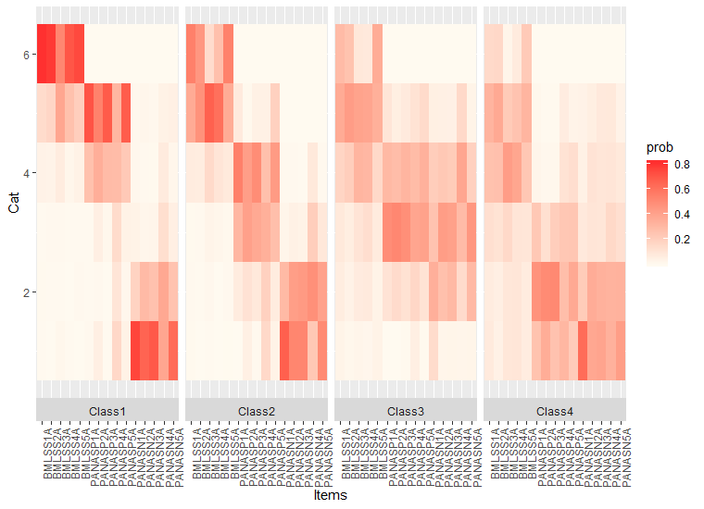

Slide 13
One Item Score for Each Class: Average
High Well-Being Class: 90.4
Next Highest Class: 81.1
Moderate Well-Being Class: 58. 9
Low Well-Being: 55.9
Overall: 79.9

Slide 14
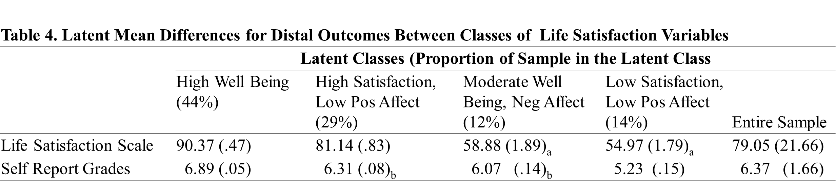
Distal Outcomes (with LCA)

Slide 15
Interpretations
Going from a lower class to higher class was associated with increasing reported life-satisfaction: If you want to use one item, it looks like you can.
Typical statistical validation methods aren’t always helping surveys and measurement.
Think about how many ways a person might think about their well-being
The desire to have general questions is problematic
Leads to questions about why use multiple items in surveys and ways in which we select items (redundancy!)
Subjectivity in item appraisals in these sorts of surveys is complex
Between person measurement even possible?
What are we measuring? Item appraisals, affect, semantics?
Brings about the challenges of between person measurement

Slide 16
Thank you
Please get in touch: I’m continuing to think about implications and limitations, and would love to hear other thoughts.
dkatz@ucsb.edu

Slide 17
Alexandrova, A., & Haybron, D. M. (2016). Is Construct Validation Valid? Retrieved from http://www.journals.uchicago.edu/t-and-c
Suldo, S. M., Thalji-Raitano, A., Kiefer, S. M., & Ferron, J. M. (2016). Conceptualizing high school students’ mental health through a dual factor model. School Psychology Review,45(4), 434–457. https://doi.org/10.17105/spr45-4.434-457.CrossRefGoogle Scholar

Slide 18
Measure1: 5-ItemBrief Multidimensional Measure of Satisfaction with Life Scale (BMLSS)
5 items each beginning with the stem: I would describe my satisfaction with __
Family
Friendship
School Experience
Myself
Where I live
6 point Likert
1—Very Dissatisfied
2 -- Somewhat Dissatisfied
3- A little Dissatisfied
4– A little Satisfied
5 – Somewhat Satisfied
6 – Very Satisfied

Slide 19
Measure 2: Positive and Negative Affect Schedule (PANASP and PANASN)-
10 items (it actually comprises 15 items)
Thinking about yourself and how you normally feel, how much do you generally feel:
Joyful
Scared
Upset
Delighted
Sad
Cheerful
Nervous
Gloomy
Alert
Determined
5-Category Likert Scale:
1 = Not At All
2 = A Little
3 = Moderately
4 = Quite a bit
5 = Extremely

Slide 20
LPA (default MPLUS-Only: Diagonal, class invariant—Variances the same, no covariance)
Number of classes | Log likelihood | BIC | ABIC | p-value of BLRT | p-value of LMRT | Entropy | BF | cmP
1 | -42975.12 | 8617.728 | 86081.418 | _ | _ | _ | #NUM! | 1
2 | -40529.76 | 81406.80 | 81260.659 | <.0001 | 0.0283 | 0.872 | 0 | 0
3 | -39149.451 | 78766.98 | 78570.003 | <.0001 | <.0001 | 0.889 | 3E-284 | 0
4 | -38436.154 | 77461.18 | 77213.371 | <.0001 | <.0001 | 0.907 | 0.00000 | 0
5 | -38048.001 | 76284.67 | 76507.028 | <.0001 | 0.0002 | 0.865 | 1E+28 | 0
6 | -37791.597 | 76413.65 | 76064.181 | <.0001 | 0.175 | 0.867 | 0 | 0

