Slide 1
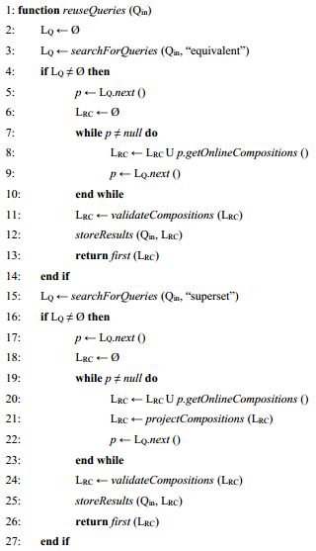
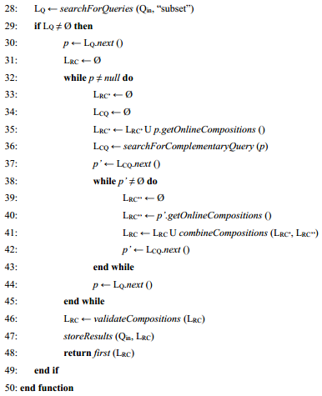
Remark of Nadia: here it is a if structure with
If (equivalent)
Else if (superset)
Else if (subset)
Else (nothing corresponds)
I could not use the structure like that once I do not know before which is the type of the query.
To know the type, first, I have to search for queries of that given type (lines 3, 15 and 28).
I could, if you think it is better, put all the calls searching for queries before and then use the structure as you asked, but we would be probably querying the database for results that we will not use at all.

Slide 2
Remark of Nadia: what does it mean? Does this corresponds to check of the criteria that will let you sort the compositions? In this case: I suggest that a method getOnlineValidatedCompositions replace directly the online and valid compositions.
This method validates the user requirements of the query. Because, for example, I can find queries that are equivalent in terms of abstract services, but the requirements could be more/less restricted.
But I can put them together, there is no problem.

Slide 3
Remark of Nadia: these two instructions could be factorized as all code is included in the if structure.
I did not understand what you mean.

Slide 4
Changes that I have done:
While implementing the stored procedure, instead of using a cursor to iterate the query and another cursor to iterate in the compositions of the query, I have created a SQL query that directly returns the compositions of all queries that matches with the incoming query.
Now, once I retrieve all the compositions, I have separated them according to their requirements type. For, example, for queries equivalent, I have created three cursors and associated them to equivalent requirements, more restricted requirements and less restricted requirements.
The same idea works for the other type of queries.

