Slide 1
SLA-guided data integration on cloud environments
N. Bennani, C. Ghedira, M. Musicante, G. Vargas-Solar
Contact: chirine.ghedira-guegan@univ-lyon3.fr
LIRIS-CNRS, INSA-Lyon, Univ. Lyon, France
Magellan, IAE, Univ. J-Moulin Lyon 3, France
DiMAP, UFRN, Brazil
CNRS, LIG-LAFMIA, France
Notes:
Good morning. It is my pleasure to present our work concerning data integration on cloud environments guided by service level agreements.
Un SLA est la formalisation d’un accord négocié entre deux parties. C’est un contrat entre clients et fournisseurs, ou entre fournisseurs. Il met par écrit l’attente des parties sur le contenu des prestations, leurs modalités d'exécution, les responsabilités des parties, les garanties, c'est-à-dire le niveau de service. Par exemple, le SLA peut spécifier les niveaux de disponibilité, de performance, d’opération ou de tout autre attribut du service en question, tel que la facturation voire les pénalités (financières ou autres) en cas de manquement au SLA.
To illustrate our ideas I will use throughout the presentation the following example.

Slide 2
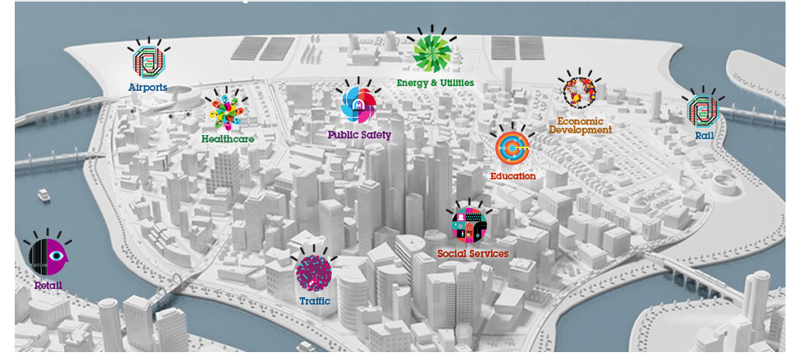


Self sustainable Smart CitY
Preferences:
<proximity, TaF, av, max $-h/watt>
Energy
Producer
Energy
Consumer
< av, TaF,
<$/Kwatt, [t1,t2]>
>
Energy “stock” exchange
Guide energy stock exchange mechanism that enables a timely provision of energy from consumers and producers located in a given region (e.g., the same city)
Choose producers according to their SLA
Determine whether providers fulfil energy requirements according to given consumer preferences
Notes:
Considérons une auto ville intelligente durable qui souhaitent guider un mécanisme d'échange d'actions de l'énergie pour permettre la fourniture en temps opportun de l'énergie pour les consommateurs et les producteurs situés dans une région donnée.
Consider a self sustainable smart city wishing to guide an energy stock exchange mechanism for enabling timely provision of energy form consumers and producers located in a given region.
Producers export their service level agreements stating the amount of Kwatts they can provide during a given interval of time at a given prices.
Consumers express criteria for filtering providers, like proximity, the maximum price per Kwat they are ready to pay.
L'objectif est de choisir les producteurs en fonction de leur SLA et
Déterminer si un ou plusieurs fournisseurs répondent aux exigences énergétiques en fonction des préférences des consommateurs
The objective is to choose the producers according to their SLA and
Determine whether one or several providers fullfil energy requirements according to given consumers preferences

Slide 3
List of green energy providers that can provision 1000 kWh, in the next 10 seconds, that are close to my city with a cost of 0,15 USD/kWh?
Challenge:
Query rewritting such that it matches the services that can provide data to build final results
Existing works:
MiniCon algorithm (Pottinger and Halevy, 2001) for query rewriting
Query rewriting techniques adapted to service composition
Look up Hubs
Locate
KNN
Sum
1000KWh, 0,15USD
[1] Pottinger, R. and Halevy, A. Y. (2001). Minicon: A scalable algorithm for answering queries using views. VLDB J., 10(2-3):182–198.
Energy provision Hub
Energy provision
services
<ID, Region, kW/rate,cost>
< av, TaF,
<$/Kwatt, [t1,t2]>
>
[2] Barhamgi, M., Benslimane, D., and Medjahed, B. (2010). A query rewriting approach for web service composi- tion. IEEE T. Services Computing, 3(3):206–222.
[3] da Costa, U. S., Alves, M. H. F., Musicante, M. A., and Robert, S. (2013). Automatic refinement of service compositions. In Daniel, F., Dolog, P., and Li, Q., editors, ICWE, volume 7977 of Lecture Notes in Com- puter Science, pages 400–407. Springer.
[4] Zhao, W., Liu, C., and Chen, J. (2011). Automatic compo- sition of information-providing web services based on query rewriting. Science China Information Sciences, pages 1–17.
< av, TaF,
<$/Kwatt, [t1,t2]>
>
Location
services
< av, TaF,
<$/Kwatt, [t1,t2]>
>
< av, TaF,
<$/Kwatt, [t1,t2]>
>
Smart meters
<ID, Loc, kW/rate, cost>
Notes:
For example, a consumer can state the following requirement:
List of green energy providers that can provision 1000 kWh, in the next 10 seconds, that are close to my city with a cost of 0,15 USD/kWh?
If we read this requirement as a query on available services deployed on a service infrastructure:
The challenge is to rewrite it coordinating the services that can participate to answer it (click)
Such coordination could look like a recurrent workflow consisting of 4 sequential activities :
One for looking up for hubs that will put in contact with energy services
The next activities for locating the services and filtering the k closest to her city as stated by the request
The last one for computing the total cost
And since energy is constantly required, the request is conitnuous and it starts over again
Query rewriting is a well known problem in databases, the challenge in this case is to rewrite the query such that it matches the services that can provide data to build final results
There are works addressing the problem by
revisting well known algorithms such as MiniCon and
for query rewriting adapted to services composition.

Slide 4

List of green energy providers that can provision 1000 kWh, in the next 10 seconds, that are close to my city with a cost of 0,15 USD/kWh?
Maximum of $5 as total query cost
Only green energy providers (provenance)
At least 85% of precision of provided data, ^{even if they are not fresh}
Availability rate of at least 90%
^{Response time of 0,01 sec.}
Challenge:
Integrate the agreed SLAs with the QoS requirements expressed by the user → Derived SLA
Existing works:
Negotiation of use conditions, which are statically agreed between the parts [1]–[3]
Monitoring of use conditions as cloud resources are used, to detect SLA contracts violation [4], [5]
Look up Hubs
Locate
KNN
Sum
1000KWh, 0,15USD
Agreed
SLA
Energy provision Hub
Agreed
SLA
Energy provision
services
<ID, Region, kW/rate,cost>
[1] V. Emeakaroha, I. Brandic, M. Maurer, and S. Dustdar, “Low level metrics to high level slas - lom2his framework: Bridging the gap between monitored metrics and sla parameters in cloud environments,” in HPCS 2010, 2010, pp. 48–54.
[2] A. V. Dastjerdi, S. G. H. Tabatabaei, and R. Buyya, “A dependency-aware ontology-based approach for deploying ser- vice level agreement monitoring services in cloud,” Softw. Pract. Exper., vol. 42, no. 4, pp. 501–518, Apr. 2012.
[3] J. Ortiz, V. T. de Almeida, and M. Balazinska, “A vision for personalized service level agreements in the cloud,” in Proc.2nd Workshop on Data Analytics in the Cloud. pp. 21–25.
< av, TaF,
<$/Kwatt, [t1,t2]>
>
< av, TaF,
<$/Kwatt, [t1,t2]>
>
Location
services
[4] M. Hale and R. Gamble, “Secagreement: Advancing security risk calculations in cloud services,” in IEEE SERVICES, 2012, pp. 133–140.
[5] I. Brandic, V. Emeakaroha, M. Maurer, S. Dustdar, S. Acs, A. Kertesz, and G. Kecskemeti, “Laysi: A layered approach for sla-violation propagation in self-manageable cloud infras- tructures,” in IEEE COMPSACW, 2010, pp. 365–370.
< av, TaF,
<$/Kwatt, [t1,t2]>
>
< av, TaF,
<$/Kwatt, [t1,t2]>
>
Smart meters
<ID, Loc, kW/rate, cost>
Notes:
Yet in our work we want the query evaluation to be guided by service level agreements. For example, the user asks that the query will not cost more than 5 USD
That only green energy providers are contacted (this is a provenance requirement) At least 85% of precision of provided data, even if they are not fresh
Availability rate of at least 90%
Response time of 0,01 sec
Le défi consiste à intégrer les SLA convenus avec les exigences de qualité de service exprimées par l'utilisateur
The challenge is to Integrate the agreed SLAs with the QoS requirements expressed by the user → Derived SLA
Existing works addressing the problem can be classified into two groups:
Those addressing negociation of use condition which are statically agreed between the parts and those monitoring of use conditions as
Cloud resources to detect SLA contract violation

Slide 5
Problem statement
How can the user efficiently obtain results for her queries such that they meet her QoS requirements
they respect her subscribed contracts with the involved cloud provider(s)
they do not neglect services contracts
Particularly, for queries that call several services deployed on different clouds
Notes:
Nous voulons au contraire de déterminer comment l'utilisateur peut obtenir efficacement des résultats de ses requêtes de telle sorte qu'ils répondent à ses exigences de qualité de service qui comprennent Ses contrats souscrits avec les fournisseurs de cloud impliqués
Les résultats ne négligent pas les contrats de services Notamment pour les requêtes qui appellent plusieurs services déployés sur différents nuages
We in contrast want to determine How can the user efficiently obtain results for her queries such that they meet her QoS requirements that include
Her subscribed contracts with the involved cloud providers
The results do not neglect services contracts
Particularly for queries that call several services deployed on different clouds

Slide 6




CHallenges
Energy provision
Hub
Requirements
Agreed
SLA₁
Service Agreed
SLA
Service Agreed
SLA
Service Agreed
SLA
How to be sure that all the agreed SLAs are respected while satisfying the user?
Notes:
Two important challenges must be considered. In the case of accessing one cloud provider where services have associated agreed SLA and there is a SLA established between the cloud provider the challenge is :
- How to be sure that all the agreed SLAs are respected while satisfying the user?

Slide 7

Challenges
Agreed
SLA₁
Energy provision
Hub
Service Agreed
SLA
Agreed
SLA₂
Service Agreed
SLA
Service Agreed
SLA
Can my constraints be satisfied? Which services shall I ask for?
How can ressources be saved for next query?
7
Notes:
And in the case of multiple clouds:
Can my constraints be satisfyed? Which services shall I ask for?
How can ressources be saved for next query?

Slide 8
objectives
Propose an SLA guided continuous data integration and provision system as a DaaS
Integrated SLA computation out of the Data agreed SLA
Optimized and adaptable data collection, query rewriting and integration according to user preferences
Learning based data integration mechanisms
Notes:
In this context:, our objective are:
Propose an SLA guided continuous data integration and provision system exported as a DaaS
- Integrated SLA computation out of the Data agreed SLA
- Optimized and adaptable data collection, query rewriting and integration according to user preferences
- Learning based data integration mechanisms

Slide 9
General approach
Query rewriting
SLA derivation
Service composition
Query evaluation
Lookup
prederived SLA
Rewrite query with SLA constraints
SLA guided
optimization
OR
SEQ
SEQ
Integrate
SLA
Store rewriten queries
Execution
SLA
management
Monitoring
Notes:
To attempt those objectives, Our general approach looks as follows:
Given that a query has associated preferences, the query evaluation process is divided in 3 phases
Phase one: SLA derivation, that consists in looking up whether a similar SLA has been already derived for a similar request, if not we compute an integrated SLA
Phase two: Service composition, the query is expressed as a workflow with associated SLA constraints specified in the derived SLA. The rewriting result is stored for further uses
Phase three: the query is optimized in terms to other elements of SLA requirements that have more to do with the consumed resources and the economic
Cost of the query. Once optimized the query is enacted by a workflow engine.
Since SLA are contracts, there is a monitoring mechanism and an SLA management module devoted to observing whether the SLAs are honoured
The paper we present focuses mainly on the SLA derivation approach. So let us zoom on this aspect:

Slide 10
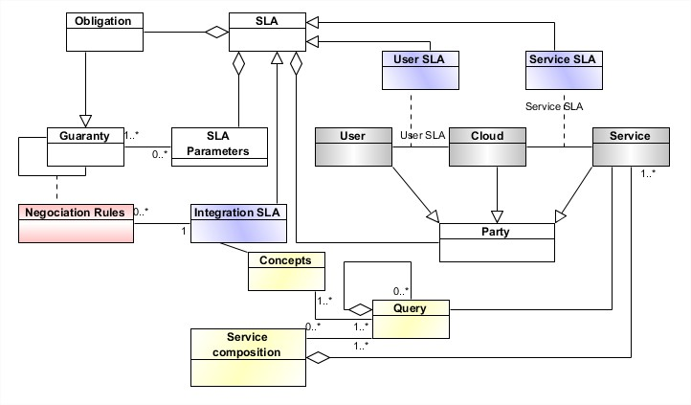
SLA Integration
Notes:
In order to integrate SLAs from services and cloud providers with user preferences we extend the following SLA model:
That represents SLA as a concept consisting of Obligations, Parameters established among Parties (shown in white boxes)
We model particularly SLA established between a User and a Cloud provider, and the SLA that a cloud provider associates to a given Service (violet boxes)
An Integrated is associated to the Concepts of a Query that is implemented by a Service composition (yellow boxes)
The integrated SLA has Negotiation Rules (pink box) that express Guaranties that the services implicated in the Query have to honour.
To illustrate the use of the model here an example:

Slide 11


SLA Integration
^{Cost of $0,05 cents per call}
^{8 GB of I/O volume/month}
Free data transfer cost within the same region
^{1 GB of storage}
Q total cost:Σ_{i=1…n} cost(s_{i}) + data transfer ≦ $5
Total response time: Σ_{i=1…n} respTime(s_{i}) + data transfer ≦ $5 0,01 sec.
Availability: (of services involved) ≦ 90%
Freshness: non
Precision: avg precision of services involved ≦ 85%
Provenance: green services
Storage: partial results size ≦ 1 Giga
Maximum of $5 as total query cost
Only green energy providers (provenance)
At least 85% of precision of provided data, ^{even if they are not fresh}
Availability rate of at least 90%
^{Response time of 0,01 sec.}
Notes:
We model the SLA established for instance through the most simple subscription to Azure with a cost of O,O5 dollar cents per call, 8 Gb of I/O per month, free data transfer cost within the same regions, and 1 GB storage space.
On the other hand we have the user preferences for the query we propose in our example. She can pay at most 5 USD as the total query cost, she only want green energy providers involved in the results, with 85% of precision of the data in with a total response of 0,01 seconds.
Enfin, le SLA dérivé intégre les deux états et conduit à un ensemble de contraintes qui porte sur
le coût de la requête totale, le temps de réponse, la disponibilité de services, la fraîcheur de données, la précision et la provenance des services et de la taille des résultats partiels qui peuvent être stockées
Finally the integrated SLA couples both statements and leads to a set of constraints that have to do
With the total query cost, the response time, the availability of services, the freshness of data, the precision and provenance of services and the size of partial results that can be stored

Slide 12
Conclusions and current work
Current big data settings impose to consider SLA and different data delivery models
The complexity of query evaluation includes steps that imply greedy computations
combine and revisit well-known solutions in parallel cloud distributed settings
Develop strategies and algorithms applied to energy consumption applications
Hints: SLA modeling and integration, automatic learning for reducing overhead, business model for delivering query results
Notes:
In order to conclude:
We believe that current big data settings impose to consider SLA and different data delivery models
In this context, the complexity of query evaluation includes steps that imply greedy computations that call to revisit well – known solutions in parallel and cloud distributed platforms
We aim at developing data integration strategies and algorithms guided by SLA constraints that can be then applied to energy consumption applications
Our hints are= SLA modelling and integration as shown today, automatic learning for reduces overhead, defining business models for delivering query results.

Slide 13
Thanks
Merci
N. Bennani, C. Ghedira, M. Musicante, G. Vargas-Solar
Contact: chirine.ghedira-guegan@univ-lyon3.fr

