Slide 1
Sarcoma
BIO392 survival project
Flurin Läuchli
Daniel Breitenmoser
2022-06-10

Slide 2
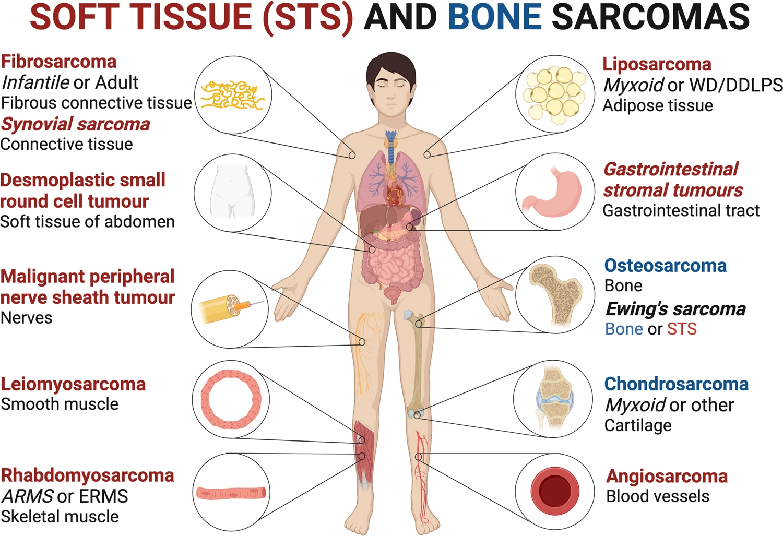
Damerell, V. et al., Molecular mechanisms underpinning sarcomas and implications for current and future therapy, 2021.

Slide 3
sarcoma
malignant tumor of mesenchymal origin
bone sarcoma
soft tissue sarcoma
symptoms depend on tumor location
generally: local swelling & pain
diagnosis: X-ray, CT, MRI, biopsy + analysis, ..
treatment: depends on grade and location
surgery, chemotherapy, radiation therapy, ..
Notes:
non-epithelial; bones, muscles, fat, .. I different classification systems I diagnosis: find lump, analyze lump

Slide 4
prognosis
factors: tumor size, local tumor spread, metastases, tumor grade, tumor location, mitotic rate
5-year survival:
bone sarcomas: 67.4%
soft tissue sarcomas: 65.4%
seer.cancer.gov, retrieved 2022
Notes:
The AJCC has identified several factors that affect prognosis of bone sarcomas:^{[4]}
Size of the tumor: larger tumors tend to have a worse prognosis compared to smaller tumors.
Spread of tumor to surrounding tissues: tumors that have spread locally to surrounding tissues tend to have a worse prognosis compared to tumors that have not spread beyond their place of origin.
Stage and presence of metastases: tumors that have spread ("metastasized") to the lymph nodes (which is rare for bone sarcomas) or other organs or tissues (for example, to the lungs) have a worse prognosis compared to tumors that have not metastasized.
Tumor grade: higher grade tumors (grades 2 and 3) tend to have a worse prognosis compared to low grade (grade 1) tumors.
Skeletal location: tumors originating in the spine or pelvic bones tend to have a worse prognosis compared to tumors originating in arm or leg bones.
For soft tissue sarcomas other than GISTs, factors that affect prognosis include:^{[4]}
Stage: as with bone sarcomas, tumors that have metastasized have a worse prognosis compared to tumors that have not metastasized.
Grade: the AJCC recommends using a grading system called the French Federation of Cancer Centers Sarcoma Group (FNCLCC) Grade for soft tissue sarcomas, with high-grade tumors having a worse prognosis compared to low-grade tumors.
For GISTs, the key factor that affects prognosis is:^{[4]}
Mitotic rate: mitotic rate refers to the fraction of cells that are actively dividing within the tumor; GISTs that have a high mitotic rate have a worse prognosis compared to GISTs that have a low mitotic rate.

Slide 5
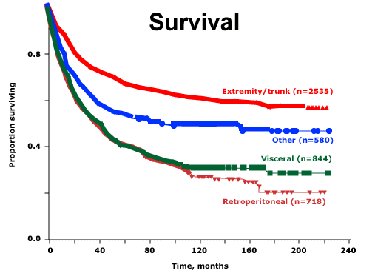
Borden et al., Soft tissue sarcomas of adults: State of the translational science, 2003

