Slide 1
PROJECT TETRIS
Team Tetra:
Daniel Agostinho, Anthony Chang, Divya Sridhar
Notes:
Good morning classmates. We are Group 11 aka Team Tetra. My name is Daniel Agostinho, my name is Anthony Chang, and my name is Divya Sridhar.

Slide 2
Introduction
1

Slide 3
The Purpose of the Project

Slide 4
Purpose
Our goals:
Reimplement an existing open source software project
Provide a stimulating challenge
Provide entertainment for everyone on any platform
The result…
PROJECT TETRIS
Notes:
The purpose of this project was to reimplement an existing open source software project. During the group selection in the first week of labs our group formed based on a common interest of games. Immediately we figured that reimplementing a video game would both manageable and very fun to do. We wanted our project to provide a stimulating challenge for all users. This was another common interest that we found we shared: solving puzzles. Playing video games not only provides an escape from our stressful work-filled lives, but it can also provide a tangible sense of accomplishment and allow for users to express their creativity and intelligence. A problem with some games is that they are exclusive to certain platforms. Our last goal was to provide entertainment for users of any age and make it available for everyone with a computer.

Slide 5
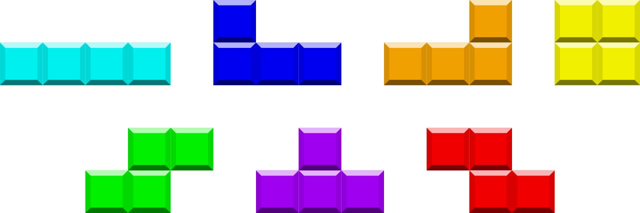
Some background info …
PROJECT TETRIS
A Java-based tile-matching puzzle video game
Reimplementation of the classic game developed by Alexey Pajitnov (1984)
Notes:
PROJECT TETRIS is a java-based tile-matching puzzle game. It is a reimplementation of the classic game created by Russian developer Alexey Pajitnov.

Slide 6
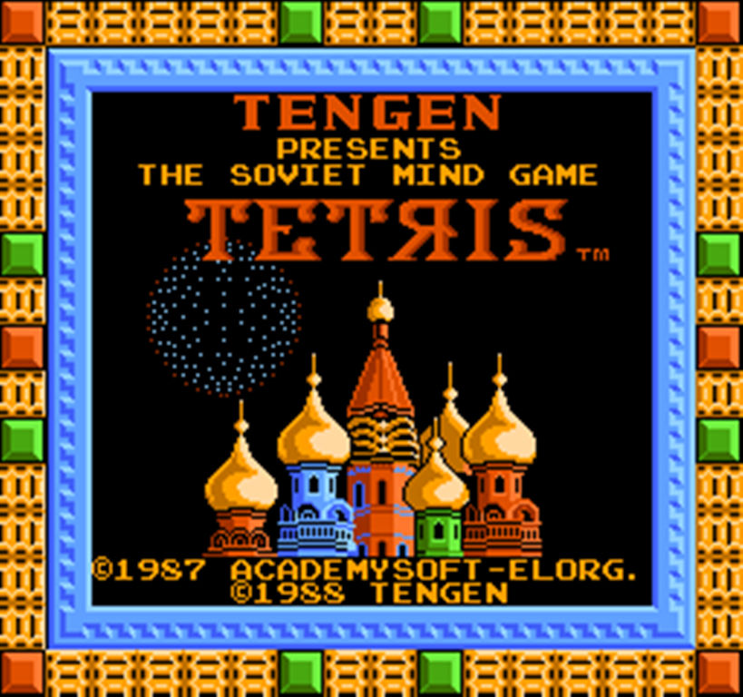
Some background info …
Objective:
Players strategically move, rotate and drop pieces called Tetriminos into a Well in order to clear as many lines as possible by completing horizontal rows of blocks.
Notes:
The object of Project Tetris is to strategically move, rotate and drop pieces called Tetriminos.

Slide 7
Discussion
2

Slide 8
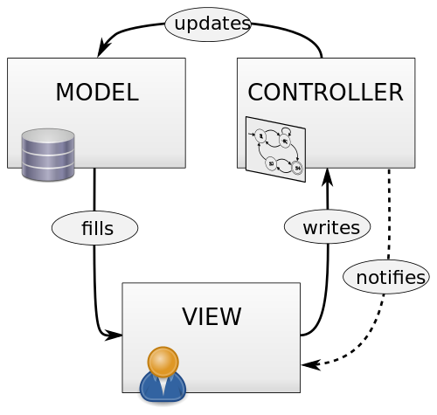
Design of Our System
Model
View
Controller

Slide 9
Qualities/ Nonfunctional Requirements

Slide 10
Qualities/ Nonfunctional Requirements
Learnability
How quickly the user can learn how to play the game.
Portability
The ability for the software to be installed and run on different environments/ operating systems.
Look and Feel
The familiarity of the software to the original Tetris game and how comfortable the UI is to interact with.
Installability
How easy it is for users to install and run the software.
Performance
How the effective the software system is in performing its task.
How responsive the system is.

Slide 11
Demonstration
3

Slide 12
Testing

Slide 13
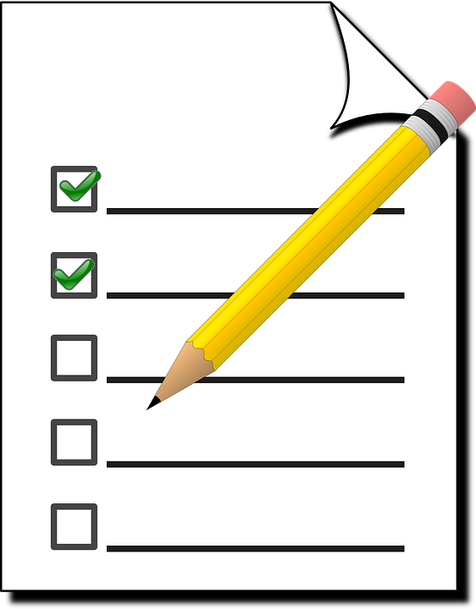
How was the system tested?
User Feedback
Quantitative
If the user could clear 3 rows in 5 mins, proved learnability.
If the user could install and run the program within 2 minutes, proved installability.
Qualitative
For users who have played the original, compare to PROJECT TETRIS (Look and Feel)

Slide 14
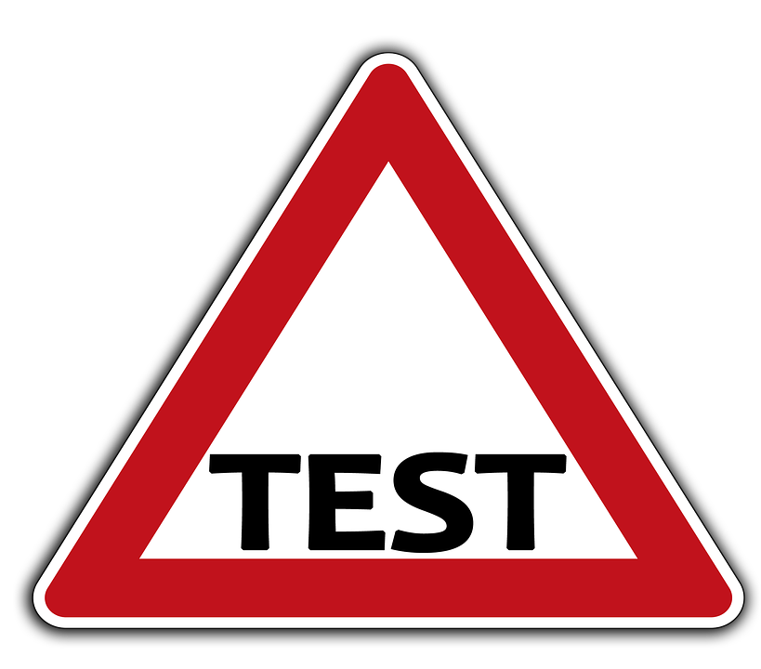
How was the system tested?
Unit Testing
Manual testing
Using specific test cases to check edge cases
Automated Testing
JUnit

Slide 15
Conclusion
3

Slide 16
Thanks!
ANY QUESTIONS?

