Slide 1

The Spatial Web and
K3D:
A 3D Knowledge
Universe
From Pages to Spaces
Transforming the internet from a 2D web of pages to an immersive
3D web of spaces,
where knowledge becomes interactive and AI and humans share
the same reality

Slide 2

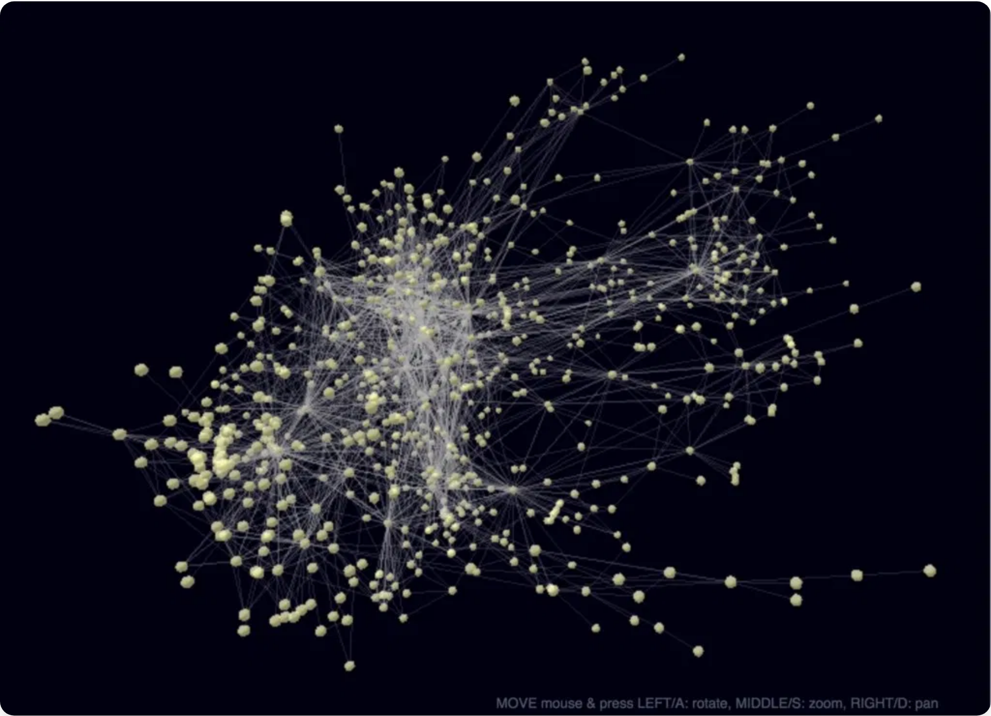
What is K3D?
Knowledge 3D (K3D)
is a revolutionary concept that
transforms abstract data into interactive, multi-layered 3D
environments.
Think of it as a
"Minecraft for data"
where knowledge is
organized within a navigable spatial landscape.
Key Features:
Multi-layered visualization of complex information
Intuitive spatial organization of knowledge
Shared cognitive model for humans and AI
Dynamic, updatable knowledge representation
K3D leverages human spatial cognition while enabling AI to operate within a structured, contextualized knowledge landscape.

Slide 3

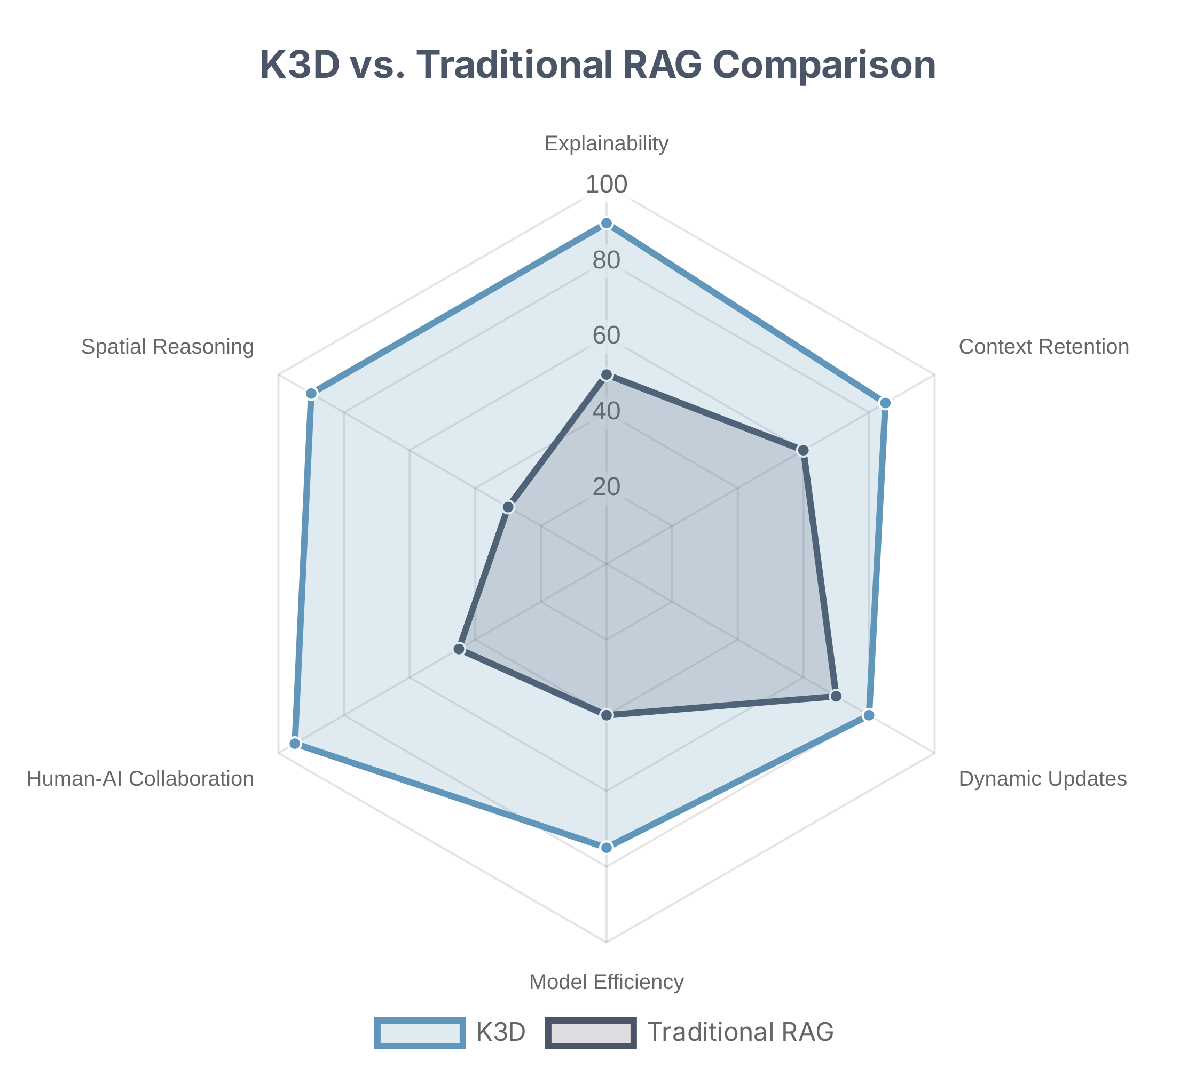
K3D vs. Traditional AI
K3D offers substantial advantages over conventional Retrieval-Augmented Generation (RAG) systems and traditional AI approaches.
The spatial approach fundamentally improves human-AI interaction by providing:
Enhanced explainability
through visual traceability and spatial context
Improved context retention
via persistent spatial memory
Seamless dynamic updates
with visual transitions
Potential for smaller AI models
by offloading knowledge to the external environment
This creates a truly shared perspective where both humans and AI can explore and make sense of information together.

Slide 4



How K3D Works: The Pipeline
K3D transforms raw information into a navigable 3D world through a sophisticated pipeline, embedding semantic meaning directly into spatial geometry.
①
②
Data Embedding
Dimensionality Reduction
Raw data (text, images) is converted by AI into high-dimensional vectors, capturing its semantic meaning.
Complex vectors are projected into 3D coordinates (X, Y, Z) using techniques like UMAP or PCA.
③
Geometry Generation
The 3D coordinates are used to procedurally generate a visual scene with shapes, colors, and connections.
Hierarchical data becomes tree-like structures
Visual properties encode additional dimensions
Related concepts connected by visible links
Game engine techniques enable navigation

Slide 5

Example: Computer Science Knowledge Tree
Computer Science is an ideal subject for K3D representation due to its inherent hierarchical structure and vast interconnectedness.
Computer Science
Artificial Intelligence
Structure:
Machine Learning
Root:
Core concept of Computer Science
Natural Language Processing
Major Branches:
Primary disciplines (AI, Software Engineering, etc.)
Computer Vision
Sub-branches:
Specialized areas within each discipline
Software Engineering
Leaves:
Individual papers, code repositories, tutorials
Development Methodologies
This structure facilitates multi-layered visualization and intuitive navigation from broad conceptual understanding to granular details.
Software Testing
Design Patterns
Data Science
Statistical Modeling
Big Data Technologies
Data Visualization

Slide 6




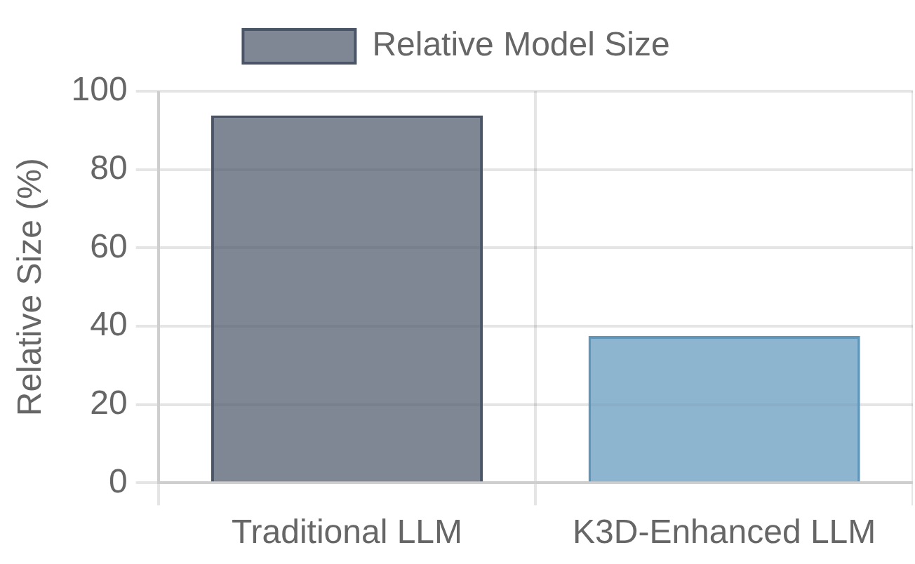
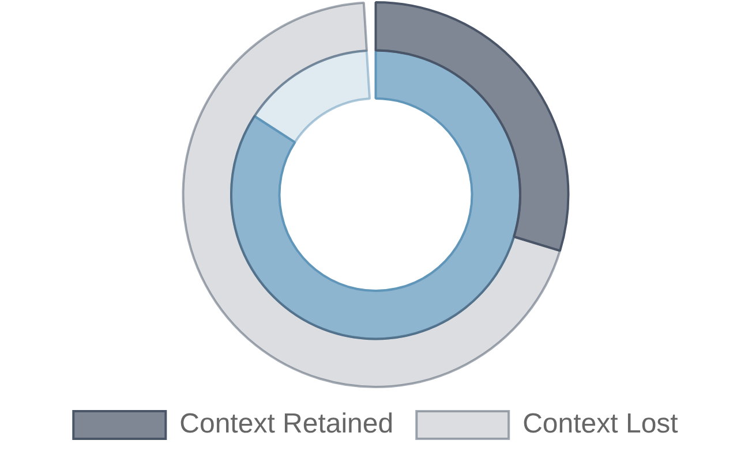
The K3D Advantage
Smaller, Focused AI Models
Superior Context Retention
Shared Human-AI Perspective
By offloading knowledge to an external environment, K3D reduces the need for monolithic AI models to memorize facts, enabling smaller, more efficient models focused on reasoning.
The persistent spatial environment acts as a "memory palace," allowing both humans and AI to build a strong mental map of the knowledge landscape, improving context over fragmented interactions.
In a K3D world, humans and AI agents see and interact with the same visual representation of data, fostering unprecedented collaboration, transparency, and shared understanding.
👤
🤖
⟷
Human
AI Agent

Slide 7

Inspiration from Science Fiction
Science fiction has long served as a catalyst for real-world innovation, inspiring scientists and engineers to translate imaginative concepts into tangible realities. The K3D vision draws from several iconic sci-fi universes:
Tron's Grid
The Matrix
Star Trek
Visualized cyberspace as "The Grid," foreshadowing immersive virtual worlds. Anticipated issues like AI, digital identity, and privacy that are central to K3D's design.
Explored advanced brain-computer interfaces and simulated realities. The concept of "downloading" knowledge directly to the brain inspires K3D's intuitive knowledge transfer.
Predicted technologies like mobile phones, tablets, and holodecks. The holodeck concept particularly resonates with K3D's immersive knowledge environments.
Star Wars
The Jetsons
Introduced 3D holograms and intelligent droids. The concept of holographic messages and data visualization has parallels in K3D's spatial representation of information.
Depicted video calls, smartwatches, and robotic assistants. This lighthearted show normalized the idea that high-tech living was not only possible but fun, building confidence in futuristic concepts.
"What appears as fantasy today can become tomorrow's fact."

Slide 8




Technical Feasibility
K3D is technically feasible based on current advancements in 3D standards, dimensionality reduction techniques, and game engines.
Enabling Technologies
Challenges & Solutions
3D Standards
Dimensionality Reduction Fidelity
glTF, X3D, and USD provide robust foundations for 3D content with metadata support and cross-platform compatibility.
Challenge: Maintaining accuracy when projecting high-
D to 3D
Solution: Hybrid approaches with real vectors stored as
metadata
Dimensionality Reduction
Performance & Scalability
PCA, t-SNE, and UMAP techniques can effectively map high-dimensional vectors to 3D space while preserving relationships.
Challenge: Handling millions of vectors in real-time
Solution: LOD systems, spatial indexing, and chunking
strategies
Game Engines
Standardization
Unreal Engine, Unity, and Godot demonstrate the capacity to render large, dynamic scenes with efficient LOD and chunking mechanisms.
Challenge: Creating interoperable formats
Solution: Open standards development with industry
collaboration

Slide 9



Future Outlook
The Path Forward
Vision: Augmented Reality Integration
Establish Open Standards
Develop and promote open standards for K3D representation, ensuring interoperability across platforms and tools.
The K3D vision extends beyond screens, integrating with Augmented Reality to create a blended reality where digital knowledge and AI companions are part of our physical world.
Create Reference Implementations
Build proof-of-concept systems demonstrating K3D's capabilities in specific domains like education, research, and enterprise knowledge management.
AR glasses will allow users to see K3D knowledge structures overlaid on their environment, making abstract concepts tangible.
Foster Ecosystem Growth
AI companions will navigate these knowledge spaces alongside humans, creating true collaborative intelligence in a shared reality.
Engage academic and industry stakeholders to drive adoption and continuous evolution of the K3D framework.
"The future is spatial - a world where knowledge is not just consumed but experienced."
Integrate with Emerging Technologies
Seamlessly combine K3D with advancements in AR/VR, AI, and brain-computer interfaces for enhanced human-AI interaction.

