Slide 1

Movie Sync
ECE532 – Group 2: Rakib Ahmed, Isidor Brkic,
Daniel Campoverde, Luis Munoz

Slide 2
Movie Sync (Re)Introduction
Goal: an immersive video viewing experience
Controls LED color/intensity and video output
Similar products: Phillips HDMI Syncbox
Our advantage: versatility
Works with any wifi-lights and HDMI sources

Slide 3
Project Goals
Collect Average Color and Intensity
Control lights over Wi-Fi
Apply Filters

Slide 4
Design Process
Developed HDMI and Network subsystems in parallel
Developed both Ethernet and WiFi subsystems as contingency

Slide 5
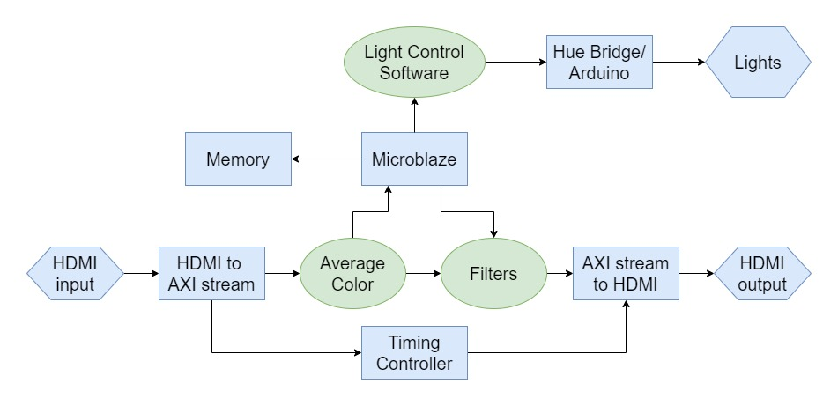
Project Goals

Slide 6
Results - HDMI
Pass through
Averaging
Filters
Streams 1080p video
Finds global average of each frame's color
Selection controlled by Microblaze
No filter, Greyscale, Vignette to Black or Vignette to Average

Slide 7
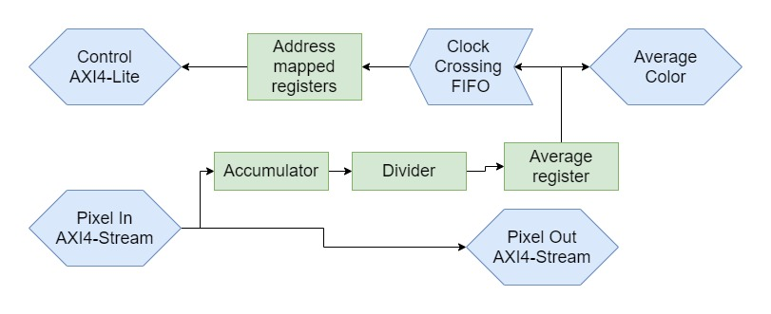
Averager

Slide 8
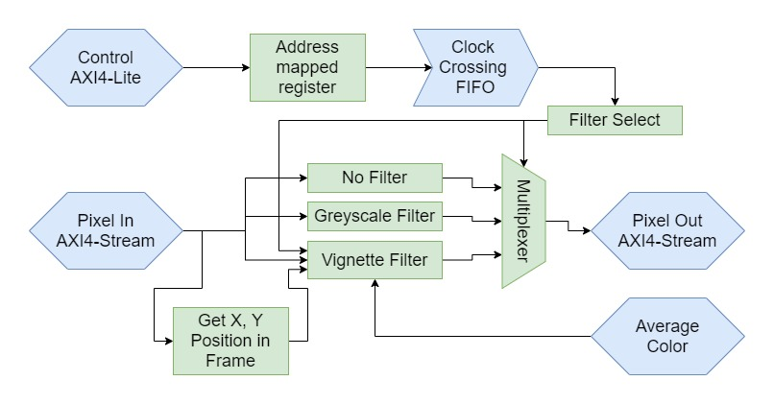
Filter

Slide 9
Results - Network Interfaces
Ethernet
TCP connection from board to host computer
Wi-Fi
TCP connection from board to Hue bridge

Slide 10
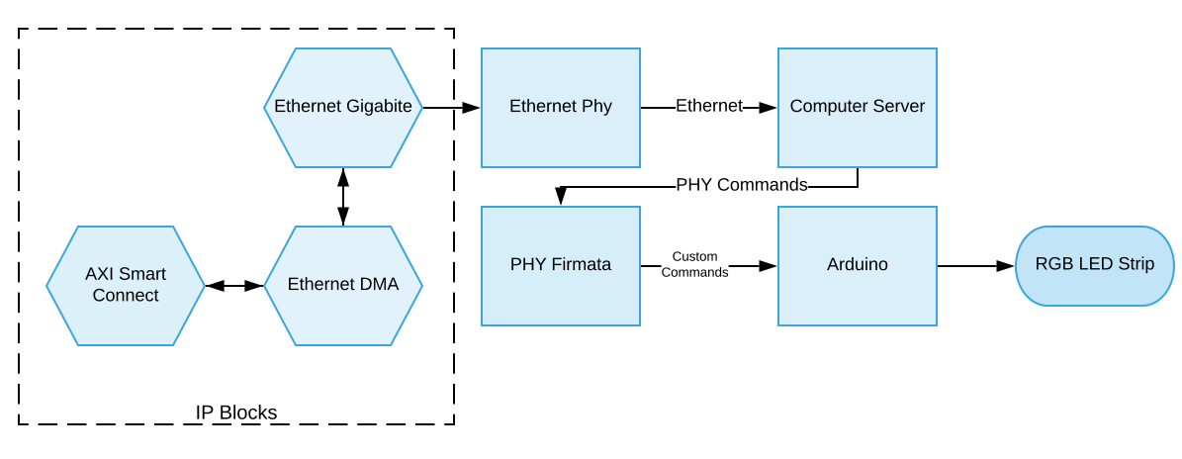
Ethernet Set-up

Slide 11
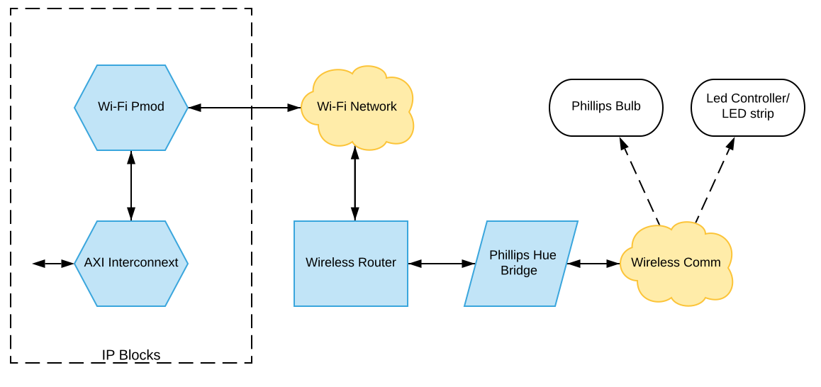
Wi-Fi Set-up

Slide 12
WI-FI (Best Option)
Pros:
Existing APIs for light control
Less Resource Utilization
Cons:
Small Delays in Data Sent
Wi-Fi Range
More Flexibility

Slide 13
Challenges /Issues
HDMI Resolution: 1080p
WIFI Pmod Drivers: Vivado/SDK 2017.4
WIFI: Latency
WIFI and Ethernet: TCP Connections Issues
Philips Hue API vs “New” Comm Protocol
Ethernet Set-up Integration
Notes:
1080p:
- Could not get the Digilent tutorial to run 1080p
- Solution: read the Xilinx documentation and build it up from scratch achiving direct video stream from HDMI in to HDMI OUT

Slide 14
Final Design Notes
5 Available Filters
Wi-Fi as main implementation
Control of multiple lightning devices
Movie Sync project was a success
Functionality as expected

Slide 15
Demo

