Slide 1
Public support for welfare and redistributive policies in Ireland
Daniel Capistrano, Bertrand Maître and Helen Russell

Slide 2
Why?

Slide 3
Questions
Is there public support for reducing income differences in Ireland?
  Who supports more?
  Who should benefit?
  Can support change?

Slide 4
Literature

Slide 5
Societal level influences
Higher support for redistribution in countries with higher inequality (Velev and Schmidt-Catran 2024; Finseraas 2009)
Support for redistribution remained apparently stable over time (Lupu and Pontusson 2023) and could be related to lack of major political reaction to income inequality.
Oorschot and Roosma (2017) note that support for welfare policies, social transfers and redistribution is conditional on the social legitimacy of these policies’ target groups

Slide 6
Socio-demographic predictors
Women are more progressive in relation to policy preferences and support for redistribution (Shorrocks and Grasso 2020; Inglehart 2018; Grasso and Shorrocks 2025)
Steele, Cohen, and Van Der Naald (2022) find that older respondents are more favourable of income redistribution.
Grasso and Shorrocks (2025) highlights the association between gender and generation, with the cohorts of women born after 1946 being more supportive of redistribution compared to men in their cohorts

Slide 7
Methods

Slide 8

Data sources
European Social Survey (2002 - 2024)
European Election Studies - Voter Survey
Eurobarometer
National Election and Democracy Study

Slide 9
Key findings

Slide 10
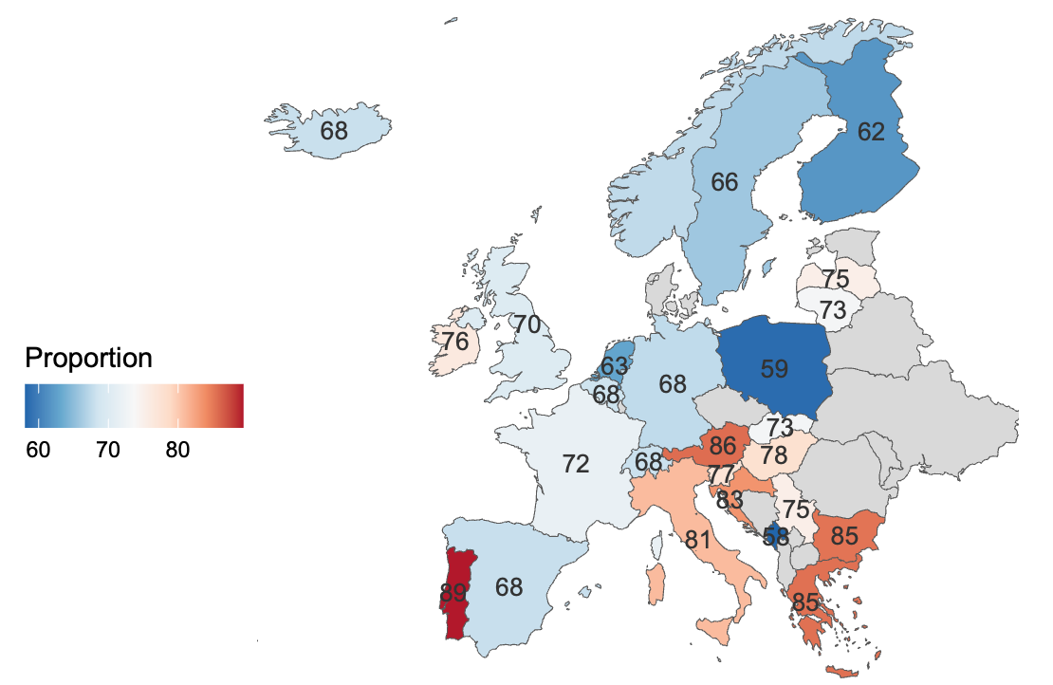
Support for government action
3 in 4
Irish residents agree that the government should reduce differences in income.

Slide 11
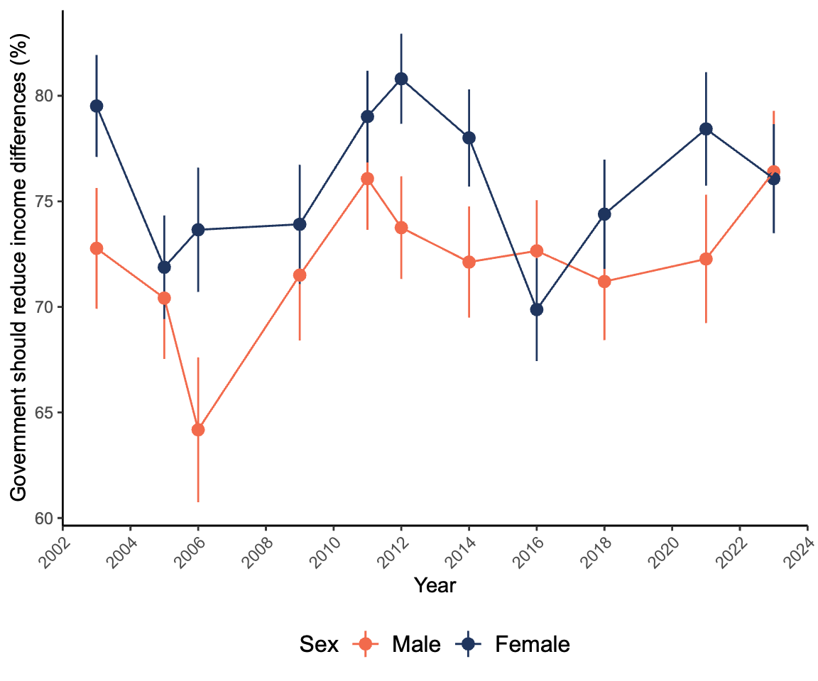
Agreement by sex 2002–2024
Considering all 11 rounds of the ESS together, there is a significantly higher support for redistribution among female respondents compared to male respondents.

Slide 12
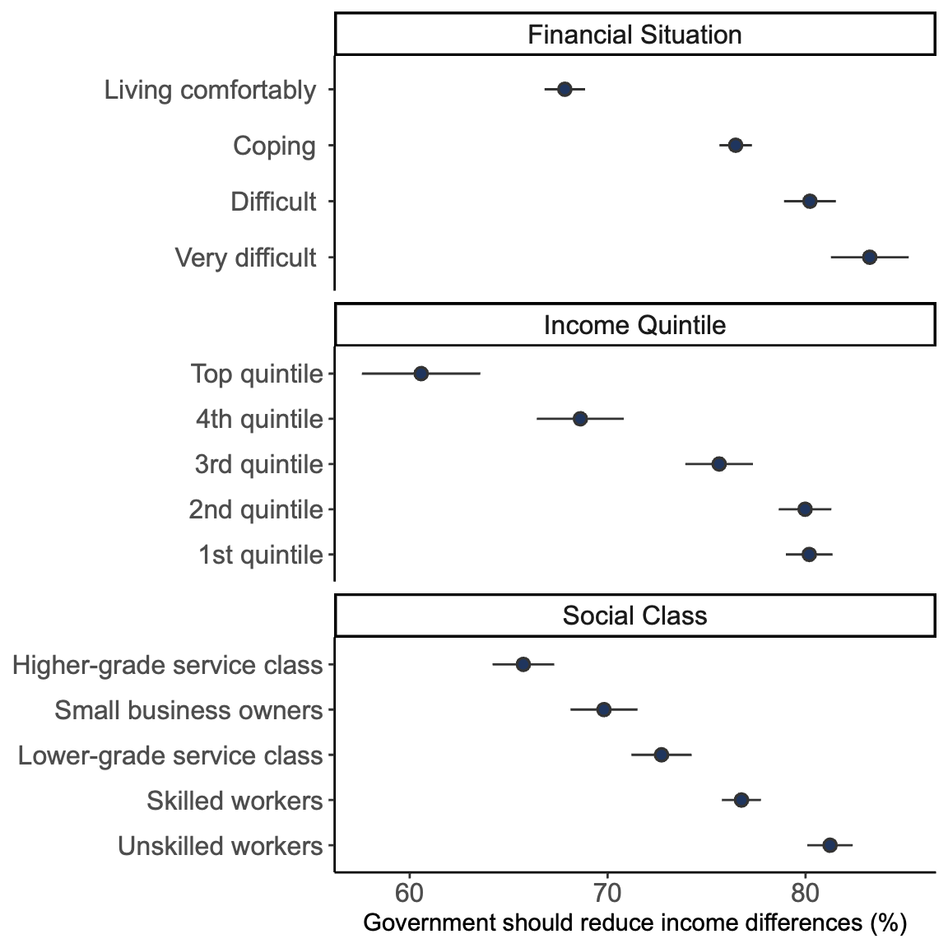
Agreement by SES 2002-2024
the analysis by social class, household income, or “financial situation” show a negative relationship between SES and support for redistribution.

Slide 13
Other positive associations
Born in Ireland
Younger
Left of the political scale

Slide 14
Deservingness and beliefs

Slide 15
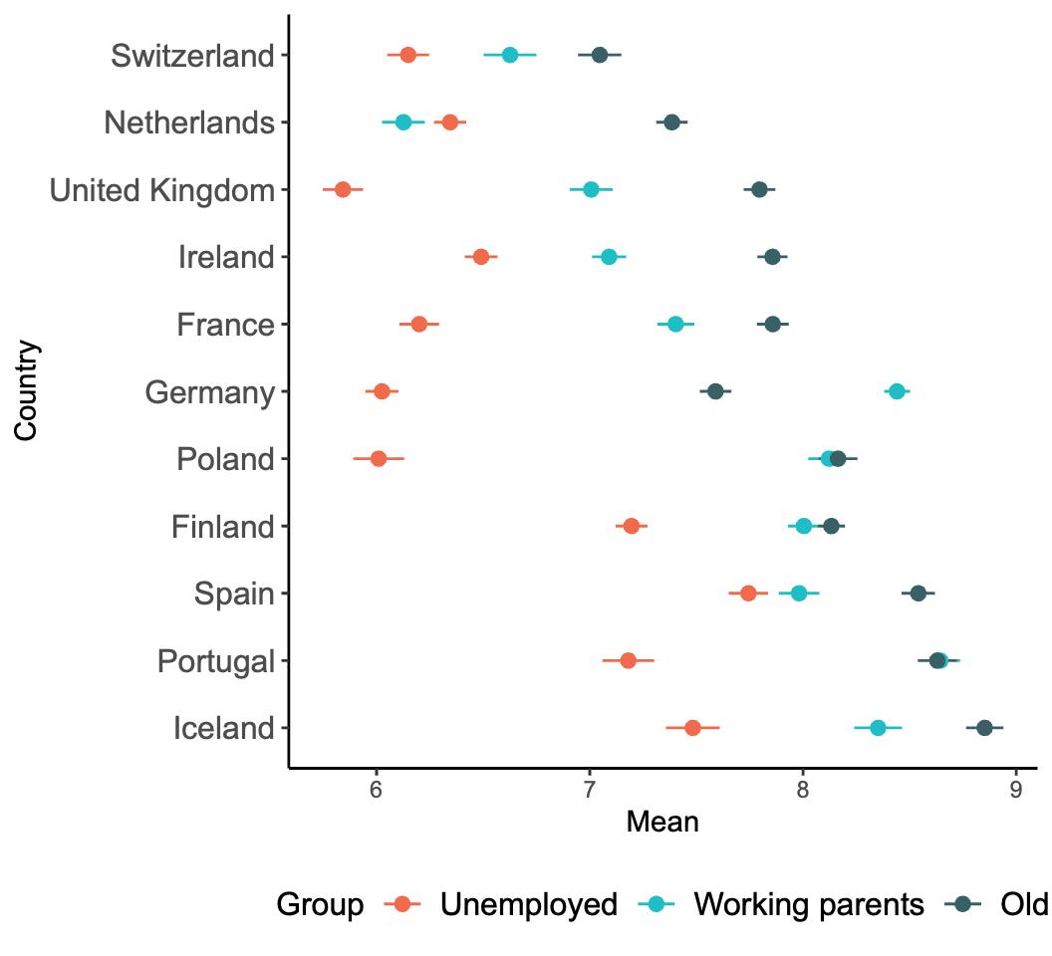
Who should receive higher priority from the government
…government should be least responsible for the unemployed compared to working parents and older citizens.

Slide 16
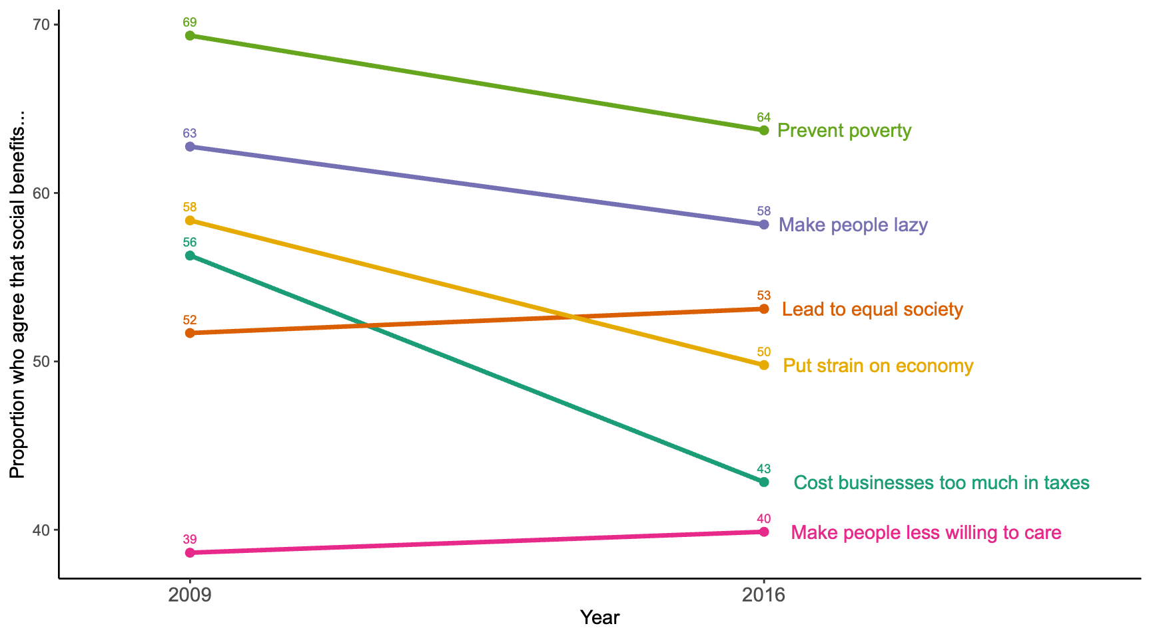
Beliefs about social benefits

Slide 17
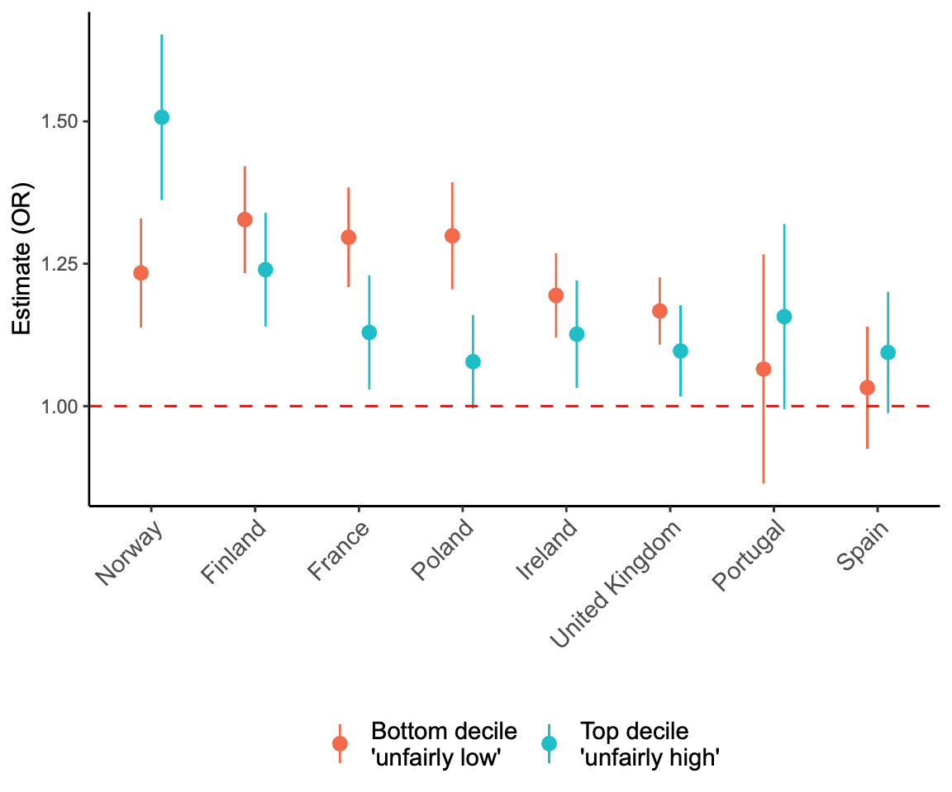
Perceptions on fairness

Slide 18
Taxes
1 in 3
Irish residents indicated that they agree with higher taxes if it means more or better public services. This is the 6th highest percentage across 27 EU countries.
Source: Authors’ own analysis of the Eurobarometer Flash Survey 2025.

Slide 19
Change over time

Slide 20
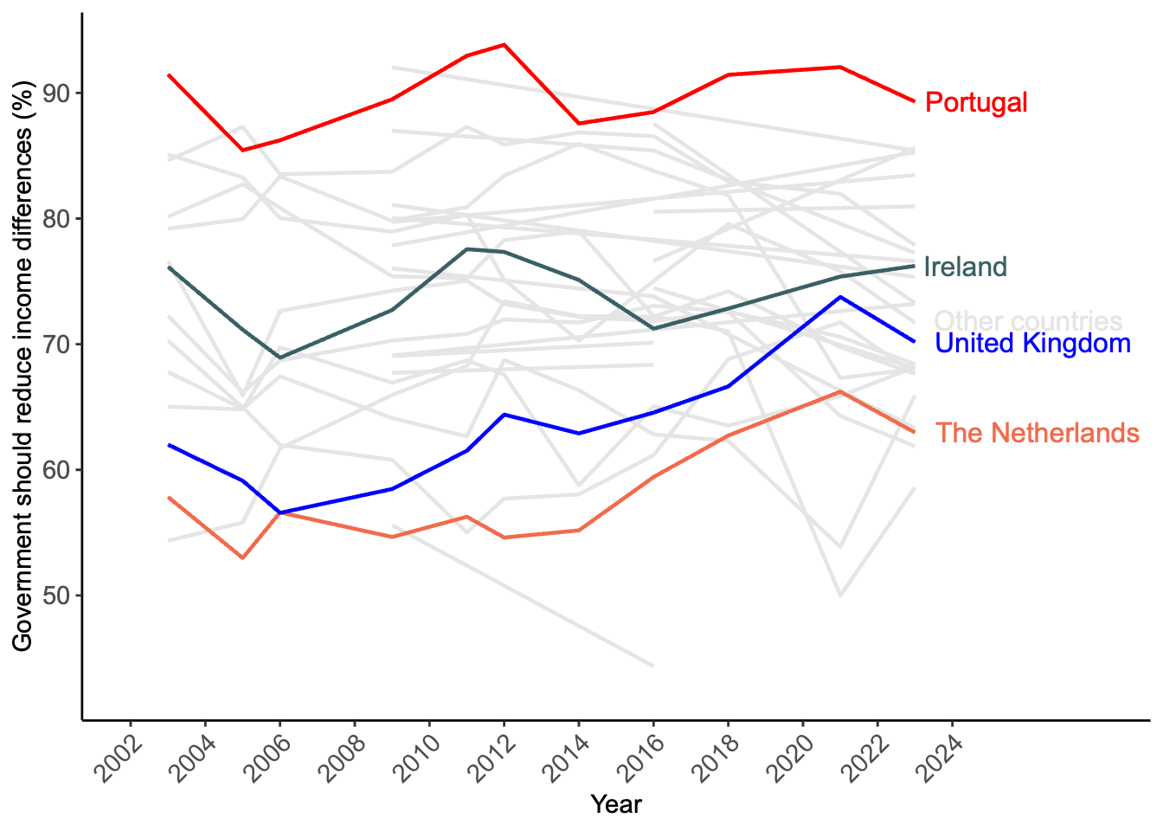
Support for government action

Slide 21
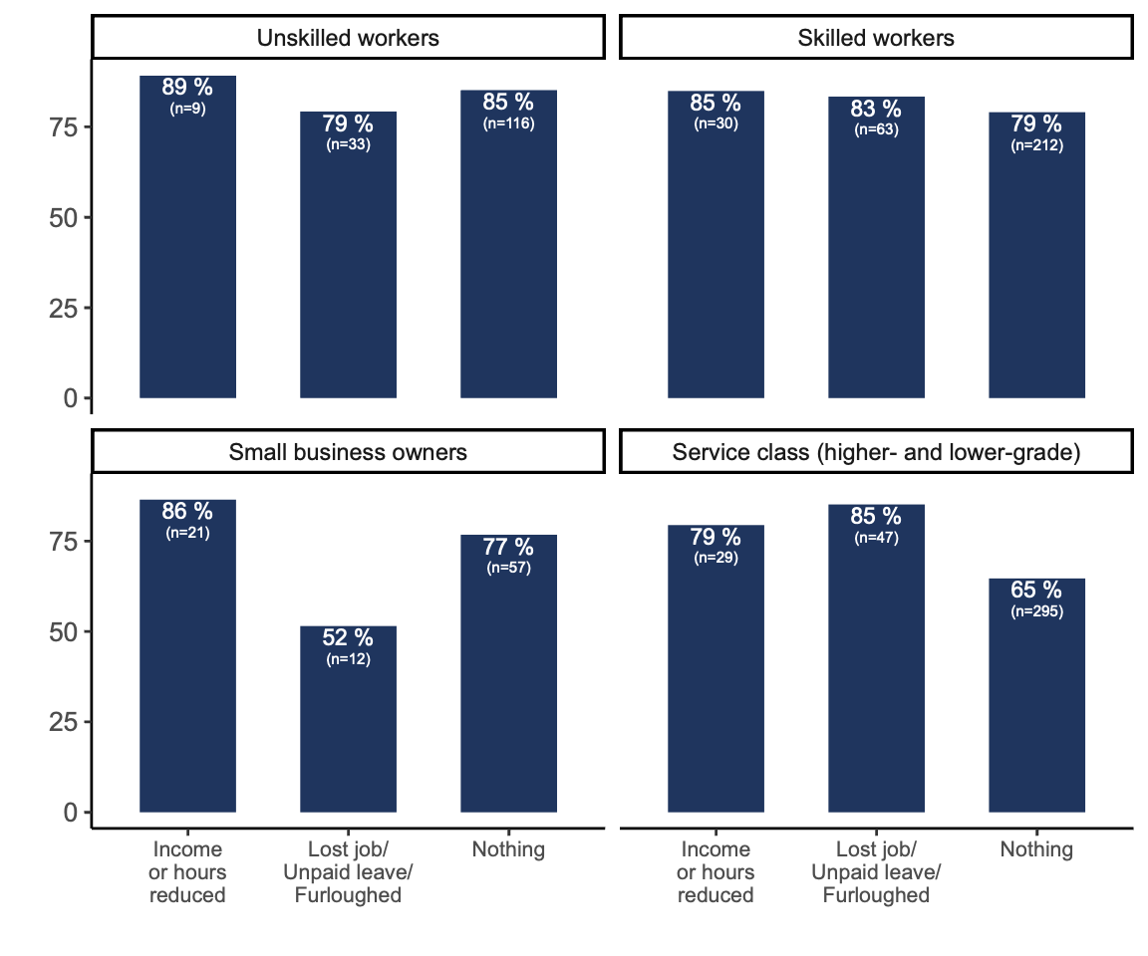
COVID19
Those who experienced job loss during the COVID19 pandemic are more supportive of redistribution, regardless of their financial situation or social class.

Slide 22
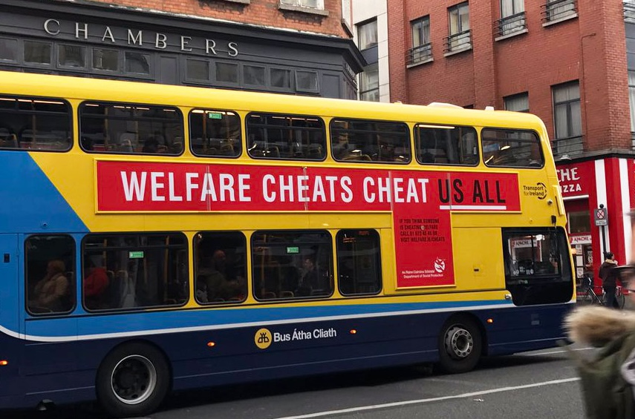
Government campaign

Slide 23
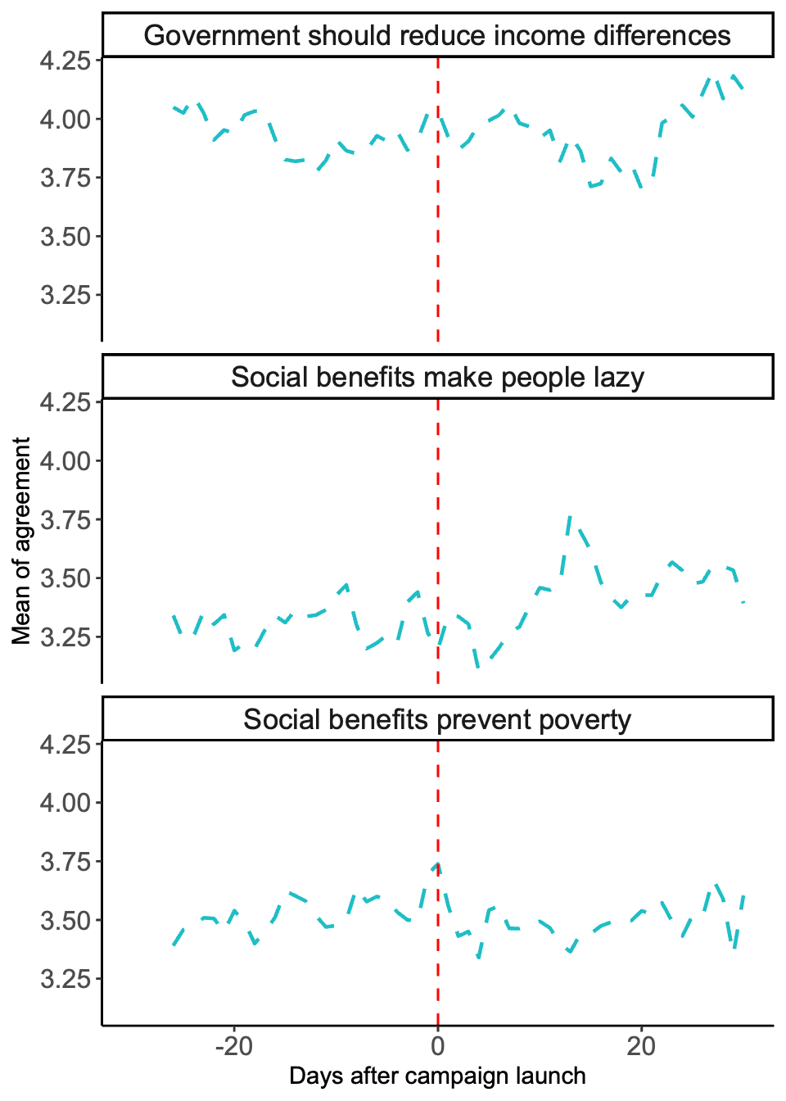
Government campaign
… seven-day exponential moving average of three variables in the 30-day time window around the launch of the campaign on 17 April 2017.

Slide 24
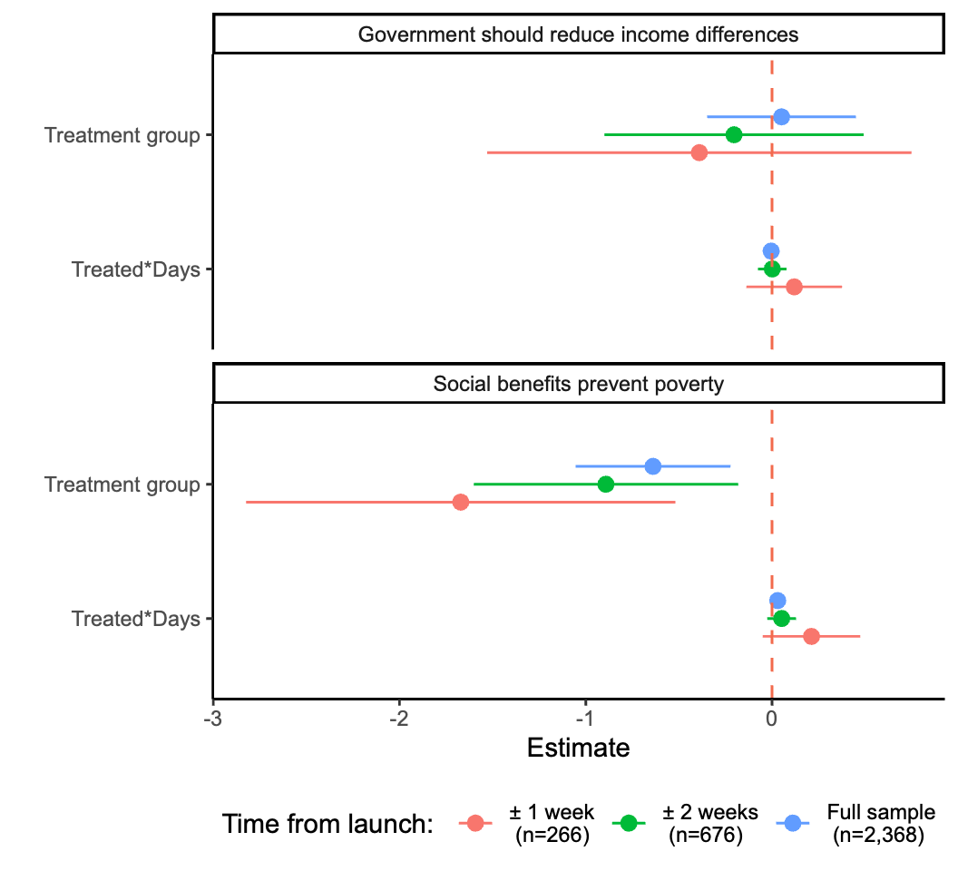
Government campaign
statistically significant decrease on the level of agreement that social benefits prevents poverty among interviews conducted after the launch of the campaign compared to those interviewed before the launch.

Slide 25
Conclusions
High support for government action to reduce income differences
Negative stereotypes about welfare recipients may undermine this support

Slide 26
References
Finseraas, Henning. 2009. “Income Inequality and Demand for Redistribution: A Multilevel Analysis of European Public Opinion.” Scandinavian Political Studies 32 (1): 94–119. https://doi.org/10.1111/j.1467-9477.2008.00211.x.
Grasso, Maria, and Rosalind Shorrocks. 2025. “Are New Generations of Women More Left-Wing Than Men? Generations and Gender Gaps in Attitudes to Inequality and Social Services.” Journal of European Public Policy, April, 1–28. https://doi.org/10.1080/13501763.2025.2490811.
Inglehart, Ronald F. 2018. Cultural Evolution: People’s Motivations Are Changing, and Reshaping the World. 1st ed. Cambridge University Press. https://doi.org/10.1017/9781108613880.
Lupu, Noam, and Jonas Pontusson, eds. 2023. Unequal Democracies: Public Policy, Responsiveness, and Redistribution in an Era of Rising Economic Inequality. 1st ed. Cambridge University Press. https://doi.org/10.1017/9781009428682.
Oorschot, Wim van, and Femke Roosma. 2017. “The Social Legitimacy of Differently Targeted Benefits.”
Shorrocks, Rosalind, and Maria T. Grasso. 2020. “The Attitudinal Gender Gap Across Generations: Support for Redistribution and Government Spending in Contexts of High and Low Welfare Provision.” European Political Science Review 12 (3): 289–306. https://doi.org/10.1017/S1755773920000120.
Steele, Liza G., Joseph Nathan Cohen, and Joseph R. Van Der Naald. 2022. “Wealth, Income, and Preferences for Redistribution: Evidence from 30 Countries.” Social Science Research 108 (November): 102746. https://doi.org/10.1016/j.ssresearch.2022.102746.
Velev, Valentin, and Alexander W Schmidt-Catran. 2024. “Economic Inequality and Public Support for Redistribution in Europe: A Cross-Sectional and Longitudinal Multilevel Analysis.” International Journal of Public Opinion Research 36 (4): edae055. https://doi.org/10.1093/ijpor/edae055.

