Slide 1


Software Engineering Internship Programme I
DATABASE DESIGN AND FEATURES PRESENTATION

Slide 2

About Us
TEAM MEMBERS
Jimmel Minguel: Business Plan and Documentation
Daniel Elliot: Database design and Implementation

Slide 3
Design Priorities
SWITCHBOARD AND FORMS
Ease of use
User–driven design
Logical, familiar layout for sub-forms
with a focus on increasing productivity
A focus on drop down menus for selection, date picker; instead of manual data entry wherever possible
Minimizes data inconsistencies and reduce data entry errors(e.g. Typing errors, date/time formatting)

Slide 4
Design Priorities
SWITCHBOARD AND FORMS
Easy to read, logically grouped reports
Hyperlinks to click directly for viewing detailed info
Options to filter the information with specified criteria
Consistent design with easy to understand buttons, labels and icons
Effective Error Handling: Entering null values, and errors that stop the switchboard from functioning

Slide 5
Design Challenges
PROBLEMS AND SOLUTIONS
Double-booking
Visual Information
In Schedule table, added an index with Date, Start Time, Lab ID fields set to unique
In Booking Entry form. Added a query to the Time selection that checks for available dates when selecting a date and lab number
Calendar view. Gives a quick, easy to read overview of scheduling for a lab. You can click directly on a booking to view more details, modify or delete the record
Current User, Date, Time. Auto refreshes every 60 seconds

Slide 6
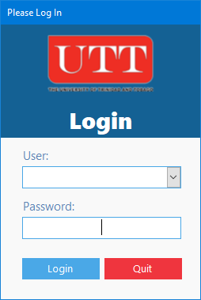
Design Features
LOGIN SCREEN
This is the first screen presented to the user
User name is presented as a selection list
Users requires password information. By default password is “password”

Slide 7
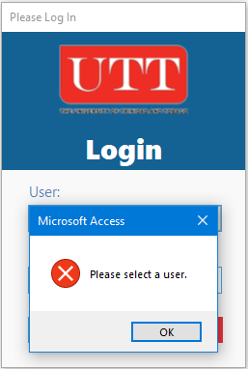
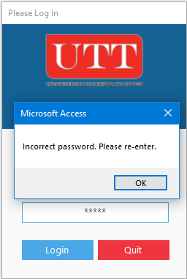
Design Features
LOGIN SCREEN VALIDATION
User error
Password error
When user hasn’t made a selection
User Names are retrieved from the database as selected item
This feature was implemented to minimize typing errors
When user has entered the wrong password
This will prevent unauthorized access

Slide 8


Design Features
LOGIN SCREEN VALIDATION
User access and permissions
Restricted access to user based on account type
Assistant account has limited access and permissions

Slide 9
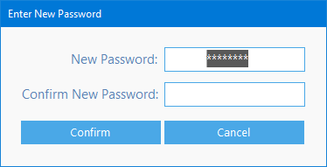
Design Features
PASSWORD RESET
On first login the user is prompted to create a new password
Password is entered twice for validation

Slide 10

Design Overview
BUTTONS AND NAVIGATION
Information bar displays the user currently logged in and the current date and time
Log off by clicking the user icon
Filter bar is used to specify different criteria to a sub-report. Appears on all sub-forms
Navigation buttons allows you to easily navigate through the switchboard
Categories are clearly labelled

Slide 11
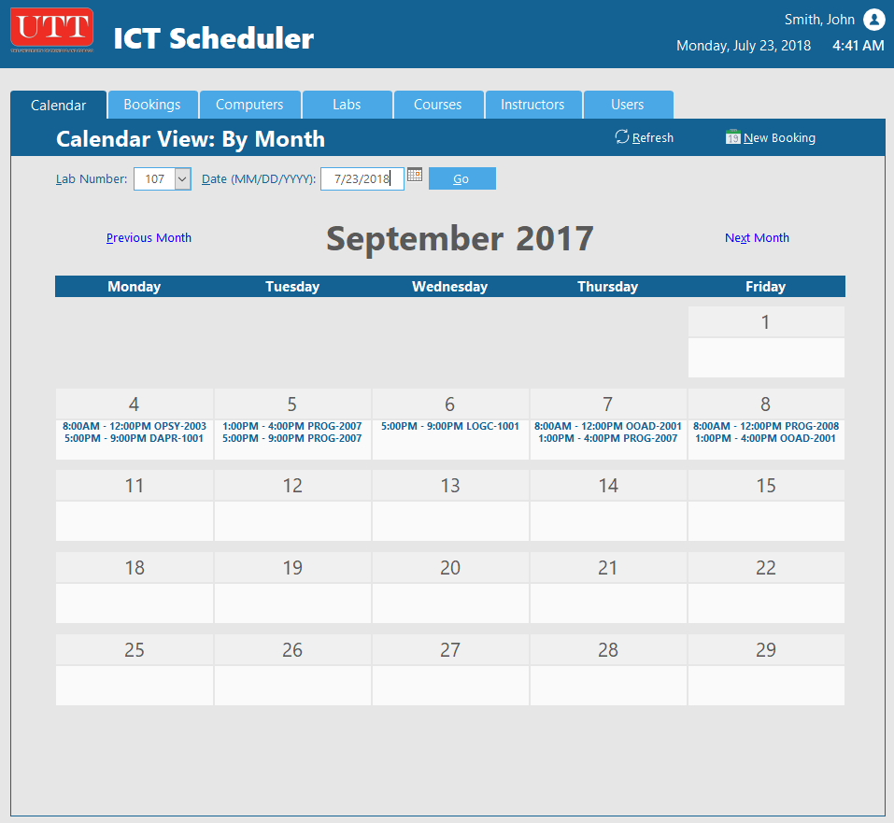
Design Overview
CALENDAR
Provides a quick overview of bookings on a monthly basis
The filtering options are: by Lab and Date
User is able to quickly view which days are full or has a vacancy
Users can directly click on the day for more information and to easily modify or delete a booking

Slide 12
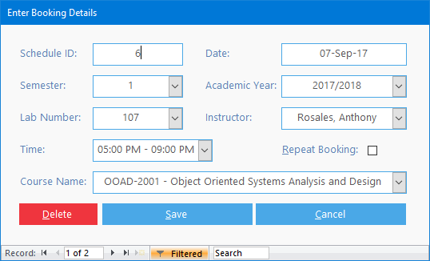
Design Overview
ENTERING BOOKING INFORMATION
Prioritize selection lists for ease of use
When a user selects a date and lab criteria, the form updates to only show the times available
The repeat booking option allows the user to repeat the booking on a weekly basis e.g. Every Thursday at 5pm – 9pm

Slide 13
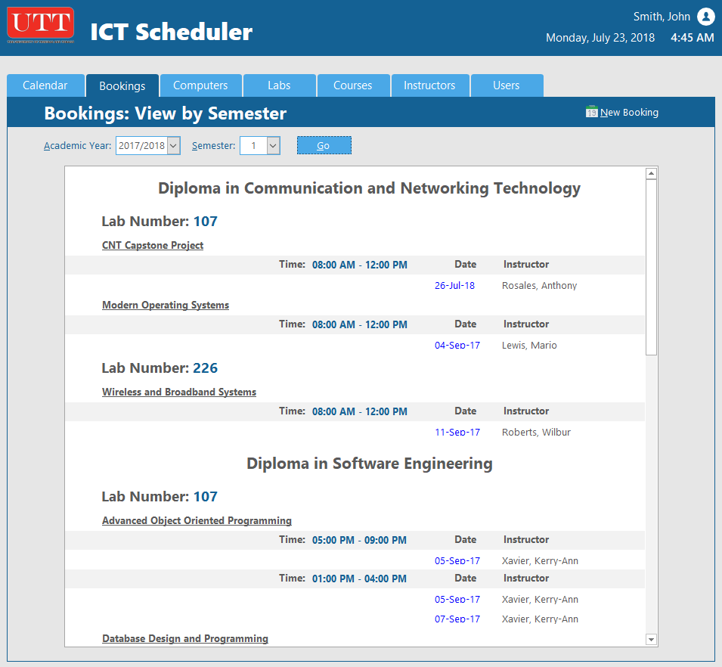
Design Overview
BOOKINGS
The purpose of this report is to filter and display bookings as a list
Filtered by Academic year and Semester
Sorted by Programme, Lab and Course
Users can click directly on a date to display further information

Slide 14
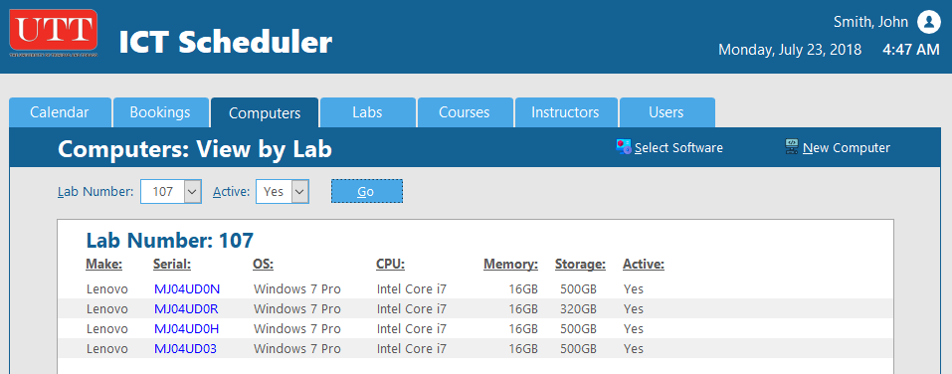
Design Overview
COMPUTERS
Displays computers for a given lab
User is able to click directly onto a computer and modify or delete records
User can add new computer and add new software

Slide 15
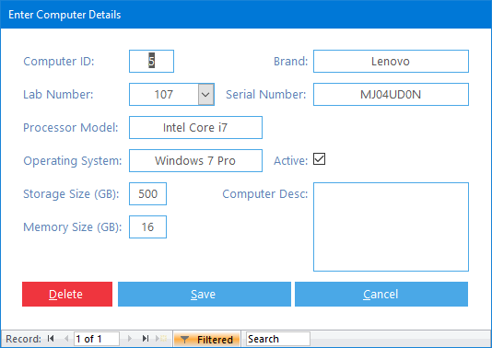
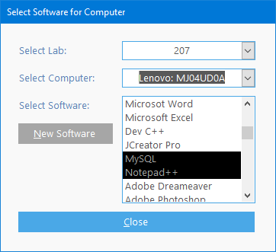
Design Overview
ENTERING COMPUTER INFORMATION
Computer entry
Software entry
Used for entering computer details
.
Used for software selection and entering new software
.

Slide 16
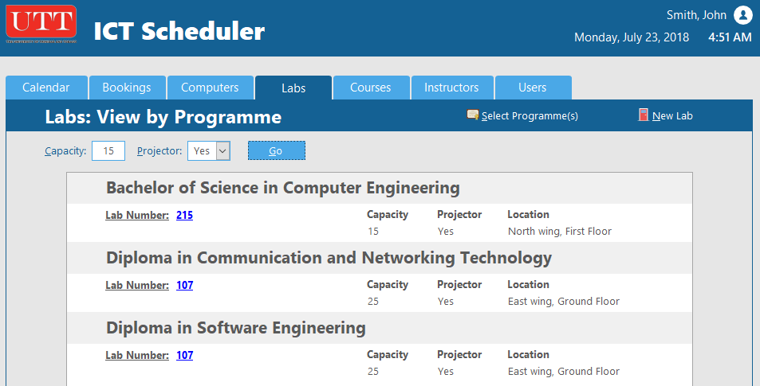
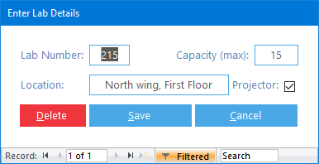
Design Overview
LABS
Lab sub-report
Displays detailed lab information and filtered by capacity and projector (yes/no)
Lab entry
Used to enter new labs or modify existing labs

Slide 17
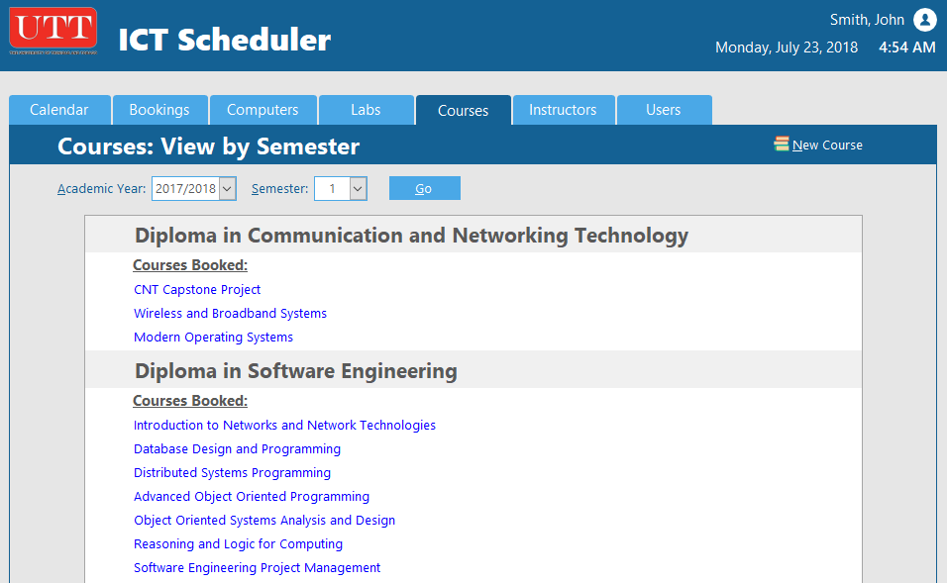
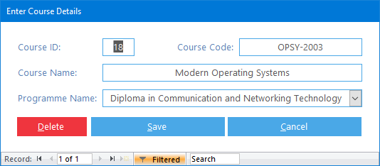
Design Overview
COURSES
Course entry
Course sub-report
Enter new courses based on selected program
Displays courses booked, sorted by Programme
Filtered by Academic year and Semester

Slide 18
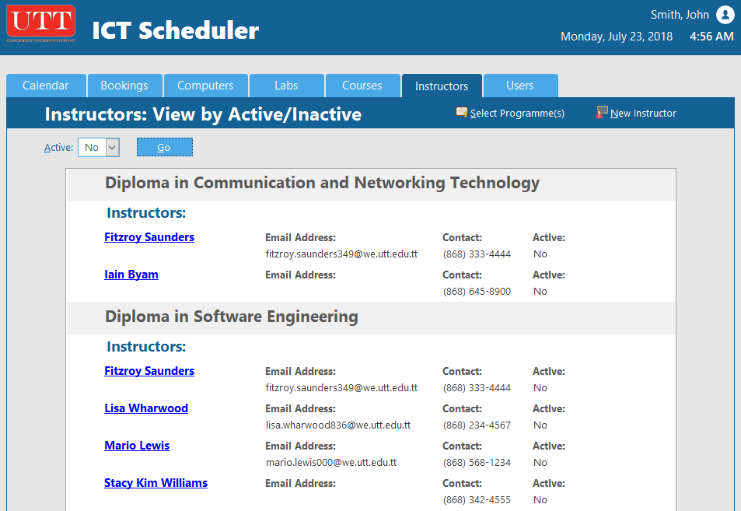
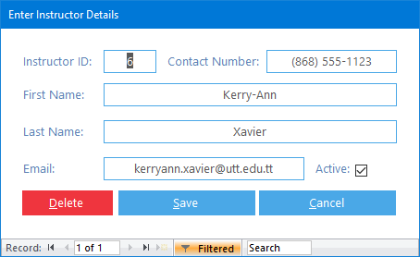
Design Overview
INSTRUCTORS
Instructor sub-report
Displays all instructors information (name, email address, contact number)
Instructor entry
Add or modify instructor details

Slide 19
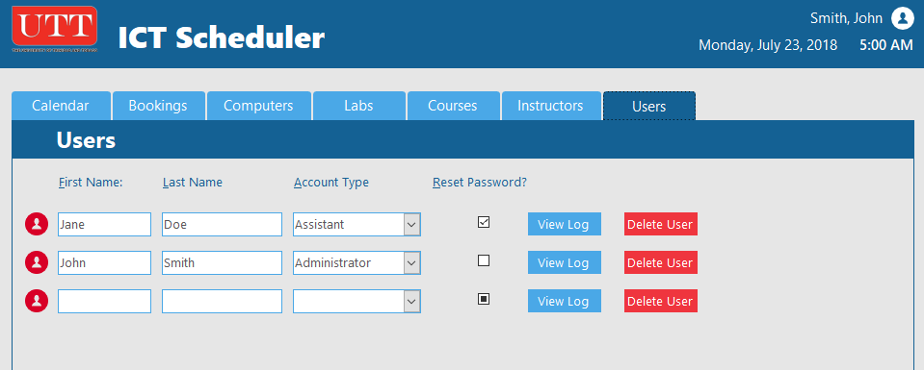
Design Overview
USERS
Administrator access only
Select user account type
View user activity log
Can reset user password

Slide 20
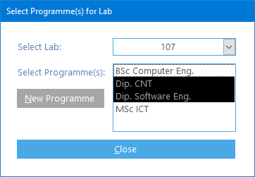
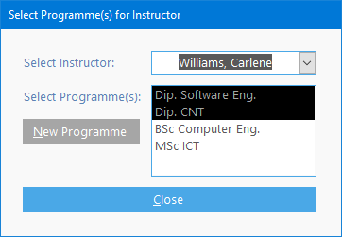
Design Overview
Programme options
Assign programmes to an instructor.
Select programmes for a particular lab.

