Slide 1
WINE CLASSIFICATION
What Determines A Good Wine?

Slide 2
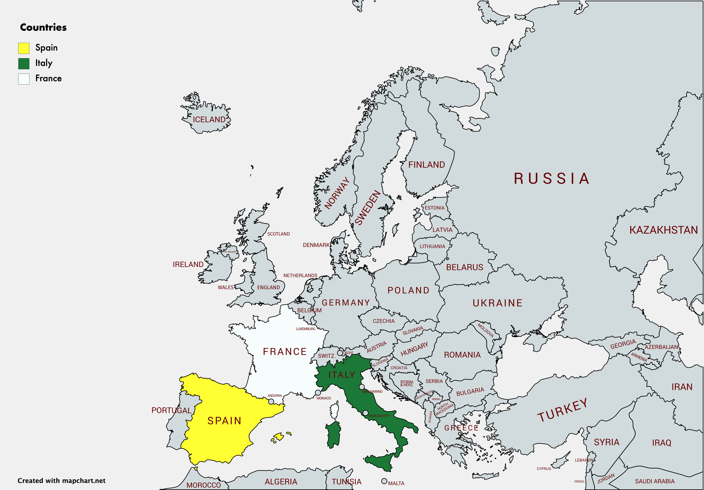
QUICK FACTS
Wine is produced in many countries in the world.
Known for its diversity of flavour (e.g. Shiraz, Riesling, Chardonnay etc.)
Top wine producing regions: France, Italy, Spain

Slide 3

FOOD FOR THOUGHT
Are the best wines only found in France, Spain, Italy?
Depends on individual preference (One man’s meat is another man’s poison)
How would you know if a wine is good?

Slide 4
PROceSS WORKFLOW
EXPLORATORY DATA ANALYSIS
CLASSIFICATION
MODELLING
VISUALIZATION

Slide 5
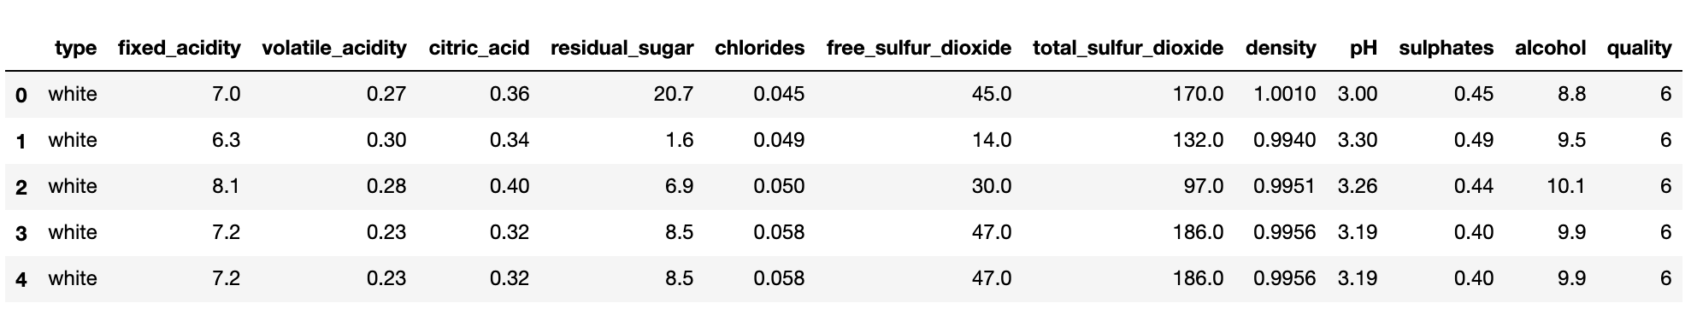
Introducing CLASSIFICATION
Dataset from Kaggle (approximately 6500 rows, 12 features)
Y target ➔ Quality ➔ Good Rating: 7 to 9

Slide 6
FEATURE ENGINEERING
Label encoding for type
red wine = 0 white wine = 1

Slide 7
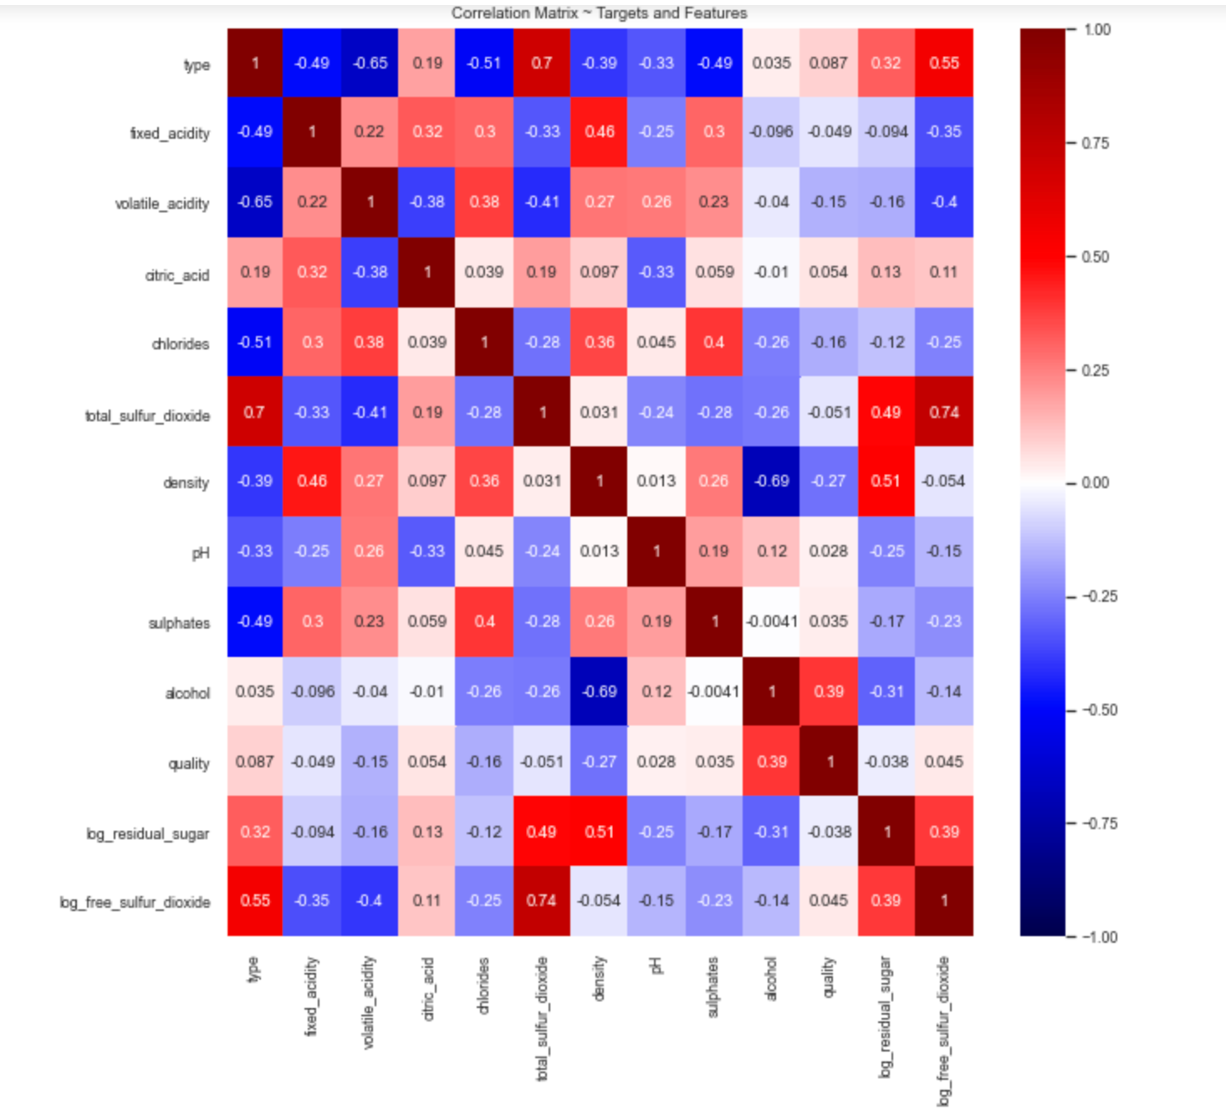
Check For Multicollinearity
Excluding Features: total_sulfur_dioxide

Slide 8
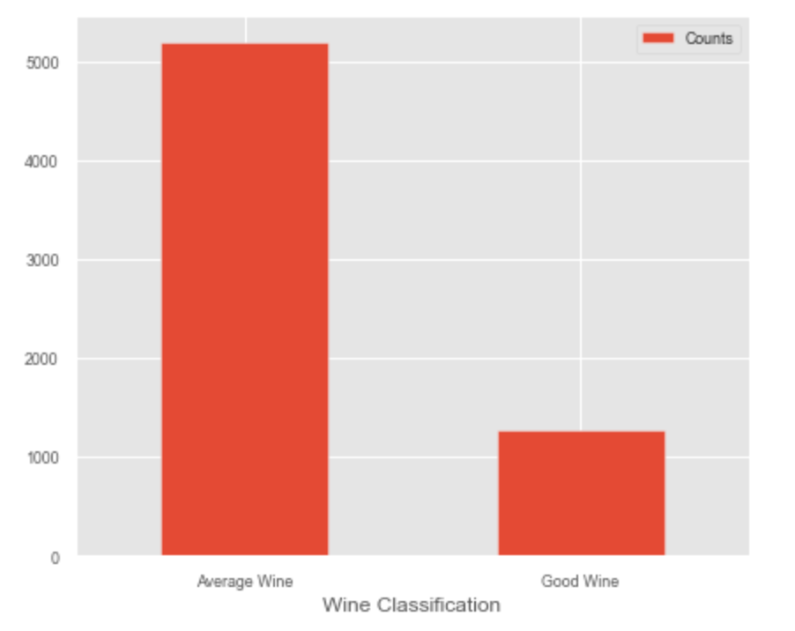
CHECK CLASS IMBALANCE
Good Wines: 19.67%
Average Wines:80.33%
No need to do any over-sampling or under-sampling on the dataset

Slide 9
GridSearch CV Results (5 Folds)
Method | Precision Val Score | AUC Val Score | F1 Val Score
K Neighbors Classifier (n neighbors = 1) | 0.525 +- 0.033 | 0.629 +- 0.014 | 0.398 +- 0.028
Logistic Regression (C = 200) | 0.557 +- 0.064 | 0.587 +- 0.014 | 0.312 +- 0.032
Decision Tree (max depth = 8) | 0.486 +- 0.071 | 0.623 +- 0.026 | 0.372 +- 0.061
Random Forest Classifier (bootstrap: False, max depth: 10, n estimators: 400) | 0.705 +- 0.073 | 0.621 +- 0.013 | 0.369 +- 0.032

Slide 10
Compare AUC Curve between models

Slide 11
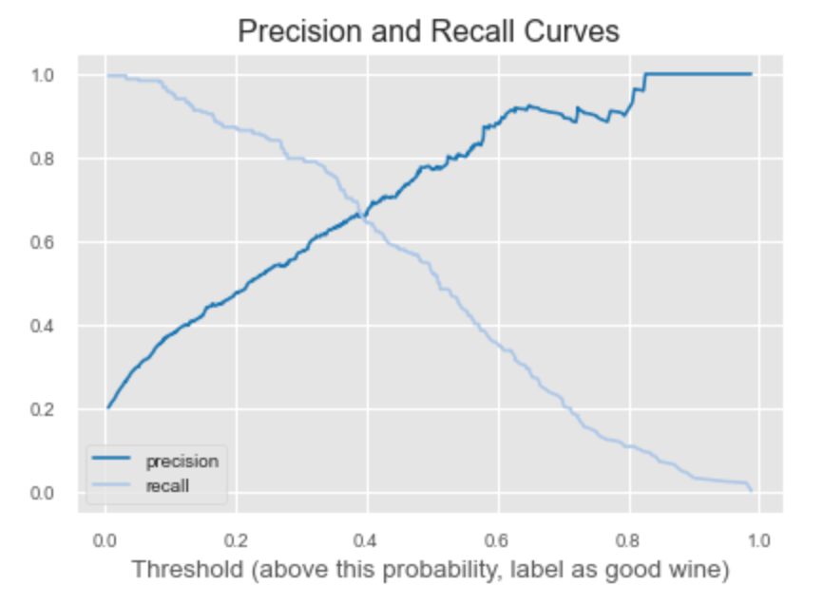
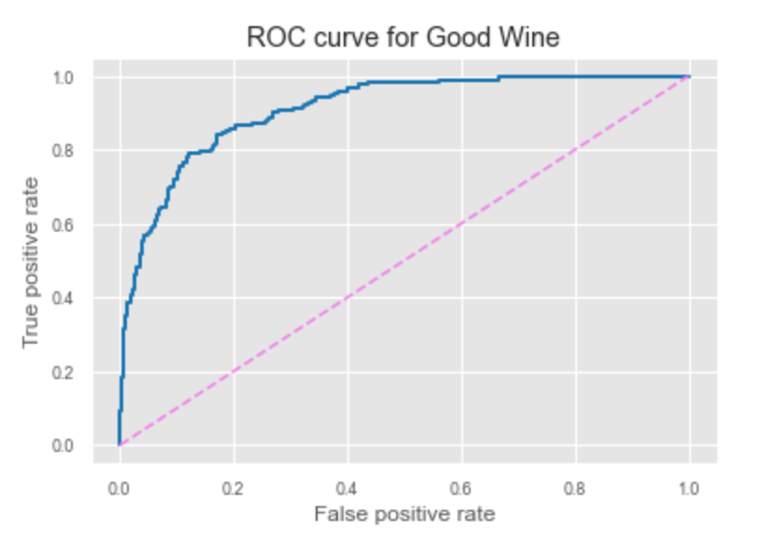
SELECTING THRESHOLD
Optimum trade-off is around 40%. Any threshold above 62% will be deem ineffective.
ROC AUC Score = 91%

Slide 12
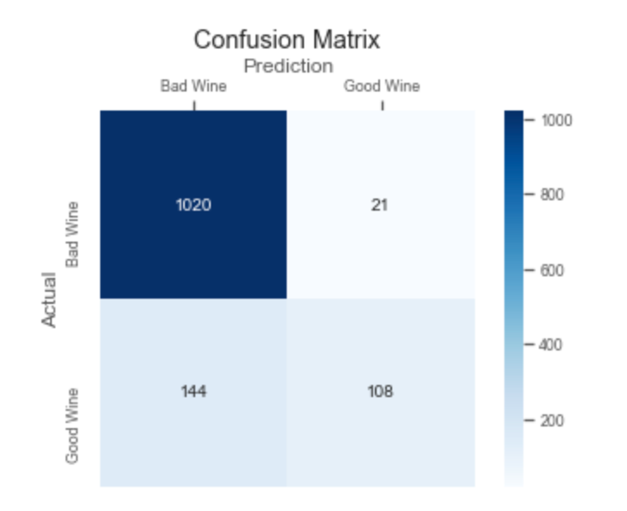
MODEL OF CHOICE: RANDOM FOREST CLASSIFER Prediction with Probability >= 0.56
Metric | Score
Precision | 83.72%
Recall | 42.86%
F1 | 56.70%
ROC AUC score | 70.42%

Slide 13
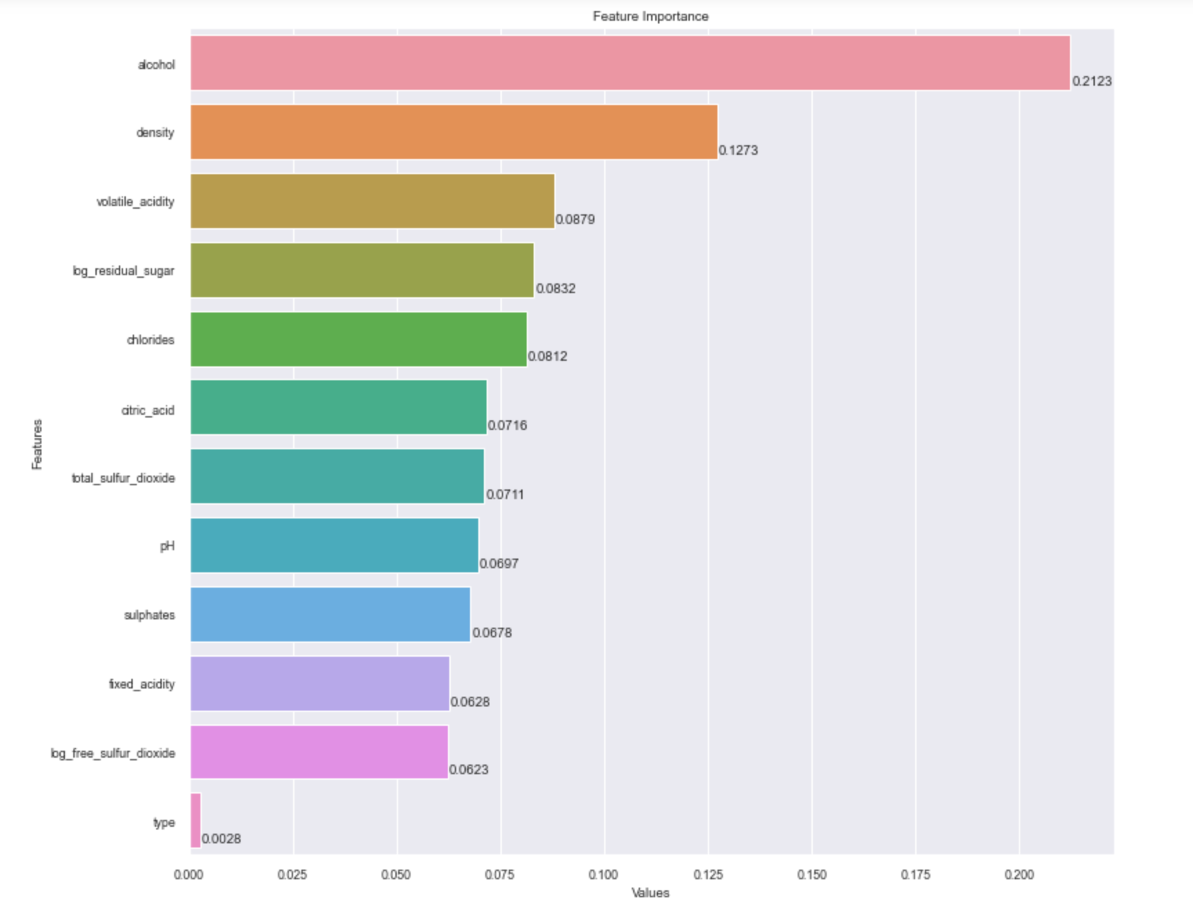
MODEL OF CHOICE: RANDOM FOREST CLASSIFER Feature Importance

Slide 14
Sample OF PREDICTED CLASSIFICATION Category: Good Wines

Slide 15
Sample OF PREDICTED CLASSIFICATION Category: Average Wines

Slide 16
Further Improvements

Slide 17
Thank you slide

