Slide 1
circadian rhythm generator in Drosophila
MATLAB problems

Slide 2
Circadian rhythms regulate our sleep-wake cycles and are disrupted by jet-lag.
Because they allow prediction of periodic changes in temperature and light, these internal rhythms are an important aspect of many organisms’ biology.
Behavioral studies of these internal clocks have shown them to have a free-running period of roughly 24 hours (i.e.in the absence of external cues).
Moreover, these rhythms are readily entrained to light and temperature cues and are remarkably robust to changes in ambient temperature.
In mammals, the primary circadian pacemaker has been identified as a group of about 8000 neurons in the suprachiasmatic nucleus (located in the hypothalamus), which have a direct connection to the retina (in the eye).
REFERENCES:
Leloup, J.-C. & Goldbeter, A .(2003).Toward a detailed computational model for the mammalian circadian clock. Proceedings of the National Academy of Sciences USA, 100, 7051–7056. Goldbeter, A. (1996). Biochemical Oscillations and Cellular Rhythms: The Molecular Bases of
Periodic and Chaotic Behaviour, Cambridge, UK: Cambridge University Press.

Slide 3
Studies of Drosophila have yielded many advances in genetics. In 1971, Ronald Konopka and Seymour Benzer published a study in which they identified flies with mutations that caused changes in the period of the free-running circadian rhythm in:
Konopka, R. J. & Benzer, S. (1971). Clock mutants of Drosophila melanogaster. Proceedings of
the National Academy of Sciences USA, 68, 2112–2116.
These mutations occurred in a gene named per (for period); the protein product is called PER. In contrast to wild-type (i.e. non-mutant) flies, whose rest/activity patterns demonstrated a roughly 24 hour free-running period, they reported on three mutations:
• an arrhythmic mutant that exhibits no discernible rhythm in its activity;
• a short-period mutant with a period of about 19 hours;
• a long-period mutant with a period of about 28 hours.
Additional molecular analysis provided clues to the dynamic behaviour of per gene expression.
Observations of wild-type flies revealed that total PER protein levels, per mRNA levels, and levels of phosphorylated PER protein all oscillate with the same 24-hour period, with the peak in mRNA preceding the peak in total protein by about 4 hours. Moreover, it was shown that when the import of PER protein into the nucleus was blocked, the oscillations did not occur.

Slide 4
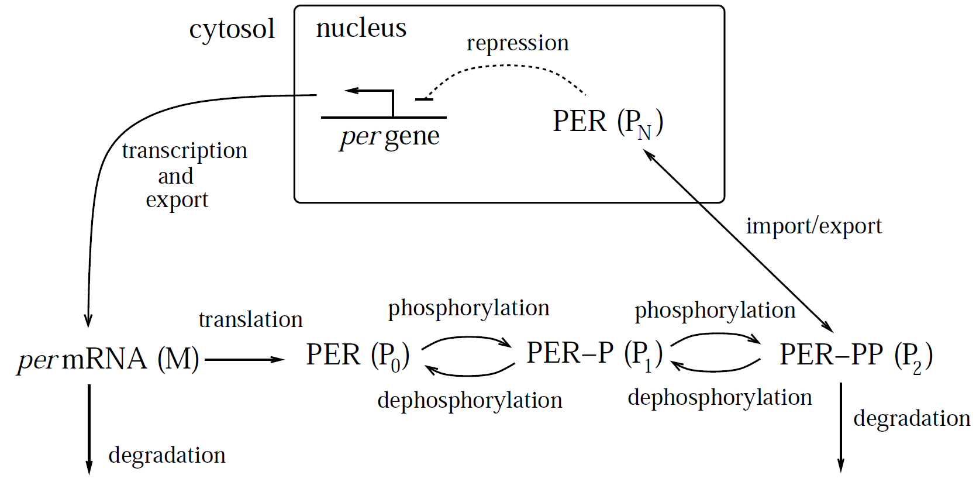
Goldbeter''s circadian oscillator model. (The dashed blunted arrow indicates repression.)
The per gene is transcribed in the nucleus;
per mRNA (M) is exported to the cytosol, where is it translated and is subject to degradation.
PER protein (P0) is activated by two reversible rounds of phosphorylation.
Active PER (P2) is subject to degradation, and can cross the nuclear membrane.
Once in the nucleus, PER (PN) represses transcription of the per gene.
Delay oscillations arise from the combination of autoinhibitory feedback, nonlinear repression kinetics, and delay.

Slide 5
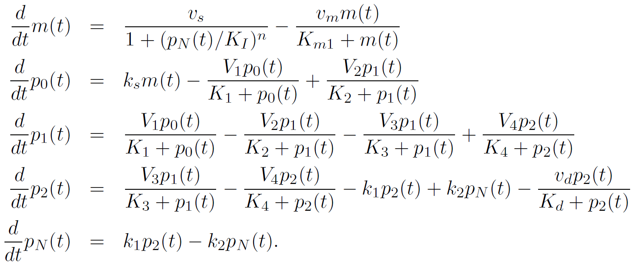
Using lowercase letters to denote concentrations, and a quasi-steady state (Michaelis-Menten) approximation for the enzymatic reactions, Goldbeter's model takes the form:
This model only exhibits oscillatory behaviour if the repression kinetics is sufficiently nonlinear. Goldbeter carried out his analysis with n =4; he found that the model can exhibit oscillations with n = 2 or even n = 1, but only under restrictive conditions on the other parameter values.

Slide 6
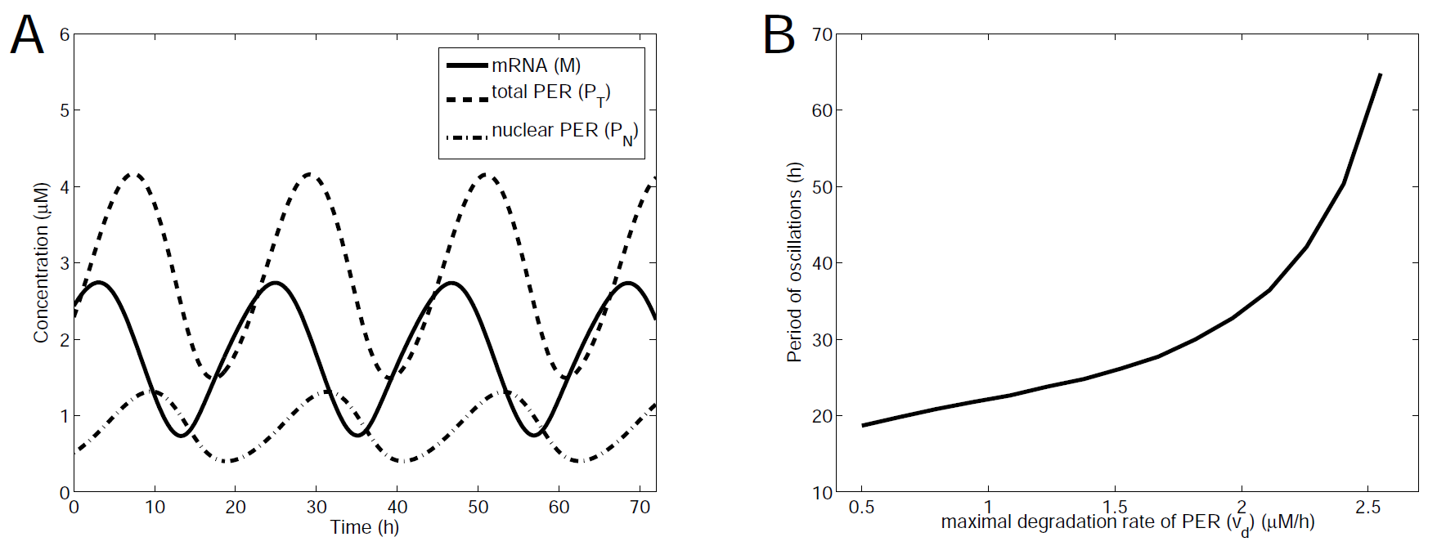
A. The simulated concentrations of mRNA(m), total PER protein (pT = p0 +p1 +p2 +pN), and nuclear PER protein(pN).
The period of the oscillation is about 24 hours, with a lag of about 4 hours between the peak in mRNA and protein levels.
B. To explore the hypothesis that these mutations affect the rate of PER degradation, continuation diagram shows the effect of changes in the maximal PER degradation rate (vd) on the oscillation period. Within the range over which oscillations occur, the period ranges from about 20 to more than 60 hours.

Slide 7
PROBLEMS (use the script circadian_drosophila_goldbeter.m ) -- see longer document for hints.
1. Using the parameter values in the Figure, run a simulation of the model.
Answer this question: the period is not quite 24hr, but a bit less.
Approximately how long is the period?
Give your answer the closest hour (24hr, 21hr, etc)
2. The oscillatory behaviour of this model is crucially dependent on the level of cooperativity.
Change n to 2.
Oscillations are now damped.
3. Now change n to 3.
What can you say about the period, compared to the case n=4?
What about the amplitude of total PER?

